Slide 1







Backend
Computing
Functions
Data Resources
2) Execute the app code and communicate with computing and data resources in backend.
RESTful APIs
AWS
Lambda
Amazon DynamoDB
Amazon API Gateway*
AWS
Lambda
Amazon S3 bucket
JavaScript
Computing & Data resources
User (Browser)
Frontend
CDN
1) Download webpage and application code
Amazon CloudFront
Amazon S3 bucket
Static webpage (html/css/javascrip)
as downloadable program
Cloud platform (e.g., AWS)

Slide 2

SSL/TLS prevent protect user data from being eavesdropped on a public channel
Backend
Computing
Functions
Data Resources
RESTful APIs
AWS
Lambda
Amazon DynamoDB
Amazon API Gateway*
HTTPS(SSL/TLS)
AWS
Lambda
Amazon S3 bucket
JavaScript
Computing & Data resources
User (Browser)
HTTPS(SSL/TLS)
Frontend
CDN
Amazon CloudFront
Amazon S3 bucket
Static webpage (html/css/javascrip)
as downloadable program
Cloud platform (e.g., AWS)

Slide 3
But how about the user data in cloud platform? Are the app provider and cloud platform provider truly trusted?
Backend
Computing
Functions
Data Resources
RESTful APIs
AWS
Lambda
Amazon DynamoDB
Amazon API Gateway*
HTTPS(SSL/TLS)
AWS
Lambda
Amazon S3 bucket
JavaScript
Computing & Data resources
User (Browser)
HTTPS(SSL/TLS)
Frontend
CDN
Also how about the user data in browsers? This may be observed by malware?
Amazon S3 bucket
Amazon CloudFront
Static webpage (html/css/javascrip)
as downloadable program
Cloud platform (e.g., AWS)

Slide 4

Data is shared between users via a cloud platform like messenger, cloud storage…
JavaScript
Backend
User (Browser)
Amazon DynamoDB
Amazon API Gateway*
Amazon S3 bucket
AWS
Lambda
Frontend
JavaScript
Amazon CloudFront
Amazon S3 bucket
User (Browser)
Cloud platform (e.g., AWS)

Slide 5


Data is encrypted in such a way that only recipient can decrypt it in the context of E2E Encryption.
JavaScript
Backend
User (Browser)
Amazon DynamoDB
Encryption/decryption key
Amazon API Gateway*
Amazon S3 bucket
AWS
Lambda
Frontend
JavaScript
Amazon CloudFront
Amazon S3 bucket
User (Browser)
Cloud platform (e.g., AWS)
Encryption/decryption key

Slide 7
128/192/256-bit
AES
Encryption
AES
Decryption
plain data
encrypted data
plain data

Slide 8
Browser
We shall check if the original data is not disclosed at the server.
AES Encryption /Decryption
HTTP PUT/GET
REST API Mock Server
Node.js
Registered Data
AES Encryption /Decryption
HTTP PUT/GET

Slide 9
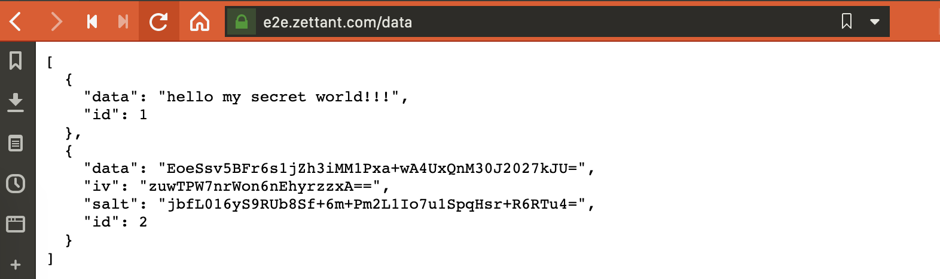
生のまま登録されているデータ (=事業者は中身を見放題)
暗号化して登録されているデータ (=事業者は中身を見られない)

Slide 10
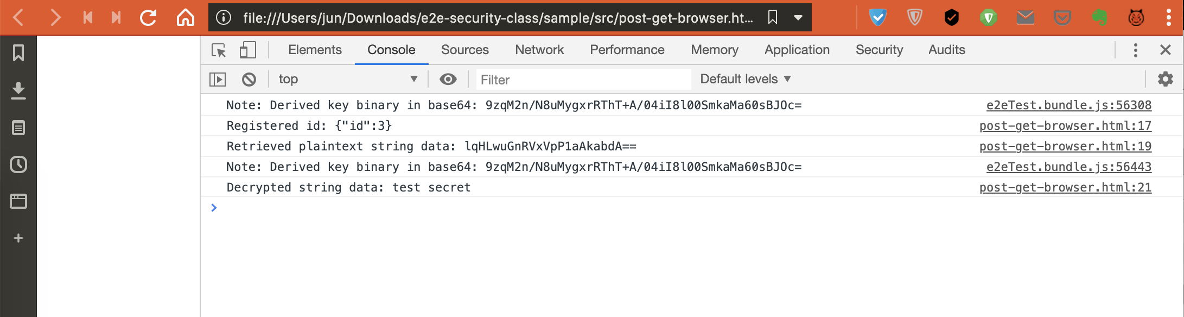
初期設定のデータを、初期設定の鍵で暗号化してid=3で登録
id=3で登録されたデータを、初期設定の鍵で復号した

Slide 11
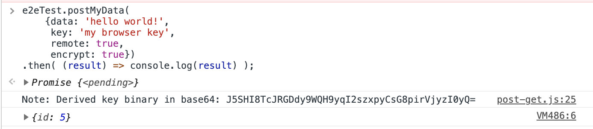
この部分を入力
id=5で登録された

Slide 12
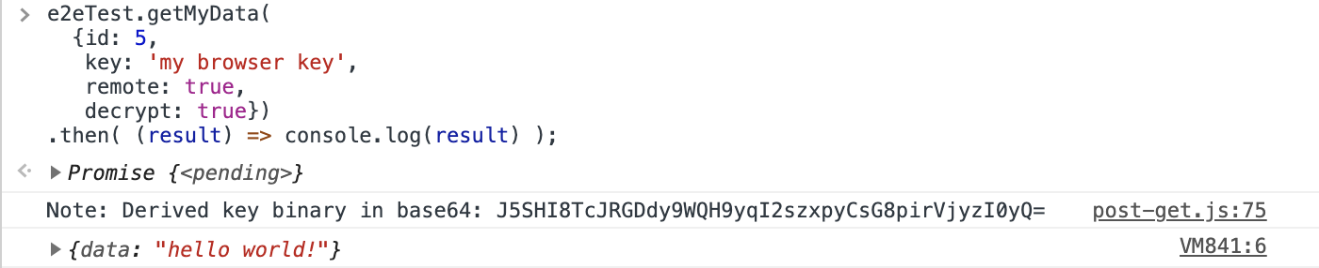
この部分を入力
取得して正しく復号できた

Slide 13
暗号化オブジェクト初期化
algorithm
暗号化処理のファイナライズ
Cipher オブジェクト
iv
createCipherIV
final
encrypted
key
update
data入力による暗号化処理 (逐次data追加可能)
復号オブジェクト初期化
algorithm
復号処理のファイナライズ
decipher オブジェクト
iv
createDecipherIV
final
decrypted
key
update
encrypted data入力による復号処理 (逐次data追加可能)

Slide 14
16bytes input 1
16bytes input 2
16bytes random data (Initial vector)
XOR
XOR
AES Encryption
AES Encryption
Key
Key
16bytes output 1
16bytes output 2

Slide 15

Encryption key (the first key)
Encrypt with the same key (or easily-derivable key from the first key)
Key leakage…
If only a key for a data got leaked, not only this encrypted data but also other encrypted data can be cracked!!!

Slide 16



The origin
(like password)
Key Derivation Function
Key Derivation Function
Key Derivation Function
Key leakage…
Encrypt with random keys probabilistically derived from the origin (or underivable key from other keys)
Even if only a key for a data got leaked, other encrypted data is unable to be cracked…

Slide 17
No cost
8 chars password (A-Za-z0-9)
Binary Representation
Candidate List of AES Encryption Key
Only 2⁴⁸ Candidates
High computational cost
8 chars password (A-Za-z0-9)
Key Derivation Function
Candidate List of AES Encryption Key
Total 2¹²⁸ x 2⁴⁸ Candidates
16 bytes random salt

Slide 18

Simple binary representation, complex cryptographic operation, etc.
Password/
Binary master secret
Key Derivation Function (KDF)
128/192/256bits AES Encryption Key

Slide 19
Encryption with ECB mode
Original images are given by Larry Ewing (lewing@isc.tamu.edu)

Slide 20

Browser/Node.js
256bits Key Derivation Function
Password
/Master Secret
KDF Parameters
AES-CBC Encryption /Decryption
HTTP PUT/GET
REST API Mock Server
Encrypted data
data

Slide 21
NOTE: This involves large computational cost to increase the attack cost.
Password
Password-based Key Derivation Function 2 (PBKDF2, RFC8018)
Key Length
Random Salt
Key
Public
Iteration Count
NOTE: This assumes a relatively long-enough master secret like > 80 bits. This is employed mainly to remove the bias of distribution.
Master Secret
HMAC-based Key Derivation Function 2 (HKDF, RFC5869)
Key Length
Key
Public
Random Salt

Slide 22
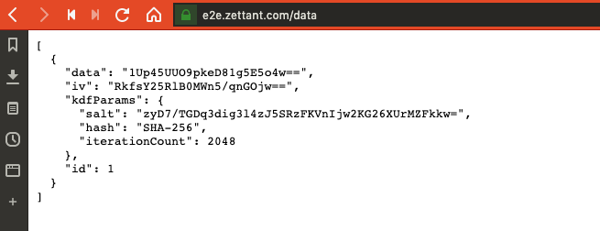
AES暗号化されたデータ
AES暗号化に使われるIV
パスワードから鍵を導出するためのパラメタ

Slide 23
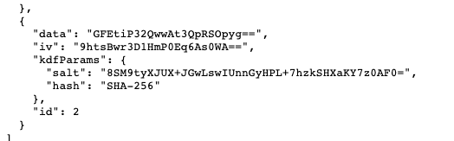
AES暗号化されたデータ
AES暗号化に使われるIV
パスワードから鍵を導出するためのパラメタ

Slide 24


Public Key
Private Key
Encrypt
Decrypt
Anyone can encrypt information only with public key without knowing private key!
Only the private key owner can decrypt the information encrypted under its paired public key.
Private Key
Pair
Public Key

Slide 25
ECDH
Used at encryption side with destination’s public key
Public Key
Shared Master Secret
ECC Key Pair Generation
Ephemeral Private Key
Ephemeral Public Key
Encryption side
Equal
Decryption side
Sent with encrypted data and used at decryption side with destination’s private key
ECDH
Shared Master Secret
Private Key
Private Key
Pair
Public Key

Slide 26
Key Derivation Function
AES
Encryption
Shared Master Secret
Key
Ciphertext
KDF params
(Salt, etc.)
Plaintext
Key Derivation Function
Key Encryption Key
AES Encryption (Key Wrapping)
Shared Master Secret
Encrypted Random Key
KDF params
(Salt, etc.)
AES Encryption
Random Key
Ciphertext
Plaintext

Slide 27
0
2¹²⁸
AES
Equivalent number of key candidates
0
2³⁰⁷²
RSA

Slide 28
Public Key PK
Original Data M
Padding
Plaintext D
RSA Encryption
Ciphertext X

Slide 29
Padding
Random
Seed
Header
0x00…
0x00
Original Data M
Mask Generation Function
XOR
XOR
Mask Generation Function
0x00
Masked
Seed
Masked Data Block
Data D (to be encrypted)

Slide 30
Data D
Encryption
Public Key
As an example of E2E security, you can register this encrypted data to the remote server.
Key Generation
Encrypted Data X
Private Key
Decryption
Data D

Slide 31

Recipient’s Public Key
Plaintext Data
ECDH
(Shared Bits Derivation)
AES Encryption
Shared Random Bits
Encrypted Data

Slide 32
A’s
Public Key
B’s
Public Key
A’s
Private Key
B’s
Private Key
Just by simply exchange the public key each other, one can calculate the shared random bits from the other’s public key and its own private key.

Slide 33
Recipient’s Public Key
Plaintext Data
Salt
ECDH
(Shared Bits Derivation)
Key Derivation Function
(we use HKDF here)
AES Encryption
(we use AES-CBC here)
My Private Key
Shared Random Bits
AES Key
Encrypted Data
Initial Vector

Slide 34


AES Key
AES Key
…
Plaintext Data
AES Encryption
Public Key Encryption 1
Public Key Encryption 2
…
AES Key
Public Key 1
Public Key 2
Encrypted Data
Encrypted AES Key 1
Encrypted AES Key 2

Slide 35

1) Generate Key Pair
1) Generate Key Pair
Private Key
Public Key
Public Key
Private Key
2) Exchange Public Key
3) Encrypt; Decrypt
Data
3) Encrypt; Decrypt
Data
If hybrid encryption is employed, the AES key is also randomly generated and discarded!
4) Discard Key Pair!
4) Discard Key Pair

Slide 36
Data D
Compute Hash/MAC/Signature
Then, we shall verify data using hash, MAC and signature, and detect malicious data modification!
Hash/MAC/Signature

Slide 37
Representative bit-sequence of Data D, which is also called ‘message digest’.
Hash Function
Data D
Hash
Unable to inversely expect data D from its hash.

Slide 38
0xABABABAB…
Hash Function
0x01A90E98DF0…
Data D1
Hash of D1
1-bit difference
Completely different hashes
0xBBABABAB…
Hash Function
0x68A78FAED22…
Data D2
Hash of D2

Slide 39
Key A
MAC Function
0x01A90E98DF0…
MAC
Different MAC from different shared key!
Key B
Data D
HMAC Function
0x68A78FAED22…
MAC (Keyed Hash)

Slide 40
Key
MAC Function
Sender:
MAC
Data D
Same value?
Key
MAC Function
Receiver:
MAC
Data D

Slide 41
Key
MAC
Function
Same value?
Data D
MAC
MAC
Key
MAC
Function
Data D
MAC
Sender:
Receiver:

Slide 42

1990
2000
2010
2020
1992: MD5 (128bits)
Cracked!
1992: SHA-1 (160bits)
Cracked!
2001: SHA-2 (224, 256, 384, 512bits)
2015: SHA-3 (224, 256, 384, 512bits)

Slide 43
Sender’s
Private Key
Sender:
Sign
Signature
Data D
Sender’s Public Key
Signature
Verify
Verification result
(True?)
Receiver:
Data D

Slide 44
Sender’s
Private Key
Sender’s Public Key
Hash
Sign
Data D
Hash h
Signature s
s’
Hash
Verify
True or False
D’
h’
Sender:
Receiver:

Slide 45
Sender:
Generate Verification Info
Data D
Verification Info
(MAC/Signature)
Data D
Receiver:
Verification
(Was D correctly sent from the sender?)
True/False
Verification
Info

Slide 46
Sender’s
Private Key
Padding
RSA Naïve Signing
Hashed Data h
Padded data m
Signature s
PKCS#1-v1.5 padding or PSS

Slide 47
Original Data D
Same Value
Hash
Func
Padding
8 bytes
0x00…
0x01
Random
Octet (Salt)
0x00…
Hash
Random
Octet (Salt)
Hash
Func
XOR
Mask Generation Function
Masked Data Block
Hash
0xBC
Padded data m (to be signed)

Slide 48
1) Generate Key Pair for Encryption
1) Generate Key Pair for Encryption
Public Key
Public Key
Sig
2) Exchange Public Key with Signature
Sig
Sig
Sig
2) Verify Signature of the Public key!
2) Verify Signature of the Public key!
3) Sharing AES/HMAC Key using Public Key Encryption (e.g., ECDH+AES)
5) AES-Decrypt and Check HMAC!
4) Send AES-Encrypted Data with HMAC
5) AES-Decrypt and Check HMAC!

