Slide 2
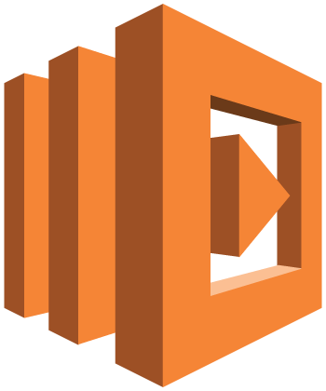





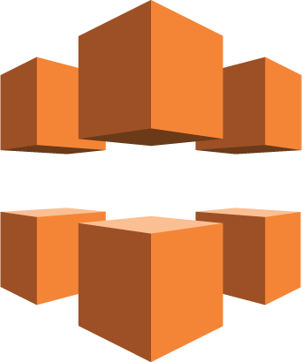
Backend
Computing
Functions
Data Resources
2) Execute the app code and communicate with computing and data resources in backend.
RESTful APIs
AWS
Lambda
Amazon DynamoDB
Amazon API Gateway*
AWS
Lambda
Amazon S3 bucket
JavaScript
Computing & Data resources
Frontend
CDN
1) Download webpage and application code
Amazon CloudFront
Amazon S3 bucket
Static webpage (html/css/javascrip)
as downloadable program
Cloud platform (e.g., AWS)

