Slide 2





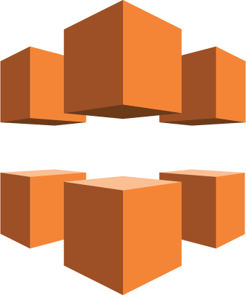
AWS
Lambda
Amazon DynamoDB
Amazon API Gateway*
AWS
Lambda
Amazon S3 bucket
Computing & Data resources
JavaScript
Amazon CloudFront
Amazon S3 bucket
Static webpage (html/css/javascrip)
as downloadable program
クラウドプラットフォーム (ex. AWS)

