Slide 1
BigRAM Coding Notice
2016/04/21
Leo Wu
WCT1/MSP/MSP1

Slide 2
Bigram memory map

Slide 3
Memory Map Spreadsheet
Refer to the attached document
Latest version @ P4
//UMOLYA/TRUNK/UMOLYA/common/interface/modem/mt6293/bigram/

Slide 4
Bigram Header file, layer-1

Slide 5
Memory Map file, Perforce
//UMOLYA/TRUNK/UMOLYA/common/interface/modem/mt6293/bigram/bigram.h
Synchronized between spreadsheet & header files
Use C structure to express BigRAM map
All developers shall read it before coding

Slide 6
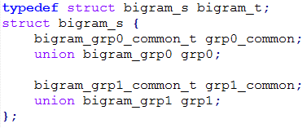
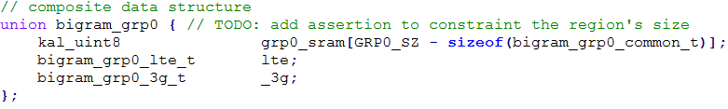
Memory Map Header File
Group0 composite data structure
Notice that union bigram_grp0 uses grp0_sram[] to guarantee the structure size honors SRAM size

Slide 7
Memory Map Header File
Check the header file, and find the part containing your memory

Slide 8
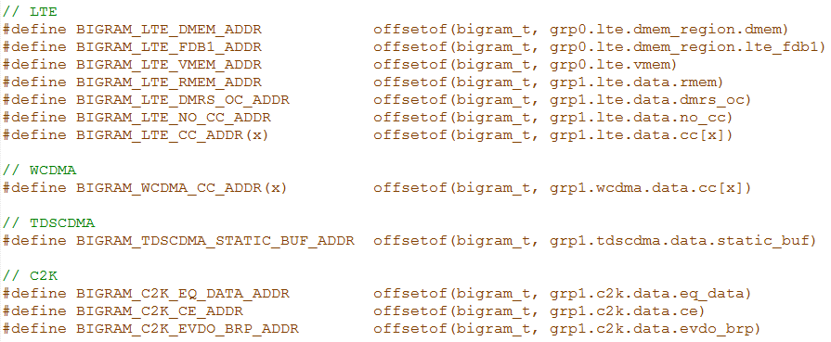
Memory Map Header File
Base address for L2 usage

Slide 9
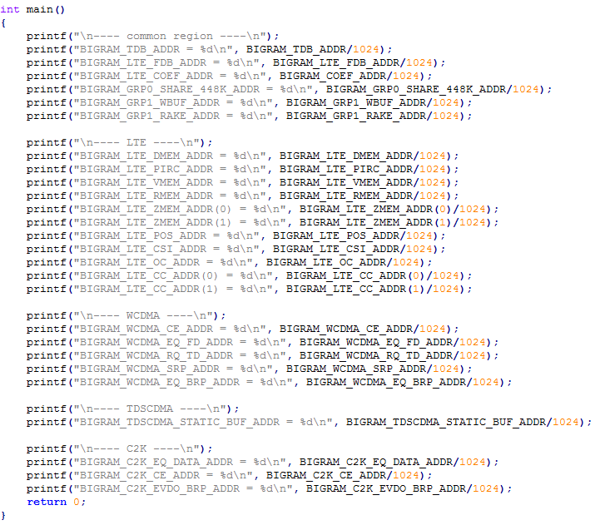
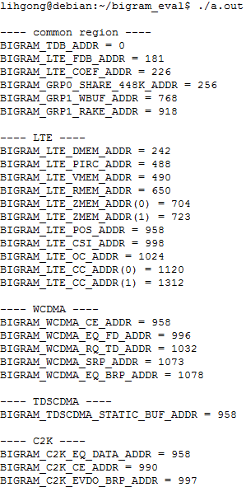
Memory Map Header File
Run-able test code

Slide 10
Bigram Header file Further decomposition

Slide 11
BigRAM Header File, layer-2
A new coding style is proposed to support
Easy to understand
Quick container/ payload size check
Quick report mechanism

Slide 12
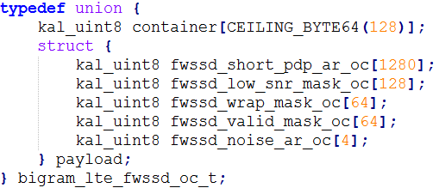
Error Detection Mechanism Container size smaller than Payload

Slide 13
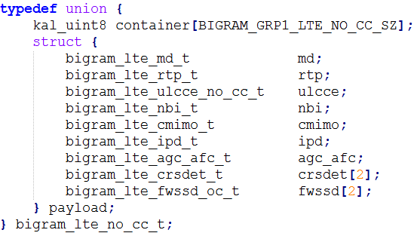
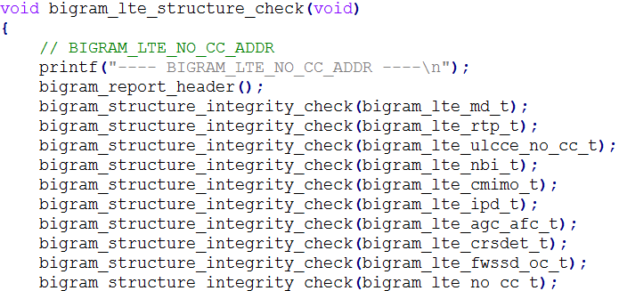
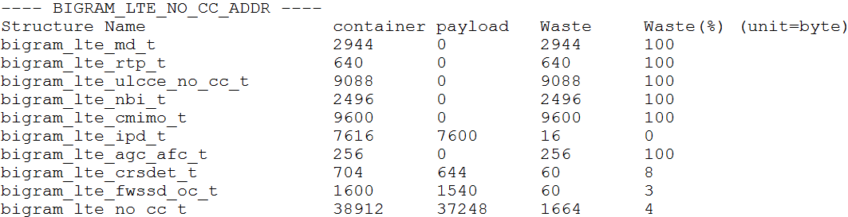
Easy to understand report

Slide 14
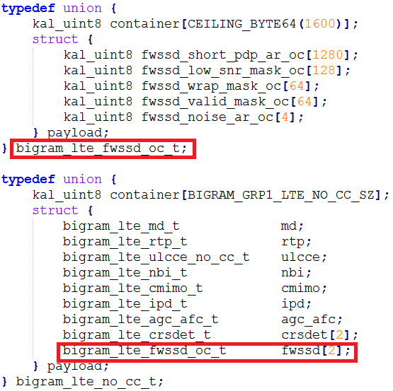
Data Structure Declaration
Declare each memory block by union with 2 elements {container/ payload}
Thanks to fixed data structure, we could check container/ payload size automatically
Data structure can be nested

Slide 15
Access Macro
Use the base address from Layer-1 directly
No module’s base address any more
Easier to maintain now
In FWSSD example, it’s located in
BIGRAM_LTE_NO_CC_ADDR +
offsetof(bigram_lte_no_cc_t,
payload.fwssd[x].payload.XXX)

Slide 16
BigRAM Data Structure SOP (1)
Declare your data structure & access macro
typedef union {
kal_uint8 container[CEILING_BYTE64[SZ];
struct {
// Put your structure here
} payload;
} bigram_lte_QQM_t; // declare the name you want

Slide 17
BigRAM Data Structure SOP (2)
Container[SZ]
The value may come from Layer-1 definition, if the memory region’s size is declared in spreadsheet
The value may come from module owner’s calculation. Fill your value here
Put your data structure in proper place
The structure might be a field of another structure or standalone one

Slide 18
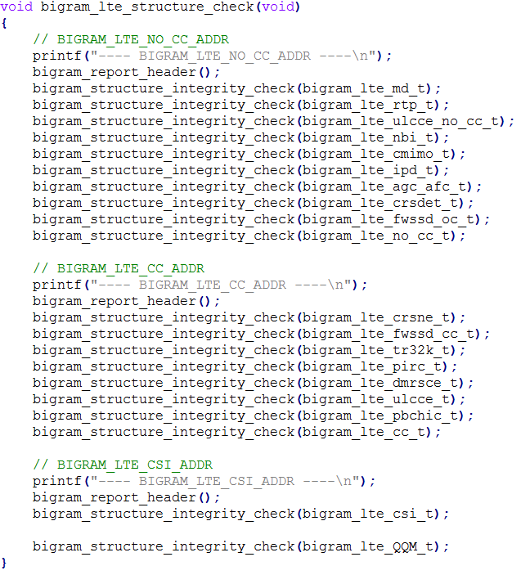
BigRAM Data Structure SOP (3)
Add integrity check in bigram_test.c

Slide 19
Coding trick (show off)

Slide 20
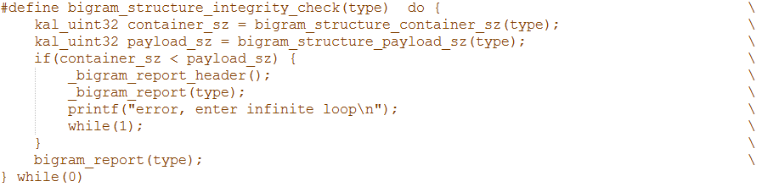
bigram_structure_integrity_check()
member_size() extracts the size of a structure field

Slide 21

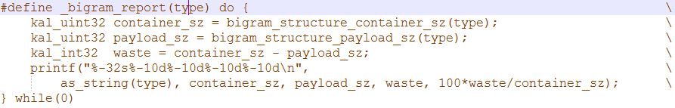
_bigram_report(type)
as_string(type) converts type name to string, which is the key to generate report

Slide 22
Bigram Header file Location & include path

Slide 23
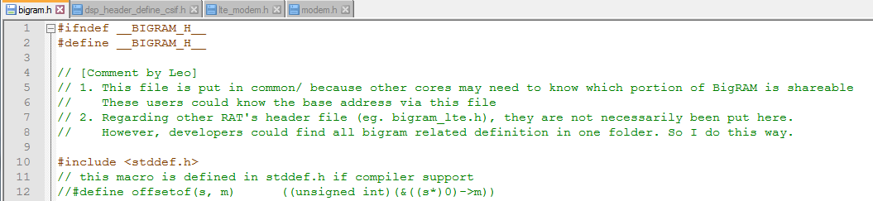
Location
Bigram related header files in common/interface/modem/mt6293m/bigram
Other cores need to know the share-base
One place to make developer’s life easier
Theoretically, Layer2 & 3 are not “common/” files
Developers find all fines in single folder rather than multiple places

Slide 24
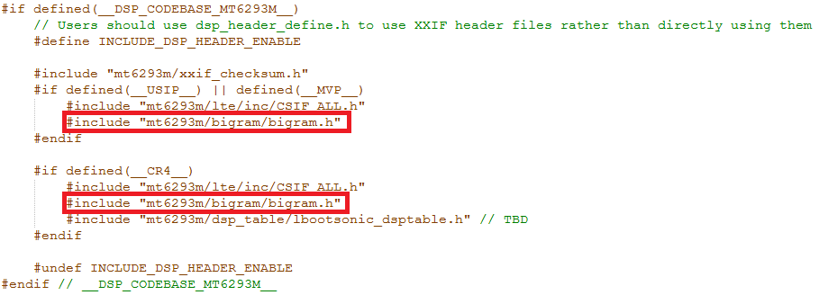
common/interface/modem/dsp_header_define_csif.h

Slide 25
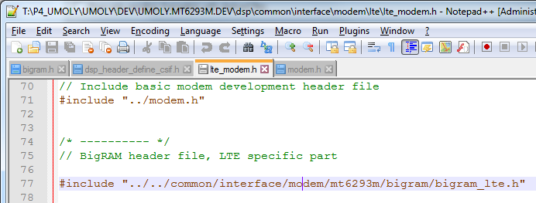
dsp/common/interface/modem/lte/lte_modem.h

Slide 26
Bigram WORKING buffer management

Slide 27
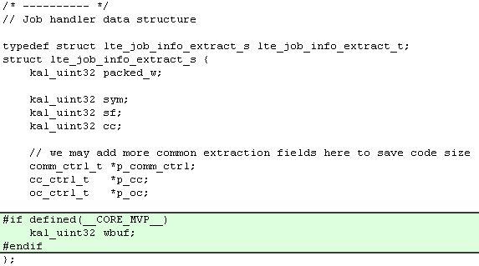
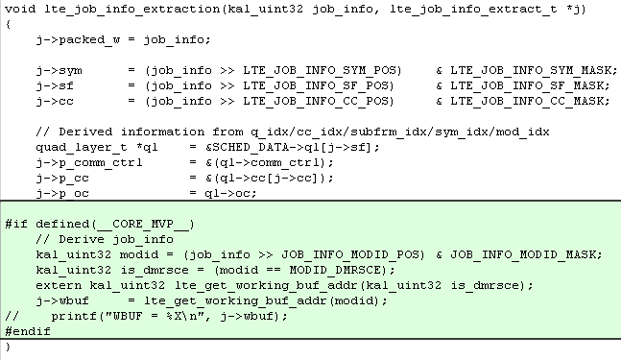
Add wbuf Field in job_info Structure

Slide 28
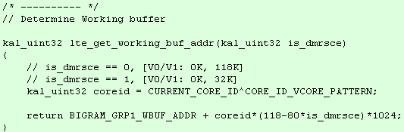
Determine Working Buffer Based On Core-ID
All RAT developer shall implement the function based on your requirement
A simpler implementation
BIGRAM_GRP1_WBUF_ADDR + coreid*32768

