Slide 1
CS 171
Intro to Artificial Intelligence:
Week 1: Search
Junkyu Lee

Slide 2
Overview
Attendance & Seating charts for Quiz 1
sign-up at checkin.ics.uci.edu
seating chart will be announced after class
Intro Agents
Uninformed Search
DFS, BFS, UCS, IDS, Bi-BFS
Heuristic Search
GBFS, A*, SMA*, RBF

Slide 3
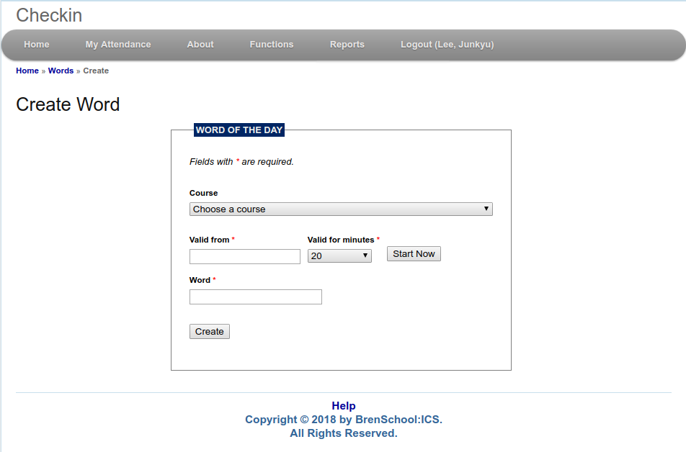
Word of the Day
checkin.ics.uci.edu -> log-in -> word: Agent / Search
checkin leaves the location records! (please don't sign up at different locations)

Slide 4
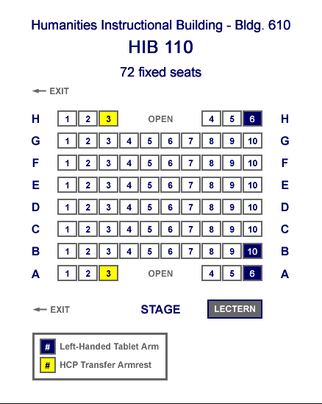
Randomized seating chart
72 Seats available
65 students registered on EEE
7 unassigned seats
B-5, C-5, D-5, E-5, F-5, G-3, G-8
You will receive an email with a PDF listing
via Canvas/Piazza announcement
Name - Seat

Slide 5
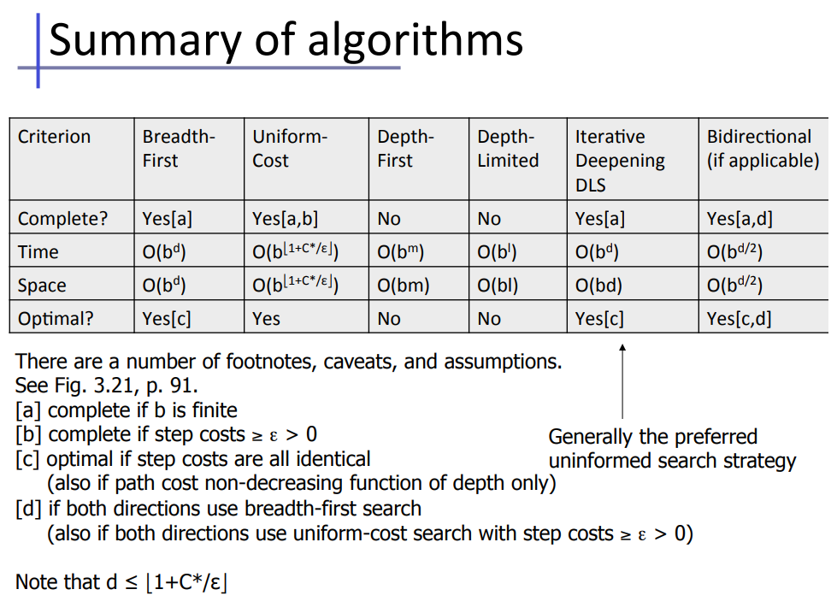
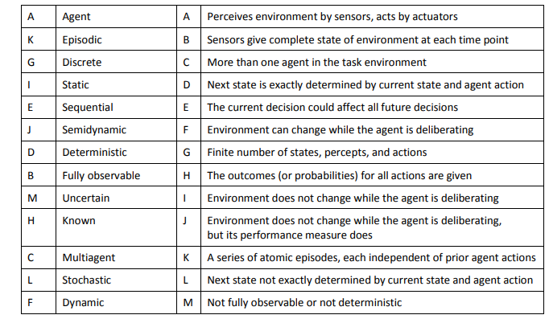
Important Things to Review
Review basic terminologies and summary of (uninformed) search algorithms

Slide 6
State Space Search - 1
Problem
states
actions available at each state
successor function defines the state transition
result(state, action) -> state
goal test to know if agent arrived at the goal state
goal_test(state) -> true / false
cost function defines the cost for moving from state1 to state2 by action
cost(state1, action, state2) -> cost

Slide 7
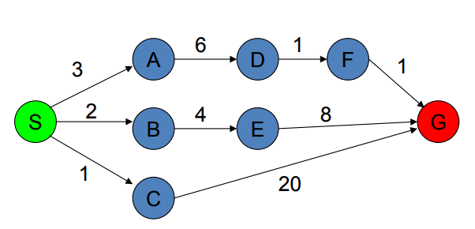
State Space Search - 2
Typically, we consider a problem of finding shortest path in a graph
state? action? successor function? cost function?

Slide 8
State Space Search - 3
Typically, we consider a problem of finding shortest path in a graph
state: label of nodes in the graph, e.g. s
action: neighbors from a node, e.g. from S edges to_A, to_B, to_C
successor: destination nodes, e.g. result(S, to_A) = A
cost: cost attached to edges, e.g. cost(S, to_A, A) = 3

Slide 9
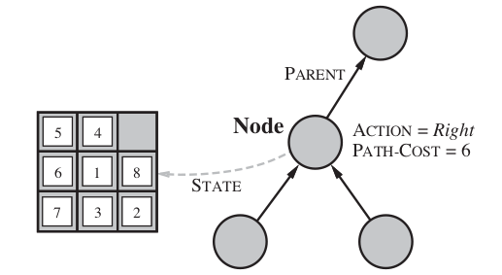
State Space Search - 4
Search Space
Search Node
state
parent
action
path_cost
depth
Search tree (graph)
Build a tree (graph) of search nodes by search algorithms
agent does not know whole input graph but it builds up search space by moving around the graph derived from the problem

Slide 10
State Space Search - 5
Search Algorithm
Build a tree of nodes for finding a path from a node representing initial state to a node representing goal state
Maintain data structure [Queues] that determines how to build a tree
Roughly,
search algorithm selects a node from the queue
expand that node, generate children node by the successor function result(s,a)
total path cost to reach a node could be computed by s1.total_cost + cost(s1, a, s2)
do goal test for the nodes
finding a path with min cost -> do it when you pop a node from a queue
only finding a path -> do it when you generating a child in expand step

Slide 11
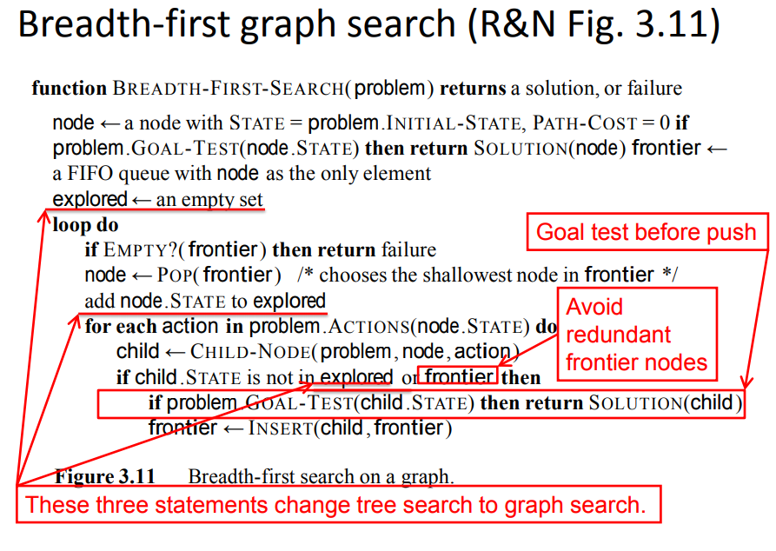

Slide 12
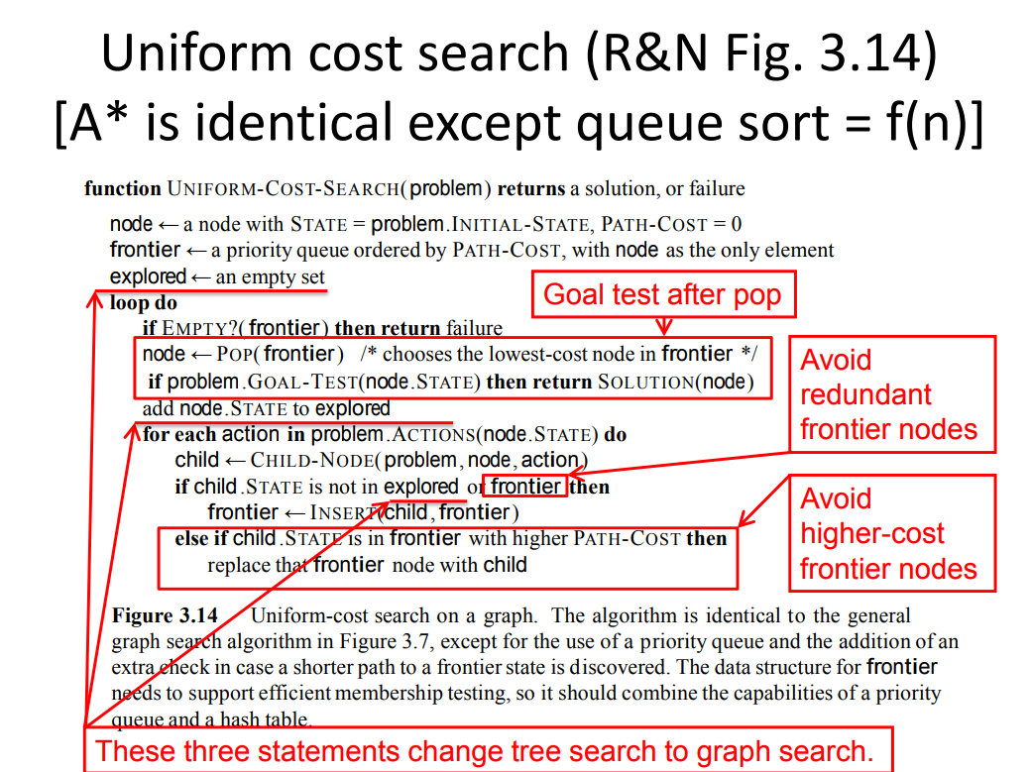

Slide 13
I will update a code little bit and post it to Piazza in a separate post by end of today for those who want to check answers (and process) of the previous problems.

