Slide 1
CS 171 Intro to AI Week 2
July 6th 2018
Junkyu Lee (junkyul@uci.edu)

Slide 2
Word of the Day
Go to checkin.ics.uci.edu
Word of the day
1 PM:
2 PM:

Slide 3
Agenda
Quiz 1
Propositional Logic Problem
Probability and Bayesian Networks Problem

Slide 4
Quiz 1
64 Students
Average 93.34
Standard deviation 8.08

Slide 5
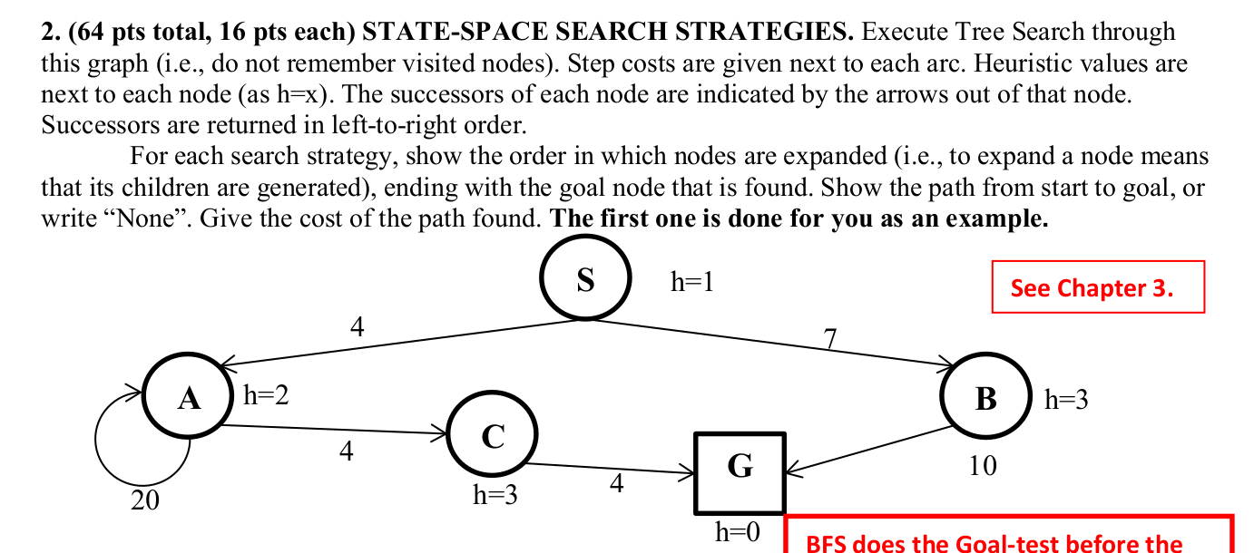
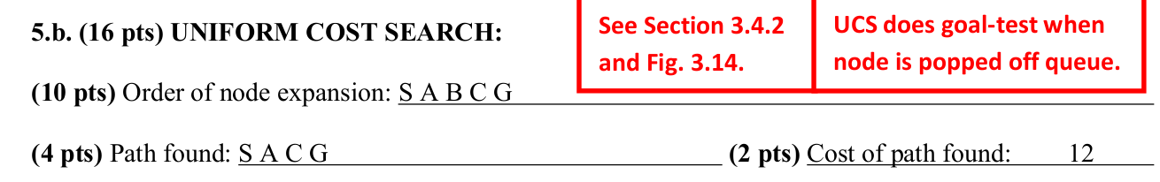
Quiz 1 – Problem 2

Slide 6
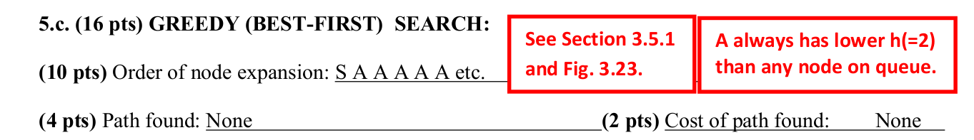
Quiz 1 – Problem 2

Slide 7
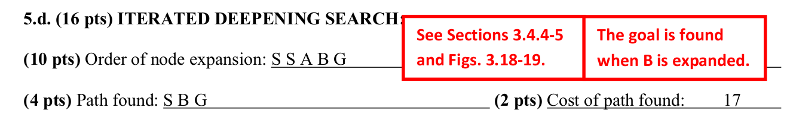
Quiz 1 – Problem 2

Slide 8
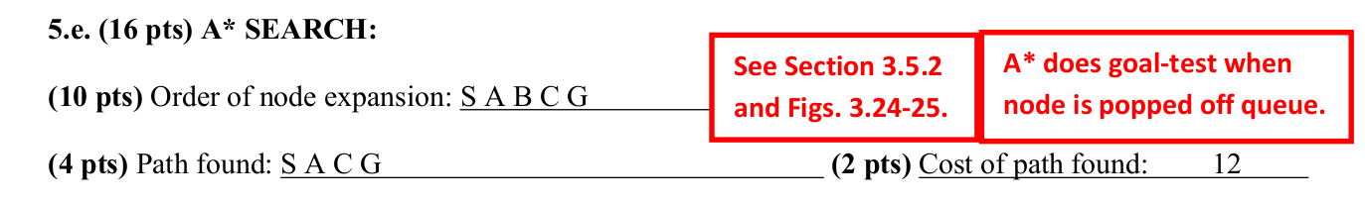
Quiz 1 – Problem 2

Slide 9
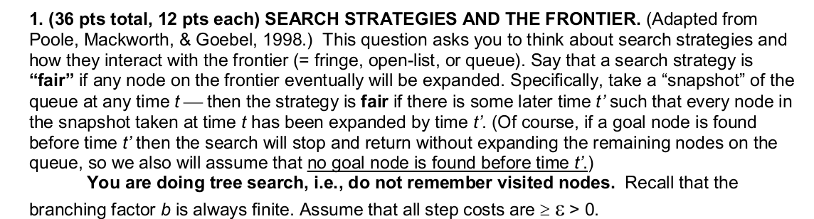
Quiz 1 – Problem 1
If "fair" search strategy is equivalent to complete search strategy...

Slide 10
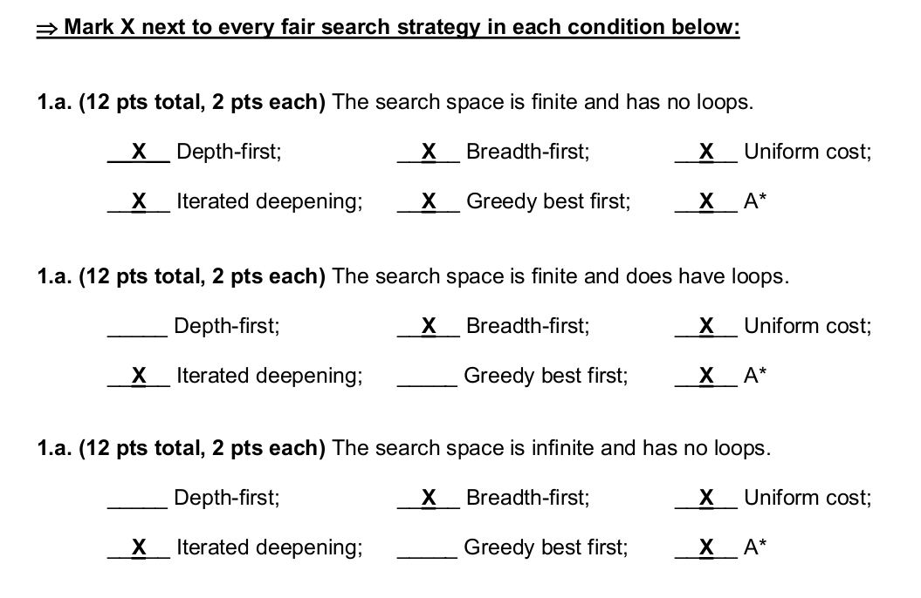
Quiz 1 – Problem 1

Slide 11
Quiz 1 – Problem 1
A search strategy is "fair"
If ANY node on the frontier eventually will be expanded
Specifically, take a "snapshot" of the queue at ANY time t – then the strategy is "fair"
If there is (EXISTS) some later time t' such that EVERY node in the snapshot taken at time t has been expanded by time t'
If a goal node is found before time t' then the search will stop and return WITHOUT expanding the remaining nodes on the queue
So we also will assume that no goal node is found before time t'
You are doing tree search (don't remember visited nodes)
Branching factor is finite, all step costs are greater than 0

Slide 12
Quiz 1 – Problem 1
what if
A goal node is found early and there remain nodes on the frontier?
Step cost is infinite?
Heuristic estimate is infinite?
…
How to fix the problem?
If there is (EXISTS) some later time t' such that EVERY node in the snapshot taken at time t has been expanded by time t'
If a goal node is found before time t' then the search will stop and return WITHOUT expanding the remaining nodes on the queue
So we also will assume that no goal node is found before time t'

Slide 13
Quiz 1 – Problem 1
A search strategy is "fair"
If ( ) node on the frontier eventually will be expanded
Specifically, take a "snapshot" of the queue at ANY time t – then the strategy is "fair"
If there is (EXISTS) some later time t' such that ( ) node in the snapshot taken at time t has been expanded by time t'
If a goal node is found before time t' then the search will stop and return WITHOUT expanding the remaining nodes on the queue
So we also will assume that no goal node is found before time t'

Slide 14
Quiz 1 – Problem 1
A search strategy is "fair"
If (ALL NODES THAT MUST BE EXPANDED TO SOLVE THE PROBLEM) on the frontier eventually will be expanded
Specifically, take a "snapshot" of the queue at ANY time t – then the strategy is "fair"
If there is (EXISTS) some later time t' such that (ALL NODES THAT MUST BE EXPANDED TO SOLVE THE PROBLEM) in the snapshot taken at time t has been expanded by time t'
If a goal node is found before time t' then the search will stop and return WITHOUT expanding the remaining nodes on the queue
So we also will assume that no goal node is found before time t'

Slide 15
Quiz 1 – Problem 1
Adapting from...
Computational Intelligence: A logical appraoch by David Poole, Alan Mackworth, Randy Goebel, 1998
A fair selection in one where a request isn't kept waiting indefinitely
If a request is repeatedly available to be selected it will eventually be selected (in a finite time, practically until finishing search)
In search, a request is selecting (pop) a node from the frontier
A set of nodes that can be returned by the fair selection
Nodes along a path from root to a goal (not necessarily optimal, or there may be more than 1 solution)

Slide 16
Formal symbol system and propositional logic
What is formal symbol system
Reasoning vs Inference
Knowledge base and entailment
Syntax and equivalence in propositional logic
Basic rules, how we evaluate truth value of a sentence
Know how to use equivalence (converting sentence to CNF/DNF)
Inference in propositional logic
Resolution
If a KB entails a sentence S, then resolution can prove it by showing (KB AND (NOT) S) is {EMPTY CLAUSE} or False; proof by contradiction;
Resolution is Sound and Refutation complete
In propositional logic, resolution terminates with {EMPTY clause} or you cannot apply resolution anymore; show the entailment of S or show that S cannot be proved

Slide 17
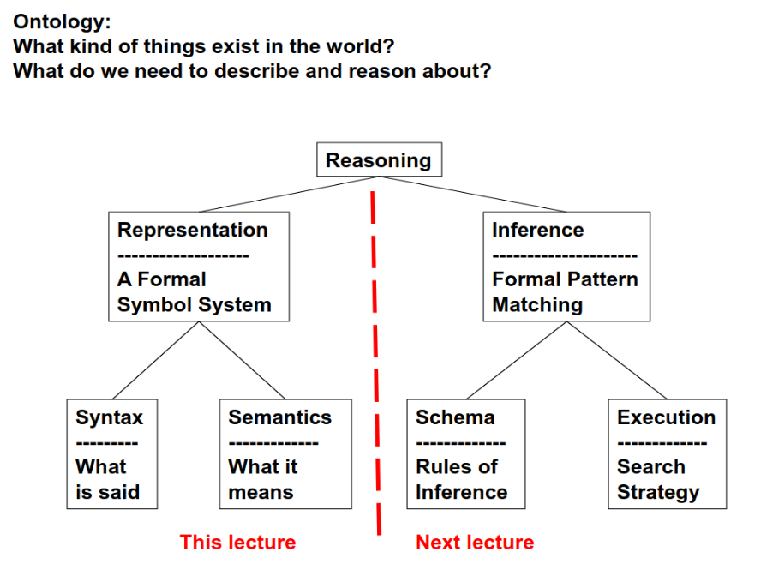

Slide 18
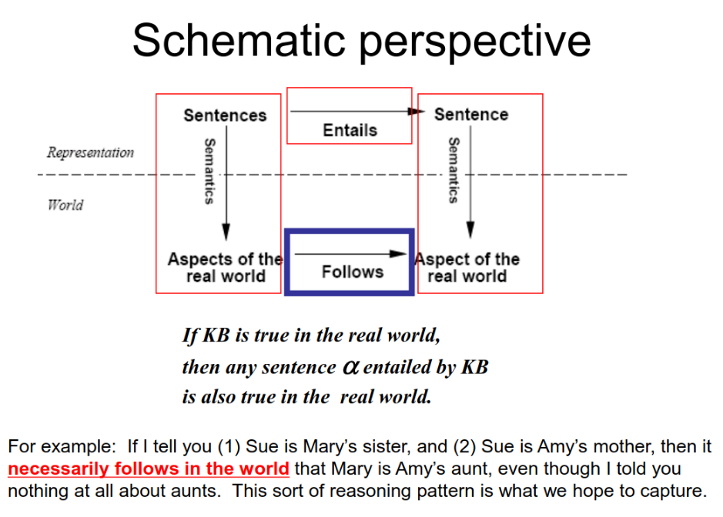

Slide 19
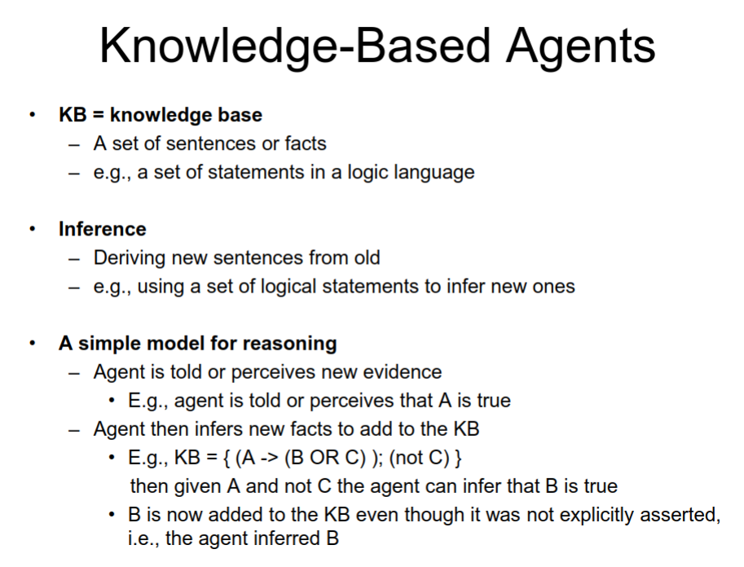

Slide 20
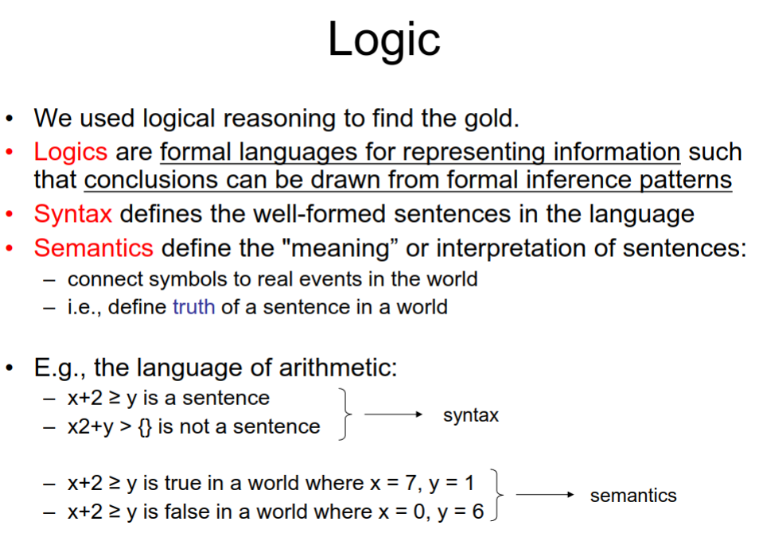

Slide 21
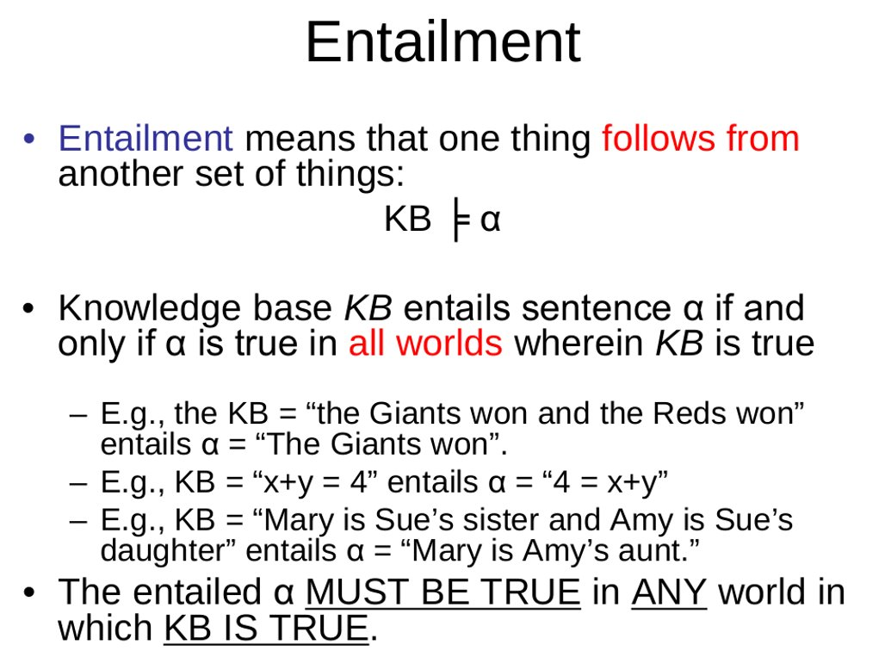

Slide 22
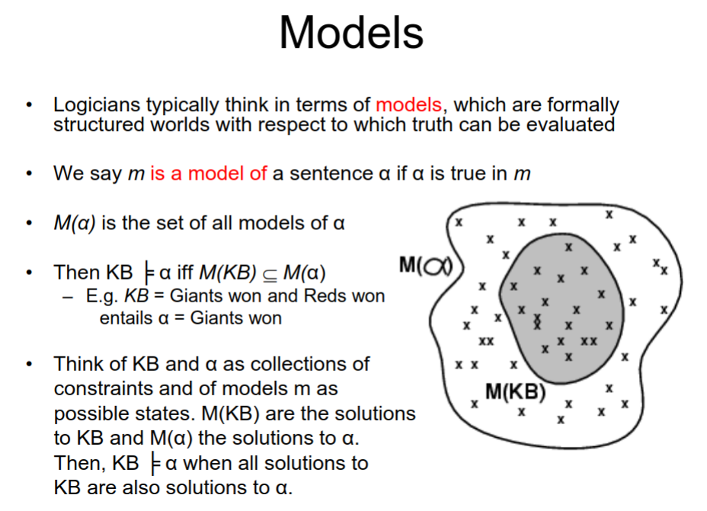

Slide 23
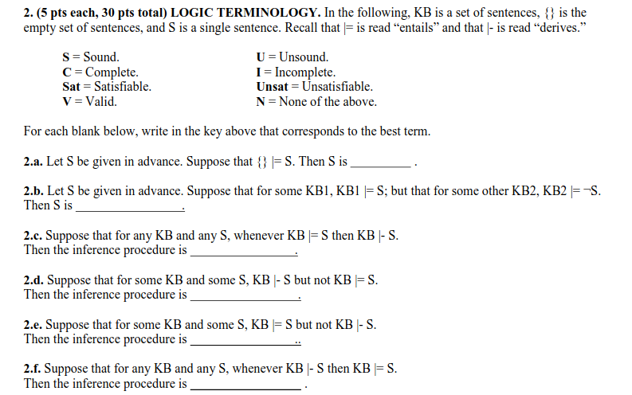

Slide 24
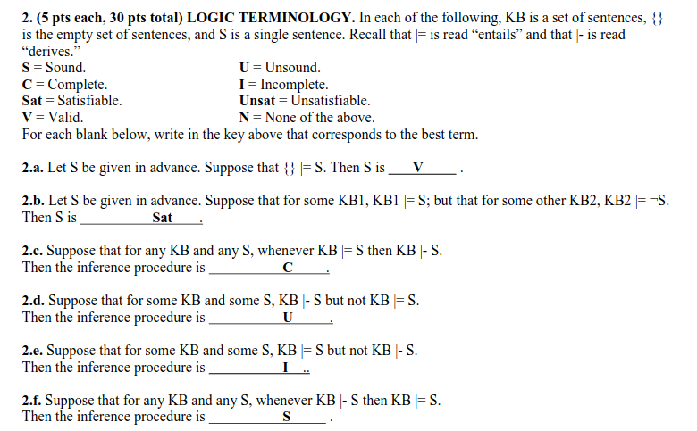

Slide 25
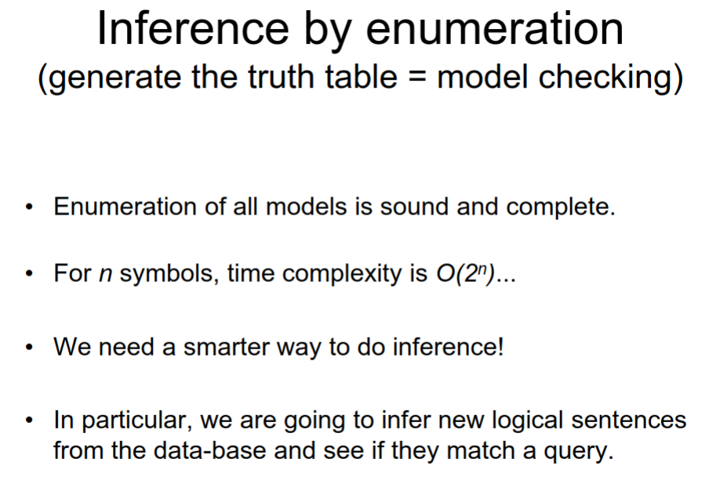

Slide 26
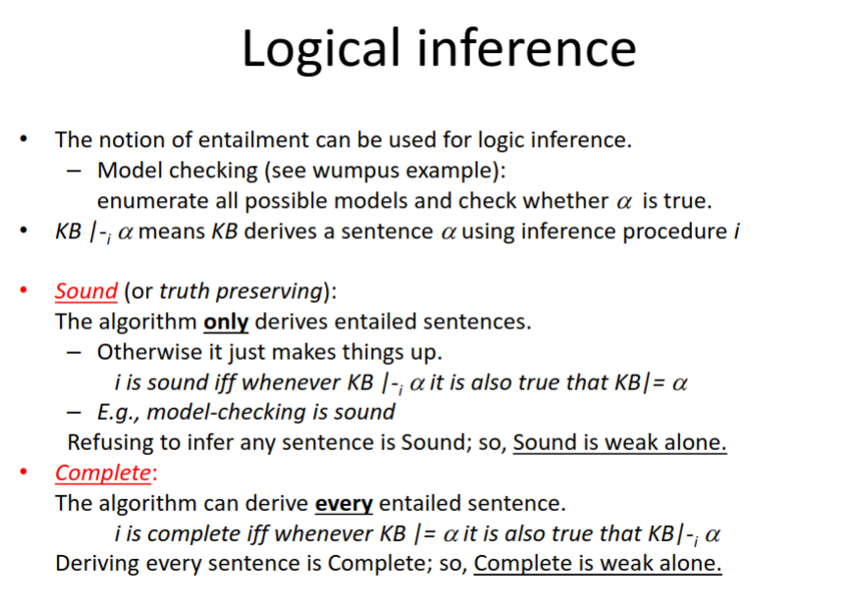

Slide 27
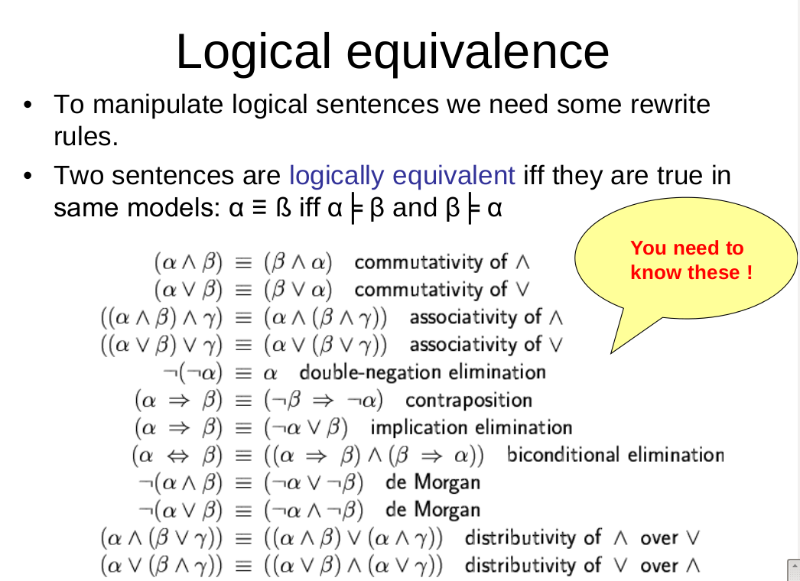

Slide 28
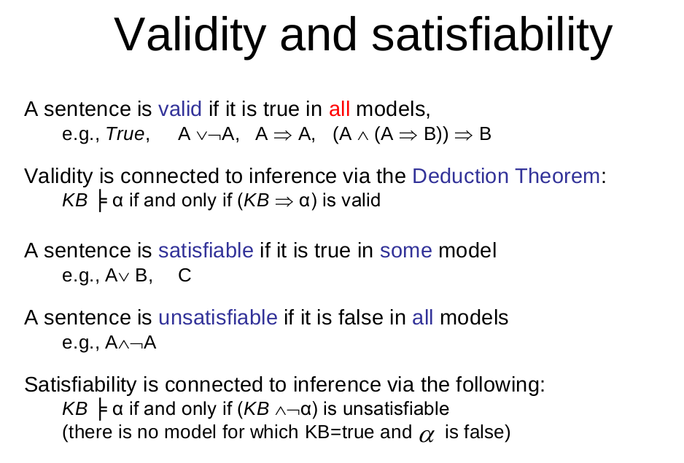

Slide 29
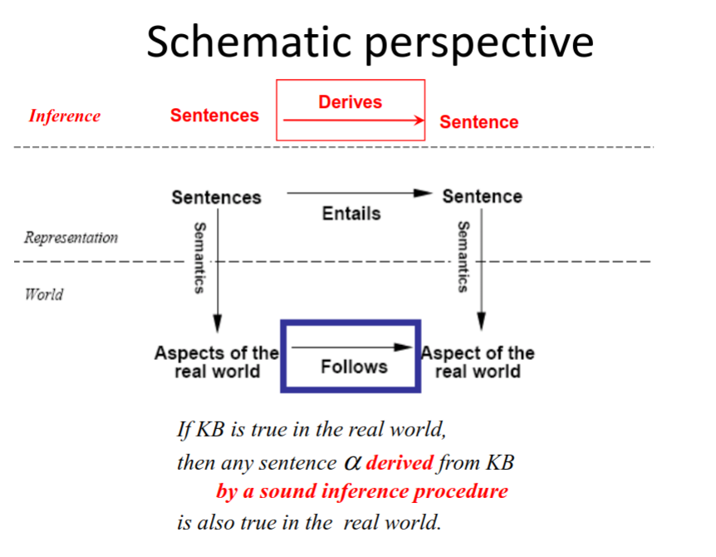

Slide 30
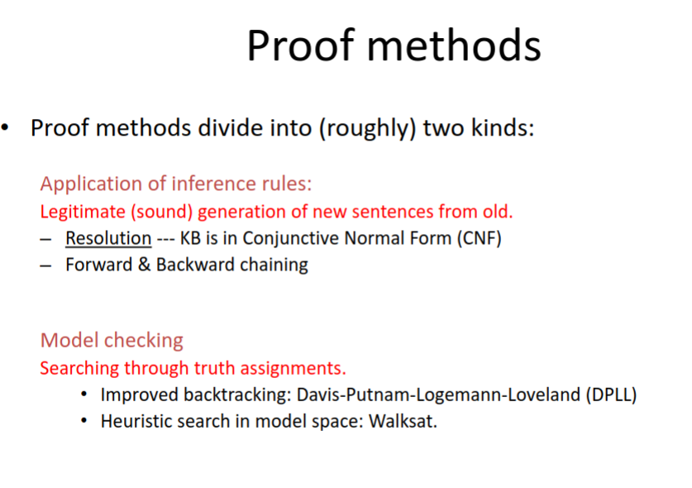

Slide 31
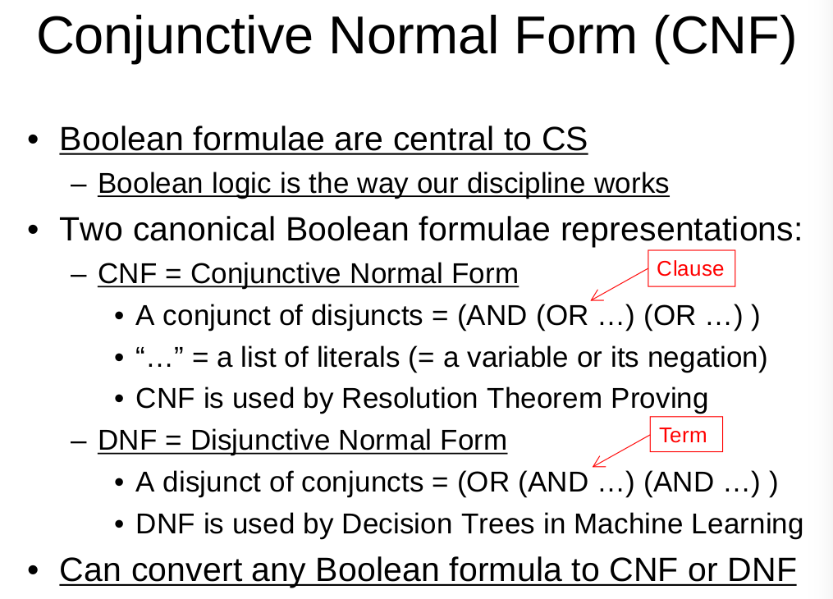

Slide 32
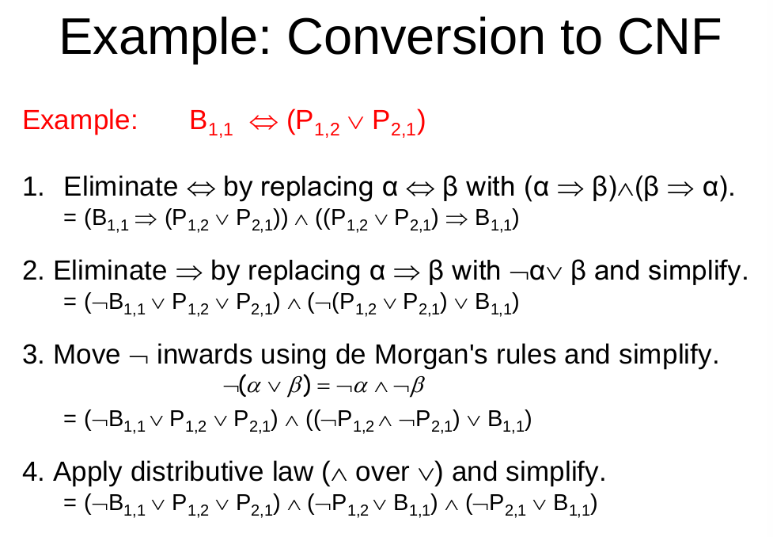

Slide 33
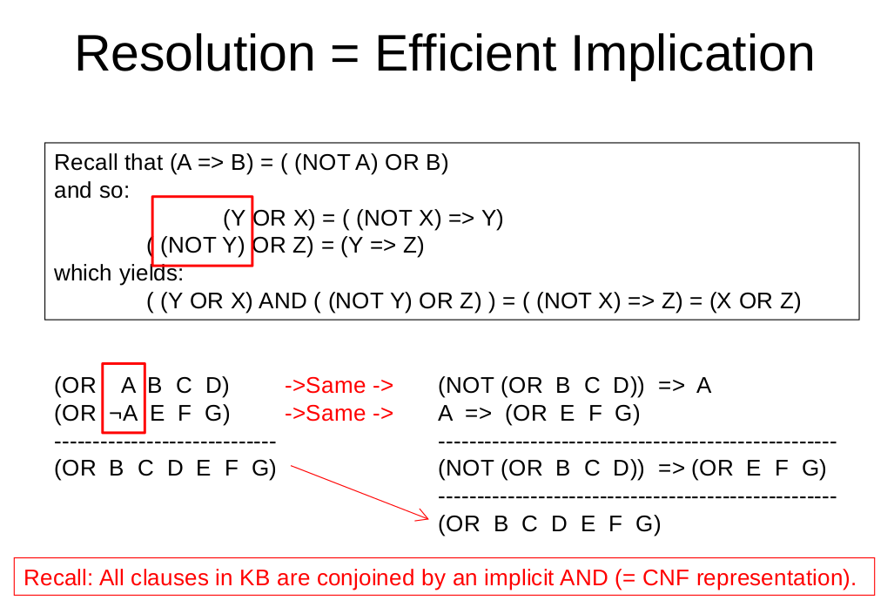

Slide 34
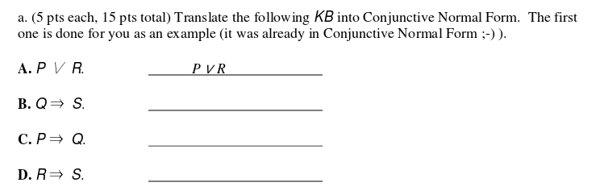

Slide 35
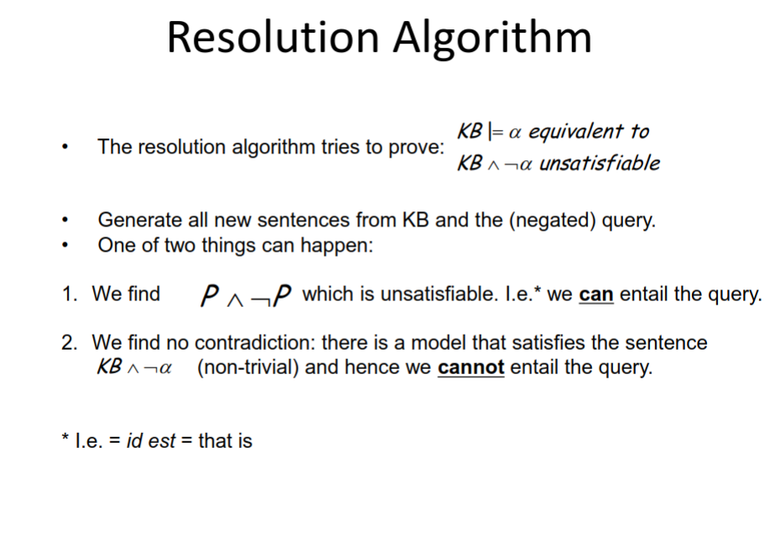

Slide 36
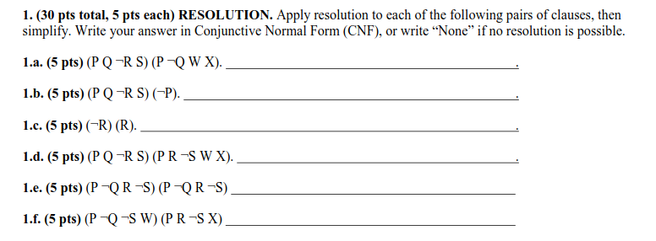

Slide 37
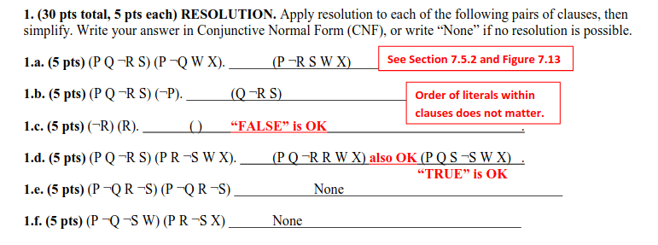

Slide 38
Probability theory and Bayesian Network
Basic probability concepts
Rules for computing probability
Write down correct probability assertions
From Probabilistic KB to Bayesian Network
Draw Bayesian Network
Read Independence, conditional independence
Compute (probabilistic inference) probability assertions from Bayesian Network

Slide 39
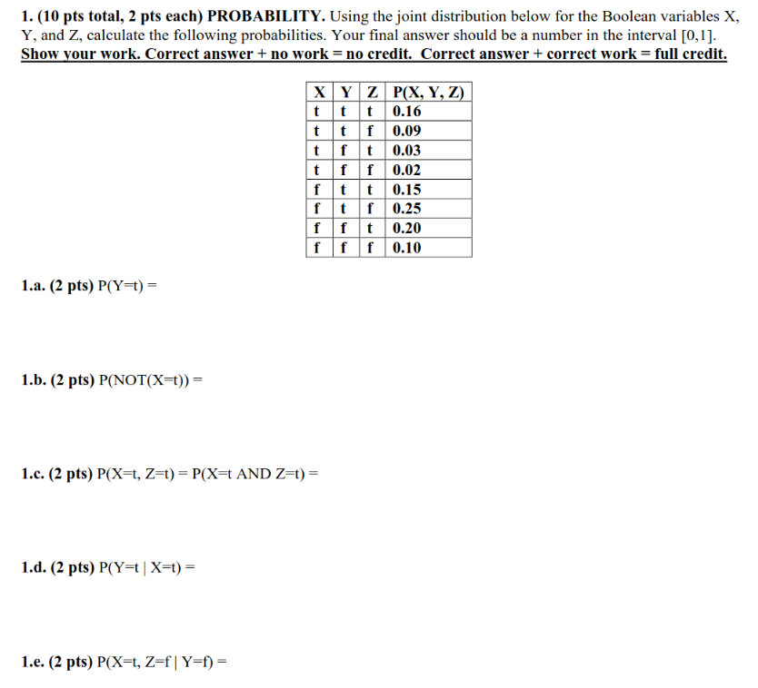

Slide 40
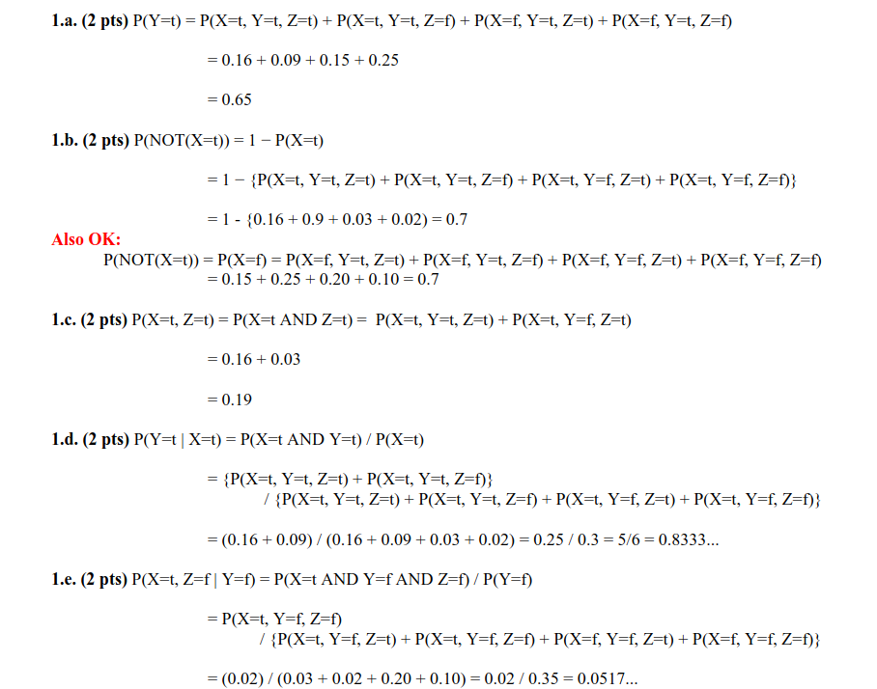

Slide 41
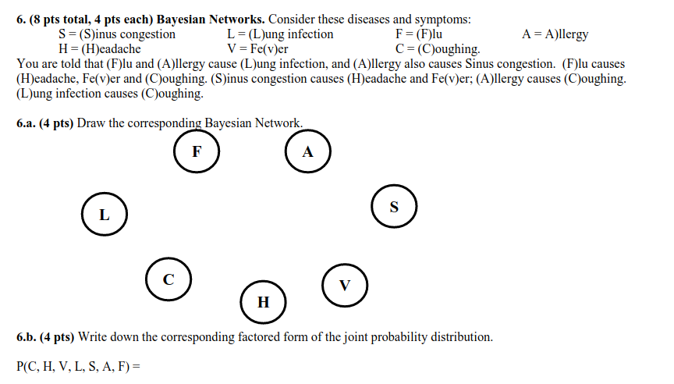

Slide 42
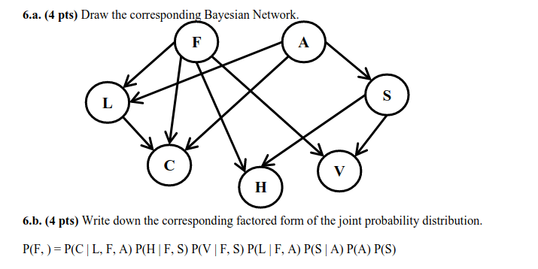

Slide 43
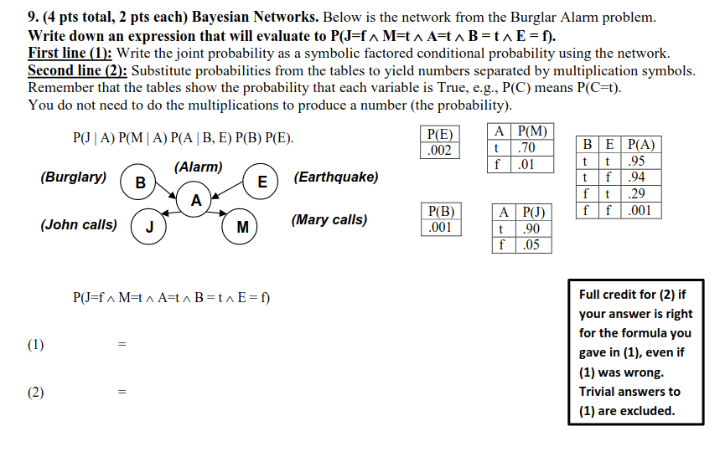

Slide 44
