Slide 1
CS-171 Summer 1 Week 3 Discussion
7. 13. 2018
Junkyu Lee (junkyul@uci.edu)

Slide 2
Word of the day
Discussion 13:00 – 13:50
Discussion 14:00 – 14:50

Slide 3
Quiz 2
Problem 1 (40 pts)
Syntax error –10 pt
-10 pt per error
No useful line or didn't solve the problem –40 pt
Problem 2 (20 pts)
10 pt per each problem
-5 pt per minor mistake (calculation, etc)
Common mistakes: computing conditional probability from full joint
Problem 3 (40 pts)
10 pt per each problem
-5 pt if close to the answer (missing 1 or 2 steps or minor errors)
Common mistakes: they are.... definition or rules, please review 3 rules (prod/sum/Bayes) and definitions (conditional probability, conditional independence etc)

Slide 4
Review Concepts in First Order Logic
Propositional Logic
First Order Logic
Knowledge base:
a set of facts/sentences or wff
written in CNF for efficient inference
World
truth assignments to propositions
Interpretation
Context independent
Model
set of worlds (truth assignments) that evaluates KB true
Knowledge base:
a set of facts/sentences or well-formed formulas
written in CNF for efficient inference
World
objects with relation (return truth value) and functions (return object)
Interpretation
mapping btw object symbols (relation/function) and objects (relation/function) in the worlds
Model
Set of worlds that evaluates KB true under some interpretation

Slide 5
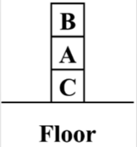
Interpretation
Real world
objects
3 block objects A, B, C
1 Floor object
Relation
On (x, y): x is on y
e.g. On(A, C) is true, On (B, C) is false
Clear(x): nothing on x
e.g. Clear(A) is false
Functions
Below(x): returns an object below x
e.g. A=Below(A)
Be careful when dealing with functions... (relational logic removes functions from first order logic)
Logical world, symbolic
The description gave a natural interpretation... but it is possible to map
Object mappings
4 things in the world to 4 constant symbols
Floor maps to Symbol B
Block B maps to Symbol A
...
Relation
2 real world relations can mapped to 2 relation symbols
On(x,y) relation maps to Symbol Clear
..
Functions
Similar to above
Almost always we want some natural interpretation

Slide 6
Review Concepts in First Order Logic
Entailment KB |= A, as a set relations between Model(KB) and Model(A)
Inference
An inference procedure "derives" a sentence A...
Sound: if KB entails A
Unsound: if KB does not entail A
Complete: if the inference can derive all sentences that can be entailed by KB
M(A)
M(KB)
M(KB)
M(KB)
M(A)
M(A)
Entailment
Classical logic is monotone
Satisfiable (not entailment)
Unsatisfiable (not entailment)

Slide 7
Syntax of First order logic
Quantifiers [FORALL] [EXISTS]
[FORALL] and [EXISTS] cannot switch order
we will see this rule when we convert a sentence to CNF
Variables: can place objects in place of the variable
Terms: an object
Constant object, an object returned by some function, ...

Slide 8
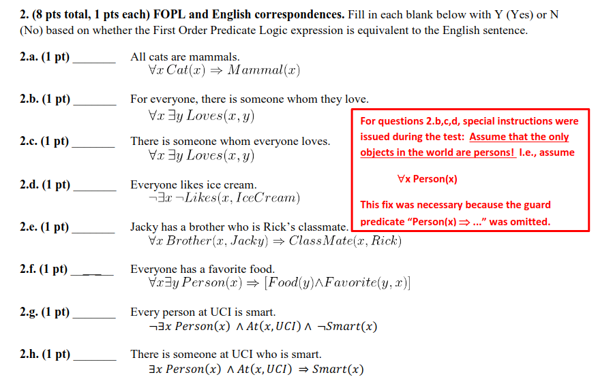
Idioms – English Sentence to WFF
Fall 2017 Final
The order of [forall] [exists]
Relation is English Verb or defining what the term
If a relation takes two terms,
the first term is Subject and the second term is Object
Passive sentence
[NOT] [QUANT] x [NOT] P(x)
Exists AND
Forall FORALL

Slide 9
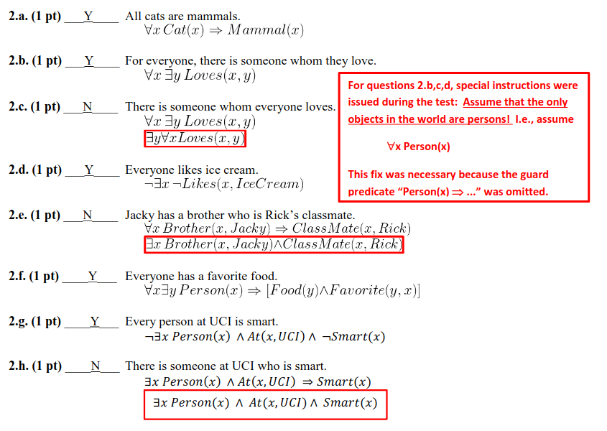

Slide 10


WFF to CNF in First Order Logic
Final goal is to obtain sentence in the following form
FORALL is dropped for notational ease; [FORALL] x is there
A Conjunction of Disjunction of Relations
Skolemize: Remove existential quantifier from a sentence by replacing a variable with an anonymous function
Note, this CNF conversion is HARD.

Slide 11
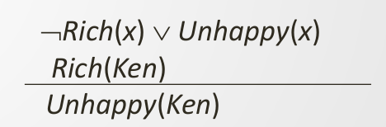

Inference (resolution) in the first order logic
Recall, resolution in the propositional logic
take two clauses, resolve 1 pair (positive and negative literals)
Resolvent of (S1 OR A) AND (S2 OR ((NOT) A)) is (S1 OR S2)
Consider the model diagram with a set notation or argument
if A is true then S2 must be true, Or if A is false then S1 must be true
So S2 or S1 must be true
In first order logic resolution,
Take two clauses with some substitution by unification, resolve 1 pair
Substitute variable symbols, terms (constant objects, objects from a function)
Most General Unifier: leave as much as variables as one can

Slide 12
Game Tree Search
What is the best move at this point?
Game tree search enumerates all possible moves from the game
I (MAX Player) want to maximize my score of the game
Opponent (MIN Player) want to minimize my score of the game
Each level of a game tree corresponds to the turn by ME or Opponent
Evaluation function evaluates the score at the leaf node of a game tree
Can be the actual score of the game, like Tic-Tac-Toe
In practice, we apply heuristic evaluation function at a certain depth.

Slide 13
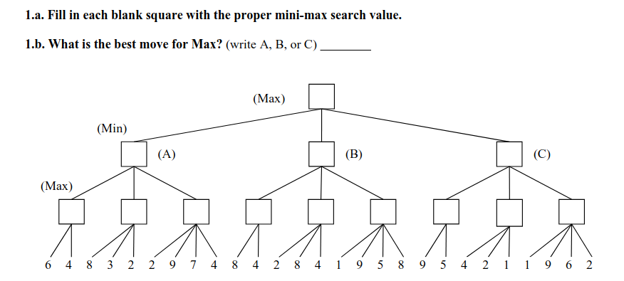
Game Tree Search – Mini-Max
Fall 2017 quiz 2

Slide 14
Game Tree Search – Mini-Max
Fall 2017 quiz 2
6
6
8
9

Slide 15
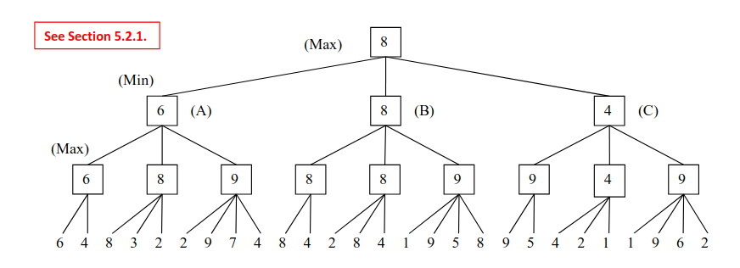
What if MAX player at the root had tie? Then the player can take both moves

Slide 16
Game Tree Search – Alpha Beta Pruning
Depth-First Search with Pruning by (ALPHA, BETA)
In Alpha-Beta Pruning, each node maintains
Value (score) of the node
Game tree search backs up (propagates a value to its parent) value from leafs to the root
Alpha:
Initially -INF
Highest score found so far at any choice point along the path for MAX
MAX player updates ALPHA
Beta
Initially INF
Lowest score found so far at any choice point along the path for MIN
MIN player updates BETA
The Alpha, Beta values are inherited from parents (but we don't back up alpha beta to parents)
MAX/MIN can prune if ALPHA >= BETA
No need to do search up to this point because the opponent will avoid this part of the search tree anyway.

Slide 17
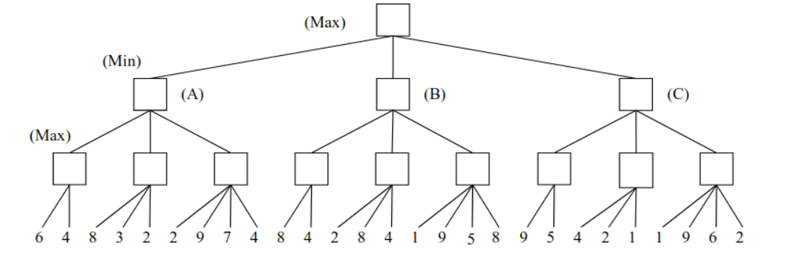
Game Tree Search – Alpha Beta Pruning
V: -
(-INF, INF)

Slide 18
Game Tree Search – Alpha Beta Pruning
V: -
(-INF, INF)
V: -
(-INF, INF)
V: -
(-INF, INF)

Slide 19
Game Tree Search – Alpha Beta Pruning
V: -
(-INF, INF)
V: -INF
(-INF, INF)
V: 6
(6, INF)
6

Slide 20
Game Tree Search – Alpha Beta Pruning
V: -
(-INF, INF)
V: -
(-INF, INF)
V: 6
(6, INF)
6

Slide 21
Game Tree Search – Alpha Beta Pruning
V: -
(-INF, INF)
V: -
(-INF, INF)
V: 6
(6, INF)
6

Slide 22
Game Tree Search – Alpha Beta Pruning
V: -
(-INF, INF)
V: 6
(-INF, 6)
6
V: 6
(6, INF)
6

Slide 23
Game Tree Search – Alpha Beta Pruning
V: -
(-INF, INF)
V: 6
(-INF, 6)
6
V: -
(-INF, 6)
6

Slide 24
Game Tree Search – Alpha Beta Pruning
V: -
(-INF, INF)
V: 6
(-INF, 6)
6
V: -
(-INF, 6)
6

Slide 25
Game Tree Search – Alpha Beta Pruning
V: -
(-INF, INF)
V: 6
(-INF, 6)
6
V: 8
(8, 6)
6
8

Slide 26
Game Tree Search – Alpha Beta Pruning
V: -
(-INF, INF)
V: 6
(-INF, 6)
6
V: 8
(8, 6)
6
8
8 >= 6 Prune

Slide 27
Game Tree Search – Alpha Beta Pruning
V: -
(-INF, INF)
V: 6
(-INF, 6)
6
V: 8
(8, 6)
6
8

Slide 28
Game Tree Search – Alpha Beta Pruning
V: -
(-INF, INF)
V: 6
(-INF, 6)
6 is less than 8, maintain it
6
V: 8
(8, 6)
6
8

Slide 29
Game Tree Search – Alpha Beta Pruning
V: -
(-INF, INF)
V: 6
(-INF, 6)
6
V: -
(-INF, 6)
6
8

Slide 30
Game Tree Search – Alpha Beta Pruning
V: -
(-INF, INF)
V: 6
(-INF, 6)
6
V: -
(-INF, 6)
6
8

Slide 31
Game Tree Search – Alpha Beta Pruning
V: -
(-INF, INF)
V: 6
(-INF, 6)
6
V: 2
(2, 6)
6
8
2
2 >= 6 ?? NO PRUNING

Slide 32
Game Tree Search – Alpha Beta Pruning
V: -
(-INF, INF)
V: 6
(-INF, 6)
6
V: 9 (9 > 2)
(9, 6)
6
8
9
MAX PLAYER: Even if I do more search, the current partial path shows that MIN player will enforce the value 6 to me any way. If I didn't know the value 9, there might be a chance that I would have lower score under this subtree that MIN player can get a lower score than 6

Slide 33
Game Tree Search – Alpha Beta Pruning
V: -
(-INF, INF)
V: 6
(-INF, 6)
6
V: 9 (9 > 2)
(9, 6)
6
8
9
9>= 6 YES PRUNE

Slide 34
Game Tree Search – Alpha Beta Pruning
V: -
(-INF, INF)
6 is less than 9 maintain 6
V: 6
(-INF, 6)
6
6
8
9

Slide 35
Game Tree Search – Alpha Beta Pruning
V: 6
(6, INF)
6 is the first value backup from the left most branch
6
V: 6
(-INF, 6)
6
6
8
9

Slide 36
Game Tree Search – Alpha Beta Pruning
V: 6
(6, INF)
6
6
V: -
(6, INF)
6
8
9

Slide 37
Game Tree Search – Alpha Beta Pruning
V: 6
(6, INF)
6
V: -
(6, INF)
6
V: -
(6, INF)
6
8
9

Slide 38
Game Tree Search – Alpha Beta Pruning
V: 6
(6, INF)
6
V: -
(6, INF)
6
V: 8
(6->8, INF)
6
8
9
8
MAX updates ALPAH from 6 to 8;
No pruning; 8 >= INF? NO

Slide 39
Game Tree Search – Alpha Beta Pruning
V: 6
(6, INF)
6
V: -
(6, INF)
6
V: 8
(8, INF)
6
8
9
8
The score 4 does not change the value of the MAX node

Slide 40
Game Tree Search – Alpha Beta Pruning
V: 6
(6, INF)
6
V: 8
(6, 8)
6
8
V: 8
(8, INF)
6
8
9
8
MIN player 8 is the first value back up from its children
Update value and BETA; 6 >=8? NO Keep searching

Slide 41
Game Tree Search – Alpha Beta Pruning
V: 6
(6, INF)
6
V: 8
(6, 8)
6
8
V: -
(6, 8)
6
8
9
8

Slide 42
Game Tree Search – Alpha Beta Pruning
V: 6
(6, INF)
6
V: 8
(6, 8)
6
8
V: 2
(6, 8)
6
8
9
8
2
The current ALPH 6 is, greater than the new value 2;
Don't update ALPHA

Slide 43
Game Tree Search – Alpha Beta Pruning
V: 6
(6, INF)
6
V: 8
(6, 8)
6
8
V: 8
(8, 8)
6
8
9
8
8
The new value 8 is greater than 2, update the value;
The value 8 is also greater than ALPHA (6), update ALPHA
Now, 8 >=8 So Prune!

Slide 44
Game Tree Search – Alpha Beta Pruning
V: 6
(6, INF)
6
V: 8
(6, 8)
6
8
V: 8
(8, 8)
6
8
9
8
8
The new value 8 is greater than 2, update the value;
The value 8 is also greater than ALPHA (6), update ALPHA
Now, 8 >=8 So Prune!

Slide 45
Game Tree Search – Alpha Beta Pruning
V: 6
(6, INF)
6
V: 8
(6, 8)
6
8
6
8
9
8
8
Backup value 8 to MIN PLAYER
The value is already 8

Slide 46
Game Tree Search – Alpha Beta Pruning
V: 6
(6, INF)
6
V: 8
(6, 8)
6
8
V: -
(6, 8)
6
8
9
8
8

Slide 47
Game Tree Search – Alpha Beta Pruning
V: 6
(6, INF)
6
V: 8
(6, 8)
6
8
V: 1
(6, 8)
6
8
9
8
8
1

Slide 48
Game Tree Search – Alpha Beta Pruning
V: 6
(6, INF)
6
V: 8
(6, 8)
6
8
V: 9
(9, 8)
6
8
9
8
8
9
After updating the value of MAX Player...

Slide 49
Game Tree Search – Alpha Beta Pruning
V: 6
(6, INF)
6
V: 8
(6, 8)
6
8
V: 9
(9, 8)
6
8
9
8
8
9
MAX can prune, 9 >=8

Slide 50
Game Tree Search – Alpha Beta Pruning
V: 6
(6, INF)
6
V: 8
(6, 8)
6
8
V: 9
(9, 8)
6
8
9
8
8
9
Back up value 9 to MIN player, but 8 is less than 9
MIN player does not change its value and BETA

Slide 51
Game Tree Search – Alpha Beta Pruning
V: 6
(6, INF)
6
V: 8
(6, 8)
6
8
6
8
9
8
8
9
MAX player now has the second value 8,
Since 8>6 update the value and ALPHA

Slide 52
Game Tree Search – Alpha Beta Pruning
V: 8
(8, INF)
6
6
8
6
8
9
8
8
9
MAX player now has the second value 8,
Since 8>6 update the value and ALPHA

Slide 53
Game Tree Search – Alpha Beta Pruning
V: 8
(8, INF)
6
V: -
(8, INF)
6
8
V: -
(8, INF)
6
8
9
8
8
9
Now search the rightmost branch;
Inherit (ALPHA, BETA)

Slide 54
Game Tree Search – Alpha Beta Pruning
V: 8
(8, INF)
6
V: -
(8, INF)
6
8
V: 9
(9, INF)
6
8
9
8
8
9
Now search the rightmost branch;
Inherit (ALPHA, BETA)

Slide 55
Game Tree Search – Alpha Beta Pruning
V: 8
(8, INF)
6
V: -
(8, INF)
6
8
V: 9
(9, INF)
6
8
9
8
8
9
9

Slide 56
Game Tree Search – Alpha Beta Pruning
V: 8
(8, INF)
6
V: 9
(8, 9)
6
8
9
V: 9
(9, INF)
6
8
9
8
8
9
9

Slide 57
Game Tree Search – Alpha Beta Pruning
V: 8
(8, INF)
6
V: 9
(8, 9)
6
8
9
V: -
(8, 9)
6
8
9
8
8
9
9

Slide 58
Game Tree Search – Alpha Beta Pruning
V: 8
(8, INF)
6
V: 9
(8, 9)
6
8
9
V: 4
(8, 9)
6
8
9
8
8
9
9
4

Slide 59
Game Tree Search – Alpha Beta Pruning
V: 8
(8, INF)
6
V: 9
(8, 9)
6
8
9
V: 4
(8, 9)
6
8
9
8
8
9
9
4

Slide 60
Game Tree Search – Alpha Beta Pruning
V: 8
(8, INF)
6
V: 9
(8, 9)
6
8
9
V: 4
(8, 9)
6
8
9
8
8
9
9
4

Slide 61
Game Tree Search – Alpha Beta Pruning
V: 8
(8, INF)
6
V: 4
(8, 4)
6
8
4
V: 4
(8, 9)
6
8
9
8
8
9
9
4
MIN Player update value from 9 to 4,
Beta from 9 to 4

Slide 62
Game Tree Search – Alpha Beta Pruning
V: 8
(8, INF)
6
V: 4
(8, 4)
6
8
4
6
8
9
8
8
9
9
4
Now 8 >=4 So, Prune!
MIN PLAYER: Under this node, it doesn't matter if I get a lower score than 4 because MAX will choose the action (B) to get 8 anyway. If MIN PLAYER didn't know the value 4, there might be a chance that the score of the current node can be greater than 8, that changes the decision of MAX PLAYER

