Slide 1
CS-171 Summer 1 Week 4 Discussion
7. 20. 2018
Junkyu Lee (junkyul@uci.edu)

Slide 2
Word of the day
Discussion 13:00 – 13:50
Discussion 14:00 – 14:50

Slide 3
Quiz 3
Problem 1 (15 pts)
Minimax
Overall OK (read problem carefully and write the answer)
Problem 2 (35 pts)
Alpha Beta Pruning
If one part gets wrong while solving problem...
Problem 3 (25 pts)
Unification
{Variable / Term, Variable / Term}
Problem 4 (25 pts)
English sentence to first order logic sentence
Overall OK

Slide 4
Midterm

Slide 5
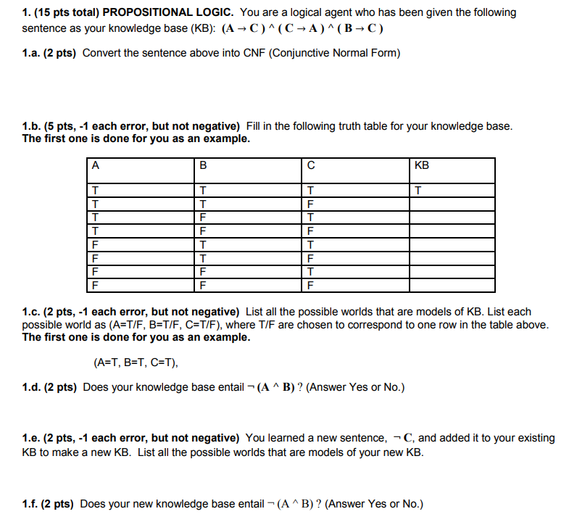

Slide 6
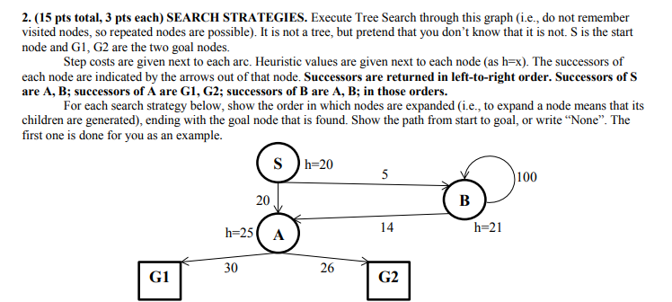
BFS
UCS
Greedy BF
IDS
A*
Following the description in the textbook,
Uninformed Search -> Do goal test when generating a node
Informed Search -> Check frontier and replace duplicated nodes with the lower cost

Slide 7
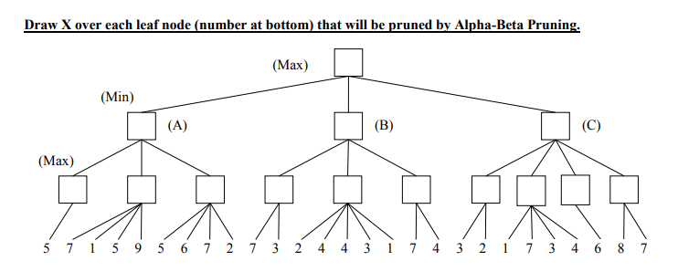

Slide 8
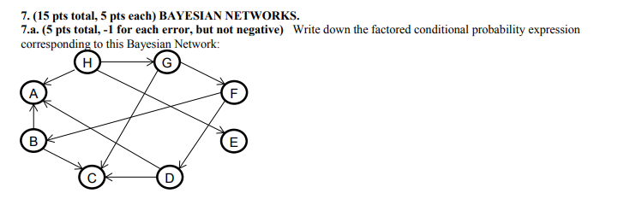
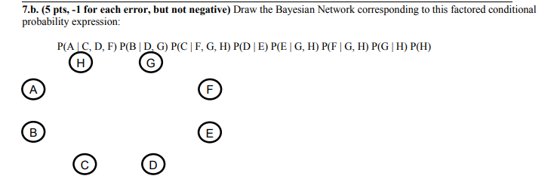

Slide 9
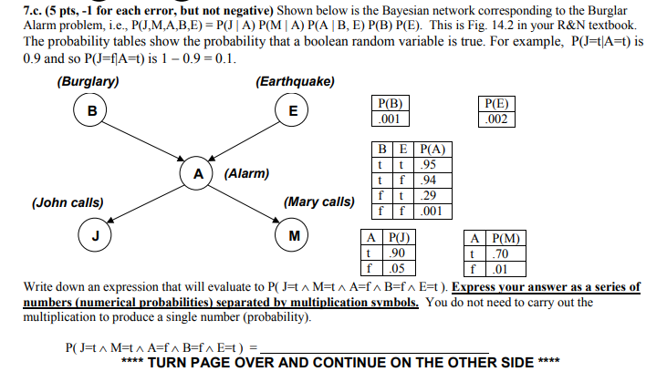

Slide 10
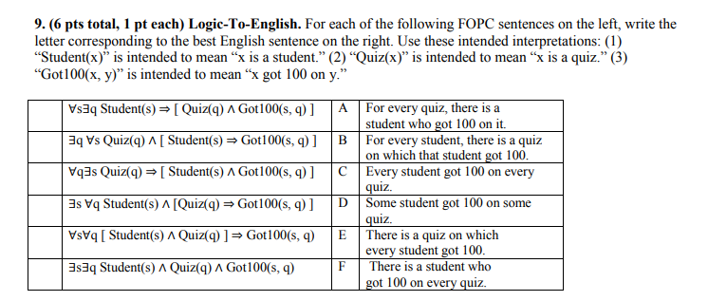

Slide 11
Constrained Satisfaction Problem
Example CSP problem
Two Students A and B coordinate a meeting
Location
Time
Student A
I am available at { 1 PM, 2PM, 3PM, 7PM, 8PM}
I will be around DBH before 6 PM (1 PM, 2PM, 3PM), and I will be at Library after 6 PM
Student B
I am available at {9 AM, 10 AM, 1 PM, 2PM}
I will be around Student Center in the morning (9 AM, 10AM) and I will be at DBH after.
Desired Solution
1 Location that both students can meet at the same time slot

Slide 12
CSP
Declare Problem
Variable
Constraints
Solve Problem
Inference
Search
Variable
Time slots for student A as A = {1 PM, 2 PM, 3PM, 7 PM, 8 PM}
Time slots for Student B as B = {9 AM, 10 AM, 1 PM, 2 PM}
Locations as L = {DBH, Student Center, Library}
Desired Solution
A set of (A, B, L)s that satisfy CONSTRAINTS
{ (1 PM, 1 PM, DBH), (2 PM, 2PM, DBH) }
Constraints
C1 (A, L) = { (1 PM, DBH), (2 PM, DBH), (3 PM, DBH), (7 PM Library), (8 PM Library) }
C2 (B, L) = { ( 9 AM, Student Center), (10 AM, Student Center), (1 PM, DBH), (2 PM, DBH) }
C3(A,B) = { (1 PM, 1PM), (2 PM, 2PM) }
Brute Force Search (Enumerate All Possible Combinations and check constraints)
(1 PM, 9 AM, DBH)
This is not consistent to C2
(1 PM, 9 AM, Student Center)
This is not consistent to C1
(1 PM, 9 AM, Library)
This is not consistent to C1 and C2
…
(1 PM, 1 PM, DBH)
This satisfies both C1 and C2, Solution!
(1 PM, 1 PM, Student Center)
(1 PM, 1 PM, Library)
...

Slide 13
CSP
Defining a problem
Variables and their domains
Up to a modeler
Constraints
Relationship between subset of variables
Enumerate "Allowed" combinations of values of the variables
One could use mathematical functions to define a relation; e.g. X + Y > 10,
In C1 (A, L), we enumerated "Allowed" combinations of A and L
Solution
From constraints defined over subset of variables (local),
Find a set of combinations that are consistent to all constraints (global)
In the previous example, solution has the form (A, B, L)
Solving a CSP problem
CSP algorithms
Derive new constraints (Inference) that will help finding the solution (Arc consistency, K-consistency, … )
Search for the solution
Back tracking search with Forward Checking, Arc consistency, etc.
Local search

Slide 14
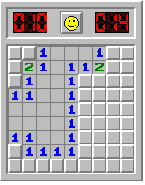
Minesweeper Example
Variables and domains
Constraints
Solution

Slide 15
Minesweeper Example
Variables and domains
42 cells are not revealed yet
we can define some relations to the cells in red boxes.
each cell can take two values {1, 0}
1 if a cell contain a mine
0 otherwise.
Vxy : x and y indicate the location of a cell
1|2|3|4|5|6|7|8|9 x
1
2
3
4
5
6
7
8
9
y

Slide 16
Minesweeper Example
Constraints
Relation over subset of variables
1|2|3|4|5|6|7|8|9 x
1
2
3
4
5
6
7
8
9
y

Slide 17
Minesweeper Example
Constraints
Relation over subset of variables
Around Cell (2, 3)
V11 + V21 + V12 + V13 = 2
Around Cell (3, 1)
V21 = 1
Around Cell (2, 3)
V12 + V13 = 1
Around Cell (1, 4)
V13 = 1
...
1|2|3|4|5|6|7|8|9 x
1
2
3
4
5
6
7
8
9
y

Slide 18
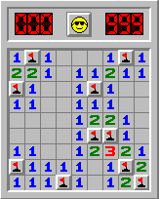
Minesweeper Example
Solution
(V11, V21, V12, V13, V18, V19, V29, V39, V49, V59, V63, V64, V65, V66, V67, V68, V69, V73, V81, V82, V83)
There could be more than 1 solutions
This assignment actually solves the game
(0, 1, 0, 1, 1, 0, 0, 0, 1, 0, 1, 0, 0, 1, 0, 0, 0, 0, 1, 0, 0)
1|2|3|4|5|6|7|8|9 x
1
2
3
4
5
6
7
8
9
y

Slide 19
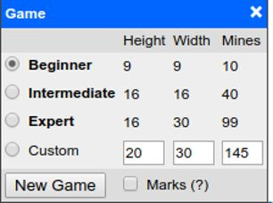
Minesweeper Example
Global Constraint
Constraints defined over all variables
Useful when we have a specialized algorithm that can process very large constraints efficiently
In case of Minesweeper, what would be a global constraint?

Slide 20
Minesweeper Example
Global Constraint (like ALLDIFF)
Constraints defined over all variables
Useful when we have a specialized algorithm that can process very large constraints efficiently
In case of Minesweeper, what would be the global constraint?
We know that there are 10 Mines in this game
Sum of all variables = 10
In this case, we should consider all unrevealed cells as our variables

Slide 21
Minesweeper Example
This is an illustration how to define a CSP problem
In your project,
Every time you make an action (click a cell, ...), you have a new CSP problem
If you encounter multiple CSP solutions, only one of them solves the game!

Slide 22
Minesweeper Example
This only illustrates how to define a CSP problem
In your project,
Every time you perform an action (click a cell, ...), you have a new CSP problem due to the change in the board
If you encounter multiple CSP solutions, only one of them solves the game!
If you find a variable that can take only 1 value, then you should mark that cell.
Given the current board,
How to define variables?
How to define constraints?
How to coordinate your algorithms with your project shell?
What algorithm to use for solving a CSP?
…

Slide 23
Summary
Define a CSP problem
Variable and its domain
Constraints
Draw a constraint graph from a CSP problem
You will use a constraint graph in the following algorithms
Arc consistency
Backtracking search
Forward checking
Degree heuristic
Least constraining value heuristic
Maintaining arc consistency

Slide 24
Summary
Arc consistency Algorithm
Heuristics in Backtracking Search
Variable selection: MRV, DH
Value selection: LCV
Consistency check: FC, MAC
Local Search
local search algorithm with Min-conflict heuristic

Slide 25
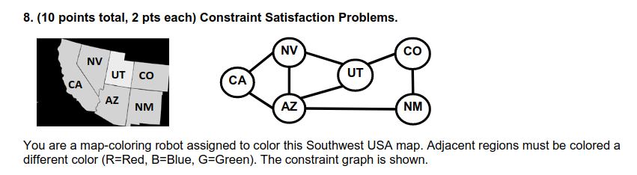
Constraint Graph
2018-WQ-CS-171 FINAL
Variables are NODEs in Constraint Graph
CA, NV, AZ, UT, CO, NM
Connect two nodes if both variables appear in a constraint
C(CA, NV), C(CA, AZ), ...

Slide 26
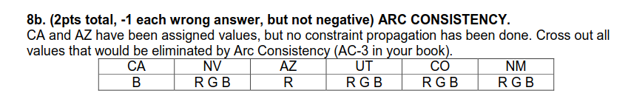
Arc Consistency
2018-WQ-CS-171 FINAL
All the constraints are consistent over ARCs after applying ARC consistency.
Remove values of each variable until you cannot remove anymore following the arcs

Slide 27
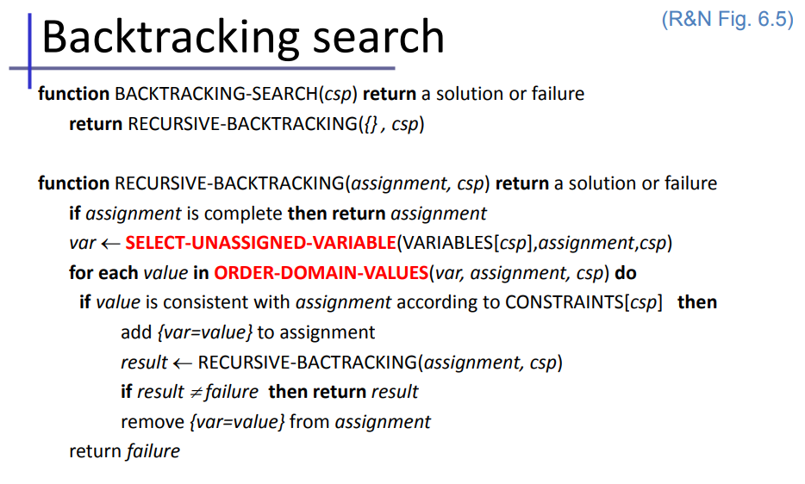

Slide 28
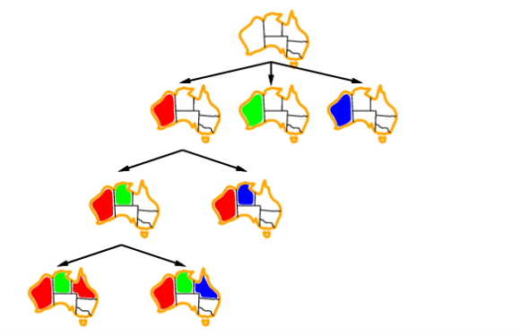
Backtracking Search
What variable to select?
What value to assign?
Check consistency
Backtracking
Book-keeping

Slide 29
Backtracking Search
What variable to select? (encounter dead-end early)
Minimum Remaining Values
Choose the variable with the fewest legal values
Degree heuristic
Choose the variable involved in the most constraints on other UNASSIGNED variables
What value to assign? (find solution early)
Least constraining values
Choose the value that removes the fewest values in the REMAINING variables
Check consistency (detect dead-end early)
Forward checking
After assigning a value, remove illegal values in the remaining variables by looking at the variables that are appear in the current set of constraints
If one of the remaining variable has no legal value, backtrack
Maintaining arc consistency
After assigning a value, perform arc-consistency
If one of the remaining variable has no legal value, backtrack

Slide 30
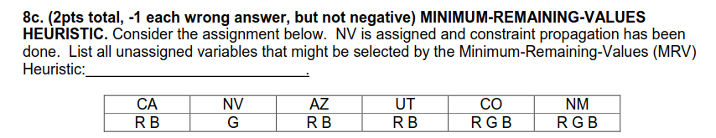
MRV heuristic
2018-WQ-CS-171 FINAL
For each variable, count the number of legal values, and select the one with the lowest

Slide 31
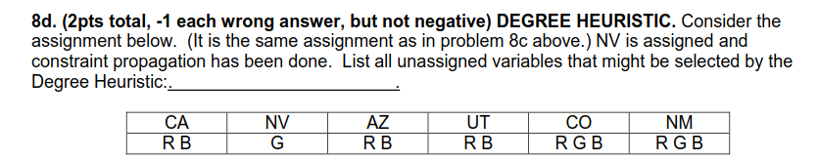
Degree heuristic
2018-WQ-CS-171 FINAL
For each variable, count the number of edges connected to the remaining variables and select the one with the greatest

Slide 32
LCV heuristic
2018-WQ-CS-171 FINAL
The varaiable AZ is selected while backtracking search.
What is the value assigned by LCV heuristic by using the following table ?
For each value, count the number of values that will be removed and select the one with the lowest

Slide 33
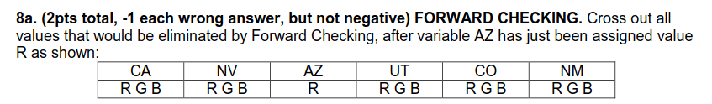
Forward Checking
2018-WQ-CS-171 FINAL
remove conflicting values for the variables that are connected to the current variable in the constraint graph

Slide 34
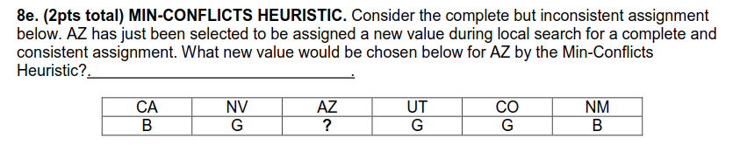
Min-Conflict Heuristic for Local Search
2018-WQ-CS-171 FINAL
For each possible value assignments, count the number of confilcts and selct the one with the lowest

