Slide 1
CS-171 Summer 1 Week 5 Discussion
7. 27. 2018
Junkyu Lee (junkyul@uci.edu)

Slide 2
Word of the day
Discussion 13:00 – 13:50
Discussion 14:00 – 14:50

Slide 3
Project submissions
MyAI
Don't change the name of this file
If you add additional files to the program, let us know
evaluation program only copies MyAI.py / MyAI.java / MyAI.cpp, MyAI.hpp from student submission to the base project
Use $make submission to create a zip file
At least submit a zip file
Don't submit codes with more than 1 language
Comment out all print statements (comment out all print statements in MyAI)
Test your program in Openlab
Compile (cpp/java) and run your code in openlab
External libraries (NUMPY ok)
Evaluation
Openlab, 3 X 1000 problems, processes are distributed across many different nodes in a random way
2 hour, 8 GB maximum is a hard deadline.
Each process guarantees to use 8 GB memory
After exceeding 2 hour, 8 GB limit, kill process

Slide 4
Quiz 4
Problem 1 (30 pts)
1.a arc consistency
1.c forward checking
Problem 2 (20 pts)
T/F
Problem 3 (50 pts)
CSP map-coloring

Slide 5
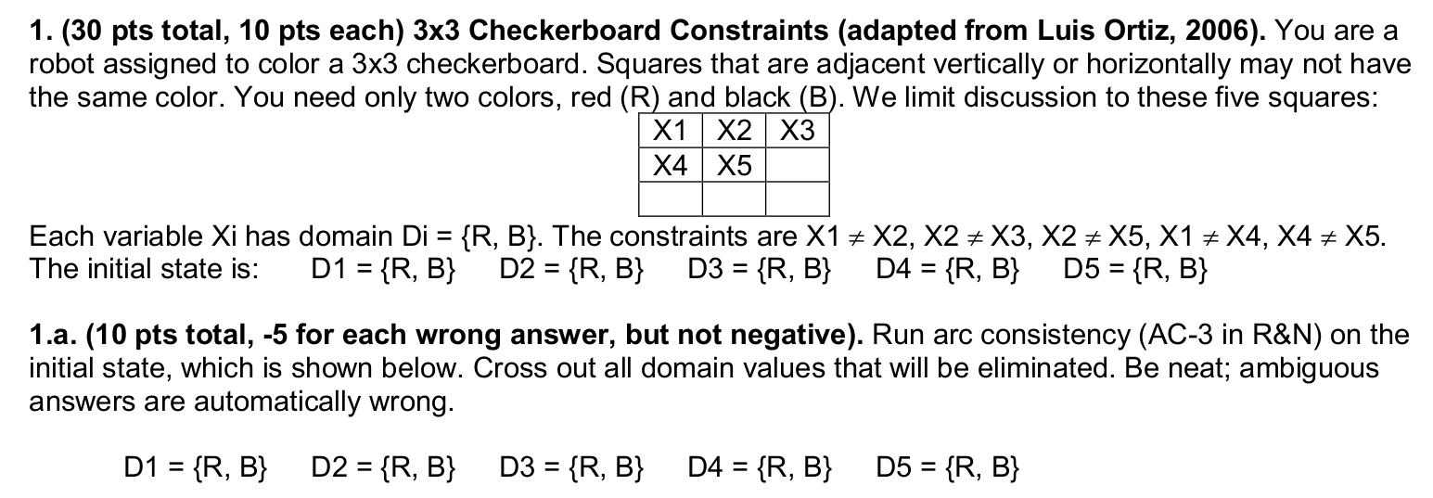
Arc consistency
X1 != X2 = { (R, B), (B, R) }, …
In case of binary CSP,
Revise(X, Y): revise domain of variable X subject to a constraint between variable X and Y
Revise(X1, X2):
For "R", there exists a pair (R,B) in the constraint X1 != X2; don't revise
For "B", there exists a pair (B,R) in the constraint X1 != X2; don't revise

Slide 6
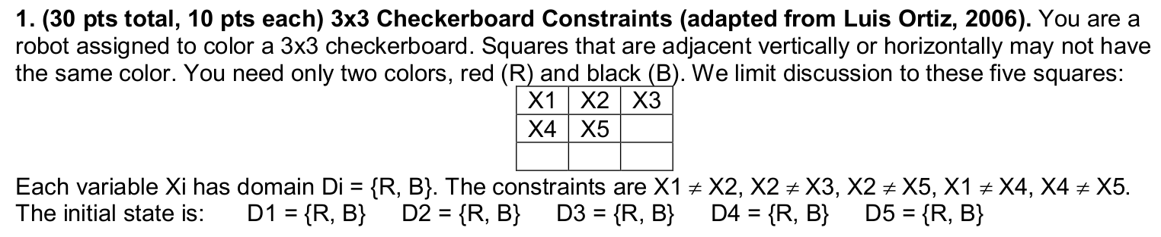
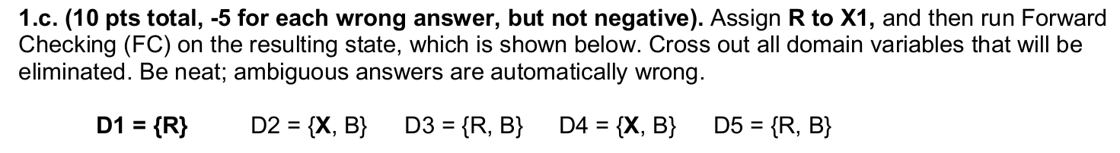
Forward checking
X1 is assigned "R"
For each constraint with X1, C(X1, Y), revise the domain of Y
X1 != X2 D2 ={R,B} to {B} because X1 != X2
X1 != X4 D4 ={R,B} to {B} because X1 != X2
See piazza post "Relationship between Forward checking and AC" @115

Slide 7
Local search
General Idea
Start from a random initial complete assignment
Heuristic evaluation function that evaluates complete assignment
Modify the current complete assignment
Random restarting
Hill-climbing search
Tabu search
Simulated annealing
Local beam search
Genetic algorithms
CSP min conflict heuristic
Some interesting behaviors or properties of local search algorithms

Slide 8
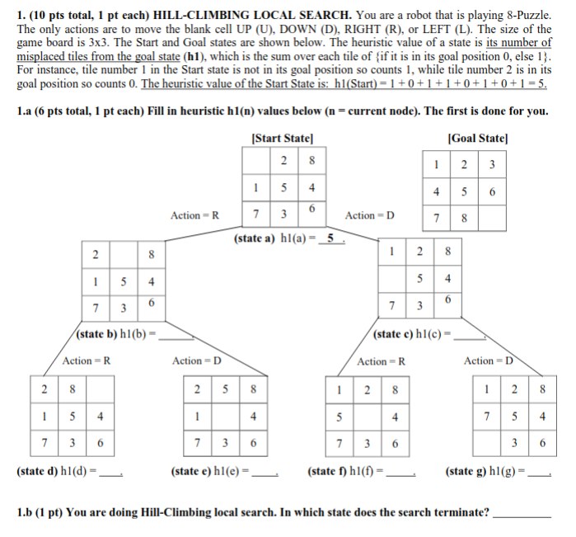
2017 fq midterm

Slide 9
2017 fq midterm
(h1) = number of misplaced tiles from goal state
There are 8 tiles
6
4
6
7
5
5

Slide 10
2017 fq midterm
(h1) = number of misplaced tiles from goal state
There are 8 tiles
Hill-climbing local search moves to a state with lower heuristic value
State a -> state c
6
4
6
7
5
5
C

Slide 11
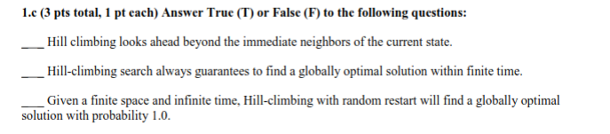
2017 fq midterm

Slide 12
2017 fq midterm
F
F
T
Finite space, infinite time, random restart

Slide 13
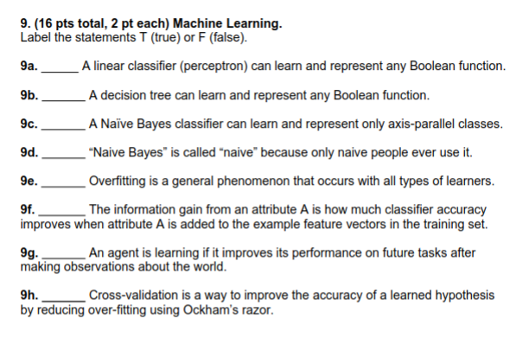
2011 sq final

Slide 14
2011 sq final
F
T
F
Decision Tree
F
T
F
Reduction in the uncertainty after applying attribute
T
F
Irrelevant to the accuracy

Slide 15
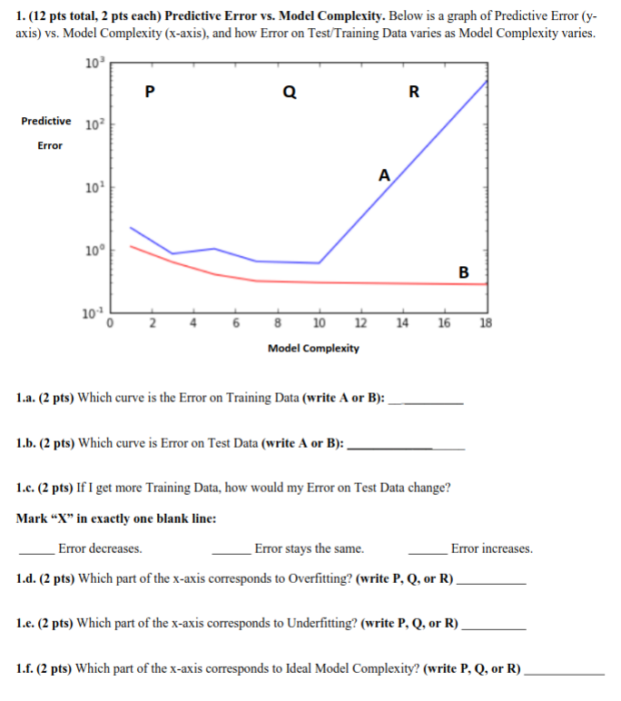
2018 wq final

Slide 16
2018 wq final
B
A
X
R
P
Q

Slide 17
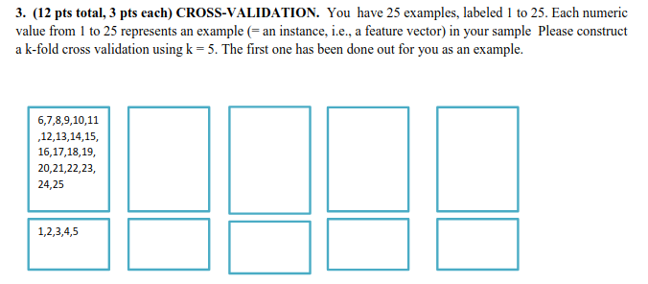
2018 wq final

Slide 18
2018 wq final
6~10
11~15
16~20
21~25
In practice, training and testing data sets are not enough to evaluate the predictive performance of learning algorithms
Cross validation splits data set to training / test sets to make assessment
Easy to understand and use and quite work well in practice

Slide 19
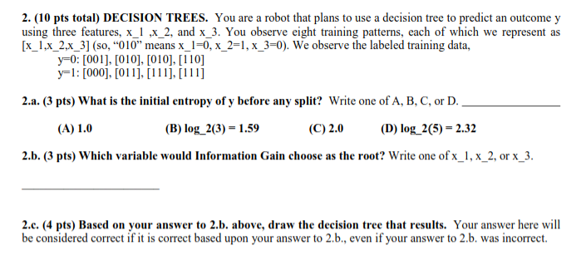
2018 wq final

Slide 20
2018 wq final
A
X3
Label 0 : 4 data points
Label 1 : 4 data points
H(Y) = -4/8 * log(4/8) - 4/8 *log(4/8) = 1 bit
4/8 : probability of a data label being Y=0, Y=1

Slide 21
2018 wq final
A
X3
Using Attribute 1,
If X1=0
Y=0: [001] [010] [010]
Y=1: [000] [011]
If X1=1
Y0 = [110]
Y1 = [111] [111]
Using Attribute 2,
If X2=0
Y=0: [001]
Y=1: [000]
If X2=1
Y0 = [010] [010] [110]
Y1 = [011] [111] [111]
Using Attribute 3,
If X3=0
Y=0: [010] [010] [110]
Y=1: [000]
If X3=1
Y0 = [001]
Y1 = [011] [111] [111]

Slide 22
Entropy
Random variable X = {x1, x2} with p(x1), p(x2)
H(X) = - [p(x1) * log (p(x1)) + p(x2) * log (p(x2))]
Conditional entropy
Joint distribution P(X, Y), conditional distribution P(Y|X), marginal P(X)
Random variable X = {x1, x2}, Y = {y1, y2}
H(Y|X) = p(x1) * H(Y|x1) + p(x2) * H(Y|x2)
H(Y|x1) = -[p(y1|x1) * log ( p(y1|x1) ) + p(y2|x1) * log( p(y2|x1) )]
H(Y|X) = - [ { p(x1) [p(y1|x1) * log (p(y1|x1)) + p(y2|x1) * log (p(y2|x1) } + { p(x2) [p(y1|x2) * log (p(y1|x2)) + p(y2|x2) * log (p(y2|x2) }]
H(Y|X) = - [ p(x1, y1) log ( p(y1|x1) ) + p(x1, y2) log ( p(y2|x1) ) + p(x2, y1) log ( p(y1|x2) ) + p(x2, y2) log ( p(y2|x2) ) ]

Slide 23
2018 wq final
A
X3
Using Attribute 3,
If X3=0
Y=0: [010] [010] [110]
Y=1: [000]
If X3=1
Y0 = [001]
Y1 = [011] [111] [111]
H(Y|X3) = P(X3=0)*H(Y|X3=0) + P(X3=1)*H(Y|X3=1) H(Y|X3=0) = -[P(Y=0|X3=0) * log (P(Y=0 | X3=) + P(Y=1|X3=0) * log (P(Y=1 | X3=)]
= -[¾ * log(¾) + ¼*log(¼)
H(Y|X3=1) = -[¼ *log(¼) + ¾*log(¾)

Slide 24
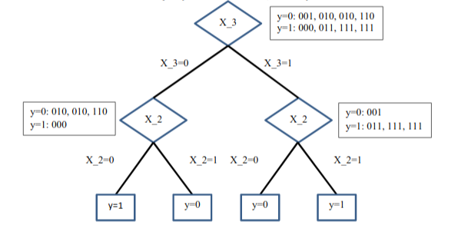
2018 wq final
Select attribute X3
Select attribute X2

Slide 25
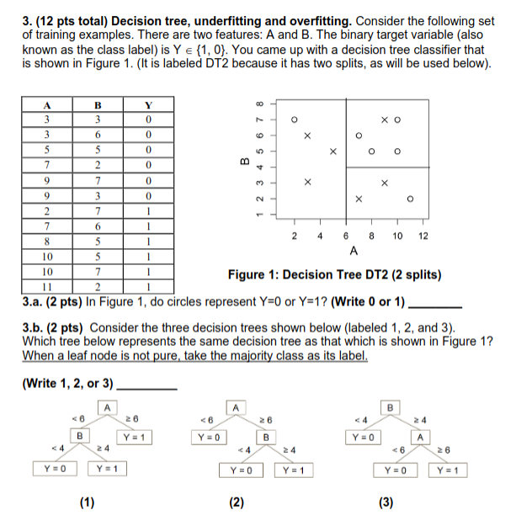
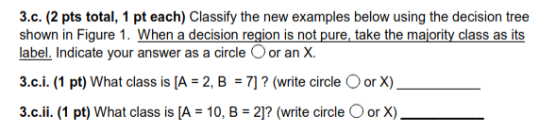
2016 smq final

Slide 26
2016 smq final
1 (check any point with the table on the left)

Slide 27
2016 smq final
1 (check any point with the table on the left)
2
If attribute A is less than 6 then X (Y=0)
Else
If attribute B is less than 4 then X (Y=0)
Else O (Y=1)

Slide 28
2016 smq final
If attribute A is less than 6 then X (Y=0)
Else
If attribute B is less than 4 then X (Y=0)
Else O (Y=1)
1
X
X

Slide 29
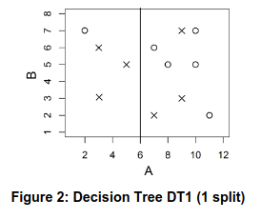
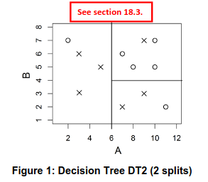
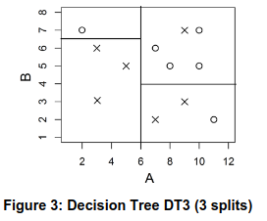
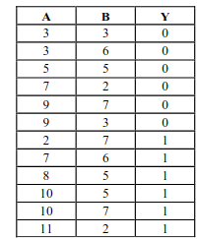

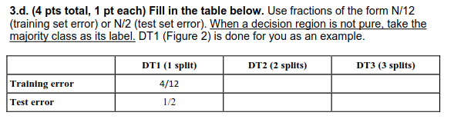

Training Data Set
Test Data Set

Slide 30
X represents Y=0
O represents Y=1
Test Data Set
Training Data Set
3/12
2/12
0/2
1/2

Slide 31
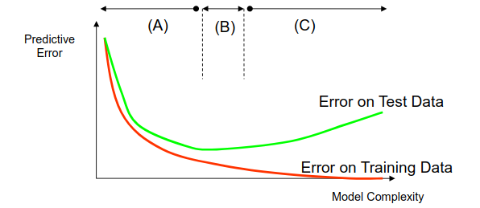
3/12
2/12
0/2
1/2
Overfitting: Training error small, Test error large DT3, region C in the picture
Underfitting: Training error large, Test error large DT1, region A in the picture

Slide 32
Classifiers
Decision Boundaries
Decision Tree
Linear Classifiers
K Nearest Neighbor
Naïve Bayes Model
Perceptron and Neural Net
Support Vector Machines

Slide 33
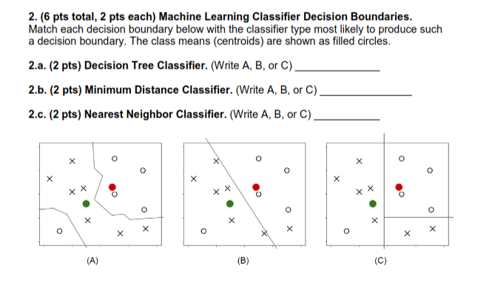
2016 smq final

Slide 34
2016 smq final
C
B
A

Slide 35
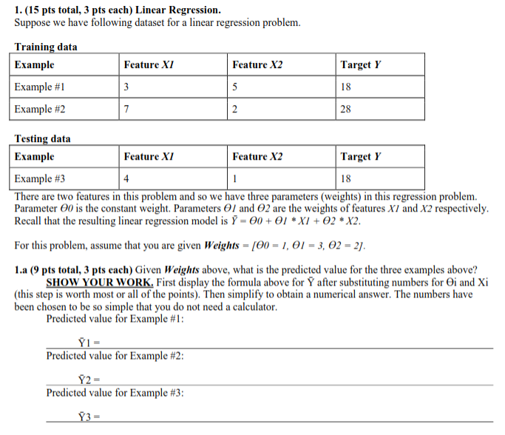
2015 fq final

Slide 36
2015 fq final
Y = 1 + 3*X1 + 2 *X2
Mean Squared Error
Training Data
½ * [(20-18)^2 + (28-26)^2] = 4
Testing Data
1/1 * [(15-18)^2] = 9
1 + 3*3 + 2*5 = 20
1 + 3*7 + 2*2 = 26
1 + 3*4 + 2*1 = 15

Slide 37
2015 fq final
Y = 1 + 3*X1 + 2 *X2
Mean Squared Error ?
Training Data
Testing Data
1 + 3*3 + 2*5 = 20
1 + 3*7 + 2*2 = 26
1 + 3*4 + 2*1 = 15

Slide 38
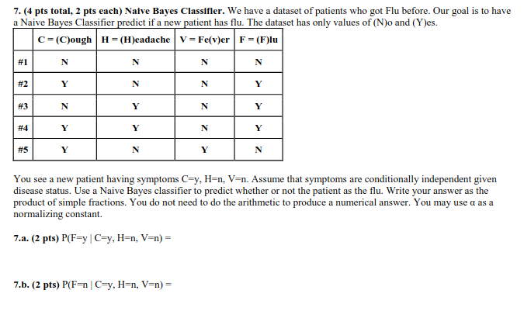
2018 wq final

Slide 39
2018 wq final
We have 5 data points.
Symptoms C, H, V
Disease: Flu
Naïve Bayes Classifier by Conditional Independence,
P(C, H, V | F) = P(C|F) P(H|F) P(V|F)
Learn each P(C|F), P(H|F), P(V|F) from 5 data points
Also learn P(F) from 5 data points
P(C=y|F=y) = 2/3 P(C=n |F=y) = 1/3
P(C=y|F=n) = 1/2 P(C=n |F=n) = ½
P(H=y|F=y) = 2/3 P(H=n |F=y) =1/3
P(H=y|F=n) = 0 P(H=n |F=n) = 1
P(V=y|F=y) = 0 P(V=n |F=y) = 1
P(V=y|F=n) = 1/2 P(V=n |F=n) = 1/2

Slide 40
2018 wq final
P(C=y|F=y) = 2/3 P(C=n |F=y) = 1/3
P(C=y|F=n) = 1/2 P(C=n |F=n) = ½
P(H=y|F=y) = 2/3 P(H=n |F=y) = 1/3
P(H=y|F=n) = 0 P(H=n |F=n) = 1
P(V=y|F=y) = 0 P(V=n |F=y) = 1
P(V=y|F=n) = 1/2 P(V=n |F=n) = ½
P(F=y) = 3/5 P(F=n) = 2/5
P(C=y, H=n, V=n | F=y) * P(F=y) / P(C=y, H=n, V=n) by Bayes rule
= Const * P(C=y|F=y) * P(H=n |F=y) * P(V=n |F=y) * P(F=y)
= Const * 1/3 * 2/3 * 1 * 3/5 = Const * (2 /15)
Constant can be obtained by computing P(F=n |C=y, H=n, V=n)
= Const * 1 /2* 1 * ½ * 2/5= Const * (1/10)
Const * (2/15) + Const * (1/10) = 1, So Const = 30/7

Slide 41
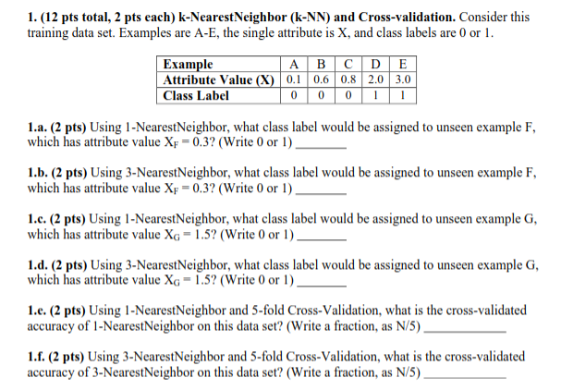
2014 fq final

Slide 42
2014 fq final
K-NN
Store training data
When predicting a label to a test data, find k-nearest points and classify the label by majority voting rule.
0 because 1 nearest neighbor is 0.1
0 because 3 nearest neighbors are 0.1, 0.6, 0.8
1 because 1 nearest neighbor is 2.0
0 because 3 nearest neighbors are 2.0, 0.8, 0.6
5/5 because A classified as 0, B classified as 0, etc
3/5 A classified as 0 B classified as 0 C classified as 0 D classified as 0 E classified as 0

Slide 43
