Slide 1
SEMI SUPERVISED VIDEO SEMANTIC RECOGNITION
Anuj Baranwal
Rohit Kumar
Siddharth Ramakrishnan

Slide 2
INTRODUCTION
Curse of Dimensionality Problem-Over fitting.
Feature Selection – High accuracy and quick computation
Supervised and Unsupervised Classification
Many unlabeled videos and few labeled. Time consuming to manually annotate.
Solution : Semi Supervised Learning

Slide 3
LITERATURE SURVEY

Slide 4
OUTCOME
Semi Supervised feature selection is the way to move forward.
Computations faster along with maintaining accuracy
Preserving data distribution and local geometry using Spline Regression – feature selection made possible
Graph based and AdaBoost learning algorithms to be used
Very suitable for video data sets

Slide 5
PROBLEM STATEMENT AND OBJECTIVES
Problem Statement
Given a large set of labelled and unlabelled training videos where num(labelled) <<num(unlabelled), apply semi supervised learning techniques to train them and subsequently classify test videos
Objectives
key frames + feature extraction
Feature Reduction using Spline Regression & PCA
Graph based SSLA using Gaussian fields and harmonic functions
AdaBoost SSLA and comparing the performance with the Graph Based SSLA
Compare results and plot graphs to determine the quality of the algorithm with varying Heuristics and Assumptions in our data set

Slide 6
RESEARCH METHODOLOGY
KeyFrames + Feature Extraction
Datasets – Human(12), Building data(11) Nature data(11) – 3 vids labelled in each.
Initial KeyFrame Extraction using OpenCV, 150 frames for a 6 second video.
FilmStrip.py – Preprocess the video to make all the frames finish within a second. 28 frames max per video.

Slide 7
RESEARCH METHODOLOGY
Feature Extraction
Feature matrix : N*F*V where N-num of vids , F – num of frames per vid, V-feature vector. (34,28,9)
Dimension 1,2 – Mean Red , STD Red:
Dimensions 3,4 - Mean Green,STD Green
Dimensions 5,6 – Mean Blue,STD blue

Slide 8
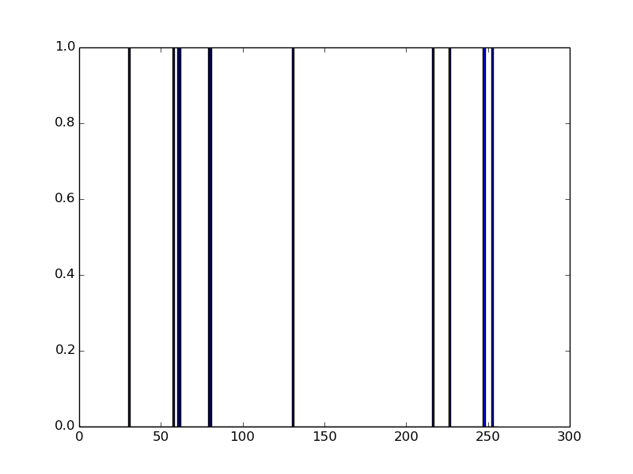
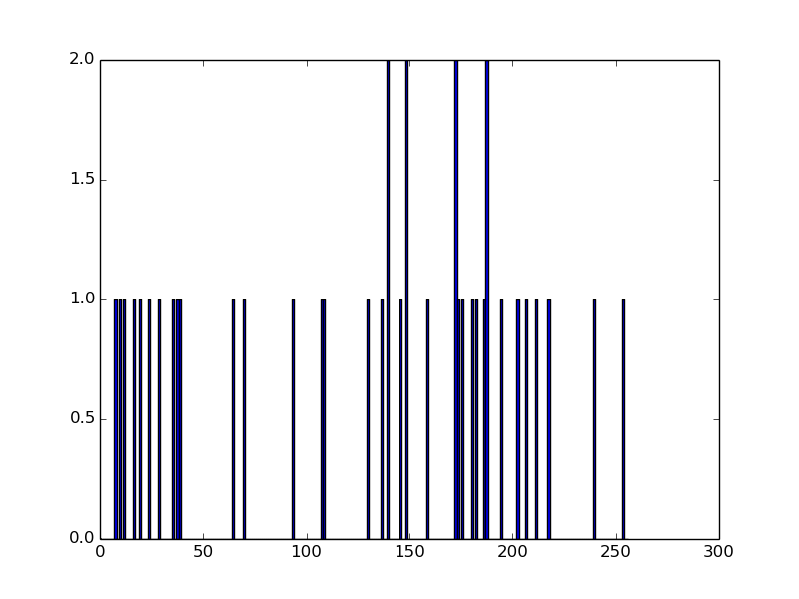
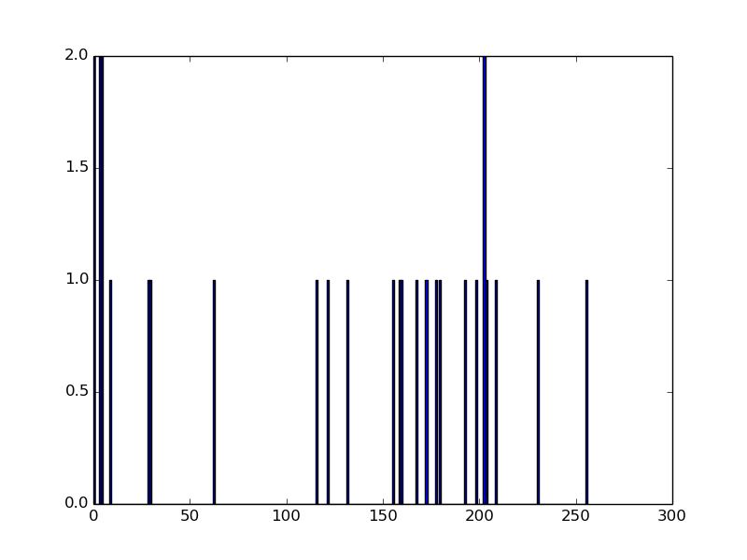
RESEARCH METHODOLOGY
Dimension 7 – Shannon’s Entropy : Texture
Color Histograms :
Bins : 0-255 (256 bins)
Split into color planes and calculate their respective color histograms.
Blue Hist Green Hist Red Hist

Slide 9
RESEARCH METHODOLOGY
Then the frequency count for each color is obtained and then the following formula is used to calculate the entropy value
entropy+ = -(Hc/frequency(color))* log10((Hc/frequency(color)))
Hc - value at ith bin of the histogram.

Slide 10
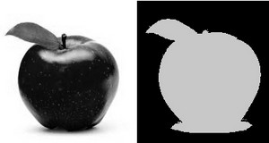
RESEARCH METHODOLOGY
Dimension 8 – White Contribution
White – Foreground and Black – Background. Calculate percentage of white
Thresholding

Slide 11
RESEARCH METHODOLOGY
Dimension 9 – Count Objects
Abstract concept
Modify known algorithms to obtain a count (not accurate due to plenty of noise, but its the difference in the values of these counts with other images which can help us determine something from the images).

Slide 12
RESEARCH METHODOLOGY
2D Convolution and Median Blurring :
low-pass filters(LPF)- removes noise, blurs the images etc.
High Pass Filters help in finding edges in the images.
Median convolution
Thresholding
Contours

Slide 13
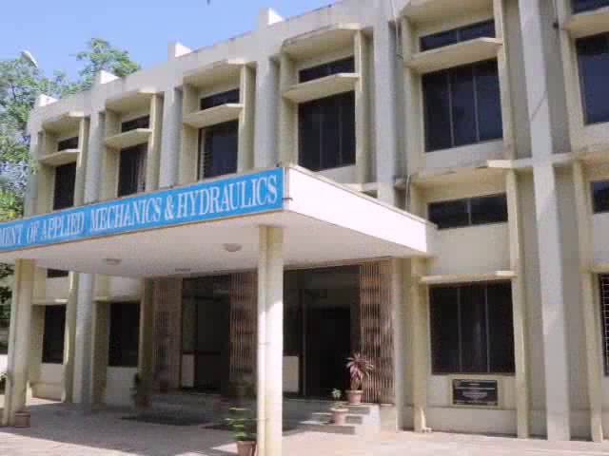

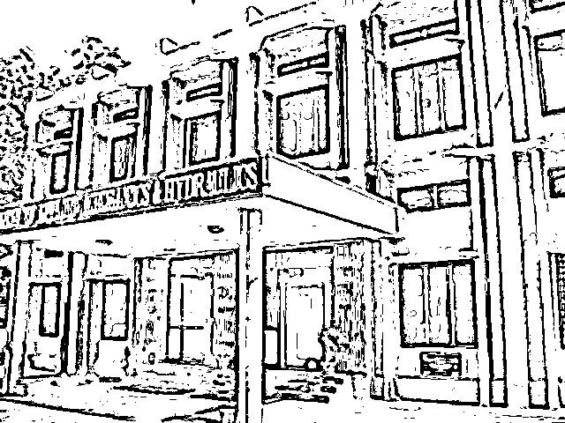
RESEARCH METHODOLOGY

Slide 14
RESEARCH METHODOLOGY
PRINCIPLE COMPONENT ANALYSIS
1) Highlight their similarities and differences. Since patterns in data 2) Lack of graphical representation
3) Quick Calculation and perhaps better visualisation
Steps Followed
Calculate mean vector
Calculate Scatter/Covariance Matrix
Find Eigen Values and Eigen Vectors and sort. Pick k components
Transform the input matrix with the help of the matrix generated in 3
Result : A new reduced dimension matrix is obtained => n*d has now become n*k where k<d

Slide 15
RESEARCH METHODOLOGY
SPLINE REGRESSION

Slide 16
Reg

Slide 17
Graph based semi supervised learning to do Video Classification

Slide 18
Why Graph-based SSL?
1) Datasets are naturally represented by a graph
Uniform representation for heterogenous data
Easily parallelizable, scalable to large data
Effective in practice
2) All the labeled and the unlabeled nodes ( data ) are represented as vertices in a weighted graph, and the edges encode the similarity between the nodes connecting them.

Slide 20
Framework:
Suppose there are l labeled points (x1,y1),(x2,y2),(x3,y3),...,(xn,yn) and u unlabeled points x(l+1),x(l+2),x(l+3),...,x(l+u); such that l << u.
Let the total number of instances be n such that n = l + u
Consider a connected graph G = (V,E) with nodes V corresponding to the n data points, with nodes L = 1,2,3,...,l corresponding to the labeled points with labels y1, y2, y3, ..., yl, and nodes U = l+1,l+2,l+3,...,l+u corresponding to the unlabeled points.
The main task is to assign labels to nodes U.

Slide 21
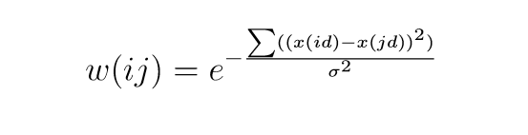
Framework
Assume there is an n * n symmetric weight matrix W on the edges of the graph. For example, when x ∈ Rm , the weight matrix can be where d = 1...m and σ1 ,σ2 ,σ3 , ... , σm are length scale hyperparameters for each dimension.
where d = 1...m and σ1 ,σ2 ,σ3 , ... , σm are length scale hyperparameters for each dimension. Thus it is evident that the nearby points in Euclidean space are assigned large edge weight.

Slide 22
Strategy
The strategy is to compute a real-valued function f :V−> R on G with certain very nice properties, and then assign labels based on f.
We constrain f to take values from the unique class points that must have been assigned to one of the labels and not otherwise.
The harmonic property means that the value of f at each unlabeled data point is the average of f at neighboring points
for j = l+1, l+2, l+3, ... , l+u which is consistent with prior smoothness of f with respect to the graph.

Slide 23
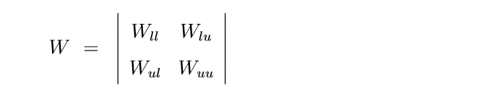
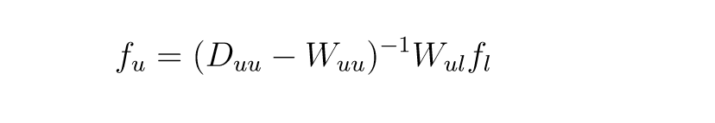
Let the W be the weight matrix.
Letting f = where fu denotes the values on the unlabeled data points, the harmonic solution del f = 0 subject to f|L = fl is given by

Slide 24
L = D−W where L is the Laplacian Matrix, D is the diagonal matrix such that each of the diagonal element gives the sum(Wij) where j = 1,2,3,...,n. L represents the del.
It is an approach to semi-supervised learning based on a Gaussian random ﬁeld model deﬁned with respect to a graph which is weighted and representing labeled data and unlabeled data.

Slide 25
Graph based semi supervised learning to do Video Classification

Slide 26
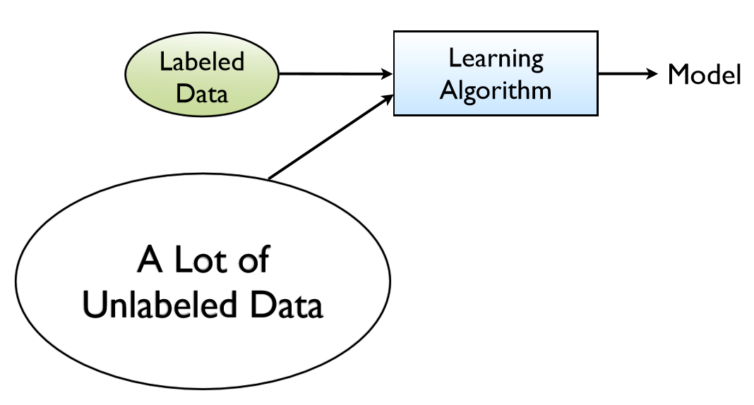
Semi Supervised Algorithm

Slide 27
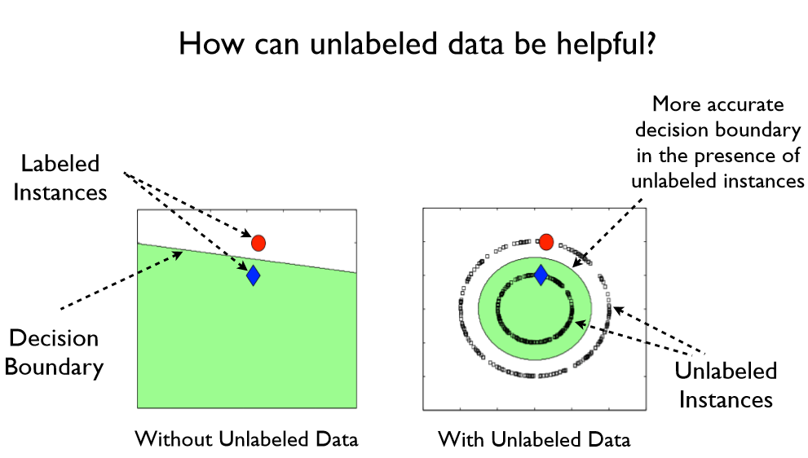
Why Semi Supervised Learning?

Slide 28
Why Graph-based SSL?
Datasets are naturally represented by a graph
Uniform representation for heterogenous data
Easily parallelizable, scalable to large data
Effective in practice

Slide 29
All the labeled and the unlabeled nodes ( data ) are represented as vertices in a weighted graph, and the edges encode the similarity between the nodes connecting them.
The learning problem is then proposed in terms of a random Gaussian ﬁeld on the graph, where the mean of the ﬁeld is basically characterized in harmonic functions, and it is eﬃciently obtained using the matrix operations and the associated methods
Methods has been incorporated to calculate the harmonic function

Slide 30
Framework:
Suppose there are l labeled points (x1,y1),(x2,y2),(x3,y3),...,(xn,yn) and u unlabeled points x(l+1),x(l+2),x(l+3),...,x(l+u); such that l << u.
Let the total number of instances be n such that n = l + u
Consider a connected graph G = (V,E) with nodes V corresponding to the n data points, with nodes L = 1,2,3,...,l corresponding to the labeled points with labels y1, y2, y3, ..., yl, and nodes U = l+1,l+2,l+3,...,l+u corresponding to the unlabeled points.
The main task is to assign labels to nodes U.

Slide 31
Framework
Assume there is an n * n symmetric weight matrix W on the edges of the graph. For example, when x ∈ Rm , the weight matrix can be where d = 1...m and σ1 ,σ2 ,σ3 , ... , σm are length scale hyperparameters for each dimension.
where d = 1...m and σ1 ,σ2 ,σ3 , ... , σm are length scale hyperparameters for each dimension. Thus it is evident that the nearby points in Euclidean space are assigned large edge weight.

Slide 32
Strategy
The strategy is to compute a real-valued function f :V−> R on G with certain very nice properties, and then assign labels based on f.
We constrain f to take values from the unique class points that must have been assigned to one of the labels and not otherwise.
The harmonic property means that the value of f at each unlabeled data point is the average of f at neighboring points
for j = l+1, l+2, l+3, ... , l+u which is consistent with prior smoothness of f with respect to the graph.

Slide 33
Let the W be the weight matrix.
Letting f = where fu denotes the values on the unlabeled data points, the harmonic solution del f = 0 subject to f|L = fl is given by

Slide 34
L = D−W where L is the Laplacian Matrix, D is the diagonal matrix such that each of the diagonal element gives the sum(Wij) where j = 1,2,3,...,n. L represents the del.
It is an approach to semi-supervised learning based on a Gaussian random ﬁeld model deﬁned with respect to a graph which is weighted and representing labeled data and unlabeled data.

Slide 35
RESEARCH METHODOLOGY
GRAPH ALGORITHM :

Slide 36
RESEARCH METHODOLOGY
Compare Results and vary parameters to see which algorithm performs best under the given circumstances.
MatPlotLib library - performance of the algorithm as well as the speed of our computation. Accuracy with respect to our training and test sets are compared and we also check the type of relationship exhibited by computational time vs accuracy.
After training our algorithm, the initially unsupervised videos, will now have labels assigned to them (with an acceptable level of error) and now we can pass our test videos against this improved training set to semantically recognize them.
carry out these procedures to perform a comparative study on whether modifying certain parameters based on the data set under consideration will have an effect in increasing/decreasing computational time and accuracy.

Slide 37
RESULTS OBTAINED
created a feature matrix corresponding to each video example
The feature vector has values which are common to all images so far so it can be seen that all videos are so far considered to be on a level playing field.
Disadvantage - time it takes to compute these features and the further problem of using these features in the learning algorithms. calls for the need of feature reduction.

Slide 38
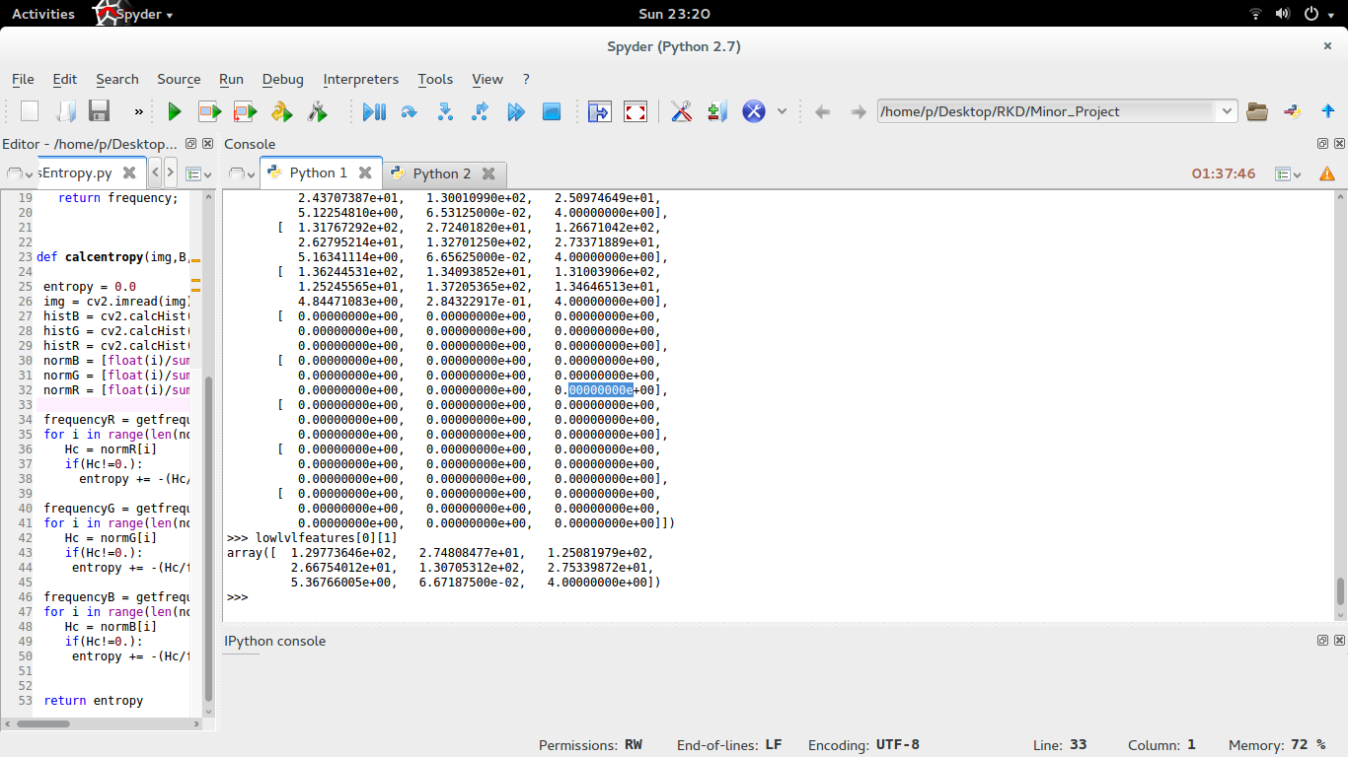
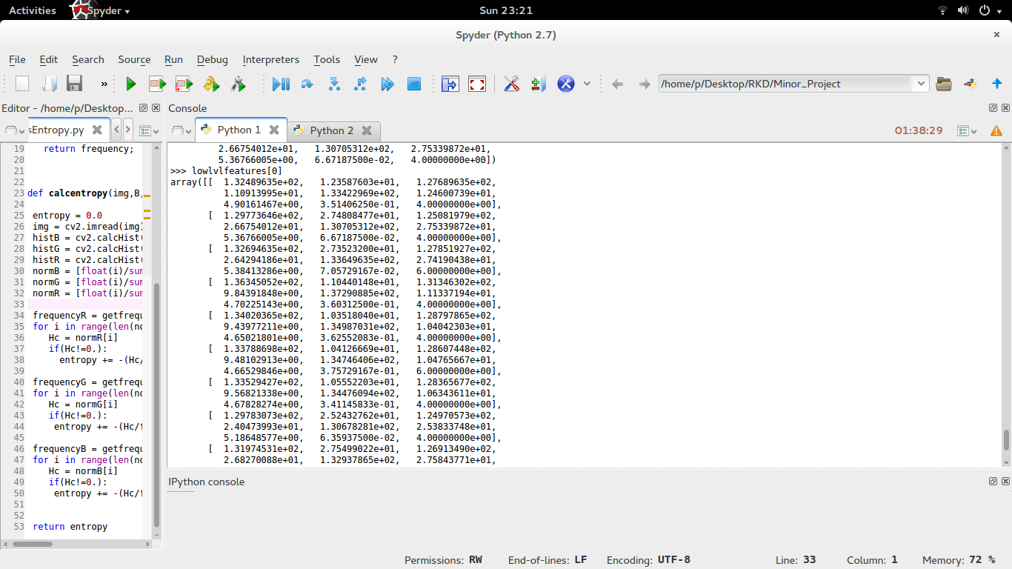
RESULTS OBTAINED

Slide 39
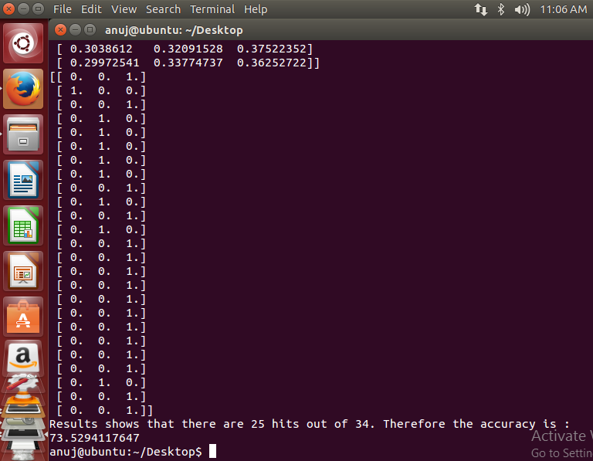
Results

Slide 40
Results shows a matrix of (n−l)∗C where n is the number of video instances, including both the labeled and the unlabeled instances and l is the number of labeled instances and C is the number of classes to which the videos can be classiﬁed. n = 34,l = 9,C = 3.
The matrix fu represents the 1 for the maximum value obtained for the unlabeled instances for the real valued function f : V → R and 0 for the other columns with 1 representing that the unlabeled instance is of that particular class and 0 represents it is not of that class where V represents the set of vertices aka instances.

Slide 41
The three columns represents the real values for unlabeled instances to which class they belong to. More the score, more the probability that the video instance will belong to that particular class.
As compared with the unlabeled instances, the matrix has shown promising results and using scores to predict about the type of dataset it refers, the accuracy is about 75%. Considering that the number of labeled videos is small, the accuracy of about 75% indicates that the graph algorithm is showing promising results and with more input labeled datasets and unlabeled datasets, the accuracy is expected to increase.

Slide 42
Results

Slide 43
Results shows a matrix of (n−l)∗C where n is the number of video instances, including both the labeled and the unlabeled instances and l is the number of labeled instances and C is the number of classes to which the videos can be classiﬁed. n = 34,l = 9,C = 3.
The matrix fu represents the 1 for the maximum value obtained for the unlabeled instances for the real valued function f : V → R and 0 for the other columns with 1 representing that the unlabeled instance is of that particular class and 0 represents it is not of that class where V represents the set of vertices aka instances.

Slide 44
The three columns represents the real values for unlabeled instances to which class they belong to. More the score, more the probability that the video instance will belong to that particular class.
As compared with the unlabeled instances, the matrix has shown promising results and using scores to predict about the type of dataset it refers, the accuracy is about 75%. Considering that the number of labeled videos is small, the accuracy of about 75% indicates that the graph algorithm is showing promising results and with more input labeled datasets and unlabeled datasets, the accuracy is expected to increase.

Slide 45
Conclusion And Future Works
Currently the weight matrix W is assumed to be totally connected. Therefore the computation is O(n^2 * d ). Sparsifying the graph can reduce the computations a lot.
Develop an approach to find the nearest neighbors to a vertex and make it connected to only those vertices and repeat it for all the vertices. Thus reducing the computations cost a lot.

Slide 46
CONCLUSION AND FUTURE WORK
Keyframe and feature extraction has been completed along with the graph learning algorithm to predict the classes of the unlabeled nodes using the labeled nodes and unlabeled nodes and the labeled classes. The predicted function is normalized over the set such that the set contains all the labeled classes at least once. And thus it uses the semi supervised learning
need to reduce the features in order to speed up computation when it comes to training the videos and testing it as well. Spline Regression is the logical next step required in order to reduce these features.
It helps preserving local geometry and data distribution and is a very good technique to implement for semi supervised learning. Once this has been carried out, we feed this normalized, reduced feature matrix through the graph algorithm and thereby complete the learning.
Another algorithm yet to implement is the Adaboost technique for multi class classification. The test set then needs to be provided to check the validity of our implementation and these results are to be compared and contrasted.

Slide 47
Conclusion And Future Works
Currently the weight matrix W is assumed to be totally connected. Therefore the computation is O(n^2 * d ). Sparsifying the graph can reduce the computations a lot.
Develop an approach to find the nearest neighbors to a vertex and make it connected to only those vertices and repeat it for all the vertices. Thus reducing the computations cost a lot.

Slide 48
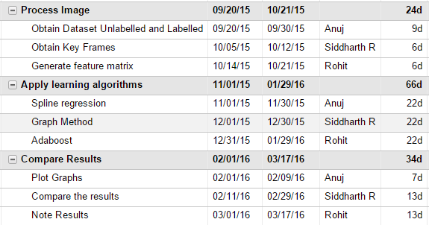
TIMELINE OF PROJECT

Slide 49
REFERENCES

Slide 50
MOTIVATION
Curse of high dimensionality
Many irrelevant features
Feature selection
Lack of labelled data sets
Utilize data distribution or local structure or both

Slide 51
Semi Supervised Learning
Supervised Learning
Unsupervised Learning
Semi-supervised Learning : The training data consists of both labeled instances & unlabeled instances
Assumption that there is much more unlabeled data than labeled data.
The goal of semi-supervised classification is to train a classifier f from both the labeled and unlabeled
data, such that it is better than the supervised classifier trained on the labeled data alone

Slide 52
Literature Survey

Slide 53
PROBLEM STATEMENT
Given a large set of labelled and un-labelled training videos, apply semi supervised learning techniques in order to semantically categorize them.
Based on the type of data received and assumptions made on the training data, provide a comparative study of which algorithm works best under what circumstances.

Slide 54
Algorithms to be implemented
Spline Regression
Graph Based Method
Adaboost

Slide 55
OBJECTIVES
Process the key frames and generate the feature set
Apply the semi supervised algorithms on the featured data set to generate reduced feature set
Obtain results and plot graphs to determine which algorithms work well with the given data set
Varying some of the assumptions and heuristics involved, check to see whether that has an impact on the performance of a given algorithm

Slide 56
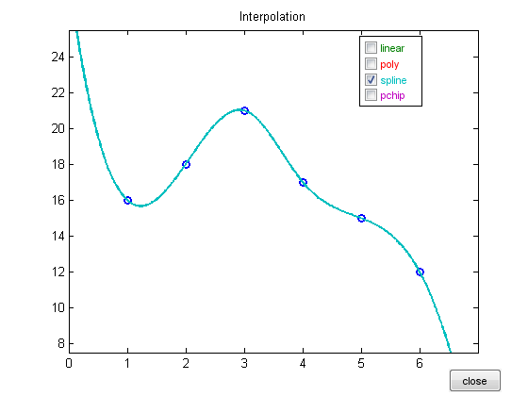
Spline Regression
Splines?

Slide 57
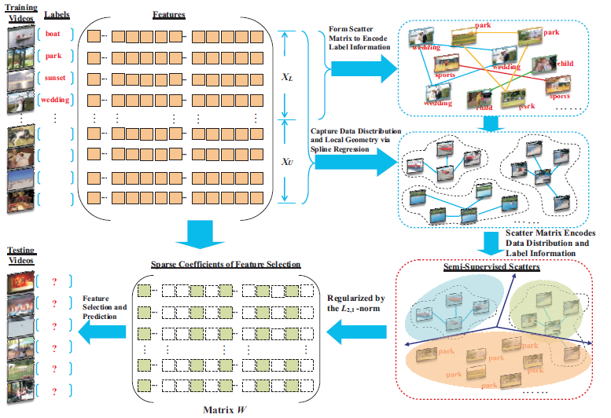
Spline Regression

Slide 58
Graph Based Method

Slide 59
Graph Based Method
efficiently search for the optimal sub graph features
containing both the labeled and the un labeled graphs.
assumption that the feature set is given, but this algorithm has the semi supervised feature selection being performed on graph data in a proceeding way together with the sub
graph feature mining process.
develop a feature evaluation criteria in order to estimate the usefulness of subgraph features based upon both the labeled graphs and the unlabeled graphs.
develop an algorithm to efficiently search for optimal subgraph features by judiciously pruning/cutting the sub graph feature space.

Slide 60
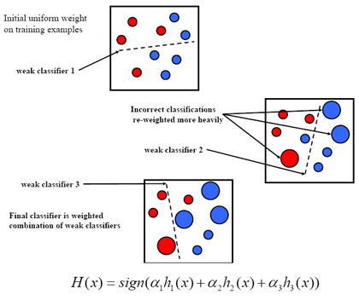
ADABOOST

Slide 61
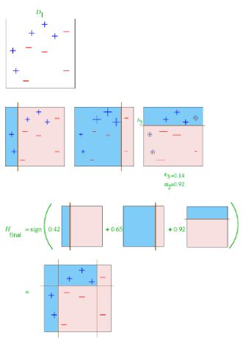
Adaboost

Slide 62
Advantages of Adaboost
It is fast, simple and easy to program.
It has no parameters to tune (except for the number of round T ).
It requires no prior knowledge about the weak learner and so can be flexibly combined with any method for finding weak hypotheses.
Finally, it comes with a set of theoretical guarantees given sufficient data and a weak learner that can reliably provide only moderately accurate weak hypotheses.
This is a shift in mind set for the learning-system designer: instead of trying to design a learning algorithm that is accurate over the entire space, we can instead focus on finding weak learning algorithms that only need to be better than random.

