Slide 1
Recursive Definitions & Structural Induction: Selected Exercises

Slide 2
Exercise 10
Give a recursive definition of S_{m}( n ), the sum of integer m + nonnegative integer n.

Slide 3
Exercise 10 Solution
Give a recursive definition of S_{m}( n ), the sum of integer m + nonnegative integer n.
S_{m}( n ) = ( n == 0 ) ? m : 1 + S_{m}( n – 1 );

Slide 4
Exercise 20
Give a recursive definition of the functions max & min so that max( a₁, a₂, …, a_{n} ) & min( a₁, a₂, …, a_{n} ) are the maximum & minimum of a₁, a₂, …, a_{n}, respectively.

Slide 5
Exercise 20 Solution
Give a recursive definition of the functions max & min so that max( a₁, a₂, …, a_{n} ) & min( a₁, a₂, …, a_{n} ) are the maximum & minimum of a₁, a₂, …, a_{n}, respectively.
max( a₁ ) = a₁;
max( a₁, a₂ ) = (a₁ ≤ a₂ ) ? a₂ : a₁; (Why is this needed?)
max( a₁, a₂, …, a_{n} ) = max (max( a₁, a₂, …, a_{n-1} ) , a_{n} )
The min function is defined similarly.

Slide 6
Exercise 30
Prove that in any bit string, the string 01 occurs at most 1 more time than the string 10.

Slide 7
Exercise 30
Prove that in any bit string “01” occurs at most 1 more time than the “10”.
Can we prove it by induction?
Can we base the induction on the length of the bit string?
If we
Show it’s true for | s | = 1
Assume it’s true for | s | < n
We try to show it’s true for | s | = n.
We break the string into bit string r = the 1st n – 1 bits, followed by the last bit.
Apply the induction hypothesis to r.
Induction step: 4 cases, depending on the last bit of r &the last bit of s.
The case fails when the last bit of r is 1 & the last bit of s is 0.
What to do?

Slide 8
Exercise 30 Proof
Basis: |s| = 1: #01(s) = 0 ≤ 1 = #10(s) + 1
Assume: |s| < n → #01(s) ≤ #10(s) + 1
Show: |s| = n → #01(s) ≤ #10(s) + 1
(Decomposing s arbitrarily into 2 smaller strings, fails. Try it.)
Case: s does not contain substring “10”:
It is of the form 0*1*.
#01(s) ≤ 1 = #10(s) + 1.

Slide 9
Case: s does contain substring “10”:
Break s into 2 strings, t and u, between a “10”
E.g., 100111011000 is broken into (100111)(011000 )
t ends in “1”; u begins with “0”.
#01(t) ≤ #10(t) + 1 (S.I.H.)
#01(u) ≤ #10(u) + 1 (S.I.H.)
#01(s) = #01(t) + #01(u) ≤ #10(t) + #10(u) + 2 = #10(s) + 1.

Slide 10
Exercise 40
To recursively define a set:
Define it to have some “initial” elements;
Give rules that compose new elements from pre-existing elements.
Recursively define the set S of bit strings with more 0s than 1s.

Slide 11
Exercise 40 Solution
Recursively define the set S of bit strings that have more 0s than 1s.
0 ∈ S.
x, y ∈ S → xy, 1xy, x1y, xy1 ∈ S.
This recursive definition of set S is like a context free grammar.
S is a context-free language.
These grammars & languages are studied in CMPSC 138.
We use them to define the syntax of programming languages, like Java, C, & C++.

Slide 12
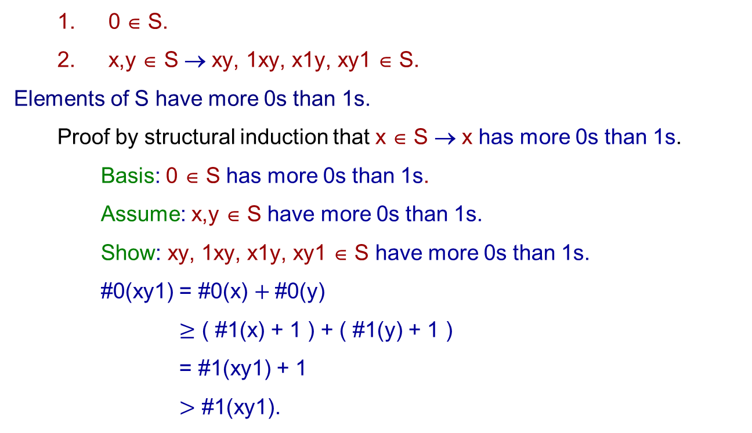
0 ∈ S.
x,y ∈ S → xy, 1xy, x1y, xy1 ∈ S.
Elements of S have more 0s than 1s.
Proof by structural induction that x ∈ S → x has more 0s than 1s.
Basis: 0 ∈ S has more 0s than 1s.
Assume: x,y ∈ S have more 0s than 1s.
Show: xy, 1xy, x1y, xy1 ∈ S have more 0s than 1s.
#0(xy1) = #0(x) $+ \text{\#0(}\text{y}\text{)}$
$≥$ ( #1(x) + 1 ) + ( #1(y) + 1 )
= #1(xy1) + 1
$>$ #1(xy1).

Slide 13
Exercise 50
Ackermann’s function is defined as follows:
A( m, n ) = 2n, if m = 0;
= 0, if m ≥ 1 ∧ n = 0
= 2, if m ≥ 1 ∧ n = 1
= A( m – 1, A( m, n – 1 ) ), if m ≥ 1 ∧ n ≥ 2.
Show that A( 1, k ) = 2^{k}, for k ≥ 1.
(We use structural induction.)

Slide 14
Exercise 50 Solution
Ackermann’s function is defined as follows:
A( m, n ) = 2n, if m = 0;
= 0, if m ≥ 1 ∧ n = 0
= 2, if m ≥ 1 ∧ n = 1
= A( m – 1, A( m, n – 1 ) ), if m ≥ 1 ∧ n ≥ 2.
Show that, for k ≥ 1, A( 1, k ) = 2^{k}.
Basis k = 1: A( 1, 1 ) = 2 = 2¹.
Show A( 1, k ) = 2^{k} → A( 1, k + 1 ) = 2^{k+1}, for arbitrary k.
Assume A( 1, k ) = 2^{k}.
Prove A( 1, k + 1 ) = 2^{k+1}:
A( 1, k + 1) = A( 0, A(1, k ) ) = A( 0, 2^{k} ) = 2 . 2^{k} = 2^{k+1}.

Slide 15
A Bijection between Z⁺ & Rooted Trees
The discussion below is based on
Peter Cappello. A New Bijection between Natural Numbers and Rooted Trees. 4th SIAM Conf. on Discrete Mathematics, San Francisco, June 1988.
Let P denote the set of primes numbers.
Let T denote the set of rooted trees.
Let p: Z⁺, → P, where p(n) is the n^{th} prime
(e.g., p(4) = 7 and p⁻¹(7) = 4 ).
p⁻¹(n) ≤ n.

