Slide 1
zeroMQ消息模式分析
邱志刚

Slide 2
zeroMQ是什么…
ØMQ \zeromq\: Ø The socket library that acts as a concurrency framework. Ø Faster than TCP, for clustered products and supercomputing. Ø Carries messages across inproc, IPC, TCP, and multicast. Ø Connect N-to-N via fanout, pubsub, pipeline, request-reply. Ø Asynch I/O for scalable multicore message-passing apps. Ø Large and active open source community. Ø 30+ languages including C, C++, Java, .NET, Python. Ø Most OSes including Linux, Windows, OS X. Ø LGPL free software with full commercial support from iMatix.

Slide 3
Core Messaging Patterns
The built-in core ØMQ patterns
Request-reply, which connects a set of clients to a set of services. This is a remote procedure call and task distribution pattern.
Publish-subscribe, which connects a set of publishers to a set of subscribers. This is a data distribution pattern.
Pipeline, connects nodes in a fan-out / fan-in pattern that can have multiple steps, and loops. This is a parallel task distribution and collection pattern.
Exclusive pair, which connects two sockets in an exclusive pair. This is a low-level pattern for specific, advanced use-cases.

Slide 4
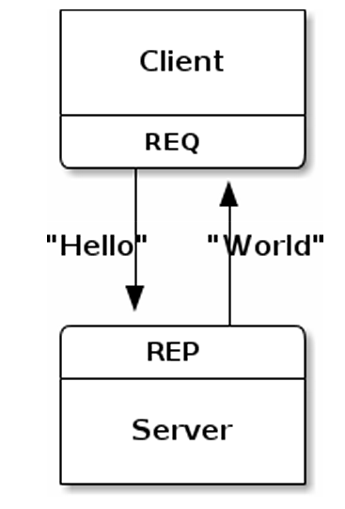
Request-Reply模式
Request-Reply是一种步调一致的同步请求应答模式，发送request之后必须等待reply才能继续发送请求

Slide 5
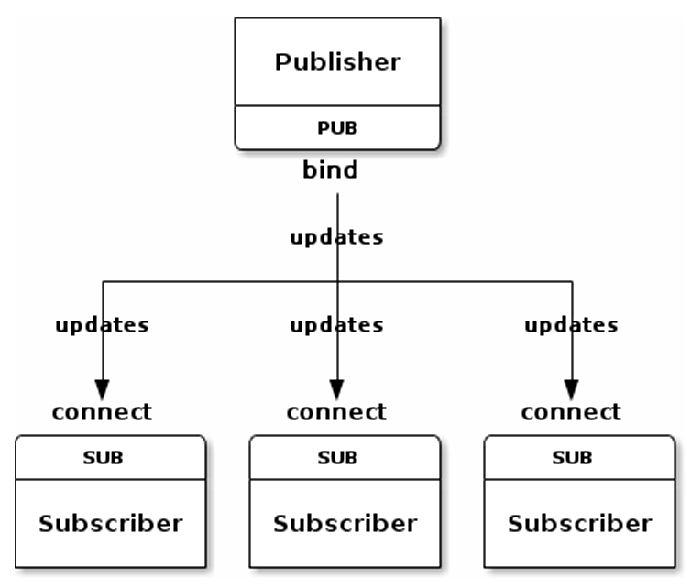
Publish-Subscribe模式
PUB-SUB是一组异步模型
Publisher向所有的subscriber push消息
Subscriber可以订阅多种消息， Subscriber会收到任何匹配的订阅
Subscriber可以过滤订阅的消息
Subscriber可以向多个Publisher订阅

Slide 6
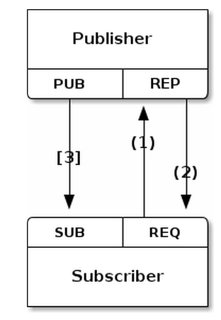
Pub-Sub Synchronization
使用REQ-REP来同步PUB与SUB,PUB等待所有SUB都启动以后再向PUB发布消息
如果PUB先运行，SUB启动以后就会丢失部分的消息
后续在Getting a Snapshot模式中有更灵活的方式来解决这个问题，可以允许SUB在任何时候加入网络，并且可以得到PUB的所有状态

Slide 7
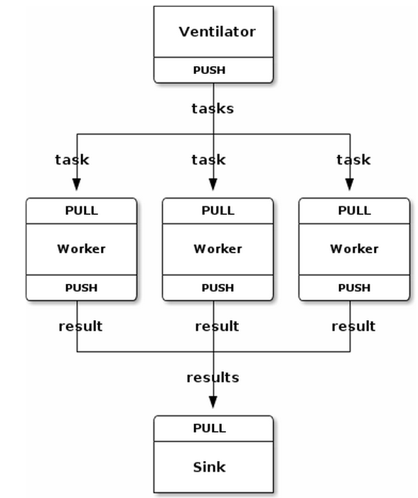
Pipeline模式
PUSH-PULL是一组异步模型
Ventilator会将任务分发到所有的Workers，workers处理后将结果发送到Sink
Parallel Pipeline是一种并行任务处理模型

Slide 8
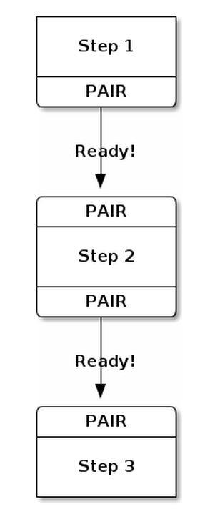
The Relay Race
通过PAIR socket实现线程同步（PAIR is exclusive），PAIR只能建立一个连接，不同于PUSH-PULL

Slide 9
基础背景知识
在介绍high-level pattern之前先介绍一下zeroMQ消息模式中的基础知识
Transient、Durable Sockets
Message Envelopes

Slide 10
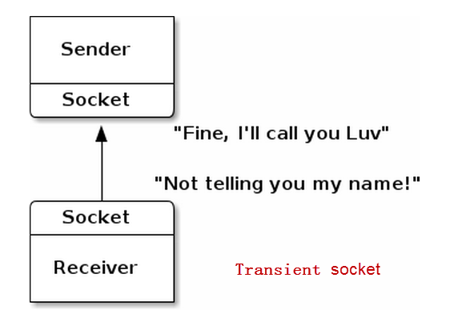
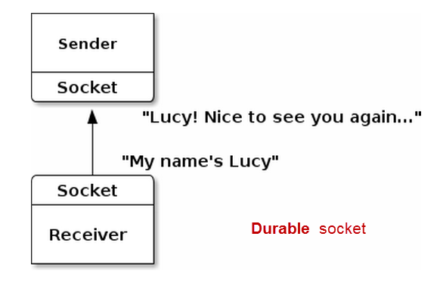
Transient vs. Durable Sockets
通过设置receiver side socket的identity使之成为durable sockets
zmq_setsockopt (socket, ZMQ_IDENTITY, "Lucy", 4);
zmq_setsockopt (publisher, ZMQ_HWM, &hwm, sizeof (hwm));
zmq_setsockopt (publisher, ZMQ_SWAP, &swap, sizeof (swap));

Slide 11
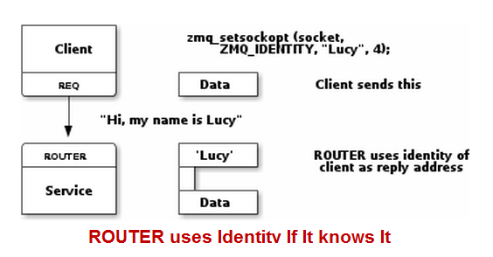
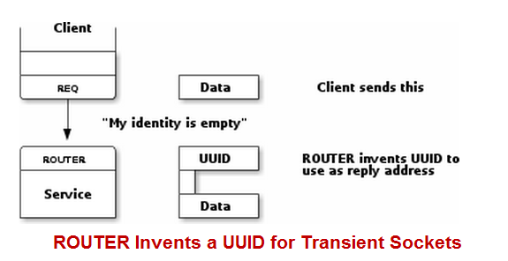
Transient vs. Durable Sockets

Slide 12
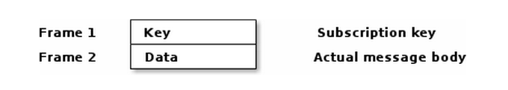
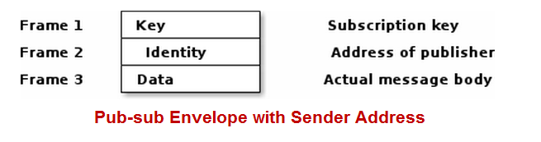
Pub-sub Message Envelopes
SUB可以根据key过滤消息

Slide 13
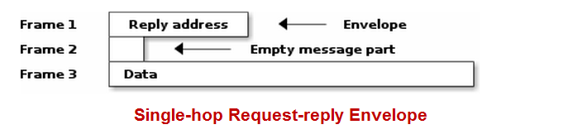
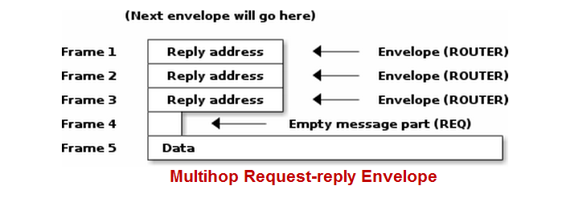
Request-Reply Envelopes
If you connect a REQ socket to a ROUTER socket, and send one request message, this is what you get when you receive from the ROUTER socket:
The empty message part in frame 2 is prepended by the REQ socket when it sends the message to the ROUTER socket

Slide 14
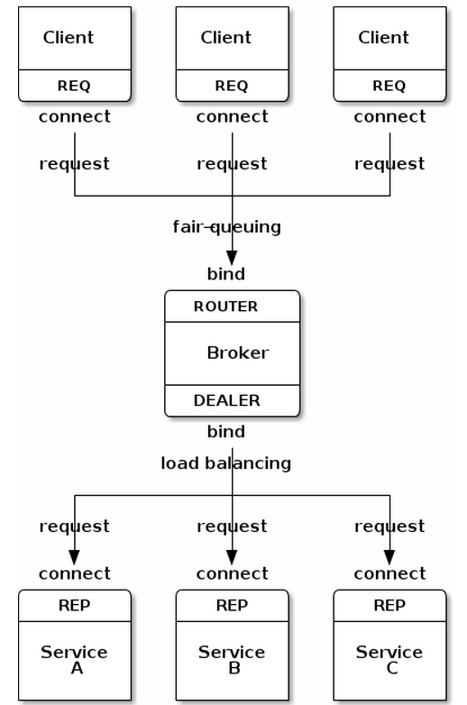
Broker
Request-Reply Broker
REQ与ROUTER通信，DEALER与REP通信
便于客户端（REQ)与Service（REP）的扩展
zeroMQ提供built-in的device
QUEUE, which is like the request-reply broker.
FORWARDER, which is like the pub-sub proxy server.
STREAMER, which is like FORWARDER but for pipeline flows.
Broker通过ROUTER和DEALER直接转发client的请求与service的应答

Slide 15
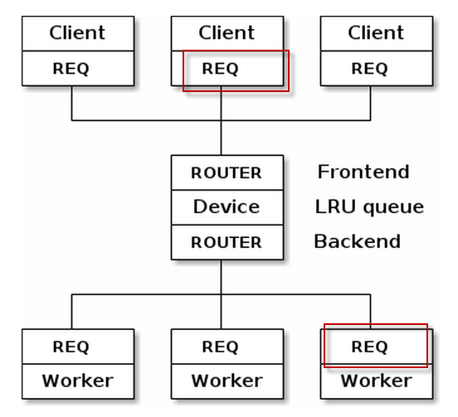
Broker with LRU（1）
Worker发送请求向Broker注册,Broker将所有的worker地址记录到队列中
Broker收到client请求后，从队列中取出LRU的worker，并将请求转发过去

Slide 16
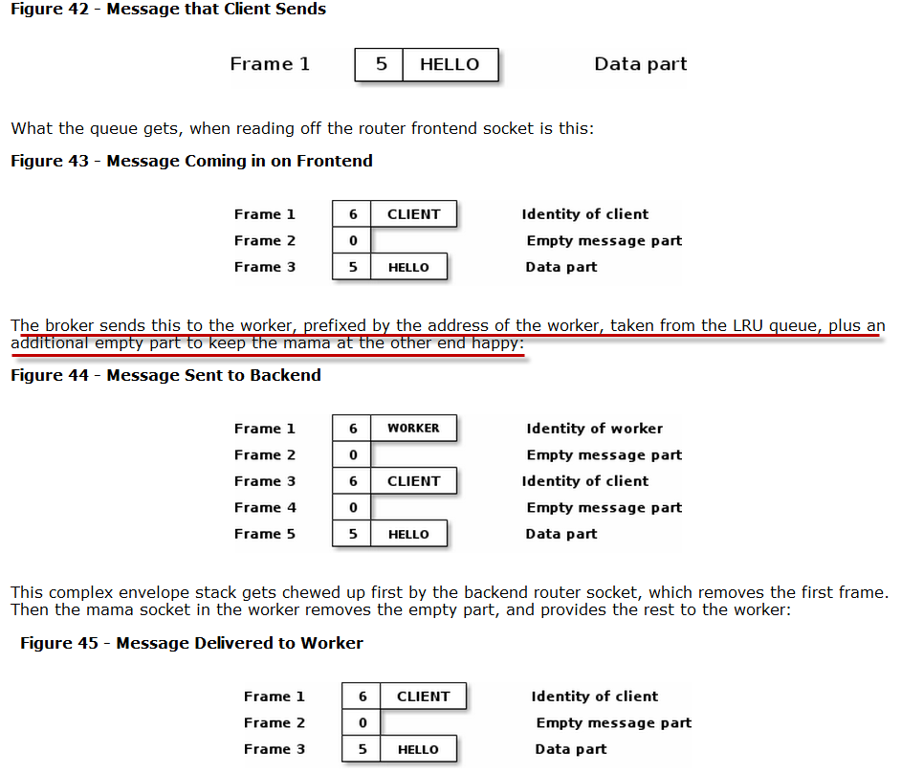
Broker with LRU（2）

Slide 17
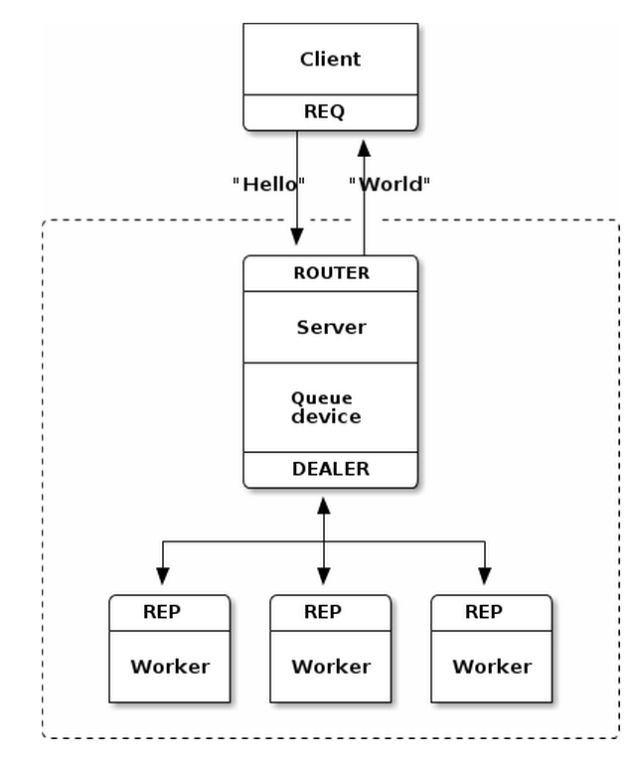
Multithreaded Server
Server启动一组worker线程处理客户端的请求
Server启动Queue device，一端ROUTER与client通信，一端DEALER与worker通信

Slide 18
Custom Request-Reply Routing patterns
ZeroMQ的built-in routing就可以满足基本的需求，比如device可以保证很好的扩展性，一般不建议定制routing。
对于定制routing有如下三个模式：
Router-to-dealer
Router-to-REQ
Router-to-REP

Slide 19
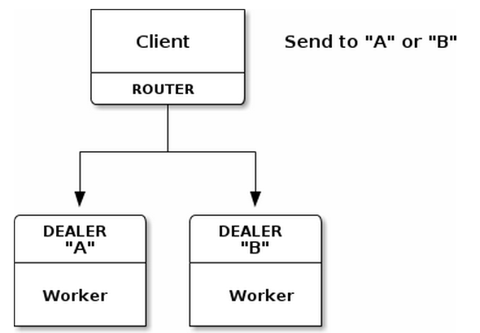
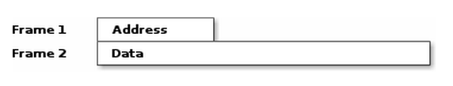
Router-to-Dealer Routing（1-to-N）
1-to-N的异步模式
client端拼接envelope message，需要在Frame 1封装Dealer的地址，
Client将消息交由router发送，下图所示为client发送出去的Routing Envelope
router socket会将Frame 1移除，根据Frame 1的地址将Frame 2发送给Dealer
Dealer应答时只发送一个Frame 2，Router封装了Dealer的地址（Frame 1）以后将消息交给应用
Dealer无法向多个Router应答，因为Dealer对并不知道router的地址

Slide 20
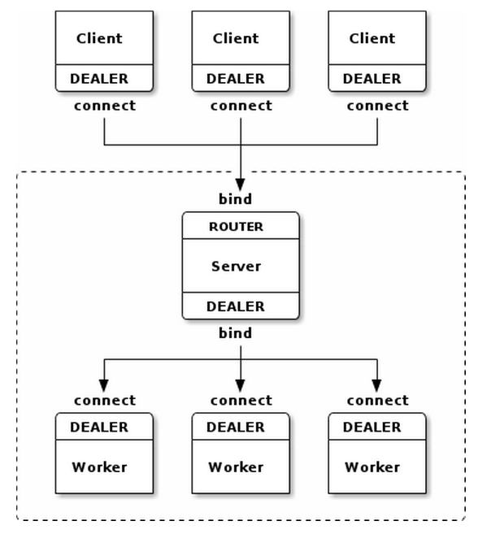
Router-to-Dealer Routing（N-to-1）
与Multithreaded server区别是，这个模式使用DEALER代替了REQ-REP，这个模式是异步模式
Server直接转发client与worker的消息转发，不保存任何状态

Slide 21
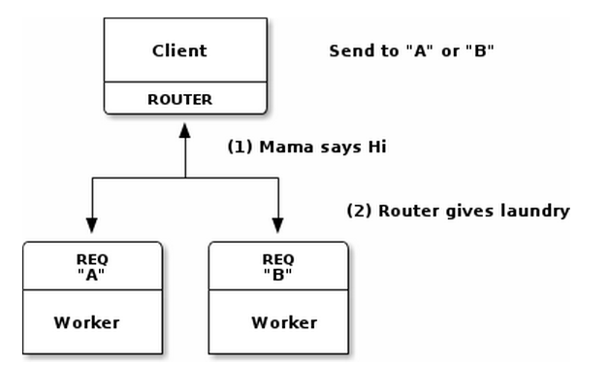
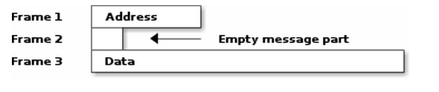
Router-to-REQ
也称为Least-Recently Used Routing (LRU Pattern)
REQ主动发送请求，只包括Frame 3,在client收到的消息如下图所示，包括REQ的地址。
由于是REQ主动发送请求，所以Router很容易知道是哪个REQ.
在Request-Reply Envelopes讲过，empty message（Frame 2）是REQ向Router发送请求时自动添加上的，
Client根据地址向REQ回复应答，由于是根据收到REQ请求的顺序进行处理，故称为LRU
同Broker LRU模式相似

Slide 22
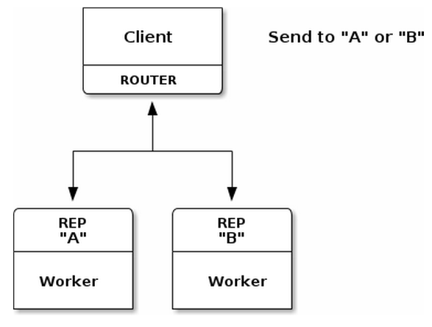
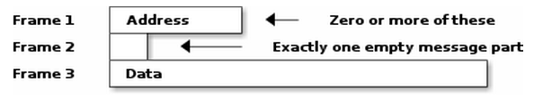
Router-to-REP
这种模式需要ROUTER事先指定向哪个REP发送消息，并且封装REP的envelope message格式，如下图所示

Slide 23
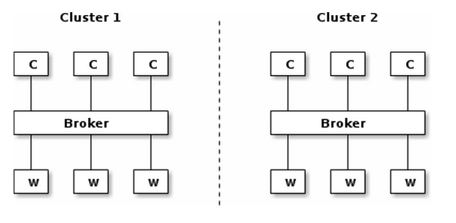
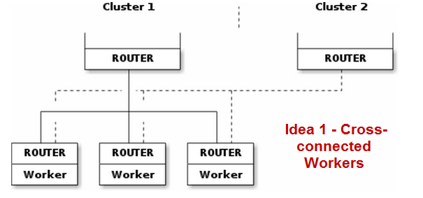
Scaling to Multiple Clusters
Idea 1：如下图，worker使用router socket，然后worker直接连接到所有的broker上。
此方案将routing logic放到了edge节点，一个worker可能一次得到两个任务，而其他workers可能还是idle的

Slide 24
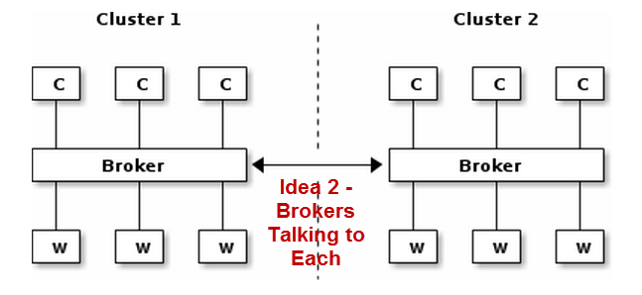
Scaling to Multiple Clusters
此方案具有更好的扩展性，扩展更多的broker会更加容易
Cluster默认可以处理本cluster的任务，特殊情况下可以做额外的工作来处理其他cluster的任务
brokers simulate clients and workers for each other

Slide 25
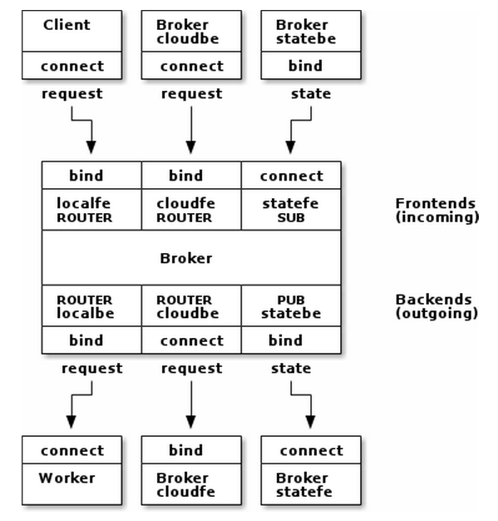
Scaling to Multiple Clusters——peering
Each broker needs to tell its peers how many workers it has available at any time.. The obvious (and correct) socket pattern for this is publish-subscribe. So every broker opens a PUB socket and publishes state information on that, and every broker also opens a SUB socket and connects that to the PUB socket of every other broker, to get state information from its peers.
Each broker needs a way to delegate tasks to a peer and get replies back, asynchronously. We'll do this using router/router (ROUTER/ROUTER) sockets, no other combination works. Each broker has two such sockets: one for tasks it receives, one for tasks it delegates.
There is also the flow of information between a broker and its local clients and workers.

Slide 26
Reliable Request-Reply
The Lazy Pirate pattern
reliable request reply from the client side.
The Simple Pirate pattern
reliable request-reply using a LRU queue.
The Paranoid Pirate pattern
reliable request-reply with heartbeating.
The Majordomo pattern
service-oriented reliable queuing.
The Titanic pattern
disk-based / disconnected reliable queuing.
The Binary Star pattern
primary-backup server fail-over.
The Freelance pattern
brokerless reliable request-reply.

Slide 27
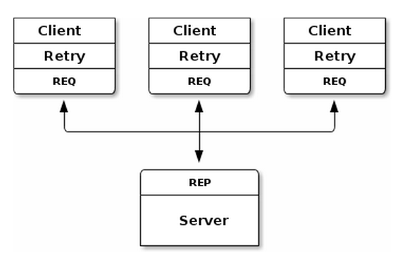
The Lazy Pirate pattern
Client-side Reliability 懒惰海盗模式
Poll the REQ socket and only receive from it when it's sure a reply has arrived.
Resend a request several times, if no reply arrived within a timeout period.
Abandon the transaction if after several requests, there is still no reply.
超时时间未收到reply，则关闭socket重新发送

Slide 28
The Lazy Pirate pattern
优点
simple to understand and implement.
works easily with existing client and server application code.
ØMQ automatically retries the actual reconnection until it works.
缺点
doesn't do fail-over to backup/alternate servers.

Slide 29
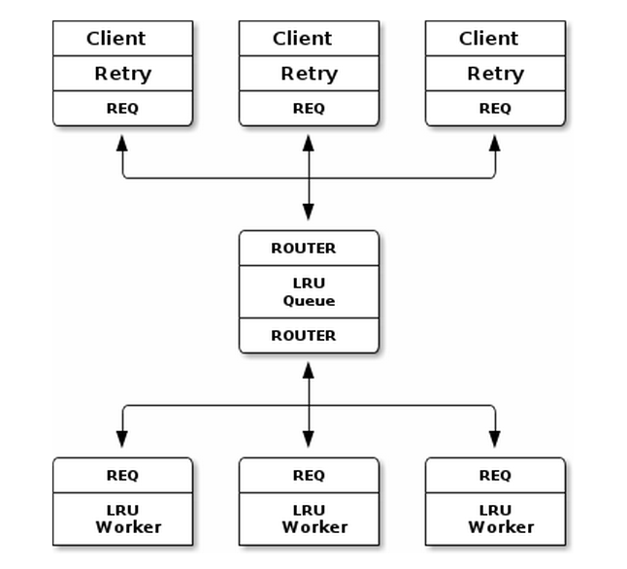
The Simple Pirate pattern
简单海盗模式
可以增加任意数目的worker，解决Lazy Pirate pattern仅一个server的缺点
缺点
queue会成为单点故障
queue故障恢复后worker无自动注册机制
queue没有自动检测worker故障，若worker故障后client需要浪费时间重试等待
Client与worker实现与Lazy Pirate pattern相同
同Broker LRU模式相似
Workers是无状态的，或者状态是共享的

Slide 30
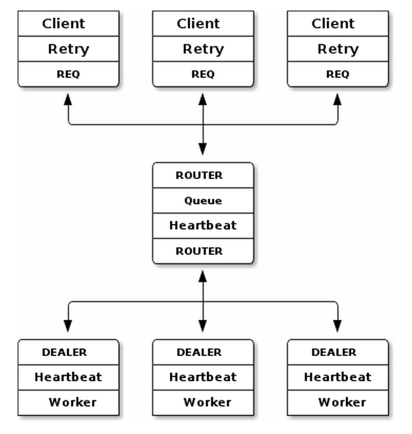
The Paranoid Pirate pattern
偏执海盗模式
在Simple Pirate pattern的基础上增加queue与worker之间的心跳检测
Worker增加故障后重新注册到Queue的机制，有如下两种方案
Client实现与Lazy Pirate pattern相同
心跳使用的是异步通信
PPP(Pirate pattern protocol)RFC:http://rfc.zeromq.org/spec:6
Worker检测与queue的心跳，当检测到broker故障以后就close socket，重新连接
也可以由queue在收到worker的心跳以后通知worker注册，这需要协议支持

Slide 31
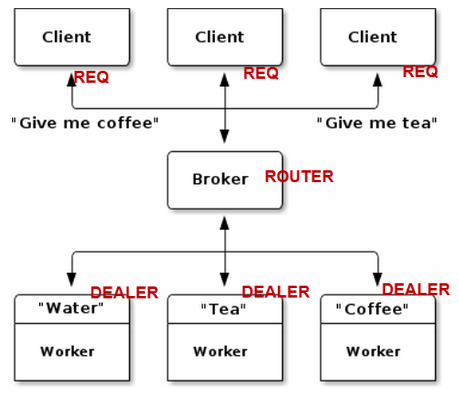
The Majordomo pattern
Service-Oriented Reliable Queuing 埃克索图斯模式
在海盗模式的基础上，Client在请求中增加service name，worker注册相关的service name
通过增加service name，Majiodomo模式成为了service oriented broker
MPP RFC:http://rfc.zeromq.org/spec:7
基于MDP协议的支持，Broker只使用一个socket，PPP需要fronend和backend两个socket
asynchronous Majordomo pattern会对性能有更大的提高
Service Discovery,MMI RFC:http://rfc.zeromq.org/spec:8
Standard solution of detecting and rejecting duplicate requests. This means:
The client must stamp every request with a unique client identifier and a unique message number.
The server, before sending back a reply, stores it using the client id + message number as a key.
The server, when getting a request from a given client, first checks if it has a reply for that client id + message number. If so, it does not process the request but just resends the reply.

Slide 32
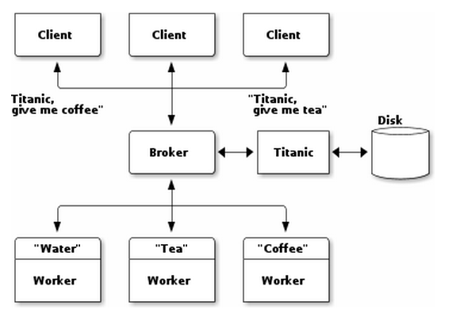
The Titanic pattern
Disconnected Reliability泰坦尼克号模式
为防止消息丢失，将消息写到硬盘，直到确认请求已经处理
Titanic是一个proxy service，对client扮演worker的角色，对worker扮演client的角色
此模式对client有影响，对worker没有任何影响
对于每个请求Titanic为client生成一个唯一的UUID，client使用UUID向Titanic获取应答
Titanic Service Protocol", TSP: http://rfc.zeromq.org/spec:9
Titanic向broker注册三个services：
titanic.request - store a request message, return a UUID for the request.
titanic.reply - fetch a reply, if available, for a given request UUID.
titanic.close - confirm that a reply has been stored and processed.

Slide 33
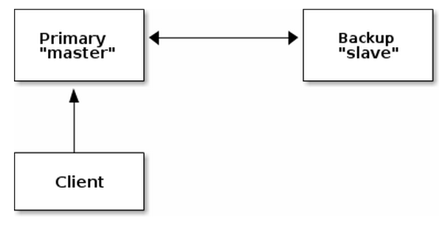
The Binary Star pattern
High-availability Pair 双星模式
The Binary Star pattern puts two servers in a primary-backup high-availability pair.
At any given time, one of these accepts connections from client applications (it is the "master") and one does not (it is the "slave").
Each server monitors the other. If the master disappears from the network, after a certain time the slave takes over as master.
Client需要知道master和slave的地址，尝试连接master，失败以后连接slave。
Client通过心跳检测故障连接，并且重传在fail-over时丢失的消息
防止脑裂：a server will not decide to become master until it gets application connection requests and it cannot see its peer server

Slide 34
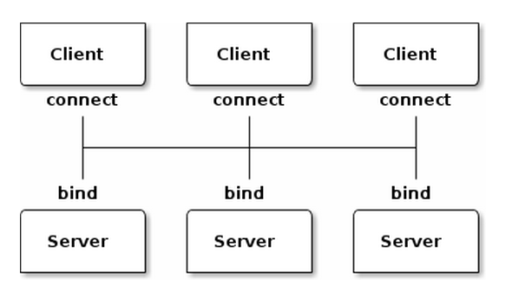
The Freelance pattern
Brokerless Reliability 自由模式
Model One - Simple Retry and Failover
REQ-REP
简单向每个server发送请求，直到其中一个server回复应答
Model Two - Brutal Shotgun Massacre
DEALER-REP
向所有server发送请求，接受第一个应答，其他应答忽略
每个请求包括一个序列号
Model Three - Complex and Nasty
ROUTER-ROUTER
client向指定的可用Server发送请求
Server使用connection endpoint作为identity
像shutgun模式一样，client首先向所有的server发送ping-pong heartbeat，http://rfc.zeromq.org/spec:10，以便维护server状态并且与server建立连接
客户端首先通过ping-pong发送一个null identity，server为client生成一个UUID的identity，同时将自己的identity发送给客户端

Slide 35
Advanced Publish-Subscribe
Suicidal Snail Pattern
Slow Subscriber Detection
Black Box Pattern
High-speed Subscribers
Clone Pattern
A Shared Key-Value Cache

Slide 36
Suicidal Snail Pattern
Classic strategies for handling a slow subscriber
Queue messages on the publisher
比如Gmail将邮件缓存到服务器
对publisher内存压力比较大
Queue messages on the subscriber
zeroMQ默认实现方式
Stop queuing new messages after a while
比如邮箱超过容量以后自动将邮件拒收或者丢弃
zeroMQ配置HWM
Punish slow subscribers with disconnect
比如长时间不登录邮箱的话，帐号会被停用
ZeroMQ不支持这种方式

Slide 37
Suicidal Snail Pattern
自杀蜗牛模式
当subscriber检测到自己运行太慢以后，就自动退出（自杀）
检测subscriber运行太慢的方案
Publisher对消息使用序列号，并且publisher配置HWM，当subscriber检测到序列号不连续以后就认为运行太慢
序列号方案对于多个publisher时，需要给每个publisher一个ID
序列号无法解决subscriber使用ZMQ_SUBSCRIBE过滤器的情况
Publisher对每个消息加时间戳，subscriber检测时间戳与当前时间的间隔，比如超过1秒就认为运行太慢

Slide 38
Black Box Pattern
黑盒模式包括如下两个模式
The Simple Black Box Pattern
Mad Black Box Pattern

Slide 39
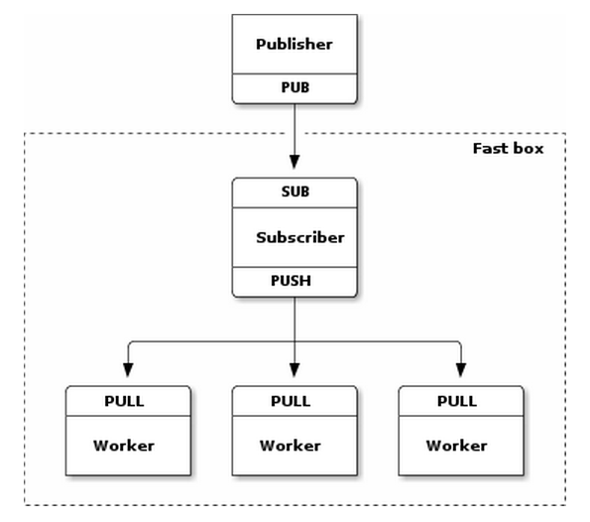
The Simple Black Box Pattern
Subscriber收到消息以后将消息分发到workers并发处理
Subscriber看上去像一个queue device

Slide 40
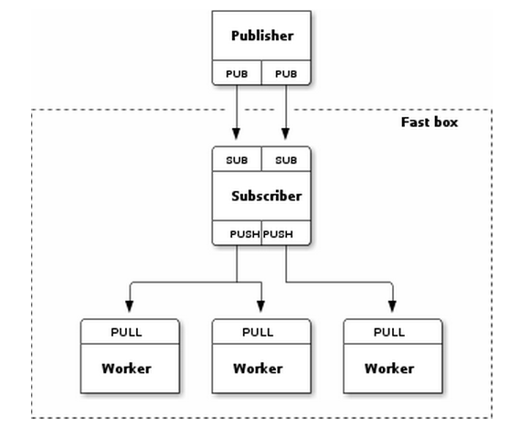
Mad Black Box Pattern
解决了Simple Black Box Pattern中单个subscriber的性能瓶颈
将work分为并行、独立的I/O thread，一半的topic在其中一个，另一半在另一个I/O thread。
甚至将I/O thread分别绑定到不同的NIC,Core以提高性能

Slide 41
Clone Pattern
Clone pattern是用来构建一种抽象的clone机制，主要解决如下几方面问题：
允许client任何时刻加入网络，并且可以可靠的得到server的状态
允许client更新key-value cache（插入、更新、删除）
可靠的将变化传播到所有client
可以处理大量的client，比如10，000或者更多
shared value-key cache,
stores a set of blobs indexed by unique keys.
根据开发clone模式的阶段，Clone pattern包括如下6个mode：
Simplest Clone Model
Getting a Snapshot
Republishing Updates
Clone Subtrees
Ephemeral Values
Clone Server Reliability

Slide 42
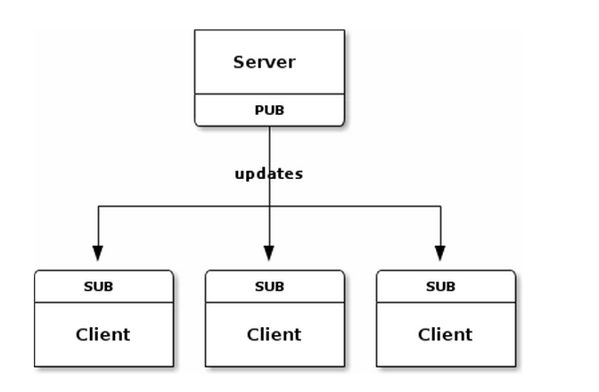
Simplest Clone Model
从Server向所有的client发布 key-value.
所有的client必须在server之前启动,而且client不允许故障
这种模式是不可靠的

Slide 43
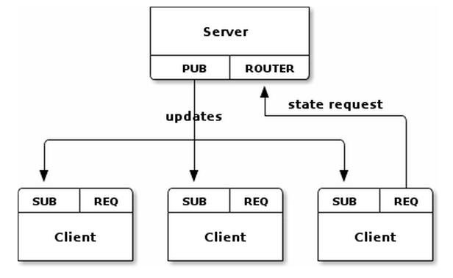
Getting a Snapshot
为了允许client任何时刻加入网络，并且可以可靠的得到server的状态
Client启动时首先通过REQ向server发送state request
server将当前的state发送给client，并最后发送sequence消息
Client接收state，最后会接收到sequence消息，client会丢弃SUB收到的序列号小于sequence的报文

Slide 44
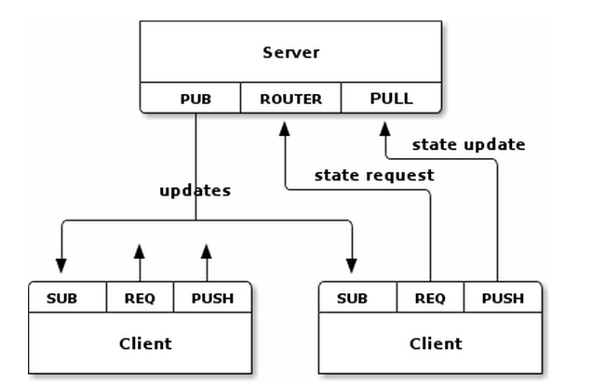
Republishing Updates
允许client更新key-value cache（插入、更新、删除），Server成为一个无状态的broker
Client通过PULL向server发送update的请求
Server收到update请求以后重置sequence，并通过publisher向client转发此消息

Slide 45
Clone Subtrees
Client如果只关心key-value cache的部分内容，用于解决这个问题
可以使用树来表示部分内容，有两种语法来表述树
Path hierarchy: "/some/list/of/paths“
Topic tree: "some.list.of.topics“
Client在发送state request时在消息中包括想要获取的路径，比如"/client/"

Slide 46
Ephemeral Values
Ephemeral Values是指会动态过期的值，比如动态DNS
Client通过给TTL property通知Server 某个属性何时过期
Client定期更新此属性，如果没有更新server就会让此属性过期,通知所有client删除此属性

Slide 47
Clone Server Reliability
解决clone server的可靠性,主要解决如下几种故障场景
Clone server process crashes and is automatically or manually restarted. The process loses its state and has to get it back from somewhere.
Clone server machine dies and is off-line for a significant time. Clients have to switch to an alternate server somewhere.
Clone server process or machine gets disconnected from the network, e.g. a switch dies. It may come back at some point, but in the meantime clients need an alternate server.
Clustered Hashmap Protocol
RFC:http://rfc.zeromq.org/spec:12

Slide 48
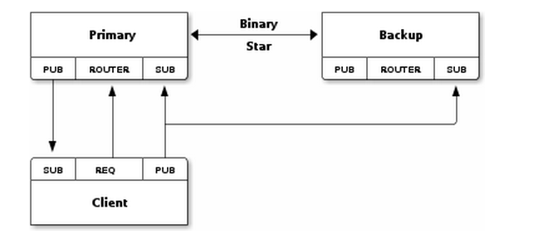
Clone Server Reliability
使用PUB-SUB代替PUSH-PULL socket
在server和client之间增加心跳，以便client可以检测到server故障
Primary server与backup server之间使用Binary Star模式连接
所有的update消息通过UUID来唯一标识
Backup server保存一个pending list，包括从client收到还未从primary收到的消息，以及从primary收到还未从client收到的消息
Client处理流程
Client启动时向第一个server请求snapshot,如果接收到就保存,如果在超时时间后没有应答,则fail-over到下一个server
Client接收了snapshot之后,开始等待和处理update,如果在超时时间之后没有任何update,则failover到下一个server

Slide 49
Clone Server Reliability
Fail-over happens as follows:
The client detects that primary server is no longer sending heartbeats, so has died. The client connects to the backup server and requests a new state snapshot.
The backup server starts to receive snapshot requests from clients, and detects that primary server has gone, so takes over as primary.
The backup server applies its pending list to its own hash table, and then starts to process state snapshot requests.
When the primary server comes back on-line, it will:
Start up as slave server, and connect to the backup server as a Clone client.
Start to receive updates from clients, via its SUB socket.

Slide 50


Slide 51
附录1
Now, imagine we start the client before we start the server. In traditional networking we get a big red Fail flag. But ØMQ lets us start and stop pieces arbitrarily. As soon as the client node does zmq_connect(3) the connection exists and that node can start to write messages to the socket. At some stage (hopefully before messages queue up so much that they start to get discarded, or the client blocks), the server comes alive, does a zmq_bind(3) and ØMQ starts to deliver messages.

Slide 52
附录2
A server node can bind to many endpoints and it can do this using a single socket. This means it will accept connections across different transports:
zmq_bind (socket, "tcp://*:5555"); zmq_bind (socket, "tcp://*:9999"); zmq_bind (socket, "ipc://myserver.ipc");
You cannot bind to the same endpoint twice, that will cause an exception.

Slide 53
附录3
The zmq_send(3) method does not actually send the message to the socket connection(s). It queues the message so that the I/O thread can send it asynchronously. It does not block except in some exception cases. So the message is not necessarily sent when zmq_send(3) returns to your application. If you created a message using zmq_msg_init_data(3) you cannot reuse the data or free it, otherwise the I/O thread will rapidly find itself writing overwritten or unallocated garbage. This is a common mistake for beginners. We'll see a little later how to properly work with messages.
The zmq_recv(3) method uses a fair-queuing algorithm so each sender gets an even chance.

Slide 54
附录4：Multithreading with ØMQ
You should follow some rules to write happy multithreaded code with ØMQ:
You MUST NOT access the same data from multiple threads. Using classic MT techniques like mutexes are an anti-pattern in ØMQ applications. The only exception to this is a ØMQ context object, which is threadsafe.
You MUST create a ØMQ context for your process, and pass that to all threads that you want to connect via inproc sockets.
You MAY treat threads as separate tasks, with their own context, but these threads cannot communicate over inproc. However they will be easier to break into standalone processes afterwards.
You MUST NOT share ØMQ sockets between threads. ØMQ sockets are not threadsafe. Technically it's possible to do this, but it demands semaphores, locks, or mutexes. This will make your application slow and fragile. The only place where it's remotely sane to share sockets between threads are in language bindings that need to do magic like garbage collection on sockets.

Slide 55
附录5：优先级方案
Server同时bind到多个优先级的Socket，client根据优先级向不同的socket发送message，Server端的fair-queuing algorithm可以保证各个优先级都有机会被接收

