Slide 1

  Zumastor: Enterprise NAS for Linux
  Daniel Phillips
  phillips@google.com

Slide 2

or: It is high time Tux arrived in the NAS space...

Slide 3
Zumastor Linux Storage Server
Multiple live volume snapshots
User accessible snapshots
Remote volume replication
Online volume backup
Kerberized NFS and Samba
CIFS previous versions API
Easy administration interface
NVRAM acceleration (work in progress)

Slide 4
ddsnap virtual block device
ddsnap is the engine of zumastor
Originally designed for cluster snapshots
Small kernel driver coupled to biggish user space server
rpc-like interface between kernel and user space
  but not big and fat like rpc
Copy-before-write snapshot strategy

Slide 5
ddsnap remote replication
Which chunks are different between two snapshots?
ddsnap server peeks into metadata
Then read snapshot data to build a volume delta
Get delta as a file or stream it
Various kinds of delta compression

Slide 6
Zumastor Volume Monitor
Hides the details of ddsnap, dmsetup, virtual device names, mountpoints
Scheduled snapshot rotations
Implements complex replication topology
All driven by a filesystem based database
Easy to use database editing interface

Slide 7
Snapshot write performance
Origin Read performance is great
Write performance does not degrade with number of snapshots
Write performance improves with larger chunk size
Write performance improves a lot with metadata in NVRAM
Write performance still pretty bad overall, partly covered up by NFS slowness

Slide 8
Delta compression performance
Delta size equates to replication time
Compression is a big payoff for slow links
Extent oriented, need big chunks to work on but still need to stream
zlib (gzip) for compression
xdelta for binary differencing
Compress or binary difference?
  Try both and pick the best

Slide 9
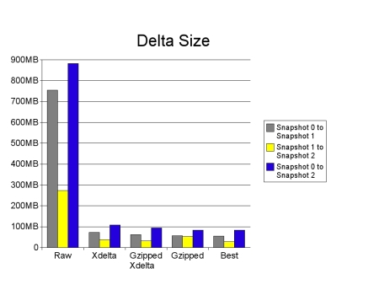
Delta compression performance

Slide 10
Zumastor Futures
It's going to get more features
It's going to get faster and more robust
It's going to get bigger

Slide 11
Zumastor Futures
Give me a graphical front end
Give it to me over the web
Give me a real volume manager
What about online resizing?
Can I have incremental backup too?
Faster, yah Faster!
I don't want to buy NVRAM, can you make it so I don't need it?

Slide 12
Zumastor Linux Storage Server
Zumastor homepage:
    http://zumastor.org
IRC channel:
irc.oftc.net #zumastor

