Slide 1
HM-tools status 1.11.07

Slide 2
Features
Load aerosol data, many instruments
Plotting, working plots, publication ready plots
Calculate number concentration from selected range
Convert between number, mass and volume concentration
Mode fitting
Growth rate, formation rate, growth factor, charging state
Condensation and coagulation sink
Particle density (dmps-elpi fitting)
Event classification/loading starting stoping times, event periods
Other helping tools, e.g. smoothing, averaging, interpolation, correlation plots
GUI

Slide 3

What we have
Load, parameter file
XML-format
    %<instrument>
    % <name>SomeName</name>
    % <path>SomePath</path>
    % <fnm>sprintf(SomeModel)</fnm>
    % <alt_fnm>sprintf(SomeModel)</alt_fnm>
    %</instrument>
Un-limited number of instruments can be added
Each sampling site/project can have specific parameter file
TODO
  Function to add default parameter file

Slide 4
What we have
Load, hm_load
hmD=hm_load(datenum(2005,03,01),datenum(2005,03,01))
Instruments:
    'dmps',... OK
    'aisn',... OK
    'aisp',... OK
    'cpc',... NOT
    'naisn',... OK
    'naisp',... OK
    'bsman',... OK
    'bsmap',... OK
    'volh',... NOT
    'volc'... NOT
Multiple days
TODO
  Add missing instruments
  Add new instruments
  Instrument specific loading functions are inside main load function, not good
  Diameter conversion?

Slide 5
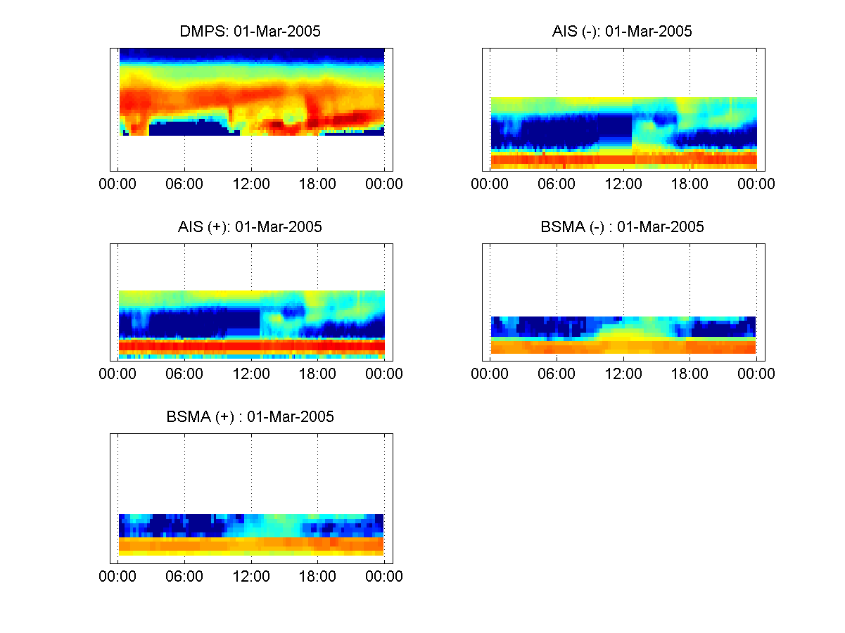
What we have
Plot, hm_plot(hmD)
plotTypes
Always operates on data that is in root
TODO
  Formatting for publication
  Plot fitting result
  Separate publication function

Slide 6
What we have
Number concentration,
AE_conc(hmD,srs,dP_lim)
Output is 2-col matrix. Not hm-structure
Calculates on diameter given by instrument
Uses same approach that dmpsconc
TODO
  -testing, only tested for dmps and ais

Slide 7
What we have
Convert to Volume conc, hmD=hm_convertN2V(hmD)
Replaces data with new one
Original coped to meta-field
TODO
  -restore original
  mass concentration

Slide 8
What we have
Mode fitting, hmD=hm_mf(hmD,meth,srs)
Hopefully final umbrella function
Currently only one method - lognorm
[AEstr,pmfR]=hm_modefitting(AEstr,srs),
  pmf based, badly coded, requires many outside functions
TODO
  -test and publish ☺
  -parameters input
  Methods to separate function

Slide 9
What we have
Growth rate, hmD=hm_gr(hmD,srs)
Manual select of virtual line from graph and fit it
TODO
  -test and publish ☺
  -parameters input
  Methods to separate function

Slide 10
What we have
Helping function
Hm_smooting
  2 methods: 2d-median filter, 2d-mean filter
  Selectable window
hm_combdays
  Combine all days to one big matrix (currently raw data on cells)
hm_durbin_watson_index
  Evaluate smoothing parameters
TODO
  -clean up repository
  Smooting, for many times

Slide 11
What we missing
Condensation and coagulation sink
Particle density
formation rate, growth factor, charging state jne

Slide 12
EventClassifier
Bugs in saving
Missing export

