Slide 1

Computer System Architecture
(THIRD EDITION)
Morris Mano
PRENTICE HALL
_{Ref: bazi.pe.kr}

Slide 2
Class Overview
Contents
  Basic Computer Hardware Architecture
  CPU, Memory, I/O System Design
  Advanced Topics: Pipeline, Multiprocessor
Related Subject
  Digital Logic (논리설계), Discrete Mathematics (이산수학)
Chapter Outline
  Ch. 1 ~ Ch. 4: Digital Computer Hardware Architecture
  Ch. 5 ~ Ch. 7: Basic Computer Design
  Ch. 8 ~ Ch. 10: CPU Architecture and Pipeline Processing
  Ch. 11 ~ Ch. 12: I/O and Memory Architecture
  Ch. 13: Multiprocessor
Homework
  Solve the selected number of problems
  Report of Survey for given theme
Reference
  Morris Mano, Computer Systems Architecture, Prentice-Hall, 3rd Ed.
  John Hennessy, David Patterson, Computer Architecture: a Quantitative approach, Morgan Kaufmann. 3rd Ed.

Slide 3
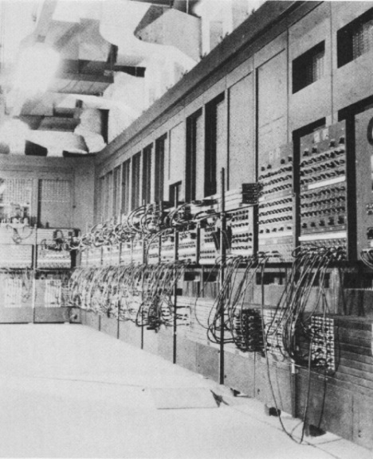
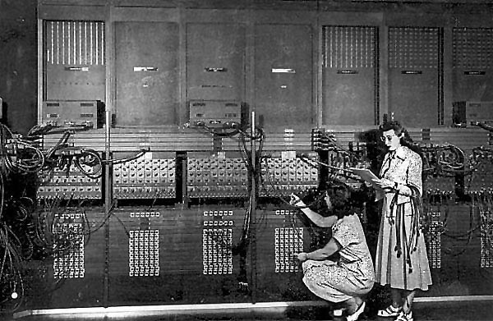
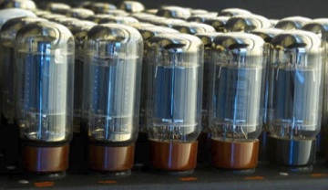
최초의 컴퓨터 ?
ENIAC (1946)

Slide 4
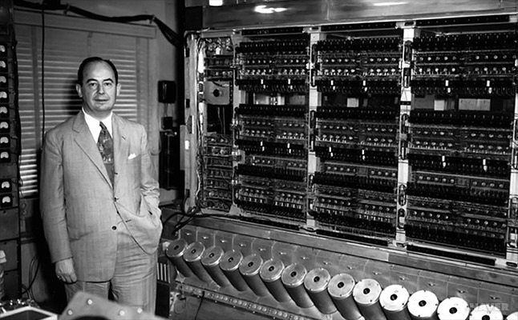
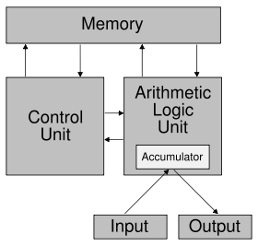
Von Neumann Architecture
John von Neumann & EDVAC

Slide 5

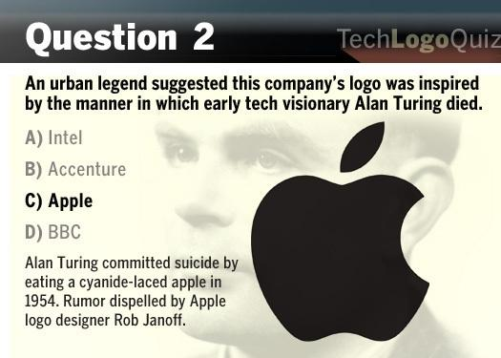
Quiz

Slide 6

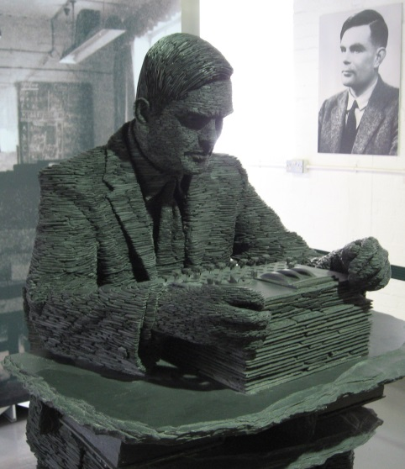
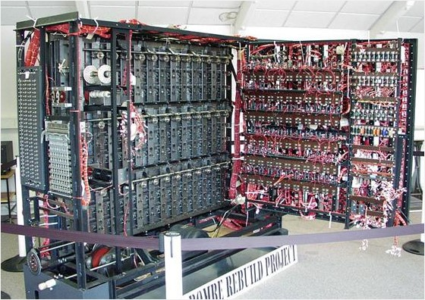
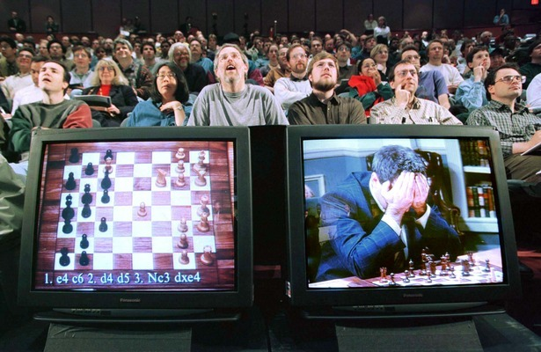


Alan Turing (1912-1954)

Slide 7
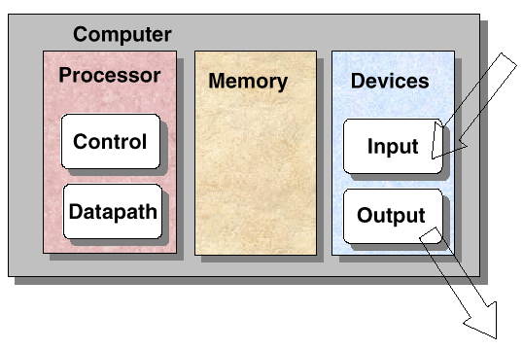
A Simple Picture

Slide 8
1-1 Digital Computers
Digital – A limited number of discrete value
Bit – A Binary Digit
Program – A Sequence of instructions
Computer = H/W + S/W
Program(S/W)
  A sequence of instruction
  S/W = Program + Data
    The data that are manipulated by the program constitute the data base
  Application S/W
    DB, word processor, Spread Sheet, game
  System S/W
    OS, Firmware, Compiler, Device Driver
Application S/W
API
Operating System
ROM BIOS
Computer H/W

Slide 9
1-1 Digital Computers
Computer Hardware
  CPU
  Memory
    Read Only Memory (ROM)
    Random Access Memory (RAM)
  I/O Device
    Input Device: Keyboard, Mouse, Scanner
    Output Device: Printer, Plotter, Display
    Storage Device(I/O): FDD, HDD, SSD
Memory
CPU
Input
Device
Interface
Output
Device
Figure 1-1 Block Diagram of a digital Computer

Slide 10
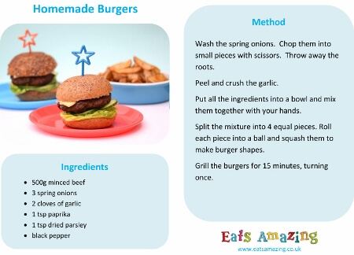
Example: Recipe
_{Program code}
_{: Set of instructions}
_{UI/UX}
_{Data}
_{Ref)} http://www.eatsamazing.co.uk/recipes-tutorials/cooking-with-small-child-homemade-burgers

Slide 11
1-1 Digital Computers
What is “Computer Architecture”?
- Hennessy and Patterson, Computer Organization and Design(1990)
  Computer Architecture
    Instruction Set Architecture (ISA)
    Machine Organization
“ISA”?
  Instructions
  Addressing modes
  Instruction and data formats
  Register
“Machine Organization”?
  CPU(Control, Data path), Memory, Input, Output

Slide 12
Class Overview
Contents
  Basic Computer Hardware Architecture
  CPU, Memory, I/O System Design
  Advanced Topics: Pipeline, Multiprocessor
Related Subject
  Digital Logic (논리설계), Discrete Mathematics (이산수학)
Chapter Outline
  Ch. 1 ~ Ch. 4: Digital Computer Hardware Architecture
  Ch. 5 ~ Ch. 7: Basic Computer Design
  Ch. 8 ~ Ch. 10: CPU Architecture and Pipeline Processing
  Ch. 11 ~ Ch. 12: I/O and Memory Architecture
  Ch. 13: Multiprocessor
Homework
  Solve the selected number of problems
  Report of Survey for given theme
Reference
  Morris Mano, Computer Systems Architecture, Prentice-Hall, 3rd Ed.
  John Hennessy, David Patterson, Computer Architecture: a Quantitative approach, Morgan Kaufmann. 3rd Ed.

Slide 13
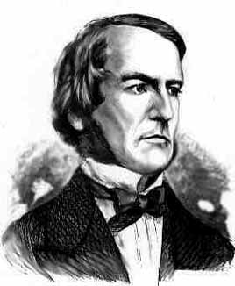
1-2 Logic Gates
ADC(Analog to Digital Conversion)
  Signal Physical Quantity Binary Information
  V, A, F, 거리 Discrete Value
Bit : 1/0
  2 bits : 00, 01, 10, 11 ; 4가지 = 2²
  3 bits : 000, 001, 010, 011, 100, 101, 110, 111 ; 8가지 = 2³
Gate
  The manipulation of binary information is done by logic circuit called “gate”.
Fig. 1-2 Digital Logic Gates
  AND, OR, INVERTER, BUFFER, NAND, NOR, XOR, XNOR
_{0 : 0.5}
_{1 : 3}
George Boole
  1815 ~ 1864

Slide 14
Boole Logic - Example
What is it?
  Input, Output 이 이진변수(binary variable)로 구성된 논리 회로
우주회 (雨酒會)
  비가 오면 → 술 먹는다
  비가 안 오면 → 술 안 먹는다
  비가 온다 : A = 1, 비가 안 온다 : A = 0
  술 먹는다 : X = 1, 술 안 먹는다 : X = 0
  If (A == 1), Then X = 1; Else, X = 0;
_{A}
_{X}

Slide 15
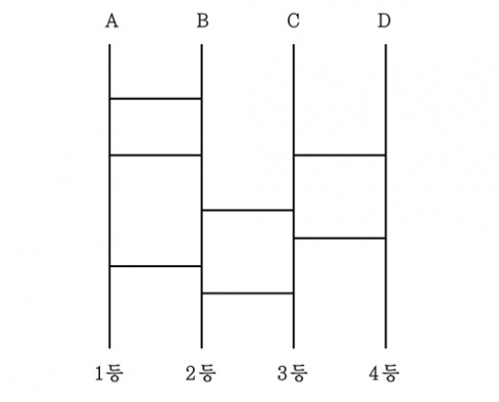
Boole Logic - Example
_{Input :}
_{Logic :}
_{Output:}
http://nogwon.blogspot.kr/2013/10/blog-post_2036.html

Slide 16
Boole Logic - Example
비(A)가 오고 친구(B)가 있으면 → 술(X) 먹는다
  If (A==1)&&(B==1), Then X = 1; Else, X = 0;
비(A)가 오고 친구(B)가 있고 돈(C)이 있으면 → 술(X) 먹는다
  If (A==1)&&(B==1)&&(C==1), Then X = 1; Else, X = 0;
_{A}
_{X}
_{B}
_{A}
_{B}
_{X}
_{C}

Slide 17
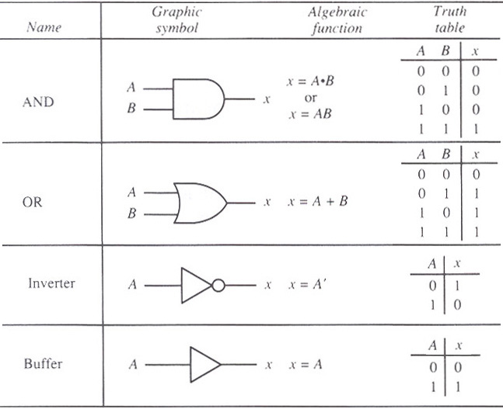
1-2 Logic Gates

Slide 18
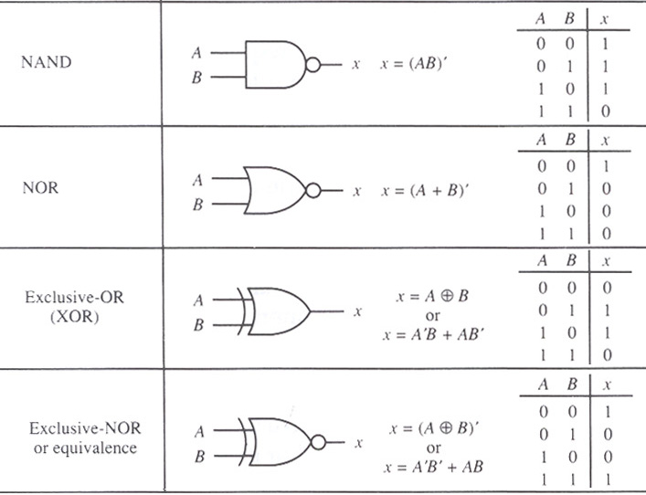
1-2 Logic Gates

Slide 19
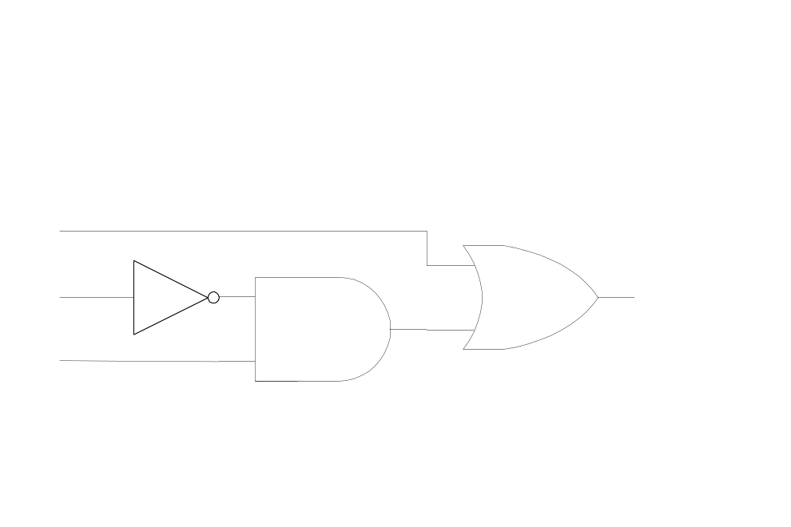
1-3 Boolean Algebra
Boolean Algebra
  binary variable(A, B, x, y: T/F or 1/0) + logic operation(AND, OR, NOT…)
Boolean Function: variable + operation
  F(x, y, z) = x + y’z
Truth Table: Fig. 1-3(a) Relationship between a function and variable
Logic Diagram: Fig. 1-3(b) Algebraic Expression
Logic Diagram(gates로 표현)
x
y
z
F
0
0
0
0
_{x}
0
0
1
1
0
1
0
0
_{y}
_{F}
2^{n} Combination
Variable n = 3
0
1
1
0
1
0
0
1
_{z}
1
0
1
1
1
1
0
1
1
1
1
1

Slide 20

1-3 Boolean Algebra
Purpose of Boolean Algebra
  To facilitate the analysis and design of digital circuit
Convenient Tools
  Truth table : relationship between binary variables
  Logic diagram : input-output relationship
  Find simpler circuits for the same function
Boolean Algebra Rule : Tab. 1-1
- Operation with 0 and 1: x + 0 = x , x + 1 = 1 , x • 1 = x , x • 0 = 0
- Idempotent Law: x + x =x , x • x = x
- Complementary Law: x + x' = 1 , x • x' = 0
- Commutative Law: x + y = y + x , x • y = y • x
- Associative Law: x + (y + z) = (x + y) + z , x • ( y • z) = (x • y) • z
- Distributive Law: x • ( y+ z) = (x • y) + (x • z) , x + (y • z) = (x + y) • (x + z)
- DeMorgan's Law: (x + y)' = x' • y’ , (x • y )’ = x’ + y’
General Form: (x₁ + x₂ + x₃ + … x_{n})' = x₁' • x₂' • x₃' • … x_{n}’
(x₁ • x₂ • x₃ • … x_{n}) ' = x₁' + x₂' + x₃' + … x_{n}’

Slide 21
1-3 Boolean Algebra
[예제]
  F= AB’ + C’D + AB’ + C’D
  = x + x (let x= AB’ + C’D)
  = x
  = AB’ + C’D
[예제]
  F= ABC + ABC’ + A’C
  = AB(C + C’) + A’C
  = AB + A’C
  1 inverter, 1 AND gate 감소
Fig. 1-6(a)
Fig. 1-6(b)

Slide 22
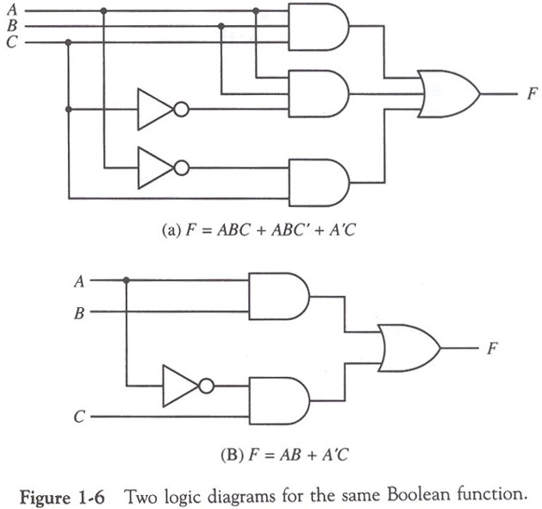
1-3 Boolean Algebra

Slide 23

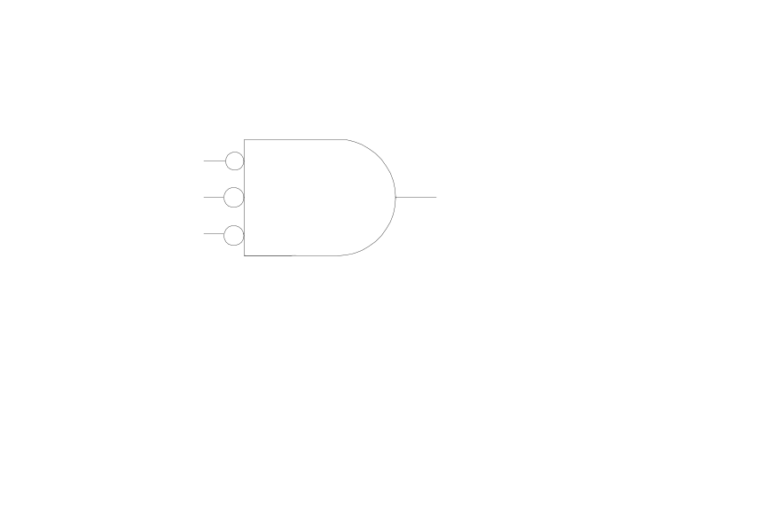
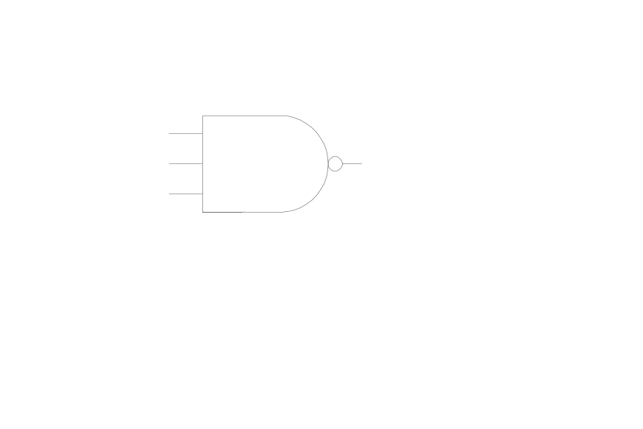

Fig. 1-4 2 graphic symbols for NOR gate
  (a) OR-invert (b) invert-OR
x
y
z
x
y
z
(x+y+z)’
x’ y’z’
Fig. 1-5 2 graphic symbols for NAND gate
  (a) NAND-invert (b) invert-NAND
x
y
z
(xyz)’
x
y
z
(x’+y’+z’)

Slide 24
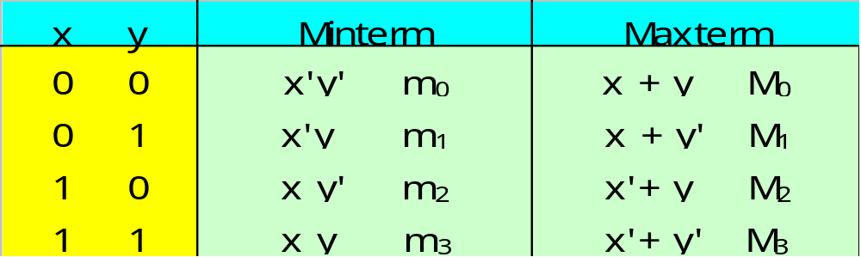
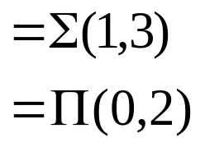
1-4 Map Simplification
Karnaugh Map(K-Map)
  Map method for simplifying Boolean expressions
Minterm / Maxterm
  Minterm : n variables product ( x=1, x’=0)
  Maxterm : n variables sum (x=0, x’=1)
2 variables example
F = x’y + xy
m₀ + m₁ + m₂ + m₃
M₀ • M₁ • M₂ • M₃
m₁
m₃
( m₁ + m₃ )
(Complement = M₀ • M₂ )

Slide 25
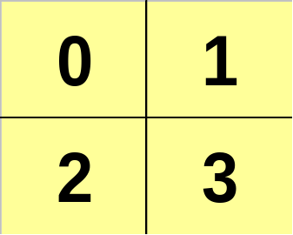
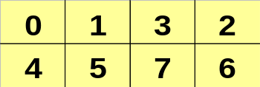
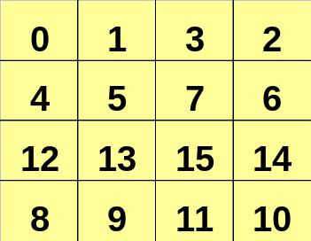
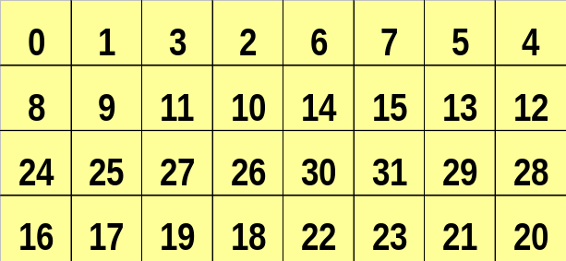
1-4 Map Simplification
Map
  2 variables
  3 variables
  4 variables
B
B
C
A
A
B
C
A
  5 variables
C
D
B
A
E
D
F
Fig 1-7 Maps for two-, three-, four-, and five-variable functions

Slide 26
Y
0
1
x
0
1

Slide 27
B
A
C
10
11
YZ
00
01
11
10
x
0
000
001
011
010
1
100
101
111
110

Slide 28
C
CD
00
01
11
10
AB
B
A
00
D
01
11
10

Slide 29

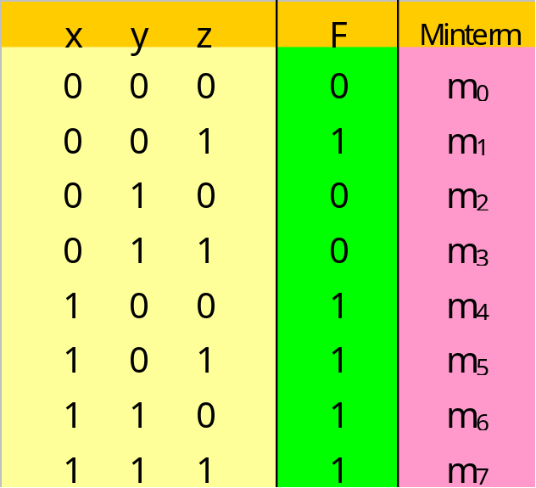
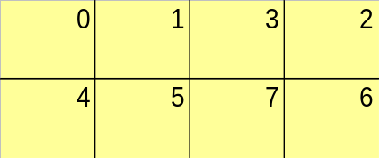
1-4 Map Simplification
[예제] F= x + y’z
  (1) Truth Table
  (2)
  (3) Karnaugh Map
y
x
z
F= x + y’z

Slide 30
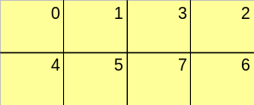
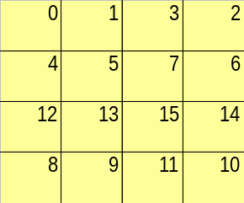
1-4 Map Simplification
Adjacent Square
  Number of square = 2^{n} (2, 4, 8, ….)
  The squares at the extreme ends of the same horizontal row are to be considered adjacent
  The same applies to the top and bottom squares of a column
  The four corner squares of a map must be considered to be adjacent
  Groups of combined adjacent squares may share one or more squares with one or more group

Slide 31




1-4 Map Simplification
B
[예제]
  F=AC’ + BC
A
C
B
[예제]
  F=C’ + AB’
A
C
C
[예제]
  F=B’C’ + B’D’ + A’CD’
B
A
Product-of-Sums Simplification
  F=B’D’ + B’C’ + A’C’D
  F’=AB + CD + BD’(square marked 0’s)
  F’’(F)=(A’ + B’)(C’ + D’)(B’ + D)
D
C
Sum of product
B
A
Product of Sum
D

Slide 32
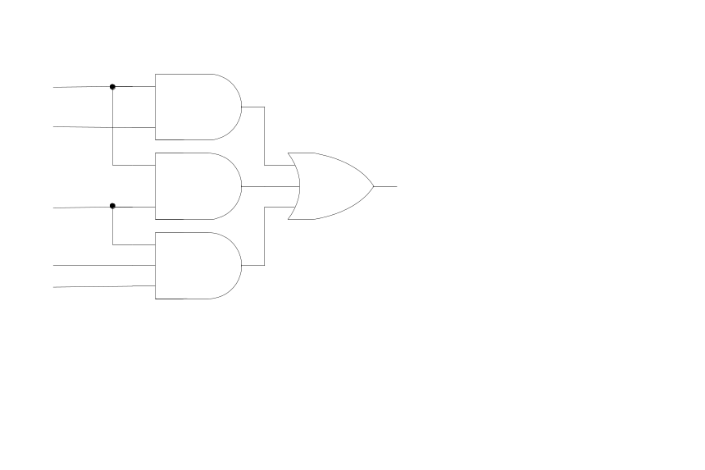
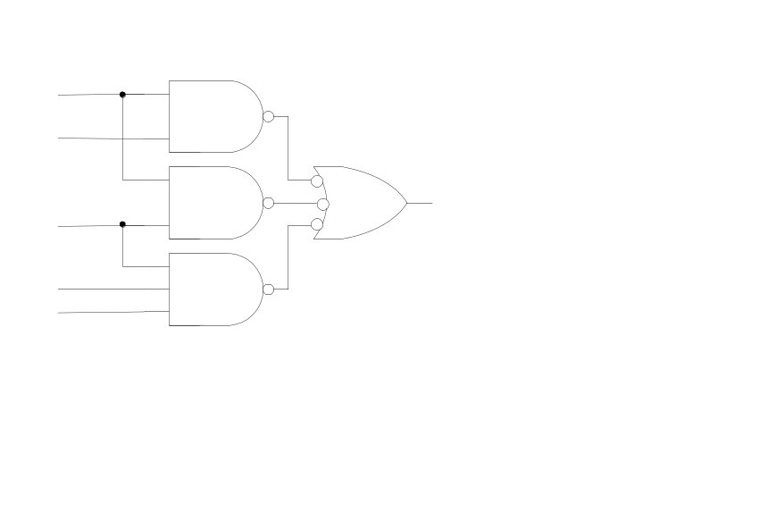
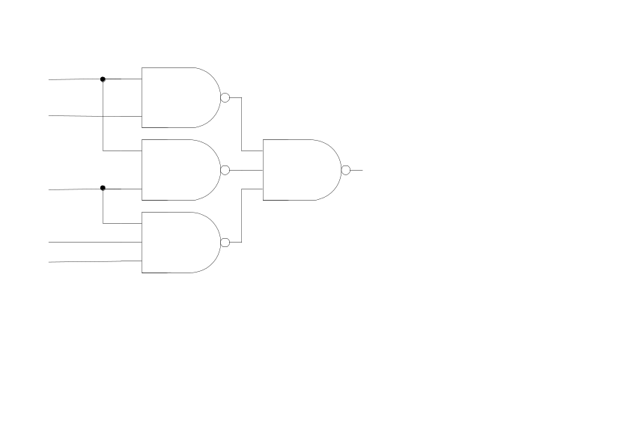
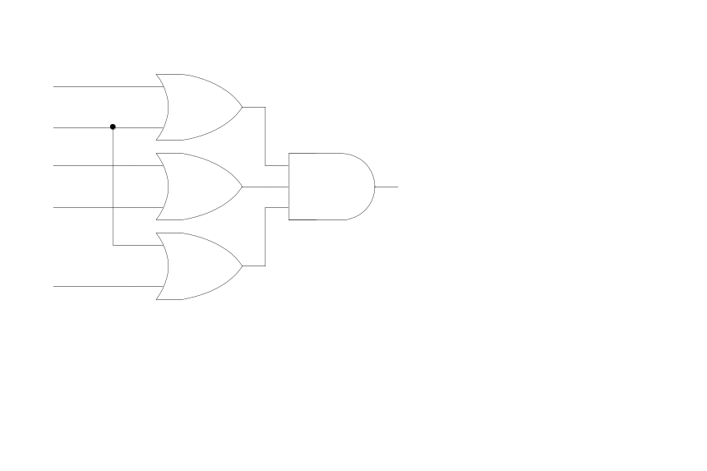
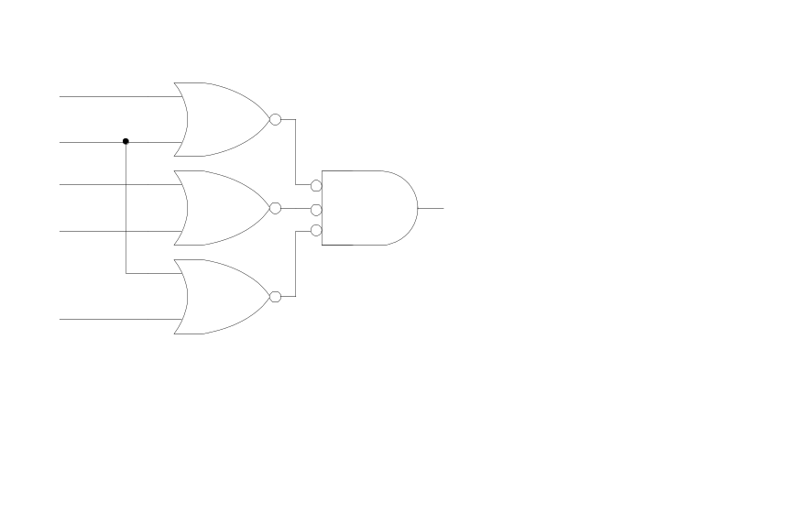
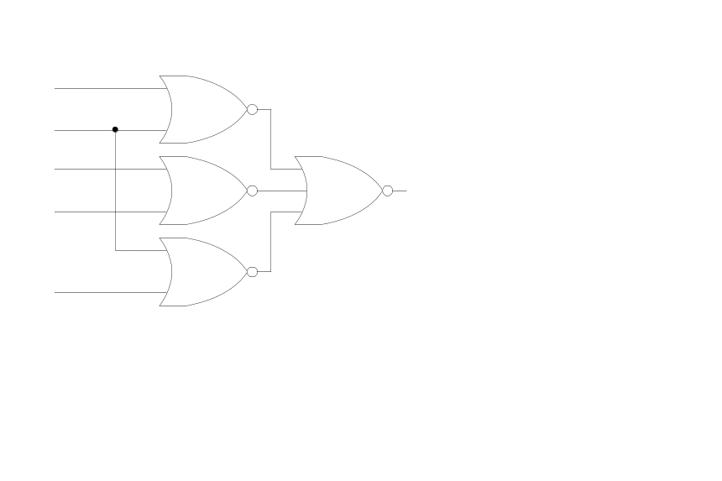
1-4 Map Simplification
NAND Implementation
  Sum of Product : F=B’D’ + B’C’ + A’C’D
NOR Implementation
  Product of Sum : F=(A’ + B’)(C’ + D’)(B’ + D)
Don’t care conditions
  F(A,B,C)=Σ(0, 2, 6), d(A,B,C)= Σ(1, 3, 5)
  F=A’ + BC’= Σ(0, 1, 2, 3, 6)
B’
D’
C’
A’
D
A’
B’
C’
D’
D’
B
1
X
X
1
A
X
C

Slide 33
조합회로 vs. 순차회로
Combinational circuit (조합회로)
  Input 값에 의해서만 Output 결정
  ex) 덧셈기(adder), 우주회(雨酒會)
  Logic gate로 회로 구성
Sequential circuit (순차회로)
  Inout 값과 상태(state)에 의해 Output 결정
  Counter
  Logic Gate + FlipFlop으로 회로 구성
1-5: 조합회로
1-6: 플립플롭
1-7: 순차회로

Slide 34
1-5 Combinational Circuits
Combinational Circuits
  A connected arrangement of logic gates with a set of inputs and outputs
  Fig. 1-15 Block diagram of a combinational circuit
Analysis
  Logic circuits diagram Boolean function or Truth table
Design(Analysis의 반대)
  1. The Problem is stated
  2. I/O variables are assigned
  3. Truth table(I/O relation)
  4. Simplified Boolean Function(Map 과 Boolean 대수 이용)
  5. Logic circuit diagram
i
f
0
0
i
Combinational
Circuits
(Logic Gates)
f
1
. . .
. . .
1
i
f
n
m
Experience

Slide 35
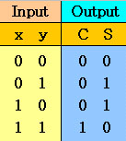

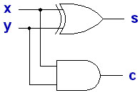
1-5 Combinational Circuits
Design Example : Half Adder
  1. Half adder is a combinational circuits that forms the arithmetic sume of two input bit
  2. 2 Input(x, y), 2 Output(S: sum, C: carry)
  3. Truth Table
  4. Simplification
      C= xy
      S= x’y + xy’
      =x ⊕ y
  5. Logic circuit diagram
  6. Block diagram
_{X}
_{y}
_{H.A}
_{S}
_{C}

Slide 36
Half Adder (반가산기) 문제점
11 3
+ 01 + 1
10 2
1
11 3
+ 01 + 1
100 4
_{Wrong}
_{Correct}

Slide 37
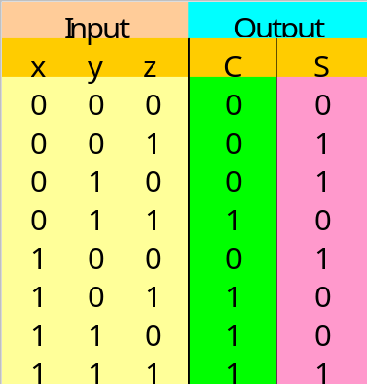
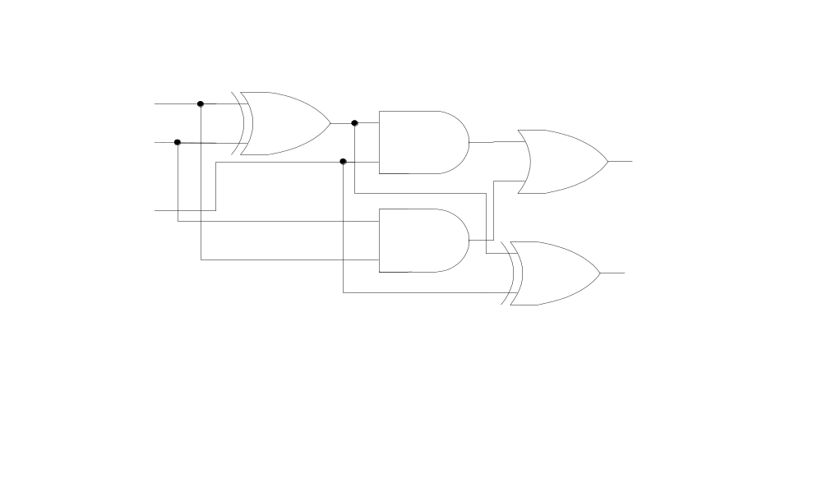
1-5 Combinational Circuits
Design Example : Full Adder
  1. Full adder is a combinational circuits that forms the arithmetic sume of three input bit(Carry considered)
  2. 3 Input(x, y, z), 2 Output(S: sum, C: carry)
  3. Truth Table
  4. Simplification
y
y
x
x
z
z
      C= xy’z + x’yz + xy
      =z(xy’ + x’y) + xy
      =z(x ⊕ y) + xy
      S=xy’z’ + x’y’z + xyz + x’yz’
      = z’(xy’ + x’y) + z(x’y’ + xy)
      = z’(x ⊕ y) + z(x ⊕ y)’
      =a’b + ab’ (let a=z, b=x ⊕ y)
      =x ⊕ y ⊕ z
  5. Logic circuit diagram
x
y
z
c
s
(x ⊕y)’=(xy’+x’y)’
=(x’+y)(x+y’)
=x’x+x’y’+xy+yy’
=x’y’+xy

Slide 38
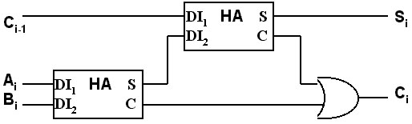
1-5 Combinational Circuits
_{X}
_{Y}
_{Z}
_{F. A}
_{S}
_{C}
_{Fig 1-18. Block diagram}

Slide 39
조합회로 vs. 순차회로
Combinational circuit (조합회로)
  Input 값에 의해서만 Output 결정
  ex) 덧셈기(adder), 우주회(雨酒會)
  Logic gate로 회로 구성
Sequential circuit (순차회로)
  Input 값과 상태(state)에 의해 Output 결정
  Counter
  Logic Gate + FlipFlop으로 회로 구성
1-5: 조합회로
1-6: 플립플롭
1-7: 순차회로

Slide 40
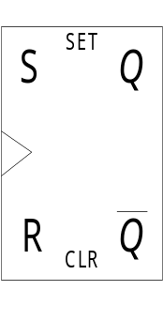
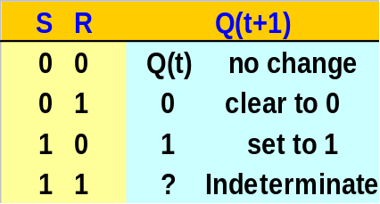
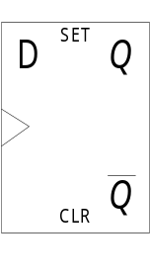
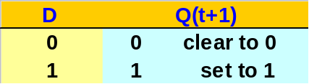
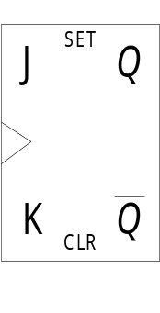
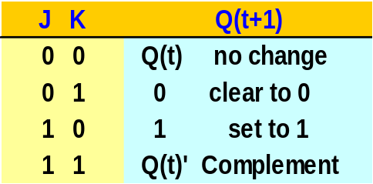
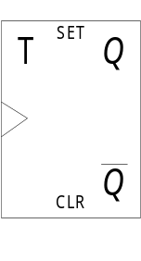
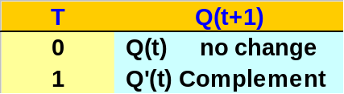
1-6 Flip-Flops
Combinational Circuit = Gate
Sequential Circuit = Gate + F/F
Flip-Flop
  The storage elements employed in clocked sequential circuit
  A binary cell capable of storing one bit of information
SR(Set/Reset) F/F
D(Data) F/F
  “no change” condition이 없다 : Q(t+1)=D
    해결방법 : 1) Disable Clock
    2) Feedback output into input
JK(Jack/King) F/F
  JK F/F is a refinement of the SR F/F
  The indeterminate condition of the SR type is defined in complement
T(Toggle) F/F
  T=1(J=K=1), T=0(J=K=0) 이면 JK F/F
  수식 표현 : Q(t+1)= Q(t) ⊕ T

Slide 41
Clock Speed
1 Hz – 1/sec
1 KHz – 1,000 (천)/sec
1 MHz – 1,000,000 (백만)/sec
1 GHz – 1,000,000,000 (십억)/sec
1 THz – 1,000,000,000,000 (조)/sec
1 PHz – 1,000,000,000,000,000 (천조)/sec
2GHz clock speed: 초당 20억번 clock 생성 -> 1 clock 당 0.5 ns
_{A}
_{B}
_{C}
_{CP}
_{Q}
_{T}
_{Q}
_{T}
_{Q}
_{T}
_{A}
_{B}
_{(a) Consists of T Flip-Flop}
_{C}
_{Count}
₀
₁
₂
₃
₄
₅
₆
₇
₀
₁
₂
_{(b) Timing chart}

Slide 42
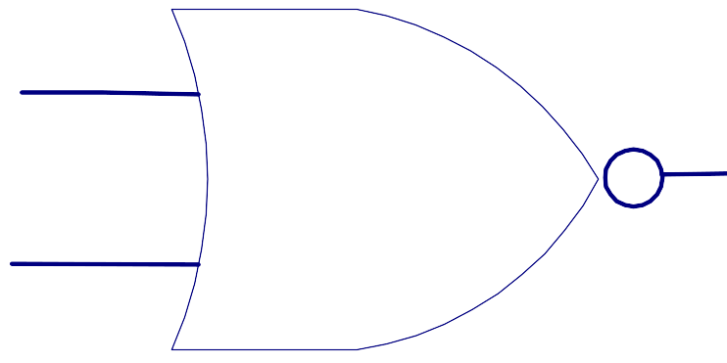
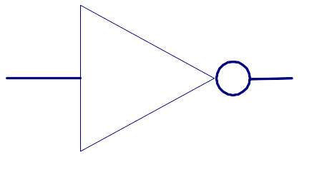
1-6 Flip-Flops
SR(Set/Reset) F/F
D(Data) F/F
_{S}
_{R}
_{Q’}
_{Q}
_{S}
_{CP}
_{R}
_{D}
JK(Jack/King) F/F
T(Toggle) F/F
_{J}
_{CP}
_{K}
_{T}
_{E}

Slide 43
1-6 Flip-Flops
Positive clock transition
Edge-Triggered F/F
  State Change : Clock Pulse
    Rising Edge(positive-edge transition)
    Falling Edge(negative-edge transition)
  Setup time(20ns)
    minimum time that D input must remain at constant value before the transition.
  Hold time(5ns)
    minimum time that D input must not change after the positive transition.
  Propagation delay(max 50ns)
    time between the clock input and the response in Q
    일반 논리 gate에서는 2-20 ns이며 setup 및 hold time은 F/F에서만 정의되며 일반 논리 gate에서는 정의되지 않음.
  Master-Slave F/F
    2개의 F/F을 사용(Slave 와 Master F/F)하며 negative-edge transition 사용
    위와 같이 사용하는 이유: Race 현상을 방지
t_{s} t_{h}

Slide 44
1-6 Flip-Flops
Master – Slave D(Data) F/F
_{D}
_{C}
_{D}
_{C}
_{Master}
_{Slave}
_{D}
_{C}
_{Q}
a. 논리도 b. 파형도

Slide 45




1-6 Flip-Flops
Race 현상
  조건 - Setup time > Propagation delay
  증상 - 0 과 1을 반복하다가 Unstable한 상태가 된다
  해결책 - Edge triggered F/F 또는 Master/Slave F/F 사용
  예제
    7470 : J-K Edge triggered F/F
    7471 : J-K Master/Slave F/F
Excitation Table
  Required input combinations for a given change of state
  Present State 와 Next State로 표현
0
Don’t Care
1 : Set to 1
0 : Complement
1 : Clear to 0
0 : No change

Slide 46

1-7 Sequential Circuits
A sequential circuit is an interconnection of F/F and Gate
Clocked synchronous sequential circuit
Flip-Flop Input Equation
  Boolean expression for F/F input
  Input Equation 예제
    D_{A} = Ax + Bx, D_{B} = A’x
  Output Equation
    y = Ax’ + Bx’
  Fig. 1-25 Example of a sequential
  circuit
Combinational Circuit = Gate
Sequential Circuit = Gate + F/F
Input
Combinational
Circuit
Output
Flip-Flops
Clock
x
D_{A}
A
A’
D_{B}
B
B’
Clock
y

Slide 47




1-7 Sequential Circuits
State Table
  Present state, input, next state, output 표현
Design Example: Binary Counter
State Diagram
  Graphical representation of state table
    Circle(state), Line(transition), I/O(input/output)
Input Equ. = Next State
11
Next State =
Output
10
  x=1: 00, 01, 10, 11,
  00, 01, …..
  x=0: no change
  State Diagram:
  4 state(00, 01, 10, 11)
11
  Excitation Table(2 bit counter = 2 F/F)
10

Slide 48

1-7 Sequential Circuits
  Map for simplification
    Input variable: A, B, x
  Logic Diagram
J_{A}
B
K_{A}
B
1
X X X X
A
X X X X
A
1
J_{A}=Bx
x
K_{A}=Bx
x
J_{B}
B
K_{B}
B
1
1
X X
X X
X X
X X
1
1
A
A
J_{B}=x
x
K_{A}=x
x
Sequential Circuit Design Procedure
  1-5 절 참고(Combinational Circuit Design)
  Sequential Circuit은 절차 3에서 State diagram및 State table 이용
  F/F 수: 2^{m+n} (m - State 수, n - Input 수)
  1. The Problem is stated
  2. I/O variables are assigned
  3. Truth table(I/O relation)
  4. Simplified Boolean Function
  5. Logic circuit diagram

