Slide 1

24-2 OSS
Team Project Proposal
22300603 Lee Harin
22300745 Cha Sangeun

Slide 2



Service Title & Key Features
Searching Music
My
Music
Playlist
Add to My Playlist
Manage My Playlist

Slide 3
CRUD Dataset
Artist Name
Music Name
Album Name
Number of Listeners
Total Times Played
Album Image
Link to Song url
Release Date
Song Description (expandable)
Memo for the song

Slide 4
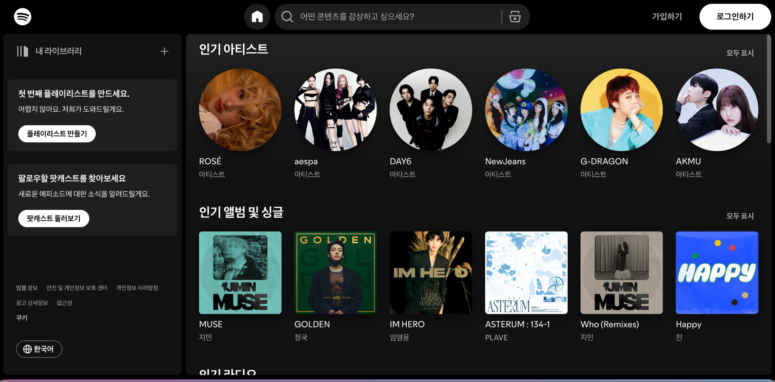
Reference

Slide 5

Open API
Title
Last.fm
Description
Get the metadata for a track on Last.fm
using the artist/track name.
Plan
enter song’s name and artist which you want to search.
send song information to fetch the song’s detail information
store information in mock API to make CRUD program
Now you can look, update, delete these information.

Slide 6
Page Design
Main
There Music search bar and “ADD” button
that can add music to the playlist
myPlaylist
Album photos added to the playlist
myPlaylistInfo
music informations and ‘Edit’ button and ‘Delete’ button

Slide 7
Page Design
adding
The window that moves when the add button is pressed
in the main, Notes about the song (optional)
updating
The window that moves when the edit button is pressed in myPlaylistInfo, can edit memo.

