Slide 1
Finding and Fixing Performance Pathologies in Persistent Memory Software Stacks
Jian Xu*, Juno Kim*, Amirsaman Memaripour, Steven Swanson
UC San Diego
* denotes equal contribution

Slide 2
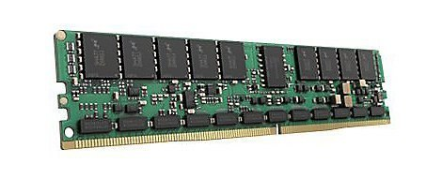
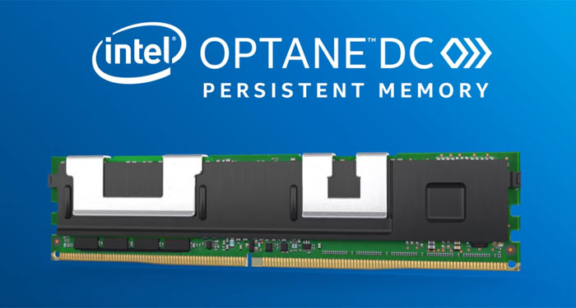
Persistent Memory
Our paper
New tier of memory
Low latency persistence (than SSD,HDD)
Large capacity (than DRAM)
Intel Optane DC Persistent Memory
First scalable persistent memory
Re-evaluated some of our results on this device
Battery-backed NVDIMM
This talk

Slide 3
Where are we now?
Application
SQLite
RocksDB
SAP HANA
Redis
MySQL
Cassandra
LMDB
and more!
PM-aware
file system
Custom file systems
BPFS [SOSP’09]
PMFS [Eurosys’14]
NOVA [FAST’16]
Strata [SOSP’17]
Legacy file systems
XFS-DAX
Ext4-DAX
Persistent memory

Slide 4
Let’s see the whole picture
Let’s fix the old codes
Legacy codes built for disk run slow on PM
Let’s study the new trade-offs
What are the best ways to optimize software systems on PM?
What are the trade-offs? Complexity vs. Performance?
Our goal: fix urgent problems and provide best practices for optimization.

Slide 5
Key questions
Application
Which optimizations offer
the best complexity/performance trade-offs?
PM-aware
file system
Are custom file systems worth it?
What bottlenecks remain?
Persistent memory

Slide 6
Contributions
Application
Which optimizations offer
the best complexity/performance trade-offs?
Analyze a range of optimization techniques
PM-aware
file system
Are custom file systems worth it?
Show why custom file system is valuable
What bottlenecks remain?
Persistent memory
Improve scalability for PM file systems

Slide 7
Candidate techniques for optimizing apps
Little to none
programming cost
Vary
Easy
Hard
Use PM file system
Emulate POSIX IO in userspace
Build PM data structure
App
App
App
File IO emulation
PM data structure
User space
POSIX API
Kernel space
PM-aware file system
DAX
DAX
Persistent Memory

Slide 8
FLEX : FiLe Emulation with DAX
Emulate POSIX IO in userspace with DAX
open + mmap a file
memcpy + clflush/clwb for write
memcpy for read
fallocate + mmap for extending file space
Pros
Bypass file system overhead (e.g. journaling)
Amortize PM allocation cost by preallocation
Cons
Guarantee only 8-byte atomicity
open
mmap
no
space?
fallocate
yes
memcpy
non-temporal store
or
clflush/clwb

Slide 9
FLEX append example
mmap address
write offset
allocated size
Application
open
User
mmap
Kernel
no
space?
fallocate
yes
memory-mapped region
memcpy
allocated PM space
non-temporal store
or
non-persisted data (in cache)
clflush/clwb
persisted data

Slide 10
Applying FLEX to applications
RocksDB, SQLite
Use file to implement Write-Ahead Logging (WAL) for consistency
Most apps do NOT rely on the parts of POSIX that FLEX sacrifices [1]
Atomicity
File descriptor aliasing semantics
Therefore, no logical change is required
RocksDB = 56 LOC, SQLite = 233 LOC
[1] Pillai et al, All File Systems Are Not Created Equal: On the Complexity of Crafting Crash-Consistent Applications, OSDI’14

Slide 11
FLEX achieves substantial speedups
On Optane DC PM
RocksDB random SET
SQLite random SET
2 ~ 6x
2 ~ 4x
3.1x
1.7x
FLEX achieved 2 ~ 6x speedups over POSIX with simple changes.
FLEX reduces the gap between three file systems

Slide 12
Let’s try a harder one
Little to none
programming cost
Vary
Easy
Hard
Use PM file system
Emulate file IO in userspace
Build PM data structure
App
App
App
File IO emulation
PM data structure
User space
POSIX API
Kernel space
PM-aware file system
DAX
DAX
Persistent Memory

Slide 13
PM data structures
Crash-consistent
No additional logging is required
Difficult to build
Complex operations (e.g. B-tree split/merge, hash table resizing)
More challenging for concurrent data structures
Recent progress
LSM-tree: NoveLSM [ATC’18], SLM-DB [FAST’19]
Hash-table: Level hashing [OSDI’18], CCEH [Fast’19]
B-tree: NV-Tree [FAST’15], FP-tree [SIGMOD’16]

Slide 14
Persistent skiplist in RocksDB
On Optane DC PM
Locking-based skiplist
Concurrent skiplist
25% faster
than FLEX
20% slower
than FLEX
Modified lines: 56 380
Modified lines: 56 380

Slide 15
Takeaway
FLEX is a cost effective option for accelerating applications.
Some applications can do this easily.
PM data structures can provide better performance but developers should carefully weigh the trade-offs.

Slide 16
Key questions
Application
Which optimizations offer
the best complexity/performance trade-offs?
Analyze a range of optimization techniques
PM-aware
file system
Are custom file systems worth it?
Show why custom file system is valuable
What bottlenecks remain?
Persistent memory
Improve scalability for PM file systems

Slide 17
Why do we need another new file system?
Legacy file systems already support PM access
XFS, EXT4 file systems are extended for PM → XFS-DAX, Ext4-DAX
Can’t we just improve them?
If we could get good performance out of one of these, we should!
Let’s try optimizing Ext4-DAX!

Slide 18
Fine-grained journaling for Ext4-DAX
Key overhead: block-based legacy journaling device (JBD2)
Write amplification: E.g. 4KB data append → 36KB writes to file/journal
Global journaling area → No concurrency
Our solution: Journaling DAX Device (JDD)
Journals individual metadata fields → No write amplification
Pre-allocates per-CPU journaling area → Good scalability
Undo logging → Simplified commit mechanism (e.g. no checkpointing)

Slide 19
JDD performance
Compare with Ext4-DAX, NOVA
Run four benchmarks
Append 4KB
Filebench varmail
SQLite (the same before)
RocksDB (the same before)
Result
Faster than Ext4-DAX by 2.3x
NOVA is still 1.5x faster.
1.5x gap

Slide 20
Can we fill the gap further?
“Disk first”
Ext4-DAX shares codebase with disk-oriented Ext4
Disruptive changes are not likely to happen
Further optimizations would make Ext4 a less-good disk-based file system.
We do actually need a custom file system for PM!

Slide 21
Key questions
Application
Which optimizations offer
the best complexity/performance trade-offs?
Analyze a range of optimization techniques
PM-aware
file system
Are custom file systems worth it?
Show why custom file system is valuable
What bottlenecks remain?
Persistent memory
Improve scalability for PM file systems

Slide 22
Poor scalability by Virtual File System
Bottleneck: Global inode structure, per-inode locking
Solution: Per-CPU inode structure, fine-grained locking
See our paper for details
[1] Min et al, Understanding Manycore Scalability of File Systems, ATC’16

Slide 23
Better scalability with NUMA-aware file access
Enabled NUMA-aware file access in NOVA
Added simple interface for querying/setting NUMA location per file
Achieved 1.2 – 2.6x better throughput
See our paper for details

Slide 24
Conclusion
FLEX is a cost-effective app optimization technique.
PM data structures can provide better performance but developers should carefully weigh the trade-offs.
Custom file system provides better performance and legacy file systems are unlikely to close the gap.
Memory-centric optimizations (e.g. NUMA) are now applicable (and profitable) for file.
Thank you! Questions?

