Slide 1

Building a Gita-Based Personality Assessment Tool
Applying NLP to Ancient Wisdom

Slide 2
Step 1: Project Objectives
What problem are we solving?
Many people are interested in applying the wisdom of the Bhagavad Gita to their daily lives, but it can be difficult to know which teachings resonate with them personally.
Traditional personality quizzes or recommendation systems do not incorporate philosophical/spiritual texts effectively.

Slide 3
Problem
Solution
How can we analyze a person's free-text responses to understand their personality tendencies and recommend Gita verses that guide them in action, devotion, or knowledge?
Build a personality assessment tool using NLP that classifies users into Karma, Bhakti, or Jnana Yoga tendencies and recommends relevant verses with explanations.

Slide 4
Who is the target user?
Individuals interested in self-development, spirituality, and philosophical guidance.
Students, researchers, or enthusiasts of Bhagavad Gita teachings.
People who want a personalized spiritual reflection tool, rather than reading the text randomly.
Users who enjoy interactive quizzes and want actionable insights from ancient wisdom.

Slide 5
What NLP techniques will be used?
01
02
Sentence embeddings
Cosine similarity
Represent user responses and verse meanings in vector form (semantic space).
Compare user embeddings with verse embeddings to find the most relevant Gita teachings.
Tool: sentence-transformers
03
04
Text preprocessing
Optional: Intent detection
Clean user responses and verse meanings for better embeddings.
Using keywords or embeddings to map free-text answers to Yoga categories.

Slide 6

What will be the output?
Dominant Yoga Type
Radar Chart
Karma, Bhakti, or Jnana.
Visual representation of the user's score in all three yogas.
Recommended Shlokas
Explanation
Top 3–5 Gita verses that align with the user's personality.
Short reasoning for why each verse is recommended.
Optional: Interactive visual or web interface for exploring

Slide 7
Step 2: Requirement Analysis + Tool Selection
Here you list what you need and which tools to use:
Functional Requirements:
Collect free-text answers from users
Analyze responses using NLP embeddings
Map responses to personality categories (Karma, Bhakti, Jnana)
Recommend verses based on semantic similarity
Visualize personality distribution

Slide 8
Tool Selection:
Programming language
NLP & embeddings
Python
sentence-transformers (for semantic similarity)
Data handling
Visualization
pandas
matplotlib (for radar charts), optional plotly for interactive charts
Machine learning utilities
Optional web interface
scikit-learn (cosine similarity)
Streamlit

Slide 9
Step 3: Data Collection
Here you gather the data your system will use:
Bhagavad Gita Dataset
Quiz Questions
Contains chapters, verses (shlokas), English meanings, and yoga type labels.
Free-text questions designed to probe user personality aligned with the three yogas.
Example columns: Chapter, Verse, Shloka, EngMeaning, Yoga_Types.
Stored in a JSON file, each with an id, question, and optional intent.

Slide 10
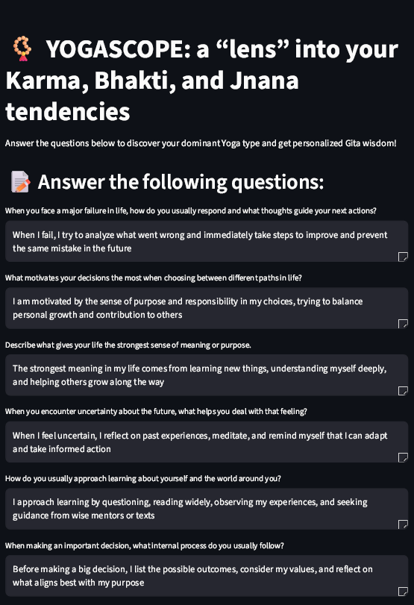
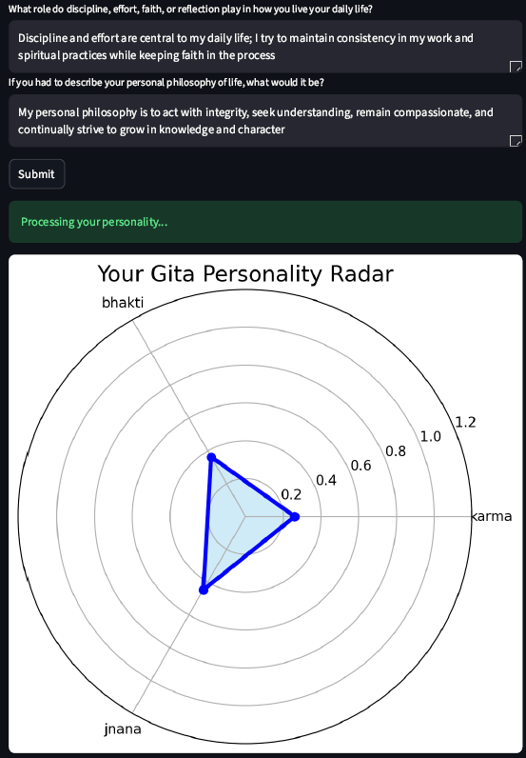
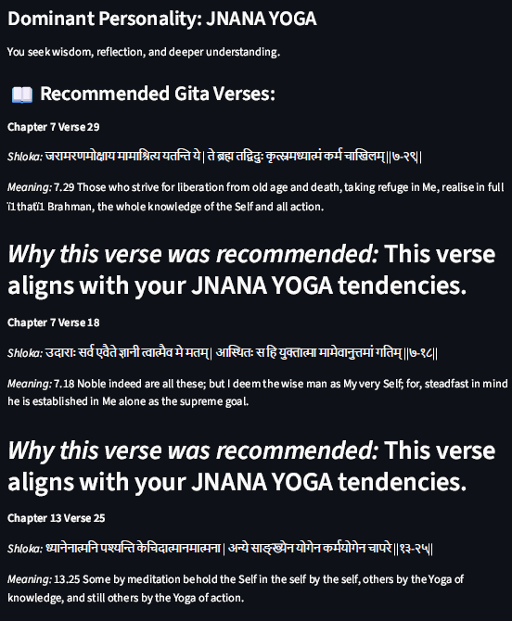
SNAPSHOTS :

Slide 11

Bringing Ancient Wisdom to Modern Technology
This project combines the timeless teachings of the Bhagavad Gita with NLP techniques to create a personalized spiritual guidance tool.

