Slide 1
Wireless Networks : Introduction
Overview of Wireless Networks
Based on material from several texts:
Computer Networking: A Top Down Approach 6th edition Jim Kurose, Keith Ross Addison-Wesley March 2012
Computer Networks, fifth edition
Andrew Tanenbaum
Pearson Education/Prentice Hall
Notes:
Last update: 11/3/2015

Slide 2
Objectives
Fundamental principles behind wireless data communications
Design issues in wireless networks
Modern examples: WiFi, 3G/4G
Future directions
Relationship between applications and wireless networks

Slide 3
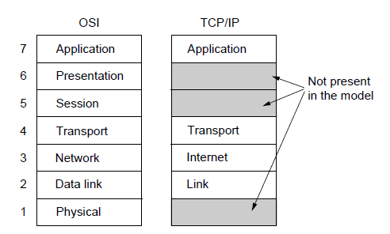
OSI Reference Model (Tanenbaum)
A principled, international standard, seven layer model to connect different systems
– Provides functions needed by users
– Converts different representations
– Manages task dialogs
– Provides end-to-end delivery
– Sends packets over multiple links
– Sends frames of information
– Sends bits as signals

Slide 4
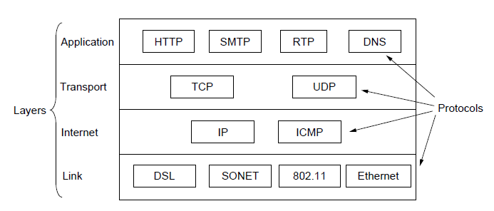
TCP/IP Reference Model
A four layer model derived from experimentation; omits some OSI layers and uses the IP as the network layer.
IP is the “narrow waist” of the Internet
Protocols are shown in their respective layers
Notes:
The comment about the narrow waist refers to the fact that the network layer of the Internet is IP (Internet Protocol) such that the network layer is called the “Internet” layer. The significance is that all Internet devices speak IP, which provides a point of interoperability that enables innovation both above (new applications and transports) and below (new link technologies).

Slide 5
Chapter 6 outline (Kurose Text)
6.1 Introduction
Wireless
6.2 Wireless links, characteristics
CDMA
6.3 IEEE 802.11 wireless LANs (“Wi-Fi”)
6.4 Cellular Internet Access
architecture
standards (e.g., GSM)
Mobility
6.5 Principles: addressing and routing to mobile users
6.6 Mobile IP
6.7 Handling mobility in cellular networks
6.8 Mobility and higher-layer protocols
6.9 Summary

Slide 6



















Elements of a wireless network
network
infrastructure

Slide 7



Elements of a wireless network
wireless hosts
laptop, smartphone
run applications
may be stationary (non-mobile) or mobile
wireless does not always mean mobility
network
infrastructure

Slide 8

Elements of a wireless network
base station
typically connected to wired network
relay - responsible for sending packets between wired network and wireless host(s) in its “area”
network
infrastructure

Slide 9
Elements of a wireless network
wireless link
typically used to connect mobile(s) to base station
also used as backbone link
multiple access protocol coordinates link access
various data rates, transmission distance
network
infrastructure

Slide 10
Elements of a wireless network
Acronym Roadmap
WiFi: (wireless lans): IEEE 802.11*
DSRC (dedicated short range communications), uses extensions to 802.11a (called 802.11p)
Zigbee (sensor networks): IEEE 802.15
Cellular: 3G, 4G, and yes…5G.
3G: many standards throughout the world but it generally refers to ‘Third Generation’ cellular systems that supports voice and data (i.e., smartphones with data rates of up to several hundred kbps)
4G: distinguished from 3G by higher data rates (multiple Mbps). Two terms to note:
WiMAX: Worldwide Interoperability for Microwave Access (standardarize by IEEE 802.16*) repesents the original direction for high speed wireless data
LTE: Long Term Evolution is the 4G technology that was adopted by the cellular industry.
network
infrastructure

Slide 11
Characteristics of selected wireless links
200
802.11n
54
802.11a,g
802.11a,g point-to-point
5-11
802.11b
4G: LTWE WIMAX
4
3G: UMTS/WCDMA-HSPDA, CDMA2000-1xEVDO
Data rate (Mbps)
1
802.15
.384
2.5G: UMTS/WCDMA, CDMA2000
.056
2G: IS-95, CDMA, GSM
Indoor
10-30m
Outdoor
50-200m
Mid-range
outdoor
200m – 4 Km
Long-range
outdoor
5Km – 20 Km

Slide 12
Elements of a wireless network
infrastructure mode
base station connects mobiles into wired network
handoff: mobile changes base station providing connection into wired network
network
infrastructure

Slide 13
Elements of a wireless network
ad hoc mode
no base stations
nodes can only transmit to other nodes within link coverage
nodes organize themselves into a network: route among themselves

Slide 14
Wireless network taxonomy
single hop
multiple hops
host connects to
base station (WiFi,
WiMAX, cellular)
which connects to
larger Internet
host may have to
relay through several
wireless nodes to
connect to larger
Internet: mesh net
infrastructure
(e.g., APs)
no base station, no
connection to larger
Internet. May have to
relay to reach other
a given wireless node
MANET, VANET
no
infrastructure
no base station, no
connection to larger
Internet (Bluetooth,
ad hoc nets)

Slide 15
Chapter 6 outline
6.1 Introduction
Wireless
6.2 Wireless links, characteristics
CDMA
6.3 IEEE 802.11 wireless LANs (“Wi-Fi”)
6.4 Cellular Internet Access
architecture
standards (e.g., GSM)
Mobility
6.5 Principles: addressing and routing to mobile users
6.6 Mobile IP
6.7 Handling mobility in cellular networks
6.8 Mobility and higher-layer protocols
6.9 Summary

Slide 16
Wireless Link Characteristics (1)
important differences from wired link ….
decreased signal strength: radio signal attenuates as it propagates through matter (path loss)
interference from other sources: standardized wireless network frequencies (e.g., 2.4 GHz) shared by other devices (e.g., phone); devices (motors) interfere as well
multipath propagation: radio signal reflects off objects ground, arriving ad destination at slightly different times
…. make communication across (even a point to point) wireless link much more “difficult”

Slide 17
Wireless Link Characteristics (2)
SNR: signal-to-noise ratio
larger SNR – easier to extract signal from noise (a “good thing”)
SNR versus BER tradeoffs
given physical layer: increase power -> increase SNR->decrease BER
given SNR: choose physical layer that meets BER requirement, giving highest thruput
SNR may change with mobility: dynamically adapt physical layer (modulation technique, rate)
10⁻¹
10⁻²
10⁻³
BER
10⁻⁴
10⁻⁵
10⁻⁶
10⁻⁷
10
20
30
40
SNR(dB)
QAM256 (8 Mbps)
QAM16 (4 Mbps)
BPSK (1 Mbps)

Slide 18

Wireless network characteristics
Multiple wireless senders and receivers create additional problems (beyond multiple access):
A
B
C
C
A’s signal
strength
C’s signal
strength
B
A
Hidden terminal problem
B, A hear each other
B, C hear each other
A, C can not hear each other means A, C unaware of their interference at B
space
Signal attenuation:
B, A hear each other
B, C hear each other
A, C can not hear each other interfering at B

Slide 19
Objectives
Fundamental principles behind wireless data communications
Design issues in wireless networks
Modern examples: WiFi, 3G/4G
Future directions
Relationship between applications and wireless networks

Slide 20
Maximum Data Rate of a Channel
Information (data) can be transmitted (sent) over a physical medium by representing data using voltage levels or by encoding the data in the frequency domain.
Physics defines how this works….
We abstract this complexity to:
A channel represents the physical medium.
Channel bandwidth (sometimes referred to as the capacity) refers to the portion of the medium used by the channel. We define this in units of Hertz (Hz).
Bandwidth represents how frequently a sine wave can oscillate in the channel.
Notes:
These are fundamental limits; real systems can only approach them.
S/N is called the signal to noise ratio SNR, and it is commonly measured in decibels on a logarithmic scale e.g., 10dB means the signal is 10X noise, 20dB means 100X noise, etc.

Slide 21
Maximum Data Rate of a Channel
Nyquist’s theorem relates the data rate to the bandwidth (B) and number of signal levels (V):
Example: A coaxial medium (i.e., a cable network) has a total capacity of about 2 GHz.
This is divided into small 6 MHz channels (Concept: frequency division multiplexing)
Different modulations are supported that offer up to 256 signal levels
Max data rate when assuming 64 signal levels: 2*6MHz*6 = 36 Mbps
Max. data rate = 2B log₂V bits/sec
Notes:
These are fundamental limits; real systems can only approach them.
S/N is called the signal to noise ratio SNR, and it is commonly measured in decibels on a logarithmic scale e.g., 10dB means the signal is 10X noise, 20dB means 100X noise, etc.

Slide 22
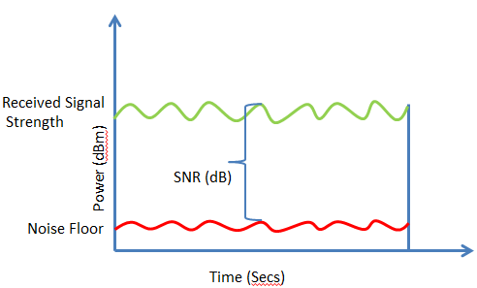
Maximum Data Rate of a Channel
Shannon's theorem relates the data rate to the bandwidth (B) and signal strength (S) relative to the noise (N):
Max. data rate = B log₂(1 + S/N) bits/sec
SNR: Represents the difference in decibels (10*log10S/N) between the received signal and the noise floor.
If the radio receives a signal of -75dBm and the measured noise floor is -90dBm, the SNR is 15dB.
Notes:
These are fundamental limits; real systems can only approach them.
S/N is called the signal to noise ratio SNR, and it is commonly measured in decibels on a logarithmic scale e.g., 10dB means the signal is 10X noise, 20dB means 100X noise, etc.

Slide 23
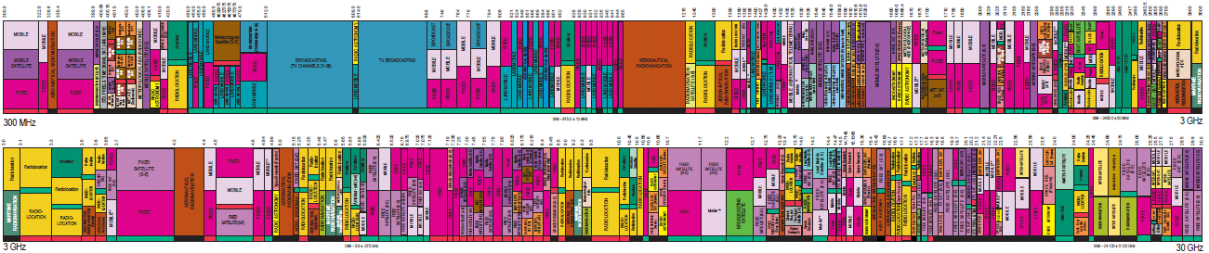
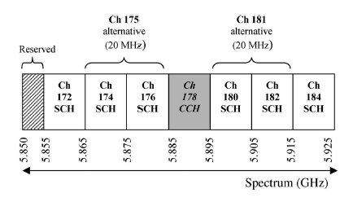
Electromagnetic Spectrum (2)
To manage interference, spectrum is carefully divided, and its use regulated and licensed, e.g., sold at auction.
300 MHz
3 GHz
WiFi (ISM bands)
3 GHz
Source: NTIA Office of Spectrum Management, 2003
30 GHz
Part of the US frequency allocations
Notes:
TV, cellular, satellite frequencies are heavily regulated.

Slide 24
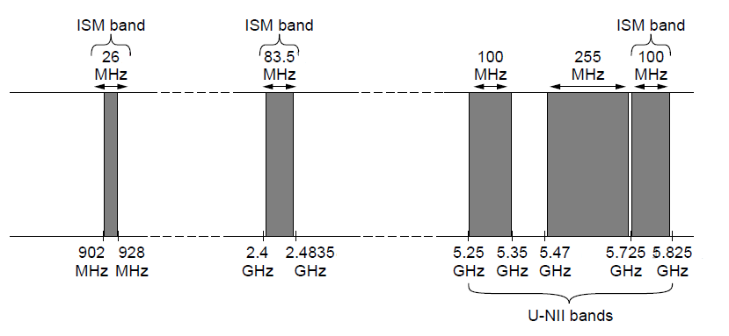
Electromagnetic Spectrum (3)
Fortunately, there are also unlicensed (“ISM”) bands:
Free for use at low power; devices manage interference
Widely used for networking; WiFi, Bluetooth, Zigbee, etc.
802.11
b/g/n
802.11a/g/n
Notes:
These bands are used for WiFi, etc., not for cellular.

Slide 25
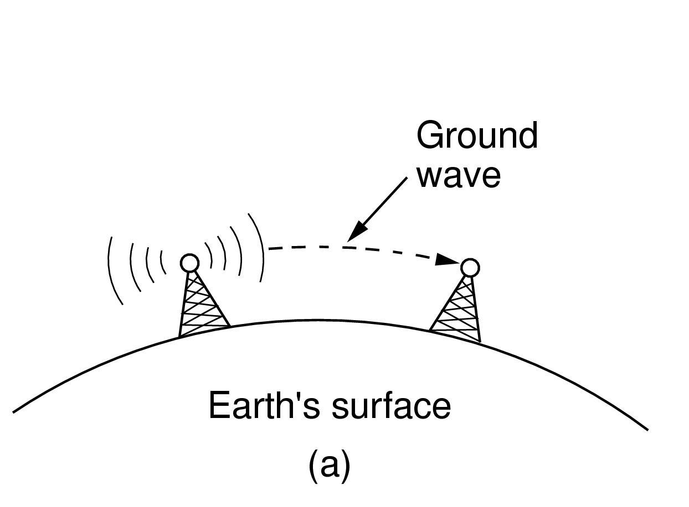
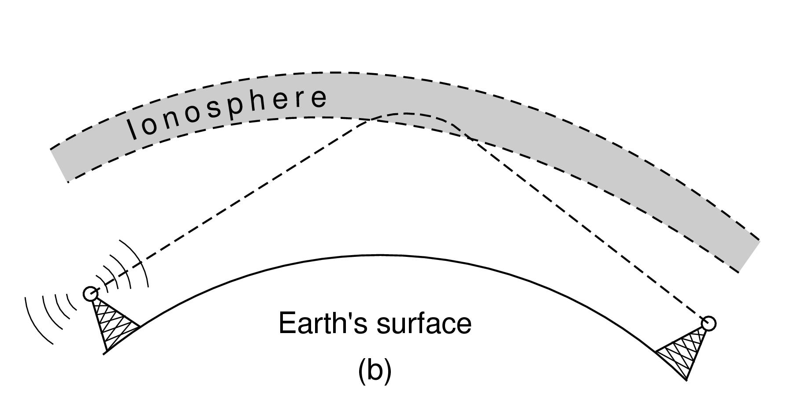
Radio Transmission
Radio signals penetrate buildings well and propagate for long distances with path loss
In the VLF, LF, and MF bands, radio waves follow the curvature of the earth
In the HF band, radio waves bounce off the ionosphere.
Notes:
The path loss makes the signal fall of at least as fast as 1/d^2 due to the RF energy being spread out over a greater region.

Slide 26
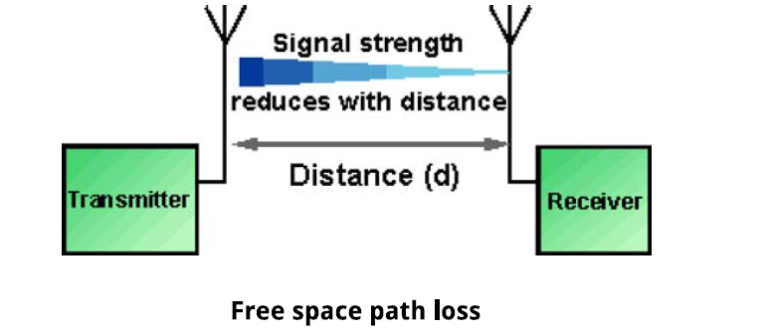
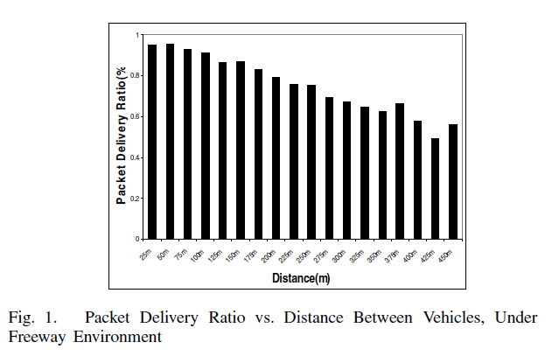
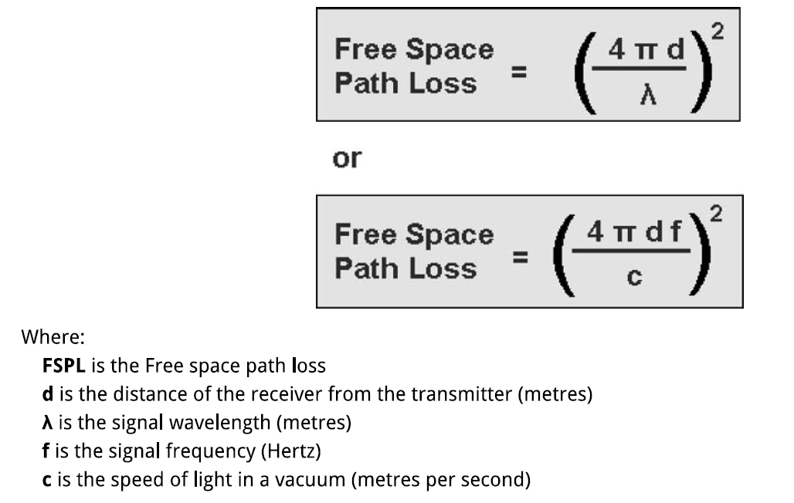
Distance and packet loss rate

