Slide 1
Azure Database for MySQL and MariaDB
Enterprise pitch deck
Notes:
Azure Database Services for MySQL and Azure Database Services for MariaDB are unique in the public cloud managed OSS database market in that a 99.99% SLA is provided on all pricing tiers, at no additional cost to the customer. This is achieved through the unique architecture of the Azure Database Services platform that enables bringing-up a new database server in the event a server fails, in seconds rather that minutes. In AWS RDS, for example, a 99.95% SLA is only offered if customers deploy their database server in a Multi-AZ configuration – which doubles the cost to the customer.
This unique architecture additionally provides the ability to scale the performance of your database server in seconds, with little/no downtime to your application. This means that you do not have to over-provision a database server to handle peak loads, but rather scale-up as necessary and then scaling back down after a peak event, enabling you to save cost.

Slide 2
Organizations are committed to open source
> 40%
>40% of CIOs have open source as primary software strategy
They invest in open source for:
Community-driven quality
Flexibility and adaptability
Modern development practices
Large developer network
Strategic long-term investment
No vendor lock-in
> 60%
>60% of developers want to see cloud providers involved in OSS
90%
90% of enterprises deploy open source in some form
Forrester 2017, Microsoft CMR, Altoros 2016-2017 trends in Open Source

Slide 3
MySQL and MariaDB have big followings
54%
9 of the 10
3x
of devs build on MySQL, the most popular OS database
top websites worldwide are powered by MySQL
popularity growth of MariaDB in the last three years
https://insights.stackoverflow.com/survey/2019?utm_source=so-owned&utm_medium=blog&utm_campaign=dev-survey-2019&utm_content=launch-blog
http://www.oracle.com/us/products/mysql/mysql-wp-top10-webbased-apps-461054.pdf
https://db-engines.com/en/blog_post/77
Notes:
MariaDB is utilized by Google, WordPress.com, Wikipedia
MariaDB has nearly tripled its popularity over the last 3 years. - https://db-engines.com/en/blog_post/77
•Developers love OSS because they care about innovation and being in control of their work.
Innovation and control are critical compononets of how Microsoft supports in this space
•AWS and GCP focus on the value of their consoles whereas Azure focuses on improving the value of OSS communities.
•A developer is focused on one particular DB and will not be comparing across OSS Azure services. (def between post and My/Maria)
Language across OSS on Azure pages does not have to be perfectly parallel.
•MySQL is still thriving and popular, however die-hard community devs jumped ship to MariaDB.
MySQL to Azure developers prioritize popular use cases such as WordPress and Drupal, whereas MariaDB devs prioritize community and enhanced functionality (JSN).

Slide 4




Key reasons behind the popularity
OLTP
Community support and a rich ecosystem of tools
Lower TCO from fewer licensing fees
Low resource consumption through ongoing advancements
Optimized for OLTP websites
A key part of the LAMP stack
Notes:
MariaDB is utilized by Google, WordPress.com, Wikipedia
MariaDB has nearly tripled its popularity over the last 3 years. - https://db-engines.com/en/blog_post/77
•Developers love OSS because they care about innovation and being in control of their work.
Innovation and control are critical compononets of how Microsoft supports in this space
•AWS and GCP focus on the value of their consoles whereas Azure focuses on improving the value of OSS communities.
•A developer is focused on one particular DB and will not be comparing across OSS Azure services. (def between post and My/Maria)
Language across OSS on Azure pages does not have to be perfectly parallel.
•MySQL is still thriving and popular, however die-hard community devs jumped ship to MariaDB.
MySQL to Azure developers prioritize popular use cases such as WordPress and Drupal, whereas MariaDB devs prioritize community and enhanced functionality (JSN).

Slide 5
Azure takes the admin out of MySQL and MariaDB
Intelligent Features |  |  | Intelligent security and performance features
Managed by Microsoft |  | Virtualization Hardware Datacenter management | High availability /DR/Backups Database provision/ Patch/Scaling O/S provision /patching Virtualization Hardware Datacenter management
Managed by customer | Applications Data High availability /DR/Backups Database provision/ Patch/Scaling O/S provision/patching Virtualization Hardware Datacenter management | Applications Data High availability /DR/Backups Database provision/ Patch/Scaling O/S provision | Applications Data
 | On-premises MySQL | IaaS Azure VMs with MySQL | PaaS Azure Database for MySQL
Azure Databases for MySQL and MariaDB are fully managed, enterprise-ready community databases-as-a-service to help you focus on your app, not your database
Protect data with greater manageability and security
Speed queries and insights with better performance and intelligence
Deploy apps globally in minutes
Save time with built-in tools and resources

Slide 6
Top use cases for Azure Databases for MySQL and MariaDB
Web apps using popular CMS
Build enterprise web apps using packaged apps such as Alfresco
Build Linux web apps quickly with Azure Database for MySQL and Azure App Service using WordPress and Drupal
Ecommerce platforms
Develop ecommerce applications including popular packaged such as Magento, Shopify
Transactional apps
Ensure streamlined and secure digital payments
Cloud-native apps
Build new custom apps in the cloud with Azure Kubernetes Service and Azure App Service
Notes:
Intelligent apps
Develop sophisticated, transformational apps using state-of-the-art machine-learning algorithms and integrated visualization tools for analytics and actionable insights.
Retail and e-commerce
Build highly secure and scalable e-commerce solutions that meet the demands of both consumer and business customers. Engage customers through targeted products and offers, process transactions quickly, and optimize fulfillment and customer service.
Scalable web and mobile applications
Rapidly build engaging, scalable cross-platform and native apps for iOS, Android, Windows, or Mac.
Digital marketing
Engage with customers around the world with rich, personalized digital marketing experiences. Quickly build and launch digital campaigns that automatically scale based on traffic and customer demand.
Financial management apps
Securely store critical data and provide high-value analytics and insights over aggregated data to users, using built-in security and high availability.
Gaming
Scale your databases elastically to accommodate unpredictable bursts of traffic and deliver low-latency multi-player experiences.

Slide 7
Build leading enterprise apps using Alfresco
Web apps using popular CMS
Alfresco deployment with cross-region read replicas
Accelerate time to market by leaving database management to Azure Database for MySQL
Integrate effortlessly with popular enterprise content management systems like Alfresco
Choose from many languages like PHP, Java, Node.js, and more
NAT gateway
Virtual private cloud
Region 1
Region 2 read replica
Azure Blob Storage
Alfresco servers
Alfresco content services
Auto scaling group
Alfresco servers
Alfresco search services
Auto scaling group
Index servers
Index servers
Notes:
Remove the AWS Availability zones and update it for different regions for Cross region read replica (real use case of Tenthline)
NAT gateway remains
Amazon S3 changes to block blob
RDS instance to Azure DB for MySQL\
remove private IP subnet

Slide 8
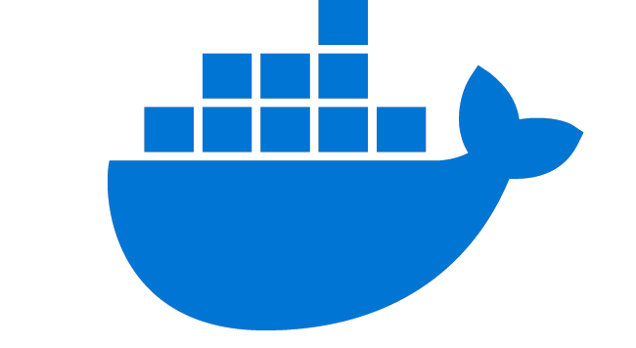

Build web apps with WordPress and Drupal
Web apps using popular CMS
Accelerate time to market by leaving database management to Azure Database for MySQL
Run an Azure Database for MySQL server side-by-side Azure App Service to simplify development
Integrate effortlessly with popular content management systems like WordPress, Drupal, and Joomla
Choose from many languages like PHP, Java, Node.js, and more
Scalable open source architecture using Azure App Service environment
Azure Database for MySQL
v
Content Delivery Network
Azure App Service
Redis Cache
Monitoring/ Logging
Users
Docker Hub
Azure Database for MySQL provides a fully managed service to store vast content as part of the Nobel Prize’s WordPress site
Notes:
https://customers.microsoft.com/en-us/story/nobel-media-media-telecommunications-linux-on-ase

Slide 9
Build ecommerce apps that delight customers
Ecommerce platforms
Provide a fast go-to-market experience for customers integrated with pre-existing app such as Magento
Ensure fault tolerant performance with built-in high availability while paying less
Complete transactions in 500 milliseconds with 20K IOPS and 16 TB of storage on Azure Database for MySQL
Leverage read-replicas to scale out read-only workloads for analytical platforms
Magento cloud architecture on Azure
AKS Kubernetes Cluster
NGINX 1.15.5 Ingress
Cache service (2 pod instances)
Varnish Pod
Varnish Pod
Redis-cache service
(1 pod instance)
Web (Magento) service
WEB Pod
Redis Cache (1)
App (Magento) service
Redis-session service
(1 pod instance)
APP Pod
Redis Cache (1)
Notes:
Complete transactions in 500 milliseconds with 20K IOPS and 16 TB of storage on Azure Database for MySQL

Slide 10


Ensure streamlined and secure digital payments
Payment and banking apps
Use MySQL in microservices architectures to store transactions and build a secure payment platform
Run ETL jobs every 15 minutes with read replicas for analytics
Enable high performance experiences for customers
Provide high uptime for transactions 24 hours a day with high levels of isolation with built-in high availability
Scale the compute and database layers based on service needs to manage costs
Digital payment platform architecture
Application platform
Analytical platform
Click stream
EventHub
Social timeline
To app
Azure APM
AKS
Cosmos DB
Azure Databricks
Azure MySQL
AKS
APP DBs
Azure MySQL
Events
Tableau
EventHub
Azure Storage
Insights generation
HSBC PayMe for Business app leverages Azure Database for MySQL for fast, secure, and simple payment transactions
Notes:
https://www.youtube.com/watch?v=KEYqG0IcUy8

Slide 11


Build custom apps in the cloud with Azure Kubernetes Service
Cloud-native apps
Assess and enhance microservice performance with built-in query insights and recommendations
Quickly provision databases with microservices architectures and flexibly scale compute and storage independently without extra configuration
Easily integrate with Azure Kubernetes Service and other managed services to improve deployment and monitoring
Microservice architecture with Azure Database for MySQL and Azure Kubernetes Service
Azure Database for MySQL
Azure API Management
Azure Traffic Manager
Azure Kubernetes Service
Docker
Users
Azure Application Gateway
Azure Blob Storage
Danish IT company KMD can scale API services multiple times a day with Azure Database for MySQL and Azure Kubernetes Service

Slide 12
Modernize and migrate to Azure

Slide 13

Simplify migration and reduce administration with Azure
Free your team from database management by migrating on-premises and IaaS open source apps to Azure Database for MySQL or MariaDB
Choose the migration approach that best fits the needs of your workloads
Reduce downtime on large or critical databases with Azure Database Migration Service*
Use dump and restore or import/export for smaller databases that allow for downtime
Options for migrating to Azure Database Services
Discover and assess
DMS Continuous Sync
Azure Database Migration Service
Test
Connect to Azure with your favorite tool
Import/Export
Remediate apps
Dump and store
Optimize
Migrate schema and data
GeekWire removed the pain of patching, scale, and back up by migrating its WordPress site to Azure Database for MySQL
*Azure Database Migration Service is only available on Azure Database for MySQL
Notes:
https://customers.microsoft.com/en-us/story/geekwire

Slide 14
Resources for migration
Microsoft Azure
Database Migration Guide http://aka.ms/datamigration
Azure Database Migration Service http://aka.ms/get-dms
Sign up for Preview http://aka.ms/dms-preview
Azure Database Migration Service
On-premises workloads
Notes:
Migration guide
Provides prescriptive guidance on how to do migrations. Customers have access to case studies of migrations that other customers already did. Customers will also find a list of partners that they can contact to get assistance to do migrations.
DMS
As organizations look to optimize their IT infrastructure to have more time and resources to focus on business transformation, Microsoft is committed to accelerating these initiatives. The new Azure Database Migration Service (DMS) is a fully managed, first party Azure service that enables seamless and frictionless migrations from heterogeneous database sources to Azure Database platforms with minimal downtime. This service will streamline the tasks required to move existing competitive and SQL Server databases to Azure.
Seamlessly migrate on-premise databases at scale
Experience near zero downtime for mission critical applications
Trust in a robust, resilient service for every migration scenario
Migrate multiple database sources to Azure
*Using DMS to migrate MySQL to Azure Database for MySQL will be at private preview during Azure Database for MySQL GA.
Migrate with minimum migrations
Uploading a large amount of data to the cloud takes some time. Customers cannot always tolerate to stop the application while the database is being migrated. Both DMS and Attunity Replicate For Microsoft Migrations allow customers to migrate with minimum application downtime. The way it works is: while the migration is happening, the data - that users change when using the application- is replicated to the target. The mount of application downtime that customers take is reduced to the time it takes them to points the application to the target (change the connection string, change the definition of the DMS alias…).

Slide 15
Build leading apps on Azure Databases for MySQL and MariaDB
Fully managed community database
Take advantage of a fully managed service with support for latest versions
Built-in high availability for lowest TCO
Ensure your data is always available without the need for additional configuration or cost
Intelligent performance and scale
Improve performance with built-in intelligence and up to 16TB storage and 20K IOPs
Industry-leading security and compliance
Protect your data with enhanced security features including Advanced Threat Protection
Integration with the Azure ecosystem
Build apps faster with Azure services and safeguard your innovation with Azure IP Advantage

Slide 16
Use your community database as a fully managed service
MySQL community versions 5.6 and 5.7
MariaDB community version 10.2 and 10.3
Infrastructure and database management, including feature updates, handled by Azure
Familiar tools and frameworks including WordPress, Drupal and Magento
Support for popular languages and drivers, such as PHP, Java and .NET
Guaranteed SLA of 99.99% connectivity

Slide 17
Lowest TCO with built-in high availability
High availability price comparison of Azure Database for MySQL and AWS RDS MySQL
Take advantage of the global reach and enterprise-ready features of Azure to maintain business continuity at 50% cost savings compared to AWS RDS
Get high availability backed with 99.99% SLA guarantees without the need to create a replica, compared to AWS’ 99.95% HA with multi-availability zones
Optimize your infrastructure cost by right-sizing your instances based on workload demands
Reduce development and DBA costs associated with performance troubleshooting and alerting
50% savings vs. AWS
50% savings vs. AWS

Slide 18
Scale elastically and retain performance
Improve performance with built-in high availability and intelligence
Ensure increased performance with 16TB storage and 20K IOPs
Bring your data closer to your customer with more global cloud regions than any other provider
Elastically scale infrastructure when greater capacity is needed

Slide 19
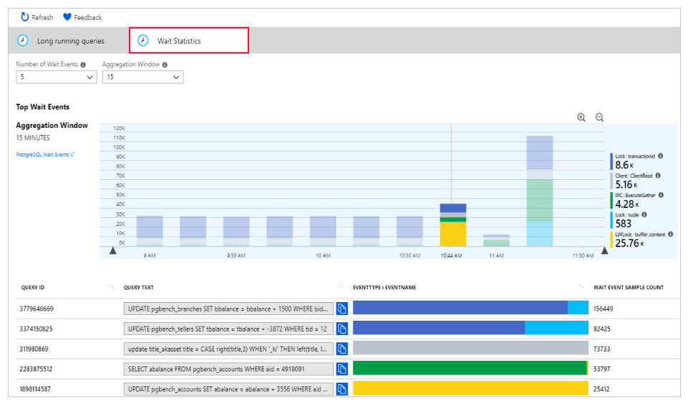
Optimize database performance with built-in intelligence
Uncovering long query times with Query Store
Query times
Query Store simplifies performance troubleshooting by helping you find the longest running and most resource-intensive queries
Query Performance Insights visualizes information to help you identify how your longest running queries change over time
Performance Recommendations analyzes your database to create customized suggestions for improved performance
Time
Wait Statistics in Query Performance Insights

Slide 20



Build safely on a cloud that offers advanced security and compliance
SOC 2
Type 2
Built-in security features like SSL, server firewall rules, VNET, and AAD integration
Data encrypted in motion and at rest
Advanced Threat Protection for automatic alerts on suspicious activities
The most comprehensive set of compliance offerings, including SOC, ISO, and HIPAA
Notes:
SOC2 - Service Organization Controls standards for operational security
ISO 27001 - Information Security Management Standards
ISO 27018 - Code of Practice for Protecting Personal Data in the Cloud
CSA STAR - Cloud Security Alliance: Security, Trust & Assurance Registry (STAR)
PCI DSS Level 1 - Payment Card Industry (PCI) Data Security Standard (DSS) Level 1 Service Provider
HIPAA / HITECH Act - Health Insurance Portability and Accountability Act / Health Information Technology for Economic and Clinical Health Act
ISO 27017:2015 - Code of Practice for Information Security Controls
ISO 9001:2015 Quality Management Systems Standards
ISO 22301:2012 Business Continuity Management Standard
ISO/IEC 20000-1:2011 Information Technology Service Management

Slide 21
Simplify app development through integration with the Azure ecosystem
Seamless integration with Azure services to extend functionality
Popular frameworks like WordPress and Drupal available in clicks with Azure App Services
Streamlined microservice management with Azure Kubernetes Service
Access to industry-leading capabilities like AI and analytics for smarter apps

Slide 22
Safeguard your innovation with Azure IP Advantage
Patent #00143518
Patent #00143581
Patent #00143562
Best-in-industry uncapped defense and indemnification coverage
Patent lawsuit protection through access to a portfolio of 10,000 patents that can be used to help counter assert against an aggressor
Patent #00143545
Patent #00143578

Slide 23
Call to action
Assess which workloads will benefit from Azure Database for MySQL and MariaDB
Connect with your Microsoft representative to learn more

Slide 24
Azure does more for MySQL and MariaDB
Fully managed community database
Built-in high availability for lowest TCO
Intelligent performance and scale
Industry-leading security and compliance
Integration with the Azure ecosystem

Slide 25
Documentation and resources
InfoPedia landing page: http://aka.ms/ossdb
MySQL Hands on Lab: http://aka.ms/mysqlhol
MySQL homepage: http://aka.ms/mysql MariaDB homepage: http://aka.ms/mariadb
MySQL documentation: http://aka.ms/mysqldocs MariaDB documentation: https://aka.ms/mariadbdocs
Ask Questions: AskAzureDBforMySQL@service.microsoft.com AskAzureDBforMariaDB@service.microsoft.com
MySQL Videos: https://aka.ms/mysql-azure-videos MariaDB Videos: https://aka.ms/mariadb-azure-videos

Slide 26






Deliver online educational programs with Moodle
Learning management platforms
Empower educators to disseminate work efficiently by deployed Moodle on Azure with Azure Database for MySQL
Employ native MySQL tools, as Azure Database for MySQL is based on community version
Enable concurrent user access with Azure Database for MySQL
Use MySQL to store student scores, grades, and other student information
Save administrators time and resources with automated patching and backups
Moodle deployment architecture on Azure
Azure
VNet
User
IP
LB
Autoscaling VMSS web frontend
Gluster FS
Azure Database for MySQL
Admin (SSH)
IP
Controller VM
(w/ opt. NFS vol.)
Elastic VMS

