Slide 1
PD3オントロジー

Slide 2
Literal
pd3:id
Literal
Literal
rdfs:comment
pd3:Object
Literal
pd3:layer
pd3:arcType
Literal
pd3:geoSourcePointX
Literal
pd3:value
Literal
rdfs:subClassOf
rdfs:subClassOf
pd3:geoSourcePointY
Literal
pd3:geoTargetPointX
Literal
pd3:target
pd3:geoTargetPointY
Literal
pd3:geoBoundingWidth
pd3:input
Literal
pd3:geoBoundingHeight
pd3:Node
pd3:Arc
pd3:exitX
Literal
pd3:geoBoundingX
pd3:output
pd3:exitY
Literal
Literal
pd3:geoBoundingY
pd3:source
pd3:entryX
Literal
rdfs:subClassOf
pd3:entryY
Literal
rdfs:subClassOf
rdfs:subClassOf
rdfs:subClassOf
rdfs:subClassOf
Literal
pd3:expansion
pd3:contraction
pd3: Container
pd3: Action
pd3: Flow
pd3: SupFlow
pd3: ContainerFlow
pd3:member
pd3:attribution
pd3:containerType
pd3:actionType
Literal
Literal

Slide 3
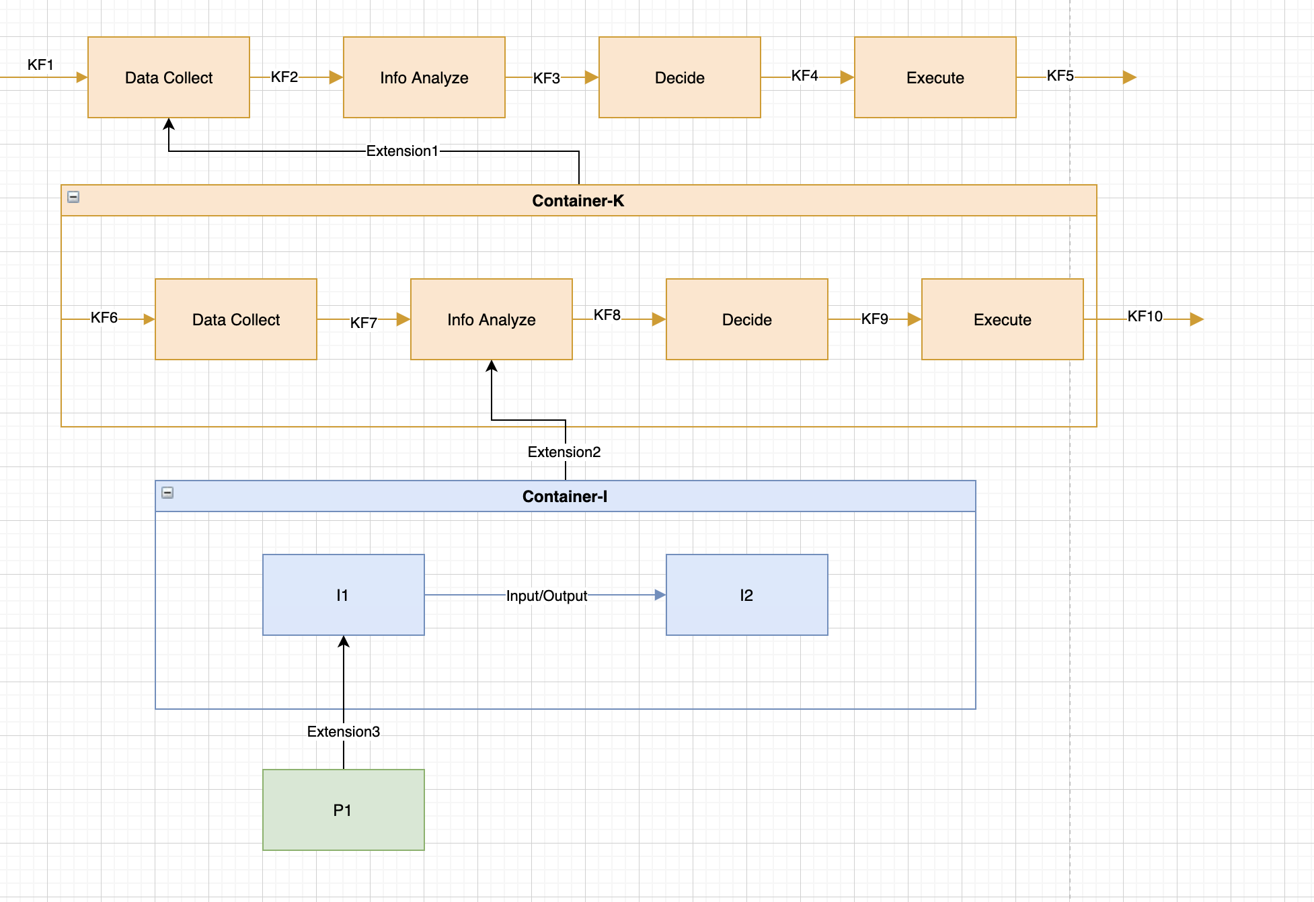
Literal
pd3:id
pd3:Object
rdfs:comment
Literal
pd3:layer
Literal
pd3:value
Literal
rdfs:subClassOf
rdfs:subClassOf
Literal
pd3:geoBoundingWidth
pd3:geoSourcePointX
Literal
Literal
pd3:geoBoundingHeight
pd3:GenericAction
pd3:GenericFlow
pd3:geoSourcePointY
Literal
Literal
pd3:geoBoundingX
pd3:geoTargetPointX
Literal
Literal
pd3:geoBoundingY
pd3:geoTargetPointY
Literal
rdfs:subClassOf
rdfs:subClassOf
rdfs:subClassOf
Literal
pd3:expansion
pd3:targetType
pd3:input
pd3:Container
pd3:contraction
pd3:Action
pd3:target
pd3:Flow
pd3:member
pd3:output
pd3:attribution
pd3:source
pd3:sourceType
pd3:containerType
pd3:actionType
Literal
Literal
Literal

