Slide 1

Functional-Structural Plant Modelling
with GroIMP and XL
Tutorial and Workshop at Agrocampus Ouest, Angers,
5-7 May, 2015
Winfried Kurth
University of Göttingen,
Department Ecoinformatics, Biometrics and Forest Growth
Introduction to rule-based programming, L-systems and the language XL

Slide 2
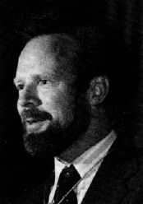
Paradigms of programming
Robert Floyd 1978:
Turing Award Lecture
"The Paradigms
of Programming"
Robert W. Floyd (1936-2001)

Slide 3
Paradigms of programming
„Paradigm“: a basic model, a way of thinking, or a philosophical approach towards reality, often expressed by examples...

Slide 4
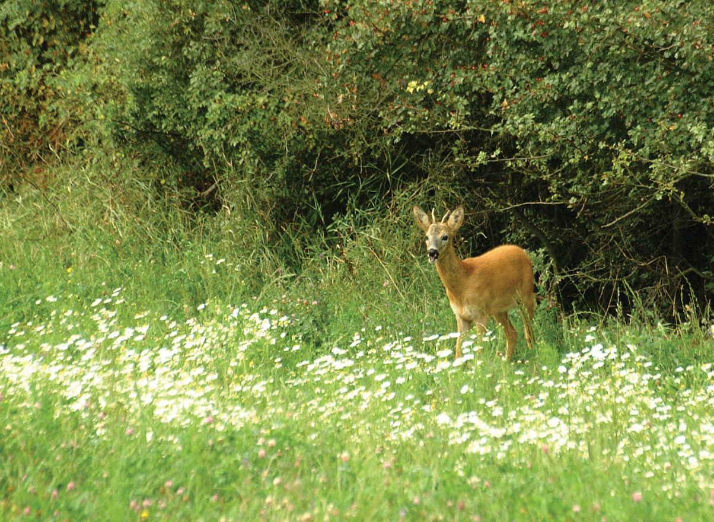
Usage for simulating an ecosystem:
processes

Slide 5
Usage for simulating an ecosystem:
processes
calculate effects

Slide 6
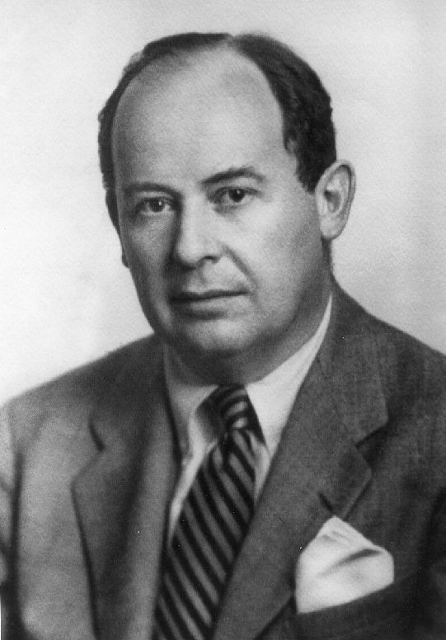
for numerical simulation of processes:
imperative paradigm
(also: von-Neumann paradigm,
control flow paradigm)
John von Neumann (1903-1957)

Slide 7
imperative programming:
computer = machine for the manipulation of values of variables
(these manipulations can have side effects).

Slide 8
programme = plan for the calculation process with specification of the commands and of the control flow (e.g. loops).
example:
x = 0;
while (x < 100)
x = x + 1;

Slide 9
(one) drawback of the imperative paradigm:
simultaneous, parallel assignment is not supported

Slide 10
(one) drawback of the imperative paradigm:
simultaneous, parallel assignment is not supported
Example (Floyd 1978):
predator-prey system (population sizes A, B), described by
A_{new} = f(A, B),
B_{new} = g(A, B)
beginners‘ mistake in programming:
for (i = ... ) {
A = f(A, B);
B = g(A, B);
}

Slide 11
(one) drawback of the imperative paradigm:
simultaneous, parallel assignment is not supported
Example (Floyd 1978):
predator-prey system (population sizes A, B), described by
A_{new} = f(A, B),
B_{new} = g(A, B)
beginners‘ mistake in programming:
for (i = ... ) {
A = f(A, B);
B = g(A, B);
}

Slide 12
programming languages which support imperative programming:
Fortran, Pascal, C, ..., parts of Java, ...,
command language of turtle geometry

Slide 13
Simulating an ecosystem:
organisms

Slide 14
Simulating an ecosystem:
organisms
describe structure

Slide 15
object-oriented paradigm
computer = environment for virtual objects
programme = list of (object) classes, i.e. general specifications of objects, which can be created and destroyed at runtime.
programming languages: Smalltalk, Simula, C++, Java, ...

Slide 16
Inheritance of attributes and methods from superclasses to subclasses
example:
public class Car extends Vehicle
{
public String name;
public int places;
public void show()
{
System.out.println("The car is a " + name);
System.out.println("It has " + places + "places.");
}
}
typical:
classes (Car) with data (name, places) and methods (show)

Slide 17
usefulness of object hierarchies in biology
for example:
organ
leaf
flower
internode
root segment
broad
leaf
needle
coarse
r.s.
fine
r.s.

Slide 18
Simulating an ecosystem:
behaviour
(under certain
conditions)

Slide 19
Simulating an ecosystem:
behaviour
(under certain
conditions)
determine laws (rules)
controlling behaviour

Slide 20
rule-based paradigm
computer = machine which transforms structures
There is a current structure (e.g., a graph) which is transformed as long as it is possible.
Work process: search and application.
matching: search for a suitable rule,
rewriting: application of the rule, thereby transformation of the structure.

Slide 21
rule-based paradigm
computer = machine which transforms structures
There is a current structure (e.g., a graph) which is transformed as long as it is possible.
Work process: search and application.
matching: search for a suitable rule,
rewriting: application of the rule, thereby transformation of the structure.
programme = set of transformation rules
to find a programme: specification of rules.
programming languages: L-system languages, AI languages, Prolog, ...

Slide 22
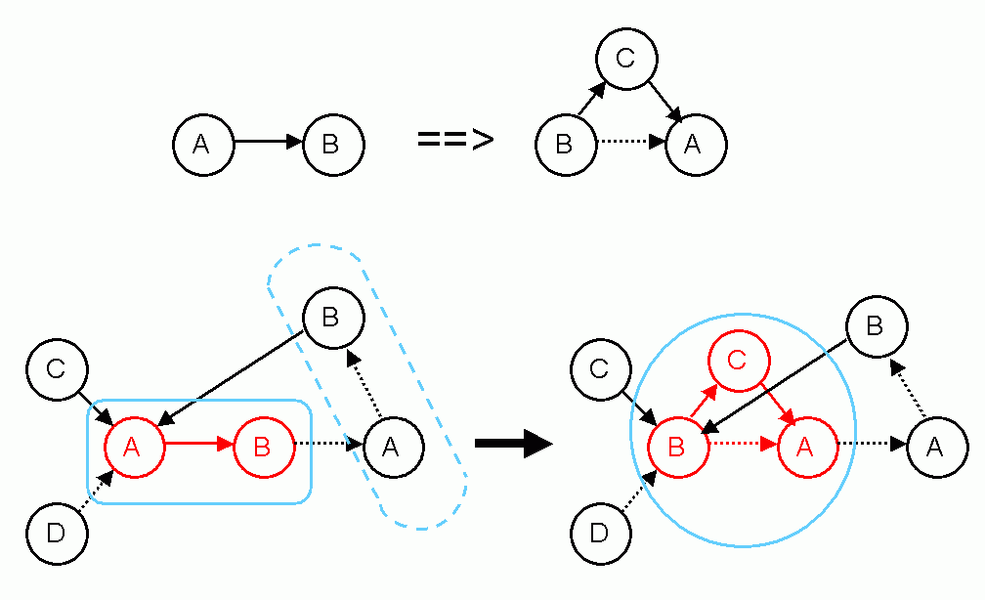
Example:
a graph grammar
rule:

Slide 23
Example:
a graph grammar
rule:
application:

Slide 24
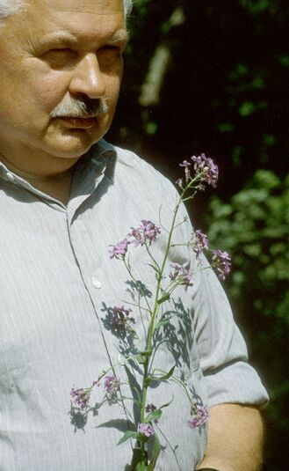
Dynamical description of structures
L-systems (Lindenmayer systems)
rule systems for the replacement of character strings
in each derivation step parallel replacement of all characters for which there is one applicable rule
by A. Lindenmayer (botanist) introduced in 1968 to model growth of filamentous algae
Aristid Lindenmayer (1925-1989)

Slide 25
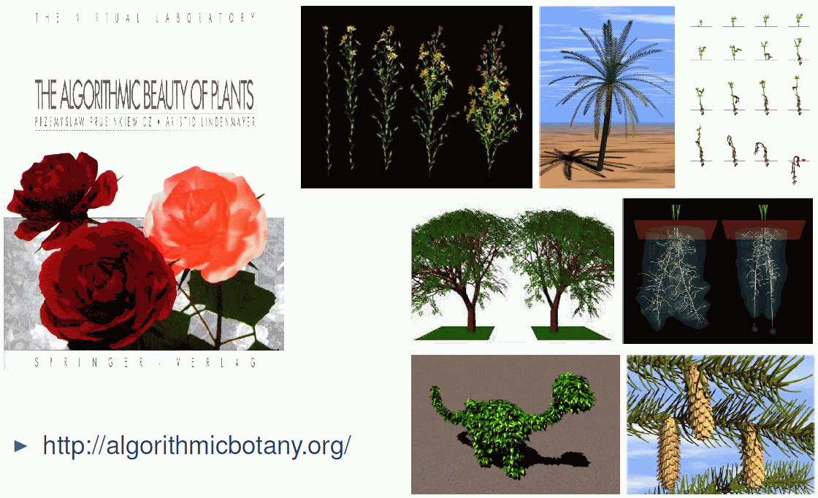
L-systems:
some results

Slide 26
L-systems mathematically:
a triple (Σ, α, R) with:
a set of characters, the alphabet,
a string with characters from Σ, the start word (also "Axiom"),
R a set of rules of the form
character → string of characters;
with the characters taken from Σ.

Slide 27
A derivation step (rewriting) of a string consists of the replacement of all of its characters which occur in left-hand sides of rules by the corresponding right-hand sides.
Convention: characters for which no rule is applicable stay as they are.
Result:
Derivation chain of strings, developed from the start word by iterated rewriting.
→ σ₁ → σ₂ → σ₃ → ....

Slide 28
Example:
alphabet {A, B}, start word A
set of rules:
A → B
B → AB
A

Slide 29
Example:
alphabet {A, B}, start word A
set of rules:
A → B
B → AB
B

Slide 30
Example:
alphabet {A, B}, start word A
set of rules:
A → B
B → AB
AB
parallel replacement

Slide 31
Example:
alphabet {A, B}, start word A
set of rules:
A → B
B → AB
BAB

Slide 32
Example:
alphabet {A, B}, start word A
set of rules:
A → B
B → AB
BAB

Slide 33
Example:
alphabet {A, B}, start word A
set of rules:
A → B
B → AB
ABBAB

Slide 34
Example:
alphabet {A, B}, start word A
set of rules:
A → B
B → AB
derivation chain:
A → B → AB → BAB → ABBAB → BABABBAB
→ ABBABBABABBAB → BABABBABABBABBABABBAB
→ ...

Slide 35
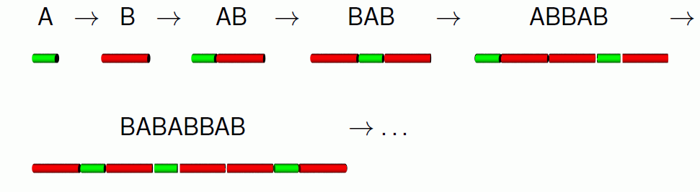
Example:
alphabet {A, B}, start word A
set of rules:
A → B
B → AB
derivation chain:
A → B → AB → BAB → ABBAB → BABABBAB
→ ABBABBABABBAB → BABABBABABBABBABABBAB
→ ...
geometrical visualization:

Slide 36
required for modelling biological structures in space:
a geometrical interpretation
Thus we add:
• a function which assigns to each string a subset of 3-D space
„interpreted“ L-system processing
α → σ₁ → σ₂ → σ₃ → ....
↓ ↓ ↓
S₁ S₂ S₃ ....
S₁, S₂, S₃, ... can be seen as developmental steps of an object, a scene or an organism.

Slide 37
For the interpretation:
turtle geometry
the turtle command set becomes a subset of the character set of the L-system.
Symbols which are not turtle commands are ignored by the turtle.
→ connection with imperative paradigm

Slide 38
A “botanical“ example:
rule:
a bud (B) is replaced by a shoot (F0),
2 lateral buds and an apical bud
Description by L-system:
B → F0 [ RU(-30) B ] [ RU(+30) B ] B

Slide 39


Slide 40


Slide 41


Slide 42
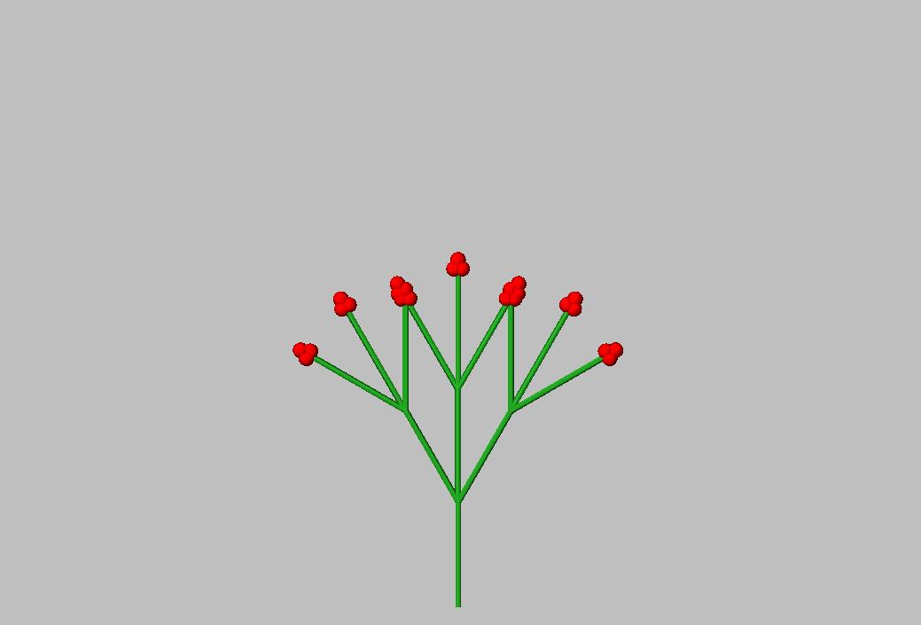

Slide 43
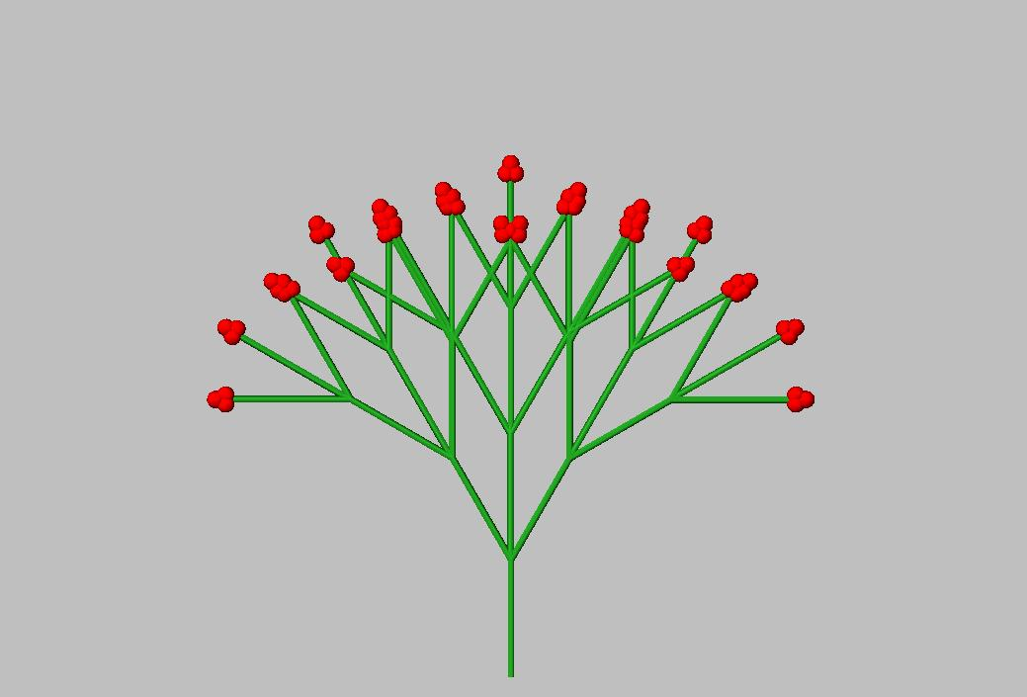

Slide 44
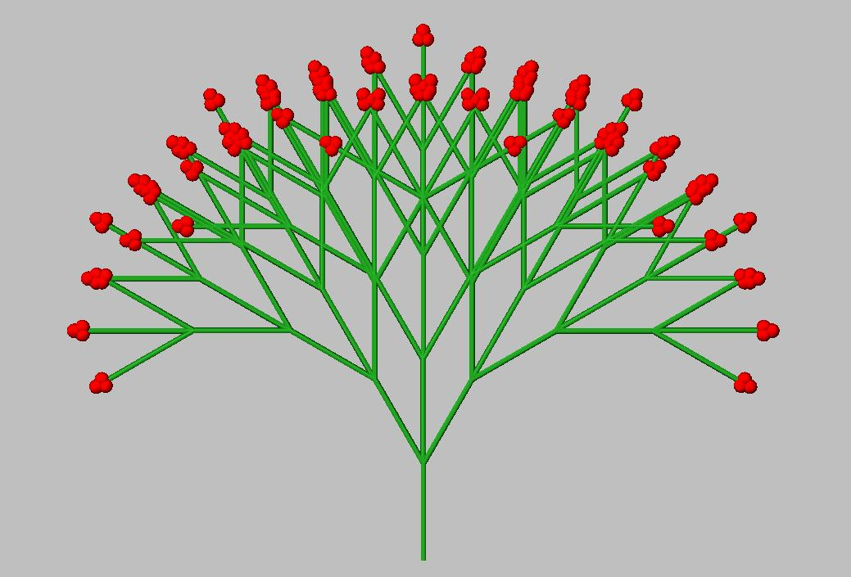

Slide 45
The programming language XL:
a synthesis of three paradigms
„eXtended L-system language“
programming language which makes parallel graph-grammars (extended L-systems) accessible in a simple way
imperative
object oriented
rule based
Java
XL

Slide 46
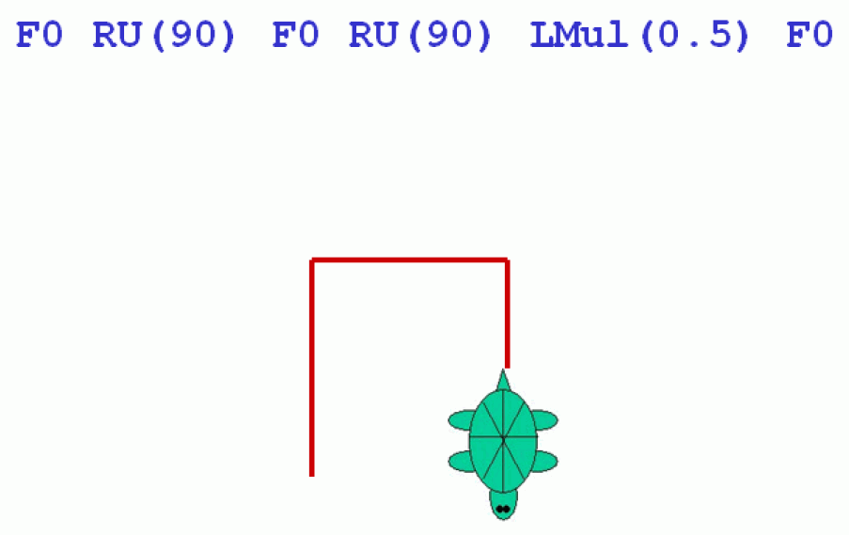
let‘s come back to turtle geometry...

Slide 47
Turtle geometry
„turtle": virtual device for drawing or construction in 2-D or 3-D space
• able to store information (graphical and non-graphical)
• equipped with a memory containing state information (important for branch construction)
• current turtle state contains e.g. current line thickness, step length, colour, further properties of the object which is constructed next

Slide 48
Turtle commands in XL (selection):
F0 "Forward", with construction of an element
(line segment, shoot, internode...),
uses as length the current step size
(the zero stands for „no explicit specification of length")
M0 forward without construction (Move)
L(x) change current step size (length) to x
LAdd(x) increment the current step size to x
LMul(x) multiply the current step size by x
D(x), DAdd(x), DMul(x) analogously for current
thickness
P(c) change current colour to c (= 0 .. 15)
F(x), F(x,d), F(x,d,c) forward and construct cylinder
with x = length, d = thickness, c = colour
RU(a) rotate right by a degrees

Slide 49
Repetition of substrings possible with "for"
e.g., for ((1:3)) ( A B C )
yields A B C A B C A B C
what is the result of the interpretation of
L(2) for ((1:6))
( F0 RU(90) LMul(0.8) ) ?

Slide 50

L(2) for ((1:6))
( F0 RU(90) LMul(0.8) )

Slide 51
How to execute a turtle command sequence with GroIMP
write into a GroIMP project file (or into a file with filename extension .rgg):
protected void init()
[
Axiom ==> turtle command sequence ;
]

Slide 52
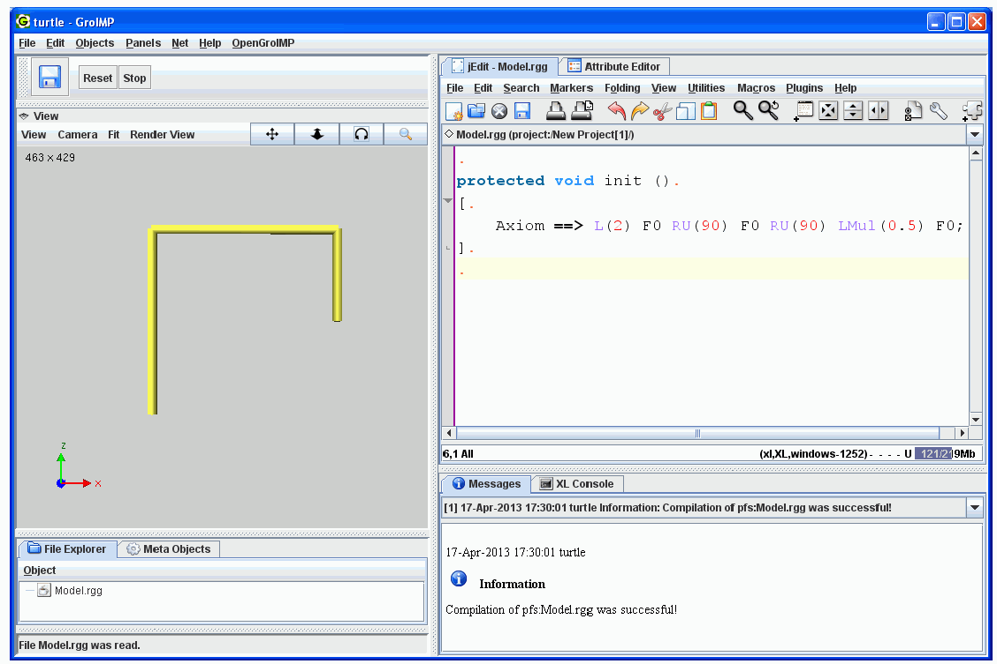
Turtle geometry with GroIMP

Slide 53
Example: Drawing a triangle
protected void init()
[ Axiom ==> RU(30) F(10) RU(120) F(10) RU(120) F(10) ]
see file sm09_e01.rgg

Slide 54
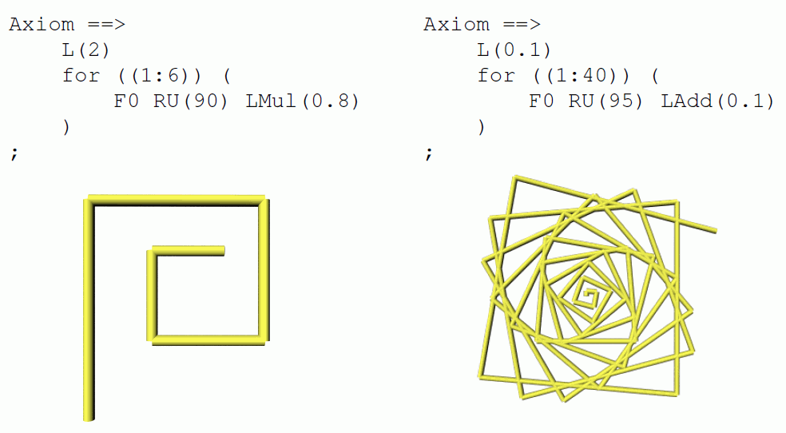
Variations of the spiral pattern

Slide 55
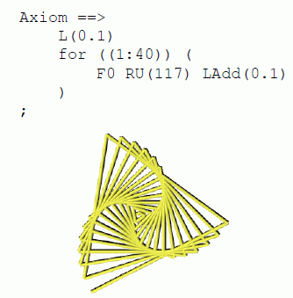
Variations of the spiral pattern

Slide 56
...and more...:
for ((1:20)) ( for ((1:36))
( F0 RU(165) F0 RU(165) ) RU(270) )

Slide 57
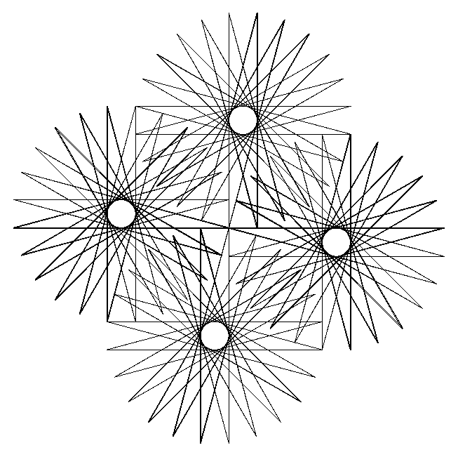
...and more...:
for ((1:20)) ( for ((1:36))
( F0 RU(165) F0 RU(165) ) RU(270) )

Slide 58
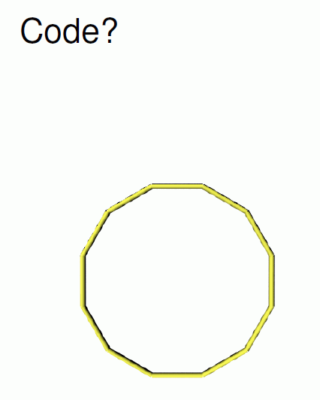
How to draw a “circle“

Slide 59
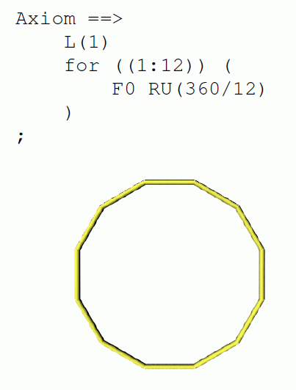
How to draw a “circle“

Slide 60
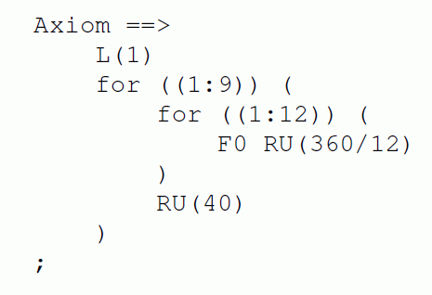
Result?

Slide 61
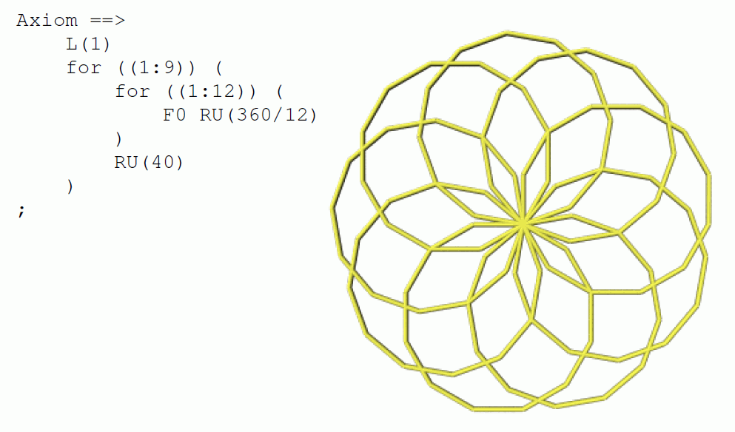

Slide 62

One more example:
L(100) D(3) RU(-90) F(50) RU(90) M0 RU(90) D(10) F0 F0
D(3) RU(90) F0 F0 RU(90) F(150) RU(90) F(140) RU(90)
M(30) F(30) M(30) F(30) RU(120) M0 Sphere(15)
generates

Slide 63

Extension to 3-D graphics:
turtle rotations by 3 axes in space

Slide 64
Extension to 3-D graphics:
turtle rotations by 3 axes in space
left
head
up

Slide 65
Extension to 3-D graphics:
turtle rotations by 3 axes in space
RL
RH
RU

Slide 66
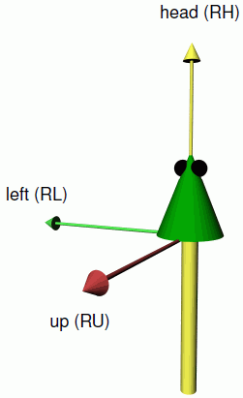

Slide 67
3-D commands:
RU(45) rotation of the turtle around the "up" axis by 45°
RL(...), RH(...) analogously by "left" and "head" axis
up-, left- and head axis form an orthogonal spatial coordinate system which is carried by the turtle
RV(x) rotation "to the ground" with strength given by x
RG rotation absolutely to the ground (direction (0, 0, -1))

Slide 68
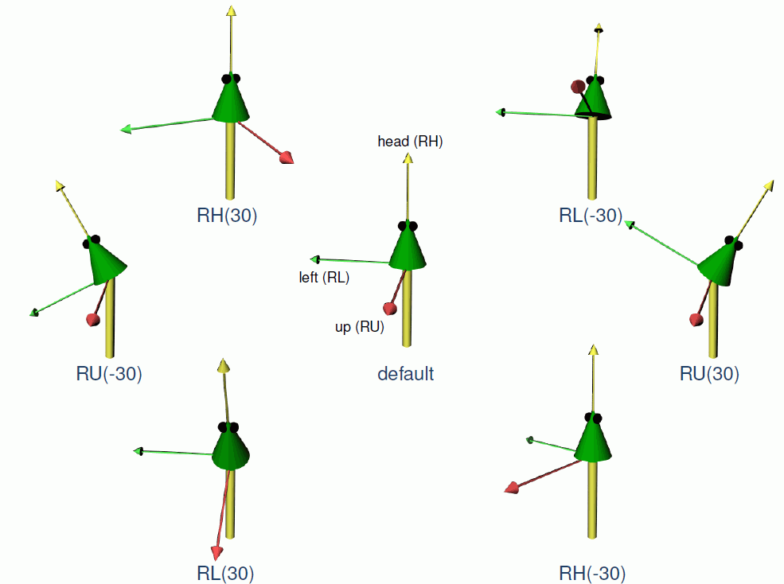

Slide 69
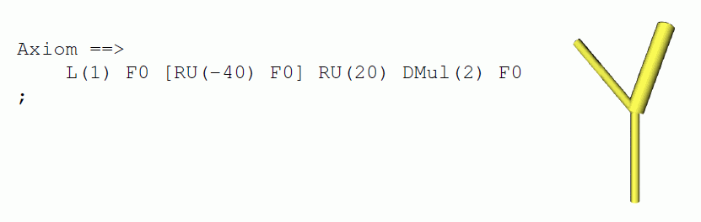
Branches:
realization with memory commands
[ put current state on stack
(last-in-first-out storage)
] take current state from stack
and let it become the current state
(thus: end of branch!)

Slide 70
Remember:
L-systems (Lindenmayer systems)
rule systems for the replacement of character strings
in each derivation step parallel replacement of all characters for which there is one applicable rule
interpreted L-systems:
turtle command language is subset of the alphabet of the L-system
Aristid Lindenmayer (1925-1989)

Slide 71
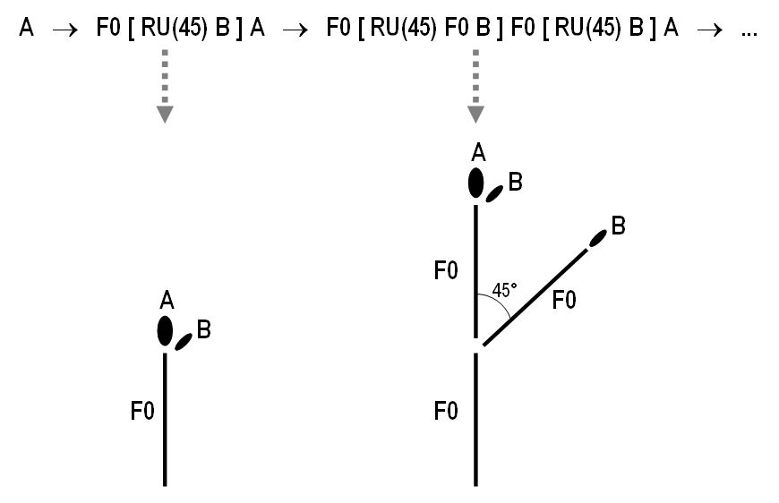
Example:
rules
A ==> F0 [ RU(45) B ] A ;
B ==> F0 B ;
start word A
(A and B are normally not interpreted geometrically.)
interpretation
by
turtle geometry

Slide 72

example space filling curve:
Axiom ==> L(10) RU(-45) X RU(-45) F(1) RU(-45) X;
X ==> X F0 X RU(-45) F(1) RU(-45) X F0 X
traditional Indian kolam
„Anklets of Krishna“

Slide 73
example for a fractal:
Koch curve
Axiom ==> RU(90) F(10);
F(x) ==> F(x/3) RU(-60) F(x/3) RU(120) F(x/3) RU(-60) F(x/3)

Slide 74


Slide 75


Slide 76


Slide 77


Slide 78
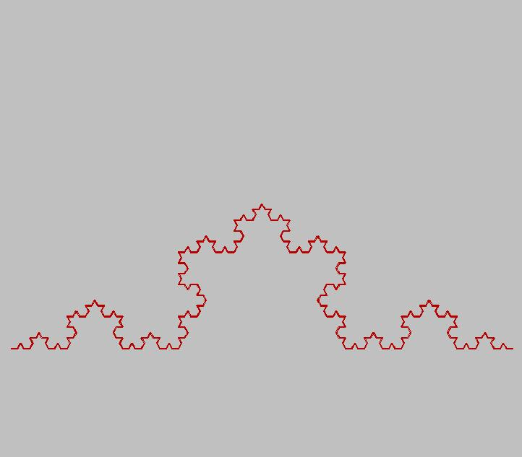

Slide 79
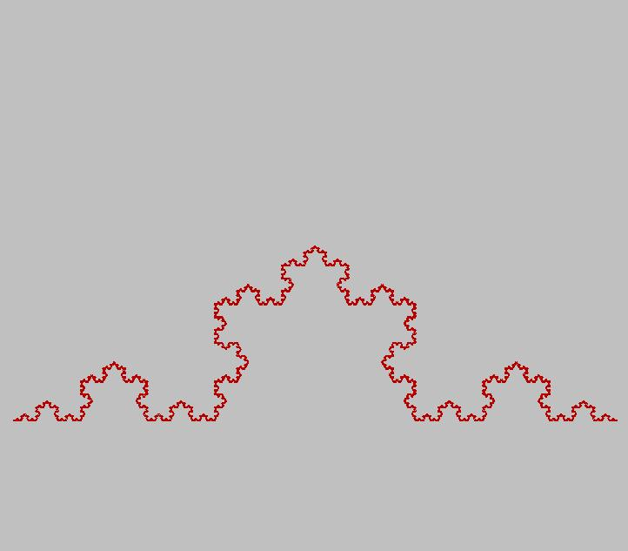
.

Slide 80
cf. sample file sm09_e02.rgg :
closed Koch curve, developed from triangle
protected void init()
[ Axiom ==> RU(50) F(10) RU(120) F(10) RU(120) F(10); ]
// public method for interactive usage in GroIMP
// (via button):
public void application()
// rules must be set in [] and finished with ;
[
// each F() is replaced by 4 smaller F()
// the length of the F on the left-hand side is taken over
// by x to the right-hand side
F(x) ==> F(x/3) RU(-60) F(x/3) RU(120) F(x/3) RU(-60) F(x/3);
]

Slide 81
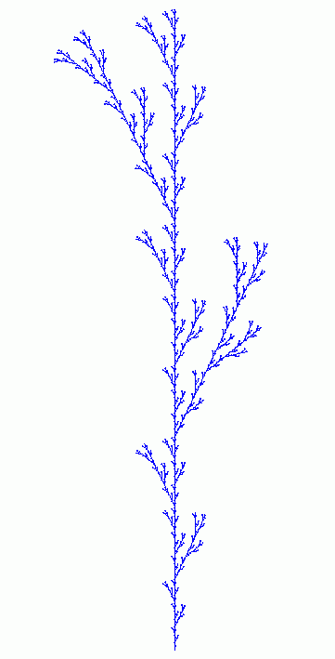
example with branching:
F0 ==> F0 [ RU(25.7) F0 ] F0 [ RU(-25.7) F0 ] F0;
Result after 7 steps:
(start word L(10) F0)
sample file sm09_e02b.rgg

Slide 82
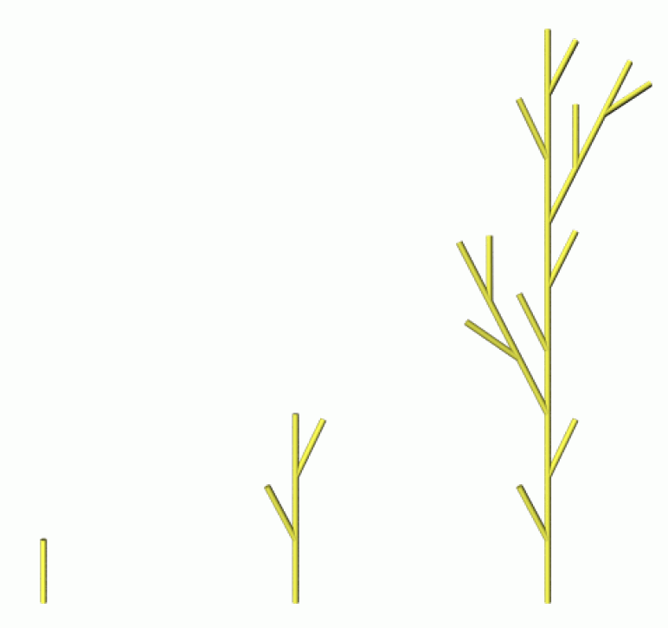
F0 ==> F0 [ RU(25.7) F0 ] F0 [ RU(-25.7) F0 ] F0;

Slide 83

branching, alternating branch position and shortening:
Axiom ==> L(10) F0 A;
A ==> LMul(0.5) [ RU(90) F0 ] F0 RH(180) A;
in XL, A must be declared as module before:
module A;
sample file sm09_e02c.rgg

Slide 84
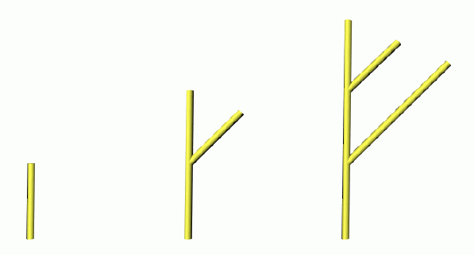
Declaration of new modules (which are not visible):
module A;
module B;
protected void init()
[ Axiom ==> L(1) A; ]
public void run()
[ A ==> F0 [ RU(45) B ] A;
B ==> F0 B; ]
sample file sm09_e02d.rgg

Slide 85
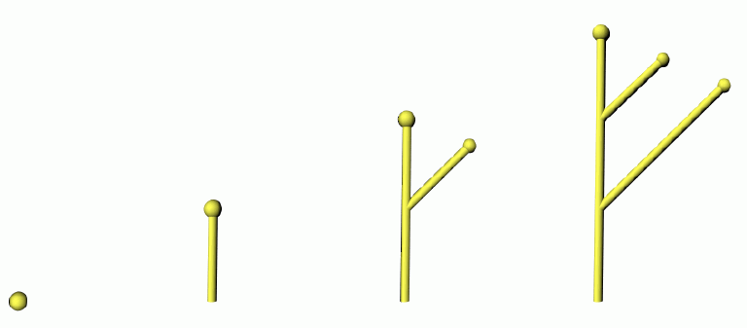
How to declare new modules with geometrical interpretation:
module A extends Sphere(0.1);
module B extends Sphere(0.08);
protected void init()
[ Axiom ==> L(1) P(14) A; ]
public void run()
[ A ==> F0 [ RU(45) B ] A;
B ==> F0 B; ]
sample file sm09_e02e.rgg

Slide 86
extension of the concept of symbol:
allow real-valued parameters not only for turtle commands like "RU(45)" and "F(3)", but for all characters
parametric L-systems
• arbitrarily long, finite lists of parameters
• parameters get values when the rule matches
Example:
rule A(x, y) ==> F(7*x+10) B(y/2)
current symbol is e.g.: A(2, 6)
after rule application: F(24) B(3)
parameters can be checked in conditions
(logical conditions with Java syntax):
A(x, y) (x >= 17 && y != 0) ==> ....

Slide 87
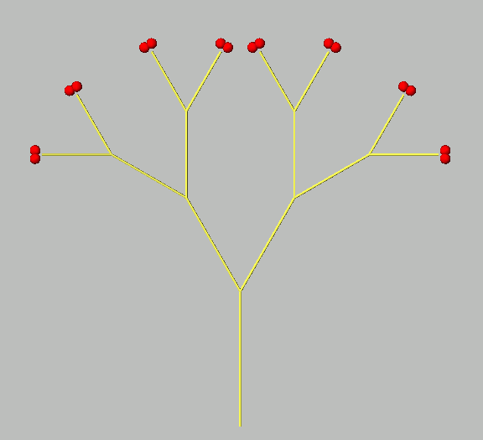
sample file sm09_e03.rgg :
// Example of a simple tree architecture (Schoute architecture)
//----------- Extensions to the standard alphabet ----------
//Shoot() is an extension of the turtle-command F() and stands for an annual shoot
module Shoot(float len) extends F(len);
// Bud is an extension of a sphere object and stands for a terminal bud
// Its strength controls the length of the produced shoot in the next timestep
module Bud(float strength) extends Sphere(0.2)
{{ setShader(RED); setTransform(0, 0, 0.3); }};
//-----------------------------------------------------------
protected void init ()
[ // start structure (a bud)
Axiom ==> Bud(5);
]
public void run ()
[
// a square bracket [] will indicate a branch
// (daughter relation)
// Rotation around upward axis (RU) and head axis (RH)
// Decrease of strength of the Bud (each step by 20%)
Bud(x) ==> Shoot(x) [ RU(30) Bud(0.8*x) ] [ RU(-30) Bud(0.8*x) ];
]

Slide 88
Test the examples
sm09_e04.rgg two blocks of rules, conditions
sm09_e05.rgg alternating positions of branches,
object (bud) with 2 parameters
sm09_e07.rgg colour specifications for single objects,
how to give names to objects

Slide 89
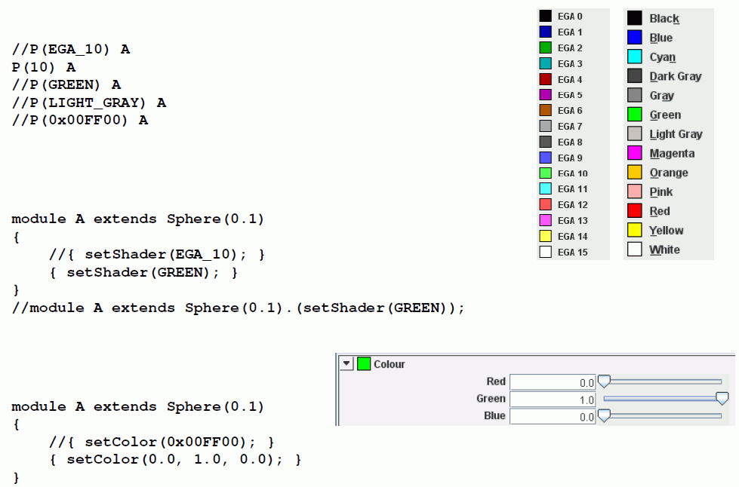
How to define colours with XL
• Turtle command P
• method setShader
• method setColor

Slide 90
Test the examples
sm09_e08.rgg using your own modules as abbreviations
sm09_e21.rgg different ways to position lateral branches

Slide 91
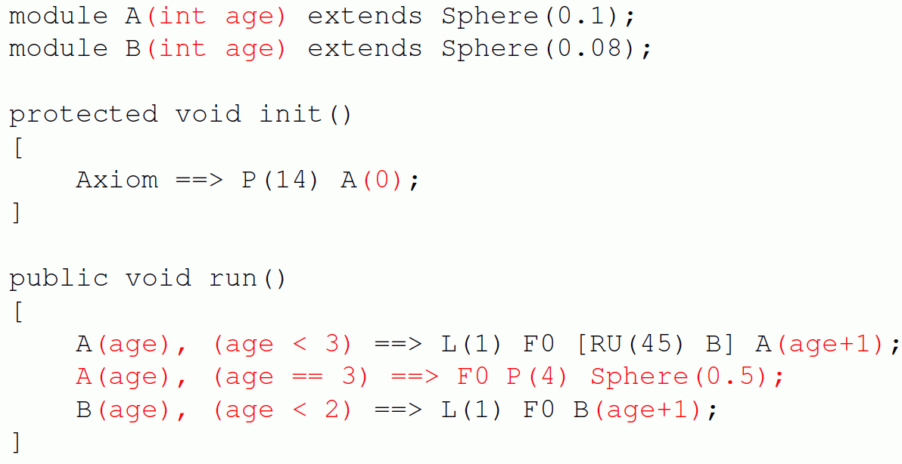
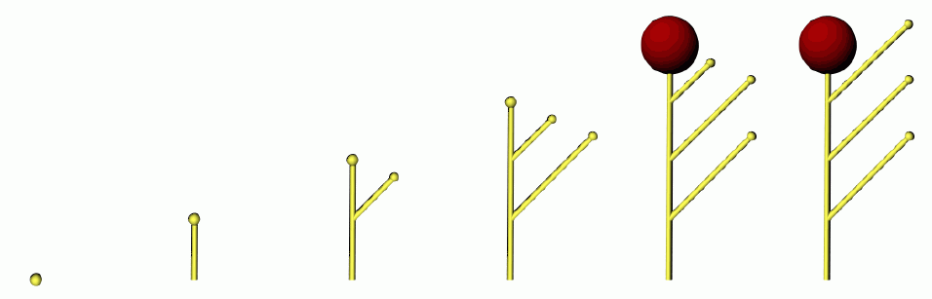
A further parametric L-system with conditions:

Slide 92
Context-sensitive L-systems
Often, the development of some object is influenced by a neighbour object
Context sensitivity:
• checking for a context (in the representing string code) which must be present in order for the rule to be applicable
• in XL, the context is given in (* ... *)

Slide 93
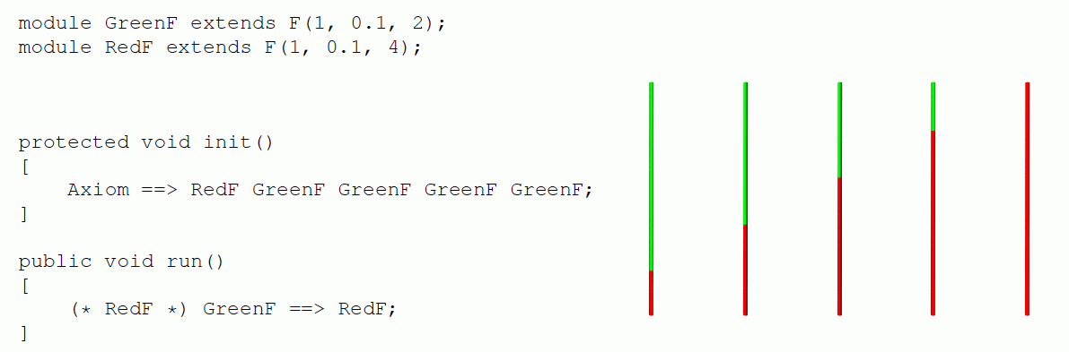
Examples:
// left context

Slide 94
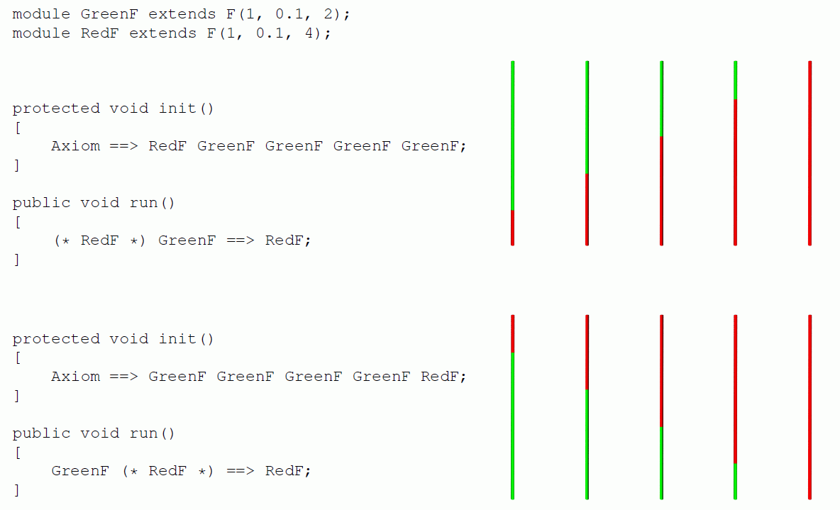
Examples:
// left context
// right context
see also sm09_e14.rgg, sm09_e15.rgg

Slide 95
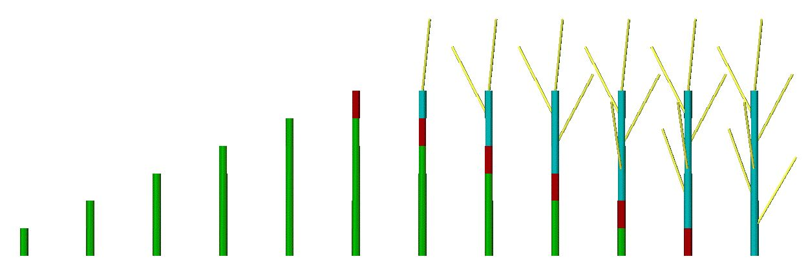
Further example for context sensitivity
const int green = 2, blue = 3, red = 4;
module A(int age);
module B(super.length, super.color) extends F(length, 3, color);
Axiom ==> A(0);
A(t), (t < 5) ==> B(10, green) A(t+1);
A(t), (t == 5) ==> B(10, red);
B(s, green) (* B(r, red) *) ==> B(s, red);
B(s, red) ==> B(s, blue) [ RH(random(0, 360)) RU(30) F(30, 1, 14) ];

Slide 96
Usage of imperative code in XL programmes
Commands like the assignment of values to variables, additions, function calls, output (print commands) etc. are specified in the same way like in Java and enclosed in braces { ... } .
Examples:
int i; // declaration of an integer variable with name i
float a = 0.0; // declaration and initialization of a floating-point var.
int[] x = new int[20]; // declaration of an array
// of length 20; access: x[0], ..., x[19]
float[] y = { 0.1, 0.2, 0.7, -1.4 };
// declaration and initialization of an array
i = 25; // assignment
i++; // i is incremented by 1
i--; // i is decremented by 1

Slide 97
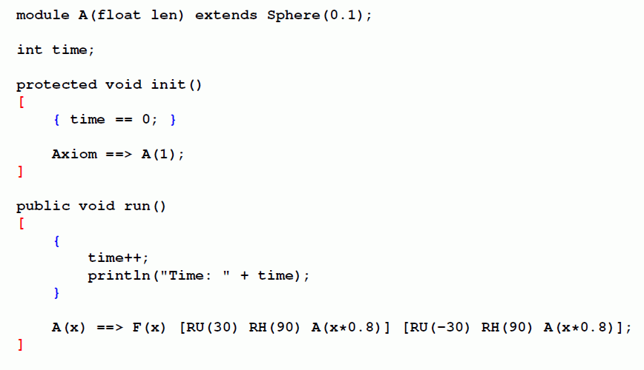
Nesting of rule-oriented blocks [ ... ] and imperative blocks { ...}
=

Slide 98
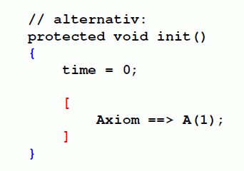
Nesting of rule-oriented blocks [ ... ] and imperative blocks { ...}
// alternatively:
=

Slide 99
usage of imperative code (continued)
i += 5; // i is incremented by 5
i -= 5; // i is decremented by 5
i *= 2; // i is doubled
i /= 3; // i gets the value i/3
n = m % a; // n gets assigned the rest of m from integer division by a
x = Math.sqrt(2); // x gets assigned the square root of 2
if (x != 0) { y = 1/x; } // conditional assignment of 1/x to y
while (i <= 10) { i++; } // loop: as long as i ≤ 10,
// i is incremented by 1
for (i = 0; i < 100; i++) { x[i] = 2*i; } // imperative
// for-loop
if (i == 0) { ... } // test for equality ( „=“ would be assignment!)

Slide 100
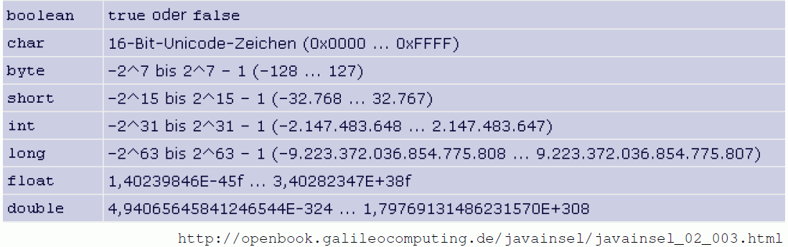
The most important primitive data types:
int integers
float floating-point numbers
double floating-point numbers, double precision
char characters
void void type (for functions which return no value)
More detailed overview:
type range of values

Slide 101
mathematical constants:
Math.PI π
Math.E e
logical operators:
&& and
|| or
! not

Slide 102
mathematical functions:
Math.abs absolute value Math.sqrt square root
Math.acos arcus cosine Math.tan tangens
Math.asin arcus sine Math.toDegrees
Math.atan arcus tangens Math.toRadians
Math.cos cosine conversion degrees ↔ radians
Math.exp exponential function e^{x}
Math.log natural logarithm
Math.max maximum of two numbers
Math.min minimum of two numbers
Math.round functin for rounding
Math.sin sine

Slide 103
sm_progbsp01.rgg: writes the numbers from 1 to 10
to the GroIMP console
protected void init()
{
int i;
for (i=1; i<= 10; i++)
println(i);
println("end.");
}

Slide 104
sm_progbsp02.rgg: writes odd square numbers
protected void init()
{
int a, b;
for (a = 1; a <= 10; a++)
{
b = a*a;
if (b % 2 != 0) println(b);
}
println("end.");
}

Slide 105
sm_progbsp03.rgg: writes the Fibonacci numbers
protected void init()
{
int i;
int[] fibo = new int[20]; /* array declaration */
fibo[0] = fibo[1] = 1;
for (i=2; i <= 19; i++)
fibo[i] = fibo[i-1] + fibo[i-2];
for (i=0; i <= 19; i++)
println(fibo[i]);
println("end.");
}

Slide 106
sm_progbsp04.rgg: Usage of a function
/* a simple imperative programme:
A function written by the user calculates x² + 1;
this is evaluated for x from 0 to 1 in steps by 0.1.
Be aware of rounding errors and of the correct upper limit for x. */
public float function(float x)
{
return x*x + 1;
}
protected void init()
{
float a = 0.0; /* floating point number */
while (a <= 1.00001)
{
println(function(a)); /* apply function and print */
a += 0.1; /* increment a */
}
println("end.");
}

Slide 107

test the examples
sm09_e20.rgg usage of arrays
sm09_e22.rgg for-loop for lateral branches

Slide 108
Remember:
parameters can be checked in conditions
(logical conditions with Java syntax):
A(x, y) (x >= 17 && y != 0) ==> ....

Slide 109
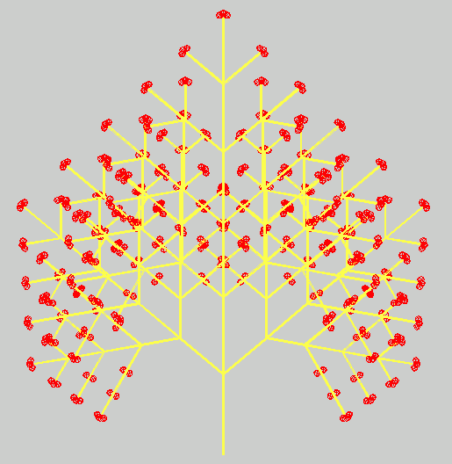
test the examples
sm09_e11.rgg conditions for rule applications
sm09_e13.rgg connection of two conditions
with logical “and“ (&&)

Slide 110
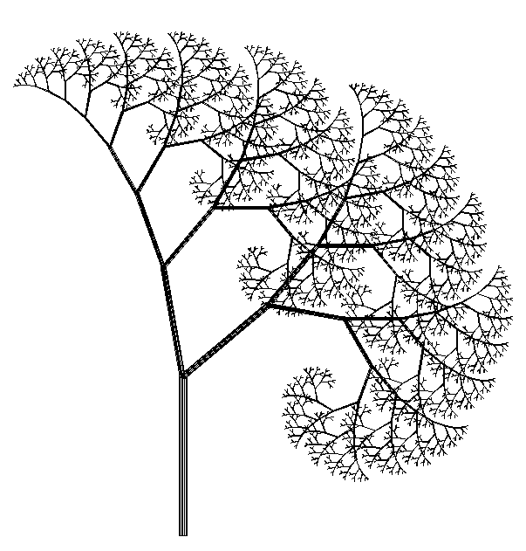
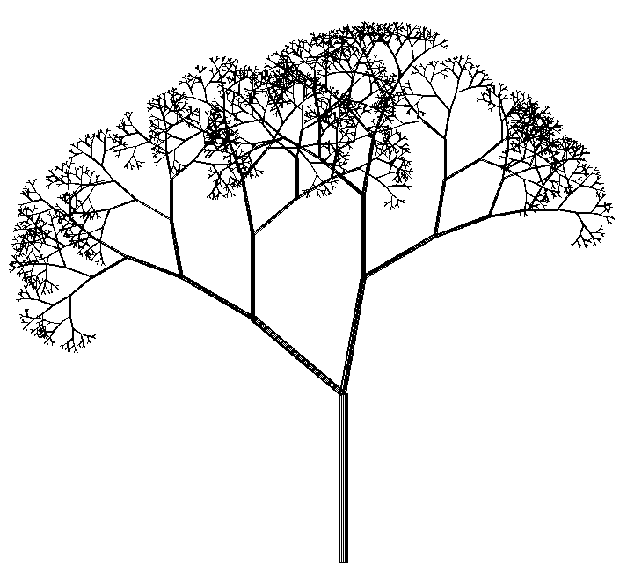
Stochastic L-systems
usage of pseudo-random numbers
Example:
deterministic stochastic
Axiom ==> L(100) D(5) A;
A ==> F0 LMul(0.7) DMul(0.7)
[ RU(50) A ] [ RU(-10) A ];
Axiom ==> L(100) D(5) A;
A ==> F0 LMul(0.7) DMul(0.7)
if (probability(0.5))
( [ RU(50) A ] [ RU(-10) A ] )
else
( [ RU(-50) A ] [ RU(10) A ] );

Slide 111
XL functions for pseudo-random numbers:
Math.random() generates floating-point random number
between 0 and 1 (uniformly distributed)
random(a, b) generates floating point random number between a and b (uniformly distributed)
irandom(j, k) generates integer random number
between j and k (uniformly distributed)
normal(m, s) generates normally-distributed random
numbers with mean m and standard
deviation s
probability(x) gives 1 with probability x,
0 with probability 1–x

Slide 112
XL functions for pseudo-random numbers:
Math.random() generates floating-point random number
between 0 and 1 (uniformly distributed)
random(a, b) generates floating point random number between a and b (uniformly distributed)
irandom(j, k) generates integer random number
between j and k (uniformly distributed)
normal(m, s) generates normally-distributed random
numbers with mean m and standard
deviation s
probability(x) gives 1 with probability x,
0 with probability 1–x
setSeed(n) determines a start value for the
pseudo-random number generator

Slide 113
XL functions for pseudo-random numbers:
Math.random() generates floating-point random number
between 0 and 1 (uniformly distributed)
random(a, b) generates floating point random number between a and b (uniformly distributed)
irandom(j, k) generates integer random number
between j and k (uniformly distributed)
normal(m, s) generates normally-distributed random
numbers with mean m and standard
deviation s
probability(x) gives 1 with probability x,
0 with probability 1–x
test the example
sm09_b19.rgg stochastic L-system

Slide 114
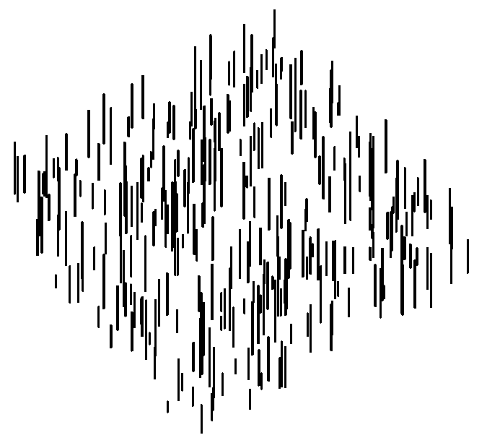

How to create a random distribution in the plane:
Axiom ==> D(0.5) for ((1:300))
( [ Translate(random(0, 100), random(0, 100), 0)
F(random(5, 30)) ] );
view from above oblique view

Slide 115
How to create a GroIMP project with textures from graphics files (e.g., photos of leaves or bark)
1. File → New → RGG Project
2. insert name of the RGG file (text file)
3. delete the default programme from the GroIMP editor, write new programme or insert it from another source file
4. store file in the editor (automatic compilation must be successful)
- textured objects are still shown in simplified form (without textures)
5. Panels → Explorers → 3D → Shaders → Object → New → Lambert
6. click twice on the name „Lambert“ (with delay between the clicks) (or F2), overwrite it with the name which is foreseen in the programme (argument of the function „shader(...)“ ), finish with <return> (don‘ forget this!!)
7. doubleclick on sphere icon → Attribute Editor opens
8. click there on: Diffuse colour → Surface Maps → Image
9. click there on: Image [ ? ] → From File

Slide 116
how to create a project
(continued)
10. choose image file, „open“
11. „Add the file“: OK
12. store editor file again / compile
- textured objects are now shown with texture
13. to store the complete project:
File → Save, write name of the project (must not necessarily coincide
with the name of the RGG source code file).

Slide 117
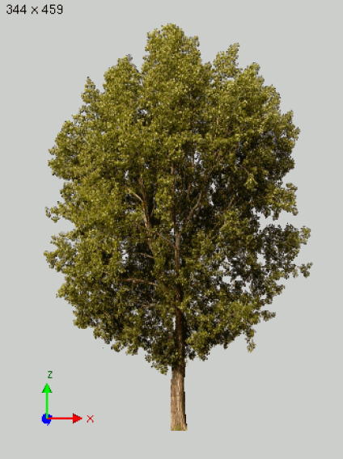
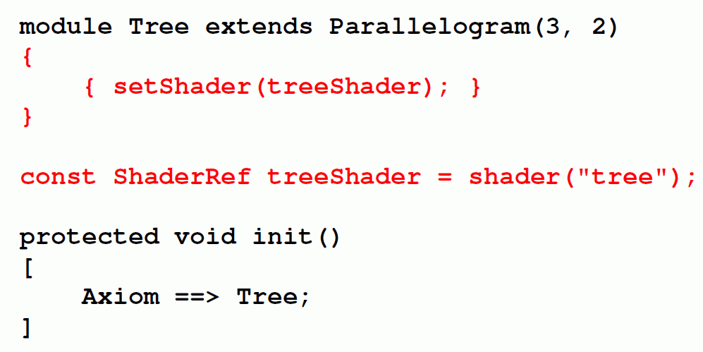
A simple GroIMP project with textures:
test the example
sm09_e10.gsz usage of a surface texture
(leaf texture)

Slide 118
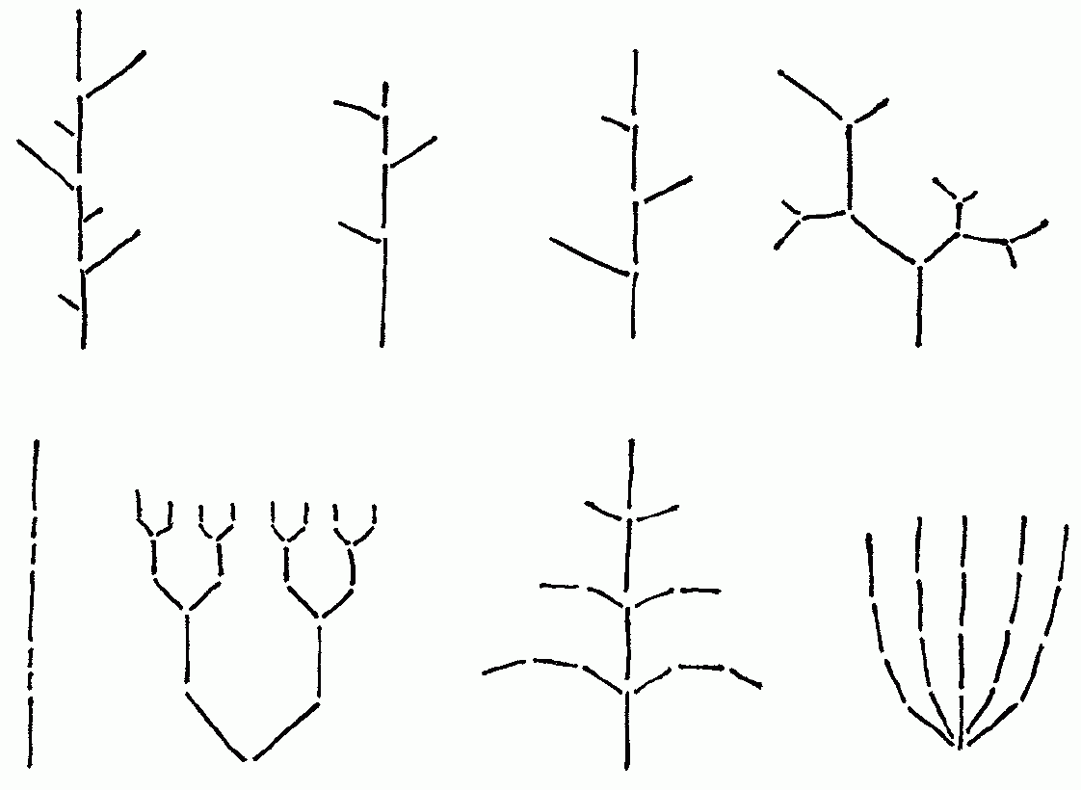
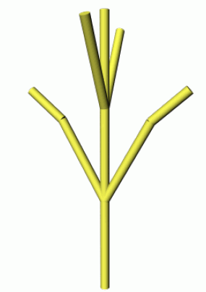
Suggestions for team session:
Create the following simple branching patterns with XL
and add colours to their elements

Slide 119
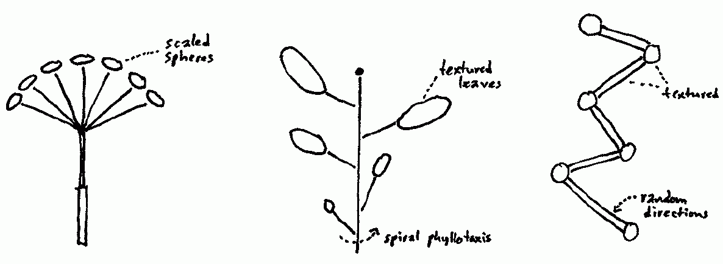
Suggestions for team session (2):
Create the following patterns as textured structures with XL

