Slide 1

Functional-Structural Plant Modelling
with GroIMP and XL
Tutorial and Workshop at Agrocampus Ouest, Angers,
5-7 May, 2015
Winfried Kurth
University of Göttingen,
Department Ecoinformatics, Biometrics and Forest Growth
Graph rewriting, interpretive rules, instantiation rules

Slide 2
The formal background of the programming language XL:
Relational Growth Grammars (RGG)
= a special form of parallel graph grammars
see
Ole Kniemeyer: Design and Implementation of a Graph Grammar Based Language for Functional-Structural Plant Modelling. Ph.D. thesis, University of Technology at Cottbus (2008); chapters 4 and 5
[http://nbn-resolving.de/urn/resolver.pl?urn=urn:nbn:de:kobv:co1-opus-5937]

Slide 3
The step towards graph grammars
Drawback of L-systems:
• in L-systems with branches (by turtle commands)
only 2 possible relations between objects:
"direct successor" and "branch"
extensions:
• to permit additional types of relations
• to permit cycles
→ graph grammar

Slide 4
a string: a very simple graph
a string can be interpreted as a 1-dimensional graph with only one type of edges
successor edges (successor relation)
A
B
A
C
A
A
B
A
C

Slide 5
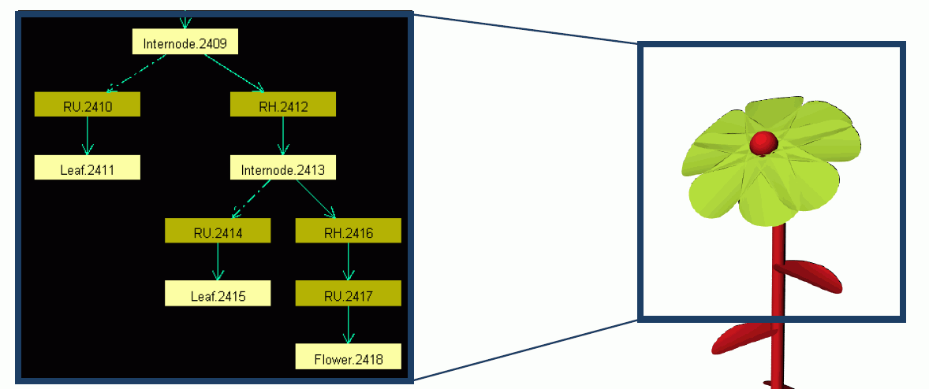
in GroIMP, all is represented in a graph:
(Smoleňová 2010)

Slide 6
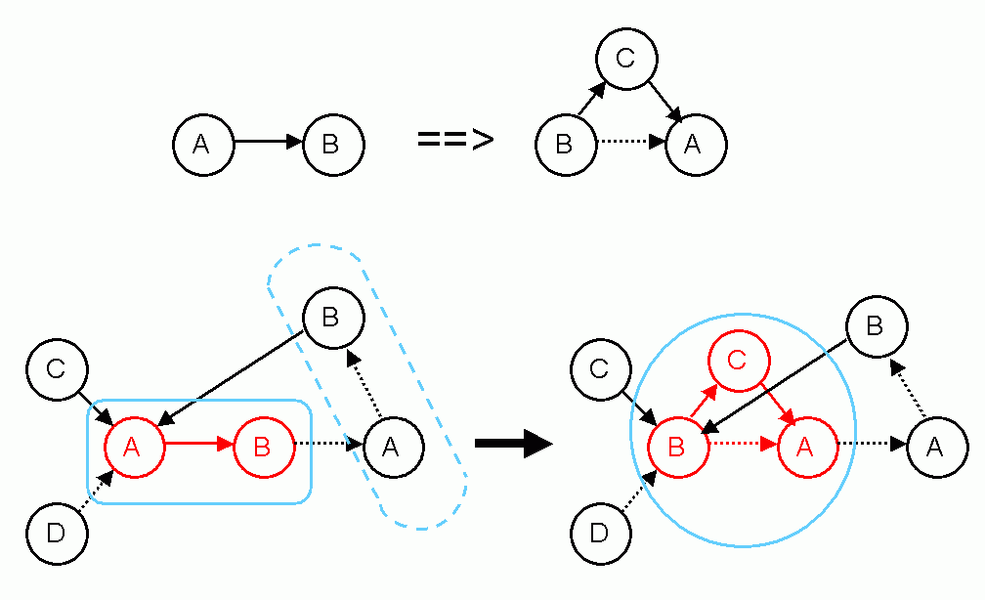
to make graphs dynamic, i.e., to let them change over time:
graph grammars
example rule:

Slide 7
A relational growth grammar (RGG) (special type of graph grammar) contains:
an alphabet
  the definition of all allowed
    node types
    edge types (types of relations)
the axiom
  an initial graph, composed of elements of the alphabet
a set of graph replacement rules.

Slide 8
How an RGG rule is applied
each left-hand side of a rule describes a subgraph (a pattern of nodes and edges, which is looked for in the whole graph), which is replaced when the rule is applied.
each right-hand side of a rule defines a new subgraph which is inserted as substitute for the removed subgraph.

Slide 9
Example:
rule:
application:

Slide 10
a complete RGG rule can have 5 parts:
(* context *), left-hand side, ( condition )
==>
right-hand side { imperative XL code }

Slide 11
in text form we write (user-defined) edges as
-edgetype->
edges of the special type "successor" are usually written as a blank (instead of -successor->)
also possible: >
Further special edge types with special notation:
"branch" edge: +> (also generated after "[")
"decomposition" edge: />

Slide 12
L-systems as a special case of graph grammars:
● the symbols of the L-system alphabet become vertices
● concatenation of symbols corresponds to successor edges
example: graph grammar in XL for the Koch curve
public void derivation()
[
Axiom ==> RU(90) F(10);
F(x) ==> F(x/3) RU(-60) F(x/3) RU(120) F(x/3) RU(-60) F(x/3);
]
vertex of the graph
edge (type „successor“)

Slide 13
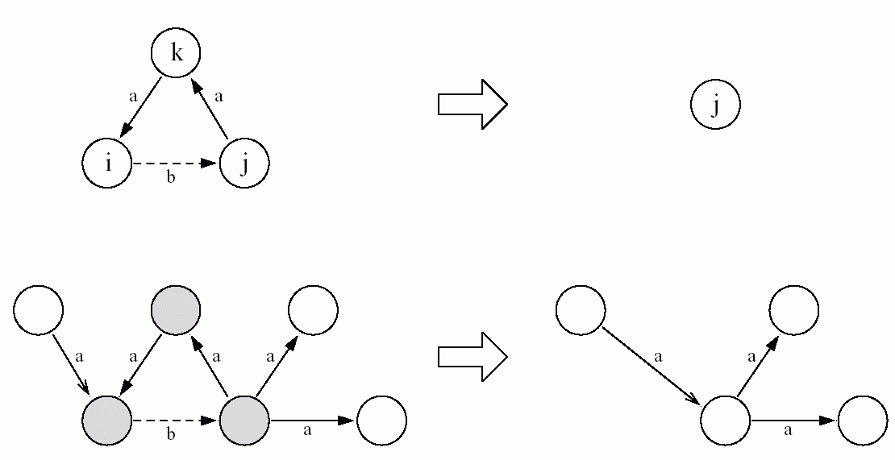
a “proper“ graph grammar (not expressible as L-system):
rule:
application:
rule in text form: i -b-> j -a-> k -a-> i = => j

Slide 14
a “proper“ graph grammar (not expressible as L-system):
rule:
application:
what happens if there are two nodes on the right-hand side instead of one?

Slide 15
2 types of rules for graph replacement in XL:
● L-system rule, symbol: ==>
provides an embedding of the right-hand side into the graph (i.e., incoming and outgoing edges are maintained)
● SPO rule, symbol: ==>>
incoming and outgoing edges are deleted (if their maintenance is not explicitely prescribed in the rule)
„SPO“ from „single pushout“ – a notion from universal algebra

Slide 16
example:
a:A ==>> a C (SPO rule)
B ==> D E (L-system rules)
C ==> A
start
graph:
A
B
C

Slide 17
a:A ==>> a C (SPO rule)
B ==> D E (L-system rules)
C ==> A
A
B
C
D
E
A

Slide 18
a:A ==>> a C (SPO rule)
B ==> D E (L-system rules)
C ==> A
A
B
C
a:
D
E
A

Slide 19
a:A ==>> a C (SPO rule)
B ==> D E (L-system rules)
C ==> A
A
D
E
A
a:
= final result
C

Slide 20
test the example sm09_e27.rgg :
module A extends Sphere(3);
protected void init()
[ Axiom ==> F(20, 4) A; ]
public void runL()
[
A ==> RU(20) F(20, 4) A;
]
public void runSPO()
[
A ==>> ^ RU(20) F(20, 4, 5) A;
]
(^ denotes the root node in the current graph)

Slide 21
Representation of graphs in XL
● vertex types must be declared with „module“
● vertices can be all Java objects
● notation for vertices in a graph:
Node_type, optionally preceded by: label:
Examples: A, Meristem(t), b:Bud
● notation for edges in a graph:
-edgetype-> (forward), <-edgetype- (backward),
-edgetype- forward or backward,
<-edgetype-> forward and backward
● special edge types:
successor edge: -successor->, > or (blank)
branch edge: -branch->, +> or [
refinement edge: />

Slide 22
Notations for special edge types
> successor edge forward
< successor edge backward
--- successor edge forward or backward
+> branch edge forward
<+ branch edge backward
-+- branch edge forward or backward
/> refinement edge forward
</ refinement edge backward
--> arbitrary edge forward
<-- arbitrary edge backward
-- arbitrary edge forward or backward
(cf. Kniemeyer 2008, p. 150 and 403)

Slide 23
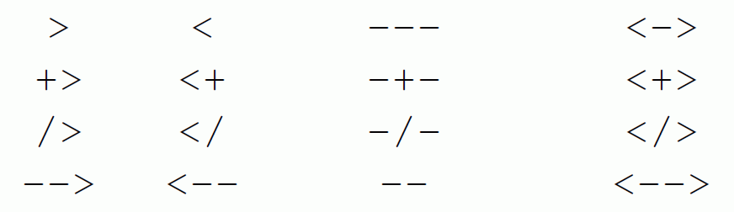
Notations for special edge types (overview)
forward backward forward or backward forward and backward
successor
branch
refinement
arbitrary

Slide 24
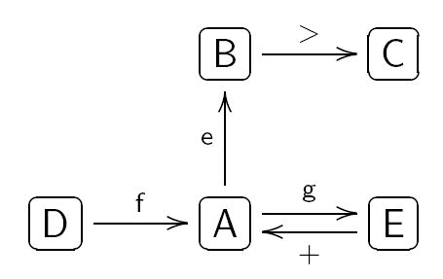
user-defined edge types
const int xxx = EDGE_0; // oder EDGE_1, ..., EDGE_14
...
usage in the graph: -xxx->, <-xxx-, -xxx-, <-xxx->
Notation of graphs in XL
example:
is represented in programme code as
(the representation is not unique!)
( >: successor edge, +: branch edge)

Slide 25
how can the following graph be described in XL code?
(the solution is not unique)
Bud
>
0
1
X
+
Leaf

Slide 26
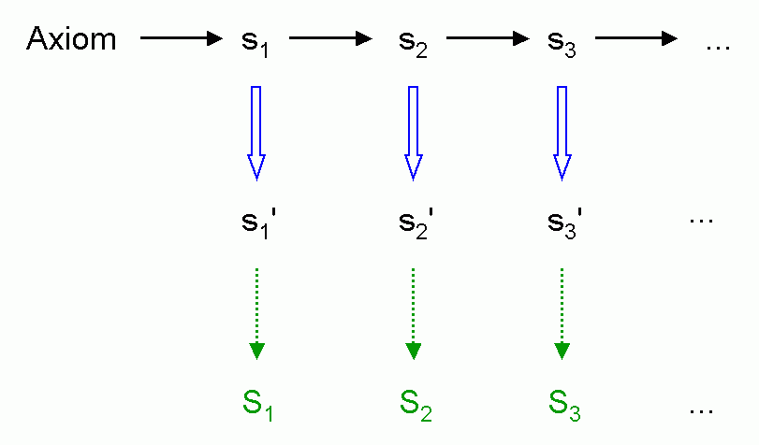
Interpretive rules
insertion of a further phase of rule application directly preceding graphical interpretation (without effect on the next generation)
application of interpretive rules
interpretation by turtle

Slide 27
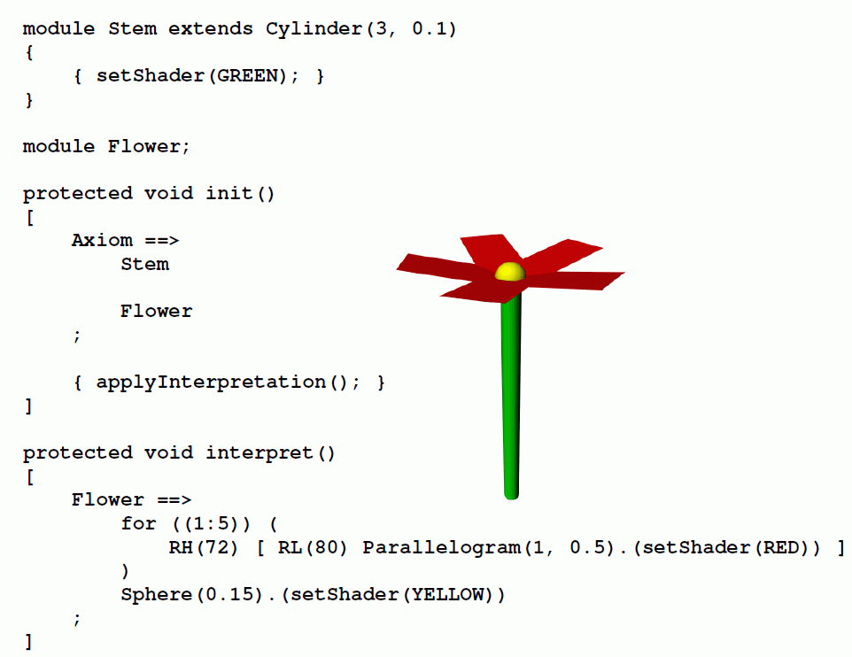
Example:
{
interpretive rule

Slide 28
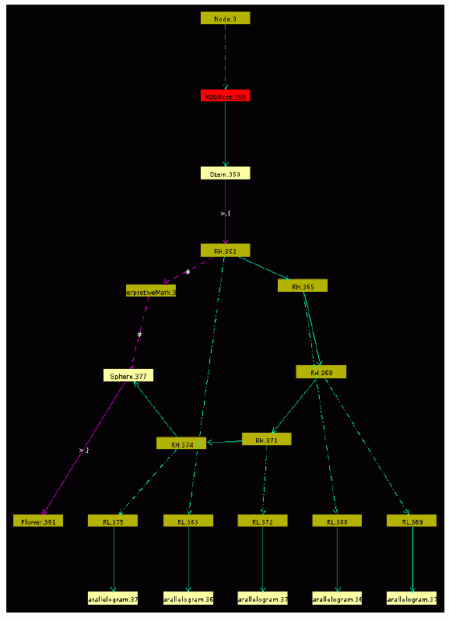

Each occurrence of the interpreted vertex (here: Flower) is individually represented in the graph.
A special (internal) edge type and special vertices are used to link the interpretation results with the rest of the graph:

Slide 29
further example:
public void run()
{
[
Axiom ==> A;
A ==> Scale(0.3333) for (int i:(-1:1))
for (int j:(-1:1))
if ((i+1)*(j+1) != 1)
( [ Translate(i, j, 0) A ] );
]
applyInterpretation();
}
public void interpret()
[
A ==> Box;
]
generates the so-called „Menger sponge“ (a fractal)

Slide 30
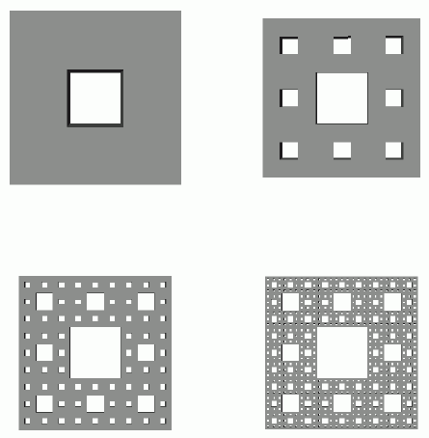
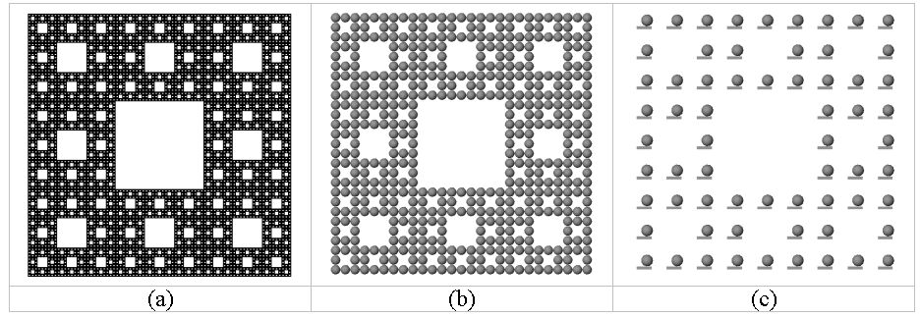
Development:
public void run()
{ [
Axiom ==> A;
A ==> Scale(0.3333) for (int i:(-1:1))
for (int j:(-1:1))
if ((i+1)*(j+1) != 1)
( [ Translate(i, j, 0) A ] );
]
applyInterpretation();
}
public void interpret()
[
A ==> Box;
]
(a)
(b)
(c)
A ==> Box(0.1, 0.5, 0.1)
Translate(0.1, 0.25, 0) Sphere(0.2);
A ==> Sphere(0.5);

Slide 31
what is generated by this example?
public void run()
{
[
Axiom ==> [ A(0, 0.5) D(0.7) F(60) ] A(0, 6) F(100);
A(t, speed) ==> A(t+1, speed);
]
applyInterpretation();
}
public void interpret()
[
A(t, speed) ==> RU(speed*t);
]

Slide 32
a very similar type of rules in XL:
instantiation rules
purpose: replacement of single modules by more complicated structures, only for visual representation
(similar as for interpretive rules)
but: less data are stored (less usage of memory)
only one vertex in the graph for the instantiated structure
in contrast to interpretive rules, no turtle commands
with effect on other nodes can be used
further, arising possibility: “replicator nodes“ for copying and relocation of whole structures

Slide 33
instantiation rules: syntax
no new sort of rule arrow
specification of the instantiation rule directly in the declaration of the module which is to be replaced
module A ==> B C D;
replaces (instantializes) everywhere A by B C D

Slide 34
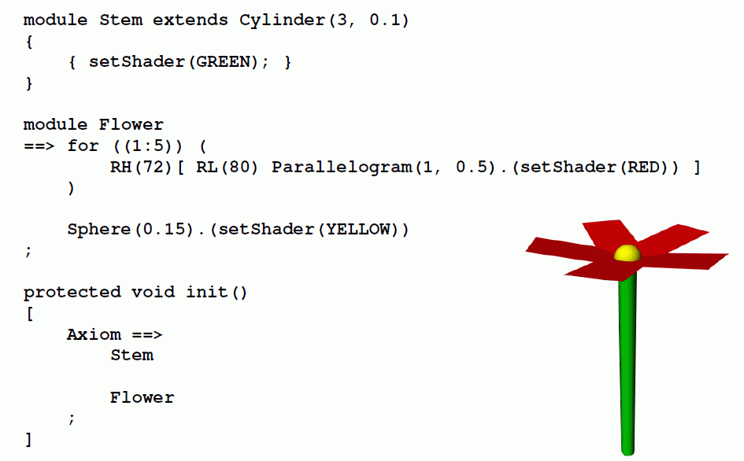
the flower example again:
{
instantiation rule

Slide 35
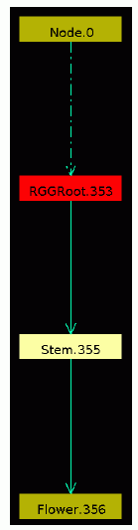
the resulting graph:

Slide 36
another example:
Usage of instantiation rules for multiplyer objects
sm09_e43.rgg
const int multiply = EDGE_0; /* user-defined edge type */
module Johnny ==> F(20, 1)
[ M(-8) RU(45) F(6, 0.8) Sphere(1) ]
[ M(-5) RU(-45) F(4, 0.6) Sphere(1) ] Sphere(2);
Johnny is instantiated with the red structure

Slide 37
another example:
Usage of instantiation rules for multiplyer objects
sm09_e43.rgg
const int multiply = EDGE_0; /* user-defined edge type */
module Johnny ==> F(20, 1)
[ M(-8) RU(45) F(6, 0.8) Sphere(1) ]
[ M(-5) RU(-45) F(4, 0.6) Sphere(1) ] Sphere(2);
module Replicator ==> [ getFirst(multiply) ] Translate(10, 0, 0)
[ getFirst(multiply) ];
Johnny is instantiated with the red structure
inserts all what comes after the „multiply“ edge

Slide 38
another example:
Usage of instantiation rules for multiplyer objects
sm09_e43.rgg
const int multiply = EDGE_0; /* user-defined edge type */
module Johnny ==> F(20, 1)
[ M(-8) RU(45) F(6, 0.8) Sphere(1) ]
[ M(-5) RU(-45) F(4, 0.6) Sphere(1) ] Sphere(2);
module Replicator ==> [ getFirst(multiply) ] Translate(10, 0, 0)
[ getFirst(multiply) ];
public void run()
[
Axiom ==> F(2, 6) P(10) Replicator -multiply-> Johnny;
]
Johnny is instantiated with the red structure
inserts all what comes after the „multiply“ edge

Slide 39
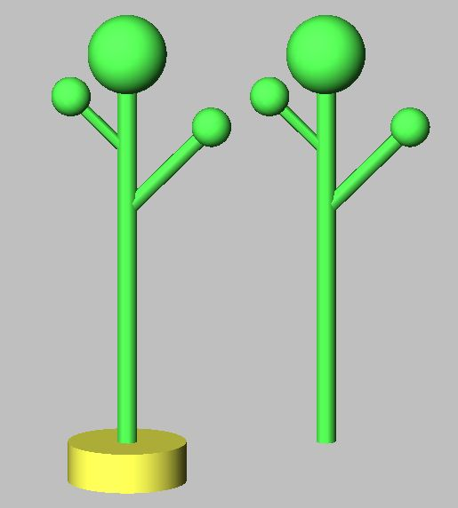
result:

Slide 40
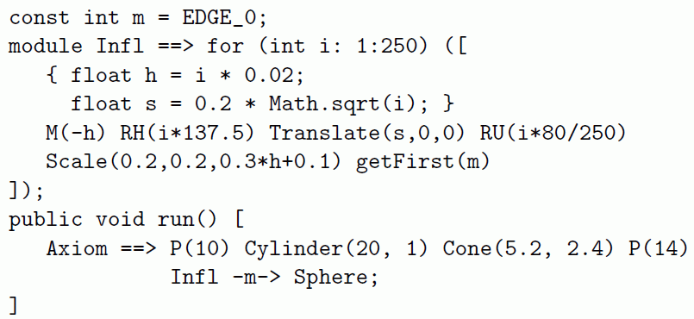
Example: Inflorescence architecture
XL code

Slide 41
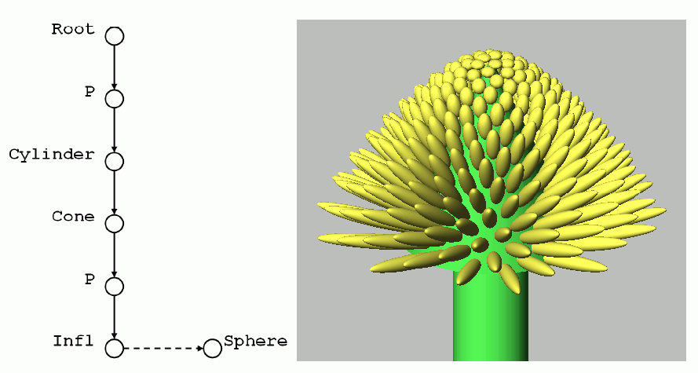
Example: Inflorescence architecture
generated graph and 3-d result

Slide 42
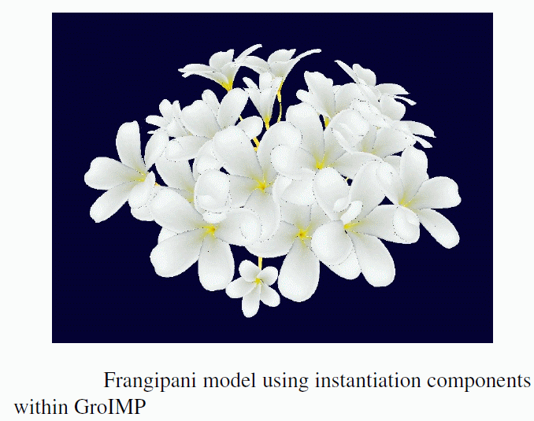
Example: Inflorescence architecture
Frangipani example
(by M. Henke)

Slide 43
Suggestions for team session
1. Generate a plant with parameterized leaves (parameters:
length, width, ratio petiole/blade length, ...)
- with interpretive rules,
- with instantiation rules.
2. Create a model for a circular arrangement of mushrooms
(“witches ring“). Use an instantiation rule for the multiplication and arrangement.

