Slide 1

Functional-Structural Plant Modelling
with GroIMP and XL
Tutorial and Workshop at Agrocampus Ouest, Angers,
5-7 May, 2015
Winfried Kurth
University of Göttingen,
Department Ecoinformatics, Biometrics and Forest Growth
More advanced XL programming
(Queries etc.)

Slide 2
The language XL
• extension of Java
• allows also specification of L-systems and RGGs
(graph grammars) in an intuitive rule notation
procedural blocks, like in Java: { ... }
rule-oriented blocks (RGG blocks): [ ... ]

Slide 3
Features of the language XL:
● nodes of the graph are Java objects (including geometry objects)
example: XL programme for the Koch curve (see part 1)
public void derivation()
[
Axiom ==> RU(90) F(10);
F(x) ==> F(x/3) RU(-60) F(x/3) RU(120) F(x/3) RU(-60) F(x/3);
]
nodes of the graph
edges (type „successor“)

Slide 4
special nodes:
geometry objects
Box, Sphere, Cylinder, Cone, Frustum, Parallelogram...
access to attributes by parameter list:
Box(x, y, z) (length, width, height)
or with special functions:
Box(...).(setColor(0x007700)) (colour)

Slide 5
special nodes:
geometry objects
Box, Sphere, Cylinder, Cone, Frustum, Parallelogram...
transformation nodes
Translate(x, y, z), Scale(cx, cy, cz), Scale(c),
Rotate(a, b, c), RU(a), RL(a), RH(a), RV(c), RG, ...
light sources
PointLight, DirectionalLight, SpotLight, AmbientLight

Slide 6
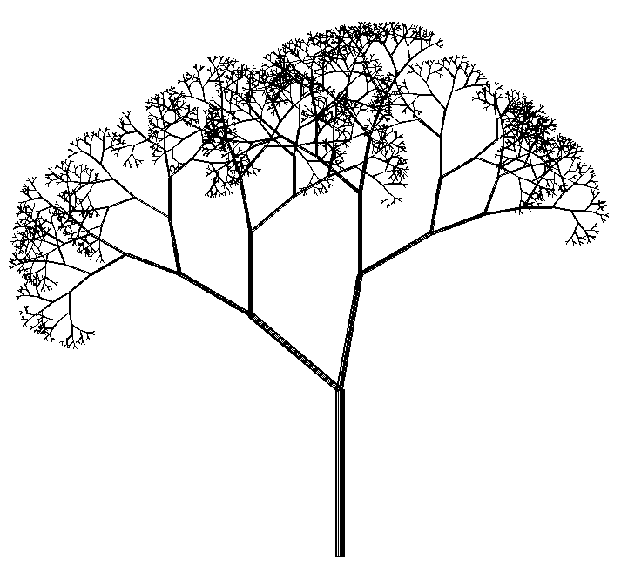
Features of the language XL:
● rules organized in blocks [...], control of application
by control structures
example: rules for the stochastic tree
Axiom ==> L(100) D(5) A;
A ==> F0 LMul(0.7) DMul(0.7)
if (probability(0.5))
( [ RU(50) A ] [ RU(-10) A ] )
else
( [ RU(-50) A ] [ RU(10) A ] );

Slide 7
Features of the language XL:
● parallel application of the rules
(can be modified: sequential mode can be switched on, see below)

Slide 8
Features of the language XL:
● parallel execution of assignments possible (deferred assignment)
special assignment operator := besides the normal =
quasi-parallel assignment to the variables x and y:
x := f(x, y);
y := g(x, y);

Slide 9
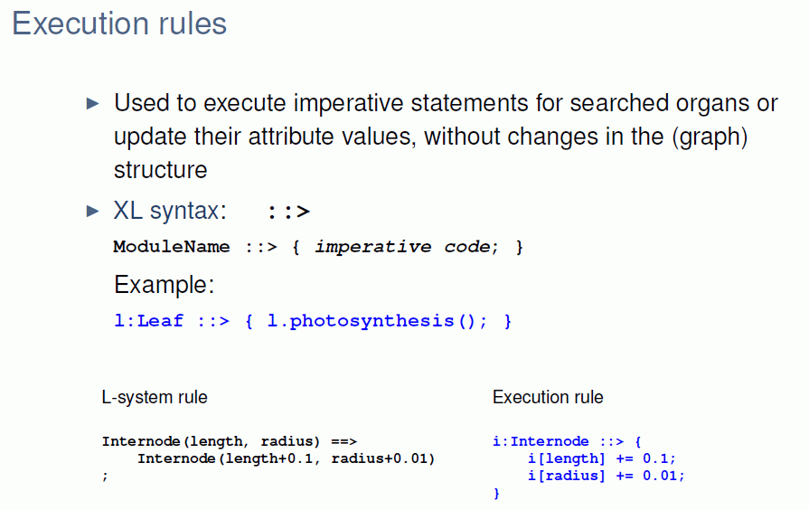
Features of the language XL:
● execution rules

Slide 10
execution rule
A ::> { imperative code };
Test the examples sm09_e25.rgg, sm09_e16.rgg,
sm09_e17.gsz, sm09_e18.rgg
and concerning the access to node attributes: sm09_e26.rgg

Slide 11
Features of the language XL:
● set-valued expressions (more precisely: producer instead of sets)
● graph queries to analyze the actual structure

Slide 12
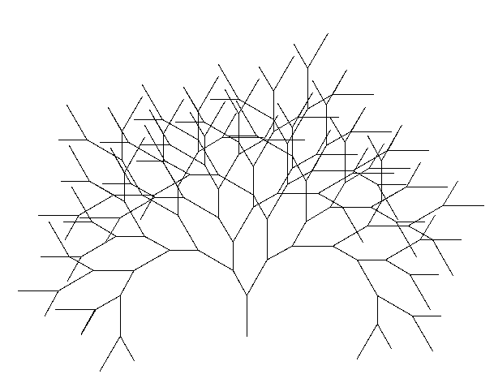
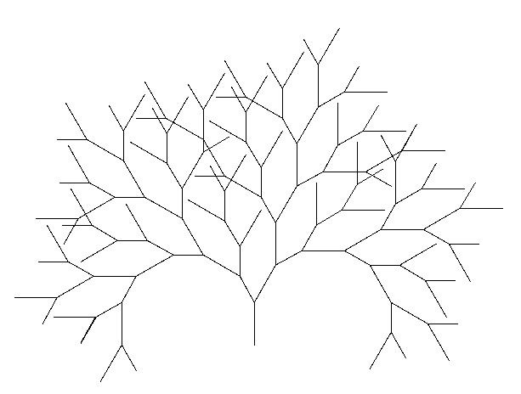
example for a graph query:
binary tree, growth shall start only if there is enough distance to other F objects
Axiom ==> F(100) [ RU(-30) A(70) ] RU(30) A(100);
a:A(s) ==> if ( forall(distance(a, (* F *)) > 60) )
( RH(180) F(s) [ RU(-30) A(70) ] RU(30) A(100) )
without the „if“ condition with the „if“ condition

Slide 13
query syntax:
a query is enclosed by (* *)
The elements are given in their expected order, e.g.:
(* A A B *) searches for a subgraph which consists of a sequence of nodes of the types A A B, connected by successor edges.
Queries as generalized contexts:
test the examples sm09_e28.rgg, sm09_e29.rgg,
sm09_e30.rgg

Slide 14
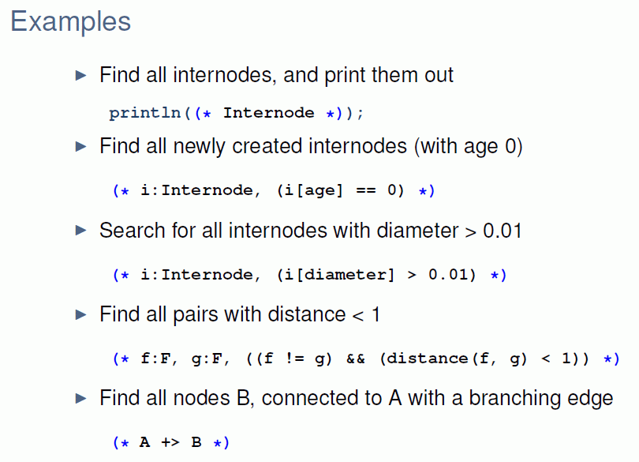

Slide 15
Features of the language XL:
● aggregating operators (e.g., „sum“, „mean“, „empty“, „forall“,
„selectWhereMin“)
can be applied to set-valued results of a query

Slide 16
Queries and aggregating operators
provide possibilities to connect structure and function
example: search for all leaves which are successors of node c and sum up their surface areas
query
result can be transferred to an imperative calculation
transitive closure
aggregation operator

Slide 17
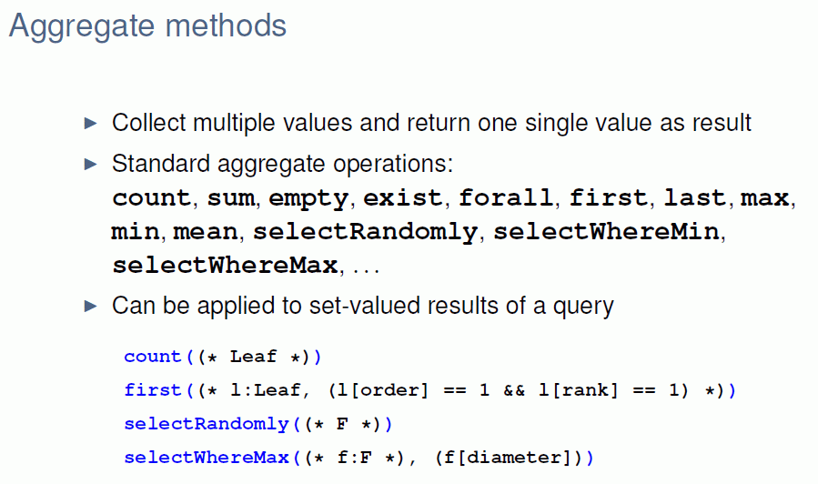

Slide 18
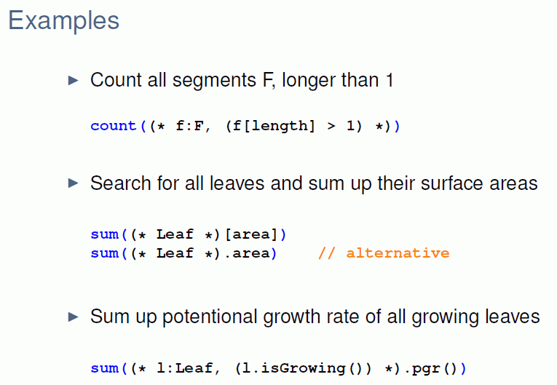

Slide 19
Queries in XL
test the examples
sm09_e31.rgg,
sm09_e35.rgg,
sm09_e36.rgg

Slide 20
for light interception / photosynthesis:
a simple model of overshadowing
using a query referring to a geometric region in space
model approach (strongly simplifying):
overshadowing of an object occurs when there are further objects in an imagined cone with its apex in the object, opened into z direction (to the sky).
example:
sm09_e42.rgg competition of three 2-dimensional model
plants for light

Slide 21
module Segment(int t, int ord) extends F0;
module TBud(int t) extends F(1, 1, 1);
module LBud extends F(0.5, 0.5, 1);
Vector3d z = new Vector3d(0, 0, 1);
protected void init()
[
Axiom ==> P(2) D(5) V(-0.15) [ TBud(-4) ] RU(90) M(600) RU(-90)
[ TBud(0) ] RU(-90) M(1200) RU(90)
[ TBud(-8) ];
]
public void run()
[
TBud(t), (t < 0) ==> TBud(t+1);
x:TBud(t), (t >= 0 && empty( (* s:Segment, (s in cone(x, z, 45)) *) ) ) ==>
L(random(80, 120)) Segment(0, 0)
[ MRel(random(0.5, 0.9)) RU(60) LBud ]
[ MRel(random(0.5, 0.9)) RU(-60) LBud ] TBud(t+1);
y:LBud,
(empty( (* s:Segment, (s in cone(y, z, 45)) *) ) ) ==>
L(random(60, 90) Segment(0, 1) RV0 LBud;
Segment(t, o), (t < 8) ==> Segment(t+1, o);
Segment(t, o), (t >= 8 && o == 1) ==>> ; /* removal of the whole branch */
]

Slide 22
Representation of graphs in XL
● node types must be declared with „module“
● nodes can be all Java objects.
In user-made module declarations, methods (functions) and
additional variables can be introduced, like in Java
● notation for nodes in a graph:
Node_type, optionally preceded by: label:
Examples: A, Meristem(t), b:Bud
● notation for edges in a graph:
-edgetype->, <-edgetype-
● special edge types:
successor edge: -successor->, > or (blank)
branch edge: -branch->, +> or [
refinement edge: />

Slide 23
Notations for special edge types
> successor edge forward
< successor edge backward
--- successor edge forward or backward
+> branch edge forward
<+ branch edge backward
-+- branch edge forward or backward
/> refinement edge forward
</ refinement edge backward
--> arbitrary edge forward
<-- arbitrary edge backward
-- arbitrary edge forward or backward
(cf. Kniemeyer 2008, p. 150 and 403)

Slide 24
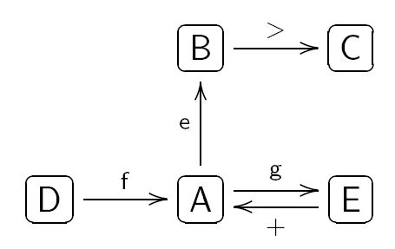
user-defined edge types
const int xxx = EDGE_0; // oder EDGE_1, ..., EDGE_14
...
usage in the graph: -xxx->, <-xxx-, -xxx-
Notation of graphs in XL
example:
is represented in programme code as
(the representation is not unique!)
( >: successor edge, +: branch edge)

Slide 25
Derived relations
Relations between nodes connected by more than 1 edge
E.g.: Relation between nodes connected by several edges (one after the other) of the same type:
„transitive closure“ of the original relation (edge)

Slide 26
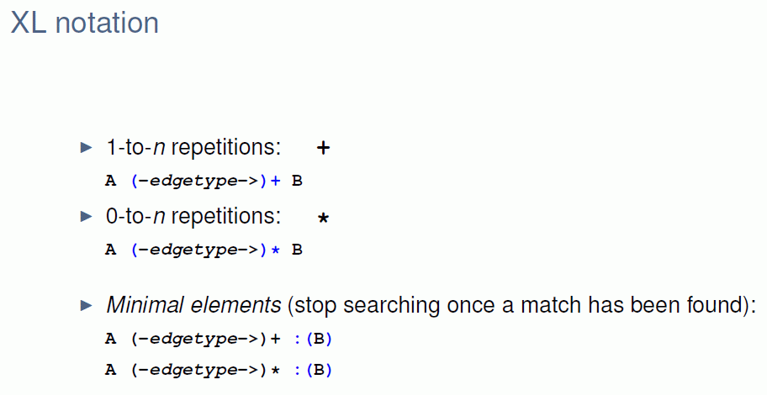

Slide 27
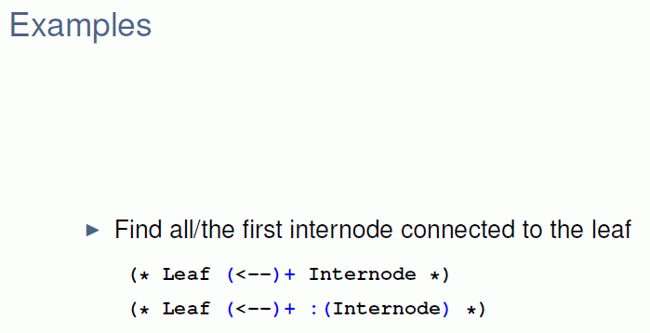

Slide 28
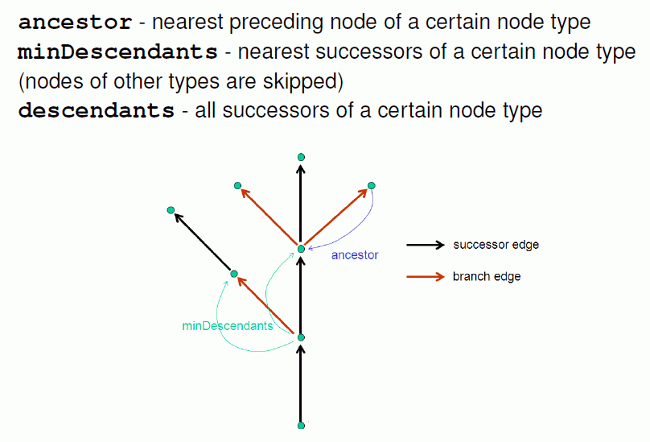

Slide 29
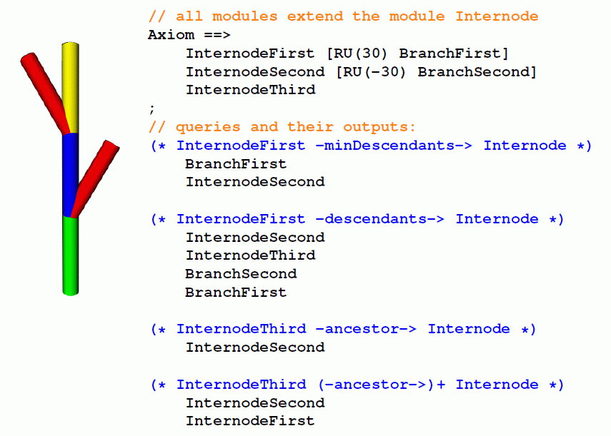

Slide 30
The current graph
GroIMP maintains always a graph which contains the complete current structural information. This graph is transformed by application of the rules.
Attention: Not all nodes are visible objects in the 3-D view of the structure!
F0, F(x), Box, Sphere: yes
RU(30), A, B: normally not (if not derived by „extends“
from visible objects)
The graph can be completely visualized in the 2-D graph view (in GroIMP: Panels - 2D - Graph).

Slide 31
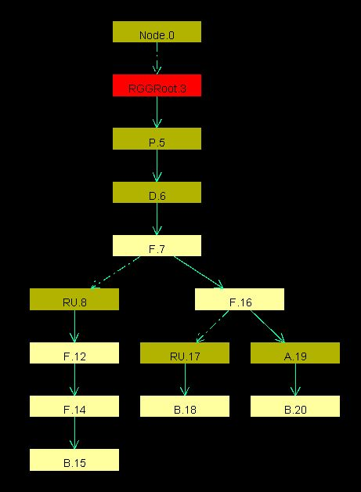
Load an example RGG file in GroIMP and execute some steps (do not work with a too complex structure).
Open the 2-D graph view, fix the window with the mouse in the GroIMP user interface and test different layouts (Layout - Edit).
Keep track of the changes of the
graph when you apply the rules
(click on „redraw“)!

Slide 32
which parts of the current graph of GroIMP are visible
(in the 3-d view) ?
all geometry nodes which can be accessed from the root (denoted ^) of the graph by exactly one path, which consists only of "successor" and "branch" edges
How to enforce that an object is visible in any case:
==>> ^ Object

