Slide 1

Functional-Structural Plant Modelling
with GroIMP and XL
Tutorial and Workshop at Agrocampus Ouest, Angers,
5-7 May, 2015
Winfried Kurth
University of Göttingen,
Department Ecoinformatics, Biometrics and Forest Growth
How to develop a simple FSPM

Slide 2
A simple FSPM in 9 steps
- no real species, more sort of a typical basic shape and development
- (cf. Goethe: „Urpflanze“)
- mimics an annual plant (but can be modified and generalized)
- functional part will be (in the end): light interception, photosynthesis, transport of assimilates in the plant
- in the first versions: purely structural model of a plant

Slide 3
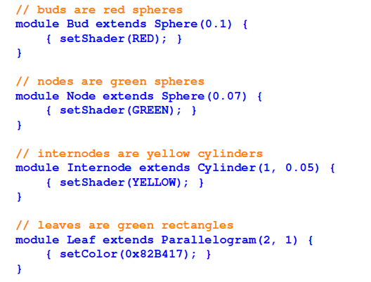

Slide 4
first version (sfspm01.rgg):
/* Steps towards a simple FSPM. sfspm01.rgg:
A simple plant with leaves and branching is generated.
Original version by G. Buck-Sorlin; modified. */
module Bud extends Sphere(0.1)
{{ setShader(RED); }};
module Node extends Sphere(0.07)
{{ setShader(GREEN); }};
module Internode extends F;
/* leaves are rectangles: */
module Leaf extends Parallelogram(2, 1);
const float G_ANGLE = 137.5; /* golden angle */
/* simple plant, with leaves and branches: */
protected void init()
[
Axiom ==> Bud;
]
public void run()
[
Bud ==> Internode Node [ RL(50) Bud ] [ RL(70) Leaf ]
RH(G_ANGLE) Internode Bud;
]

Slide 5
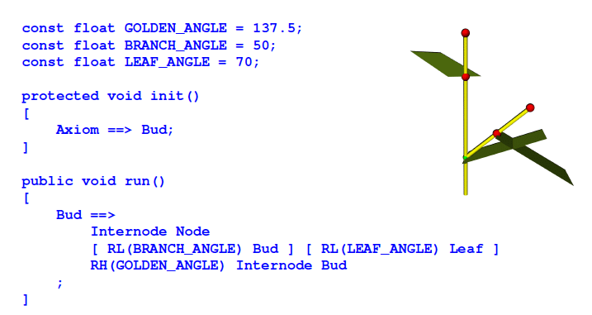

Slide 6
second version (sfspm02.rgg):
module Bud(int order) extends Sphere(0.0001)
{{ setShader(RED); setRadius(0.2); }};
module Node extends Sphere(0.07)
{{ setShader(GREEN); }};
module Internode extends F;
/* leaves are rectangles: */
module Leaf extends Parallelogram(2, 1);
const float G_ANGLE = 137.5; /* golden angle */
/* simple plant, with leaves and branches: */
protected void init()
[
Axiom ==> Bud(0);
]
public void run()
[
Bud(o), (o < 3) ==> Internode Node [ RL(50) Bud(o+1) ]
[ RL(70) Leaf] RH(G_ANGLE) Internode Bud(o);
]

Slide 7
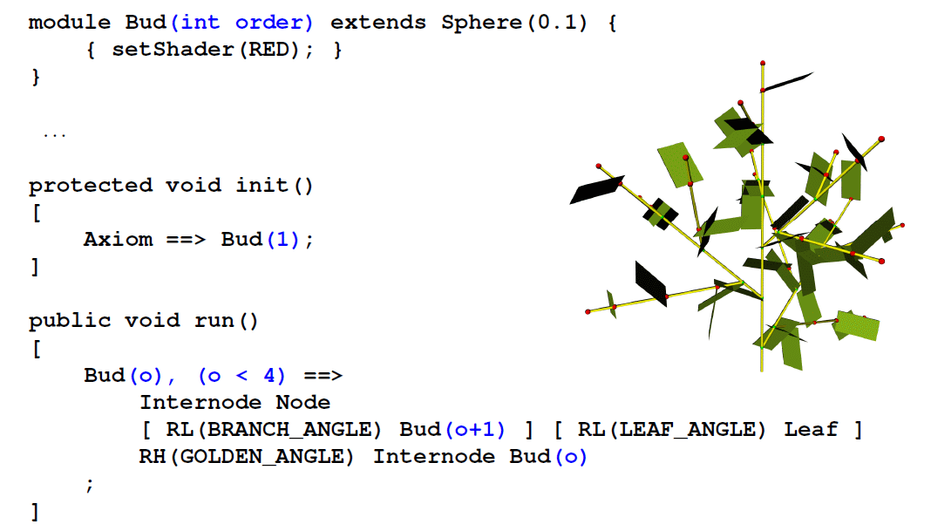

Slide 8
third version:
more precise timing for appearance of new metamers (internode, node, leaf)
phyllochron = time span between the appearances of new metamers in apical position at the same shoot axis
(often used as synonym: plastochron, but this means in its proper sense the time span between two initiations of new metamers)
(phyllochron: notion does not depend on growth being preformed or neoformed)
Time count in the model in discrete steps
(1 step = 1 parallel application of rules)

Slide 9
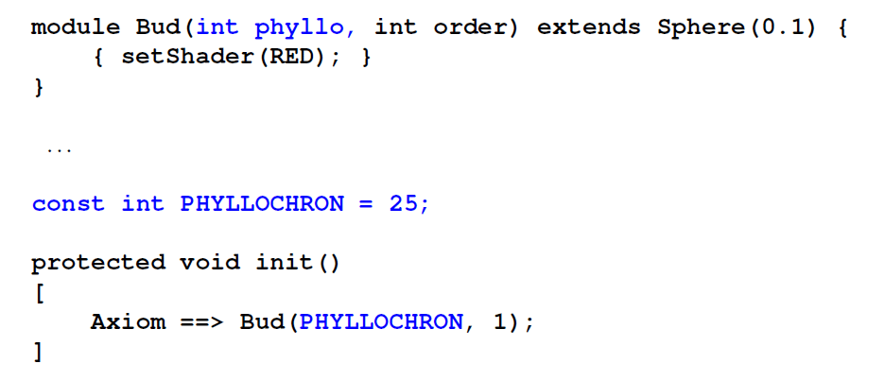

Slide 10
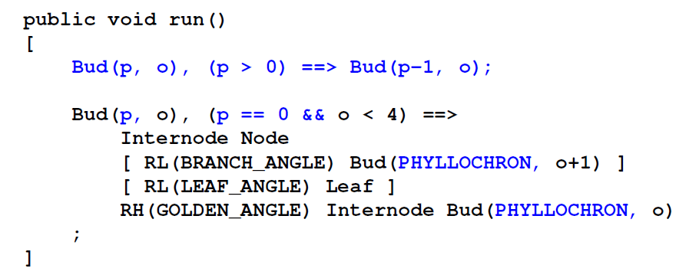

Slide 11
sfspm03.rgg
module Bud (int ph, int order) extends Sphere(0.1)
{{ setShader(RED); }};
module Node extends Sphere(0.07)
{{ setShader(GREEN); }};
module Internode extends F;
module Leaf extends Parallelogram(2, 1);
const float G_ANGLE = 137.5; /* golden angle */
/* introducing a phyllochron */
const int phyllo = 25;
protected void init()
[
Axiom ==> Bud(phyllo, 0);
]
public void run()
[
Bud(p, o), (p > 0) ==> Bud(p-1, o); /* first parameter
counted down until...*/
Bud(p, o), (p == 0 && o <= 1) ==> Internode Node
[ RL(50) Bud(phyllo, o+1) ] [RL(70) Leaf]
RH(G_ANGLE) Internode Bud(phyllo, o);
/* (order restricted to 1 ... for efficiency) */
]

Slide 12
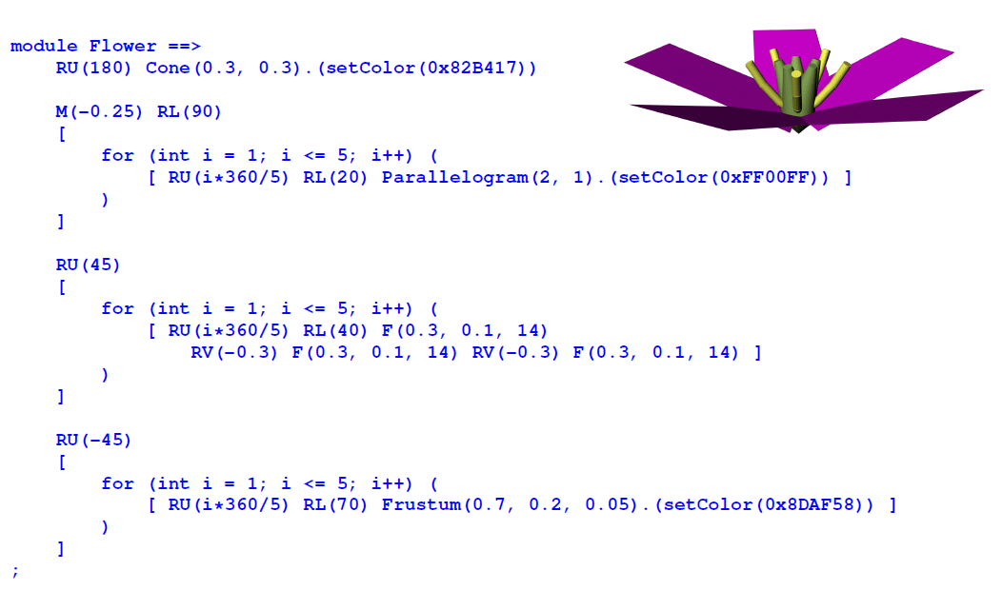
Introducing flowers

Slide 13
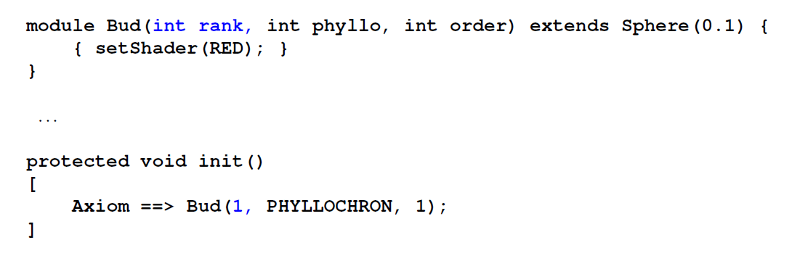

Slide 14
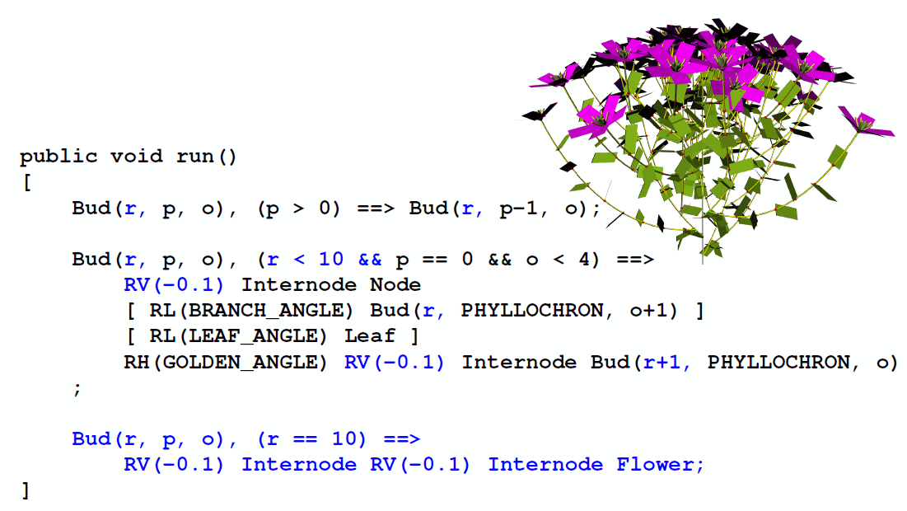

Slide 15
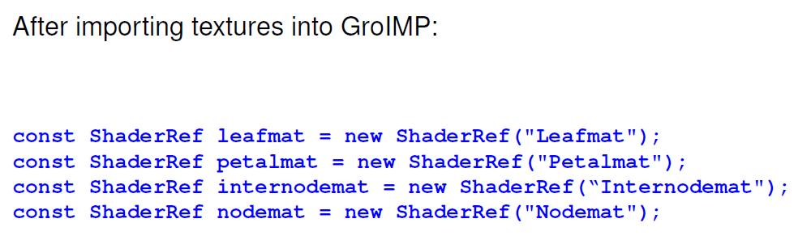

Slide 16
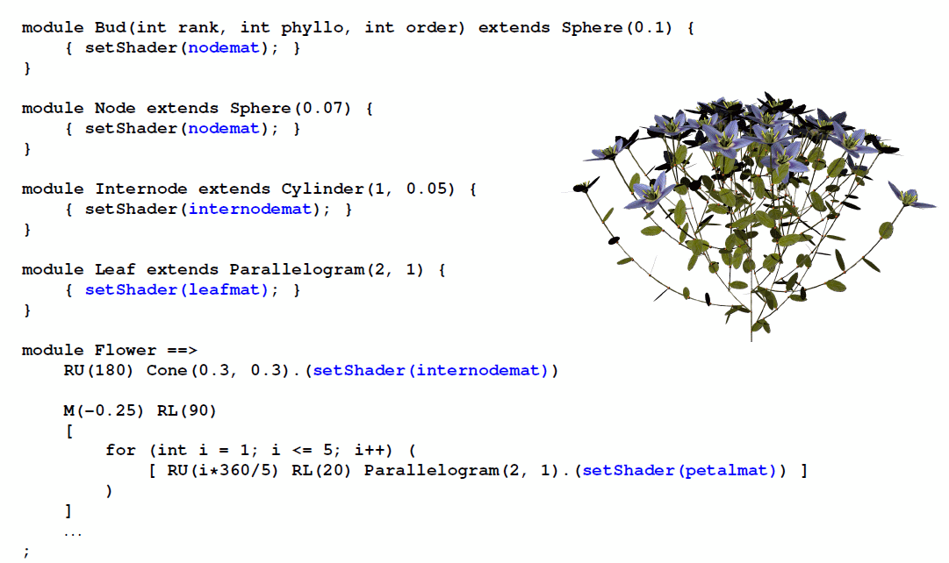

Slide 17
sfspm04.gsz: with flowers; textured organs
const ShaderRef leafmat = new ShaderRef("Leafmat");
const ShaderRef petalmat = new ShaderRef("Petalmat");
const ShaderRef internodemat = new ShaderRef("Internodemat");
const ShaderRef nodemat = new ShaderRef("Nodemat");
module Bud(int time, int ph, int order) extends Sphere(0.1)
{{ setShader(nodemat); }};
module Node extends Sphere(0.07)
{{ setShader(GREEN); }};
module NiceNode extends Sphere(0.07)
{{ setShader(nodemat); }};
module Internode extends F(1, 0.1, 7);
module NiceInternode extends Cylinder(1, 0.08)
{{ setShader(internodemat); }};
module Leaf extends Parallelogram(2, 1)
{{ setColor(0x82B417); }};
module NiceLeaf extends Parallelogram(2,2)
{{ setShader(leafmat); }};
module Flower ==> /* instantiation rule */
RU(180) Cone(0.3, 0.3).(setColor(0x82B417)) M(-0.25) RL(90)
[ for (int i=1; i<=5; i++) ( [ RU(i*360/5) RL(20)
Parallelogram(2, 1).(setColor(0xFF00FF)) ] ) ] RU(45)
[ for (int i=1; i<=5; i++) ( [ RU(i*360/5) RL(40) F(0.3, 0.1, 14) RV(-0.3)
F(0.3, 0.1, 14) RV(-0.3) F(0.3, 0.1, 14) ] ) ] RU(-45)
[ for (int i=1; i<=5; i++) ( [ RU(i*360/5) RL(70)
Frustum(0.7, 0.2, 0.05).(setColor(0x8DAF58)) ] )
module NiceFlower ==>
RU(180) Cone(0.3, 0.3).(setShader(internodemat)) M(-0.25) RL(90)
[ for (int i=1; i<=5; i++) ( [ RU(i*360/5) RL(20)
Parallelogram(2, 1).(setShader(petalmat)) ] ) ] RU(45)
[ for (int i=1; i<=2; i++) ( [ RU(i*360/3) RL(40) F(0.3, 0.1, 14) RV(-0.3)
F(0.3, 0.1, 14) RV(-0.3) F(0.3, 0.1, 14) ] ) ] RU(-45)
[ for (int i=1; i<=5; i++) ( [ RU(i*360/5) RL(70)
Frustum(0.7, 0.2, 0.05).(setColor(0x8DAF58)) ] ) ];

Slide 18
// sfspm04.gsz, continued
const float G_ANGLE = 137.5; /* golden angle */
const int phyllo = 25;
protected void init()
[
Axiom ==> Bud(1, phyllo, 0);
]
public void run()
[
Bud(r, p, o), (p > 0) ==> Bud(r, p-1, o);
Bud(r, p, o), (r<10 && p==0 && o<=2) ==> RV(-0.1) NiceInternode NiceNode
[ RL(50) Bud(r, phyllo, o+1) ] [ RL(70) NiceLeaf ] RH(G_ANGLE) RV(-0.1)
NiceInternode Bud(r+1, phyllo, o);
Bud(r, p, o), (r == 10) ==> RV(-0.1) NiceInternode RV(-0.1) NiceInternode NiceFlower;
]
additionally there are image files for the used textures, which are connected manually in GroIMP with the shader names „Leafmat“, „Petalmat“ etc.

Slide 19
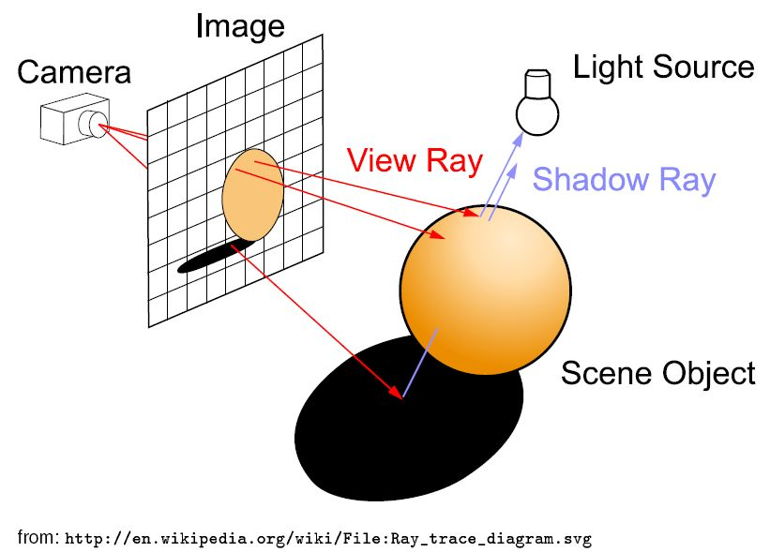
principle of radiation model
ray tracing – a method from computer graphics
basic idea:
additionally the ray can be traced along one or several reflections

Slide 20
we do not want to generate an image, but calculate for all leaves of the virtual plant the amount of intercepted light
→ reversal of the direction of the rays:
they run from the light sources to the objects. An extra shadow test is no longer necessary.
A large number of rays with random directions is generated: „Monte-Carlo ray tracing“
accumulation of the intercepted power of radiation (in the unit W = Watt) is possible for each object
Condition: there has to be a light source in the scene

Slide 21
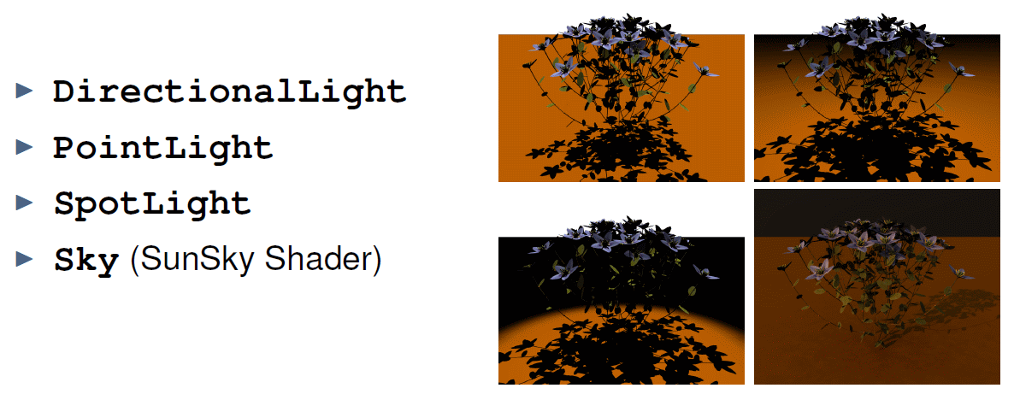
Light sources in GroIMP

Slide 22
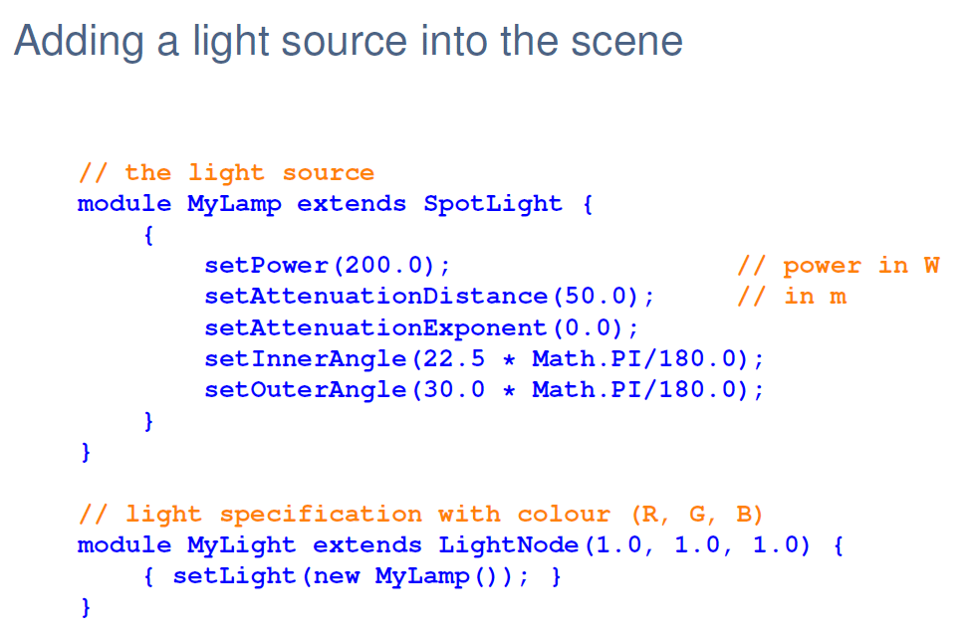

Slide 23
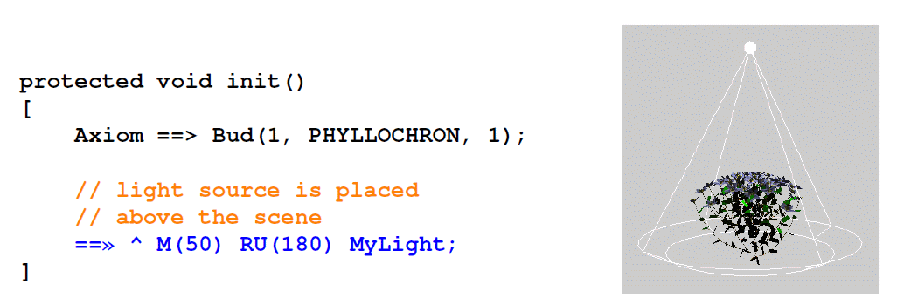

Slide 24
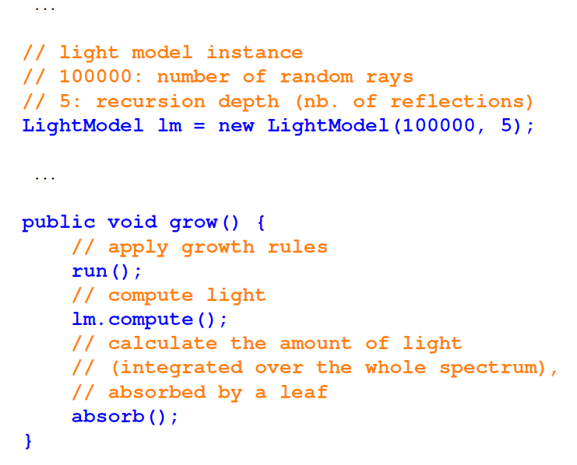

Slide 25
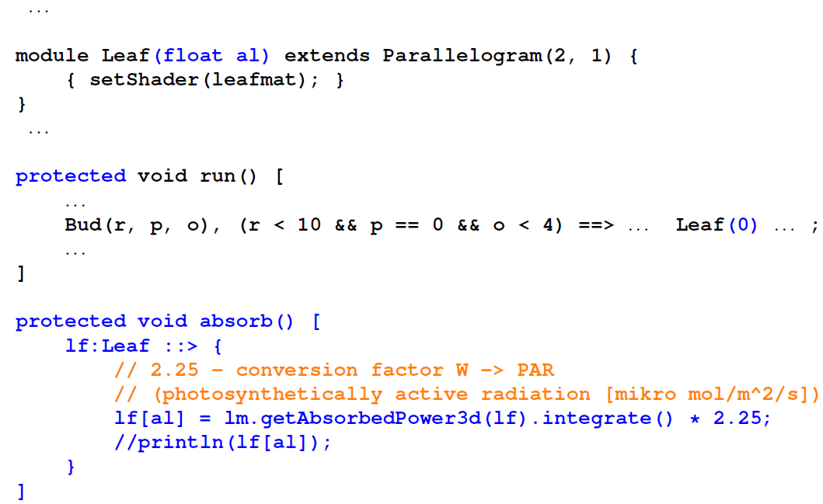

Slide 26
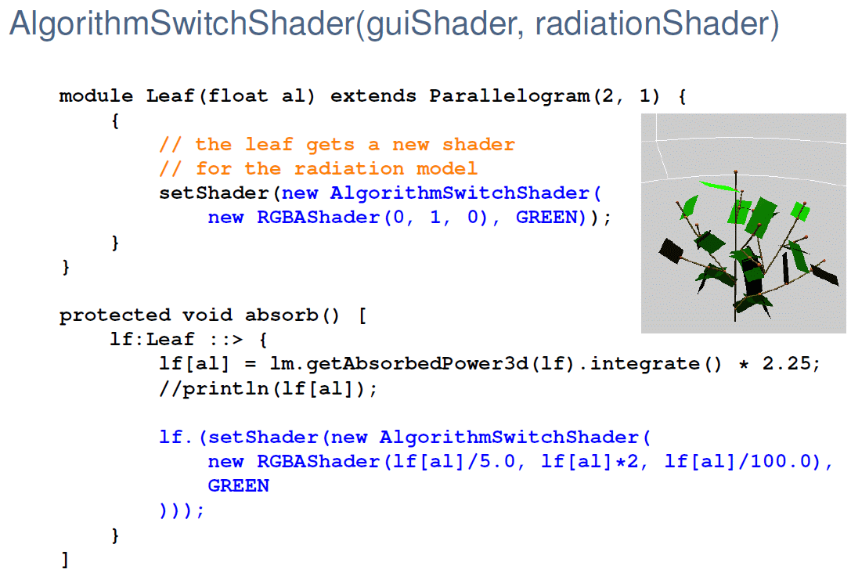

Slide 27
sfspm05.gsz (only the new parts of the model are displayed: )
// ..... module definitions .....
/* the leaf collects light and gets a new shader for the radiation model: */
module Leaf(float al) extends Parallelogram(2, 1)
{{ setShader(new AlgorithmSwitchShader(new RGBAShader(0, 1, 0), GREEN)); }};
// ..... further module definitions .....
/* the light source: */
module MyLamp extends SpotLight
{{
setPower(200.0); /* power in W */
setAttenuationDistance(50.0); /* in m */
setAttenuationExponent(0.0);
setInnerAngle(22.5*Math.PI/180.0);
setOuterAngle(30.0*Math.PI/180.0);
}};
module MyLight extends LightNode(1.0, 1.0, 1.0) /* R, G, B */
{{ setLight(new MyLamp()); }};
/* the radiation model is defined */
LightModel lm = new LightModel(100000, 5);
/* 100000: number of random rays, 5: recursion depth (nb. of reflections) */

Slide 28
sfspm05.gsz (only new parts of the model are displayed; continued: )
protected void init()
[
Axiom ==> Bud(1, phyllo, 0);
==> ^ M(50) RU(180) MyLight; /* Light source is placed above the scene */
]
public void grow()
{
run();
lm.compute();
absorb();
}
protected void run()
[
Bud(r, p, o), (p>0) ==> ..........
// further rules....
]
protected void absorb()
[
lf:Leaf ::>
{
lf[al] = lm.getAbsorbedPower3d(lf).integrate() * 2.25;
lf.(setShader(new AlgorithmSwitchShader(
new RGBAShader((float) lf[al]/5.0, (float) lf[al]*2, (float) lf[al]/100.0),
GREEN)));
println(lf[al]);
}
]

Slide 29
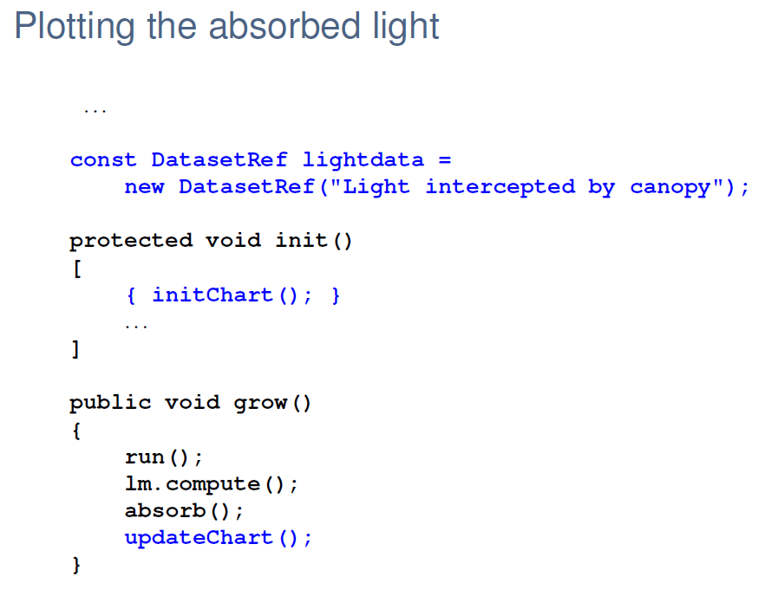

Slide 30
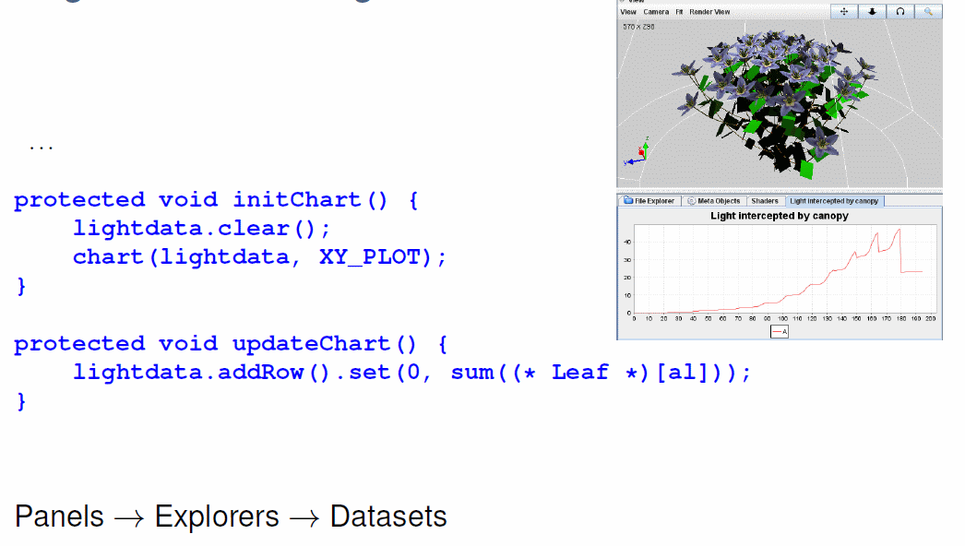

Slide 31
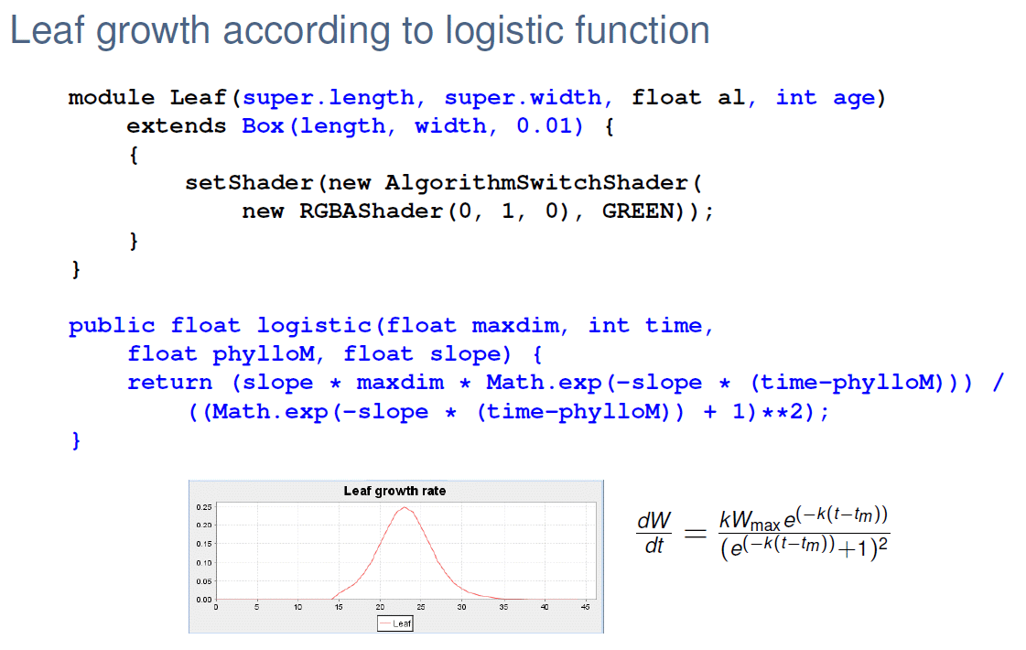

Slide 32
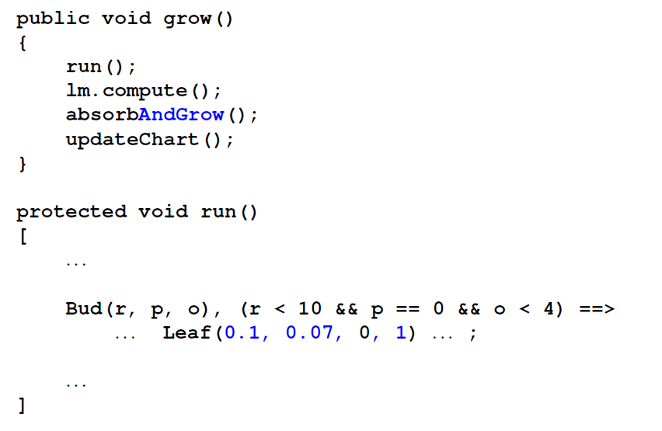

Slide 33
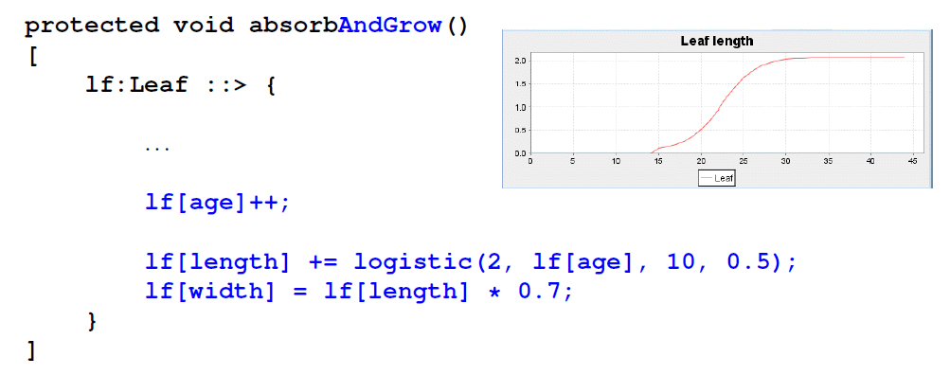

Slide 35
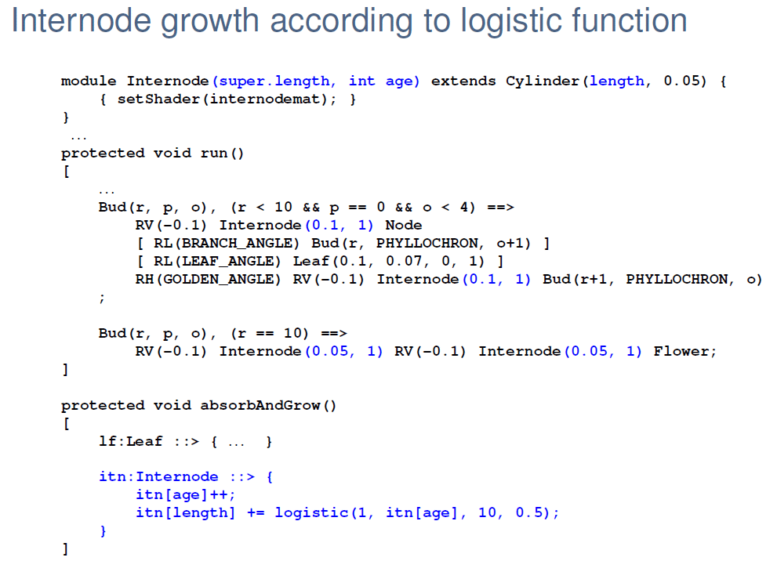

Slide 36
sfspm06.gsz: leaf growth according to logistic function,
plotting the absorbed light in a chart (new parts of model only: )
/* the leaf is modelled as a 3-d box now and gets new parameters: */
module Leaf(super.length, super.width, float al, int age)
extends Box(length, width, 0.01)
{{ setShader(new AlgorithmSwitchShader(new RGBAShader(0, 1, 0), GREEN)); }};
// ............
/* Introducing leaf growth: */
/* derivative of logistic function */
public float logistic(float maxdim, int time, float phylloM, float slope)
{
return (slope * maxdim * Math.exp(-slope*(time-phylloM))) /
((Math.exp(-slope*(time-phylloM))+1)**2);
}
/* Table for absorbed light values: */
const DatasetRef lightdata = new DatasetRef("Light intercepted by canopy");
protected void init()
[
{
lightdata.clear(); /* the chart is initialized */
chart(lightdata, XY_PLOT);
}
Axiom ==> Bud(1, phyllo, 0);
==> ^ M(50) RU(180) MyLight; /* Light source is placed above the scene */
]

Slide 37
sfspm06.gsz: leaf growth according to logistic function,
plotting the absorbed light in a chart (new parts of model only; continued: )
public void grow()
{
run();
lm.compute();
absorb_and_growleaf();
lightdata.addRow().set(0, sum((* Leaf *)[al]));
}
protected void run()
[
Bud(r, p, o), (p>0) ==> ...........
// further rules....
]
protected void absorb_and_growleaf()
[
lf:Leaf ::>
{
lf[al] = lm.getAbsorbedPower3d(lf).integrate();
lf.(setShader(new AlgorithmSwitchShader(
new RGBAShader((float) lf[al]/5.0, (float) lf[al]*2, (float) lf[al]/100.0),
GREEN)));
println(lf[al]);
lf[age]++; /* the leaf is ageing */
lf[length] += logistic(2, lf[age], 10, 0.5); /* logistic growth */
lf[width] = lf[length]*0.7;
}
]

Slide 38
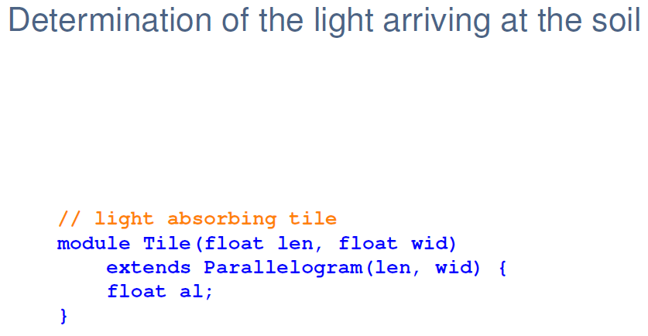

Slide 39
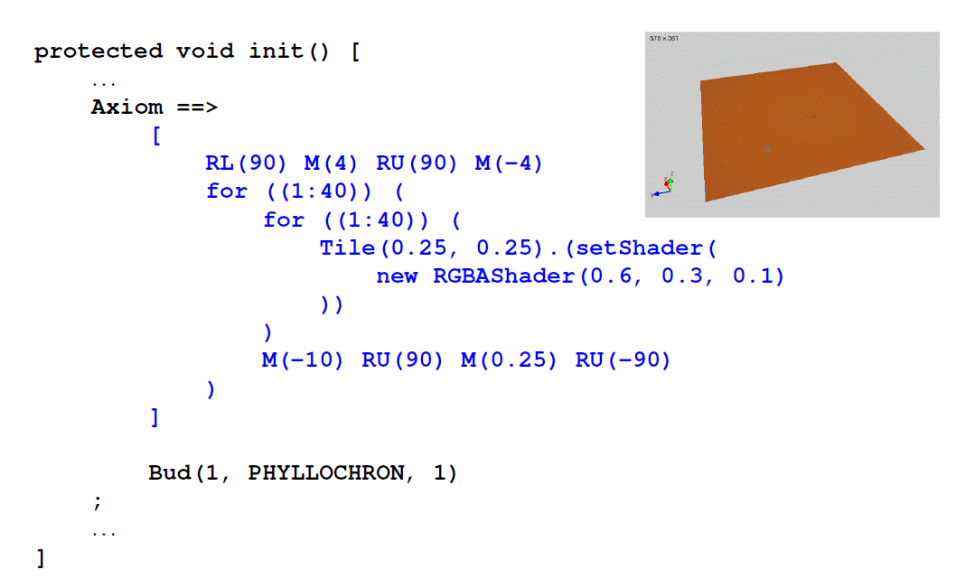

Slide 40
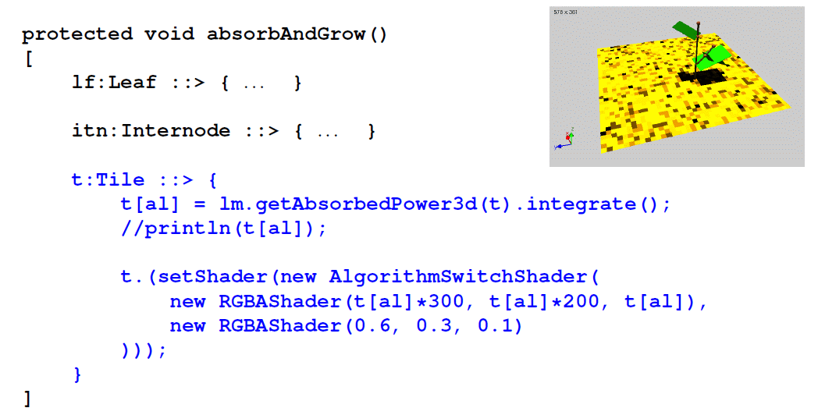

Slide 41
sfspm07.gsz: determination of the light arriving at the soil
(new parts of model only: )
// .....
/* a single tile (will be positioned on the ground): */
module Tile(float len, float wid) extends Parallelogram(len, wid)
{ float al; };
// .....
protected void init()
[
{
lightdata.clear(); /* the chart is initialized */
chart(lightdata, XY_PLOT);
}
Axiom ==> [ RL(90) M(4) RU(90) M(-4) for ((1:40)) /* paving the ground */
( for ((1:40))
( Tile(0.25, 0.25).(setShader(new RGBAShader(0.6, 0.3, 0.1))) )
M(-10) RU(90) M(0.25) RU(-90)
) ]
Bud(1, phyllo, 0);
==> ^ M(50) RU(180) MyLight; /* Light source is placed above the scene */
]
// .....
protected void absorb_and_grow()
[
lf:Leaf ::> ......
p:Tile ::>
{
p[al] = lm.getAbsorbedPower3d(p).integrate();
println(p[al]);
p.(setShader(new AlgorithmSwitchShader(new RGBAShader(
p[al]*300, p[al]*200, p[al]), new RGBAShader(0.6, 0.3, 0.1))));
}
]

Slide 42
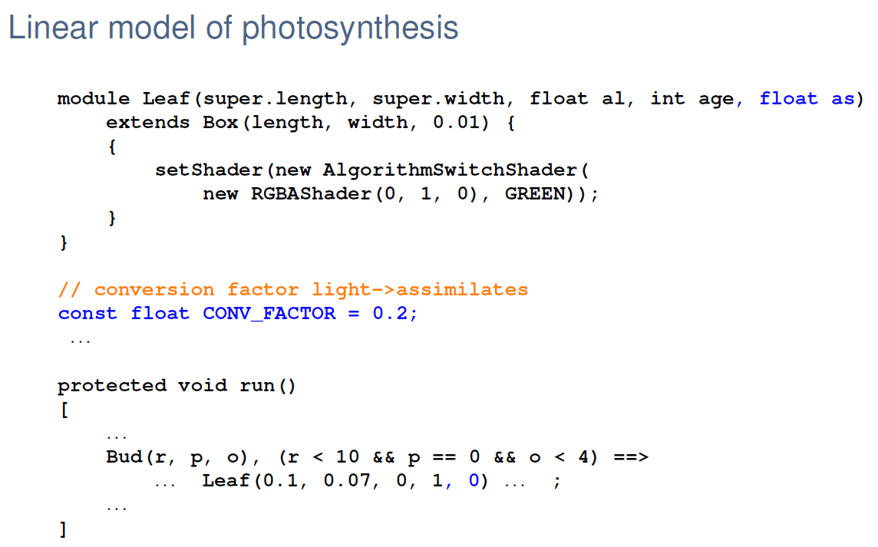
Most simple model of photosynthesis:
Assumption of a linear relationship between the absorbed light and the amount of assimilates produced in the leaf
- conversion factor CONV_FACTOR
- Leaf gets new property „as“ (produced amount of assimilates)

Slide 43
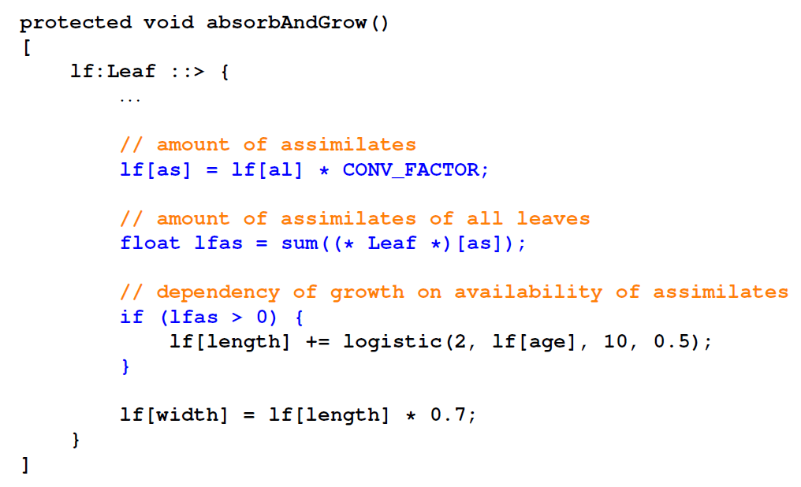

Slide 44
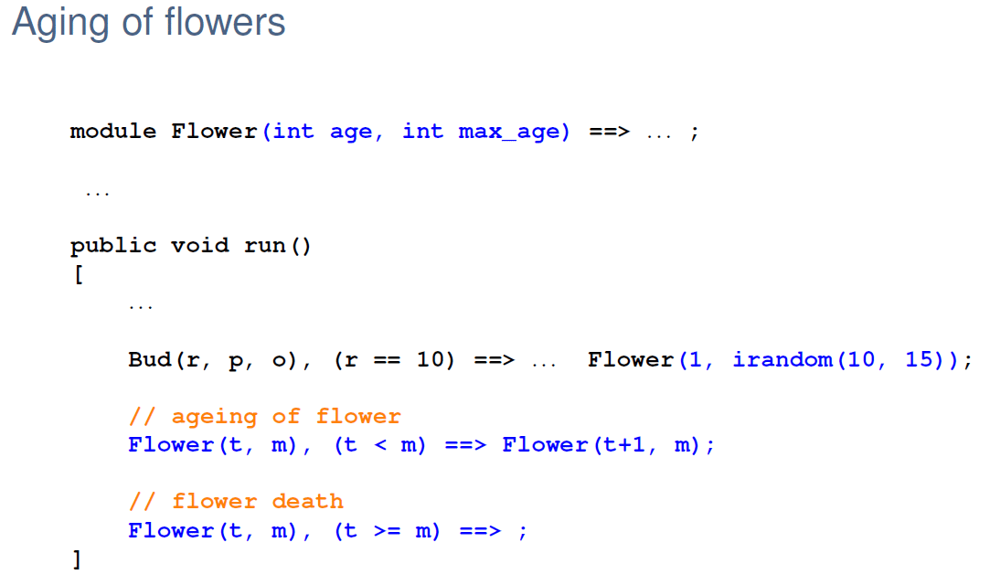

Slide 45
sfspm08.gsz: Usage of the linear model of photosynthesis
(new parts of model only: )
// .....
const float CONV_FACTOR = 0.2; /* conversion factor light->assimilates */
// .....
protected void absorb_and_grow()
[
lf:Leaf ::>
{
lf[al] = lm.getAbsorbedPower3d(lf).integrate()*2.25;
// ...................
lf[as] = lf[al] * CONV_FACTOR; /* amount of assimilates */
float lfas = sum((* Leaf *)[as]); /* ... of all leaves */
if (lfas > 0) /* dependency of growth on availability of assimilates */
{
lf[length] += logistic(2, lf[age], 10, 0.5); /* logistic growth */
}
lf[width] = lf[length]*0.7;
}
itn:Internode ::> // ......
]

Slide 46
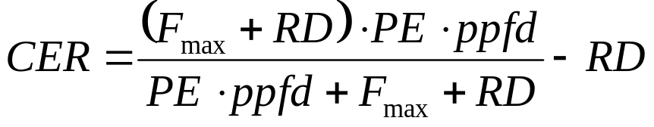
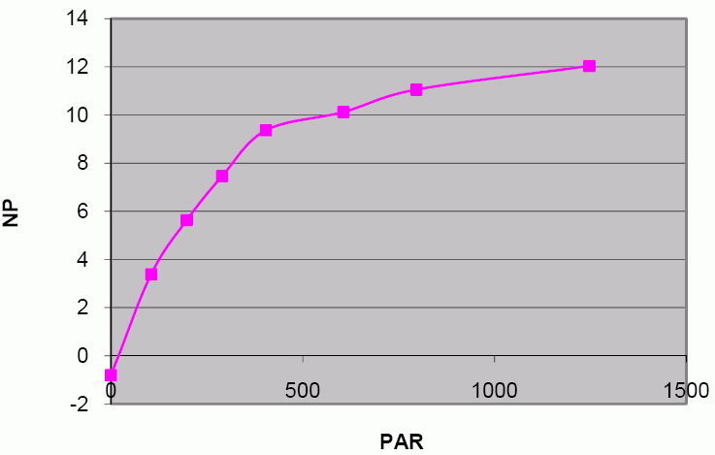
Inclusion of a more realistic (non-linear) model of photosynthesis
CO₂ exchange rate (CER): saturation curve in dependence of photon flux densitiy (ppfd) according to
with RD = dark respiration
PE = photosynthetic efficiency
F_{max} = maximal photosynthesis
Units:
CER, ppfd, RD, Fmax : μmol ⋅ m⁻¹⋅ s⁻¹ ; PE : dimensionless
sfspm09.gsz: Photosynthesis in the leaves with improved model
(calculation of photosynthesis only: )
/* function calculateCER gives the instantaneous CO2 fixation rate
(micromol CO2 m-2 s-1) depending on light intensity (ppfd).
Dependency on temperature is not included. */
float calculateCER(float ppfd)
{
return (float) ( (FMAX+DARK_RESPIRATION_RATE) * PHOTO_EFFICIENCY * ppfd) /
(PHOTO_EFFICIENCY*ppfd + FMAX + DARK_RESPIRATION_RATE) - DARK_RESPIRATION_RATE;
}
CER
ppfd

Slide 47
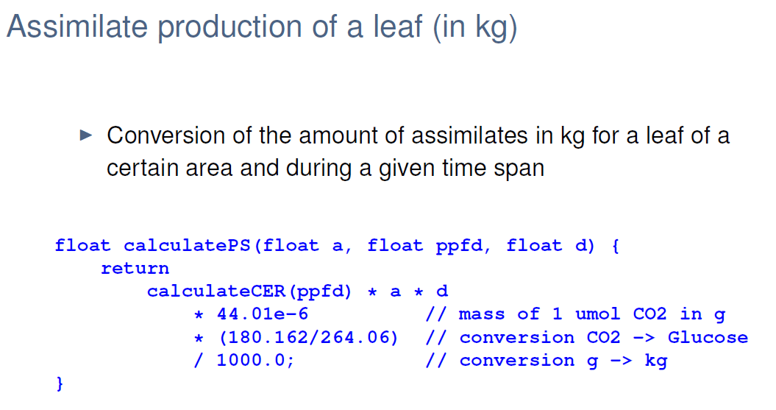

Slide 48
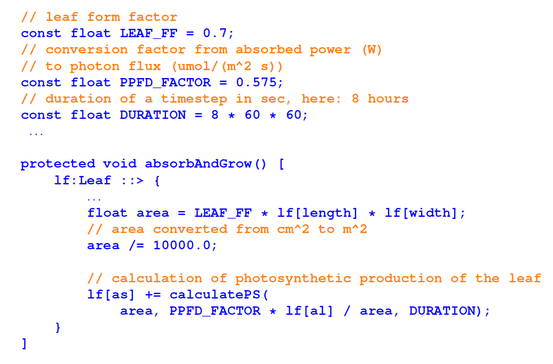

Slide 49
Conversion of the amount of assimilates in kg for a leaf of a certain area and during a given time span:
/* function calculatePS gives the assimilate production (in kg) of a leaf,
depending on leaf area a (in m**2), ppfd (in umol/(m**2 s)) and duration
d (in seconds) of light interception.
Dependency on temperature is not included. */
float calculatePS(float a, float ppfd, float d)
{
return
calculateCER(ppfd) * a * d
* 44.01e-6 /* mass of 1 umol CO2 in g */
* (180.162/264.06) /* conversion CO2 -> Glucose */
/ 1000.0; /* conversion g -> kg */
}
conversion of photon flux from W (power) in μmol ⋅ s⁻¹ :
const float PPFD_FACTOR = 0.575; /* conversion factor from absorbed
power (W) to photon flux (umol/s);
unit: umol/J; after Kniemeyer 2008 */
// .............
lf:Leaf ::>
{
lf[al] = lm.getAbsorbedPower3d(lf).integrate();
// ................
float area = LEAF_FF * lf[length] * lf[width] / 10000.0;
/* converted from cm**2 to m**2 */
/* calculation of photosynthetic production of the leaf: */
lf[as] += calculatePS(area, PPFD_FACTOR * lf[al] / area, DURATION);
// ................
}

Slide 50
required for the distribution of the assimilates:
modelling of transport processes
model assumption: substrate flows from elements with high concentration to elements with low concentration (principle of diffusion)
example:
sm09_e41.rgg (concentration of a substrate is visualized
by the diameter here)

Slide 51
module Internode(super.diameter) extends F(100, diameter);
protected void init()
[
Axiom ==> P(14) Internode(1) P(2) Internode(1)
P(4) Internode(1) P(15) Internode(60);
]
public void transport()
[
i_above:Internode < < i_below:Internode ::>
{
float r = 0.1 * (i_below[diameter] - i_above[diameter]);
i_below[diameter] :-= r;
i_above[diameter] :+= r;
}
]
(two reverse successor edges after the other)

Slide 52
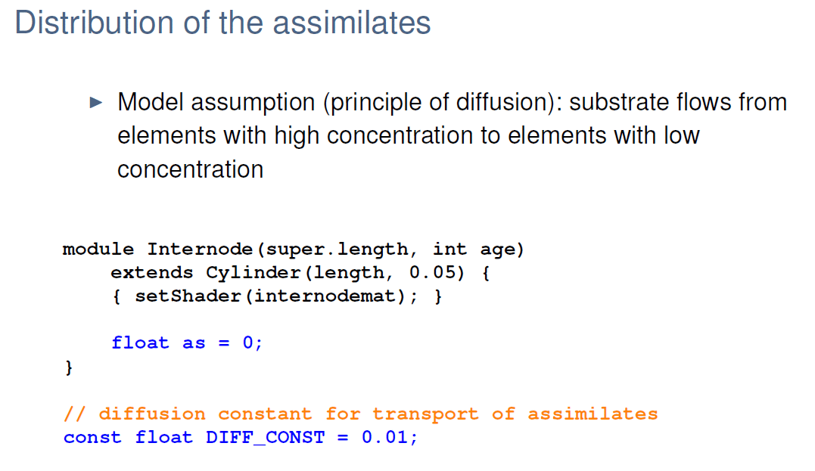

Slide 53
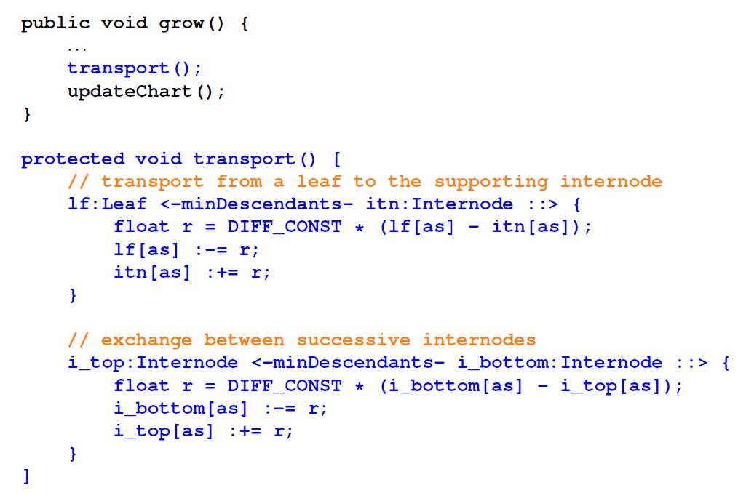

Slide 54
modelling of transport in sfspm09.gsz :
const float DIFF_CONST = 0.01; /* diffusion constant for transport
of assimilates */
// ..........
public void grow()
{
run();
lm.setSeed(irandom(1,100000));
lm.compute();
absorb_and_grow();
for (apply(5)) transport(); /* 5 iterations of transport per step */
// ..........
}
protected void transport()
[
/* transport of assimilates from a leaf to the supporting internode: */
lf:Leaf <-minDescendants- itn:Internode ::>
{
float r = DIFF_CONST * (lf[as] - itn[as]);
lf[as] :-= r;
itn[as] :+= r;
}
/* exchange between successive internodes: */
i_top:Internode <-minDescendants- i_bottom:Internode ::>
{
float r = DIFF_CONST * (i_bottom[as] - i_top[as]);
i_bottom[as] :-= r;
i_top[as] :+= r;
}
]

Slide 55
Open questions / deficiencies of the model:
- is this transport mechanism realistic?
- how are the conditions in the very beginning?
- what about buds which do not yet produce assimilates but need some for extension growth?
- For growth and photosynthesis, nitrogen (N) is needed, too. This is delivered by the roots. How would a transport model for N differ from that for C?

