Slide 1

Functional-Structural Plant Modelling
with GroIMP and XL
Tutorial and Workshop at Agrocampus Ouest, Angers,
5-7 May, 2015
Winfried Kurth
University of Göttingen,
Department Ecoinformatics, Biometrics and Forest Growth
Solving ordinary differential equations in XL

Slide 2
The Problem
• Development of structures often described by L-systems or graph grammars (in discrete time)
• functional parts often described by ordinary differential equations (ODEs) (in continuous time)
• examples: biosynthesis and transport of hormones, photosynthesis, carbon transport, xylem sap flow
• ODEs often not analytically solvable
• thus numerical solutions needed (numerical integrators)

Slide 3
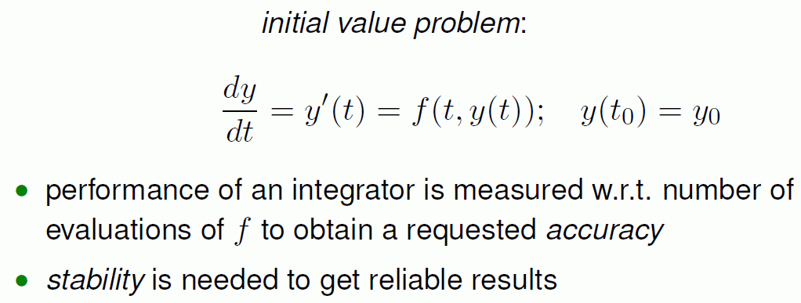
mathematical formalism:
ODE
initial condition

Slide 4

mathematical formalism:
ODE
initial condition
simplest discrete solution scheme:
Euler integrator
step size

Slide 5
mathematical formalism:
ODE
initial condition
simplest discrete solution scheme:
Euler integrator
step size
h

Slide 6
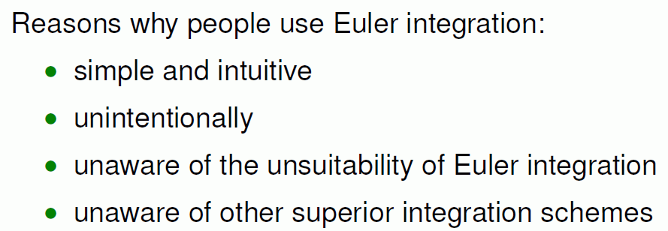

Slide 7
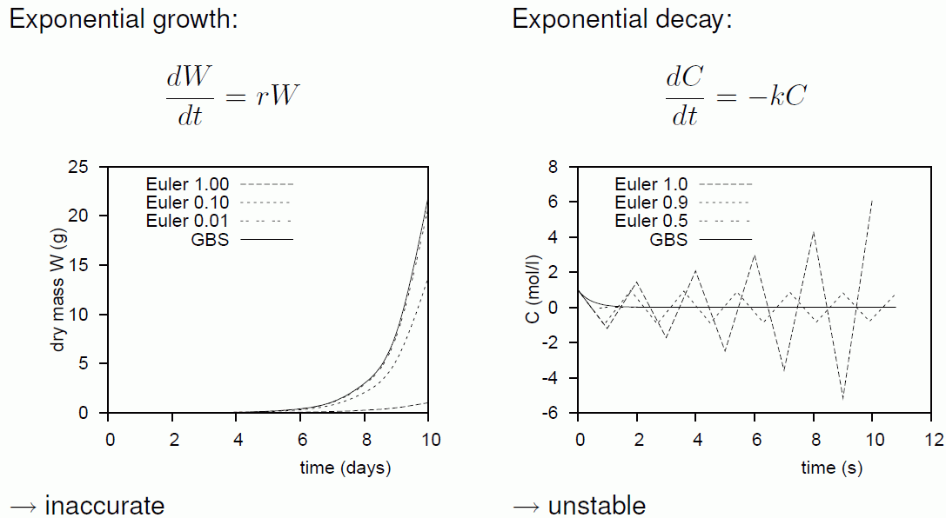
Problems with Euler integration: 2 examples
(r > 0)
(k > 0)
h
h
(Reference: GBS = Gragg-Bulirsch-Stoer integrator, a more accurate method)

Slide 8
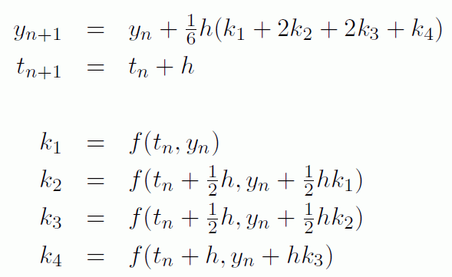
Better integration methods exist –
for example: the Runge-Kutta method

Slide 9
Better integration methods exist –
for example: the Runge-Kutta method
But: this requires much efforts to implement it in Java or XL within a plant model

Slide 10
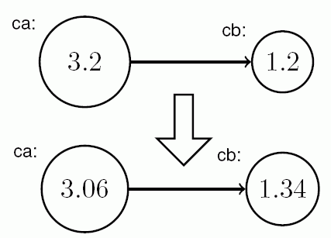
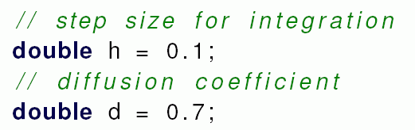
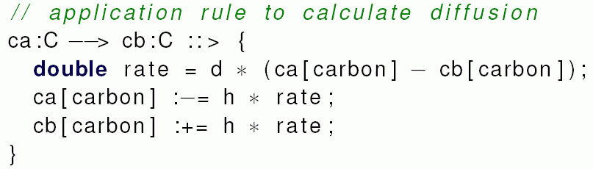
An example occurring in plant models
Model of diffusion
version without rate assigment operator
d[carbon]
dt
= d ⋅ Δ[carbon]
// Euler method
(Hemmerling 2010)

Slide 11
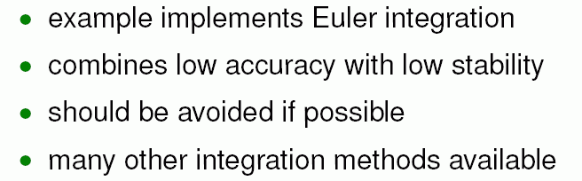
The rate assignment operator
Syntax in XL:
node_type[attribute_name] :‘= value
example:
c:C ::> { c[carbon] :‘ = productionRate; }
(Hemmerling 2010)

Slide 12
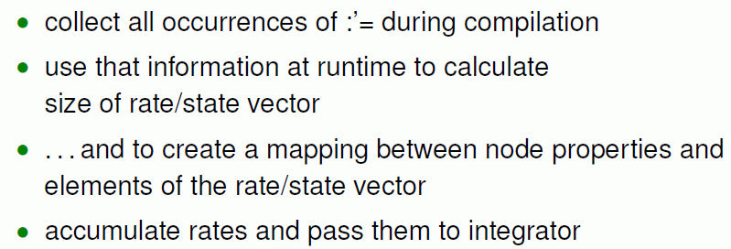
What does the operator in the background?

Slide 13
What does the operator in the background?
The integrator itself is not fixed.
It can be chosen by the user from numerics libraries: e.g.,
setSolver(new org.apache.commons.math.ode.nonstiff.AdamsBashforthIntegrator
(3, 0, 1, 1E-4, 1E-4));

Slide 14
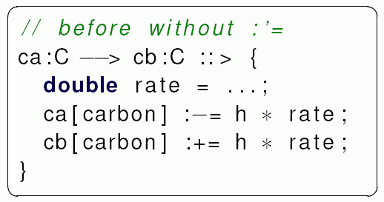

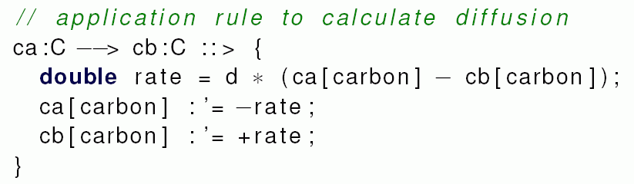
The diffusion example again, with rate assignment operator:
(Hemmerling 2010)

Slide 15
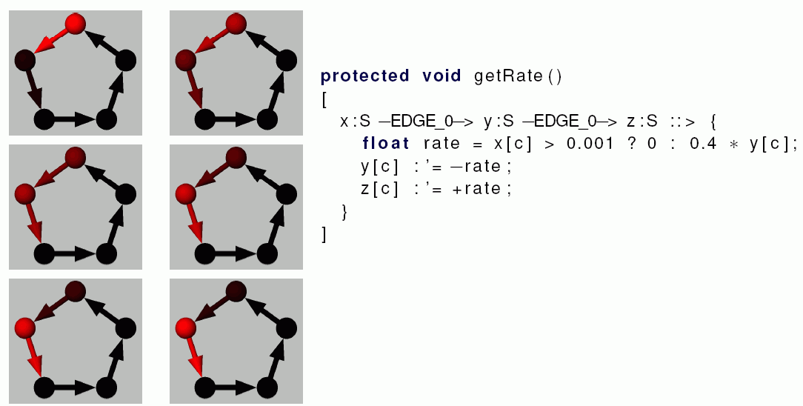
another example:
(Hemmerling 2010)

Slide 16
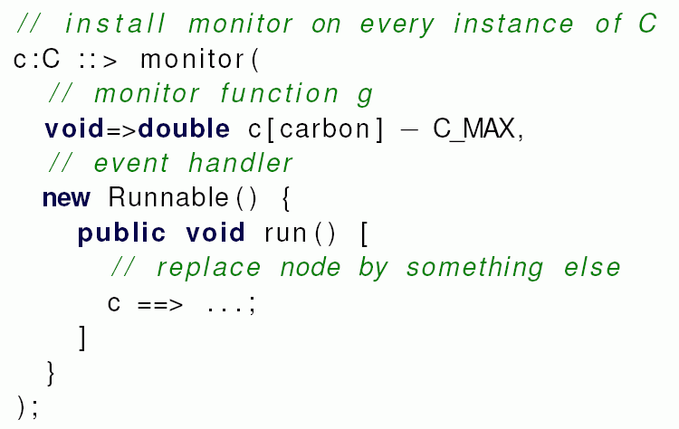
extension by the use of monitor functions:
- e.g., to plot data about the state in regular intervals
- or to stop integration once a condition is fulfilled
A monitor function maps the states to real numbers. Root finding algorithms are used to find its zeros, i.e., exact event time
(Hemmerling 2010)

Slide 17
Example simpleode.rgg: Declarations
const double uRate = 0.1;
const double vRate = 0.2;
const double wRate = 1;
const double threshold = 10.0;
const double periodLength = 1.0;
/* growing structure with several variables which are controlled
by ODEs: */
module C(double len) extends Cylinder(len, 0.05)
{
double u = 1;
double v = 0;
double w1 = 0;
double w2 = 1;
};
/* stable structure which is not influenced by ODEs: */
module S(double len) extends Cylinder(len, 0.05);
double time;
const DatasetRef diagram = new DatasetRef("function plot");

Slide 18
Initializations:
protected void init()
[
Axiom ==> C(1);
{
time = 0;
/* optionally, some preferred ODE solver can be specified: */
// setSolver(new org.apache.commons.math.ode.nonstiff.EulerIntegrator(0.1));
// setSolver(new org.apache.commons.math.ode.nonstiff.ClassicalRungeKuttaIntegrator(0.1));
// setSolver(new org.apache.commons.math.ode.nonstiff.GraggBulirschStoerIntegrator(0, 0.01, 1E-4, 1E-4));
// setSolver(new org.apache.commons.math.ode.nonstiff.AdamsBashforthIntegrator(3, 0, 1, 1E-4, 1E-4));
// setSolver(new org.apache.commons.math.ode.nonstiff.DormandPrince54Integrator(0, 1, 1E-4, 1E-4));
diagram.clear();
chart(diagram, XY_PLOT);
}
]

Slide 19
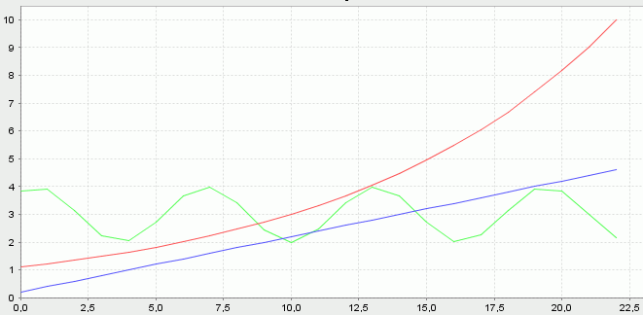
The central part: rate assignment
protected void getRate()
[
{ time :'= 1; }
/* apply differential increments to the variables of the C nodes.
ODE for u: u'(t) = uRate * u(t) ( => solution u = exp t)
ODE for v: v'(t) = vRate ( => solution v = c*t )
ODE for w1: w''(t) = -w(t) ( => solution w = cos t) */
c:C ::> {
c[u] :'= uRate * c[u];
c[v] :'= vRate;
c[w1] :'= wRate * c[w2];
c[w2] :'= -wRate * c[w1];
}
]
u
plotted diagram after 1 step:
v
w

Slide 20
Translation to 3-d structure
and step control by monitor functions:
public void develop()
[
/* set monitor to stop integration when variable u reaches
threshold value and to trigger structural changes: */
a:C ::> monitor(void=>double a[u] - threshold, new Runnable() {
public void run() [
a ==> s:S RU(10) M(-1) c:C(1)
{
c[u] = 1;
c[v] = 0;
c[w1] = 0;
c[w2] = 1;
s[length] = a[u];
s[radius] = 3 + a[w1];
println("stopped!");
};
]
});

Slide 21
Translation to 3-d structure
and step control by monitor functions (continued):
/* perform integration
and trigger visualization and plotting periodically: */
{
println("<");
/* visualize current state in regular intervals: */
monitorPeriodic(periodLength, new Runnable() {
public void run() {
print(".");
[
c:C ::> {
c[length] = c[u];
c[radius] = 3 + c[w1];
diagram.addRow().set(0, c[u]).set(1, c[v]).set(2, 3+c[w1]);
}
]
derive(); /* necessary here for update! */
}
});
integrate();
println("time = " + time);
}
]
see simpleode.rgg

Slide 22
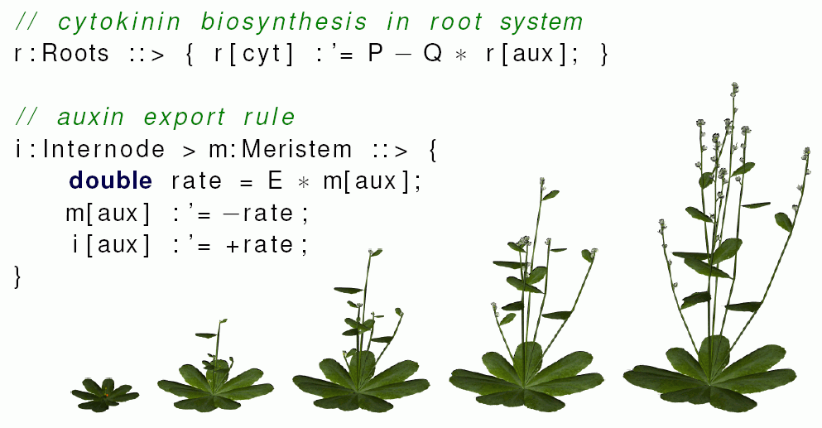
Arabidopsis example (from Hemmerling & Evers 2010):

Slide 23
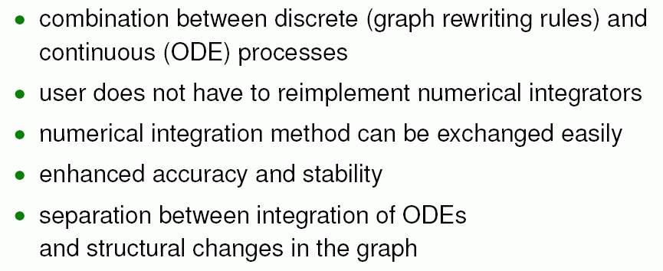
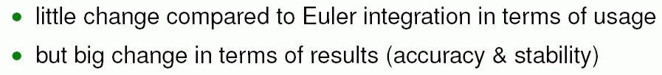
rate assignment operator / conclusion:
(Hemmerling 2010)

