Slide 1

Functional-Structural Plant Modelling
with GroIMP and XL
Tutorial and Workshop at Agrocampus Ouest, Angers,
5-7 May, 2015
Winfried Kurth
University of Göttingen,
Department Ecoinformatics, Biometrics and Forest Growth
Modelling multiscale structures in XL
(parts from the doctoral defense of Yongzhi Ong, 27.04.2015)

Slide 2
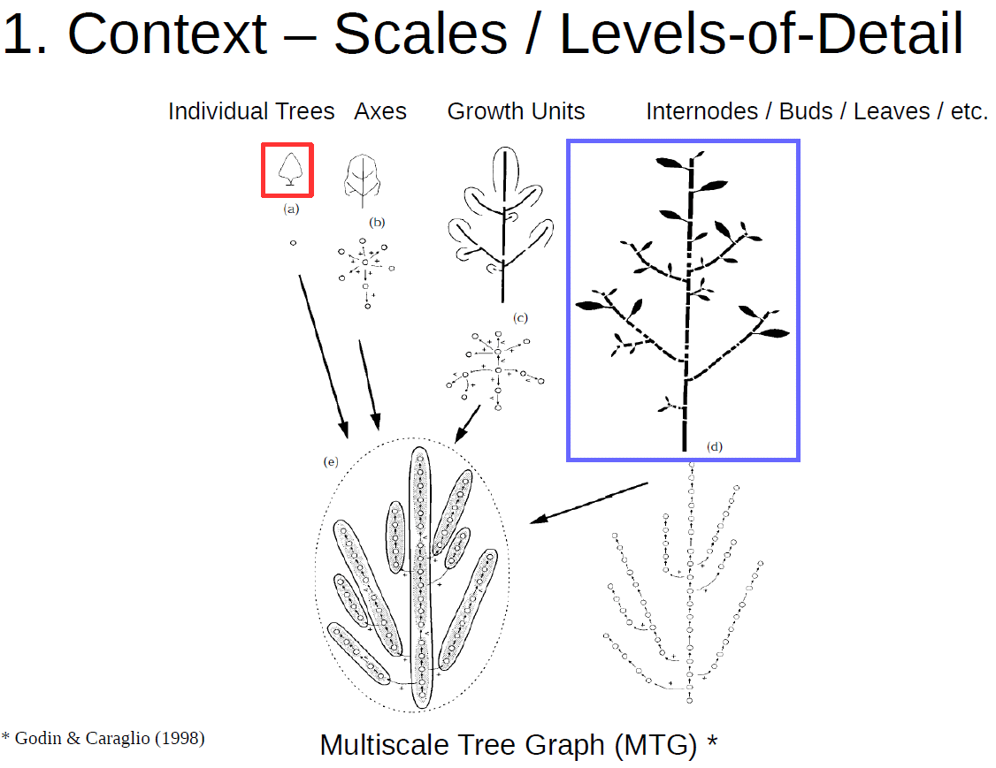

Slide 3
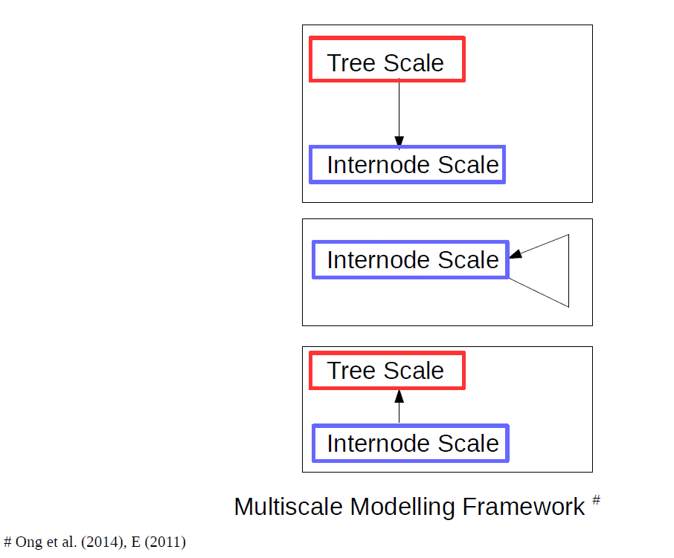

Slide 4
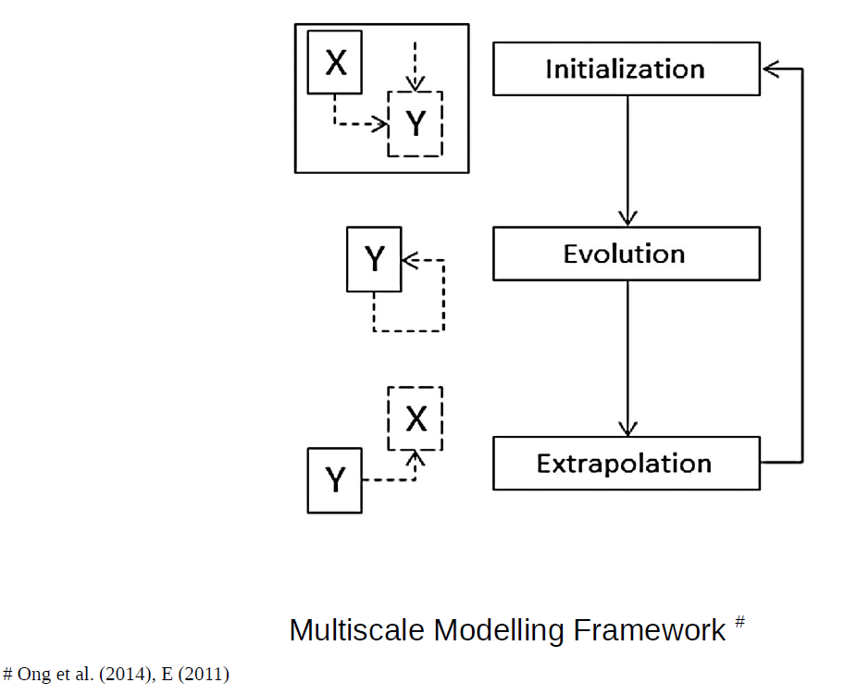

Slide 5
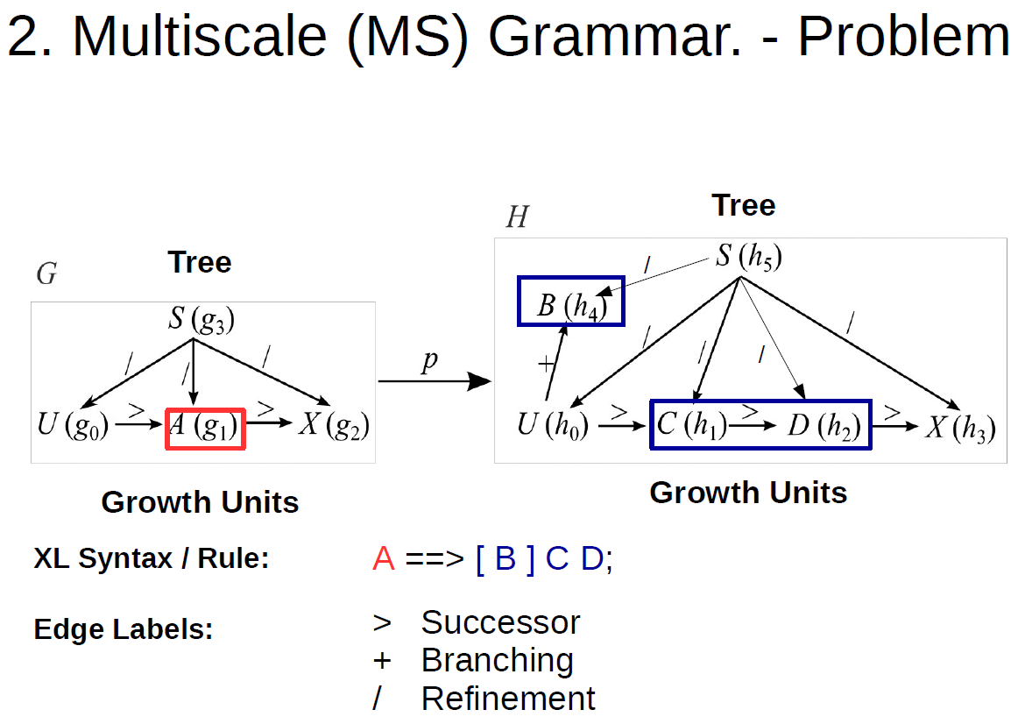

Slide 6
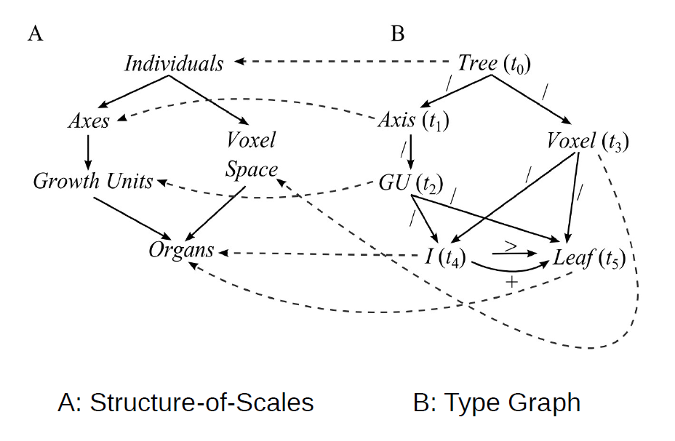
A data structure consisting of 3 graphs: Structure of scales, type graph, instanced graph

Slide 7
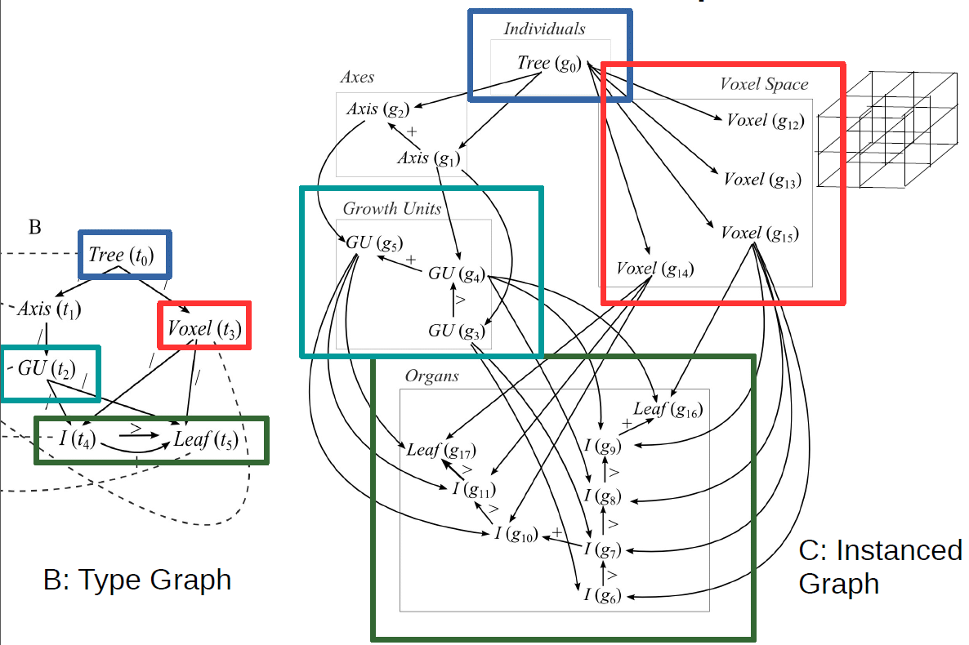

Slide 8
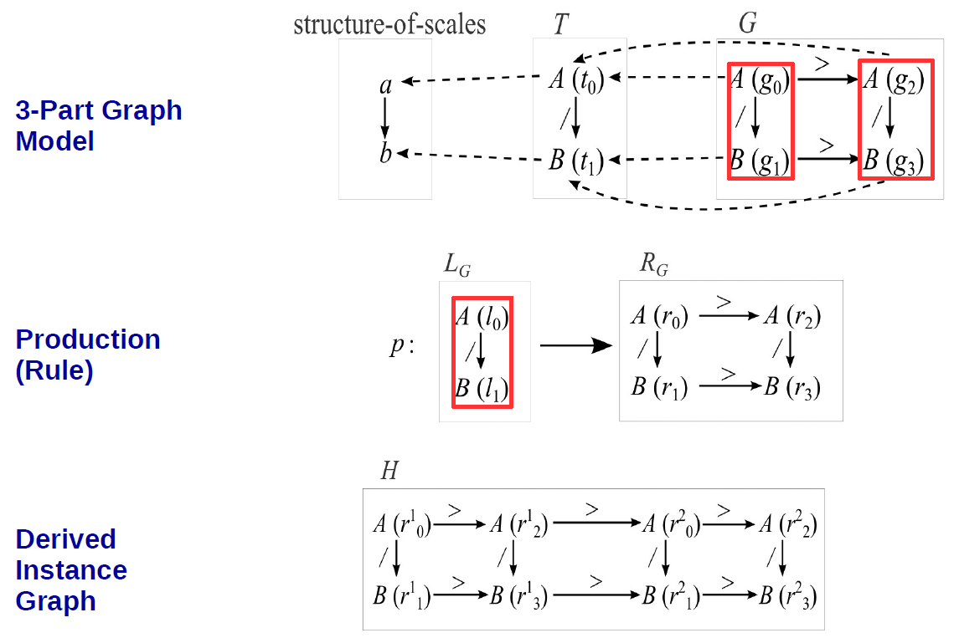
Rewriting: The simplest case (l.h.s. of rule specified for each scale)

Slide 9
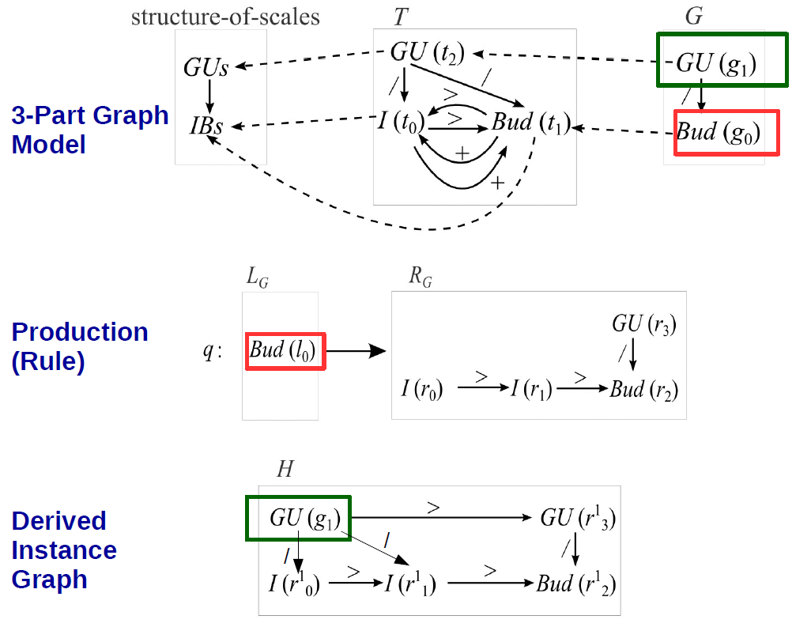
Rewriting: L.h.s. specifies only an organ at finest scale, generation of new entities at higher scales in r.h.s.

Slide 10
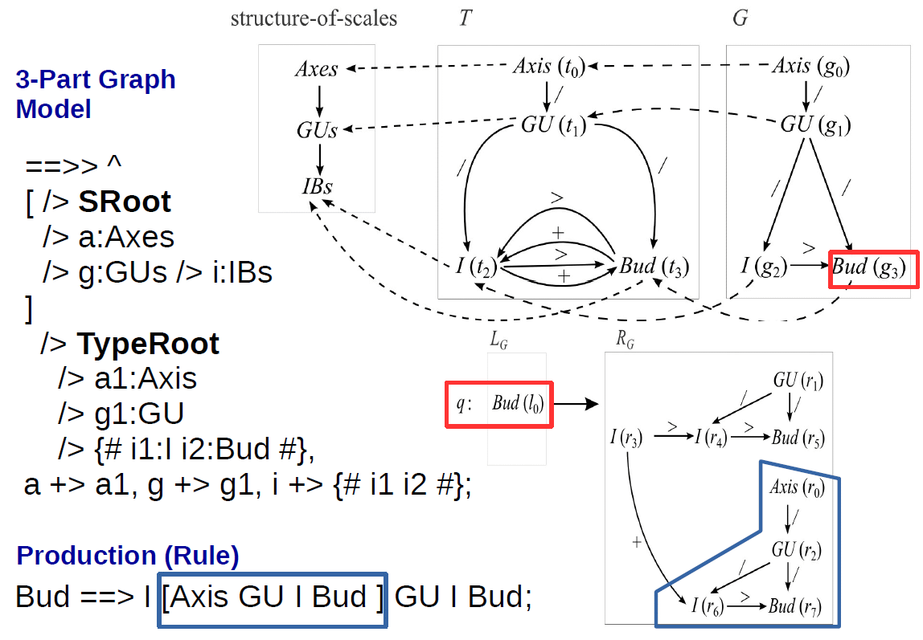
XL syntax for 3-part graph structure and for rewriting

Slide 11
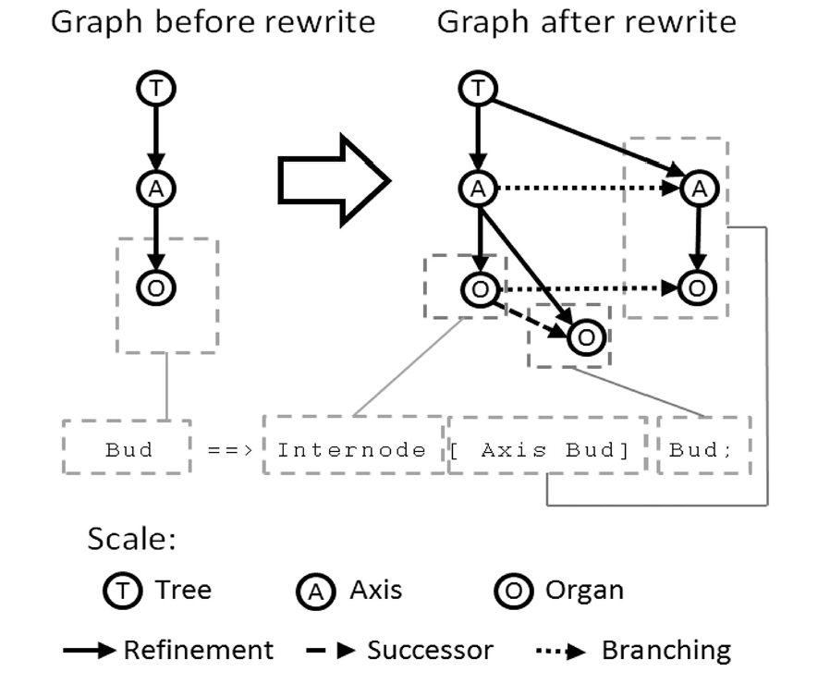
Example

Slide 12
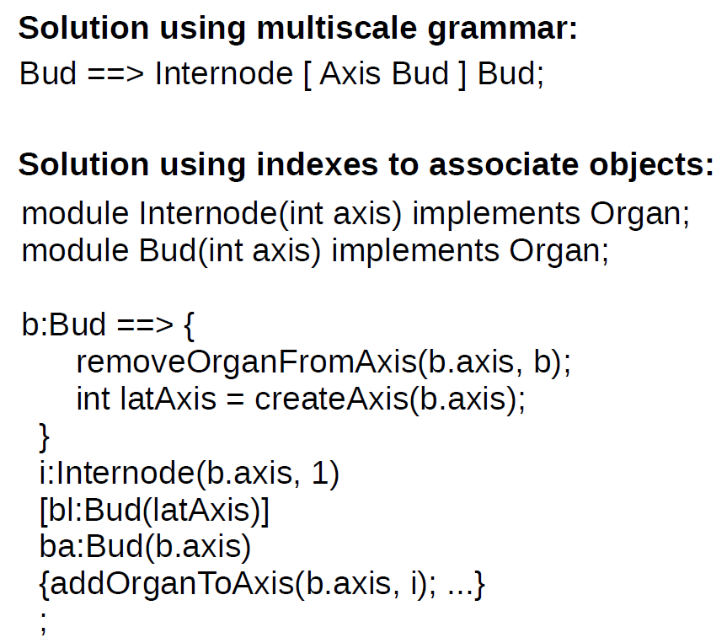

Slide 13
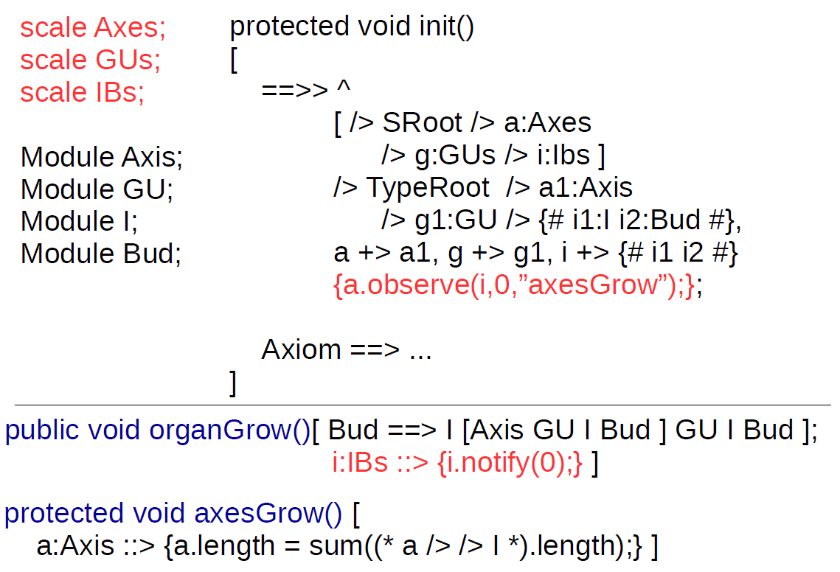
XL implementation of the observer pattern for information exchange between scales

Slide 14
The most simple example:
static int EVOLVE = 1;
scale A(float len);
scale B;
protected void init ()
[
Axiom ==> a:A(1) b:B, {b.observe(a, EVOLVE, "m");};
]
public void run ()
[
a:A ::> {a.notify(EVOLVE);}
]
protected void m()
[
b:B ::> {println("someting has changed");}
]
scaleclass A(float len);
scaleclass B;

Slide 15
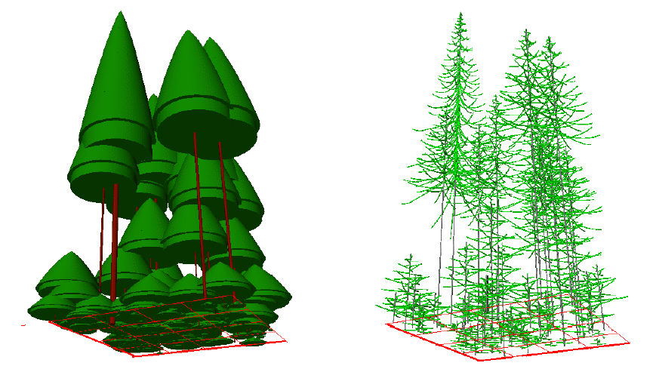
Thank you for your attention!

