Slide 1

Developing a 3D Root Architecture for Apple Tree Systems
James Bristow
Junqi Zhu
Edmar Teixeira
Adam Friend
Notes:
Hello everybody.
My name is James, and I’ll just be talking about what I’ve been up to during my summer studentship at Plant and Food alongside Junqi, Thomas, Edmar, and Adam.
Which is the development of a 3D root model for apple trees, with the long term goal of producing a digital twin

Slide 2

James Bristow
Masters of Information Sciences
Massey University
Thesis: Bayesian hierarchical growth models for chondrichthyans
Adam Smith
Brit Finucci
Bachelors of Science, Majoring in Statistics
Research interests:
Simulation methods
Machine learning
Bayesian statistical modelling
Notes:
I’m currently doing a Masters of Information Sciences over at Massey.
I’m on my second year, and my thesis is on Bayesian hierarchical growth models for con-drick-thee-ans; cartilaginous fishes
My supervisors are Adam Smith and Brit Finiccu. Brit is a researcher over at NIWA, and these models will be developed for them.
I did my undergrad in Stats, and most of the postgrad papers I’ve taken are also in Stats
My research interests are in simulation based methods, machine learning (particularly deep learning), and Bayesian modelling

Slide 3
Introduction
Societal challenges and food production systems:
Population growth
Climate change
Biodiversity
Supply chain disruptions.
Digital technologies and Future Orchard Production Systems (FOPS)
Increased profitability, resilience, and sustainability
Digital twins for FOPS apple trees
Notes:
As a society, there are many challenges that relate to our food production systems.
The effects of population growth, the effects of anthropogenic climate change, loss of biodiversity, and supply chain disruptions (which we’re actually experiencing now due to Covid)
We can use digital technologies to help contend with these challenges. Plant and Food has embraced as part of their Growing Futures program, in particular with their Future Orchard Production Systems
Digitization can lead to increased profitability, resilience, sustainability of our prediction systems and supply chains.
The use of digital twins can help to facilitate these benefits. For instance, with FOPS apple trees.

Slide 4
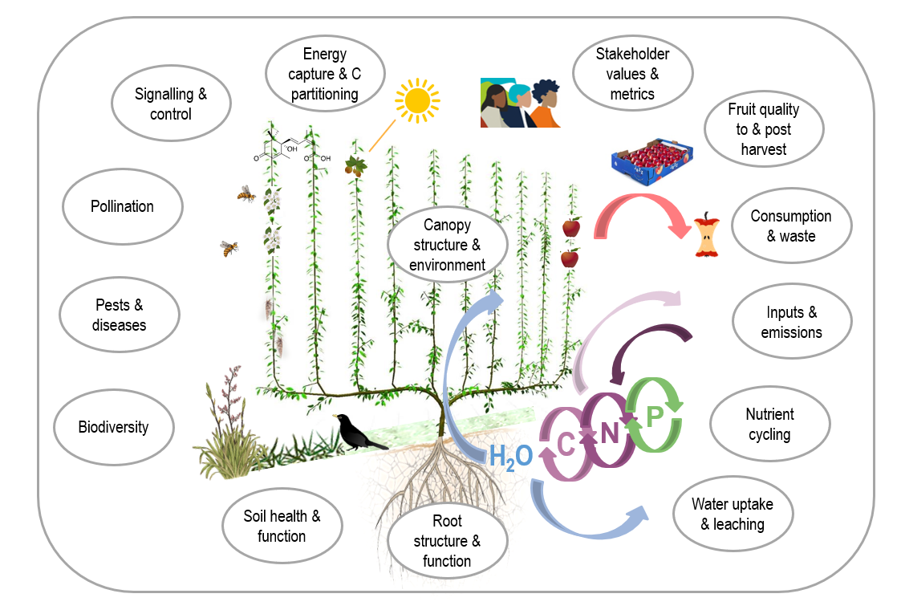
Digital twins
Digital twins
Analyse, monitor, evaluate and simulate food production systems
Develop a 3D root model
Source: Mawson, J., …, Harker R.. (n.d.). Digital Horticultural Systems: Building a digital twin of a perennial tree crop food system [PowerPoint slides]. The New Zealand Institute for Plant and Food Research Limited.
Notes:
So these twins can be used for the analysis, monitoring, evaluation, and simulation of our food production systems.
We can simulate individual apple trees and entire orchards.
Below you can see an example of a digital twin, where Plant and Food is utilising their domain expertise and knowledge of apple tree structure and function.
At the very bottom, you have the root system. And I have been working on developing this 3D root model.

Slide 5
Benefits
Black box
Relationship between roots and soil
Carbon and energy input
Water and solutes uptake
Root distribution
Root-Shoot interactions
Forecasting
Sensitivity analysis
Notes:
What are the benefits of adopting a simulation based approach to root system modelling?
To first factor to consider is that roots are very much a black box.
Because roots are present within an opaque environment, soil, it becomes more costly and difficult to experiment with these roots without extracting them from this environment which would be disruptive and destroy many of them.
So while different regions within the soil have different concentrations of nutrients, and we would expect that to have an affect on root movement and development, it’s difficult to model the relationship between roots and soil
And that’s important because it has implications with respect to the carbon and energy input and water and solutes uptake of the root system, which has an effect on the development of the entire tree
And if we’re modelling an entire orchard, we have to consider the root distribution of individuals trees and those surrounding it. So there’s a spatial component that we want to capture.
So we want to model these root systems without having to dig up roots and dismantle the orchard., which would be counter-productive which is where simulations are beneficial
We can use these simulation based models to explore root-shoot interactions, for instance their degree of cooperation for nutrient uptake and assimilation
We can use them for forecasting by estimating the ways in which these trees will develop in future, so that managers may plan accordingly
We can perform sensitivity analysis, by exploring how different degrees of biotic and abiotic factors, such as the concentration of nitrogen within soil, effect root development.

Slide 6
Aims
Apple Tree Model¹
Mycorrhizal Root Colonisation Model²
Approximate Bayesian Computation (ABC) Model
Synthetic Root Generator
Parameter Optimiser
1: Zhu, J., Dai, Z., Vivin, P., Gambetta, G. A., Henke, M., Peccoux, A., ... & Delrot, S. (2018). A 3-D functional–structural grapevine model that couples the dynamics of water transport with leaf gas exchange. Annals of Botany, 121(5), 833-848.
2: de Vries, J., Evers, J. B., Kuyper, T. W., van Ruijven, J., & Mommer, L. (2021). Mycorrhizal associations change root functionality: a 3D modelling study on competitive interactions between plants for light and nutrients. The New Phytologist, 231(3), 1171.
Notes:
So this is just a very high level view of the project aims.
We have an existing whole-tree apple model. This was adapted and extended from Junqi’s grapevine model called GrapeVineXL . This is aimed at modelling water transport and leaf gas exchange. and was developed in plant modelling platform called GroIMP.
We have mycorrhiza fungi root colonisation model, which is used to simulate the effects that colonisation has on root development. They have a symbiotic relationship. This model was also developed in GroIMP. We wanted to integrate this colonisation model with Junqi’s existing work on the apple tree root system.
We also want to initialise the root architecture of apple trees, more specifically, seven year old apple trees. So synthetic root data generator needed to be developed.
We also wanted to ensure that this generator produced realistic roots, so we needed a way of exploring the generator’s parameter space and identifying the optimal values leading to the creation of these realistic roots.
One approach to exploring the parameter space is to use Bayesian inference by creating a Bayesian model. For simulation modelling, the Approximate Bayesian Computation (ABC) method is ideal.
This was also a preliminary investigation to see if this ABC method could be used on the whole tree model. By adopting this Bayesian approach, we would then benefit from the ability to incorporate prior knowledge into model, to quantify the uncertainty of the model estimates in an easily interpretable manner, and to approximate the underlying distribution that produced this apple tree data.
The current whole-tree model use optimisation to select its parameter values. So we needed to compare and contrast an ABC root model with a parameter optimiser. That way we cam gauge the benefits and limitations of switching.

Slide 7
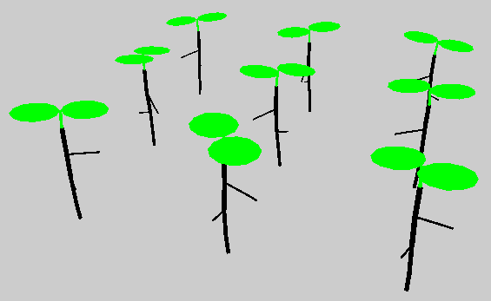
Mycorrhizal Root Colonisation Model
ArchiSimple¹
3D architecture: Organs, entire plants, and populations
Nutrient uptake: Nitrogen and phosphorus
1: Pagès, L., Moreau, D., Sarlikioti, V., Boukcim, H., & Nguyen, C. (2012, October). ArchiSimple: A parsimonious model of the root system architecture. In 2012 IEEE 4th International Symposium on Plant Growth Modeling, Simulation, Visualization and Applications (pp. 297-303). IEEE.
Notes:
To give a bit of history , this root colonisation model was itself extended from a simple root model called ArchiSimple. As the name suggests, it was deliberately designed to be parsimonious – simple. The ArchiSimple was originally developed in the C language, and the creators of the root colonisation model have reimplemented it in GroIMP, just with the presence of mychirhizal as an additional factor.
Below you can see the root colonisation model running within GroIMP. GroIMP is capable of simulating the 3D architecture of organs, entire plants, and populations, for instance an entire apple orchard.
It simulates the root uptake of nitrogen and phosphorous within a soil grid. And unlike in real life, this soil is invisible so you can see the roots at the bottom there.

Slide 8
Mycorrhizal Root Colonisation Model
Model integration
Water transport: Hydraulic conductance
Initial integration was successful
Notes:
So by integrating this root conisation model with the whole-tree model, we get the benefits of both.
We can now simulate mycorrhizal colonisation and nutrient uptake within soil, but we can also simulate water transport. Both whole root system water transport, and localised water transport within individual root segments.
This initial integration process was successful. We were able to merge the relevant code together, and create a synthesis of the two.

Slide 9
Synthetic Root Generator
1st Order Roots | Higher Order Roots
30 cm in length | Initially 2 m in length
Greater diameter | Progressively smaller diameter
Majority should extend horizontally from plant base | Higher variation in extension location
Attributes are consistent | Attributes vary depending on branching location
Lower density (large interbranch distance) | Higher density (smaller interbranch distance)
Notes:
Next, we needed to initialise the architecture of the root system using a synthetic data generator.
First order roots are those that emerge directly from the base of the plant. While higher roots emerge from a parent root belonging to the previous order.
And there were various attributes that needed to be simulate, with some variation between orders.
First order roots are around 30cm in length, while second order roots are around 2m. Higher order roots become progressively shorter in length
Same with diameter. 1st order roots have a large diameter, which progressively becomes smaller as order increases
The majority of 1st order roots emerge horizontally from the plant base, with fewer vertical roots. There’s more variation with higher roots.
The attributes of higher roots varies depending on their branching location. Those that are closer to the root base tend to be larger than those near the root apex.
And there’s lower density of 1st order roots with a steadily increased probability of branching for higher order roots, leading to a higher root density

Slide 10
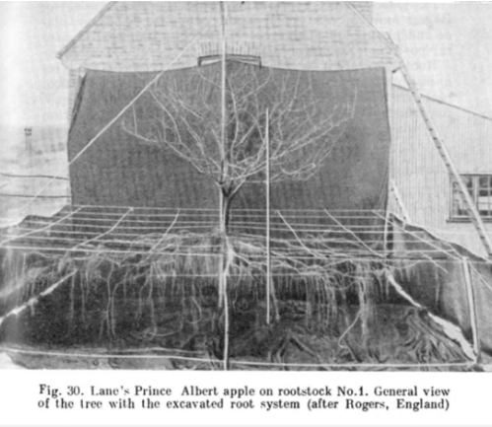
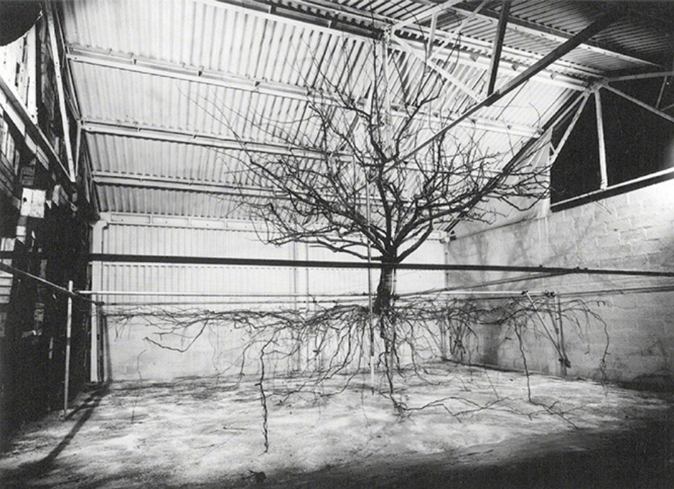
Synthetic Root Generator
Notes:
So what you can see here are images from Cox apple tree roots that we’ve used as references for the first iteration of the root generator.
Again, it comes back to the idea that the soil system is opaque. These roots have been extracted from the soil so while we can visualise them, it’s not a realistic representation of a root system within soil. For one thing, the roots are supported by the soil, so gravitropism is present, the effects of gravity on the roots are not going to be so evident.
We visited Adam Friend over at the Motueka site, and he provided us with some useful advice for revising this root generator.
So we can have all this sophisticated modelling technology, but it’s not going to supersede domain expertise

Slide 11
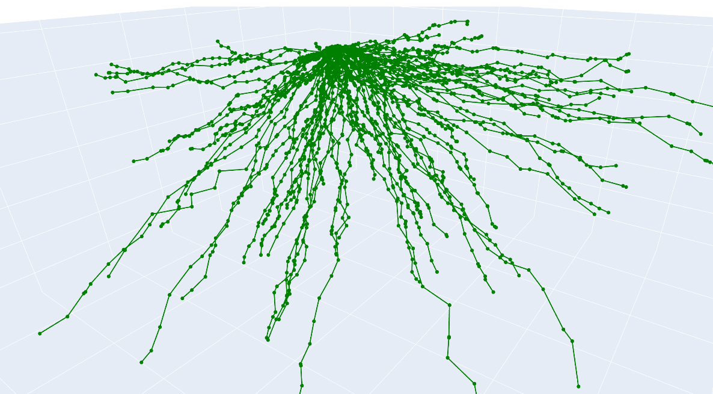
Synthetic Root Generator
Notes:
This is just a visualisation of a synthetic root system that’s been outputted by the generator
So this root creation process is stochastic. Root segments have random variation in their length and diameter, and the overall root length also varies
Same applies to their branching location
Root segment angles also have some variation
So these various factors are affected by parameters of the generator, which means that if the root system looks unrealistic, we can experiment with the parameter values

Slide 12
Synthetic Root Generator
Optimisation | Bayesian Inference
Optuna | PyMC3
Optimise an objective function | Model the underlying distribution of a data generating phenomena
Tree-structured Parzen Estimator (TPE)¹ Multi-objective Tree-structured Parzen Estimator (MOTPE)² Covariance Matrix Adaptation Evolution Strategy (CMA-ES)³ Nondominated Sorting Genetic Algorithm II (NSGA-II)⁴ | Approximate Bayesian Computation Sequential Monte Carlo (ABC-SMC)⁵
Sources:
Bergstra, J., Bardenet, R., Bengio, Y., & Kégl, B. (2011). Algorithms for hyper-parameter optimization. Advances in neural information processing systems, 24.
Ozaki, Y., Tanigaki, Y., Watanabe, S., & Onishi, M. (2020, June). Multiobjective tree-structured parzen estimator for computationally expensive optimization problems. In Proceedings of the 2020 Genetic and Evolutionary Computation Conference (pp. 533-541).
Iruthayarajan, M. W., & Baskar, S. (2010). Covariance matrix adaptation evolution strategy based design of centralized PID controller. Expert systems with Applications, 37(8), 5775-5781.
Deb, K., Agrawal, S., Pratap, A., & Meyarivan, T. (2000, September). A fast elitist non-dominated sorting genetic algorithm for multi-objective optimization: NSGA-II. In International conference on parallel problem solving from nature (pp. 849-858). Springer, Berlin, Heidelberg.
Toni, T., Welch, D., Strelkowa, N., Ipsen, A., & Stumpf, M. P. (2009). Approximate Bayesian computation scheme for parameter inference and model selection in dynamical systems. Journal of the Royal Society Interface, 6(31), 187-202.
Notes:
The parameter space can be explored algorithmically. Here, we are using five different algorithms, and we want to compare the Bayesian approach with the optimisation approach
4 are optimisation methods. While the other an ABC method
For optimisation, the Optuna library is being used. And it’s trying to do is optimise an objective function
For Bayesian inference, I’m using PyMC3 which is a probabilistic programming language. Here’ we’re doing a bit more than just optimisation.
We want to treat the synthetic root generator as a generative model, and use it to better unstand the underlying distribution of the data generating process. If we do that, we can quantify the uncertainty of the parameter estimates of the model.
I wouldn’t be able to explain how these algorithms work in under 10 minutes, so I’ve left some links at the bottom.
The top two optimisation algorithms are Bayesian optimisation methods, while the bottom two are genetic algorithms. They are going to intelligently explore the parameter search space to find some optimal value
ABC-SMC is an efficient sampling technique for performing Bayesian inference. So we are sampling from a target distribution, and using those samples as evidence to make a conclusion.

Slide 13
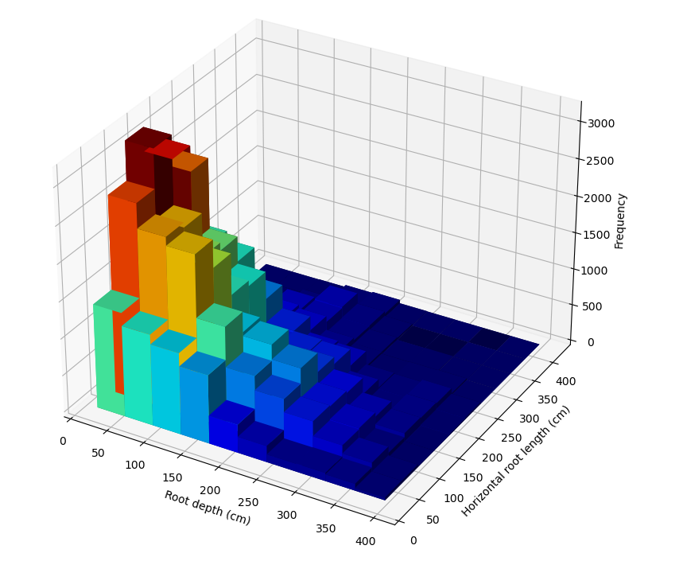
Synthetic Root Generator
Methodology
Calculate summary statistics of ground truth root system
Cumulative horizontal root distance and root soil depth
Generate synthetic root system
Calculate summary statistics of synthetic root system
Minimise dissimilarity between synthetic and group truth statistics
Create a realistic simulation
Repeat 1000 times
Notes:
The methodology for both the optimisers and ABC model are the same
We calculate some summary statistics from a ground truth root system dataset
In this case, that’s the cumulative horizontal root distance and root soil depth.
We generate a synthetic root system, and calculate the same summary statistics for the synthetic data.
What we are trying to optimise is the dissimilarity between the ground truth and synthetic statistics
If we do that, we can ideally create a realistic simulation
And we repeat this 1000 times, so we have 1000 synthetic root systems

Slide 14
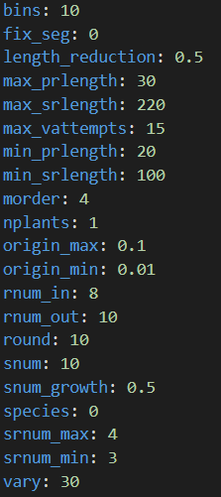
Synthetic Root Generator
Validation
Ground truth data was created using root generator
Repeat 5 times for each of the 5 algorithms
25,000 synthetic root systems
Notes:
Initially, what I wanted to do is validate both the Bayesian model and optimiser
I did that by creating the ground truth dataset using the synthetic root generator. So the ground truth is also synthetic data.
So I know precisely what the parameter values are that lead to the creation of the ground truth dataset
And the test is to see if the optimiser and Bayesian model are both able to recover these values
For each of the five algorithms, I generated 1000 synthetic root systems. I repeated that 5 times each.
So there’s 25000 synthetic root systems in total

Slide 15
Synthetic Root Generator
Optimisation Method | Best trial | Score
TPE | 534 | 0.028
MOTPE | 534 | 0.049
CMA-ES | 202 | 0.072
NSGA-II | 822 | 0.029
Bayesian Method | Mean Score
ABC-SMC | 0.028
Notes:
So these are the results of this validation process. I’m just showing the best score from each of the replicates, but the results were pretty consistent across all 5 iterations
The top performer is the TPE method, which is actually the default algorithm that Optuna uses. The NSGA algorithm is competitive, but you can see from the trial number that it takes a bit longer to find a the minima
The ABC-SMC method is competitive. But really, the principal advantage is its ability to quantify uncertainty

Slide 16
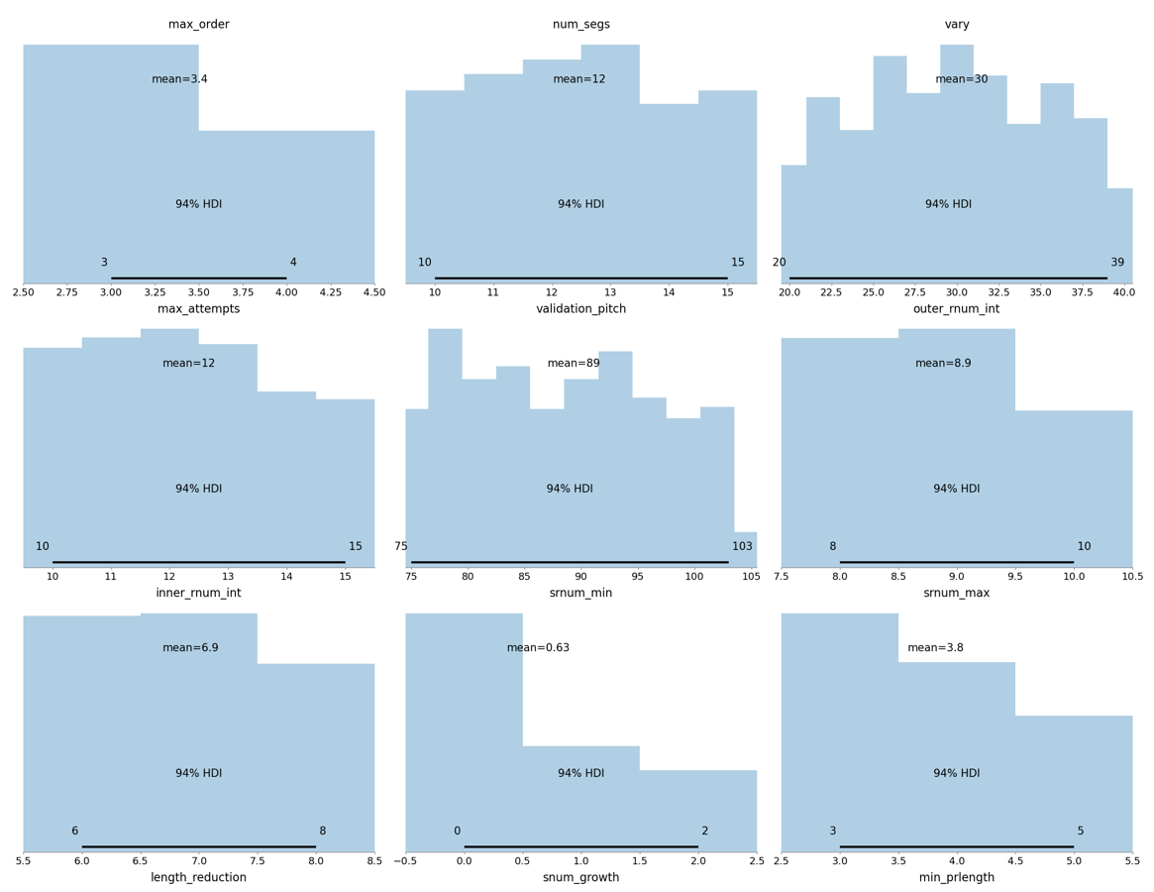
Synthetic Root Generator
Notes:
So this is just an example where you can see the joint probability distribution of parameter values for the root generator.
This was produced by the ABC model.
If we want to treat this as an optimisation task, we just take the mean value of each. But we also have 94% credible intervals, so there’s your uncertainty quantification
So there were some interesting results. The ABC model nearly perfectly recovered the parameter values of continuous values, but struggled with discrete values
With the optimisers, it was the other way round.
So there are some implications there if we adopt this ABC method for the whole-tree model
And we also need to validate the optimiser and ABC model against real root data

Slide 17
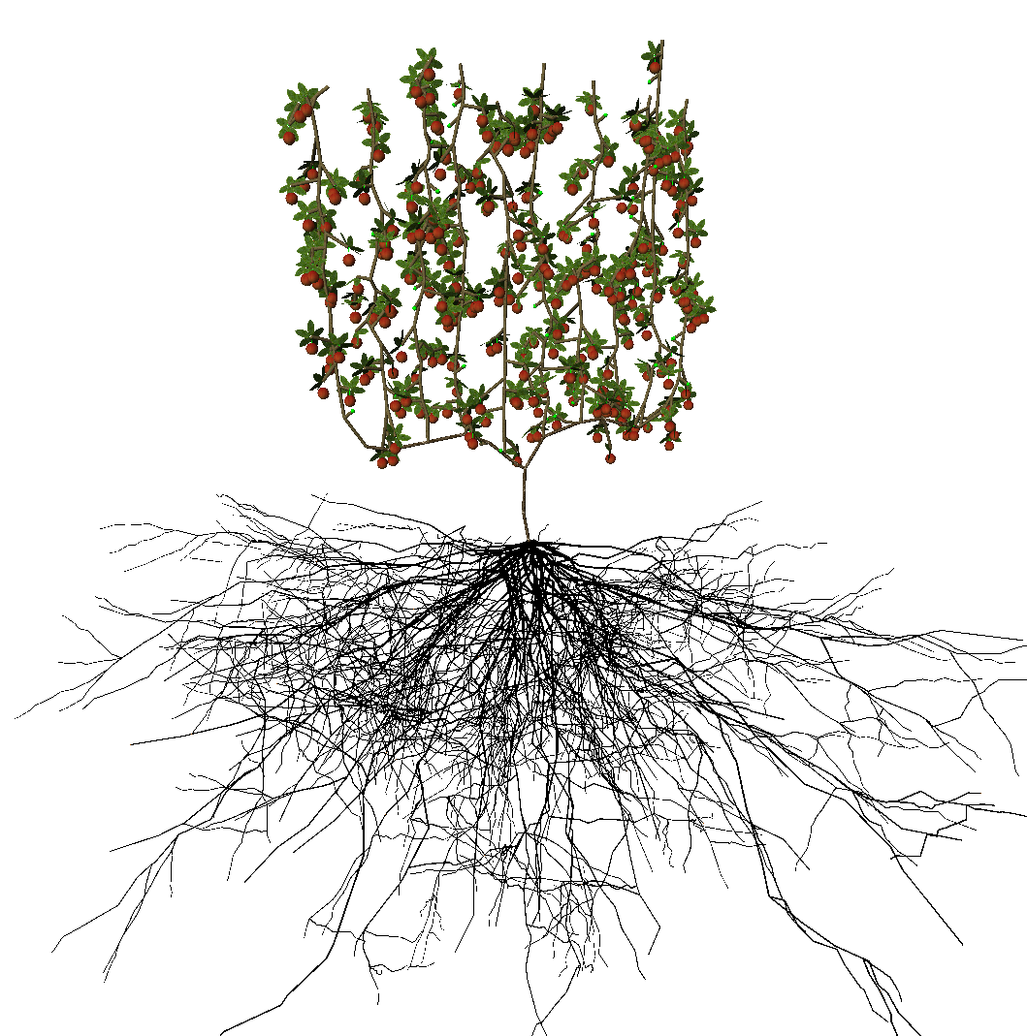
GroIMP Root Model
XEG reader¹
Receives root generation data as input
Recursively constructs the root system using coordinate, order, and parent root information
Can be applied to other organ types
1: Kniemeyer, O., & Kurth, W. (2007, October). The modelling platform GroIMP and the programming language XL. In International Symposium on Applications of Graph Transformations with Industrial Relevance (pp. 570-572). Springer, Berlin, Heidelberg.
Notes:
So, with help from some of Junqi’s colleagues , we’ve incorporated a data import method using XEG reader
XEG reader takes the synthetic root data as an input and recursively constructs the entire root system , incorporating information such as root coordinate, order, parent root
This import method is generalisable, so we can use it with other organ types such as thetree trunk, the shoots that Thomas has been working on, leaves, and petioles.

Slide 18
GroIMP Root Model
Root order is mapped to different organ types
Root attributes such as:
Length
Diameter
Angle variation
Density
Notes:
So the root order is mapped to various organ types from the Mycorrhizal colonisation root model . Be it the thicker structural roots, or the thinner fine roots that emerge from structural roots.
Root attributes such as length, diameter angle variation, and root density are taken from the synthetic root generator and incorporated into GroIMP.
So our root model is able to account for the variation between different roots

Slide 19
Conclusions
Integration of Mycorrhizal root model with whole apple tree model
Extending existing root simulation features
Synthetic root system framework
Real root data
ABC methodology for the whole-tree model
Water transport
Whole-root-system water transport
Localised water transport using root length density in a soil grid
Notes:
In conclusion, we’ve successful integrated the mychorizal root model with the whole-tree model
Extending the features offered the existing root system model by incorporating the influence of nitrogen and phosphorus uptake from soil, as well as mychorizal colonisation on root development
These results also offer support that the ABC methodology could be applied to whole-tree model to incorporate prior knowledge, quantify variance, and determine the underdyling distribution of the data
In doing so, we’ve assisted in the development of the FOPS apple tree digital twin
A synthetic root system framework has been developed and validated using optimization and ABC methods. We next need to evaluate the framework against real root data.
We have included the simulation of whole-root system water transport. But localised water transport using root length density within the soil grid is still under development

Slide 20
Acknowledgements and Questions
Junqi Zhu
Edmar Teixeira
Adam Friend

