Slide 1
Human Activity Recognition using Machine Learning techniques
THAM JUN QUAN
THOMAS JIANG CHENYANG
AUSTIN ZHANG YI

Slide 2

Machine Learning
Task
Predict the activity and the person performing the activity
Performance
Number of actions and person performing the activity correctly classified
Experience
PAMAP2 data set of labeled IMU readings available from the UCI Machine Learning Repository

Slide 3
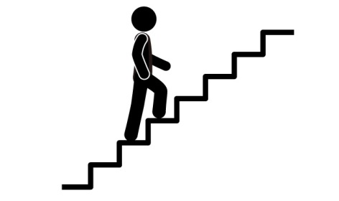





PAMAP2 Data Set
A Physical Activity Monitoring dataset
3 wireless inertial measurement units (IMU):
sampling frequency: 100Hz on wrist, chest and ankle
record temperature, acceleration, orientation…
1 heart rate monitor:
sampling frequency: ~9Hz
Activities:

Slide 4
Methodology
Data Cleaning
Understand data and handle missing values
Data Preprocessing
Univariate analysis (distribution)
Bivariate/Multivariate analysis
Correlation
PCA
Training and Test Data Segregation
Choose Algorithm (Iterative approach)
Train and Test Models
Refine Parameters
Key Python Libraries: sklearn, numpy, matplotlib, pandas
Source Control: Github

Slide 5
About the Models
Model 1
Classify Subject (Person) --> Feed subject back into model to classify action of the subject
Model 2
Classify Action --> Feed action back into model to the classify subject
Model 3
Classify both subject and action simultaneously

Slide 6
Data Set Overview
A summary of the number of records and columns is provided below.
Total Records Read From Original Data Set: 2,872,533
Total Records Written to Consolidated Data Set: 1,893,512
Total Records Filtered: 979,021
Total Columns in Consolidated Data Set: 55

Slide 7
Some Initial Exploration Results
Exploration item | Remarks & Potential implication
Subject 9 has significantly lower amounts of recorded data than the other subjects | Exclude subject 9 from our analysis.
The data set consists of a significant amount of NaN data | Will affect PCA. There are missing values mainly because of technical issues and the fact that heart rate and other recorded variables were measured at different frequencies. As such, we have to handle the missing data.
Timestamps are available | Including the timestamp in the analysis will cause the model to be biased - it is possible to predict results solely based on timestamps as subjects performed the activities in a sequence. As such, we have to exclude timestamps.
Some activities were only carried out by a few subjects (e.g. watching TV was only carried out by 1 subject) | Activities carried out by less than 6 out of 8 subjects should be left out in order to train the model properly.

Slide 8
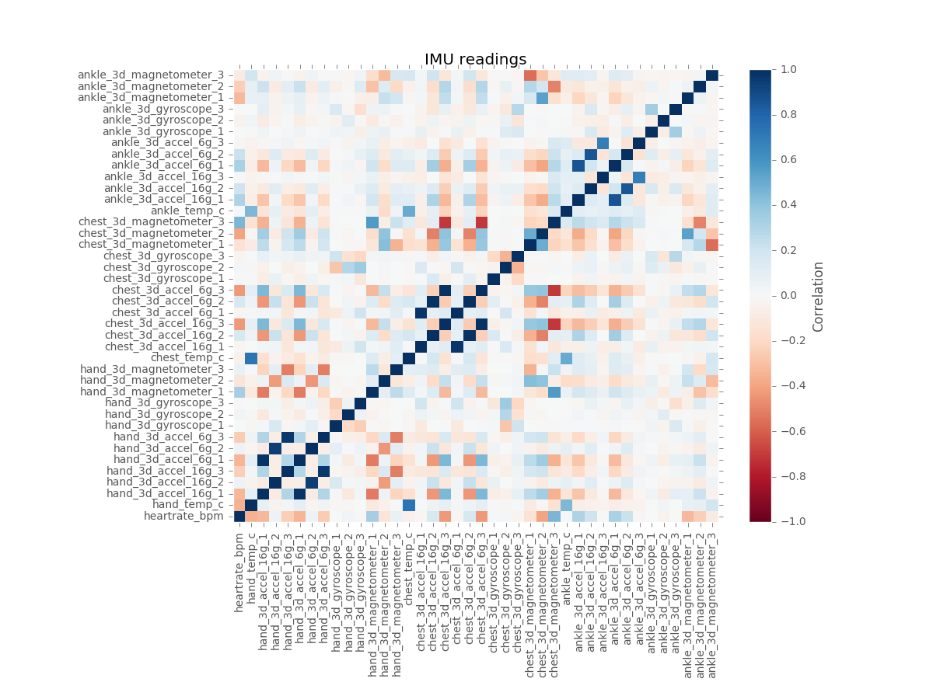

Slide 9
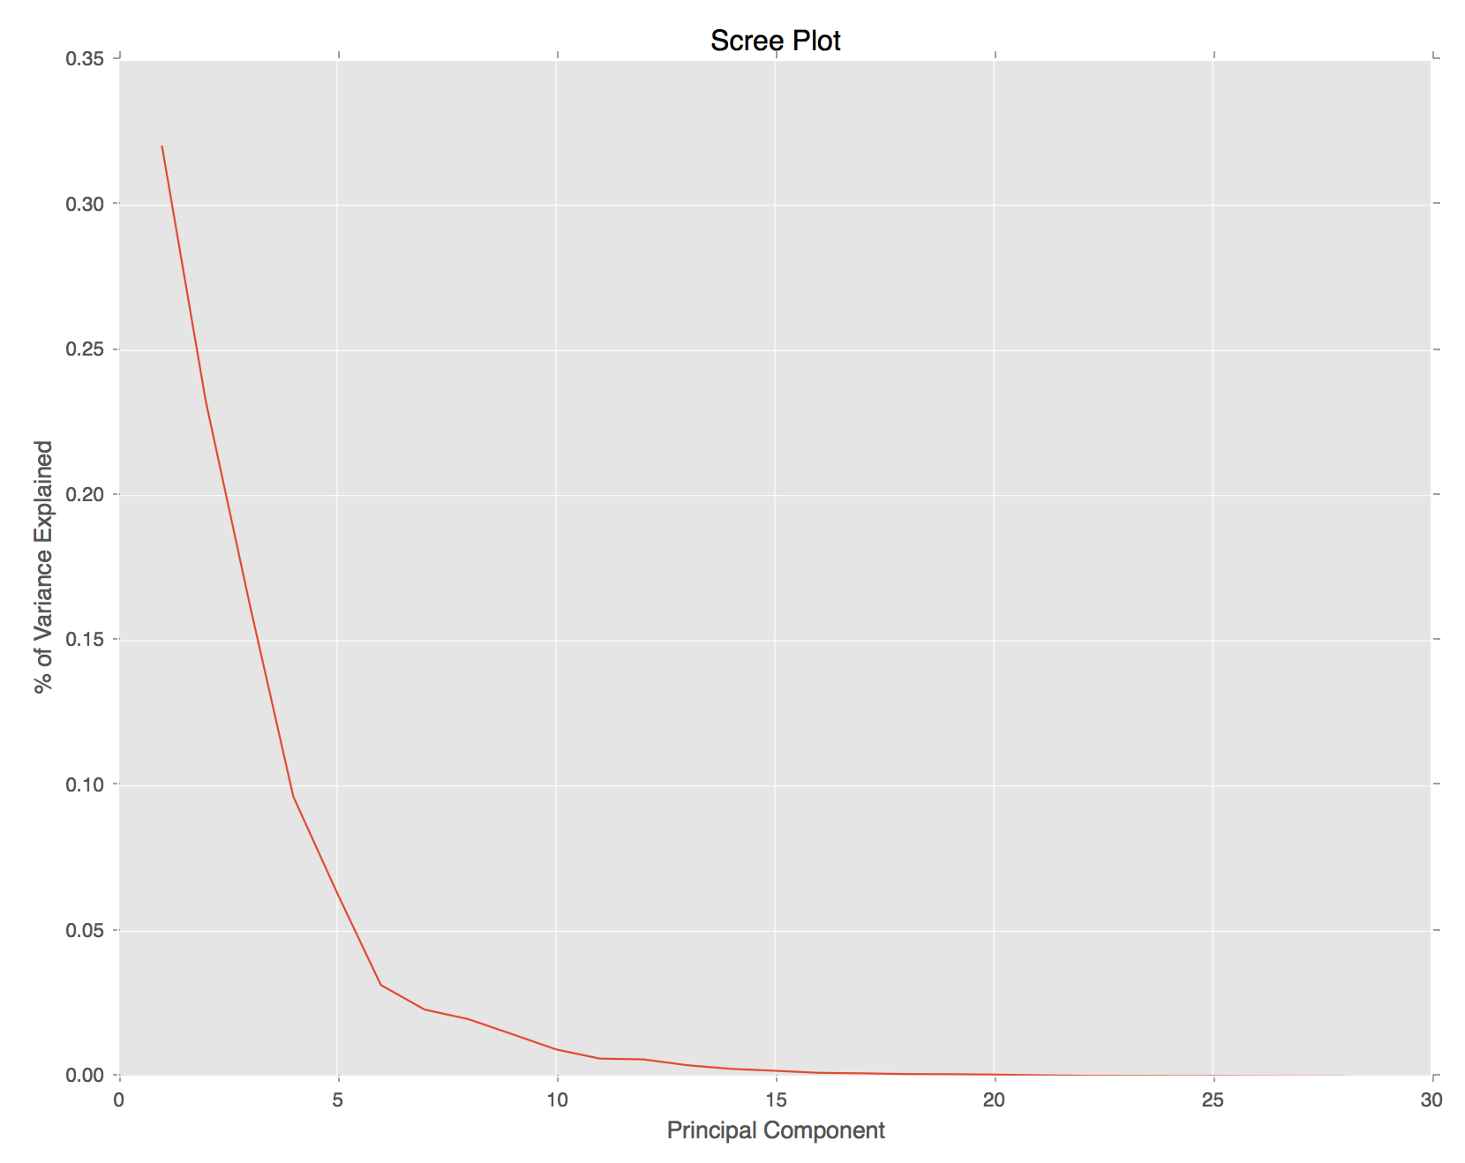

Slide 10
End

