Slide 1
Human Activity Recognition using Machine Learning techniques
  THAM JUN QUAN
  THOMAS JIANG CHENYANG
  AUSTIN ZHANG YI

Slide 2
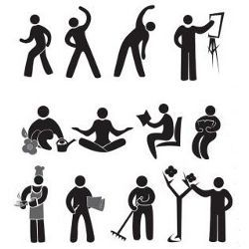
Machine Learning
Task - Predict the activity and the person performing the activity
Performance - Number of actions and person performing the activity correctly classified
Experience - PAMAP2 data set of labeled IMU readings available from the UCI Machine Learning Repository

Slide 3
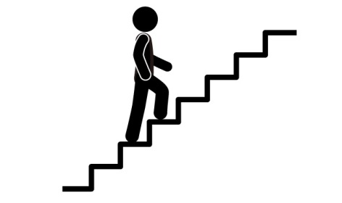
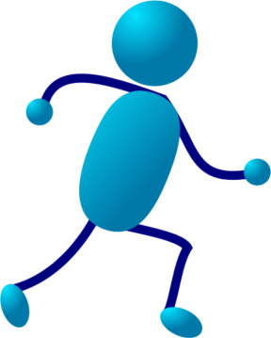





PAMAP2 data set
A Physical Activity Monitoring dataset
3 wireless inertial measurement units (IMU):
- sampling frequency: 100Hz
- on wrist, chest and ankle
- record temperature, acceleration, orientation…
1 heart rate monitor:
- sampling frequency: ~9Hz
Activities:

Slide 4
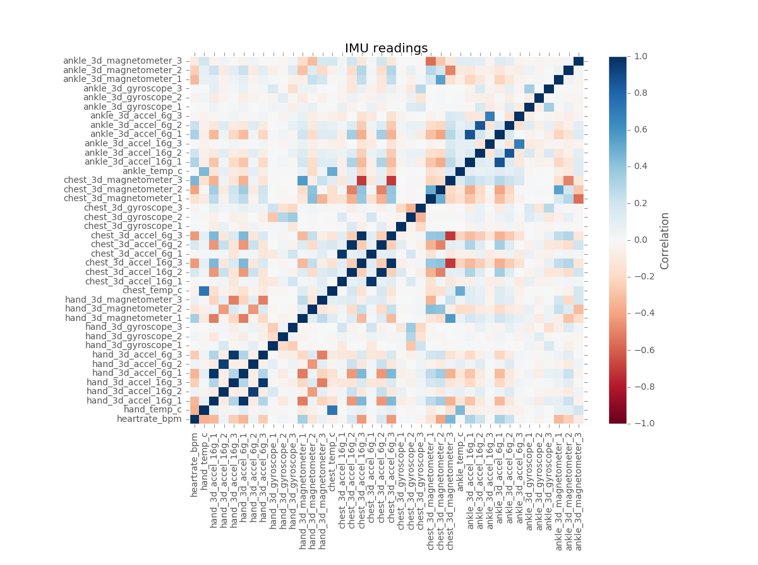
Correlations Among Different Measurement

Slide 5
Classification Model
Model 1 - Classify a person, followed by classify actions of the person.
Model 2 – Classify an Action, followed by classify a person of the action
Model 3 - Classify both person and action simultaneously

