Slide 1

2023 Bell Geekfest – Team Creative
TCM
Terms and Conditions Manager
Team : Creative
Branden Min
Junseo Yang
Jisang Kim
Jaewon Yang

Slide 2
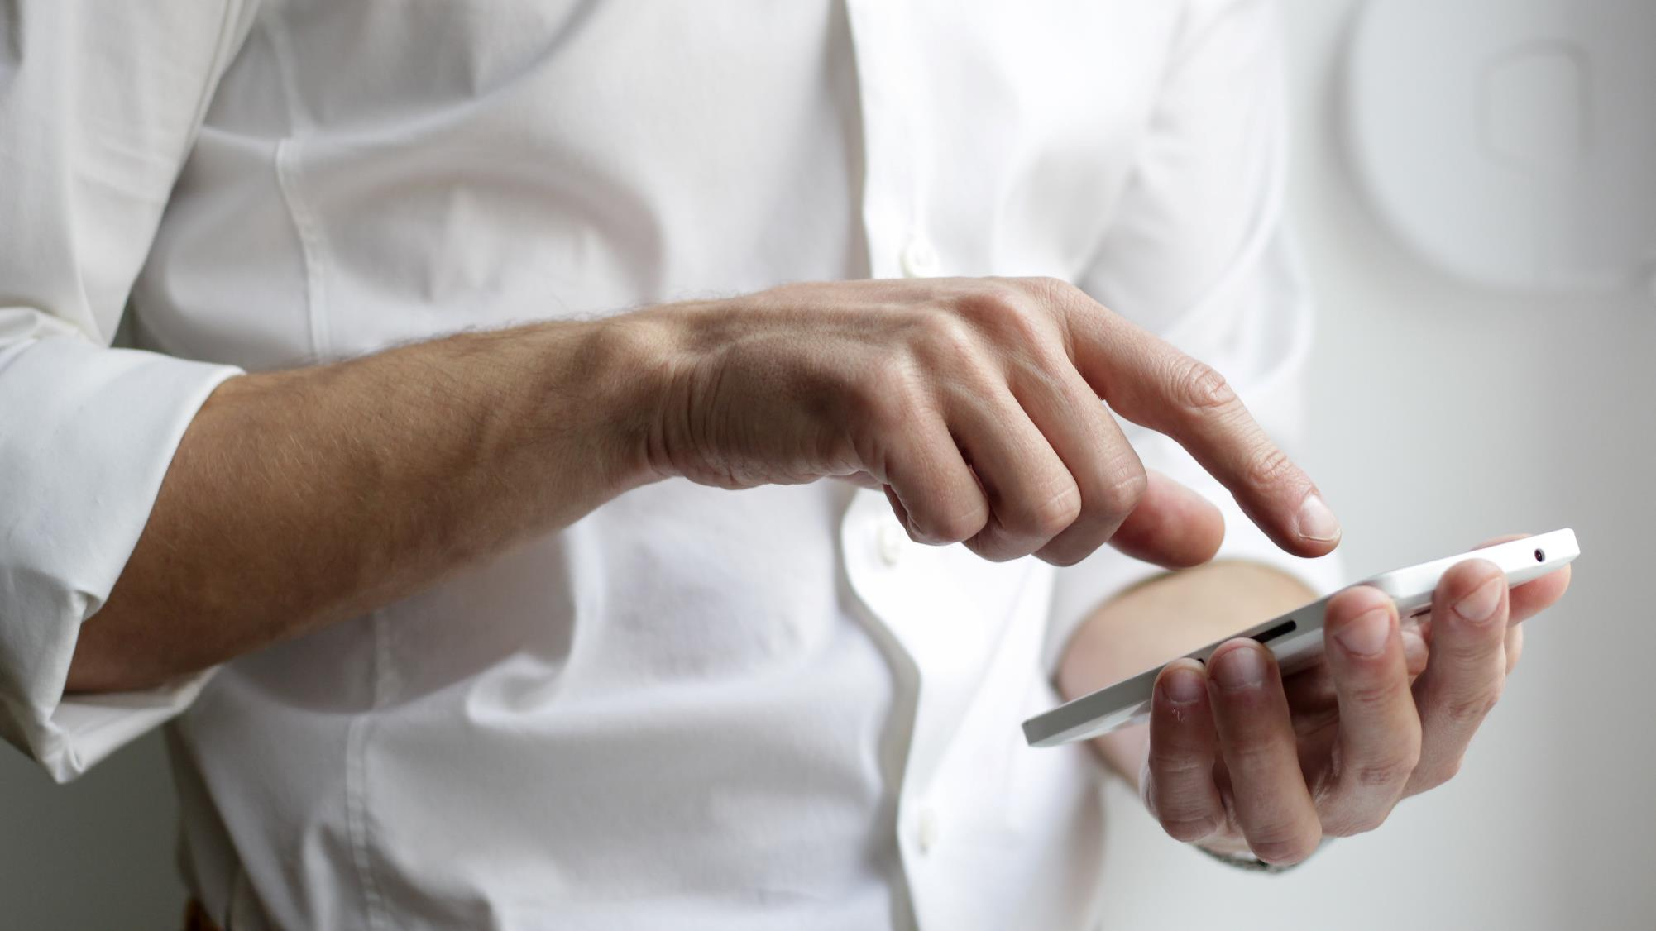
2023 Bell Geekfest – Team Creative
Terms & Conditions

Slide 3


Part x,
Template
2023 Bell Geekfest
test
TCM
Extension for
“To Protect Your Consent Better And Keep Managing It Safely from Cyber Attacks."
https://freebiesupply.com/logos/google-chrome-logo/

Slide 4
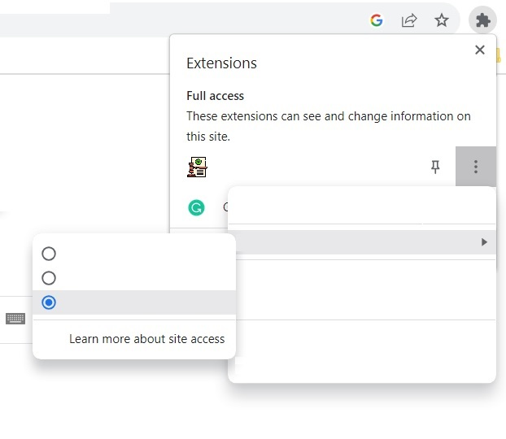
2023 Bell Geekfest
Terms and Conditions Safe Protect
What TCM is
TCM
Recent terms & conditions
Condos.com (contract)
1
Apple (sign up)
Check terms & conditions
Keep Managing
Bell (sign up)
Consult terms & conditions
Settings
2
Prevent Losing Data
About
3
Better Understand & Time Save

Slide 5

2023 Bell Geekfest
Need
“https://www.awesome-and-non-evil-corporation.ca”

Slide 6
2023 Bell Geekfest
TEST PAGE
“https://www.apple.com/legal/internet-services/itunes/fsb/terms-en.html”

Slide 7





2023 Bell Geekfest
Technology
How to implement our product
+
+
HTML
CSS
Front-end
Back-end
A.I.
https://www.javascripttutorial.net/wp-content/uploads/2021/04/JavaScript-Tutorial.svg
https://www.python.org/
https://seeklogo.com/vector-logo/332714/open-ai
https://en.m.wikipedia.org/wiki/File:React-icon.svg

Slide 8
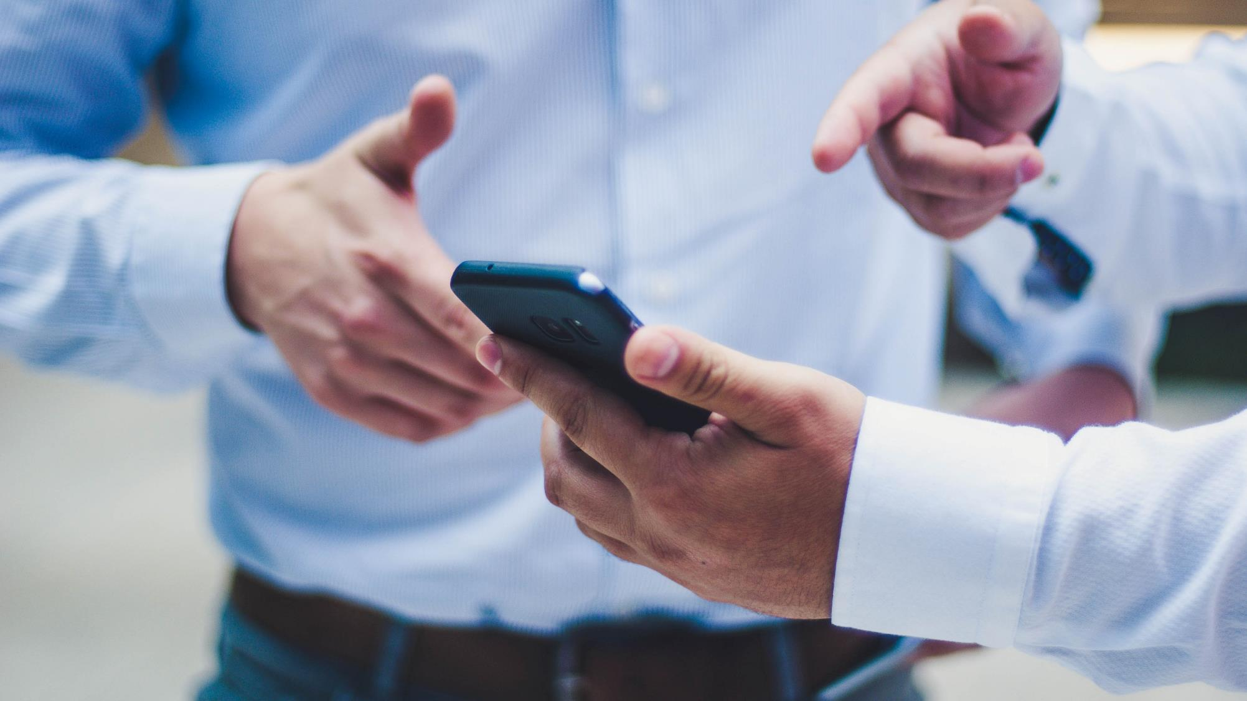
2023 Bell Geekfest
Q&A

Slide 9
2023 Bell Geekfest
「
THANK YOU
」

