Slide 1
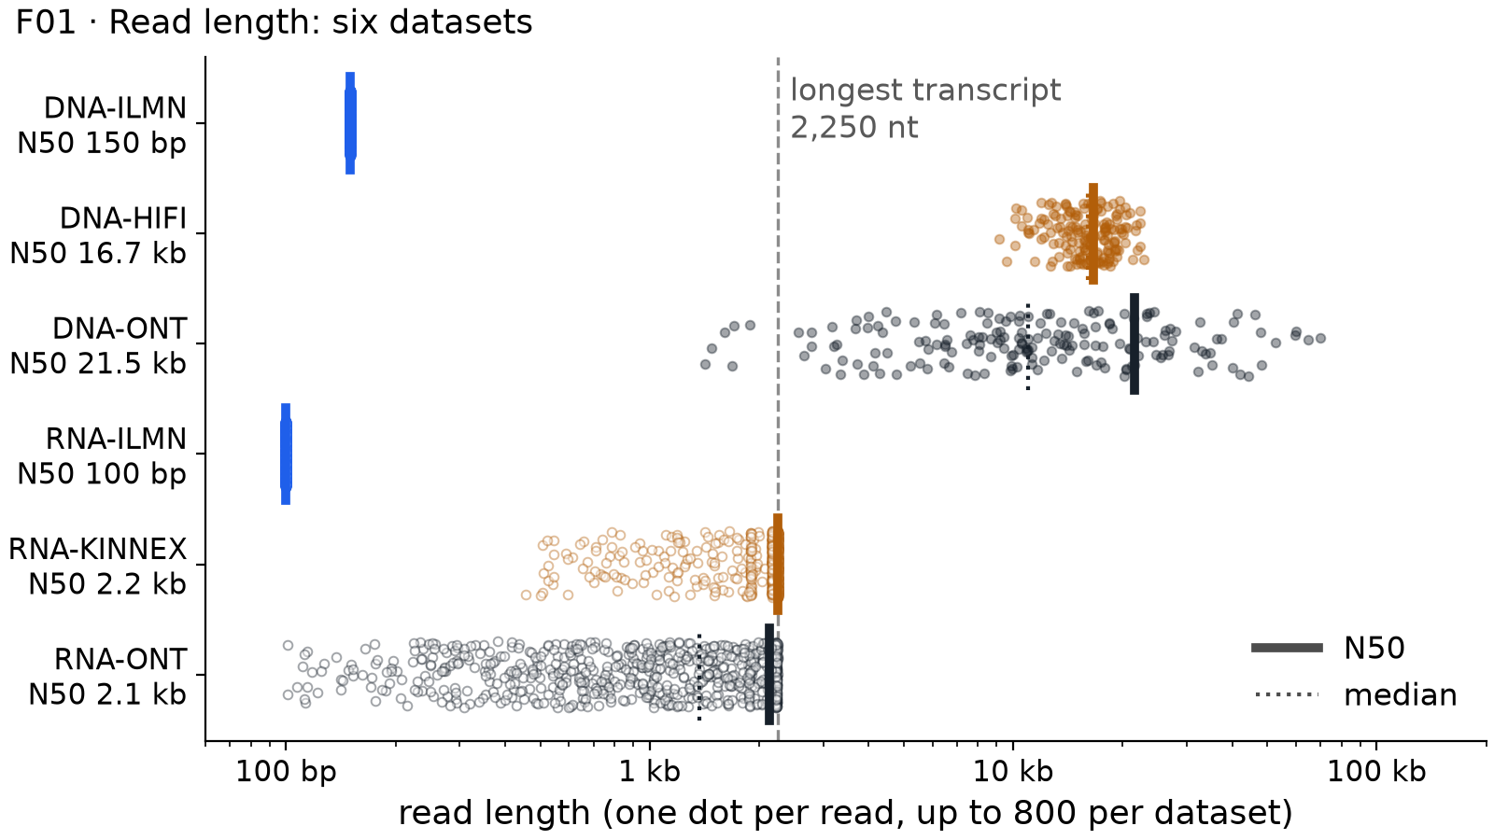
F01 · Read length: six datasets
LIGHTNING TALK · WORKED EXAMPLE
CLAIM
Long DNA reads follow the length of the DNA molecule, but long RNA reads stop at the length of the transcript.
1 · Axes and colours
Read length on a log scale, one row per dataset. Colour = platform; open circles = RNA; bar = N50, dotted = median.
2 · Evidence: one number
Nanopore DNA reads have an N50 of 21.5 kb; Kinnex RNA reads stop at 2.2 kb, the longest transcript here (2,250 nt).
3 · So what: choice and one limit
To cross a 6-kb duplicated block in DNA, choose HiFi or Nanopore DNA. Limit: fewer reads, higher cost per base than Illumina.
Q. Why are the long RNA reads not 20 kb long, like the long DNA reads?
A.
Each RNA read is one copy of one transcript, so it cannot be longer than the transcript: at most 2,250 nt here.
Pair: instructor · Figure F01 · Practice 3, synthetic data
01 / 2
Notes:
Worked example for the instructor, about two minutes. Start with the axes: read length on a log scale, one row per dataset, colour for the platform and open circles for RNA; the thick bar is the N50 and the dotted line the median. Then the claim: long DNA reads follow the length of the DNA molecule, but long RNA reads stop at the length of the transcript. The evidence: the Nanopore DNA reads have an N50 of 21.5 kilobases, while the Kinnex RNA reads stop at 2.2 kilobases, because the longest transcript in this locus is 2,250 nucleotides. So what: to cross a 6-kilobase duplicated block in DNA I would choose HiFi or Nanopore DNA reads; their limit is fewer reads and a higher cost per base than Illumina. The question I expect from the floor: why are the long RNA reads not 20 kilobases long? Because each RNA read is one copy of one transcript, so it cannot be longer than the transcript.

Slide 2
F__ · The title of your figure
LIGHTNING TALK · 2 MIN
CLAIM
Your claim: one sentence that a classmate can check against the figure
1 · Axes and colours
What is on each axis? What do the colours and line styles mean?
Paste your figure here (outputs/practice3_F__ ... .png), then delete this box
2 · Evidence: one number
Point at one part of the figure. Quote one number from the CHECK output.
3 · So what: choice and one limit
Which dataset would you choose for this question, and what can it not do?
Q. What question do you expect from the floor?
A.
Your answer, in one sentence.
Pair: ________ and ________ · Figure F__ · Practice 3, synthetic data
02 / 2
Notes:
How to use this slide. Replace the grey text, paste your figure from the outputs folder, and keep everything else. You have two minutes: about 20 seconds for the claim, a minute for the evidence, and 40 seconds for the so what. The claim is one sentence with a direction that a classmate can check by looking at the figure. For the evidence, point at one part of the figure and quote one number from the CHECK output; say what the axes show first. For the so what, name the dataset you would choose for this kind of question and one thing it cannot do. The Q/A bar is the question you expect from the floor and your one-sentence answer.

