Slide 1
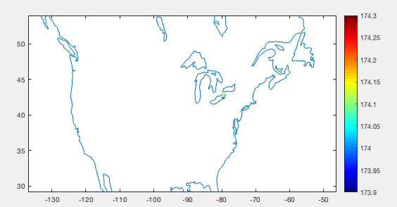
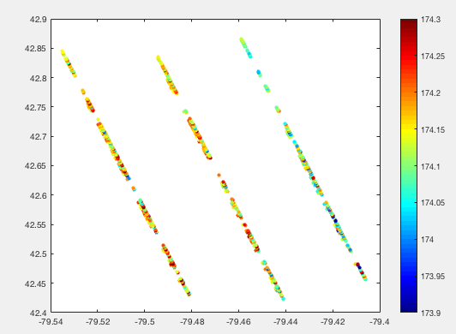
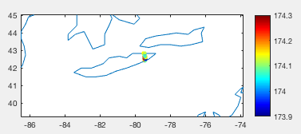
Lake Erie
October 18, 2018
GT1L 1R 2L 2R 3L 3R
174.1656 / 174.1654 / 174.1652 / 174.1523 / 174.1128 / 174.0986
60 450 60 330 30 390

Slide 2
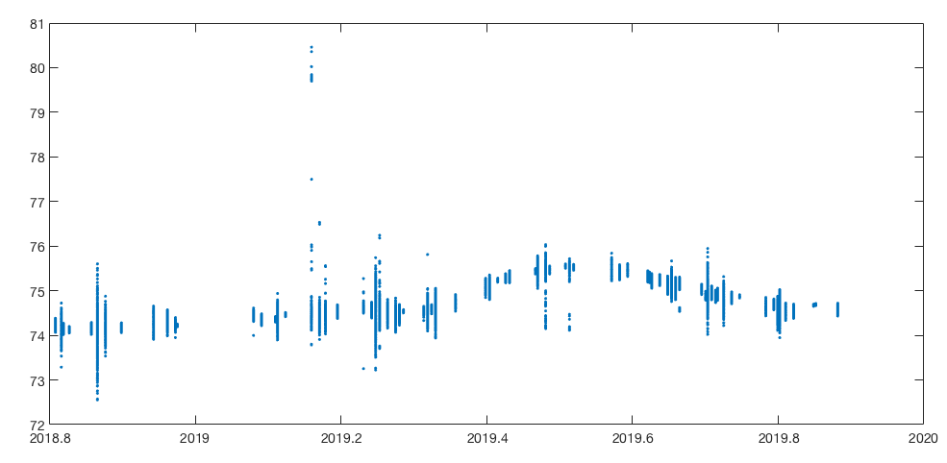
ATL13_201810_201911_Ontario ( # 297,360 measurements)

Slide 3
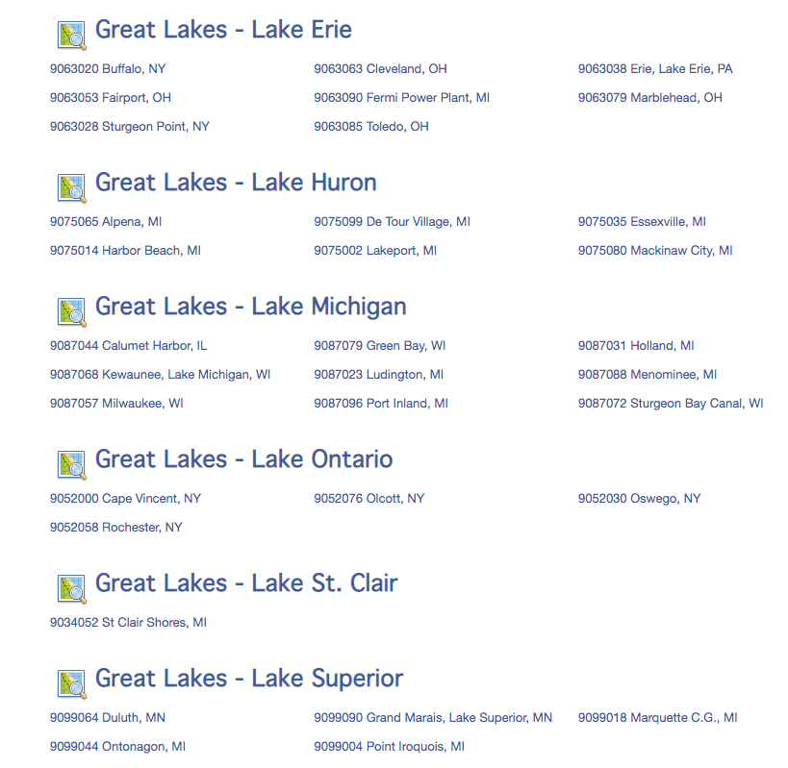
https://tidesandcurrents.noaa.gov/stations.html?type=Water+Levels#GreatLakes-LakeOntario

Slide 4
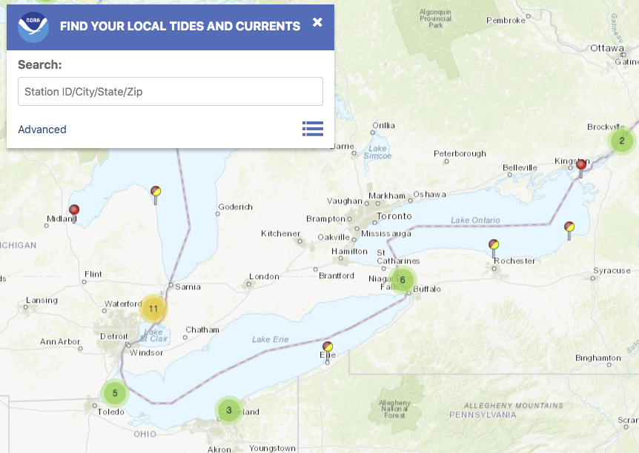
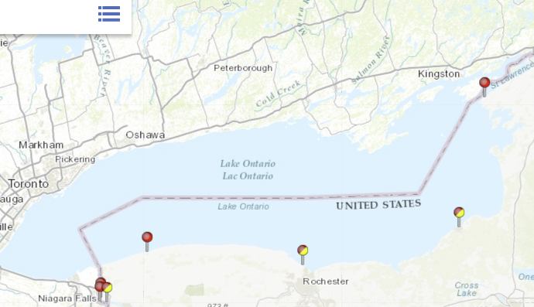
latObs = 43.4633 44.1300 43.3383 43.2683
lonObs = -76.5117 -76.3317 -78.7267 -77.6250
biasNAVD88toEGM2008 = -0.5010 -0.4660 -0.5020 -0.5560
https://tidesandcurrents.noaa.gov/map/index.html?type=active&region=Great%20Lakes%20-%20Lake%20Ontario

Slide 5
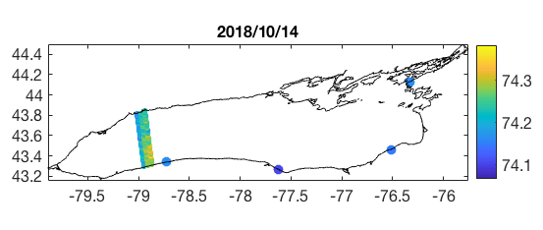
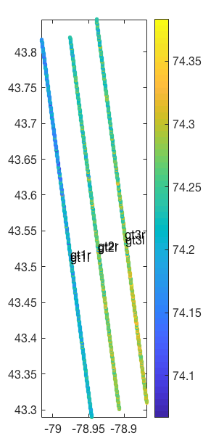
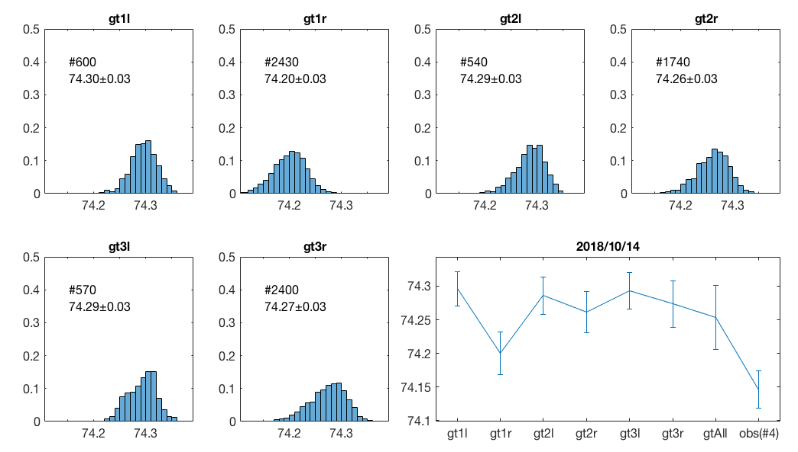

Slide 6
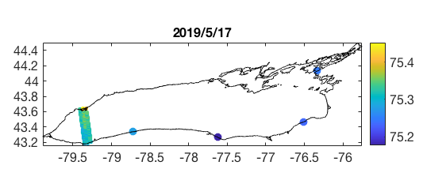
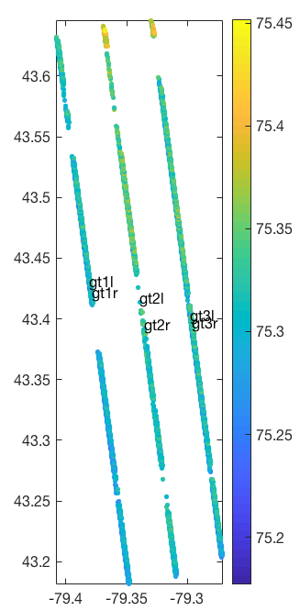
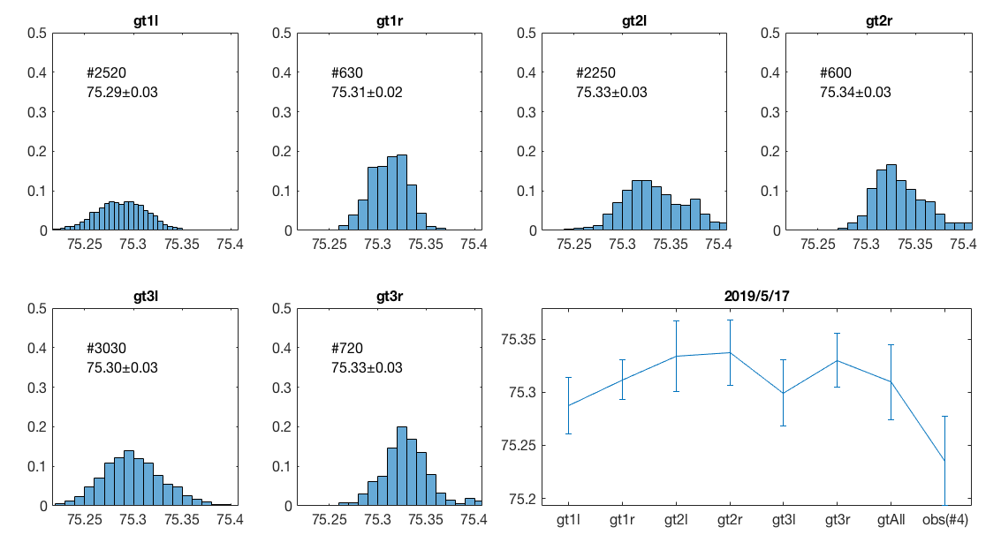

Slide 7
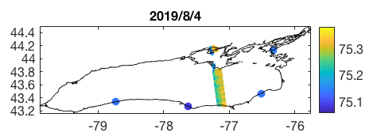
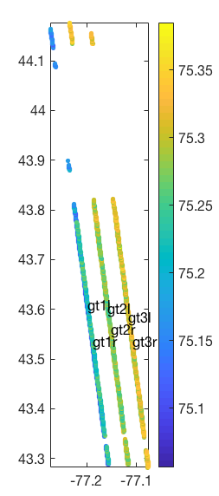
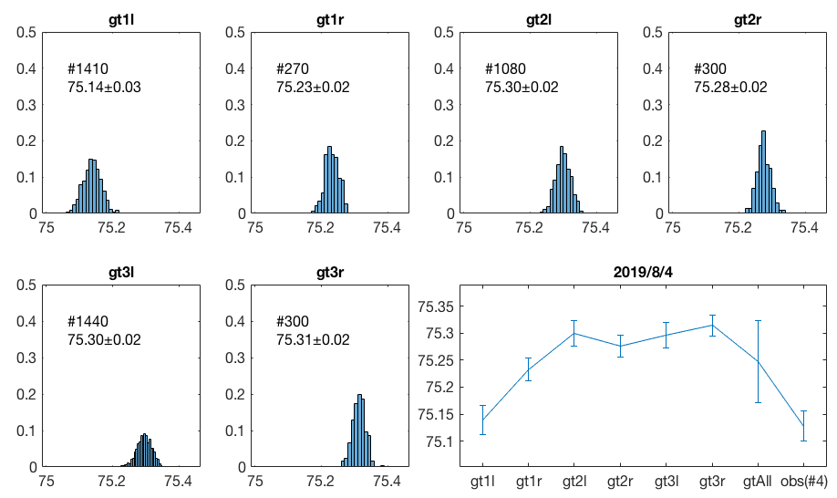

Slide 8
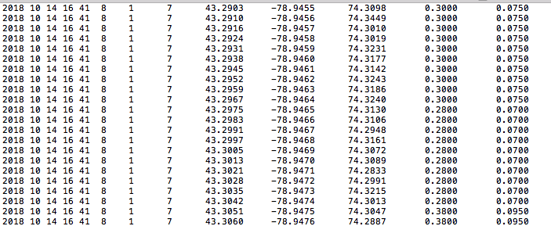
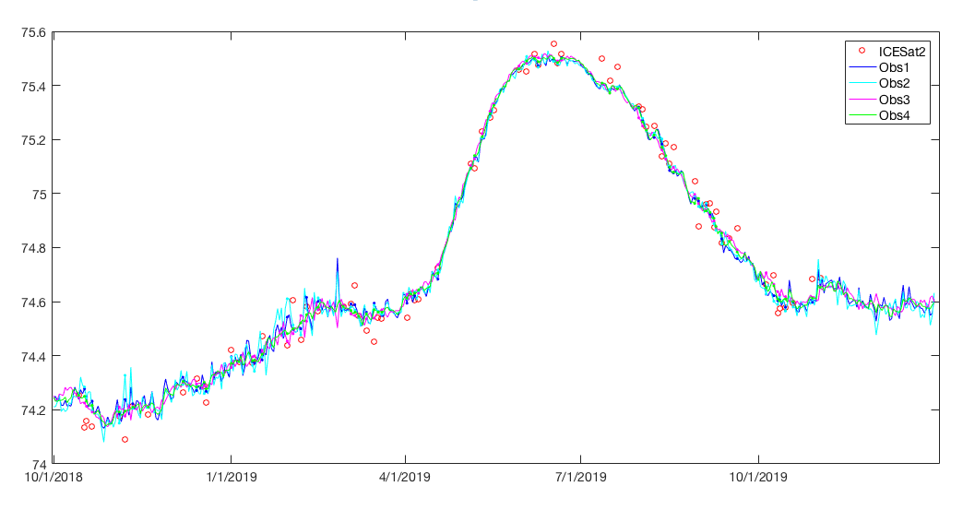
yy mm dd hh mm ss. #beam. #lake_id Lat. Lon. ortho_hgt Sig_wave_hgt. sigma

