Slide 1
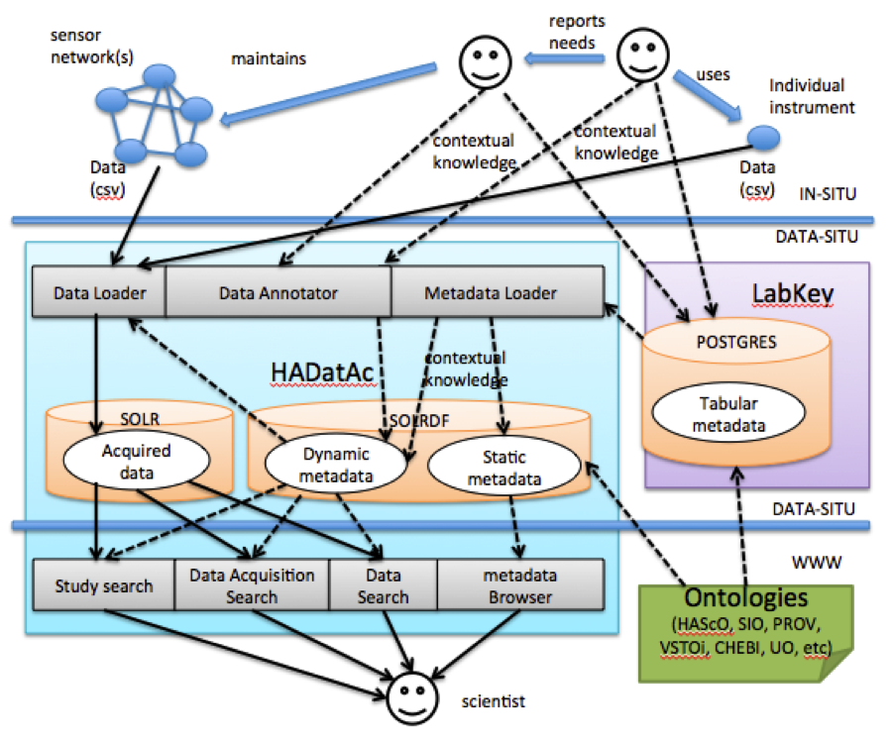
Introduction to HADatAc

Slide 2
What is HaDatAc?
Human Aware Data Acquisition framework
Hadatac allows users to store traditional longitudinal data
Contextual knowledge (referred to as metadata) is linked to the data using semantic web ontologies
Hadatac then allows users to query the data using its web interface, or through API’s

Slide 3
Semantic Web
“The Semantic Web is an extension of the World Wide Web through standards set by the World Wide Web Consortium. The goal of the Semantic Web is to make Internet data machine-readable.”
Ontologies are a key part of the semantic web, allowing knowledge to be linked.
Important ontologies we use: Unit Ontology (uo), Environment Ontology (envo), Sustainable Development Goals Interface Ontology (sdgio)
We also maintain our own ontology, the SEVA ontology, to create our own classes, and add information to classes from other ontologies.

Slide 4
Key Concepts
Instruments
Platforms
Deployments
Studies

Slide 5
Instruments
What is generally referred to as a “sensor” is not standardized.
Hadatac defines a sensor as an instrument with detectors.
A detector is a device that takes a physical reading.
An instrument is what converts that reading into human readable information.
An instrument can also take the form of a questionnaire, or a computer model.

Slide 6
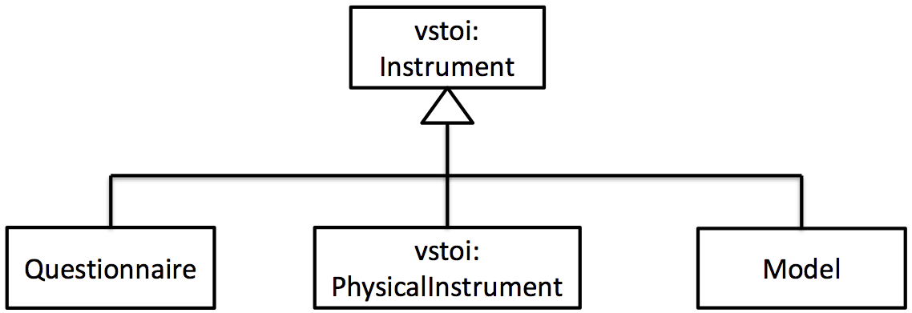
Instruments (cont.)

Slide 7
Platform
A platform is a physical location, where an instrument can be placed
Contextual knowledge is create by creating subclasses of the base platform from the vstoi ontology.
For example, we could create a room platform in the metadata like so:
hasURI | rdfs:subClassOf | rdfs:label
seva:PLTYP-Room | vstoi:Platform | Room

Slide 8
Deployment
“A Deployment is the placement of an instrument in a platform so that it can be ready for acquiring data.”
A deployment must have a start time, and can also have an end time.
If no end time is given, the deployment is considered ongoing.

Slide 9
Study
A study is a collection of data acquisitions.
“A DataAcquisition is both an event of using an instrument to acquire data, as well as the overall collection of all data values acquired by the instrument, during its deployment, where all the points belonging to the collection have exactly the same quality.”
A data acquisition is essentially the set of data collected from a deployment that pertains to a given study.

Slide 10
Studies and Deployments
Segregating studies and deployments gives users of hadatac two primary advantages
  A long study can have instruments deployed many times, as they break, are recalibrated, etc.
  A long deployment can be utilized by many studies without confusion. Studies don’t need to utilize the entirety of the data.

Slide 11
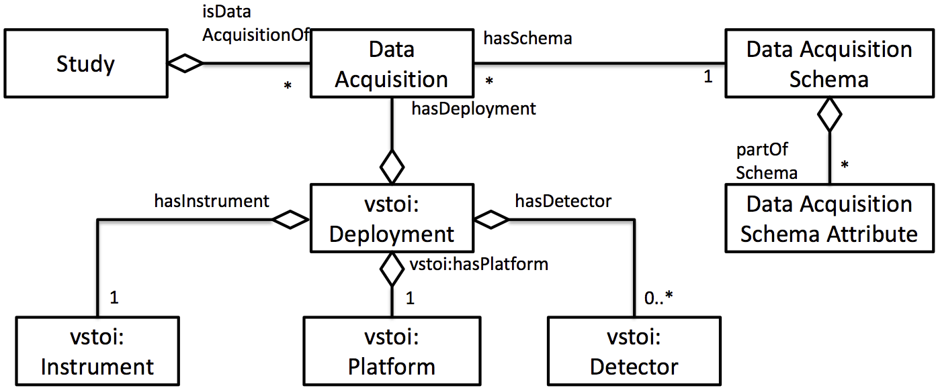
Studies and Deployments (cont.)

Slide 12
Data Upload
Data is uploaded to hadatac in one of two file formats, csv and xlsx.
Different files are used to represent different types of knowledge.
  DPL: Used to specify deployments
  STD: Used to create a study
  SSD: Used for semantic study design
  SDD: Semantic Data Dictionary
  OAS: Used to link deployments to the SDD
  DA: Used for data acquisition
The abbreviation is used as a prefix in the filename so hadatac understands how to process the file.

Slide 13
DPL File
The DPL is an xslx file
The DPL file is the main source of metadata
Each sheet is used to create deployments, platform models, platforms, instruments, detector models, and detectors.

Slide 14
STD File
The STD file is an xlsx file.
The STD is used to create a study
Important information about the study is stored such as the location, the principal investigator, and the aims of the study.

Slide 15
SSD File
The SSD is an xlsx file.
“Semantic Study Designs are required when the structure of the study affects the understanding and quality of the data acquired from the study.”
Generally, the SSD is used to create “objects” that correspond to platforms.

Slide 16
SDD File
The SDD is an xlsx file.
The semantic data dictionary serves many functions, but the main two are as follows:
  Link the headers from the DA files to an ontology to give contextual knowledge of the data, as well as the unit
  If categorical data is collected, the Codebook is used to represent the categories ie 0 – off, 1 - On

Slide 17
OAS Files
The OAS files are stored as csv’s.
The OAS links the deployment, the study, and the SDD the data acquisitions will use.
An OAS must be created for each object (platform).

Slide 18
DA Files
DA files are stored as csv’s.
The DA files are the source of the traditional data.
Every DA must be named using the prefix specified in the OAS ex DA-MyStudy-sensor1.csv
Each header must match what is specified in the SDD, or the data will not be stored.
There must be a “timestamp” column, and every row must have an ISO 8601 timestamp ex “2020-03-03T00:00:00Z”
All of the data for a deployment does not need to be in a single DA file. However, too many files will cause the hadatac interface to slow down.

Slide 19
Terminology
When hadatac processes files, it is referred to as “ingestion”
Metadata files are handled by the “data annotator”
Data files are handled by the “data loader”

Slide 20
Sources
https://en.wikipedia.org/wiki/Semantic_Web
https://github.com/paulopinheiro1234/hadatac/wiki

