Slide 1
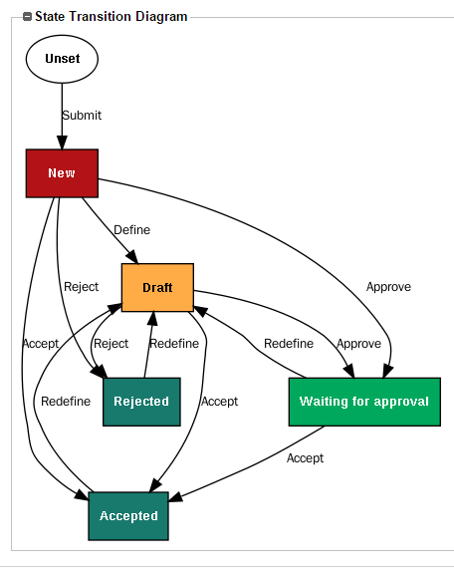
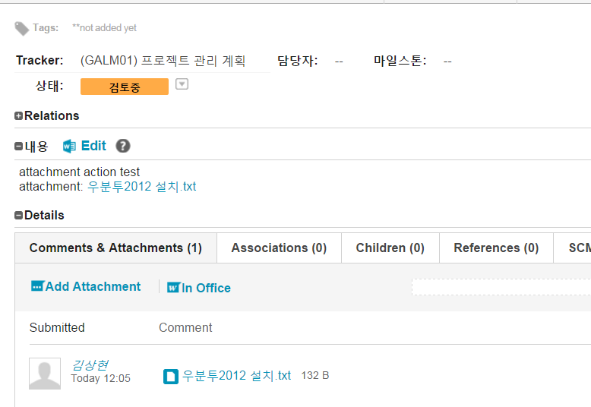
2. ) ()
내용
From-To
1
3
5
7
9
2
4
6
8

Slide 2
1. 제목

Slide 3
1.제품 기능

Slide 4
Using Upsource to browse repositories
User settings
Favorite projects
Impersonating a VCS username
Viewing history of changes in a repository
Navigating within a projects
Different ways to compare code
Revision view with inline diff
Side-by-side diff view
Comparing revisions and branches
Browsing code in a repository
Searching
Searching for revision
Searching for code
Searching news feed
Searching reviews
Viewing individual files
Displaying code inspections in files
Navigating within and from a file
Viewing file history
Viewing and comparing branches

Slide 5
1. 대제목 1) 중제목 (2) 소제목
상세 설명

