Slide 1
Yao Zijun| NHL Performance Analytics Portfolio: Driving Decisions with Data
Junior Data Engineer/ Data Analyst

Slide 2
The challenge & project overview
The Challenge: NHL team was underperforming and required data-driven insights to optimize performance.
Project Goal: Improve gameplay, optimize team dynamics and identify individual performance gaps.
Key Deliverables (My Focus):
Power BI Dashboard (Goaltender & Player Analysis)
Actionable Recommendations for coaching staff

Slide 3
My role & core Contributions
Role: Junior Data Engineer/Data Analyst
Key Contributions:
Cleaned goalie stats and game goals data and utilized teammate-prepared player dataset for analysis and visualization
Developed Power BI visualizations for goalie performance and player fatigue analysis
Applied SQL for metric calculations (e.g., save percentages by situations)
Delivered actionable insights to support coaching strategy

Slide 4
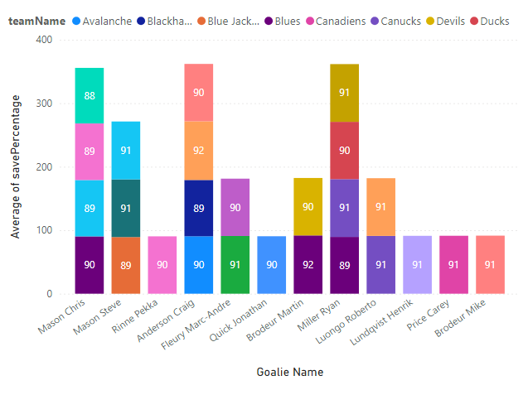
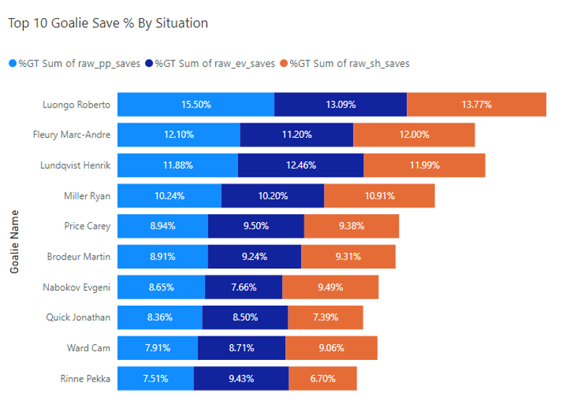
Goaltender Analysis
Objective: Assess goalie performance beyond overall stats; identify strengths/weaknesses in specific game situations.
My Approach:
Identified need for situational analysis (Even Strength, Power Play, Shorthanded Saves)
Wrote SQL queries to calculate situational save percentages
Created visual comparisons to evaluate goalie consistency
Key Insight:
Identified Roberto as elite across all save categories (consistent top performer)
Highlighted goalies with weaknesses (e.g., underperformance during shorthanded play)
Actionable Recommendation:
Informed targeted training or strategic deployment

Slide 5
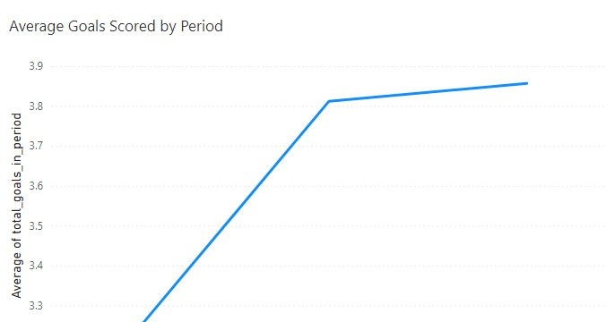
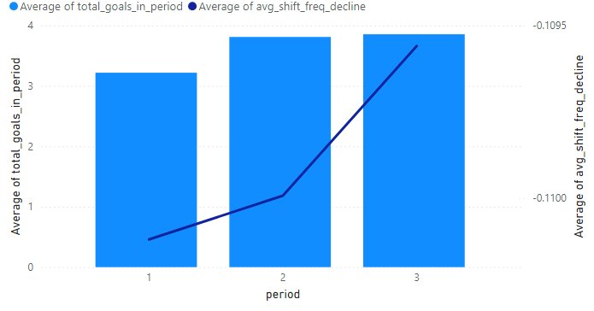
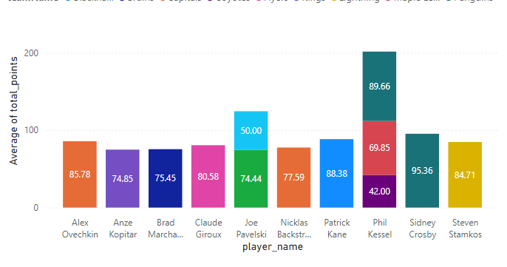
Player analysis
Objective: Analyze offensive contribution and endurance patterns
Approach:
Ranked top players by total goals and assists
Calculated points using SQL logic (goals + assists)
Examined scoring patterns across periods
Key Insight:
Players tended to score more in later periods despite longer shifts
Actionable:
Suggested period-specific strategies and load management

Slide 6
Impact and learnings
Project Impact:
Delivered insights to support player development and tactical planning
Empowered coaching staff with data-backed recommendations
My Key Learnings:
Used Power BI to develop interactive dashboards
Cleaned and prepared data using Python (pandas)
Applied SQL to calculate and extract meaningful performance metrics

Slide 7
Thank you Connect with me: LinkedIn | Email: junyeoo001@gmail.com

