Slide 1
Immediate Feedback Collaborative Code Tracing
Jun Zheng, Sohee Kang, Brian Harrington
Department of Computer and Mathematical Sciences
University of Toronto Scarborough
WCCCE 2019
Notes:
Good afternoon, my name is Jun Zheng from the University of Toronto, I am here today to talk about our paper on a software we have developed called IFCAT.

Slide 2
Most assessment techniques...
Doesn’t provide immediate feedback
Doesn’t help student retain the course material
Hard for instructors to approximate knowledge
Little to no collaboration between students
Notes:
Let’s get started by thinking about many of the assessment techniques we are using today, let it be tests or quizzes.

Slide 3
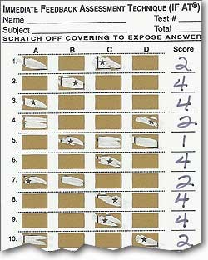
IF-AT
IF-AT is a system solves many of these problems by using scratch cards
scratch open a box student think is correct
a star means the answer is right, and the student shall move on
instructors can approximate knowledge by number of boxes scratched open
Immediate feedback has been shown to help students retain course materials (Epstein et al, 2002).
https://blogs.uco.edu/tts/use-if-at-cards-make-tests-fun/

Slide 4
IF-AT
But…..
scratch cards are expensive
they have to be physically produced for individual quizzes
https://blogs.uco.edu/tts/use-if-at-cards-make-tests-fun/

Slide 5


Slide 6
So what about collaboration?

Slide 7
Think-Pair-Share
TPS is a popular collaboration model
students attempt to answer questions individually first
then brings their answer to group
eventually submit final answer as a group
Has been shown to be very effective in large CS1 classes (Kothiyal, 2013).
Effective in advanced level too (Pardeshi, 2016).

Slide 8
Think-Pair-Share
But…
Hard to facilitate

Slide 9
Why don’t we develop a software tool that solves these problems?
Notes:
Then we thought, why don’t we develop a software tool that combines immediate feedback and TPS while solving all the problems they have.

Slide 10
IFCAT
A web-based assessment tool designed for in-class collaborative tests and quizzes.
Support for
Multiple choices
Short answers
Code tracing
Mobile friendly
Accessible from any internet enabled devices
Notes:
….
I have a few screenshots to give you a better understanding of how this system works.

Slide 11
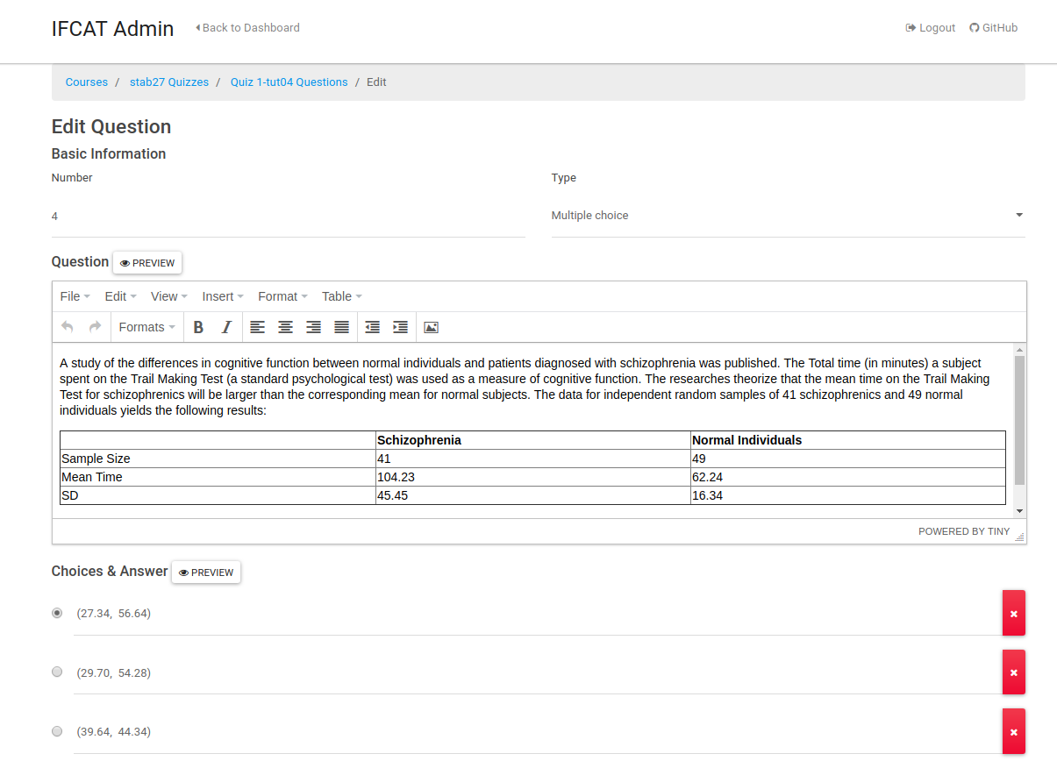
Instructor
Web based question editor for easy quiz management

Slide 12
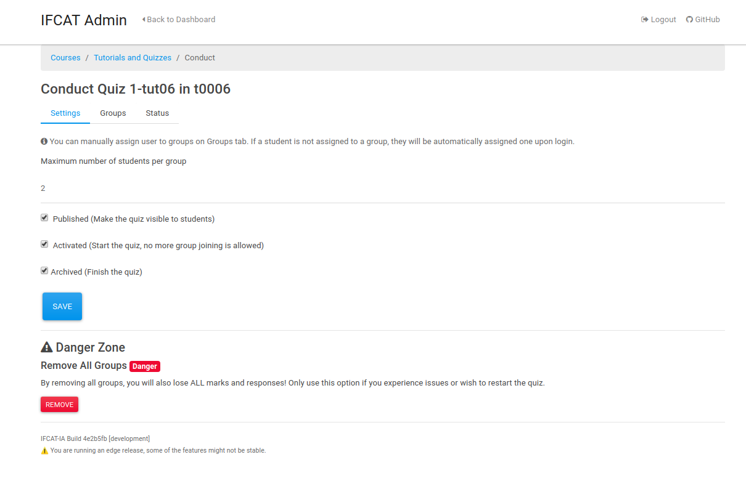
TA
Interface to monitor and conduct quizzes.

Slide 13
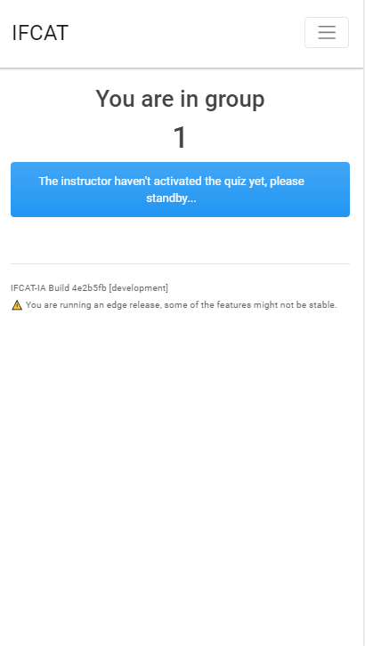
Students
Students will be assigned to groups randomly upon joining the quiz.

Slide 14
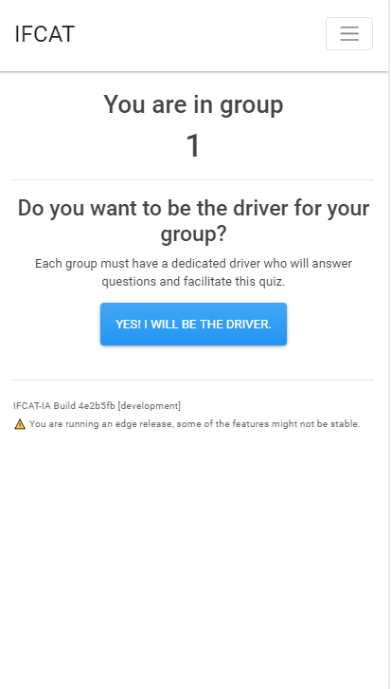
Students
Students will be assigned to groups randomly upon joining the quiz.
Each group must elect a “driver” to submit all answers.

Slide 15
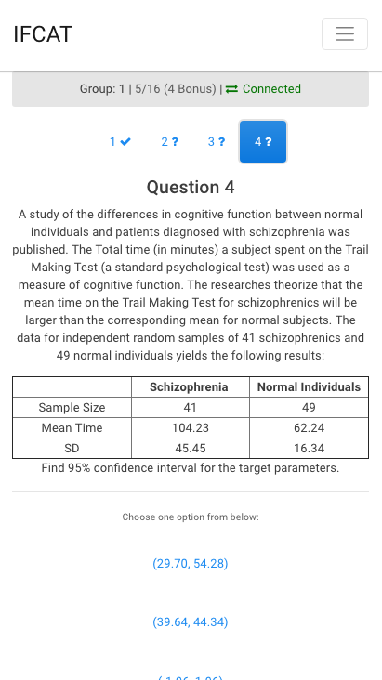
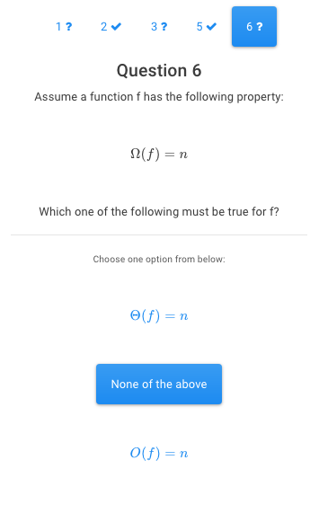
Students
Rich text support.
Intuitive interface, students can jump around between questions.

Slide 16
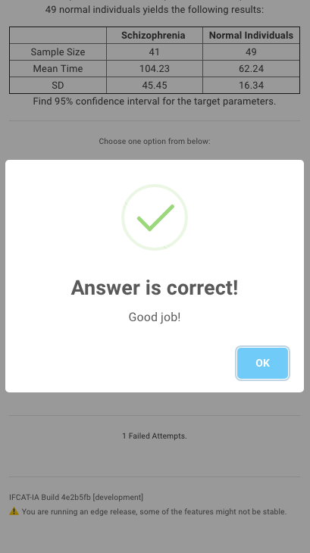
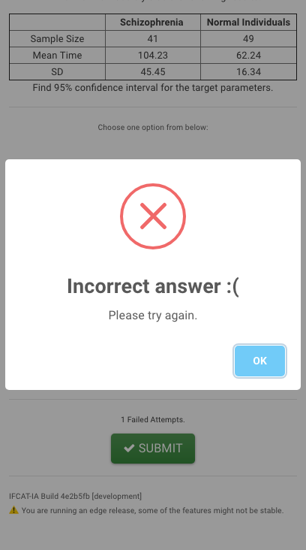
Immediate Feedback
Group will know immediately if they answered a question wrong.
Marks are automatically calculated based on number of failed attempts.

Slide 17
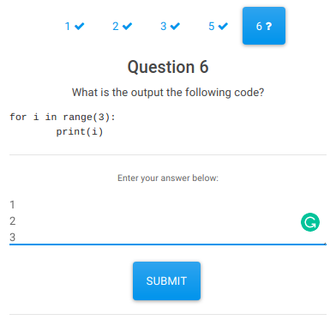
Code Tracing
Student answer individually first without feedback.

Slide 18
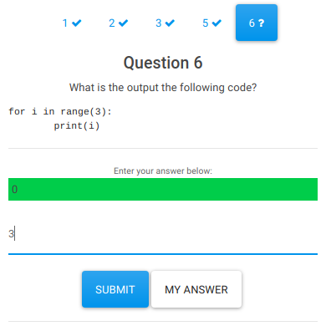
Code Tracing
Submit after each line of input

Slide 19
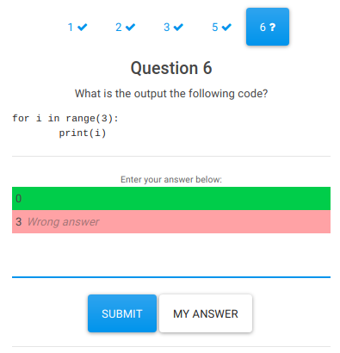
Code Tracing
Submit after entering each line of output.
Immediately shows the wrong line entered, cannot proceed to next line until the wrong line is corrected.

Slide 20
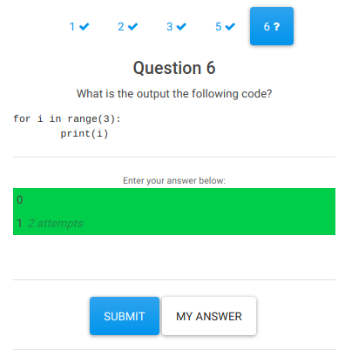
Code Tracing
Submit after entering each line of output.
Immediately shows the wrong line entered, cannot proceed to next line until the wrong line is corrected.

Slide 21
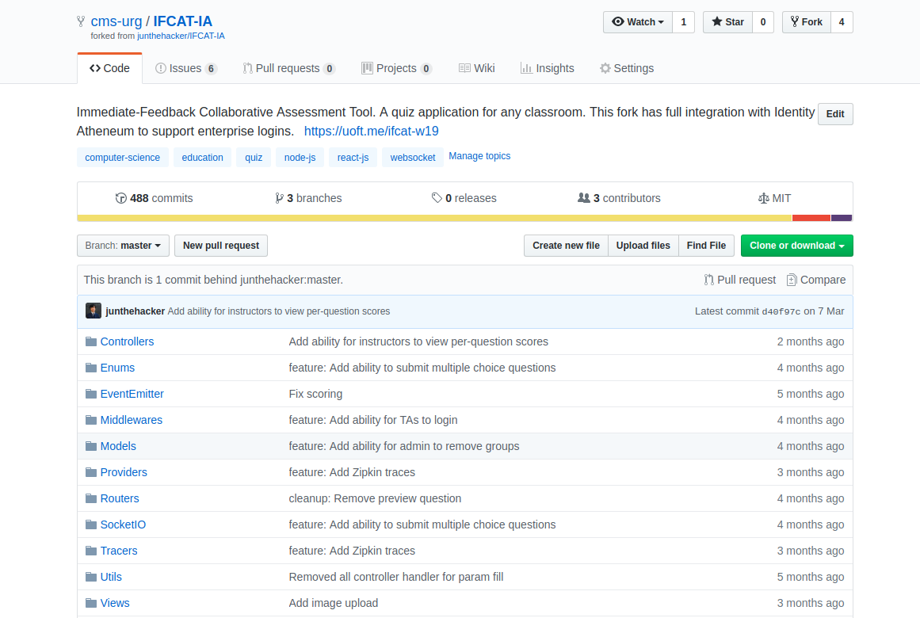
Current State
System was tested in an introductory statistics course.
Fully open-source (https://github.com/cms-urg/IFCAT-IA)
In active development.

Slide 22
Future Research
Currently conducting a research at UofT Scarborough
Volunteers will be randomly assigned to subgroups to complete tracing questions throughout the term.
Control group will use IFCAT without immediate feedback and collaboration.
Another group with immediate feedback
Another with TPS collaboration
Final group will have fully function IFCAT with immediate feedback and collaboration
Will monitor satisfaction, usage, immediate learning gains (exit slips), and long term learning gains.

Slide 23
References
Michael L. Epstein, Amber D. Lazarus, Tammy B. Calvano, Kelly A. Matthews, Rachel A. Hendel, Beth B. Epstein, , and Gary M. Brosvic. 2002. Immidiate Feedback Assessment Technique Promotes Learning and Corrects Inaccurate First Responses. The Psychological Record 52 (2002), 187–201
Brian Harrington and Ayaan Chaudhry. 2017. TrAcademic: improving participation and engagement in CS1/CS2 with gamified practicals. In Proceedings of the 2017 ACM Conference on Innovation and Technology in Computer Science Education. ACM, 347–352
Brian Harrington and Nick Cheng. 2018. Tracing vs. Writing Code: Beyond the Learning Hierarchy. In Proceedings of the 2018 ACM Conference on Innovation and Technology in Computer Science Education. ACM, 423–428
Aditi Kothiyal, Rwitajit Majumdar, Sahana Murthy, and Sridhar Iyer. 2013. Effect of think-pair-share in a large CS1 class: 83% sustained engagement. In Proceedings of the ninth annual international ACM conference on International computing education research. ACM, 137–144
Raymond Lister, Colin Fidge, and Donna Teague. 2009. Further evidence of a relationship between explaining, tracing and writing skills in introductory programming. In ITiCSE ’09 Proceedings of the 14th annual ACM SIGCSE conference on Innovation and technology in computer science education. ACM, 161–165
Komal Pardeshi. 2016. Improving the Student Performance Using Think-PairShare for Operating System. Journal of Engineering Education Transformations (2016)

