Slide 1
Battle Of Neighborhoods Amsterdam

Slide 2
Introduction
Amsterdam is the capital city of the Netherlands, and is also one of the most popular tourist destinations in Europe.
The project attempts to provides the travelers to Amsterdam with a comprehensive comparison of different neighborhoods of the city to help them when deciding the location of their stay.
We classify the neighborhoods into clusters of similar characteristic to give a better idea about the type of neighborhoods one is looking to stay.

Slide 3
Data Acquisition
Amsterdam Airbnb listing data and neighborhood list from Kaggle website
Geospatial coordinates of Amsterdam neighborhood using Geopy package of Python.
Use Foursquare API to return venues of interests by passing the geospatial coordinates.

Slide 4
Data Cleaning And Preparation
Removed any inactive listing that was last reviewed before year 2018
One listing where price value is zero is removed as bad data and another one with extreme outlier prize of 5,000 is also removed.
After cleaning, 3 relevant features from the main Airbnb dataset were derived.
This is combined with venue features to form a final dataset with total of 8 features.

Slide 5
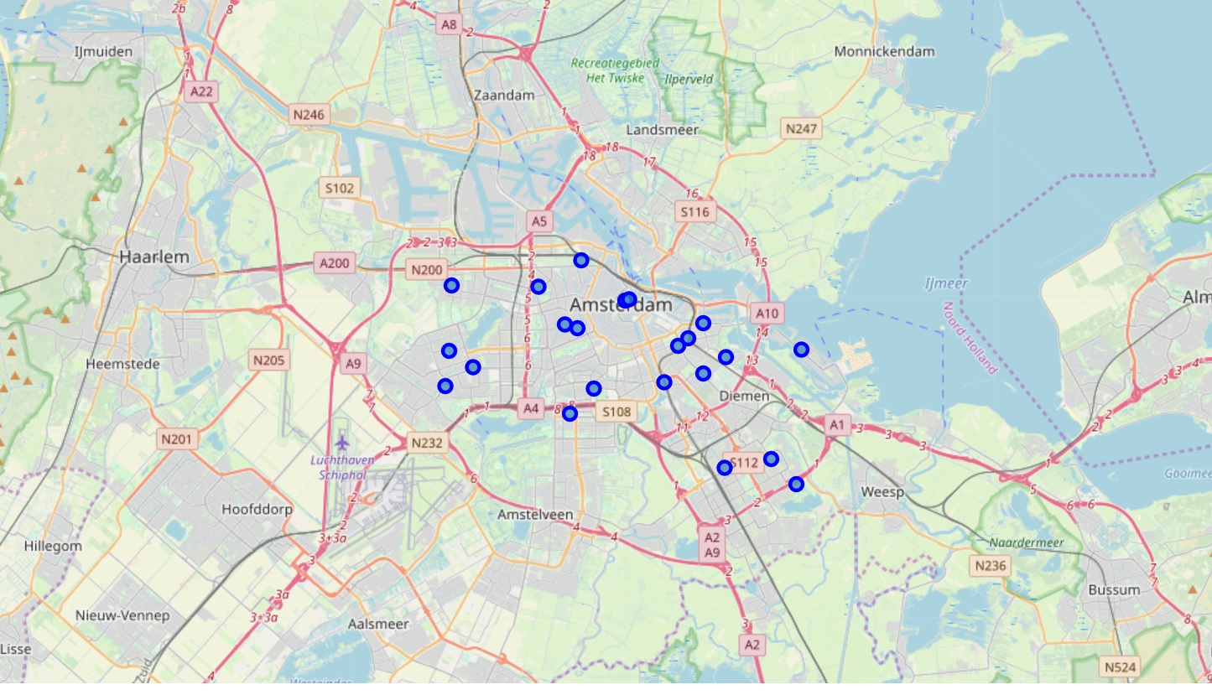
Exploratory Data Analysis
Neighborhood Map
Most of the neighborhoods are located centrally
Two distinct outer spatial clusters having three neighborhoods each.
Two neighborhoods are further far from the center and also from other neighborhoods.

Slide 6


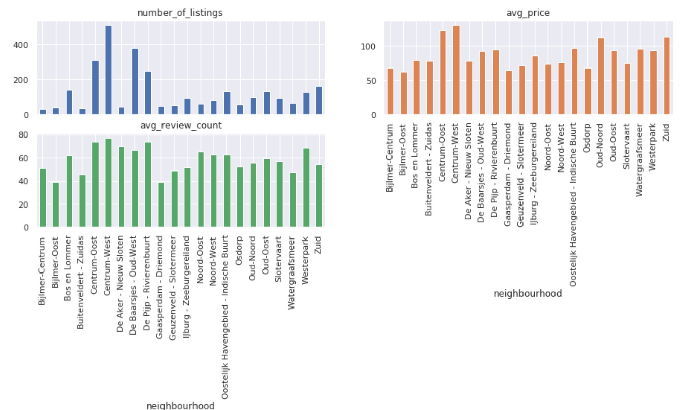
Exploratory Data Analysis
Central neighborhoods score high for each category and these should form a cluster.
Neighborhood “Centrum-West” appears to be most popular with maximum number of listings.
Average prices are lower and are similar among the neighborhoods which are not central.

Slide 7
K-means Clustering
We used the unsupervised classification algorithm K-means algorithm to classify the neighborhoods.
K-Means algorithm is one of the most common cluster method of unsupervised learning.
We choose value of K to be equal to 3.
The features are normalized using a Min-Max normalization algorithm

Slide 8
Results
Cluster 1 | Cluster 2 | Cluster 3
Bijlmer-Oost | Centrum-West | Bijlmer-Centrum
Buitenveldert - Zuidas | De Baarsjes - Oud-West | Bos en Lommer
De Aker - Nieuw Sloten | Noord-West | Centrum-Oost
Gaasperdam - Driemond | Oud-Noord | De Pijp - Rivierenbuurt
Geuzenveld - Slotermeer |  | Oostelijk Havengebied - Indische Buurt
IJburg - Zeeburgereiland |  | Oud-Oost
Noord-Oost |  | Westerpark
Osdorp |  | Zuid
Slotervaart
Watergraafsmeer
Cluster 1 contains four central neighborhoods
Number of neighborhoods in each cluster varies

Slide 9
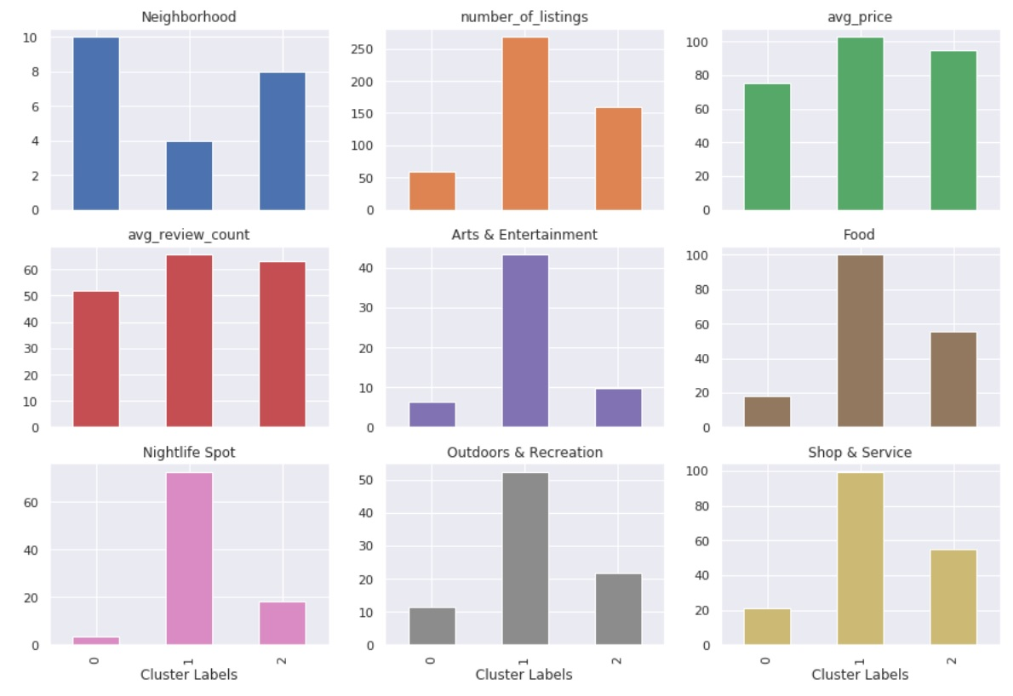
Cluster Feature Analysis
Cluster 1 is the main central area and has the highest concentration of all types of venues but is also costlier on average.
Cluster 2 has more(8), neighborhoods and is cheaper than cluster 0 on average
It also matches or exceeds cluster 0 in total number of listings and venues

Slide 10
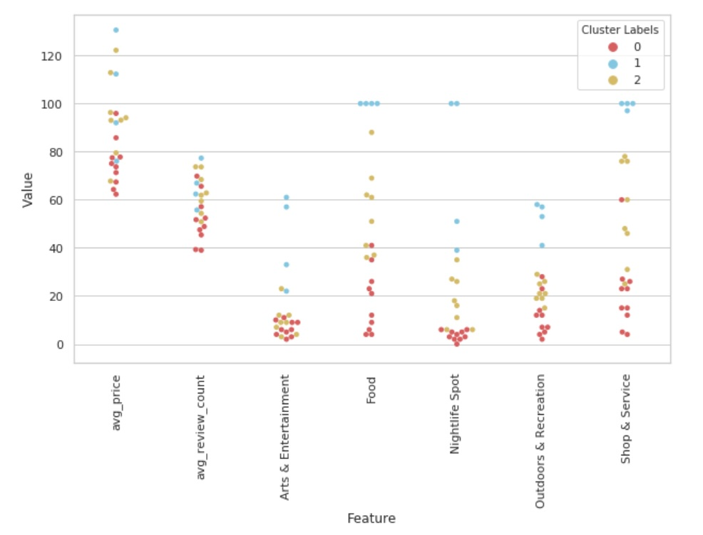
Neighborhood Features In Each Cluster
Visualize how the feature values vary among neighborhoods within each cluster
Revealed that even with in a cluster, most of the values varies significantly

Slide 11
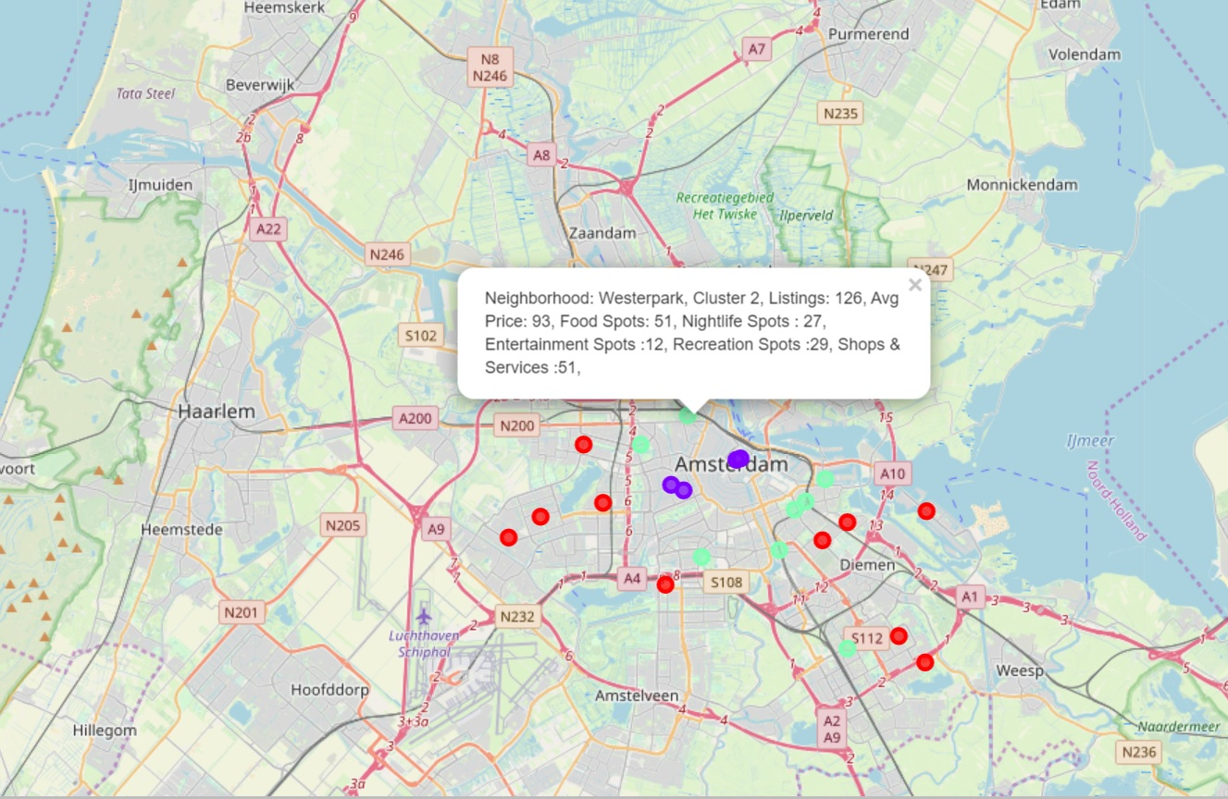
Neighborhood Clusters On The Map
Clusters are color coded
Reveals strong correlation between actual geo-spatial clusters and logical clusters formed by the algorithm.
A short info snippet about the neighborhood also pops up.

Slide 12
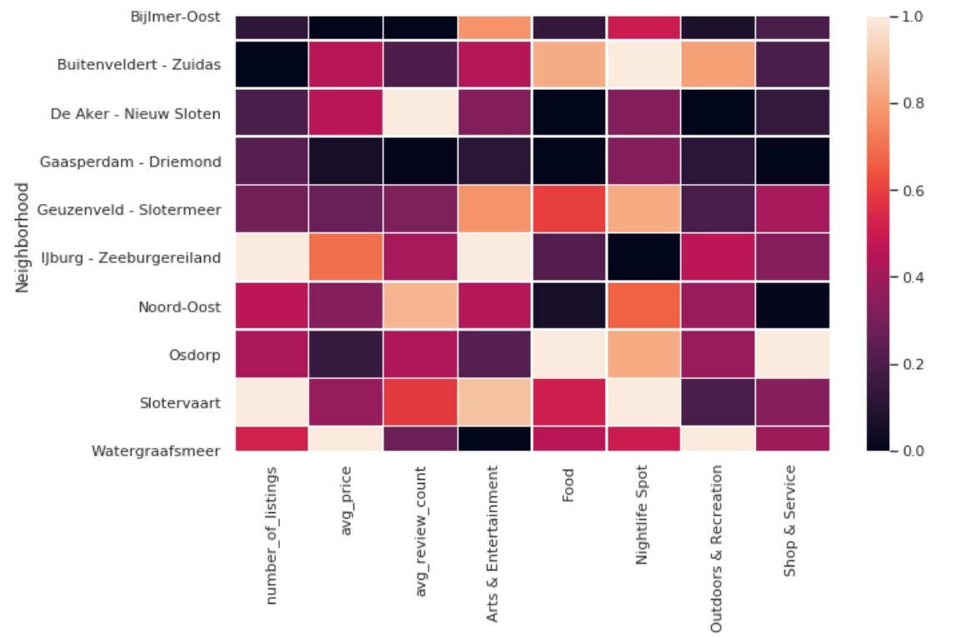
Heatmap - Cluster 0
This cluster has the most number of neighborhoods.
Very diverse cluster with all types of neighborhoods.

Slide 13
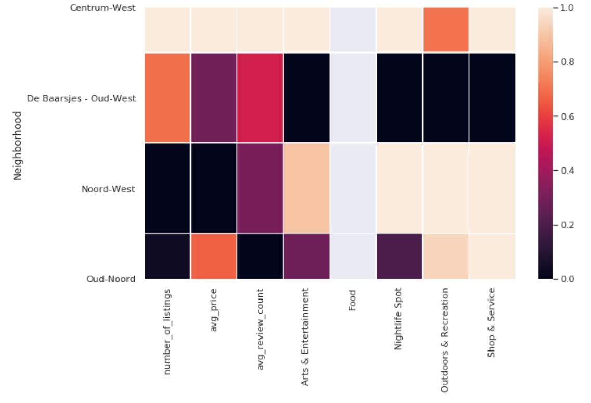
Heatmap - Cluster 1
Centrum- West stands out in most categories but is also costlier.
Noord-West fares the best with low price and most venues around.

Slide 14
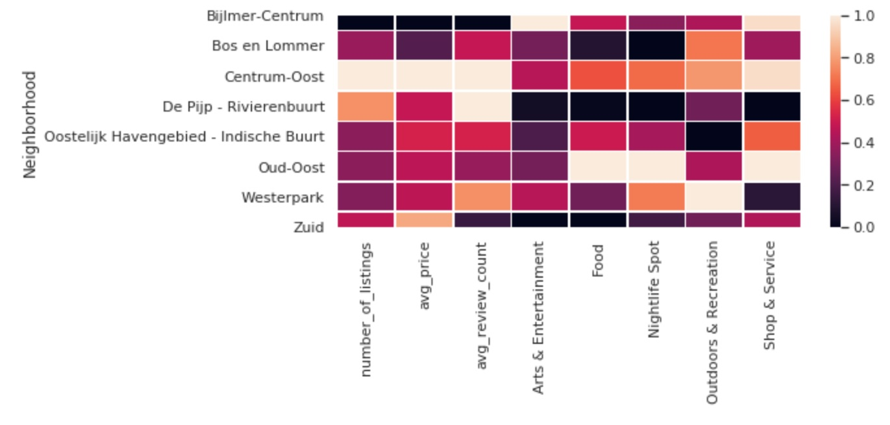
Heatmap -Cluster 2
This cluster has second most number of neighborhoods and is also very diverse.
Centrum-Oost is the outright winner in this cluster

Slide 15
Conclusion And Future Recommendations
We used K-Means clustering algorithm to classify the neighborhoods
We got three distinct clusters of different size.
We characterized the clusters and analyzed the clusters individually
Future recommendation include
Include full homes/apartments listings for analysis as this can bring in more listings located non-centrally
Obtain dataset with more recent listings and this can present a different case for each neighborhood

