Slide 1
Accelerating Data Analytics Using Object-based Computational Storage System in HPC
Jongryool Kim
Director, Architecture Enabling
Memory Forsest x&D, SK Hynix Inc.

Slide 2
Legal Disclaimer
The information contained in this document is claimed as property of SK hynix. It is provided with the understanding that SK hynix assumes no liability, and the contents are provided under strict confidentiality.
This document is for general guidance on matters of interest only. Accordingly, the information herein should not be used as a substitute for consultation or any other professional advice and services.
SK hynix may have copyrights and intellectual property right. The furnishing of document and information disclosure should be strictly prohibited.
SK hynix has right to make changes to dates, product descriptions, figures, and plans referenced in this document at any time. Therefore the information herein is subject to change without notice.
ⓒ 2023 SK hynix Inc. All rights reserved

Slide 3
Agenda
Challenges of Analytics System
Motivation
Data-aware Computational Storage
OCS System
Open Ecosystem
OCS System Demonstration

Slide 4
Challenges of Analytics Systems: A Traditional Approach
Big data analytics systems spend most of execution time on “Computing” and “IO” for query^{[1]} processing
[ Big Query : End-to-End Execution Breakdown ]
Overall Average
0
10
20
30
40
50
60
70
80
90
100
Overall Percentage of Queries(%)
CPU Remote Work IO
Traditional solutions have focused on improving the performance of “Computing” and “IO”
Fast “Computing” : high-speed CPU core, GPU, HW accelerators …
Fast “IO” : HDD → SATA SSD → SAS SSD → NVMe SSD → Optane SSD …
But limitation on improving device performance
[1] A. Gonzalez et al., Profiling Hyperscale Big Data Processing, in Proceedings of ISCA, 2023, pp. 47:1–47:16

Slide 5
Challenges of Analytics System: A New Approach
New system approaches are to reduce “work” for computing
Distributed computing can reduce “work” in single compute node
Disaggregated system can reduce “work” in compute node
“Work” for only application can be run in compute node through disaggregated Reduce “Data Movement”
And to reduce “data movement” for IO
Query pushdown can reduce “data movement” between analytics system
Query pushdown is the method of optimizing a query by reducing the amount of data read and processed
Can save memory space, network bandwidth, and reduces the query execution time by moving some parts of the query execution closer to the data source
Computational storage can reduce “data movement” from storage system
Offloading “Computing Operation” to storage and executing “Computing Operation” where data resides
Can deliver only computing results from storage system

Slide 6
Motivation: Data-aware Computational Storage
Current block-based data-agnostic computational storage is not suitable for data analytics
Data-agnostic computational storage is good for in-line & stream processing (e.g. compression, EC, encryption, …)
But for analytics, it requires many information from a file system or database in host system
Data-aware Computational Storage is good for in-situ & stored data processing (e.g. analytics functions)
Thanks to understanding data format, it can analyze data without host system’s assistance
Application
Bob, (123)456-7890
Jack, (123)999-3490…
Need information to analyze data (LBA, Data Structure, Range, …)
Retrieve analytics results
Inform data identifier
(ID, Key, Name, …)
Data-agnostic Computational Storage
Data-aware Computational Storage
Block
…
01010101100111
01110010101010110
Bob, (123)456-7890
Jack, (123)999-3490…
…
Doesn’t know about Data
Understand Data format

Slide 7
1st Data-aware Computational Storage: KVCSD
Ordered Key-Value Computational Storage Drive (KVCSD)
KVCSD supports basic Key-Value operations and offloads computations including indexing and query processing
Offloading both primary and secondary index operations to a device
KVCSD reduces data movement and accelerate query performance by filtering ordered row-based records
Suitable for existing KV stores (e.g. RockDB and LevelDB) which analyze row-based data structures
Simulation
Analysis
Simulation
Analysis
check-pointing
check-pointing
Indexing
Query (w. Index)
offloaded
offloaded
write
read
put, bulk-put
get, range get
Block Device
Indexing
Query
(w. Index)
KVSSD
+
CSD
➔ KVCSD

Slide 8
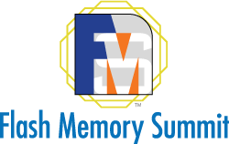
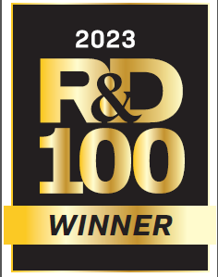
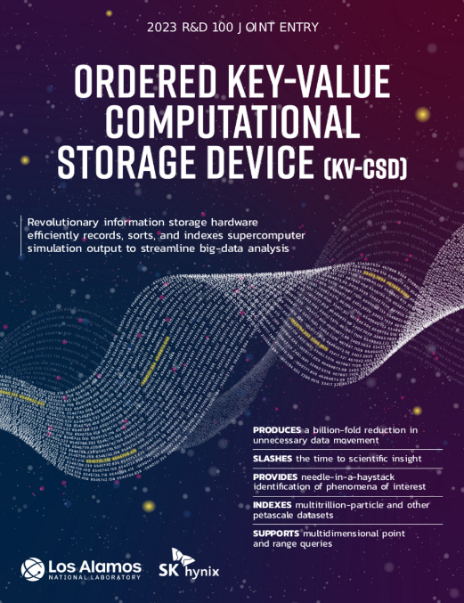

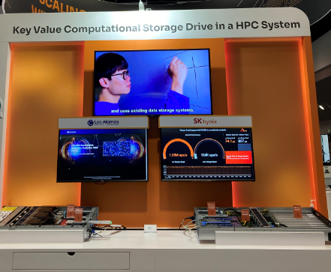
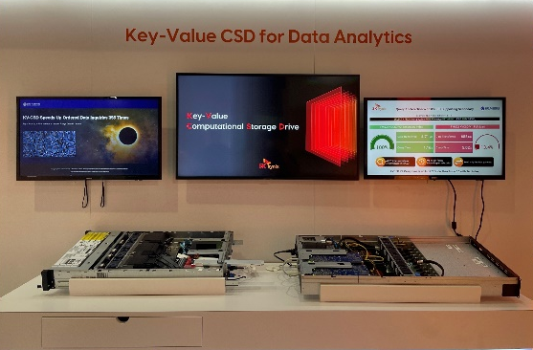
1st Data-aware Computational Storage: KVCSD
More on Ordered Key Value Computational Storage Drive (KVCSD)
KVCSD paper at IEEE Cluster Computing Conference 2023
Demonstration at Flash Memory Summit 2022, 2023 (w/ LANL)
2023 R&D 100 Award Winner
2022, 2023 KV-CSD Live Demo W/ LANL
KV-CSD: A Hardware-Accelerated Key-Value Store for Data-Intensive Applications

Slide 9
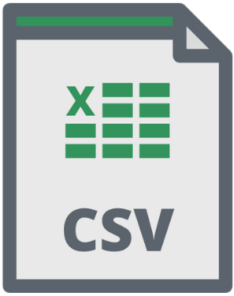


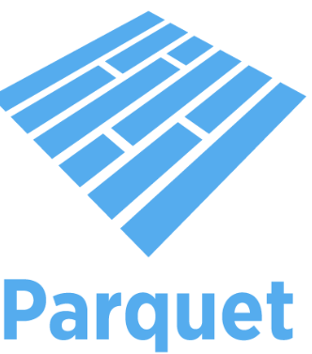
2nd Data-aware Computational Storage: OCS System
“Object”-based Computational Storage (OCS)
High Scalability : Object storage is suitable for big data.
Data Awareness : Can handle data without application’s assistance - Not “Block”, But “Object”.
Object Metadata : Can add useful information in metadata for analytics
Compute
Schedule
Join
Filtering
“Suitable for columnar data analytics such as parquet”
Object ID(Key)
Object ID(Key)
Offloading function
Object
Object ID
Ex) “Author”, “Publisher”, “Copyright”, “Index”, …
Object based Computational Storage
Metadata
Metadata
User
Metadata
Object
Data
Filtering
System Metadata
EX) “Object Size”, “Storage Tier”, “Access Permission”, “Date”, …
Object
Object = Object ID + Metadata + Data

Slide 10

OCS System: Architecture
OCS System basically consists of OCS Front-end Server and OCSA (Object Computational Storage Array) appliance
Disaggregates storage back-end (OCSA) through NVMe over Fabrics
Vertically optimize object I/O and analytics - OCSA supports object interface and analytics features
OCS Frontend Server
Supports S3 REST API & open format data
Support query pushdown interface
Perform query execution with OCSA
CPU
Object Management & Placement
Analytics Processing & Management
OCS System
NVMe -oF
Object Path-through
Offloading Analytics
New Interface: Object based NVMe I/O & Analytics commands
Accelerate analytics: Filtering or query processing by own analytics engine
Utilize heterogeneous devices: NVMe SSD, CSD, CXL, …
OCSA Appliance (DPU-based)
DPU
Object I/O
Analytics/Compute
Heterogeneous device management
NVMe SSD
OCSD
CXL Mem
CXL SSD

Slide 11
Key Success Factors: Everywhere Compute w/ Object
Everywhere compute with the same view & the same interface & the same method
Object enables the same view of “analytics chunk” everywhere (Client, OCS Frontend Server and OCSA Appliance)
Client
Object
OCS Frontend Server
Object Path-through
Object
OCS System
OCSA Appliance
Object
NVMe SSD
OCSD
CXL Mem
CXL SSD

Slide 12


Key Success Factors: Everywhere Compute w/ Analytics Eco.
Everywhere compute with the same view & the same interface & the same method
Apache Arrow and Substrait enables the same interface & method (Client, OCS Frontend Server and OCSA Appliance)
Client
Substrait
Object
Same interface: Remove data transformation between different systems
Pushdown query using “Substrait”
Transfer data using “Arrow”
OCS Frontend Server
Substrait
Object
Substrait
OCS System
Same interface & method: Reduce complexity to pushdown query and expect to increase flexibility
Pushdown query using “Substrait”
Transfer data using “Arrow”
OCSA Appliance
Substrait
Object
NVMe SSD
OCSD
CXL Mem
CXL SSD

Slide 13
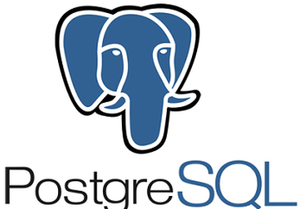



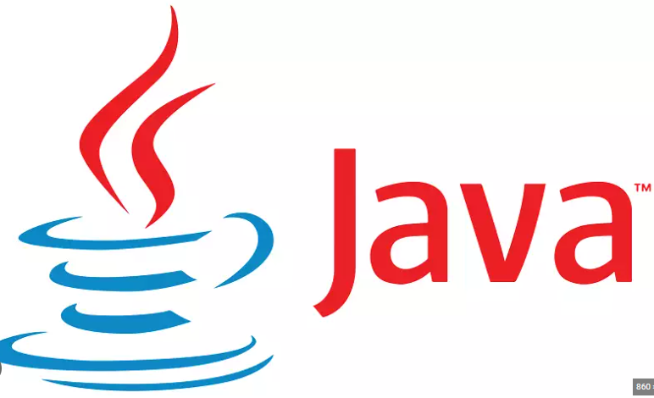









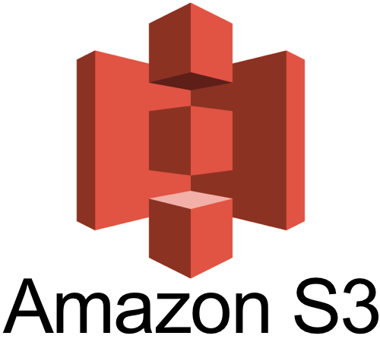



OCS System: Align with Analytics System Trends
Standardization efforts
Reduce overheads from various Interfaces & data formats
Support to analyze Columnar Data (e.g. Arrow, Parquet, …)
Columnar data is widely used
Great fit for analytics(OLAP) application
Exploit parallelism of modern hardware architecture(SIMD, GPU, …)
Exploit efficient compression, encoding (I/O ) techniques due to columnar layout
Analytics
DSLs
…
Substrait
Query
Engines
OCS Front-end Server
Substrait
Object
Substrait
OCSA Appliance
Storage
Systems
Substrait
Object
NVMe SSD
OCSD
CXL Mem
CXL SSD
<Current Analytics System Trends>
<OCS System>

Slide 14
OCS System: Expected Benefits
Reduce data movement between a host system and a storage system
Performs data analytics where data reside
Efficient data movement increase data analytics performance
Save host system resources
Push-down query execution to OCS system, can save host CPU & memory resources
High interoperability & flexibility
Based on standard data format & interface(Apache Arrow & Substrait)
Break away from fixed and limited pushdown functionality

Slide 15

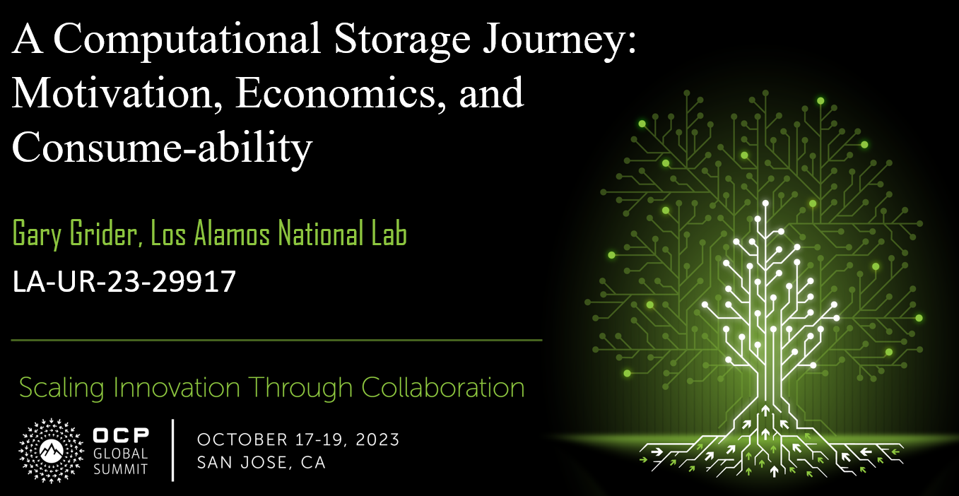
Open Ecosystem
v
To deploy a new computational storage system to industry, a standard and an ecosystem must be prepared
We have started working on to create an open ecosystem
Hive map schema
S3
Client
Presto
Pushdown GRPC test client
Modified Hive Connector
File Access Method
S3 Access Method
Pushdown GRPC client
Sim files via NFS
TCP/IP
Initiator test vehicle (uses OCS SPDK down)
AirMettle Analytics
Object Server (Get, Put, List, (uses REST protocol up and OCS SPDK down)
Value add
Pushdown GRPC server [uses Pushdown GRPC up and OCS SPDK down)
Query results
SPDK initiator (Get, Put, List)
select
NVME/NVMEoF
SPDK target
SPDK target
SPDK target
OCS (A/D) target test vehicle
SK Hynix OCSV1+ push down target
NB CSA device
Object files (in a file system on the OCSA/OCSD system via NFS)
Local Storage
AirMettle
NeuroBlade
Versity
SK hynix / LANL
Open Source
Proprietary

Slide 16






Open Ecosystem: Partners

Slide 17
OCS System Demonstration
Proof-of-Concept: OCS demonstration system supports key features
Demo explanation
Comparing between “legacy analytics” vs “offloading to OCS system”
Query execution time, Memory & CPU utilization of Client System
Data Set
Parquet Format Object (ex. NY texi data, 216MB)
SQL Query
ex. “select * from data.parquet where trip_distance > 29”
Test Scenario
Analytics App 1 : Read object data and then filtering by itself
Analytics App 2 : Call “S3_Select API” and get filtered data from OCS system
Client
Analytics Application 1
Analytics Application 2
Read & Filter Data
Retrieve Filtered Results
Get Object
S3 REST API over Network
S3 Select
CPU
OCS Front-end Server
Versity G/W
OCSA Plugin
RNIC
OCS
System
NVMe over Fabrics
RNIC
OCSA Appliance
Object I/O
Analytics Acceleration
File System & Block Layer
CPU
NVMe SSD
NVMe SSD
…
NVMe SSD
< OCS Demo System>

Slide 18

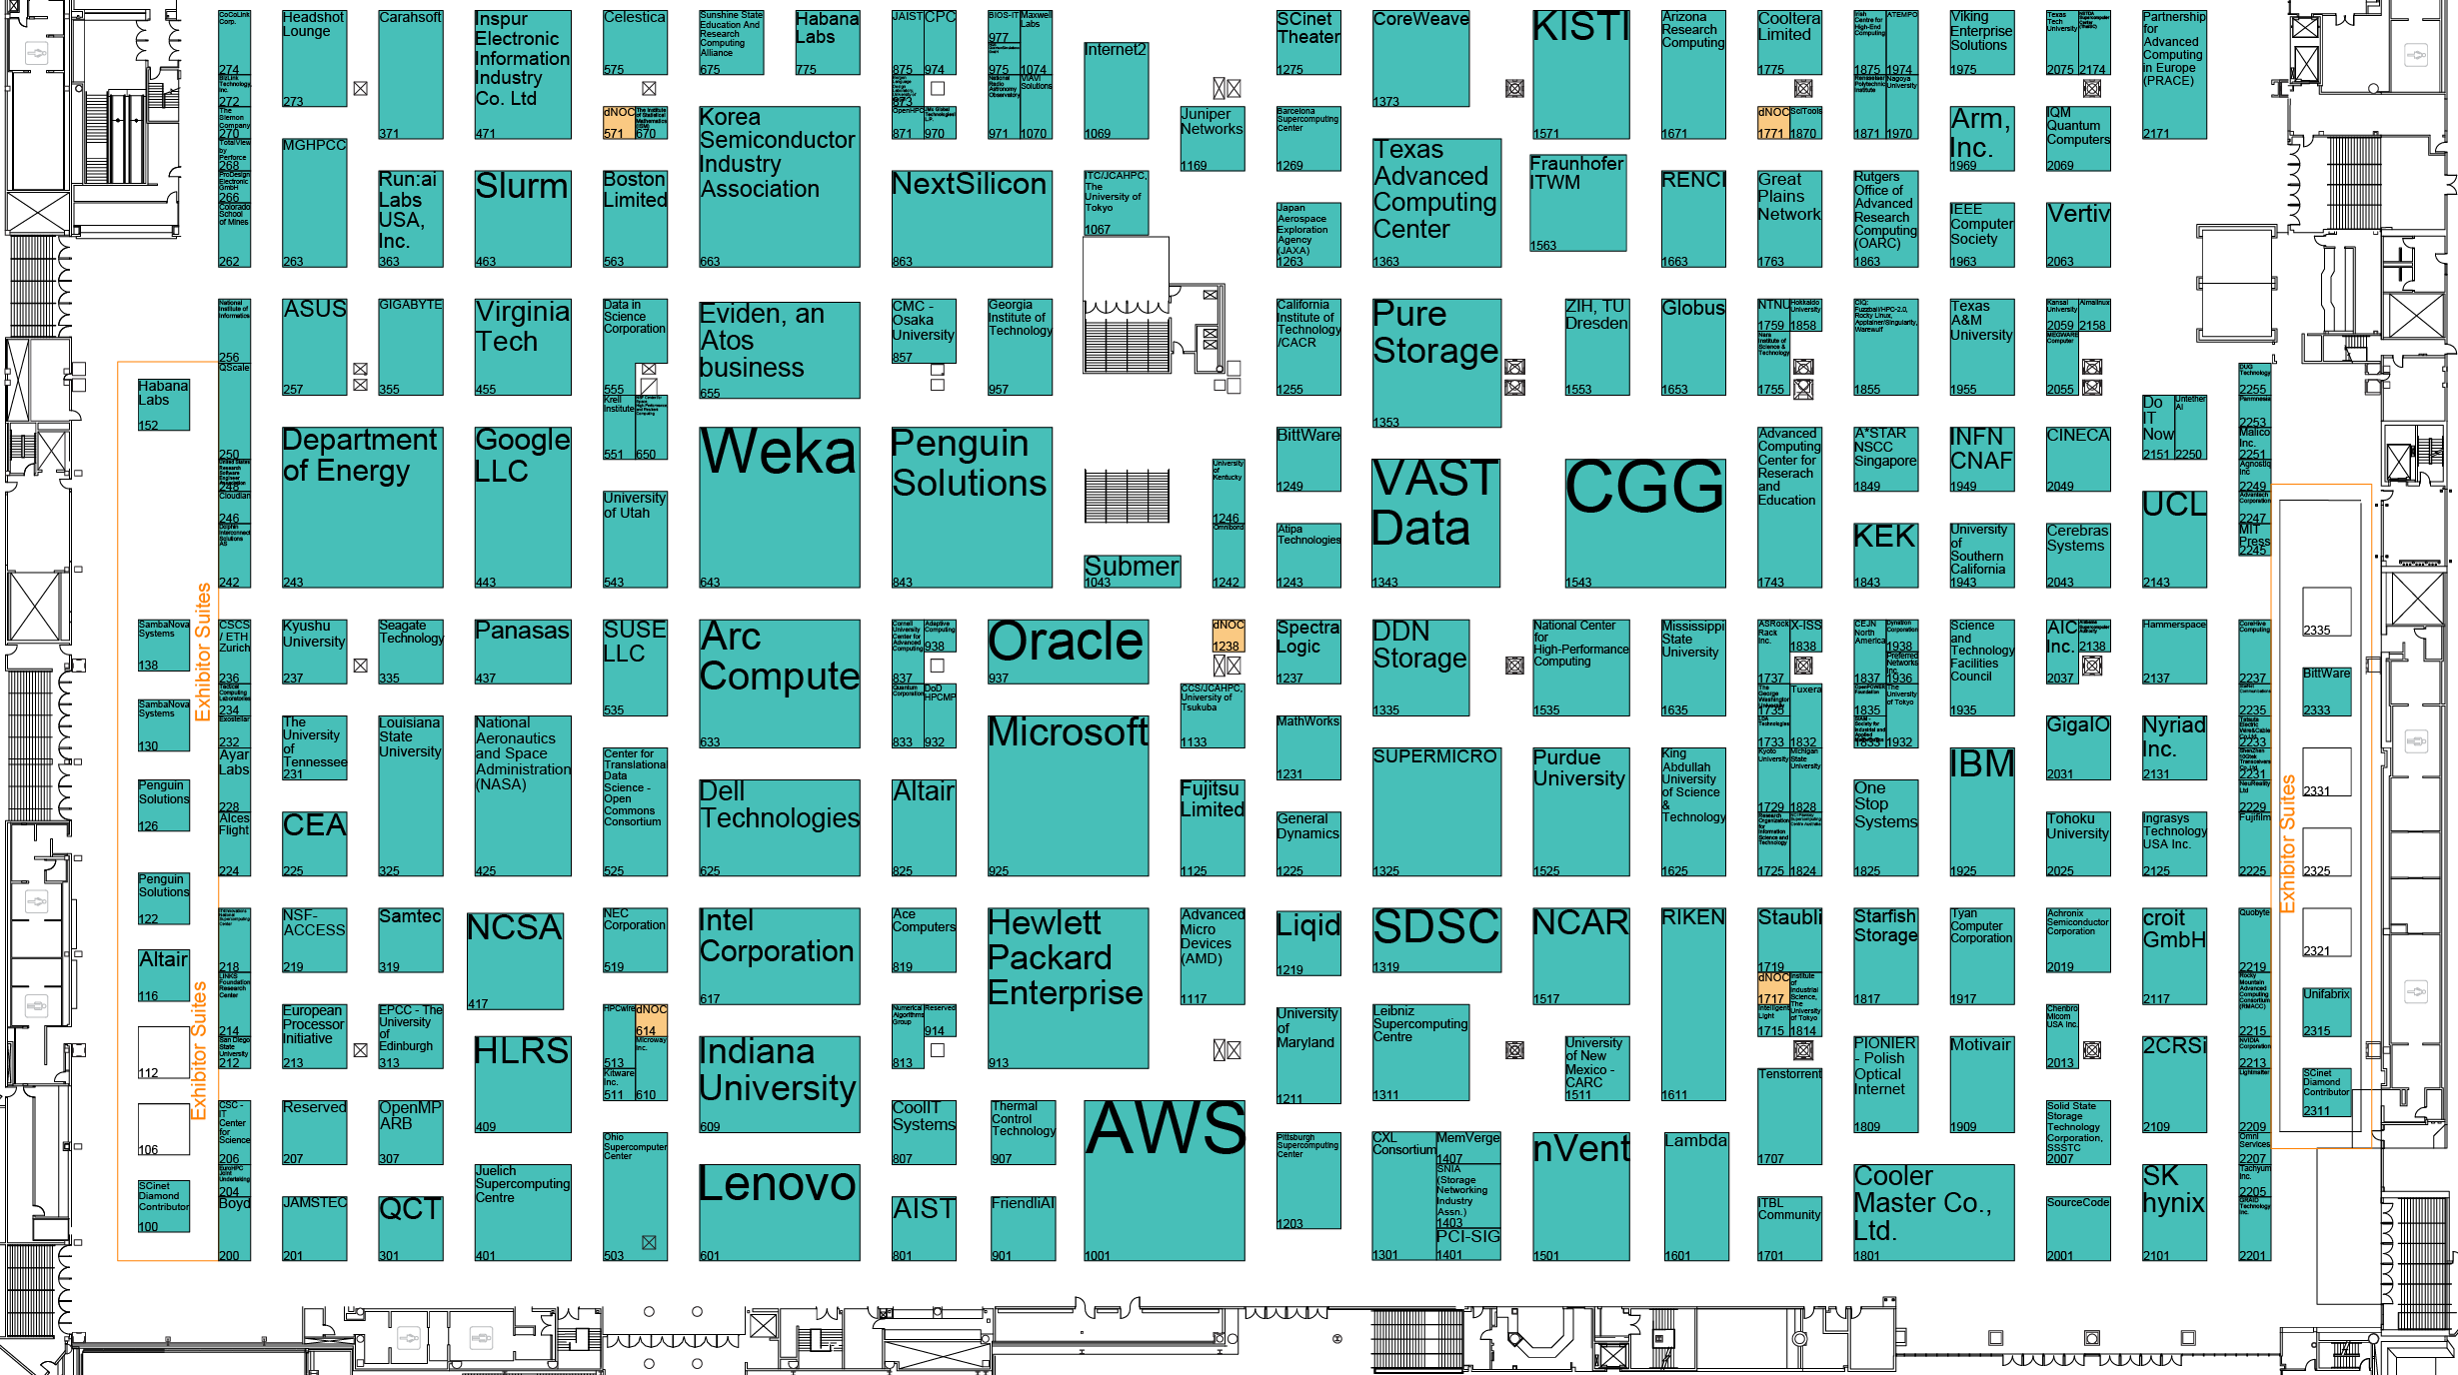
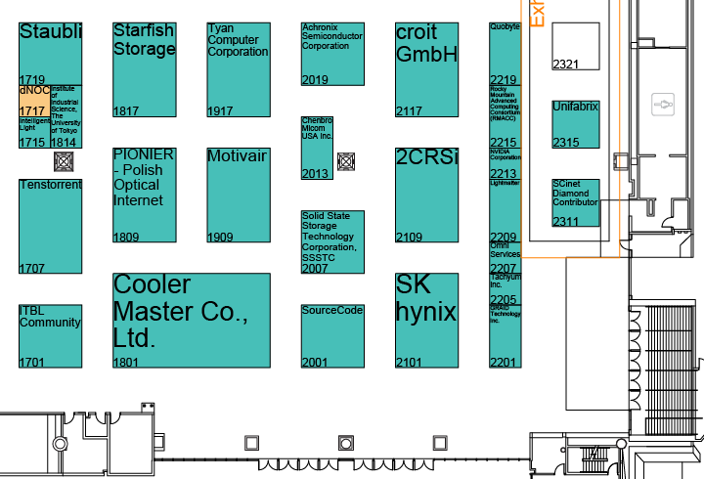

Learn More about our OCS System
Booth #2101
Visit Booth #2101 and Experience SK hynix OCS System demonstration

