Slide 1
Representation of trade and transportation networks in global energy models Updates: 2019-08-07
Jun Ukita Shepard
IIASA-YSSP 2019

Slide 2
Updates
All energy commodities represented in trade technologies
Crude oil, light oil, fuel oil, LNG, coal
Shipping technologies parameterized
Scenarios developed:
High tariff, low tariff
NAM-CPA sanction
LNG/electricity-fueled shipping becomes cost competitive by 2100
Run scenarios and compare

Slide 3
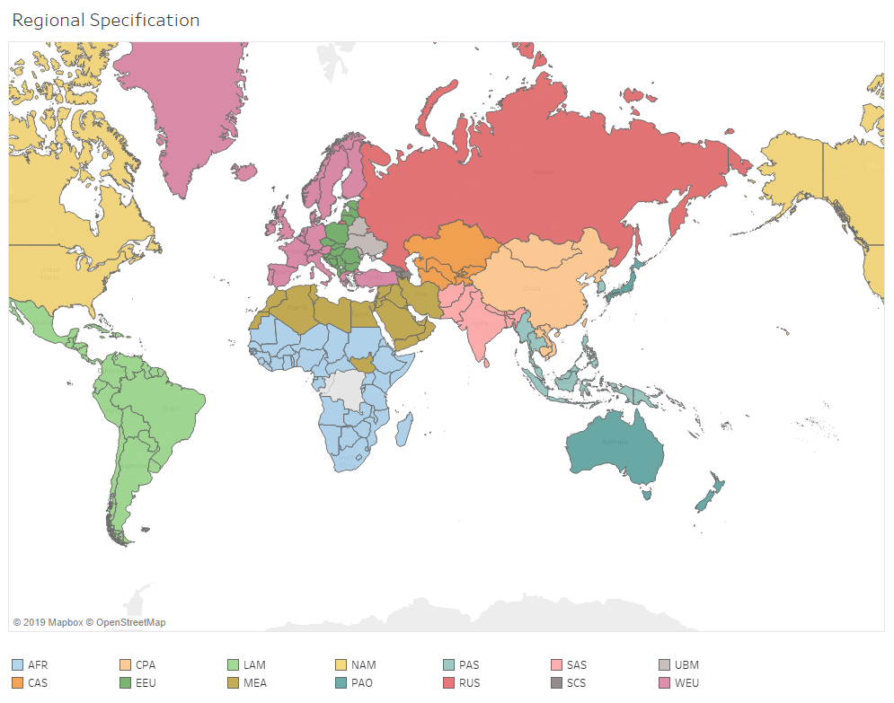
Regional specification

Slide 4
Representing shipping in MESSAGE Global pool of shipping capacity
SECONDARY
EXPORT
fueloil
liquid_shipping_capacity
AFR
Input
liquid_shipping
Output
GLB
node_loc
AFR
Legend:
Level (e.g. primary)
Node (e.g. R14_RUS)
Commodity (e.g. crude oil)
Technology (e.g. oil_exp)
Parameter (e.g. input)

Slide 5
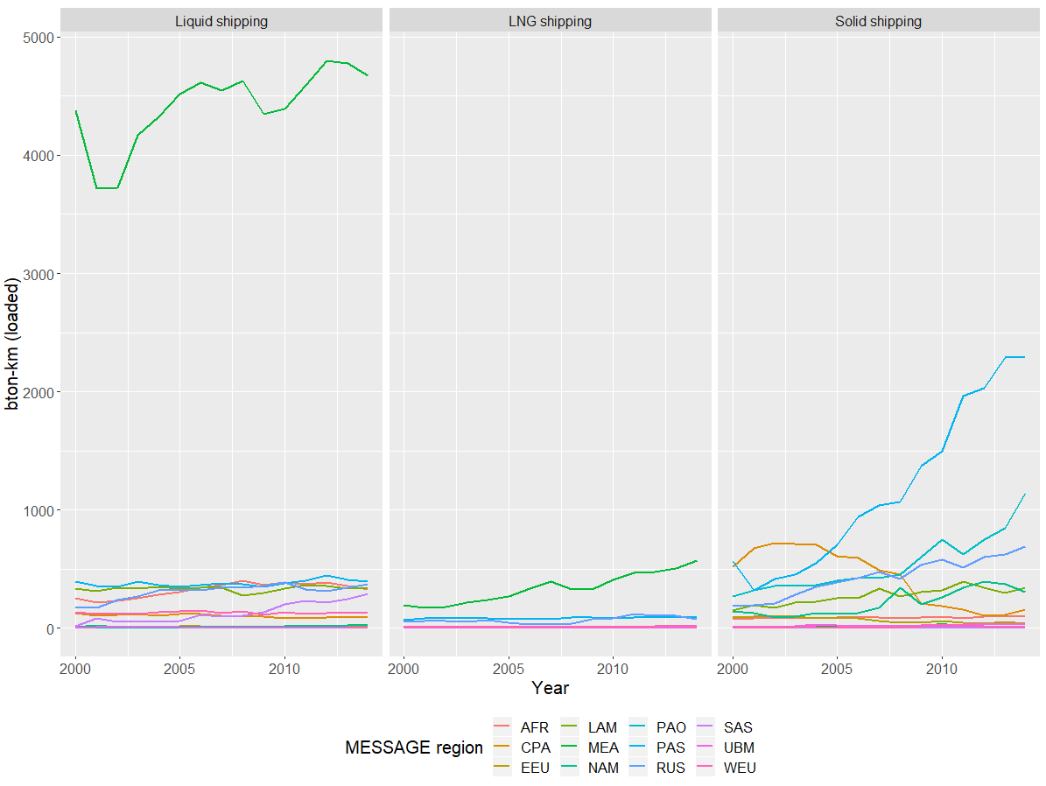
Shipping technology specification Historical activity
UNCTAD has global historical activity in billion tonnes-km (2000-2018)
UNCTAD has activity in million tonnes disaggregated by region for 2006-2017
Take share of region activity in million tonnes to disaggregate global historical activity

Slide 6
Shipping technology specification Investment cost
Type of shipping |  | Fuel input (kg/bton-km-y) |  |  | Captial cost |  |  | Assumptions
 | Type of fuel | By weight (kg/bton-km-y) | By energy (GWa/bton-km-y) | Emissions factor (Mt/bton-km-y) | Overnight cost ($M) | Annualized, 10%DR ($M/y) | Annualized ($M/bton-km-y) | DWT (ton) | Annual distance (10^9km/y) | Number of ships | Average payload per ship (bton-km/y) | Average distance traveled (km/y)
Liquid | Diesel | 6894865.04 | 0.01 | 0.02 | 76.00 | 8.37 | 6.24 | 100000 | 5.05 | 376219 | 1.34 | 13423.03
Liquid | LNG | 3678751.33 | 0.00 | 0.01 | 96.00 | 10.58 | 7.88 | 100000 | 5.05 | 376219 | 1.34 | 13423.03
Liquid | Electricity | NA | 0.00 | 0.00 | 192000.00 | 21152.27 | 15758.19 | 100000 | 5.05 | 376219 | 1.34 | 13423.03
Solid | Diesel | 7283748.84 | 0.01 | 0.02 | 51.60 | 5.68 | 4.24 | 100000 | 5.05 | 376219 | 1.34 | 13423.03
Solid | LNG | 3052216.32 | 0.00 | 0.01 | 71.60 | 7.89 | 5.88 | 100000 | 5.05 | 376219 | 1.34 | 13423.03
Solid | Electricity | NA | 0.00 | 0.00 | 1432000.00 | 157760.68 | 117529.83 | 100000 | 5.05 | 376219 | 1.34 | 13423.03
LNG | Diesel | 16810656.90 | 0.02 | 0.05 | 180.00 | 19.83 | 14.77 | 100000 | 5.05 | 376219 | 1.34 | 13423.03
LNG | LNG | 5594115.78 | 0.01 | 0.01 | 200.00 | 22.03 | 16.41 | 100000 | 5.05 | 376219 | 1.34 | 13423.03
LNG | Electricity | NA | 0.00 | 0.00 | 4000000.00 | 440672.29 | 328295.62 | 100000 | 5.05 | 376219 | 1.34 | 13423.03

Slide 7
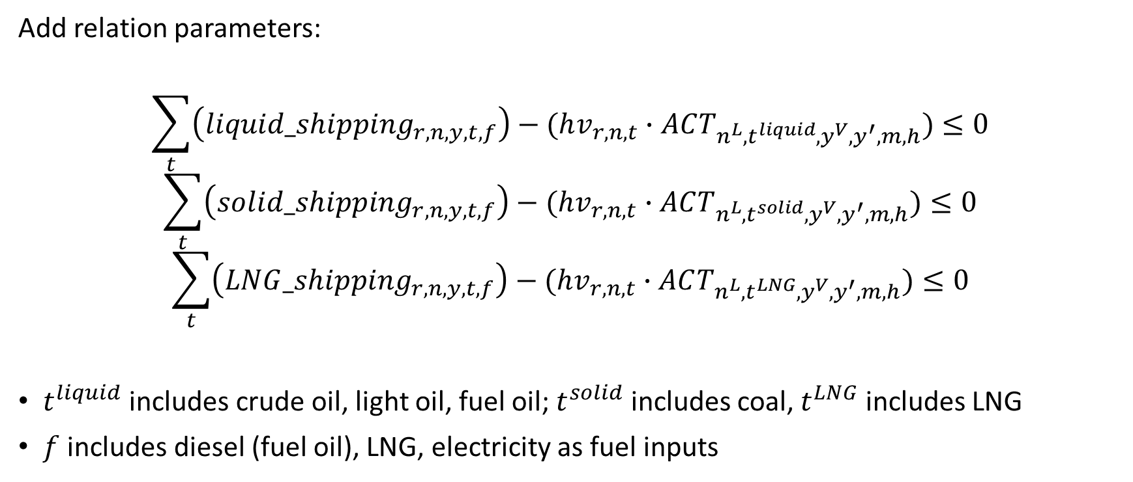
Shipping relation specification
Add relation parameters:
$$\sum_{t}{\left(liquid_shipping_{r,n,y,t,f}\right)−(hv_{r,n,t}∙ACT_{n^{L}, t^{liquid},y^{V},y^{′},m,h})}≤0$$
$$\sum_{t}{\left(solid_shipping_{r,n,y,t,f}\right)−(hv_{r,n,t}∙ACT_{n^{L}, t^{solid},y^{V},y^{′},m,h})}≤0$$
$$\sum_{t}{\left(LNG_shipping_{r,n,y,t,f}\right)−(hv_{r,n,t}∙ACT_{n^{L}, t^{LNG},y^{V},y^{′},m,h})}≤0$$
$t^{liquid}$ includes crude oil, light oil, fuel oil; $t^{solid}$ includes coal, $t^{LNG}$ includes LNG
$f$ includes diesel (fuel oil), LNG, electricity as fuel inputs

Slide 8
Scenarios
Baseline, global schema
Baseline, bilateral schema (distance only)
Baseline, distance and tariffs
High tariffs
Low tariffs
NAM-CPA sanction
LNG/Electric shipping cost-competitive by 2100
Carbon emissions capped at 1000Gt, cumulative

Slide 9
Building scenarios Tariffs
Use historical import tariff rates on primary products
Aggregate to MESSAGE region
High tariffs = tariffs are 1000% historical median by 2030
Low tariffs = tariffs are -1000% of historical median by 2030
Apply to historical import prices, derived from trade data
Apply to the variable cost parameter (var_cost) for import technologies

Slide 10
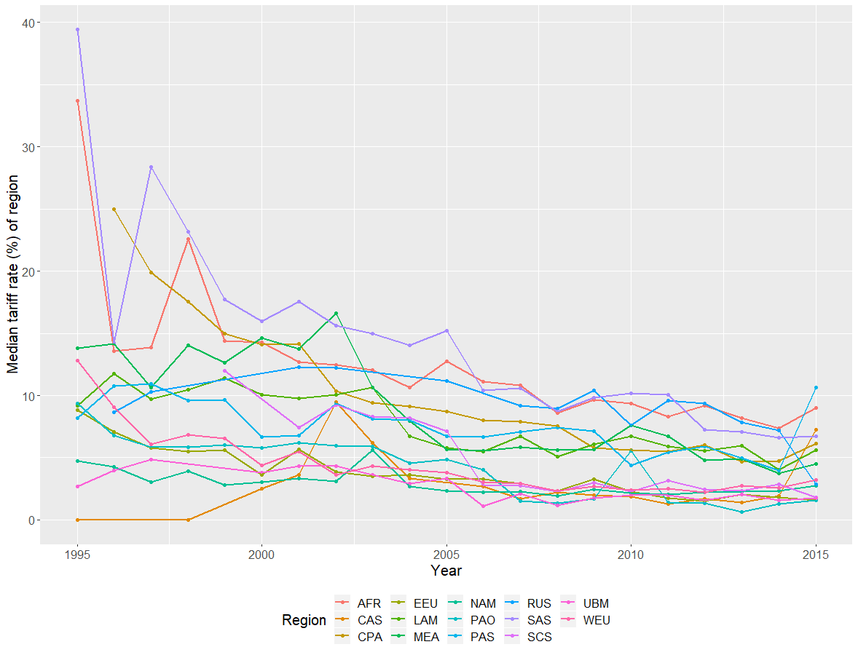
Building scenarios Historical Tariff Rates

Slide 11
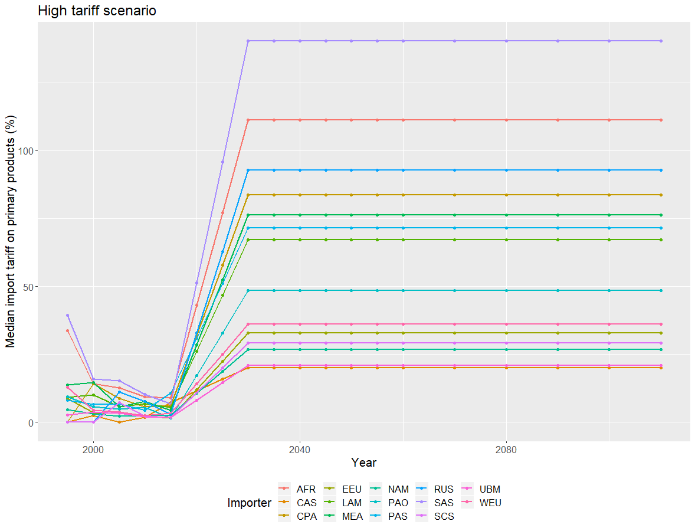
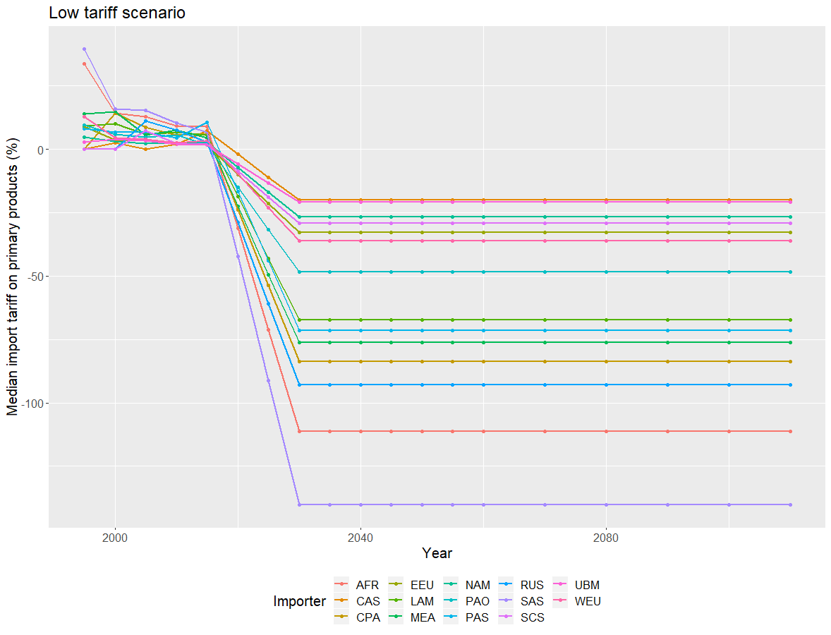
Building scenarios Scenario Tariff Rates

Slide 12
Building scenarios Sanctions
Run baseline scenario
Based on activity, generate indicators for embodied sanction
Example:
NAM and CPA apply sanctions to each other
LAM trades with NAM in year 2020
LAM will be in “embodied sanction” with CPA in year 2020
If LAM trades with both NAM and CPA, whichever activity is greater
If in embodied sanction, variable cost goes up 30%
If in total sanction, variable cost goes up to 10 times maximum (prohibitive)

Slide 13
Tableau Workbooks
Compare sanction scenarios: https://public.tableau.com/profile/jun.shepard#!/vizhome/model_trade_paths/CompareSanctions?publish=yes
Compare tariff scenarios:
https://public.tableau.com/profile/jun.shepard#!/vizhome/model_trade_paths/Comparetariff?publish=yes
Compare CO2 bound scenario:
https://public.tableau.com/profile/jun.shepard#!/vizhome/model_trade_paths/CompareCO2?publish=yes

Slide 14
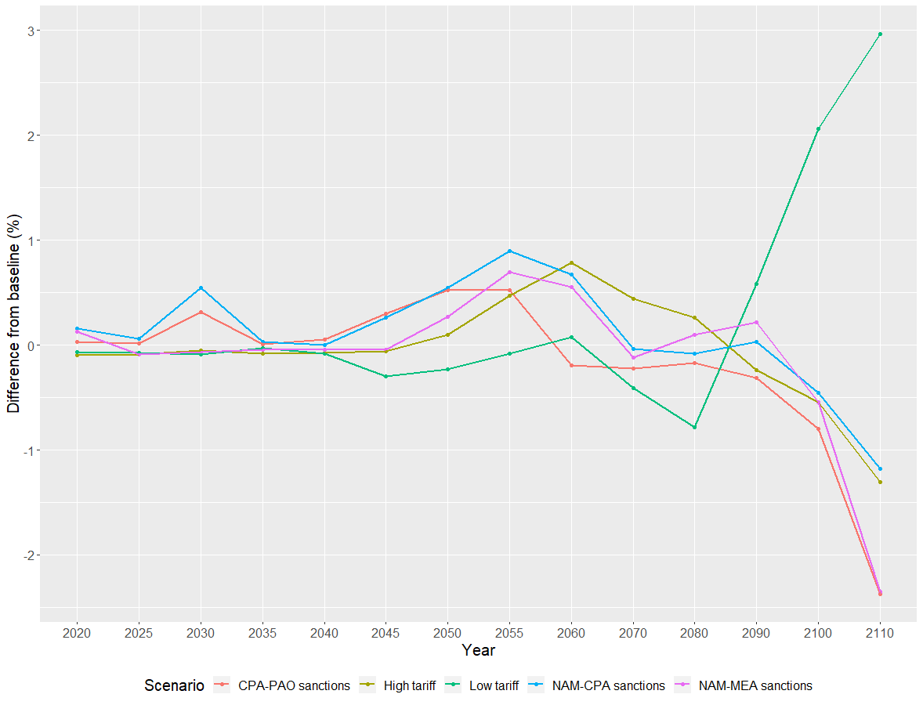
Total carbon emissions, by scenario Difference from baseline

Slide 15
Total System Cost System cost by scenario

Slide 16
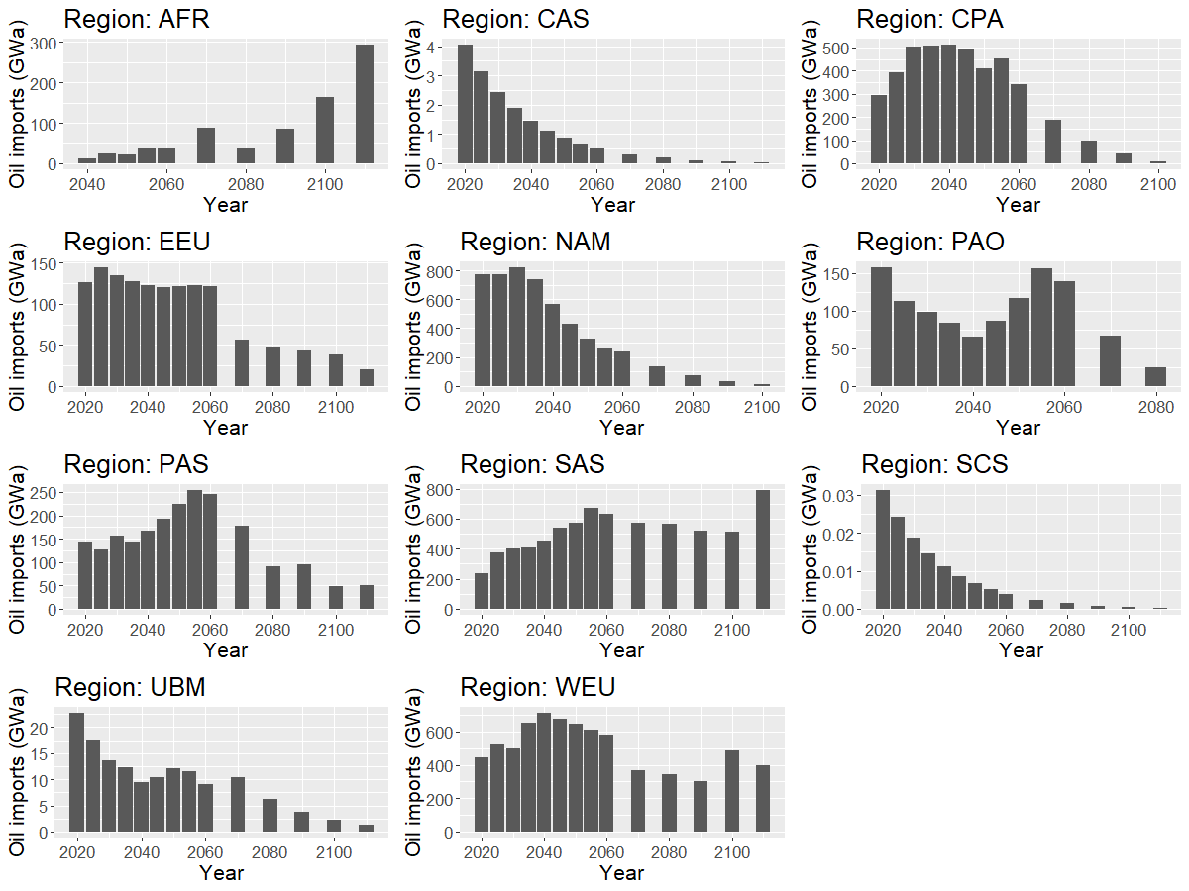
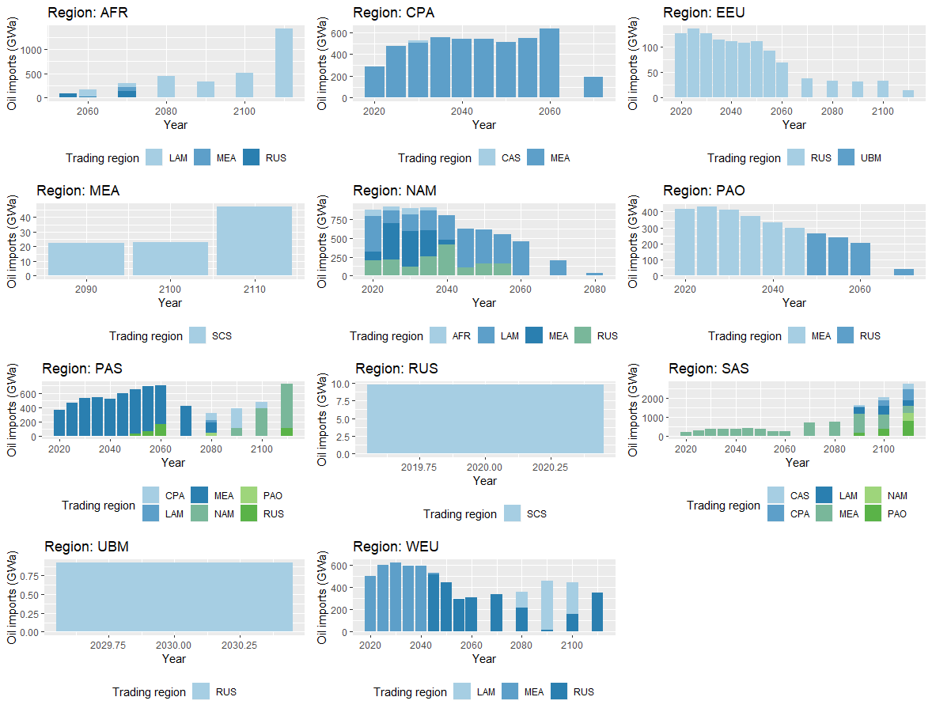
Compare global schema to bilateral schema Crude oil imports

Slide 17
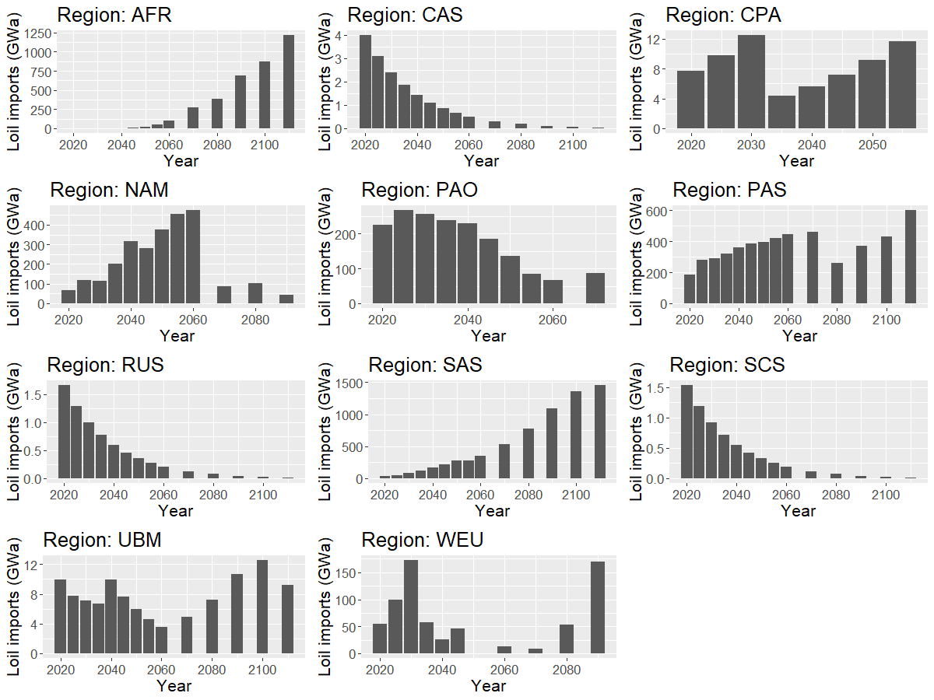
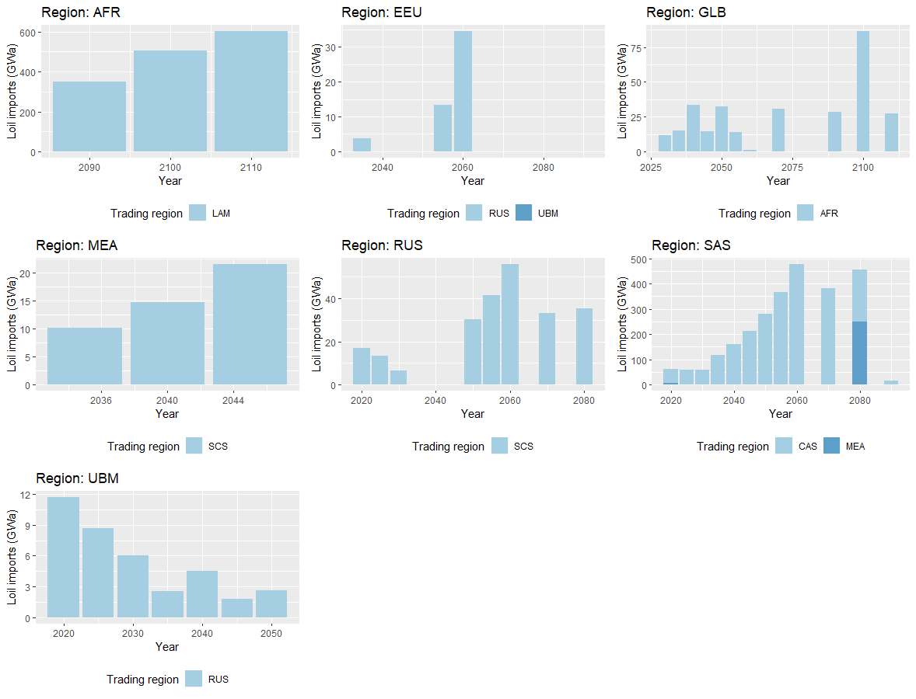
Compare global schema to bilateral schema Light oil imports

Slide 18
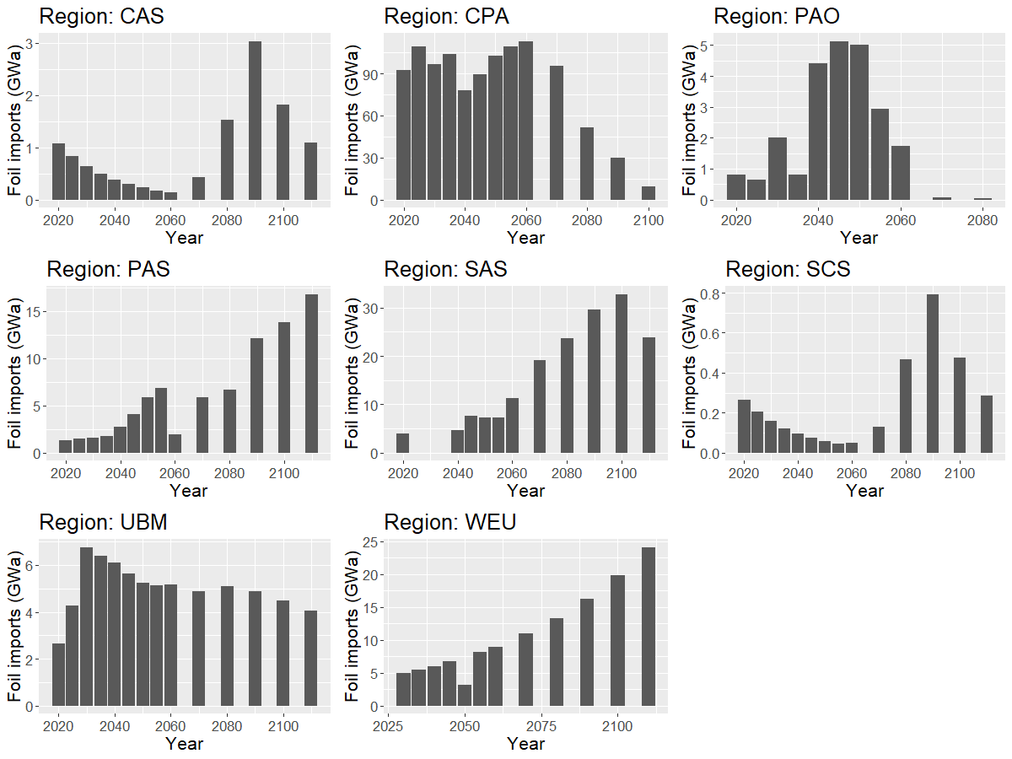
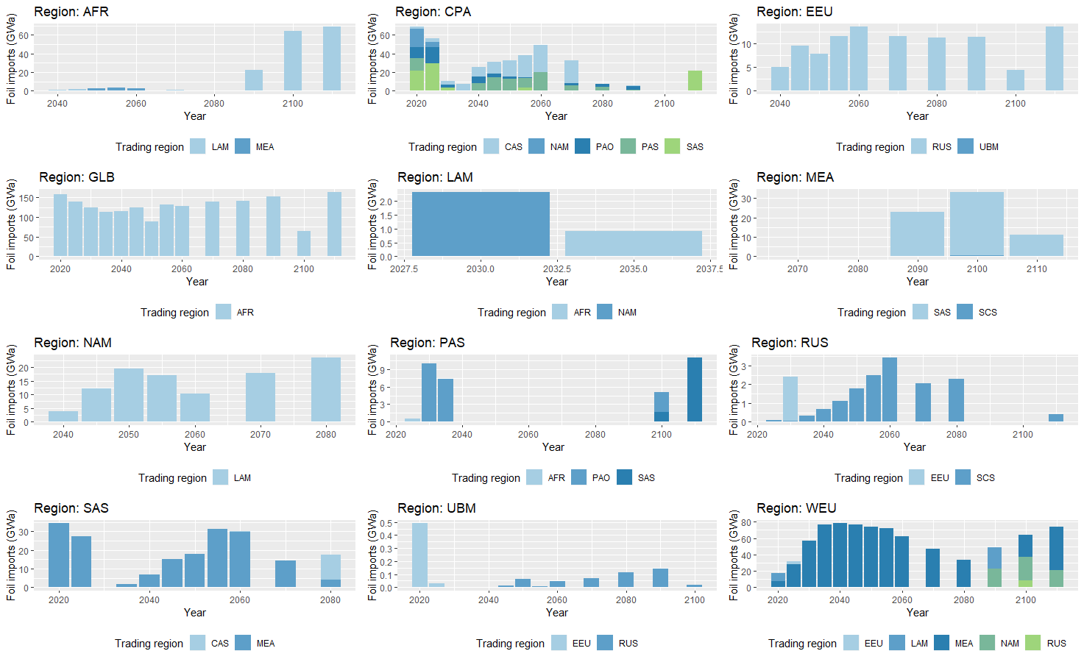
Compare global schema to bilateral schema Fuel oil imports

Slide 19
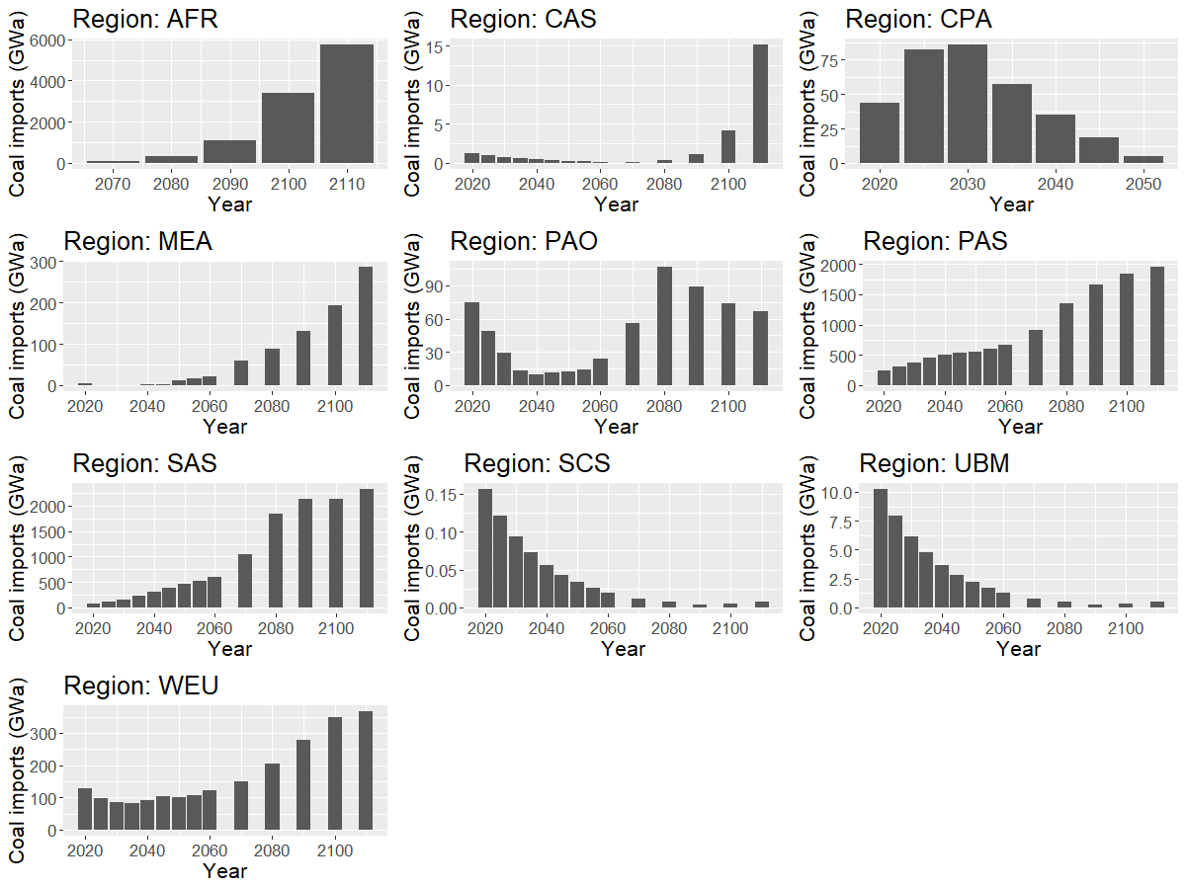
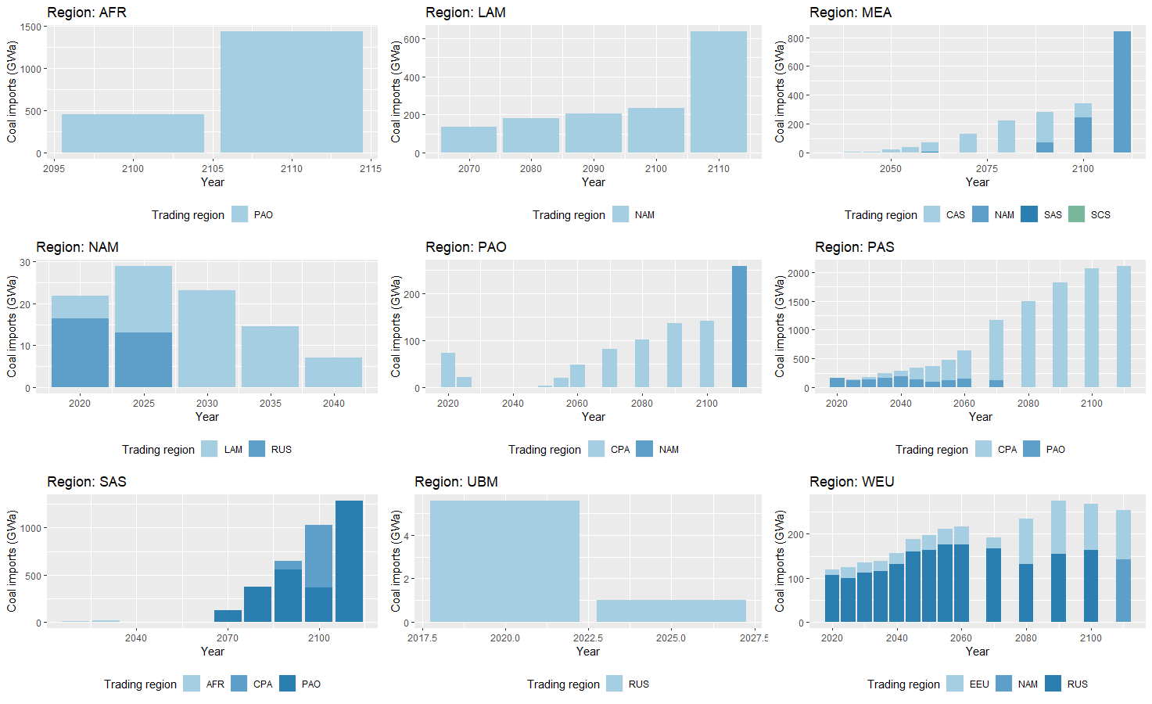
Compare global schema to bilateral schema Coal imports

Slide 20
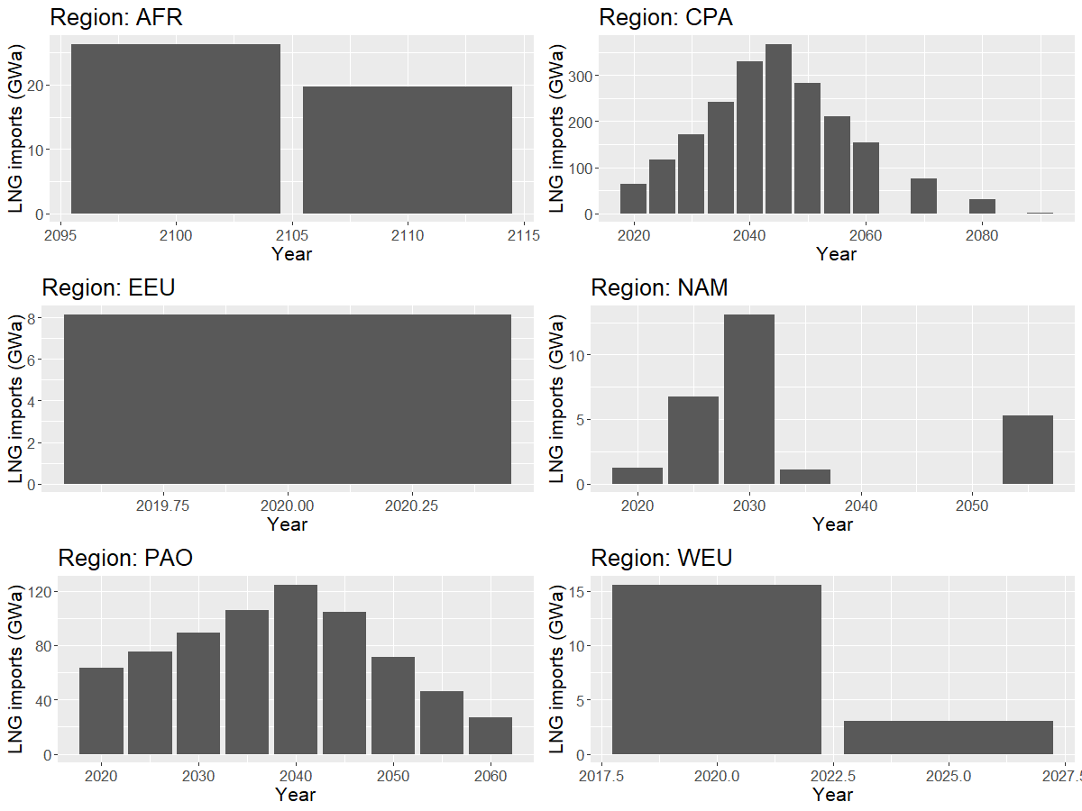
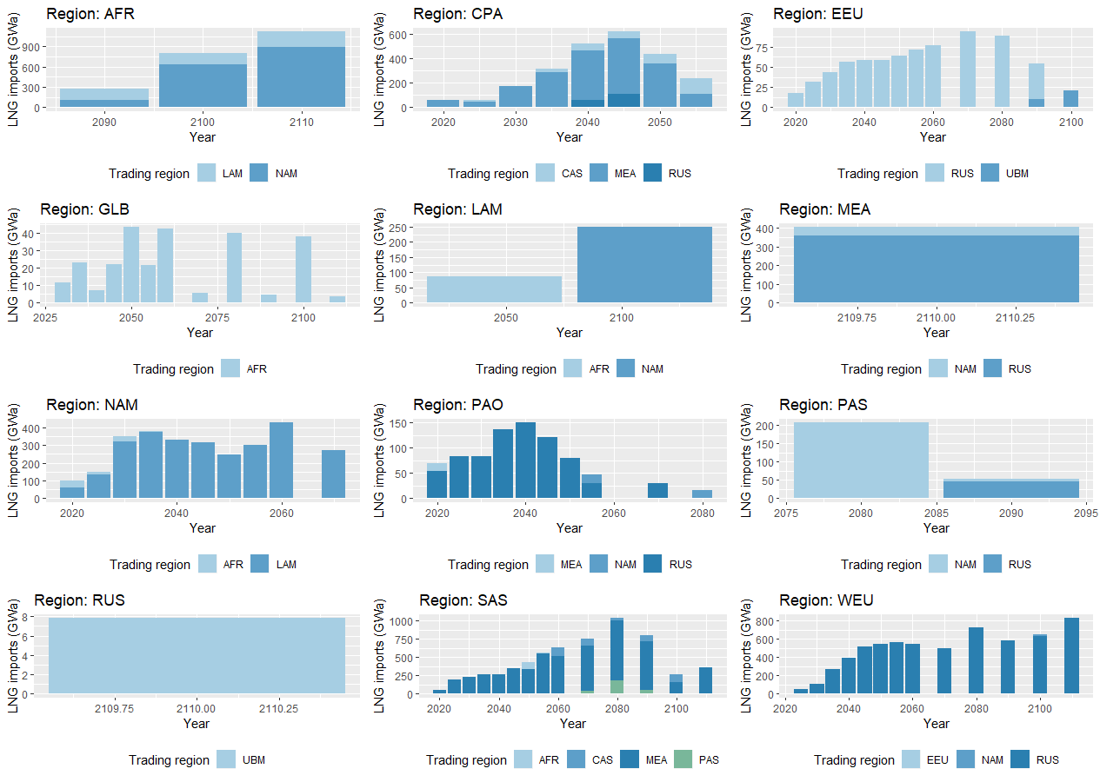
Compare global schema to bilateral schema LNG imports

Slide 21
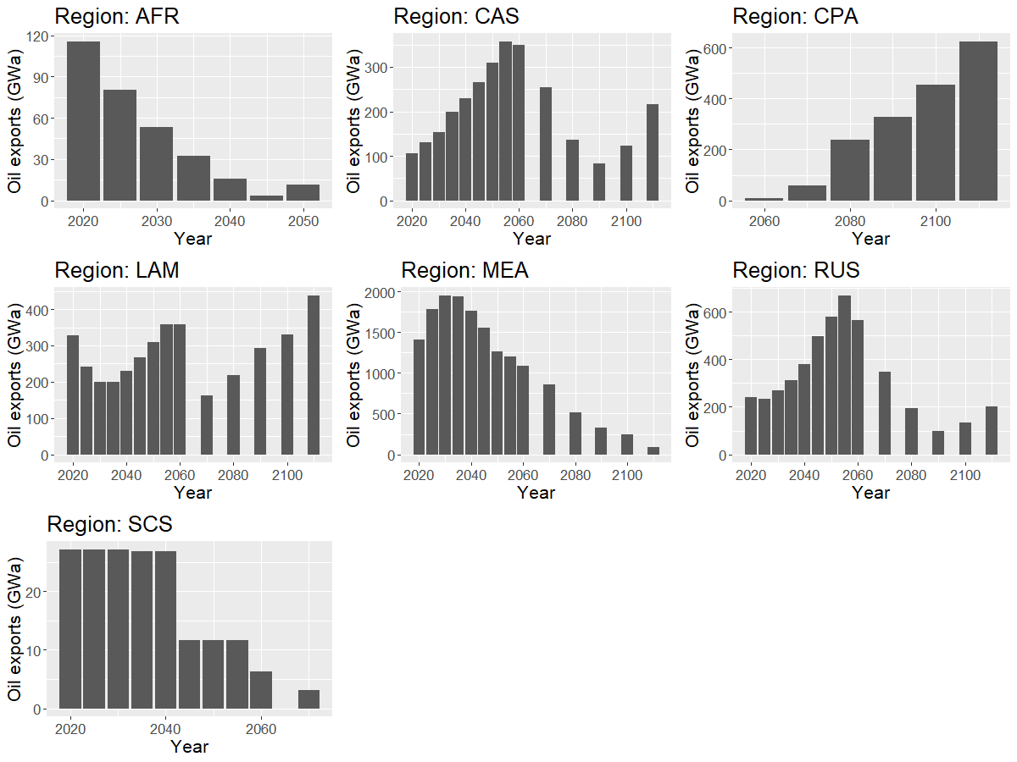
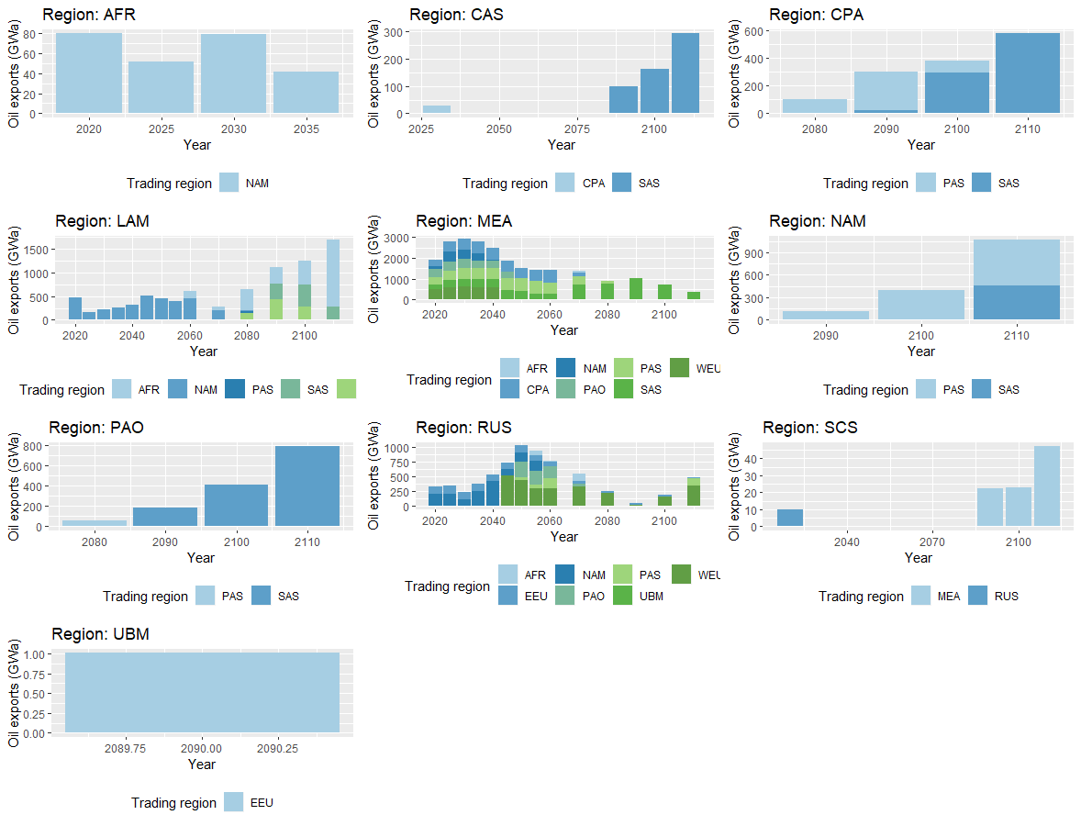
Compare global schema to bilateral schema Crude oil exports

Slide 22
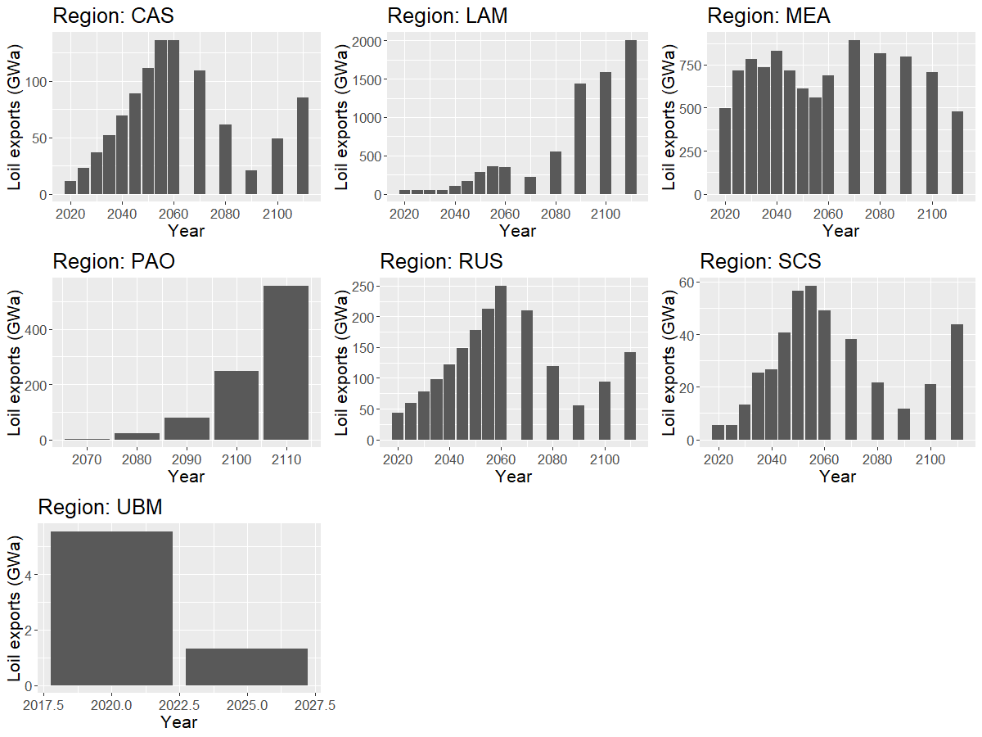
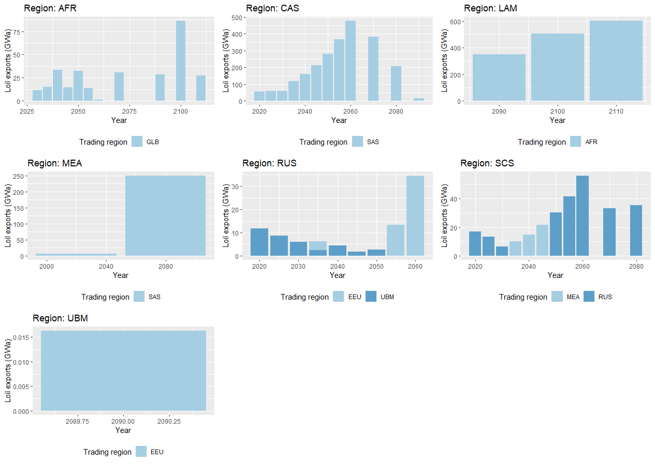
Compare global schema to bilateral schema Light oil exports

Slide 23
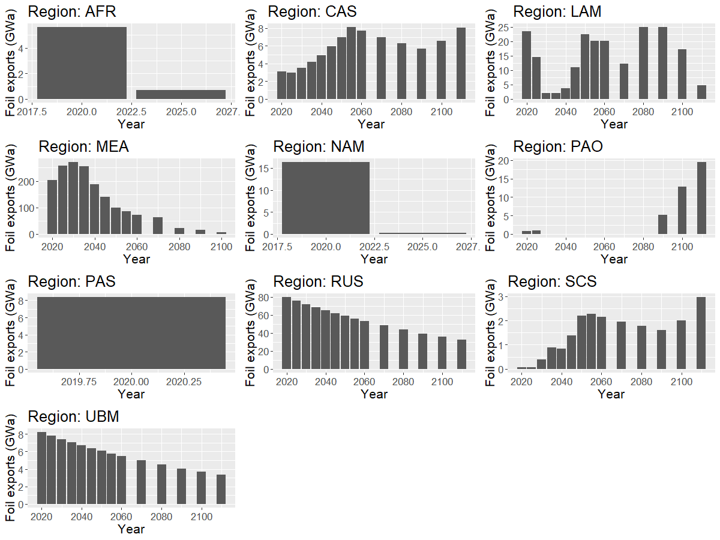
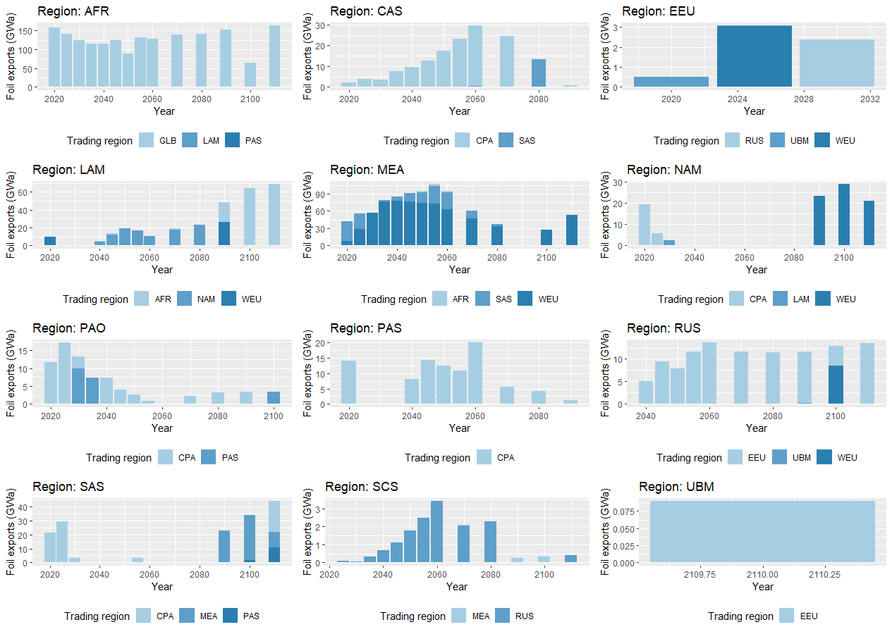
Compare global schema to bilateral schema Fuel oil exports

Slide 24
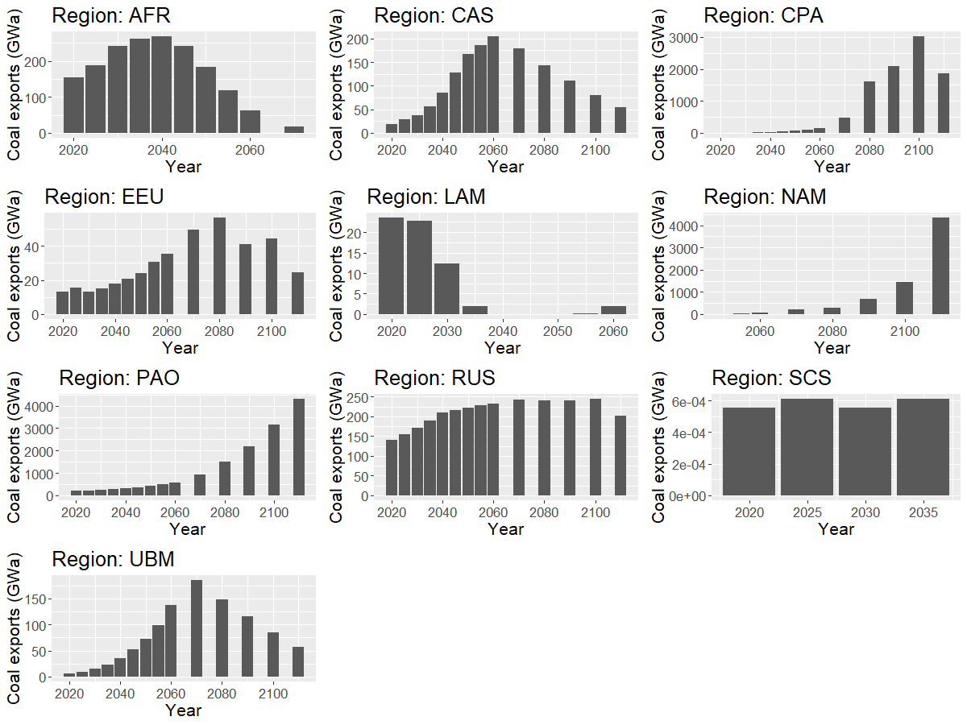
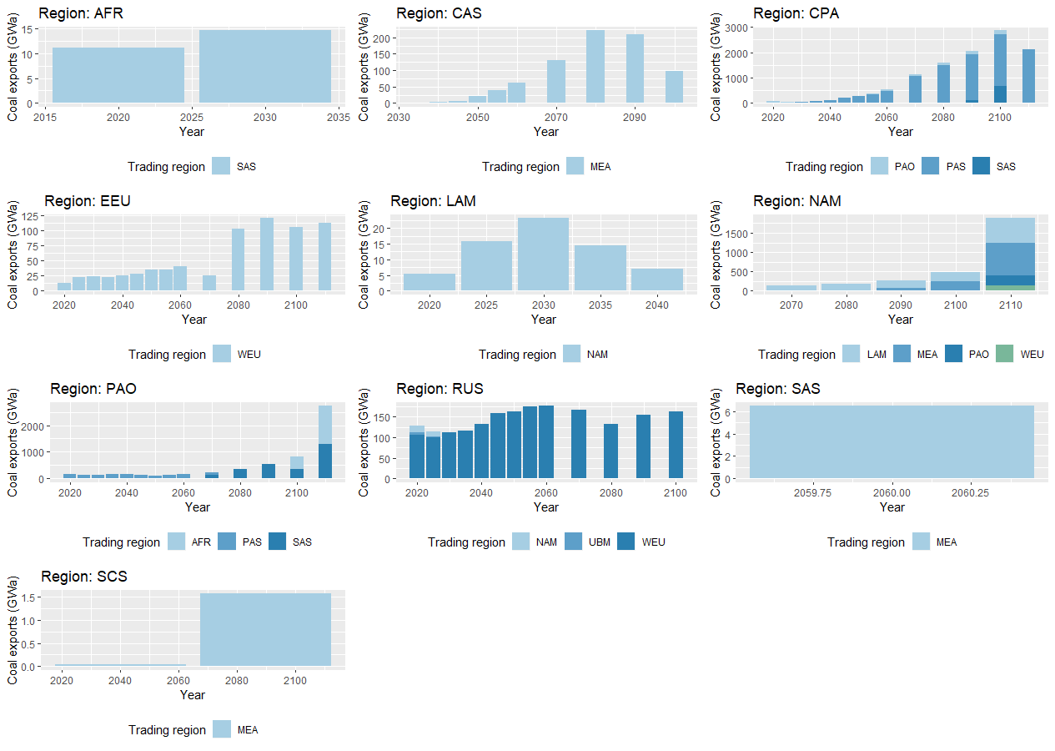
Compare global schema to bilateral schema Coal exports

Slide 25
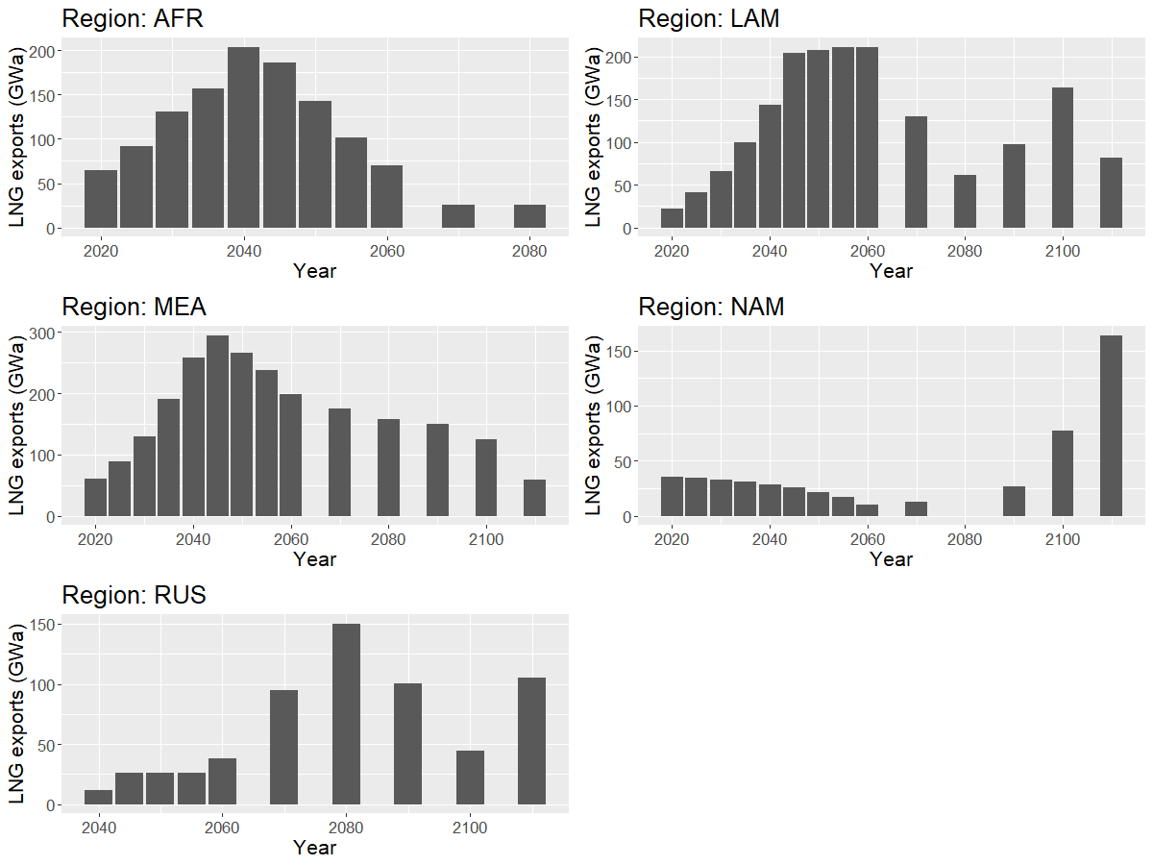
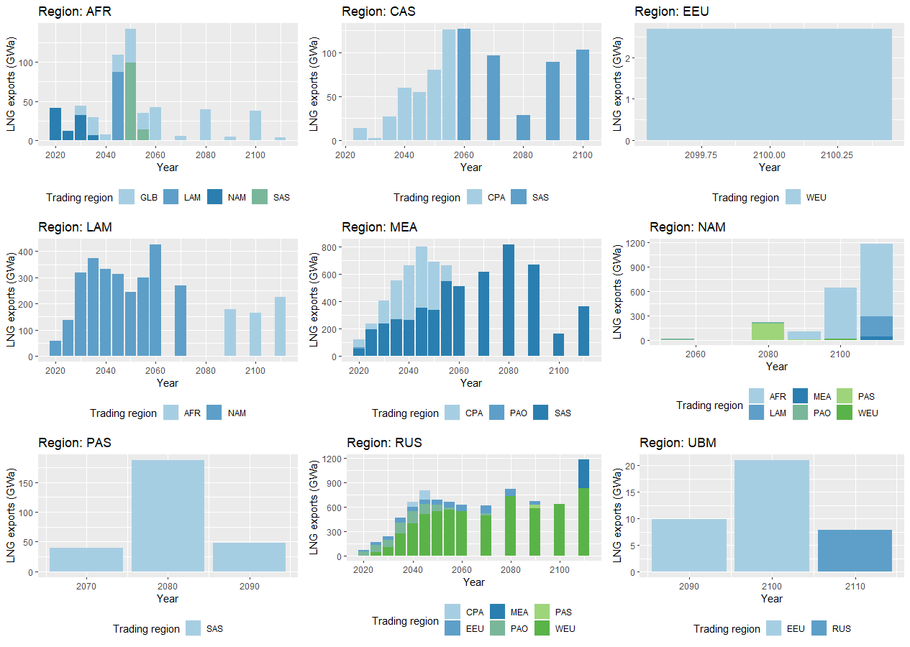
Compare global schema to bilateral schema LNG exports

