Slide 1
Representation of trade and transportation networks in global energy models Updates: 2019-06-12
Jun Ukita Shepard
IIASA-YSSP 2019

Slide 2
Updates
Data validation
Built local SQL database for trade and energy data
Validate trade data by using region-specific specific energy
Visualize validation
Mapping shortest paths
Add ports to the “major ports” dataset to include 835 most active sea ports
Made node compilation flexible
Literature review
Double-constrained gravity model

Slide 3
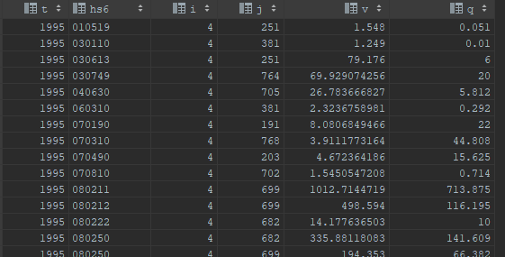
SQL database: BACI and IEA-WEB
BACI trade data (1995)

Slide 4
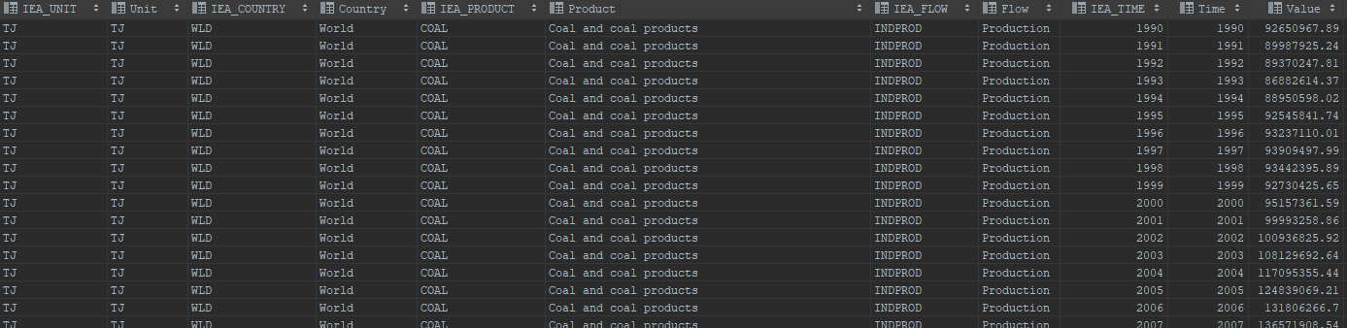
SQL database: BACI and IEA-WEB
IEA World Energy Balance

Slide 5
Converting trade to physical energy
Region-specific energy values for coal (COAL) and crude (CRU)
Overall specific energy for petroleum (PET), uranium (NUC), and bioenergy (BIO)….for now

Slide 6
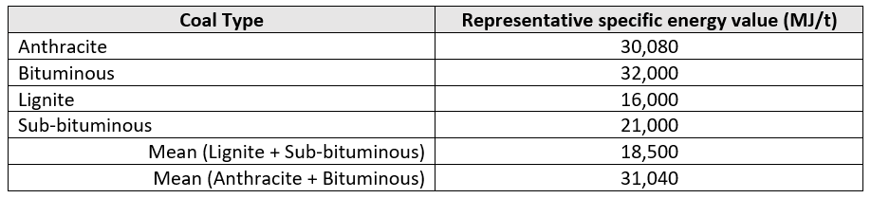
Converting trade to physical energy
Coal
Share of (lignite + sub-bituminous) and (anthracite + bituminous) in reserves (BP Statistical Workbook, 2007)
Calculate mean specific energy, weighted by reserve share for each country/region

Slide 7

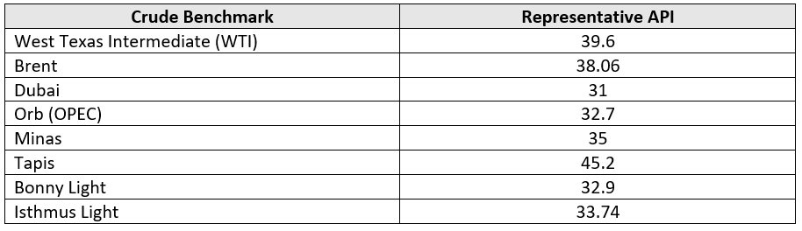
Converting trade to physical energy
Crude
Use representative API gravity for each benchmark and assign to region
Calculate specific energy based on:

Slide 8
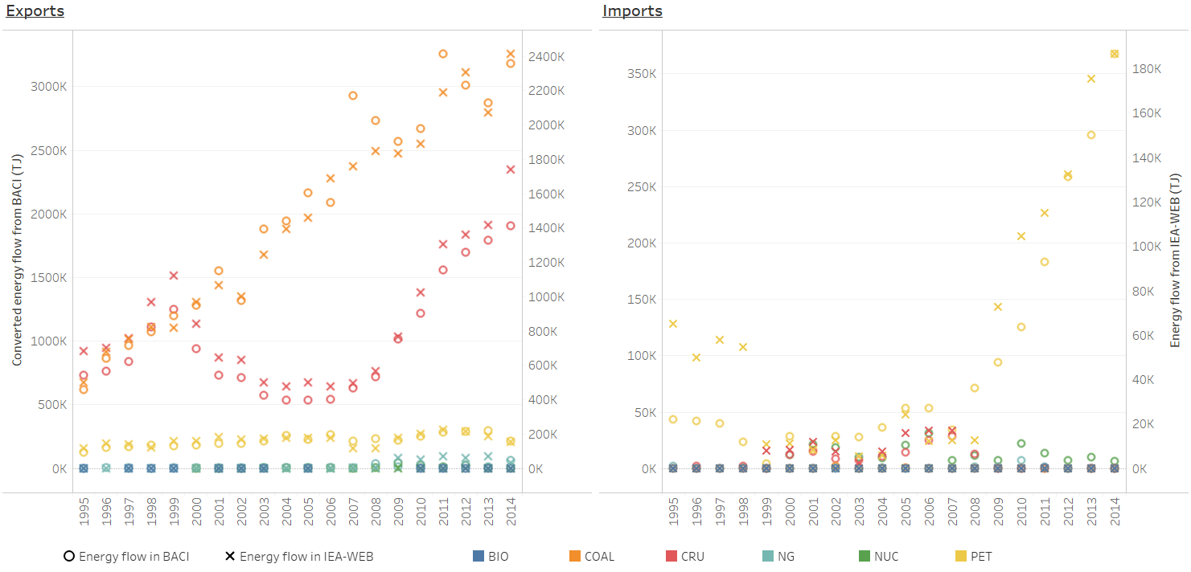
Compare to IEA data

Slide 9
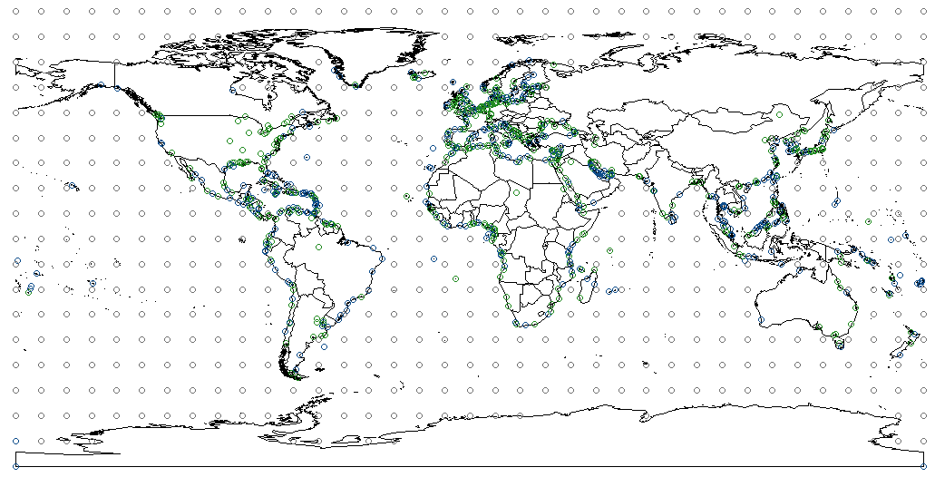
Mapping shortest paths
New dataset includes major sea ports and inland water ports
Green = inland
Blue = sea port
Grey = sea node

Slide 10
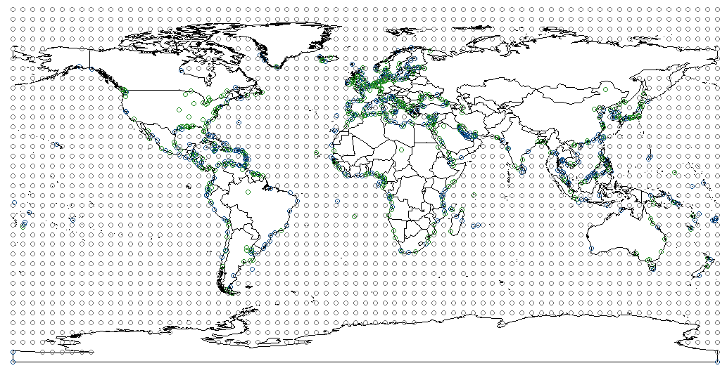
Mapping shortest paths
User can change how granular nodes should be (e.g. 5 degrees)
Green = inland
Blue = sea port
Grey = sea node

Slide 11
Double-constrained gravity model
Solve trade flows based on:
Supply from region i
Demand in region j
Distance between i and j

Slide 12
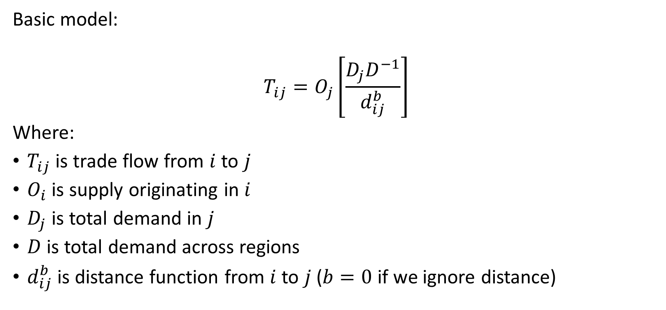
Double-constrained gravity model (Alward et al., 1998)
Basic model:
$$T_{ij}=O_{j}\left[\frac{D_{j}D^{−1}}{d_{ij}^{b}}\right]$$
Where:
$T_{ij}$ is trade flow from $i$ to $j$
$O_{i}$ is supply originating in $i$
$D_{j}$ is total demand in $j$
$D$ is total demand across regions
$d_{ij}^{b}$ is distance function from $i$ to $j$ ($b=0$ if we ignore distance)

Slide 13
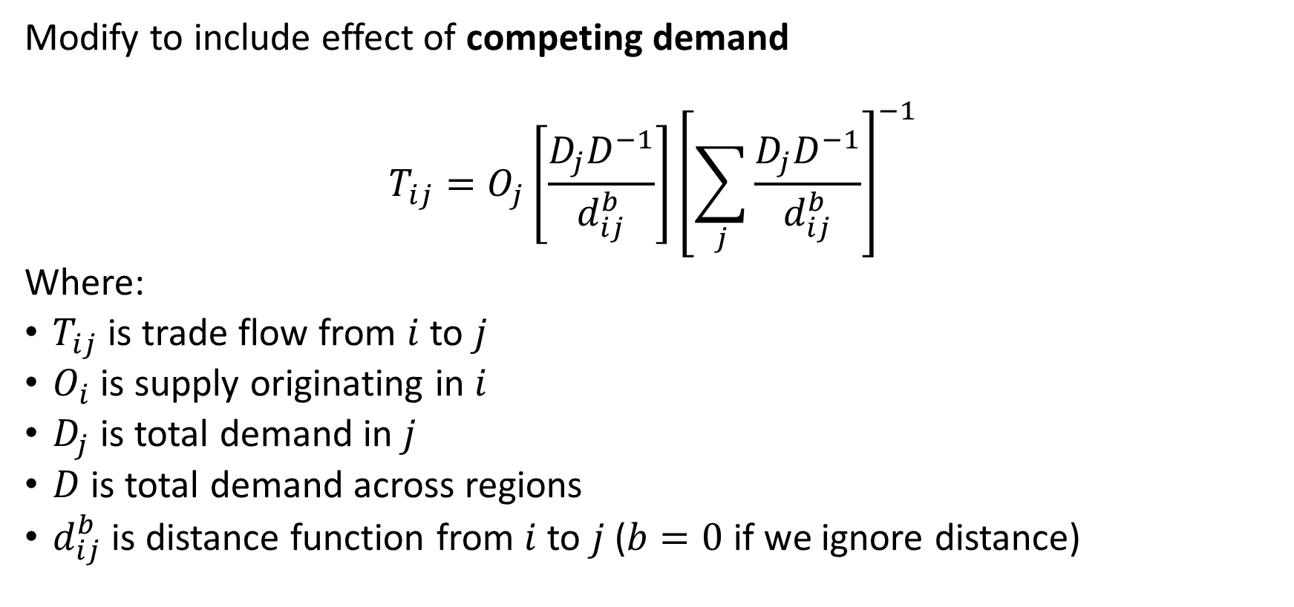
Double-constrained gravity model (Alward et al., 1998)
Modify to include effect of competing demand
$$T_{ij}=O_{j}\left[\frac{D_{j}D^{−1}}{d_{ij}^{b}}\right]{\left[\sum_{j}{\frac{D_{j}D^{−1}}{d_{ij}^{b}}}\right]}^{−1}$$
Where:
$T_{ij}$ is trade flow from $i$ to $j$
$O_{i}$ is supply originating in $i$
$D_{j}$ is total demand in $j$
$D$ is total demand across regions
$d_{ij}^{b}$ is distance function from $i$ to $j$ ($b=0$ if we ignore distance)

Slide 14
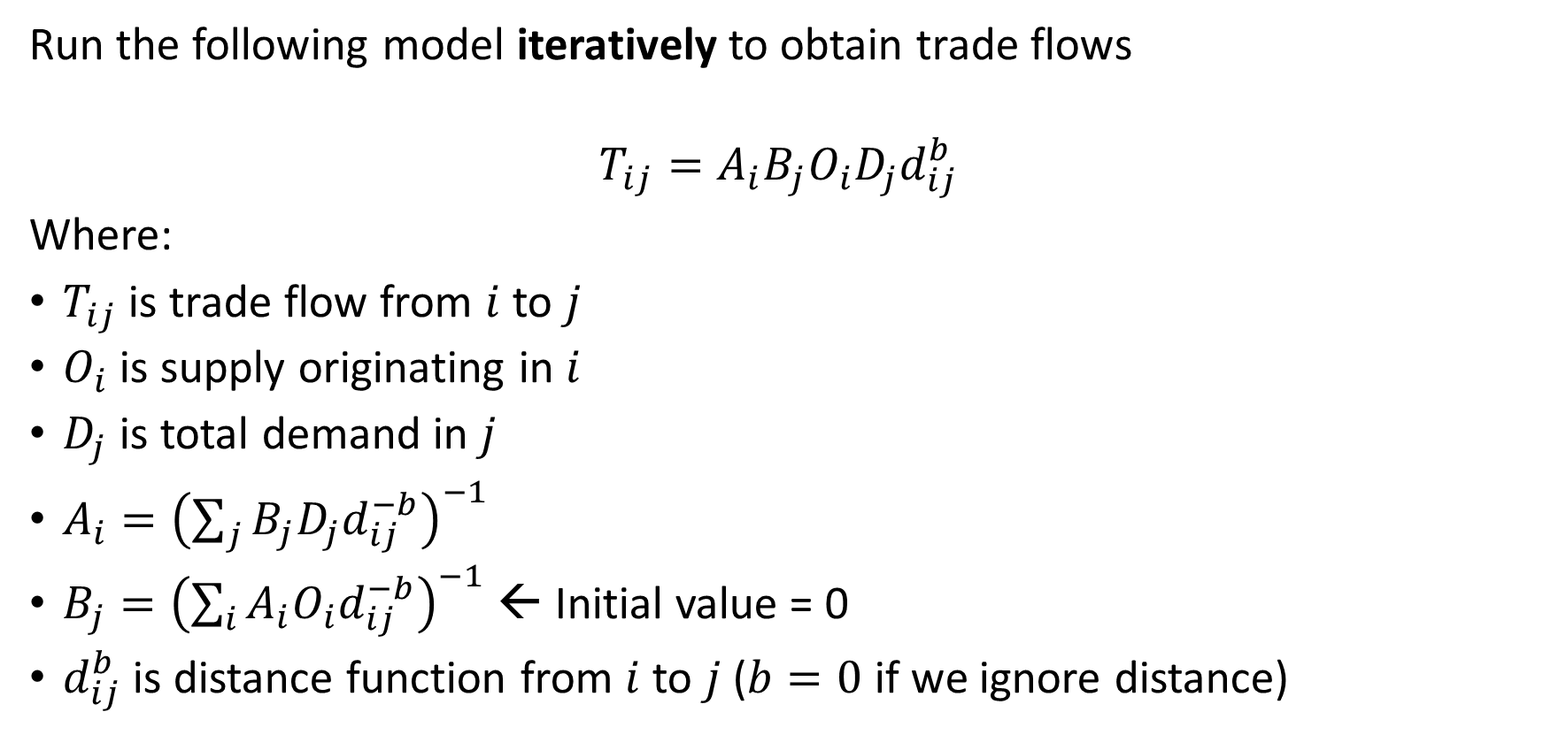
Double-constrained gravity model (Alward et al., 1998)
Run the following model iteratively to obtain trade flows
$$T_{ij}=A_{i}B_{j}O_{i}D_{j}d_{ij}^{b}$$
Where:
$T_{ij}$ is trade flow from $i$ to $j$
$O_{i}$ is supply originating in $i$
$D_{j}$ is total demand in $j$
$A_{i}={\left(\sum_{j}{B_{j}D_{j}d_{ij}^{−b}}\right)}^{−1}$
$B_{j}={\left(\sum_{i}{A_{i}O_{i}d_{ij}^{−b}}\right)}^{−1}$ ← Initial value = 0
$d_{ij}^{b}$ is distance function from $i$ to $j$ ($b=0$ if we ignore distance)

Slide 15
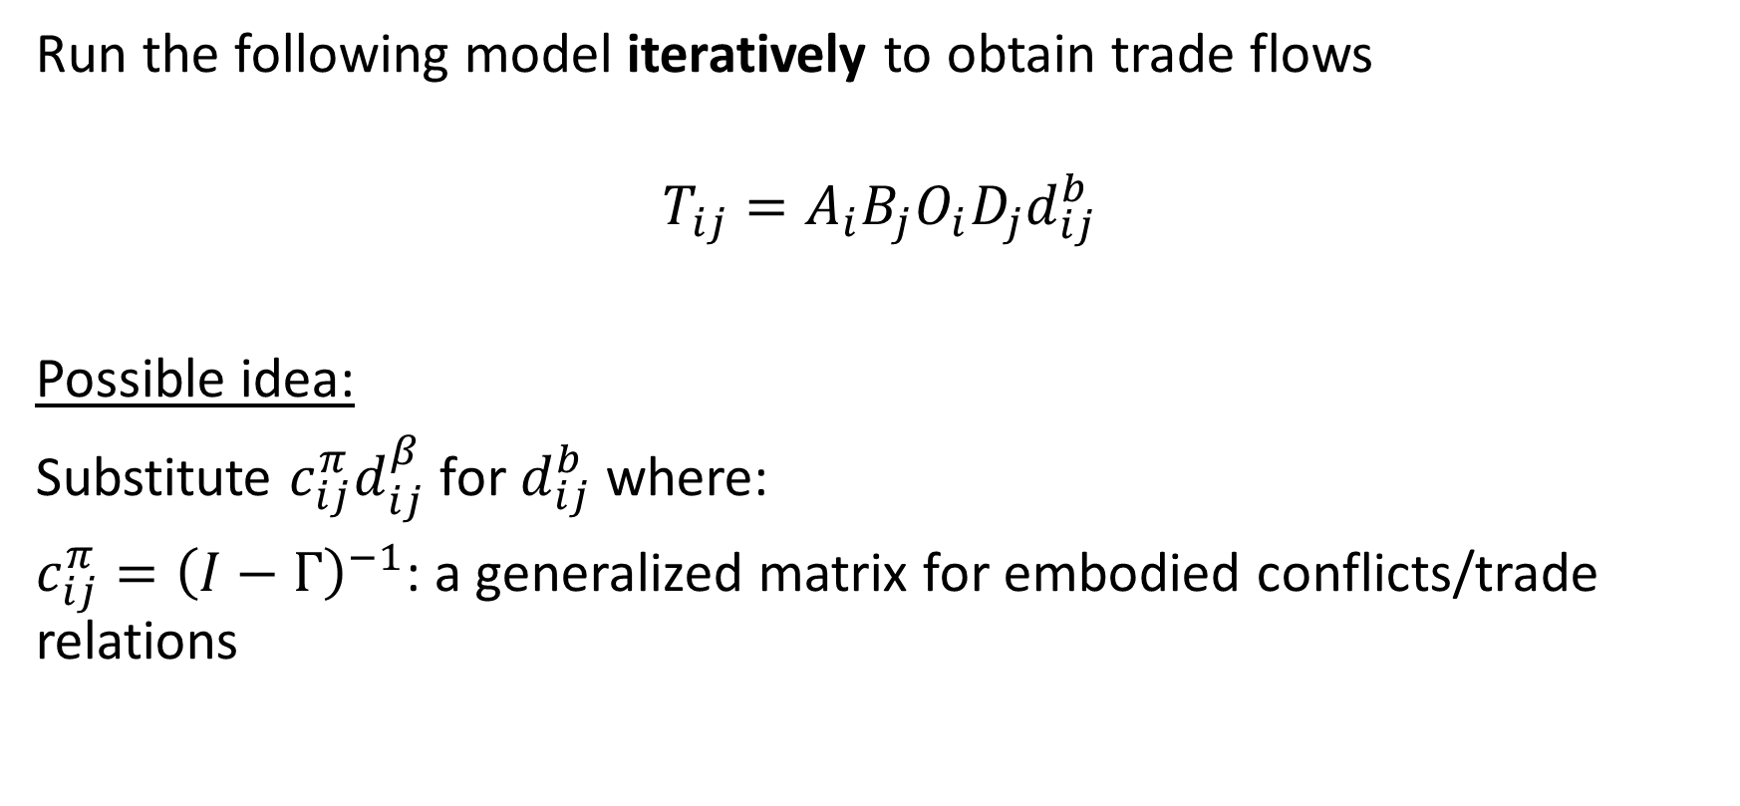
Double-constrained gravity model (Alward et al., 1998)
Run the following model iteratively to obtain trade flows
$$T_{ij}=A_{i}B_{j}O_{i}D_{j}d_{ij}^{b}$$
Possible idea:
Substitute $c_{ij}^{π}d_{ij}^{β}$ for $d_{ij}^{b}$ where:
$c_{ij}^{π}={\left(I−Γ\right)}^{−1}$: a generalized matrix for embodied conflicts/trade relations

Slide 16
Next steps
Mapping shortest paths
Rewrite Floyd-Warshall algorithm so that it’s flexible
Import road networks to include land transport into algorithm
Regional aggregation
Designate major port by region, for each energy commodity
Map trade flows by energy commodity using new regional definition
Make sure regional definition remains flexible (user input)

Slide 17
Next steps
If moving ahead with double-constrained gravity model…
Begin building matrices of
Trade flows by energy commodity, by year
Trade indicator (of any commodity) in time (t-1), by year
Conflict, by year

