Slide 1
A representation of trade and shipping networks in global energy models
Author: Jun Ukita Shepard (ENE)
Supervisors: Bas van Ruijven, Behnam Zakeri
YSSP Symposium (2019)

Slide 2
Trade networks and global energy models Motivation
Globalization is tied to energy transitions
Fossil fuel trade networks and transportation systems are dynamic
Volatility in trade linkages can impact the rate of technological transitions
Energy security relies on the who/what/how much of energy trade

Slide 3
Trade networks and global energy models Overview
Research questions:
1: Do energy trajectories change when we include dynamic shipping costs?
2: How do fossil energy trade networks adapt to projected energy trajectories?
3: Do trade and climate policies shape long-term fossil energy trade networks?

Slide 4
Methods Overview
Convert trade of key energy commodities from “global pool” schema to “bilateral trade” schema
Add shipping technologies
1
Reframe MESSAGE global model
Estimate shipping distances
Create dataset of key trade variables
Regional aggregation of data
Translate to a premium (i.e. cost)
2
Parameterize trade and shipping networks
Based on historical impacts of key variables (2b), create scenarios (e.g. high tariff)
Run scenarios in MESSAGE and compare
3
Run and compare trade scenarios
Notes:
Prior to IIASA and in the first week, I compiled trade data and validated it with IEA values

Slide 5
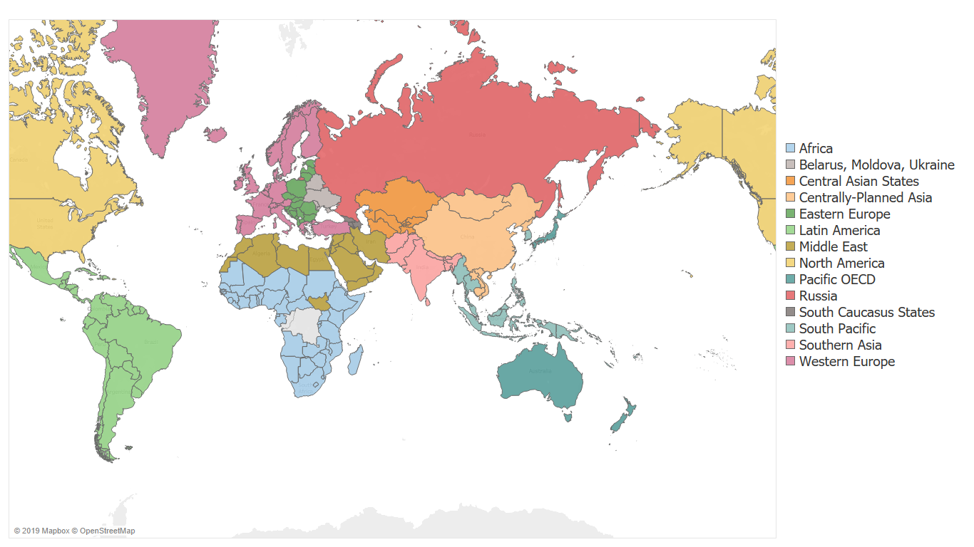
Methods The world as seen by MESSAGE

Slide 6
Methods Global pool schema → bilateral trade schema
Global Pool Schema
GLOBAL OIL POOL
Bilateral trade schema

Slide 7
Global pool → bilateral trade in MESSAGEix Technologies of interest
gas_exp_afr
coal_exp_afr
lh2_exp_afr
Natural gas
(piped)
…
Coal
…
Liquid H2
…
gas_exp_weu
coal_exp_weu
lh2_exp_weu
lng_exp_afr
loil_exp_afr
meth_exp_afr
LNG
…
Light oil
(petroleum)
…
Methanol
…
lng_exp_weu
loil_exp_weu
meth_exp_weu
foil_exp_afr
oil_exp_afr
eth_exp_afr
Fuel oil
(petroleum)
…
Crude oil
…
Ethanol
…
foil_exp_weu
oil_exp_weu
eth_exp_weu
22 parameters converted from global pool → bilateral trade schema
5 trade technologies (e.g. crude oil) → 70 region-specific technologies

Slide 8
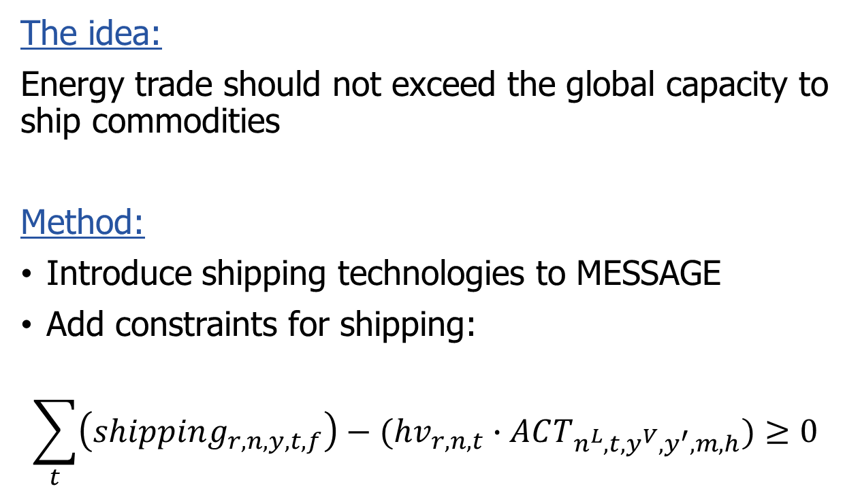
Shipping technologies Constraints to model
The idea:
Energy trade should not exceed the global capacity to ship commodities
Method:
Introduce shipping technologies to MESSAGE
Add constraints for shipping:
$$\sum_{t}{\left(shipping_{r,n,y,t,f}\right)−(hv_{r,n,t}∙ACT_{n^{L}, t,y^{V},y^{′},m,h})}≥0$$
Cargo:
Liquid energy
(crude, fuel oil, light oil)
Fuel:
Diesel
LNG
Elec.
Cargo:
Solid energy
(coal)
Fuel:
Diesel
LNG
Elec.
Cargo:
LNG
Fuel:
Diesel
LNG
Elec.

Slide 9
Scenario Analysis Overview
Baseline
Exporter variable cost = f(distance), Importer variable cost = f(tariffs)
Tariff scenarios
High tariff: tariff rates increase to 200% of 2015 levels by 2030
Low tariff: tariff rates decrease to 0 by 2030
Sanction scenarios
North America + Centrally Planned Asia
Centrally Planned Asia + Pacific OECD
North America + Middle East
Emission taxes
Global emission tax set to $30/tCO2 in 2020, increasing 5% annually
Run for baseline and tariff scenarios

Slide 10
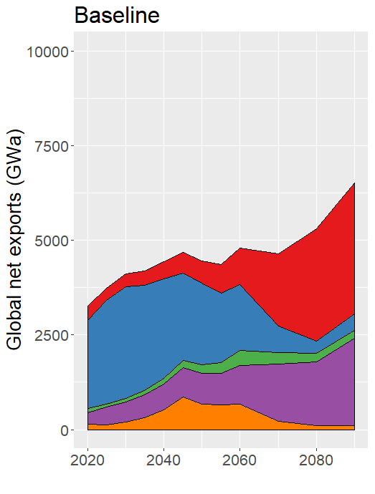
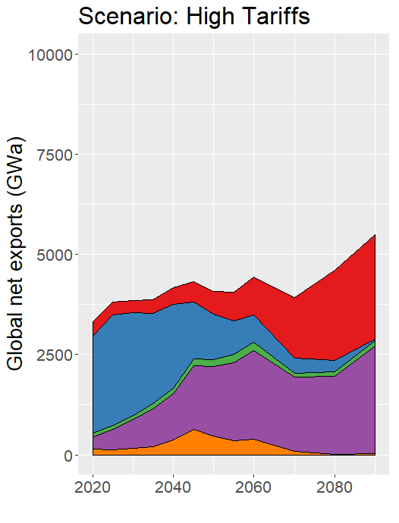
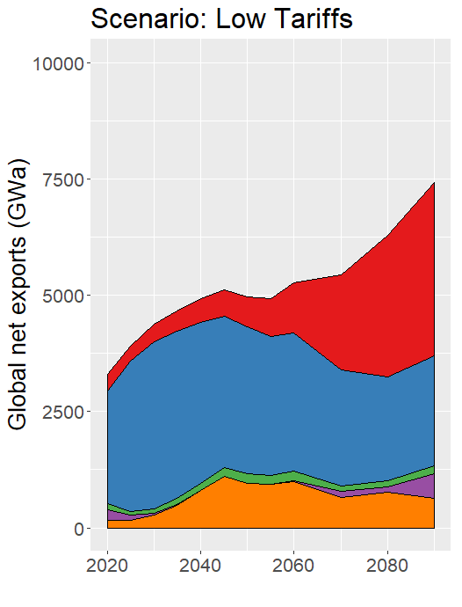
How do tariff policies impact energy trade? Global net exports (2020-2090)

Slide 11
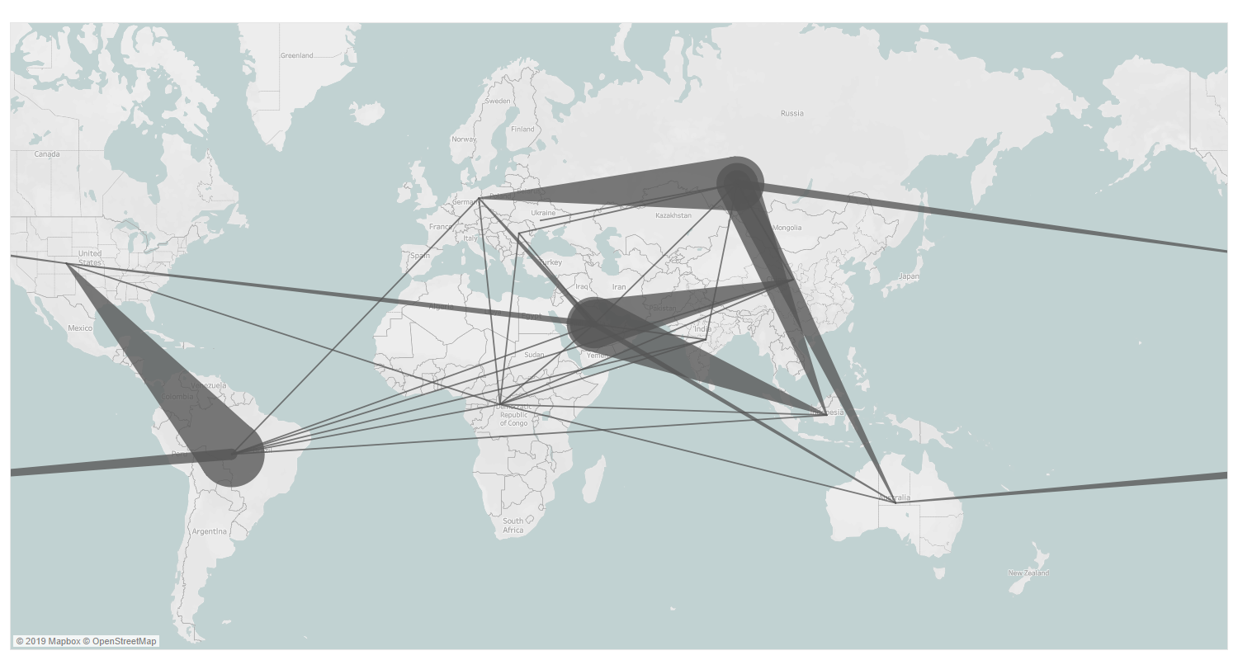
How do sanction policies impact energy trade? The case of crude oil in 2050
Baseline: Crude oil trade in 2050
Notes:
Sanctions don’t really change the shape of the network, but do make things really expensive
NAM-CPA: 26% higher than baseline
CPA-PAO: 2 times higher than baseline
NAM-MEA: 5 times higher than baseline

Slide 12
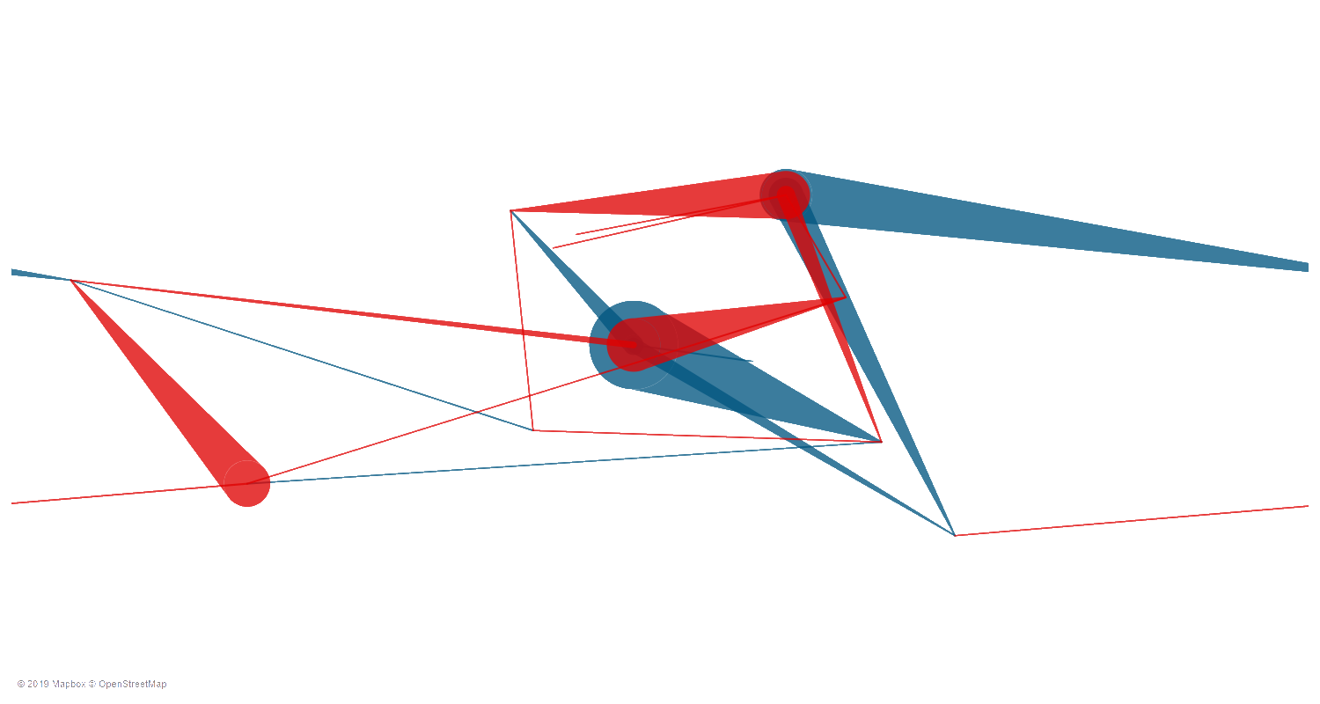
How do sanction policies impact energy trade? The case of crude oil in 2050
Sanction: North America – Middle East
Red: Reduced trade flow
Blue: Increased trade flow
Notes:
Sanctions don’t really change the shape of the network, but do make things really expensive
NAM-CPA: 26% higher than baseline
CPA-PAO: 2 times higher than baseline
NAM-MEA: 5 times higher than baseline

Slide 13
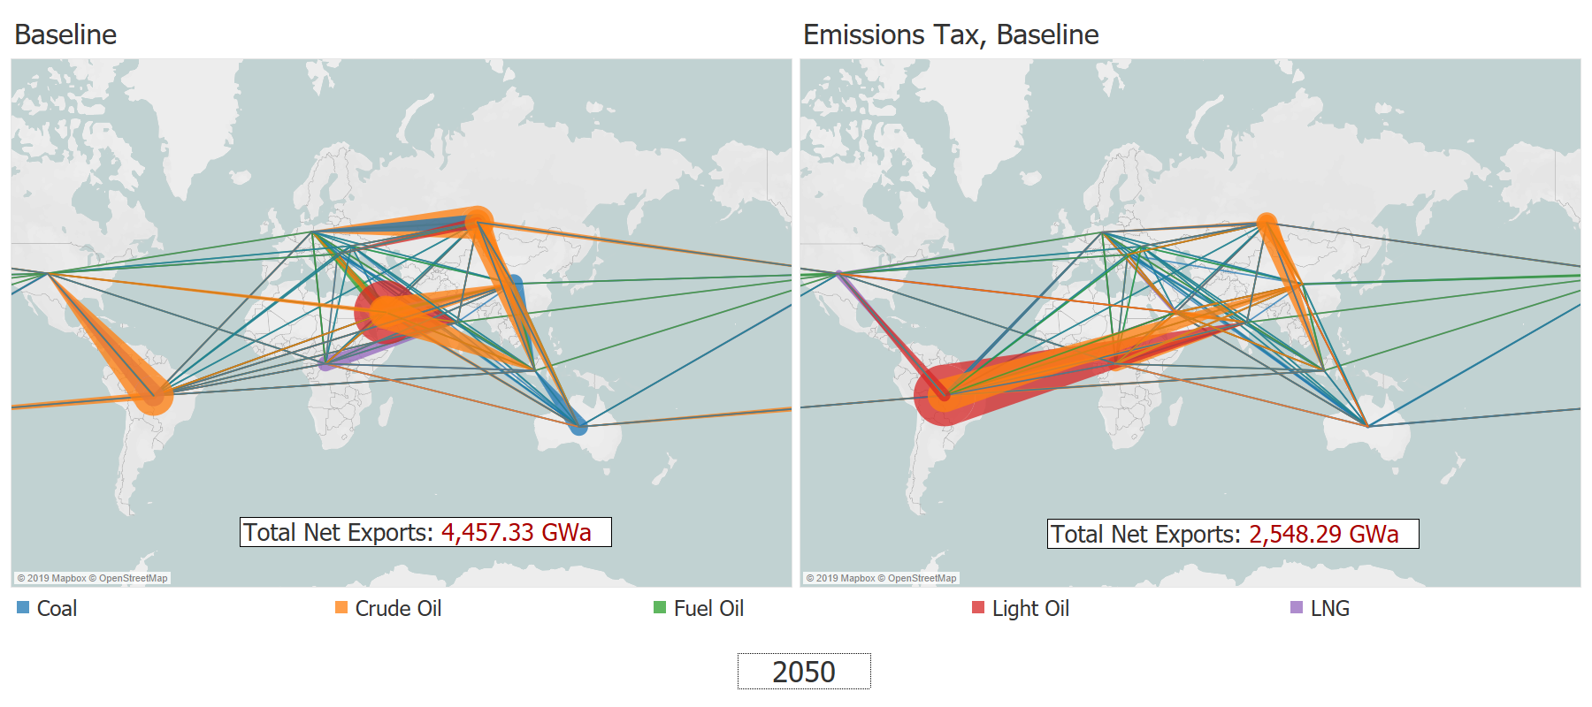
Emissions taxes can alter the energy network Composition of network changes
Notes:
Under CO2 tax, crude oil networks phase out
The total volume of trade also drops to nearly 50% by 2050 across all CO2 tax scenarios
Of course, low tariff will have more trade than high tariff/baseline
Cost across scenarios is about 5 times that of baseline

Slide 14
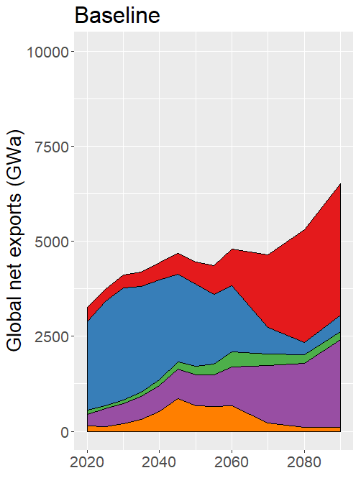
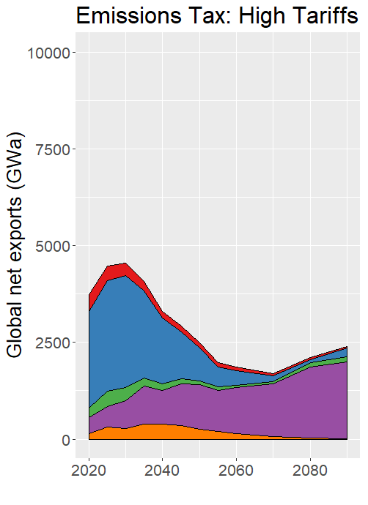
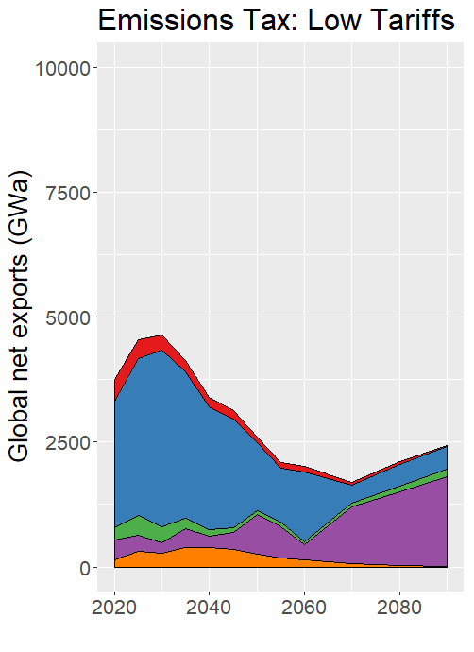
Emissions taxes can alter the energy network Fossil fuel trade reduced by 50%
Notes:
Under CO2 tax, crude oil networks phase out
The total volume of trade also drops to nearly 50% by 2050 across all CO2 tax scenarios
Of course, low tariff will have more trade than high tariff/baseline
Cost across scenarios is about 5 times that of baseline

Slide 15
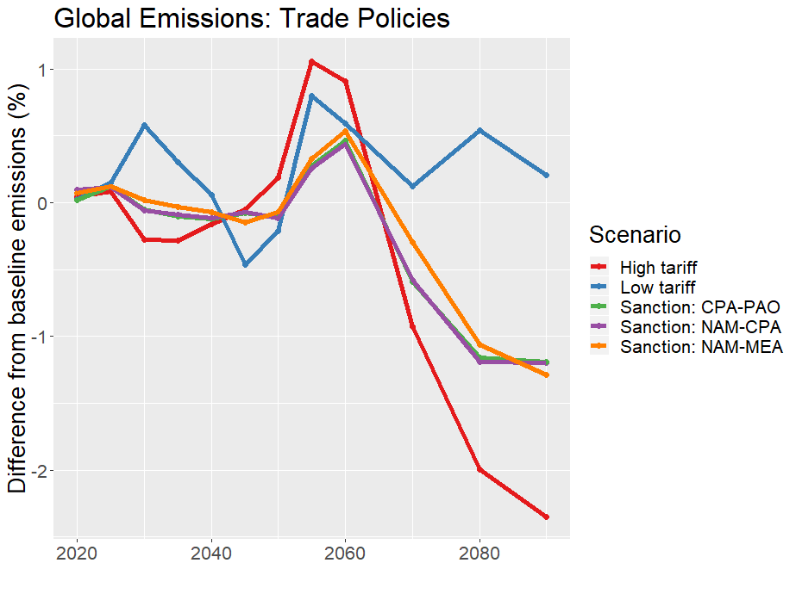
Trade policies have little effect on global emissions

Slide 16
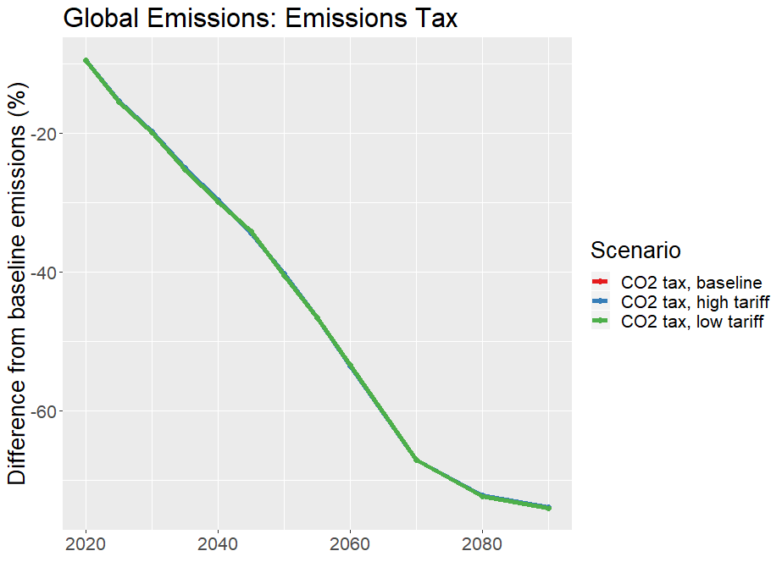
Carbon tax allows for rapid emissions reduction …and overshadows trade policy effects

Slide 17
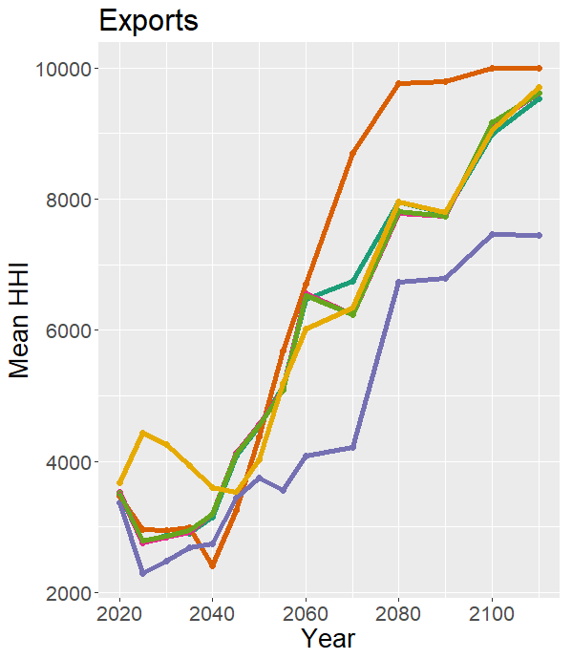
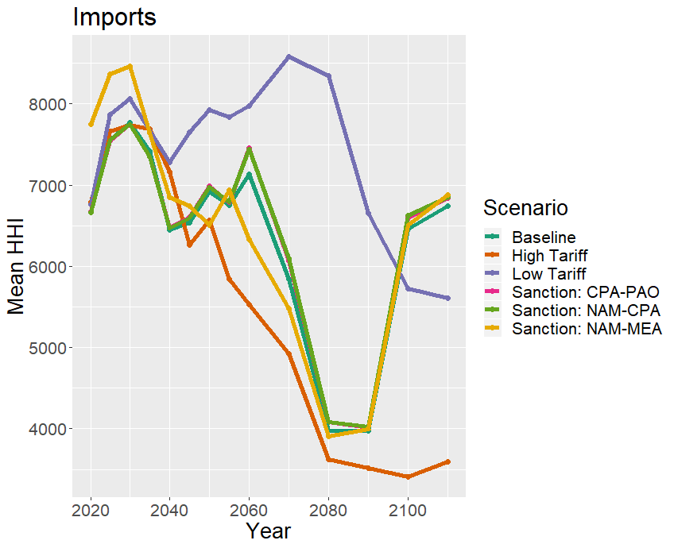
Implications for energy security The case of crude oil trade diversity

Slide 18
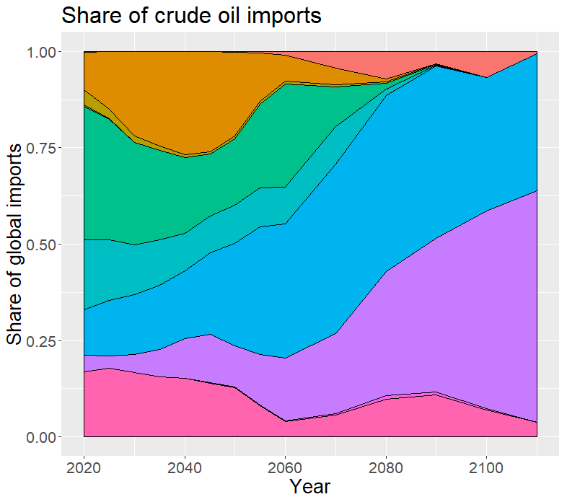
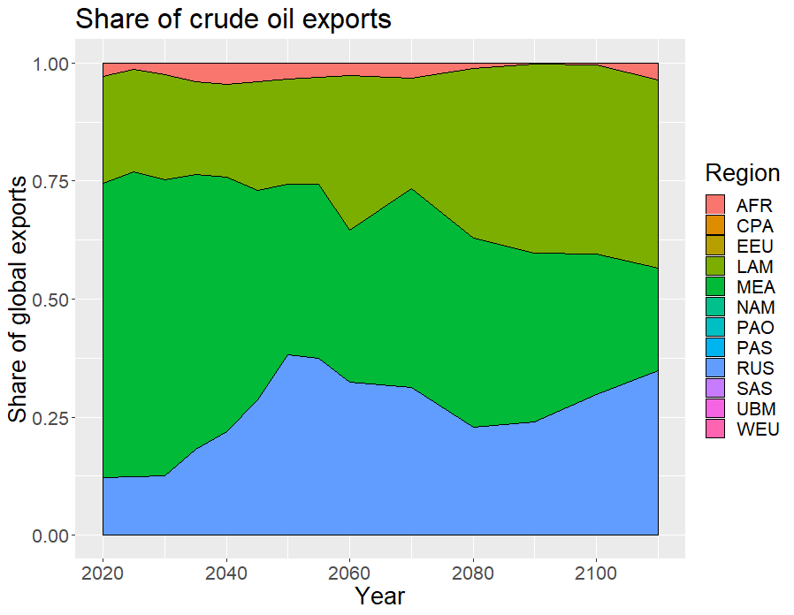
Implications for energy security The case of crude oil trade diversity

Slide 19
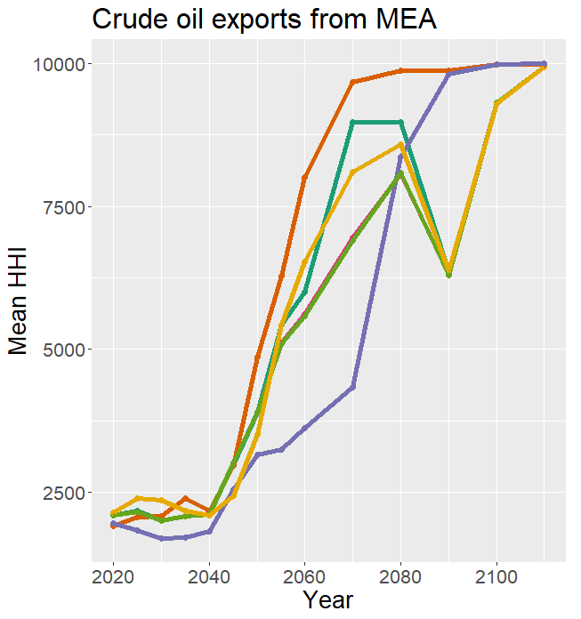
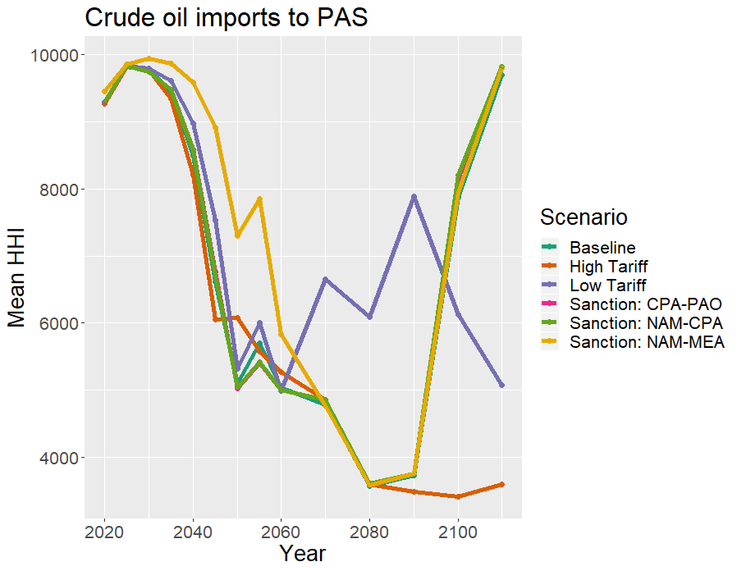
Implications for energy security The case of crude oil trade diversity

Slide 20
Preliminary Conclusions
Sustained tariff policies influence long-term energy networks
Sanction policies significantly increase the cost of the energy system
Trade policies have marginal effects on global emissions
Emissions taxes alter the trajectory of energy trade networks
Long-term energy security is less driven by trade policy
More driven by underlying socioeconomic pathways and climate policy

Slide 21
Appendix

Slide 22
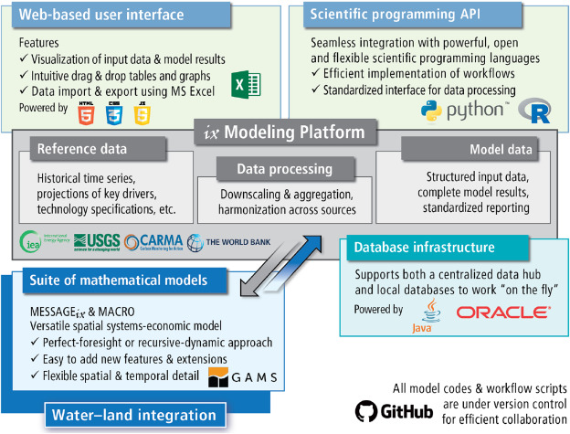
Methods What is MESSAGEix?
Image Source: Huppmann et al. (2019)

Slide 23
Tariff scenarios Definitions
Run baseline model (no tariffs)
Identify prices of energy at “shipped” level
Multiply result (2020-2110) by scenario tariff rates
Set prices as importer variable cost in MESSAGE
Baseline tariff:
Tariffs are set to historical median for primary product
High tariff:
Tariff rates increase to 200% of 2015 levels by 2030
Low tariff:
Tariff rates decrease to 0 by 2030

Slide 24
Global pool → bilateral trade in MESSAGEix Methods
“Global Pool” Schema:
PRIMARY
EXPORT
EXPORT/IMPORT
SECONDARY
crudeoil
crudeoil
crudeoil
crudeoil
crudeoil
crudeoil
AFR
Input
oil_exp
Output
GLB
GLB
Input
oil_trd
Output
GLB
GLB
Input
oil_imp
Output
WEU
node_loc
node_loc
node_loc
AFR
GLB
WEU
Legend:
Level (e.g. primary)
Node (e.g. R14_RUS)
Commodity (e.g. crude oil)
Technology (e.g. oil_exp)
Parameter (e.g. input)

Slide 25
Global pool → bilateral trade in MESSAGEix Methods
“Bilateral Trade” Schema:
PRIMARY
SHIPPED-OIL
SECONDARY
crudeoil
crudeoil_weu
crudeoil_weu
crudeoil
AFR
Input
oil_exp_weu
Output
GLB
GLB
Input
oil_imp
Output
WEU
node_loc
node_loc
AFR
WEU
Legend:
Level (e.g. primary)
Node (e.g. R14_RUS)
Commodity (e.g. crude oil)
Technology (e.g. oil_exp)
Parameter (e.g. input)

Slide 26
Shipping technologies Trade schema
SECONDARY
EXPORTS
fueloil
liquid_shipping_capacity
AFR
Input
liquid_shipping
Output
GLB
node_loc
AFR
Legend:
Level (e.g. primary)
Node (e.g. R14_RUS)
Commodity (e.g. crude oil)
Technology (e.g. oil_exp)
Parameter (e.g. input)

Slide 27
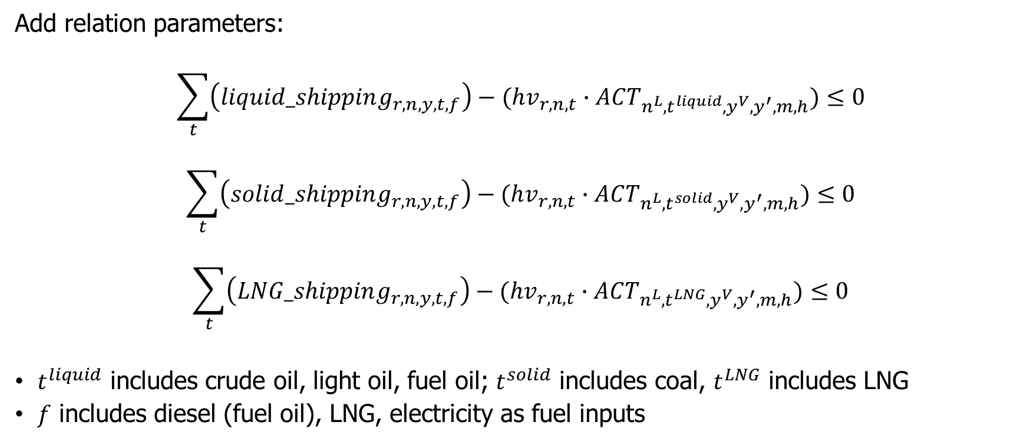
Shipping technologies Constraints to model
Add relation parameters:
$$\sum_{t}{\left(liquid_shipping_{r,n,y,t,f}\right)−(hv_{r,n,t}∙ACT_{n^{L}, t^{liquid},y^{V},y^{′},m,h})}≤0$$
$$\sum_{t}{\left(solid_shipping_{r,n,y,t,f}\right)−(hv_{r,n,t}∙ACT_{n^{L}, t^{solid},y^{V},y^{′},m,h})}≤0$$
$$\sum_{t}{\left(LNG_shipping_{r,n,y,t,f}\right)−(hv_{r,n,t}∙ACT_{n^{L}, t^{LNG},y^{V},y^{′},m,h})}≤0$$
$t^{liquid}$ includes crude oil, light oil, fuel oil; $t^{solid}$ includes coal, $t^{LNG}$ includes LNG
$f$ includes diesel (fuel oil), LNG, electricity as fuel inputs

Slide 28
Sanction scenarios Definitions
Compile data on historic alliances (Gibler, 2009)
Based on modelled trade activity, assign indicator for embodied sanction (ES)
(Assume sanctions last 5 years)
Example: North America (NAM) and Centrally Planned Asia (CPA) sanctions
If LAM trades with NAM and not CPA, assign ES with CPA
If LAM trades with both NAM + CPA, assign ES to less allied region
If LAM does not trade with either, assign ES to both
For the 2 regions in sanction, make prohibitively expensive to trade with each other
For regions in ES, increase trade cost by 20% during the sanction

Slide 29
MESSAGE output
Total system costs
Scenario name | Version | Scenario | Description | Total systems cost
baseline_global_schema | 1 | Baseline (global schema) | Global schema, no variable costs or shipping technologies | 2,516,900.68
baseline_no_tariff | 2 | Baseline, distance only | Baseline distance-differentiated variable costs | 2,505,424.12
baseline | 12 | Baseline, distance and tariff | Baseline distance and tariff-differentiated variable costs | 2,532,183.21
tariff_high | 10 | High tariff | Distance and tariff-differentiated variable costs, tariffs rates set to two times historic region median | 2,538,409.36
tariff_low | 6 | Low tariff | Distance and tariff-differentiated variable costs, tariffs rates set to 10% of historical region median | 2,523,891.50
NAM_CPA_sanction | 7 | Sanctions between North America and Centrally Planned Asia | Make trade between NAM and CPA prohibitively expensive, increase embodied cost by 30% for other regions' trade with NAM (CPA) if counterfactual has them trade with CPA (NAM) | 2,542,224.73
CPA_PAO_sanction | 5 | Sanctions between Centrally Planned Asia and Pacific-Oceania | Make trade between CPA and PAO prohibitively expensive, increase embodied cost by 30% for other regions' trade with CPA (PAO) if counterfactual has them trade with PAO (CPA) | 2,725,966.55
NAM_MEA_sanction | 4 | Sanctions between North America and Middle East | Make trade between NAM and MEA prohibitively expensive, increase embodied cost by 30% for other regions' trade with NAM (MEA) if counterfactual has them trade with CPA (MEA) | 3,129,566.27
CO2_tax_baseline | 15 | Apply CO2 price, with baseline tariffs | Add $30/tCO2 tax on emissions, allowing increase of 5% per year from 2020, cap at $100/tCO2 | 3,615,096.60
CO2_tax_tariff_high | 7 | Apply CO2 price, with high tariff scenario | Add $30/tCO2 tax on emissions, allowing increase of 5% per year from 2020, cap at $100/tCO2 | 3,641,055.45
CO2_tax_tariff_low | 4 | Apply CO2 price, with low tariff scenario | Add $30/tCO2 tax on emissions, allowing increase of 5% per year from 2020, cap at $100/tCO2 | 3,586,652.90

Slide 30
Shipping technology specification
Investment costs
Type of shipping |  | Fuel input (kg/bton-km-y) |  |  | Captial cost |  |  | Assumptions
 | Type of fuel | By weight (kg/bton-km-y) | By energy (GWa/bton-km-y) | Emissions factor (Mt/bton-km-y) | Overnight cost ($M) | Annualized, 10%DR ($M/y) | Annualized ($M/bton-km-y) | DWT (ton) | Annual distance (10^9km/y) | Number of ships | Average payload per ship (bton-km/y) | Average distance traveled (km/y)
Liquid | Diesel | 6894865.04 | 0.01 | 0.02 | 76.00 | 8.37 | 6.24 | 100000 | 5.05 | 376219 | 1.34 | 13423.03
Liquid | LNG | 3678751.33 | 0.00 | 0.01 | 96.00 | 10.58 | 7.88 | 100000 | 5.05 | 376219 | 1.34 | 13423.03
Liquid | Electricity | NA | 0.00 | 0.00 | 192000.00 | 21152.27 | 15758.19 | 100000 | 5.05 | 376219 | 1.34 | 13423.03
Solid | Diesel | 7283748.84 | 0.01 | 0.02 | 51.60 | 5.68 | 4.24 | 100000 | 5.05 | 376219 | 1.34 | 13423.03
Solid | LNG | 3052216.32 | 0.00 | 0.01 | 71.60 | 7.89 | 5.88 | 100000 | 5.05 | 376219 | 1.34 | 13423.03
Solid | Electricity | NA | 0.00 | 0.00 | 1432000.00 | 157760.68 | 117529.83 | 100000 | 5.05 | 376219 | 1.34 | 13423.03
LNG | Diesel | 16810656.90 | 0.02 | 0.05 | 180.00 | 19.83 | 14.77 | 100000 | 5.05 | 376219 | 1.34 | 13423.03
LNG | LNG | 5594115.78 | 0.01 | 0.01 | 200.00 | 22.03 | 16.41 | 100000 | 5.05 | 376219 | 1.34 | 13423.03
LNG | Electricity | NA | 0.00 | 0.00 | 4000000.00 | 440672.29 | 328295.62 | 100000 | 5.05 | 376219 | 1.34 | 13423.03

Slide 31
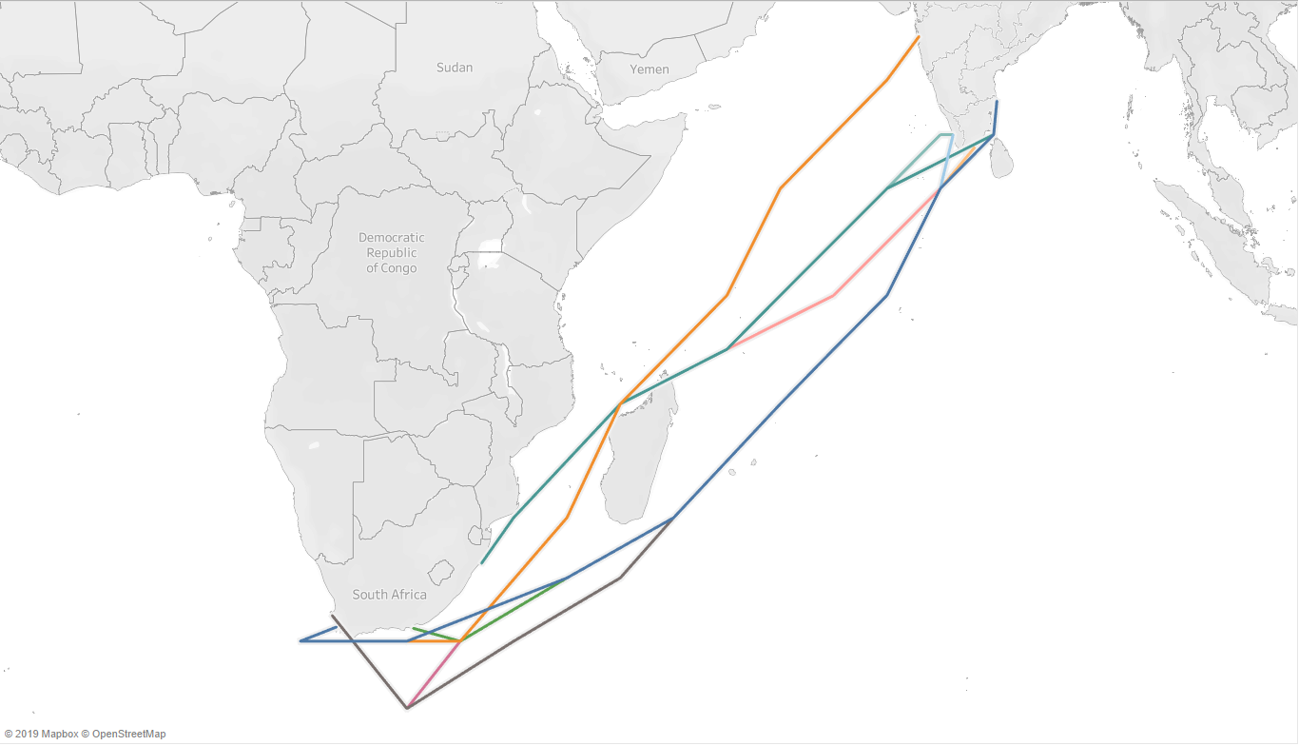
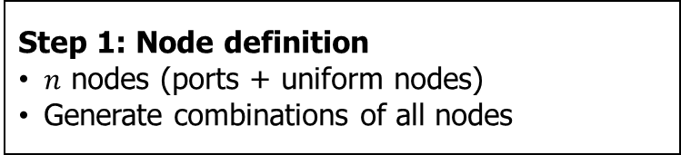
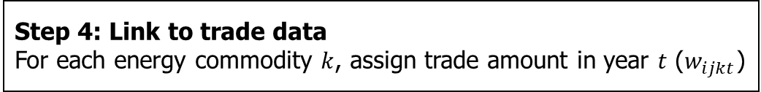
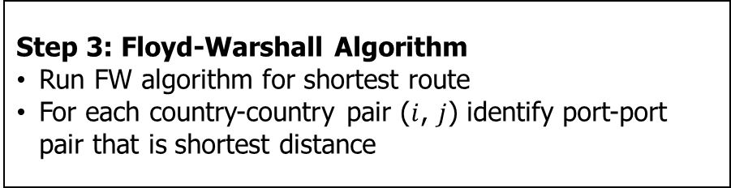
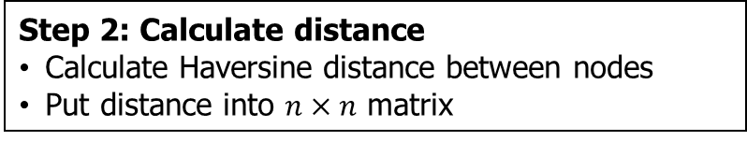
Estimating shipping distance Methods
Step 1: Node definition
$n$ nodes (ports + uniform nodes)
Generate combinations of all nodes
Step 2: Calculate distance
Calculate Haversine distance between nodes
Put distance into $n×n$ matrix
Step 3: Floyd-Warshall Algorithm
Run FW algorithm for shortest route
For each country-country pair ($i$, $j$) identify port-port pair that is shortest distance
Shortest paths between South Africa and India
Step 4: Link to trade data
For each energy commodity $k$, assign trade amount in year $t$ ($w_{ijkt}$)

Slide 32

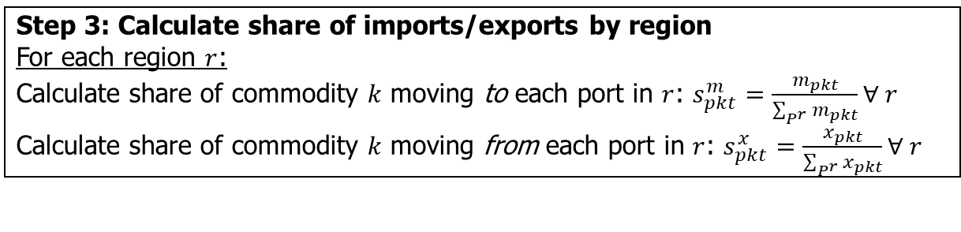
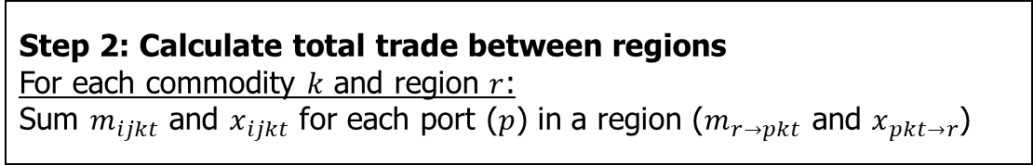
Aggregating distance to regional level Methods
Step 1: Assign trade to port
For each commodity $k$:
Assign trade amount in year $t$ ($m_{ijkt}$ for imports, $x_{ijkt}$ for exports) to each port-port combination
Step 2: Calculate total trade between regions
For each commodity $k$ and region $r$:
Sum $m_{ijkt}$ and $x_{ijkt}$ for each port ($p$) in a region ($m_{r→pkt}$ and $x_{pkt→r}$)
Step 3: Calculate share of imports/exports by region
For each region $r$:
Calculate share of commodity $k$ moving to each port in $r$: $s_{pkt}^{m}=\frac{m_{pkt}}{\sum_{P^{r}}{m_{pkt}}}∀ r$
Calculate share of commodity $k$ moving from each port in $r$: $s_{pkt}^{x}=\frac{x_{pkt}}{\sum_{P^{r}}{x_{pkt}}}∀ r$
Step 4: Identify primary ports by region
For each region $r$:
The port with the largest $s_{pkt}^{m}$ and $s_{pkt}^{x}$ are the primary import/export port for region $r$ in year $t$ for commodity $k$
Notes:
In the first stage, we assigned a port-port combination to each country-country combination
We link this to trade data, so now for each commodity, we have the port-port combination associated with bilateral trade
We aggregate trade up to the region level (like WEU), which is a user specified aggregation

Slide 33
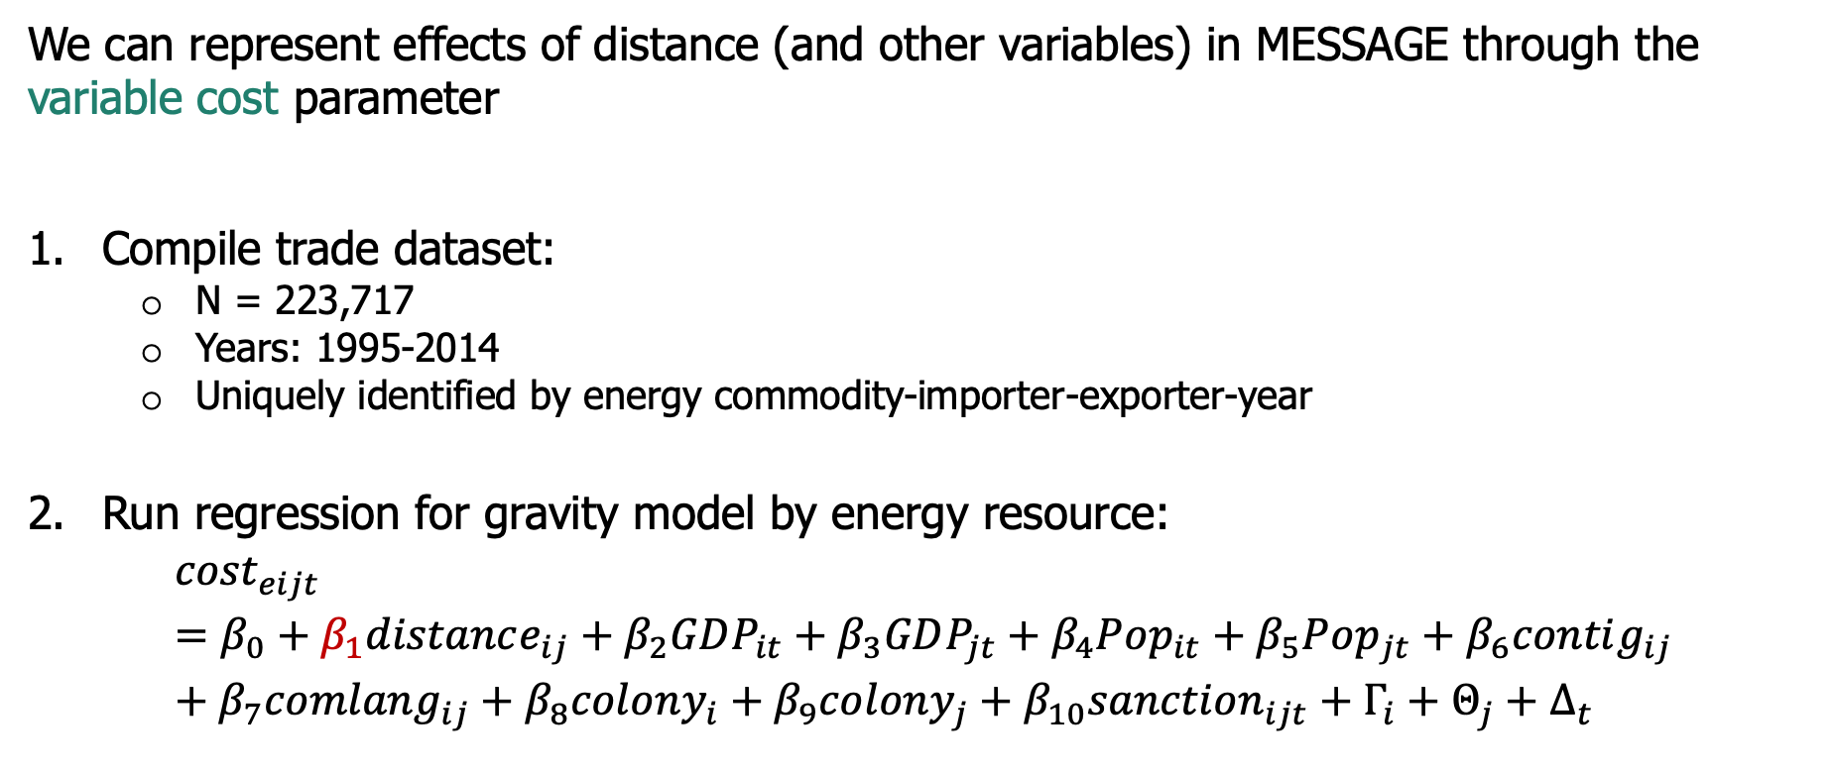
Translating variables to premiums Methods
We can represent effects of distance (and other variables) in MESSAGE through the variable cost parameter
Compile trade dataset:
N = 223,717
Years: 1995-2014
Uniquely identified by energy commodity-importer-exporter-year
Run regression for gravity model by energy resource:
$${cost}_{eijt}=β_{0}+β_{1}distance_{ij}+β_{2}GDP_{it}+β_{3}GDP_{jt}+β_{4}Pop_{it}+β_{5}Pop_{jt}+β_{6}contig_{ij}+β_{7}comlang_{ij}+β_{8}colony_{i}+β_{9}colony_{j}+β_{10}sanction_{ijt}+Γ_{i}+Θ_{j}+Δ_{t}$$
Note: $i$ is exporting country, $j$ is importing country, $t$ is year
Notes:
For translating the effect of variables, we do not worry about regional aggregation (yet)

Slide 34
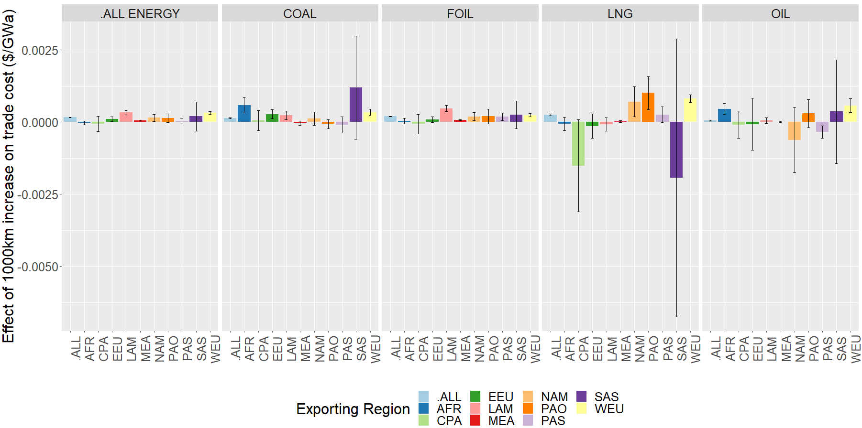
Parameterizing trade through variable costs Results
Effect of distance on trade cost, error bars represent 95% confidence

Slide 35
Parameterizing trade through variable costs Results
Takeaways:
Distance has a significant effect overall
Distance matters for some fuels (e.g. LNG) more than others (e.g. coal)
There is too much uncertainty in heterogeneity by region
Probably best to use a distance effect that is:
Constant across regions
Varies by energy type
Effect of distance on trade cost, error bars represent 95% confidence

Slide 36
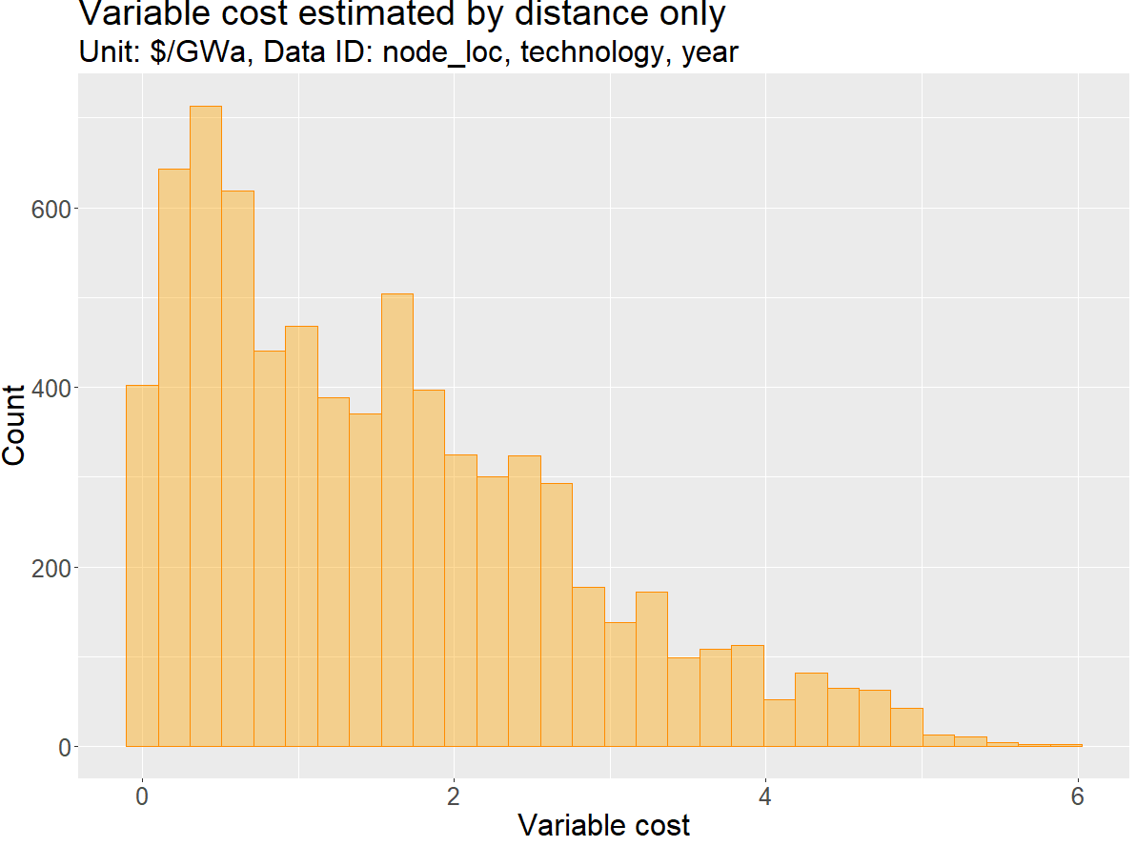

Parameterizing trade through variable costs Regression results
$varcost_{r_{1}r_{2}kt}=β_{1}×distance_{r_{1}r_{2}kt}$
…so variable cost still varies by region,
commodity, and year

Slide 37
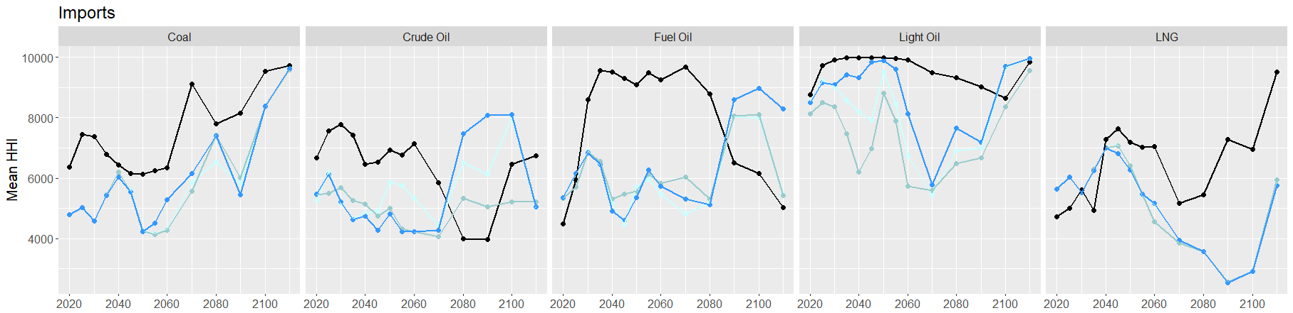
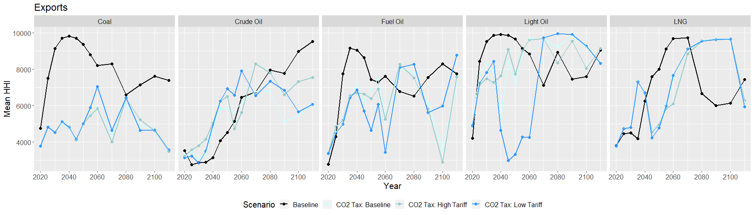
Energy security Effect of an emissions tax

