Slide 1
A representation of trade and shipping networks in global energy models
Author: Jun Ukita Shepard (ENE)
Supervisors: Bas van Ruijven, Behnam Zakeri
YSSP Symposium (2019)

Slide 2
Updates since final presentation
Initial activity constraints are divided bilaterally based on trade activity
Growth activity constraints are held the same as global schema
Update tariff scenarios’ regional aggregation
Compare sanction scenarios with and without indirect effects

Slide 3
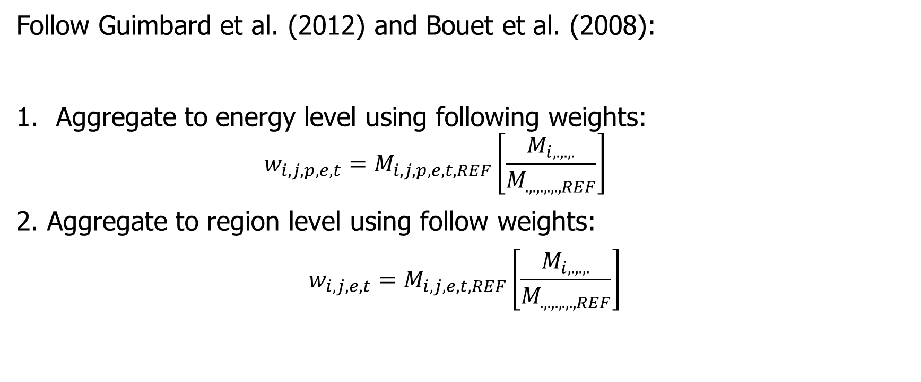
Updates to tariff scenarios Regional aggregation
Follow Guimbard et al. (2012) and Bouet et al. (2008):
Aggregate to energy level using following weights:
$$w_{i,j,p,e,t}=M_{i,j,p,e,t,REF}\left[\frac{M_{i,.,.,.}}{M_{.,.,.,.,.,REF}}\right]$$
2. Aggregate to region level using follow weights:
$$w_{i,j,e,t}=M_{i,j,e,t,REF}\left[\frac{M_{i,.,.,.}}{M_{.,.,.,.,.,REF}}\right]$$

Slide 4
Long-term outlook for energy security Tariff scenarios and diversity index

Slide 5
Long-term impacts of short-term trade policy Sanction scenarios

Slide 6
Effect of emission tax on energy trade networks Emission tax scenario

Slide 7
MESSAGE-Trade Flexibility in use

Slide 8
MESSAGE-Trade Documentation

Slide 9
Trade networks and global energy models Motivation
Globalization is tied to energy transitions
Energy trade networks and transportation systems are dynamic
Volatility in trade linkages can impact the rate of technological transitions

Slide 10
Trade networks and global energy models Overview
Research questions:
1: How do energy trade networks adapt to projected energy trajectories?
2: Do trade and climate policies shape long-term energy trade networks?

Slide 11
Methods Overview
Convert trade of key energy commodities from “global pool” schema to “bilateral trade” schema
Add shipping technologies
1
Reframe MESSAGE global model
Estimate shipping distances
Create relational database of key trade variables
Regional aggregation of data
Translate to a premium (i.e. cost)
2
Parameterize trade and shipping networks
Based on historical impacts of key variables (2b), create scenarios (e.g. high tariff)
Run scenarios in MESSAGE and compare
3
Run and compare trade scenarios
Notes:
Prior to IIASA and in the first week, I compiled trade data and validated it with IEA values

Slide 12
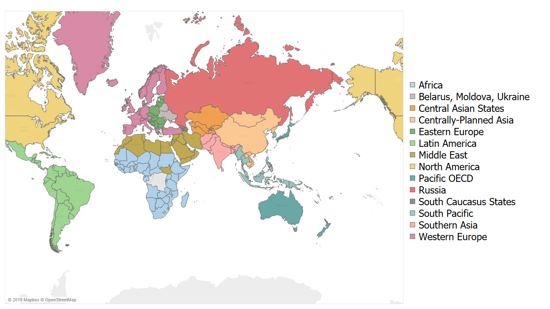
Methods The world as seen by MESSAGE

Slide 13
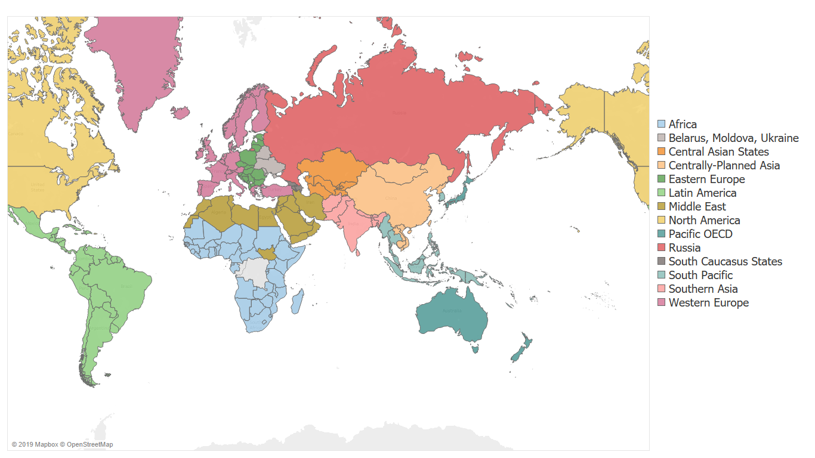
Methods Global pool schema → bilateral trade schema
Global Pool Schema
GLOBAL OIL POOL
Bilateral trade schema

Slide 14
Methods Global pool schema → bilateral trade schema
Global Pool Schema
GLOBAL OIL POOL
Bilateral trade schema
Energy commodities modeled:
Coal
Crude oil
Fuel oil
Light oil
LNG

Slide 15
Methods Shipping constraints
The idea:
Energy trade should not exceed the global capacity to ship commodities
Method:
Introduce shipping technologies to MESSAGE
Add constraints for shipping
Cargo:
Liquid energy
(crude, fuel oil, light oil)
Fuel:
Diesel
LNG
Elec.
Cargo:
Solid energy
(coal)
Fuel:
Diesel
LNG
Elec.
Cargo:
LNG
Fuel:
Diesel
LNG
Elec.

Slide 16
Methods Scenarios
Baseline
Exporter variable cost = f(distance), Importer variable cost = f(tariffs)
Tariff policies
High tariff: rates increase to 200% of 2015 levels by 2030
Low tariff: rates decrease to 0 by 2030
Sanction policies
North America + Middle East (2020-2025)
Emission taxes
Global emission tax set to $30/tCO2 in 2020, increasing 5% annually
Run for baseline and tariff scenarios

Slide 17
Methods Scenarios
Baseline
Exporter variable cost = f(distance), Importer variable cost = f(tariffs)
Tariff policies
High tariff: rates increase to 200% of 2015 levels by 2030
Low tariff: rates decrease to 0 by 2030
Sanction policies
North America + Middle East (2020-2025)
Emission taxes
Global emission tax set to $30/tCO2 in 2020, increasing 5% annually
Run for baseline and tariff scenarios
These scenarios can influence:
Composition of network
Magnitude of trade
Carbon emissions
Energy security

Slide 18
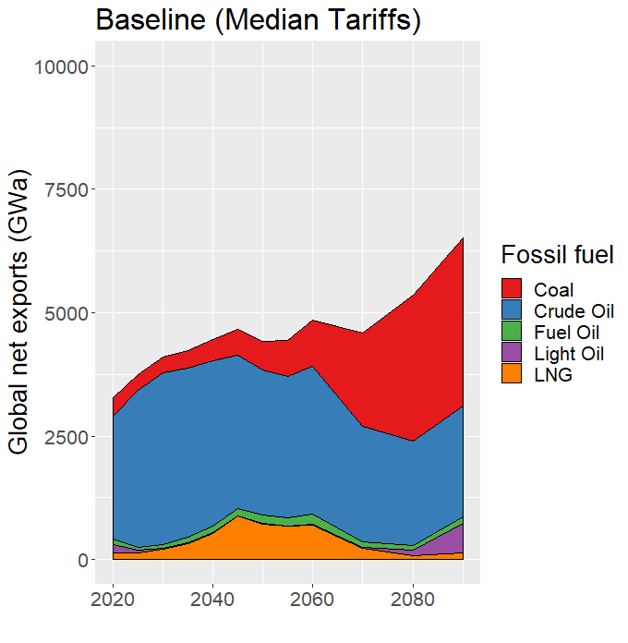
How do tariff policies impact energy trade? Global net exports (2020-2090)

Slide 19
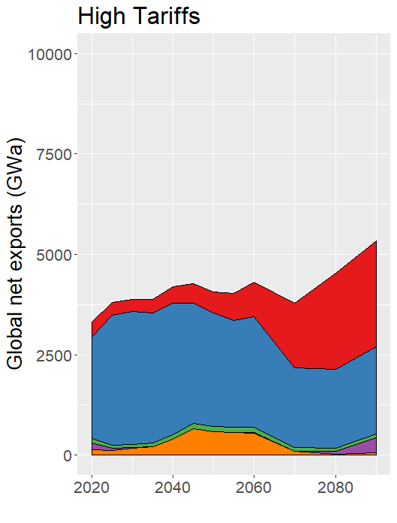
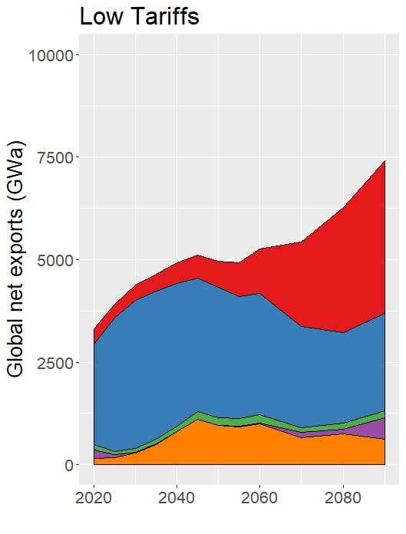
How do tariff policies impact energy trade? Global net exports (2020-2090)

Slide 20
How do tariff policies impact energy trade? Global net exports (2020-2090)
High tariffs reduce fossil fuel trade magnitude
Low tariffs increase fossil fuel trade magnitude

Slide 21
How do tariff policies impact energy trade? Global net exports (2020-2090)
Low tariffs allow for LNG trade to persist

Slide 22
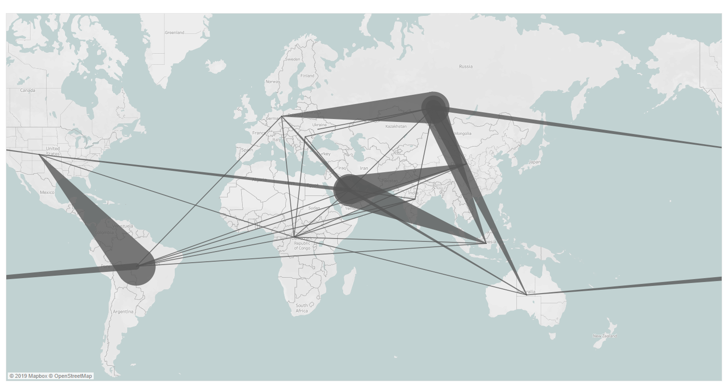
How do sanction policies impact energy trade? The case of crude oil in 2050
Baseline (no sanction): Crude oil trade in 2050

Slide 23
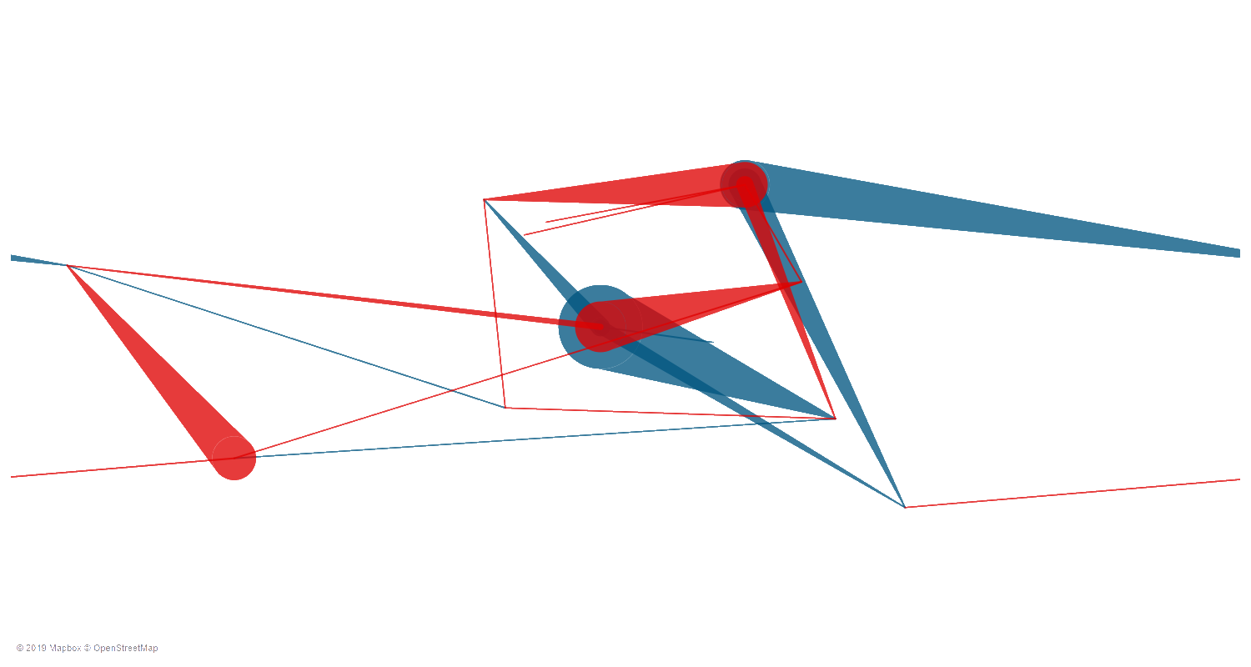
How do sanction policies impact energy trade? The case of crude oil in 2050
Sanction: North America – Middle East
Red: Reduced trade flow
Blue: Increased trade flow
Notes:
Total cost of sanction decays:
Regional energy system cost increases 50% during sanction
Regional energy system costs 15% more during the next 5 years
Decays to 0
Average increase = 5% above baseline

Slide 24
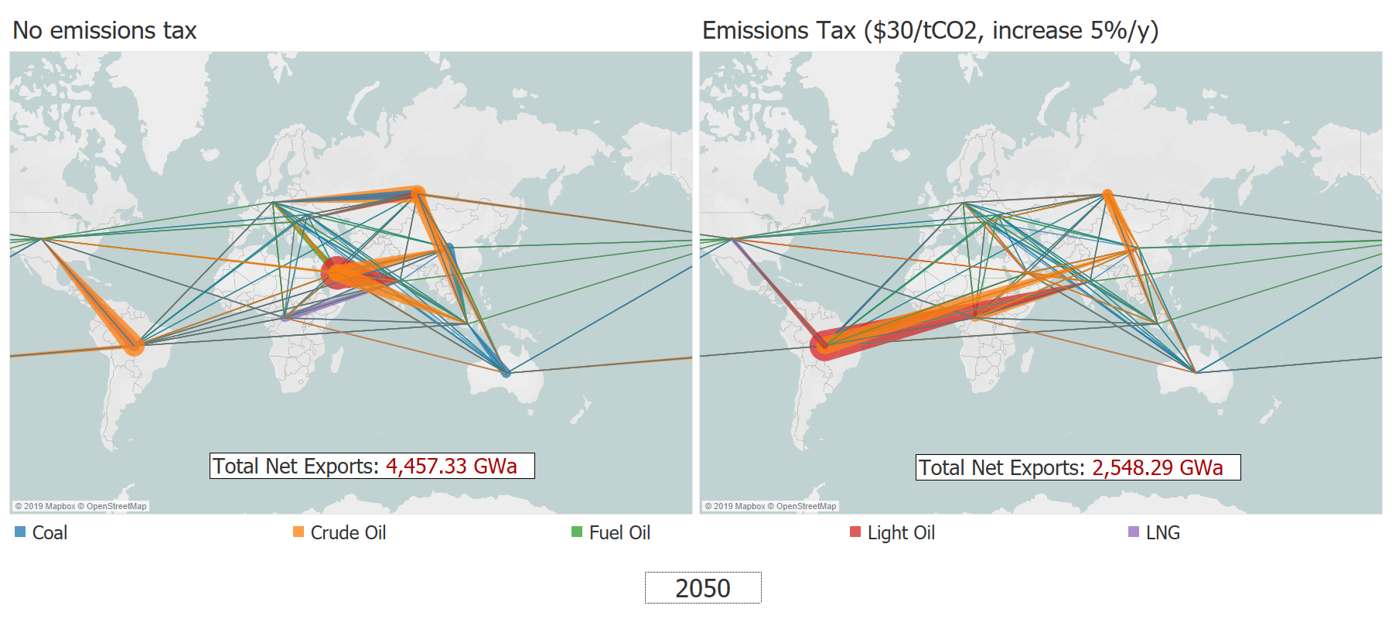
Emissions taxes alter the energy network Composition of network changes

Slide 25
Emissions taxes alter the energy network Composition of network changes
Overall reduction in fossil fuel trade

Slide 26
Emissions taxes alter the energy network Composition of network changes
Reduced trade flow from Middle East

Slide 27
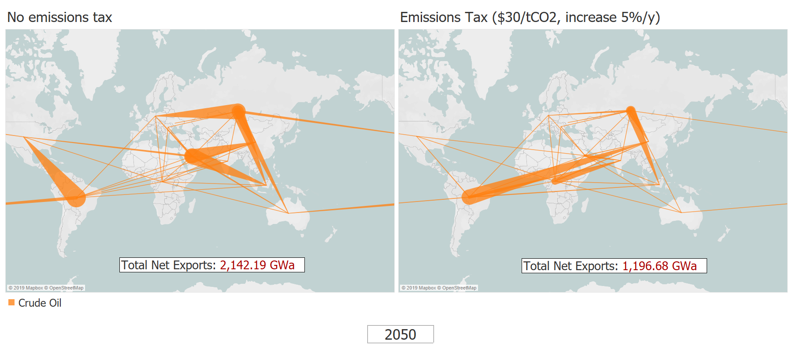
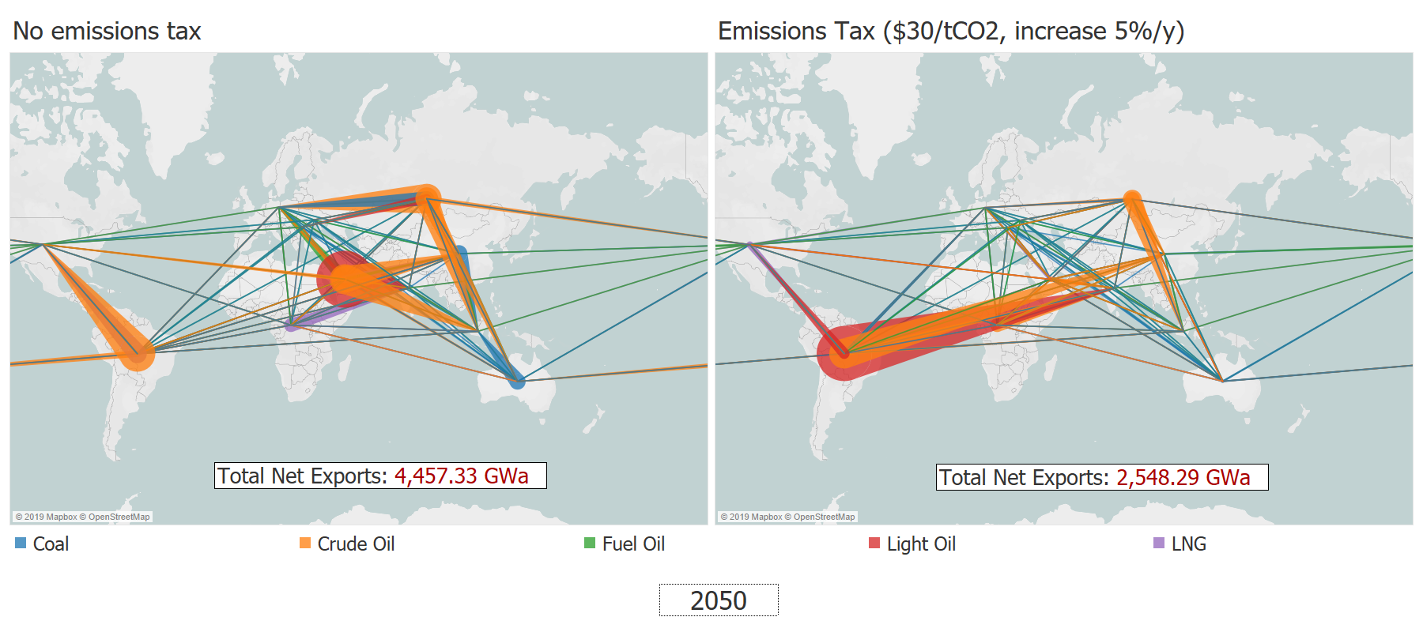
Emissions taxes alter the energy network Composition of network changes
Reduced crude oil trade network

Slide 28
Emissions taxes alter the energy network Composition of network changes
Displacement of crude oil exports from Latin America

Slide 29
Emissions taxes alter the energy network Composition of network changes
Displacement of crude oil exports from Latin America
Why?
Middle East reduces crude oil extraction
North America ramps up LNG production
China increases its fuel oil use for power/heat

Slide 30
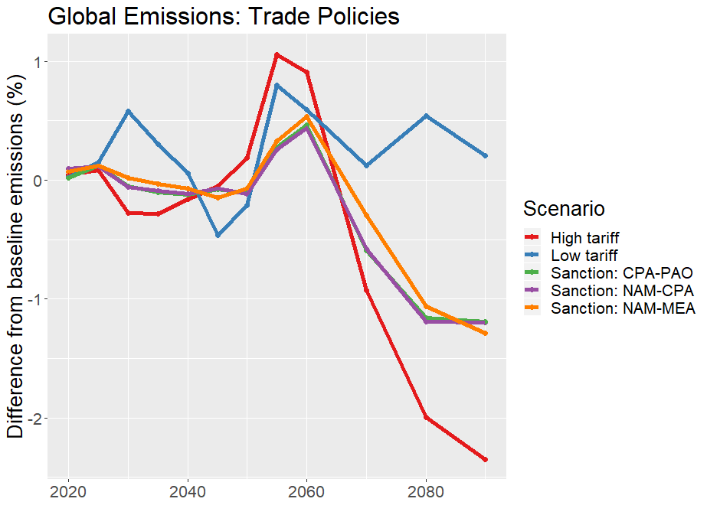
What are the implications for emissions? Trade policies have little effect on global emissions

Slide 31
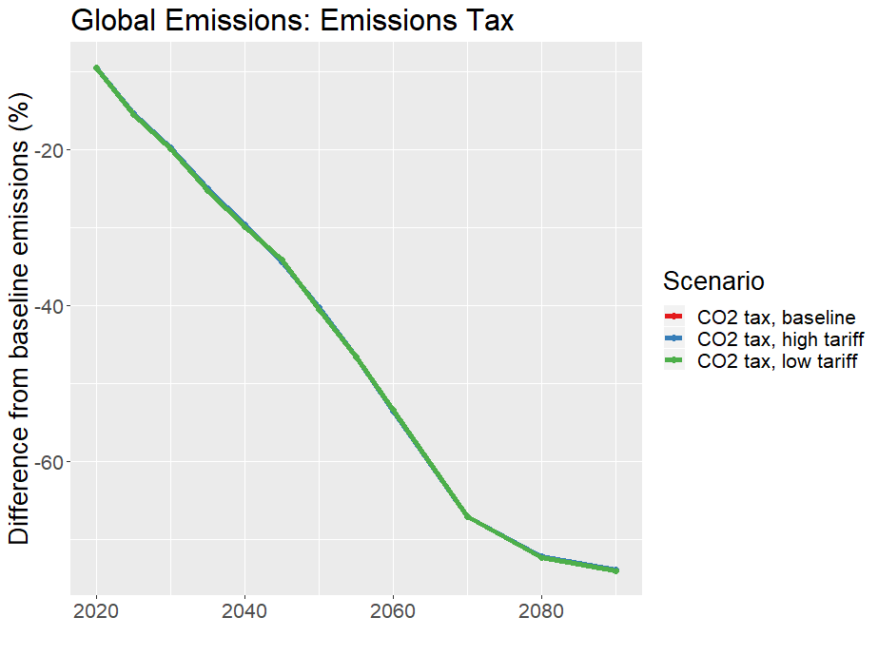
Carbon tax allows for rapid emissions reduction …and overshadows trade policy effects

Slide 32
Preliminary Conclusions
Sustained tariff policies can reduce fossil fuel trade
Short-term sanction policies change the composition of network and increase regional energy system costs
Emissions taxes dramatically alter the trajectory of energy trade networks
Trade policies independently have marginal effects on global emissions

Slide 33
Thank you! Jun Ukita Shepard Duke University, Nicholas School of the Environment Division of Earth and Ocean Sciences jun.shepard@duke.edu

Slide 34
Appendix

Slide 35
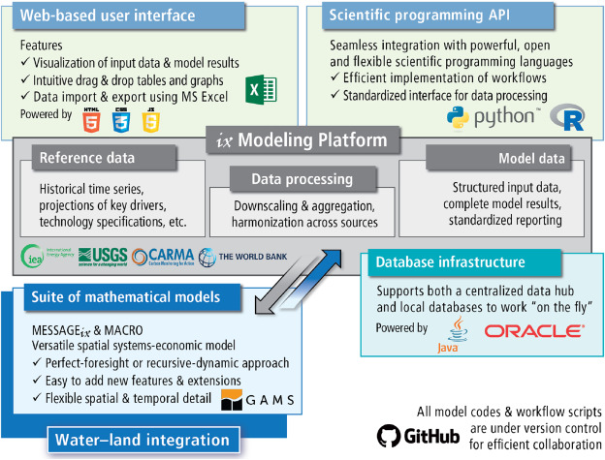
Methods What is MESSAGEix?
Image Source: Huppmann et al. (2019)

Slide 36
Tariff scenarios Definitions
Run baseline model (no tariffs)
Identify prices of energy at “shipped” level
Multiply result (2020-2110) by scenario tariff rates
Set prices as importer variable cost in MESSAGE
Baseline tariff:
Tariffs are set to historical median for primary product
High tariff:
Tariff rates increase to 200% of 2015 levels by 2030
Low tariff:
Tariff rates decrease to 0 by 2030

Slide 37
Global pool → bilateral trade in MESSAGEix Methods
“Global Pool” Schema:
PRIMARY
EXPORT
EXPORT/IMPORT
SECONDARY
crudeoil
crudeoil
crudeoil
crudeoil
crudeoil
crudeoil
AFR
Input
oil_exp
Output
GLB
GLB
Input
oil_trd
Output
GLB
GLB
Input
oil_imp
Output
WEU
node_loc
node_loc
node_loc
AFR
GLB
WEU
Legend:
Level (e.g. primary)
Node (e.g. R14_RUS)
Commodity (e.g. crude oil)
Technology (e.g. oil_exp)
Parameter (e.g. input)

Slide 38
Global pool → bilateral trade in MESSAGEix Methods
“Bilateral Trade” Schema:
PRIMARY
SHIPPED-OIL
SECONDARY
crudeoil
crudeoil_weu
crudeoil_weu
crudeoil
AFR
Input
oil_exp_weu
Output
GLB
GLB
Input
oil_imp
Output
WEU
node_loc
node_loc
AFR
WEU
Legend:
Level (e.g. primary)
Node (e.g. R14_RUS)
Commodity (e.g. crude oil)
Technology (e.g. oil_exp)
Parameter (e.g. input)

Slide 39
Shipping technologies Trade schema
SECONDARY
EXPORTS
fueloil
liquid_shipping_capacity
AFR
Input
liquid_shipping
Output
GLB
node_loc
AFR
Legend:
Level (e.g. primary)
Node (e.g. R14_RUS)
Commodity (e.g. crude oil)
Technology (e.g. oil_exp)
Parameter (e.g. input)

Slide 40
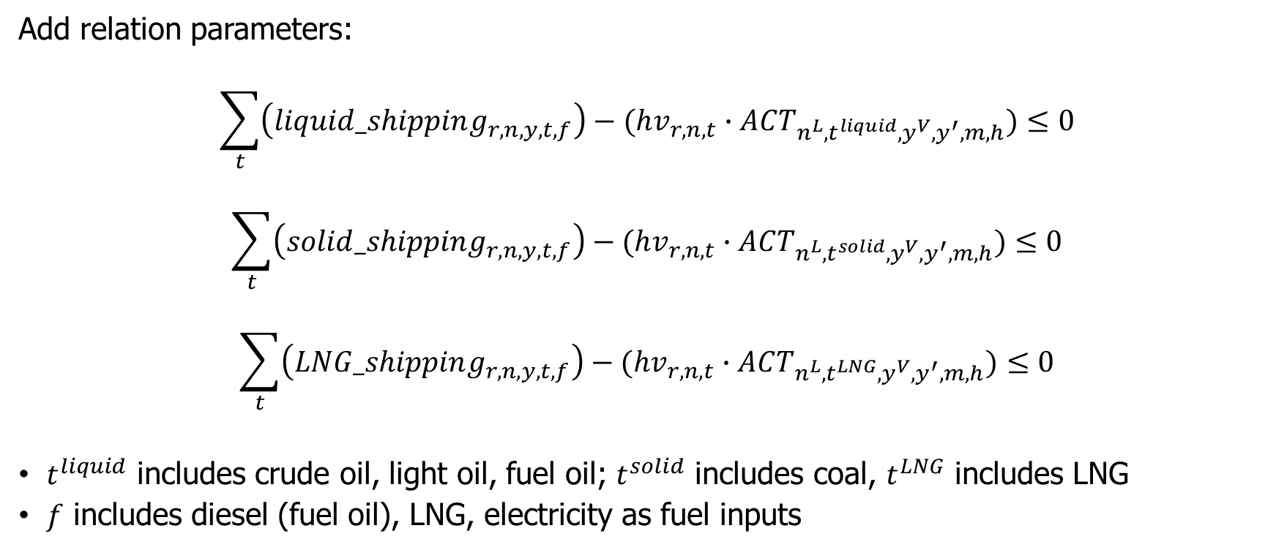
Shipping technologies Constraints to model
Add relation parameters:
$$\sum_{t}{\left(liquid_shipping_{r,n,y,t,f}\right)−(hv_{r,n,t}∙ACT_{n^{L}, t^{liquid},y^{V},y^{′},m,h})}≤0$$
$$\sum_{t}{\left(solid_shipping_{r,n,y,t,f}\right)−(hv_{r,n,t}∙ACT_{n^{L}, t^{solid},y^{V},y^{′},m,h})}≤0$$
$$\sum_{t}{\left(LNG_shipping_{r,n,y,t,f}\right)−(hv_{r,n,t}∙ACT_{n^{L}, t^{LNG},y^{V},y^{′},m,h})}≤0$$
$t^{liquid}$ includes crude oil, light oil, fuel oil; $t^{solid}$ includes coal, $t^{LNG}$ includes LNG
$f$ includes diesel (fuel oil), LNG, electricity as fuel inputs

Slide 41
Sanction scenarios Definitions
Compile data on historic alliances (Gibler, 2009)
Based on modelled trade activity, assign indicator for embodied sanction (ES)
(Assume sanctions last 5 years)
Example: North America (NAM) and Centrally Planned Asia (CPA) sanctions
If LAM trades with NAM and not CPA, assign ES with CPA
If LAM trades with both NAM + CPA, assign ES to less allied region
If LAM does not trade with either, assign ES to both
For the 2 regions in sanction, make prohibitively expensive to trade with each other
For regions in ES, increase trade cost by 20% during the sanction

Slide 42
MESSAGE output
Total system costs
Scenario name | Version | Scenario | Description | Total systems cost
baseline_global_schema | 1 | Baseline (global schema) | Global schema, no variable costs or shipping technologies | 2,516,900.68
baseline_no_tariff | 2 | Baseline, distance only | Baseline distance-differentiated variable costs | 2,505,424.12
baseline | 12 | Baseline, distance and tariff | Baseline distance and tariff-differentiated variable costs | 2,532,183.21
tariff_high | 10 | High tariff | Distance and tariff-differentiated variable costs, tariffs rates set to two times historic region median | 2,538,409.36
tariff_low | 6 | Low tariff | Distance and tariff-differentiated variable costs, tariffs rates set to 10% of historical region median | 2,523,891.50
NAM_CPA_sanction | 7 | Sanctions between North America and Centrally Planned Asia | Make trade between NAM and CPA prohibitively expensive, increase embodied cost by 30% for other regions' trade with NAM (CPA) if counterfactual has them trade with CPA (NAM) | 2,542,224.73
CPA_PAO_sanction | 5 | Sanctions between Centrally Planned Asia and Pacific-Oceania | Make trade between CPA and PAO prohibitively expensive, increase embodied cost by 30% for other regions' trade with CPA (PAO) if counterfactual has them trade with PAO (CPA) | 2,725,966.55
NAM_MEA_sanction | 4 | Sanctions between North America and Middle East | Make trade between NAM and MEA prohibitively expensive, increase embodied cost by 30% for other regions' trade with NAM (MEA) if counterfactual has them trade with CPA (MEA) | 3,129,566.27
CO2_tax_baseline | 15 | Apply CO2 price, with baseline tariffs | Add $30/tCO2 tax on emissions, allowing increase of 5% per year from 2020, cap at $100/tCO2 | 3,615,096.60
CO2_tax_tariff_high | 7 | Apply CO2 price, with high tariff scenario | Add $30/tCO2 tax on emissions, allowing increase of 5% per year from 2020, cap at $100/tCO2 | 3,641,055.45
CO2_tax_tariff_low | 4 | Apply CO2 price, with low tariff scenario | Add $30/tCO2 tax on emissions, allowing increase of 5% per year from 2020, cap at $100/tCO2 | 3,586,652.90

Slide 43
Shipping technology specification
Investment costs
Type of shipping |  | Fuel input (kg/bton-km-y) |  |  | Captial cost |  |  | Assumptions
 | Type of fuel | By weight (kg/bton-km-y) | By energy (GWa/bton-km-y) | Emissions factor (Mt/bton-km-y) | Overnight cost ($M) | Annualized, 10%DR ($M/y) | Annualized ($M/bton-km-y) | DWT (ton) | Annual distance (10^9km/y) | Number of ships | Average payload per ship (bton-km/y) | Average distance traveled (km/y)
Liquid | Diesel | 6894865.04 | 0.01 | 0.02 | 76.00 | 8.37 | 6.24 | 100000 | 5.05 | 376219 | 1.34 | 13423.03
Liquid | LNG | 3678751.33 | 0.00 | 0.01 | 96.00 | 10.58 | 7.88 | 100000 | 5.05 | 376219 | 1.34 | 13423.03
Liquid | Electricity | NA | 0.00 | 0.00 | 192000.00 | 21152.27 | 15758.19 | 100000 | 5.05 | 376219 | 1.34 | 13423.03
Solid | Diesel | 7283748.84 | 0.01 | 0.02 | 51.60 | 5.68 | 4.24 | 100000 | 5.05 | 376219 | 1.34 | 13423.03
Solid | LNG | 3052216.32 | 0.00 | 0.01 | 71.60 | 7.89 | 5.88 | 100000 | 5.05 | 376219 | 1.34 | 13423.03
Solid | Electricity | NA | 0.00 | 0.00 | 1432000.00 | 157760.68 | 117529.83 | 100000 | 5.05 | 376219 | 1.34 | 13423.03
LNG | Diesel | 16810656.90 | 0.02 | 0.05 | 180.00 | 19.83 | 14.77 | 100000 | 5.05 | 376219 | 1.34 | 13423.03
LNG | LNG | 5594115.78 | 0.01 | 0.01 | 200.00 | 22.03 | 16.41 | 100000 | 5.05 | 376219 | 1.34 | 13423.03
LNG | Electricity | NA | 0.00 | 0.00 | 4000000.00 | 440672.29 | 328295.62 | 100000 | 5.05 | 376219 | 1.34 | 13423.03

Slide 44
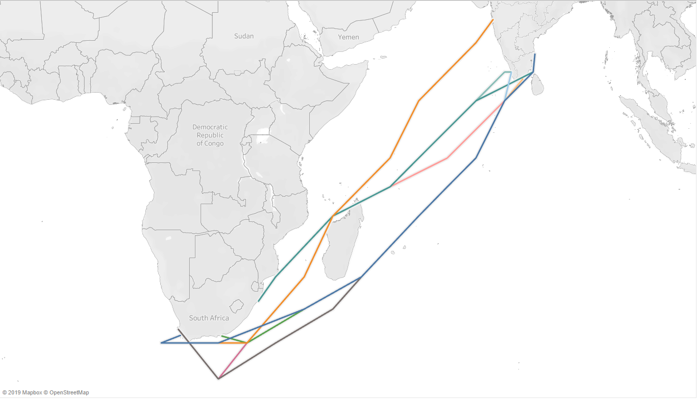
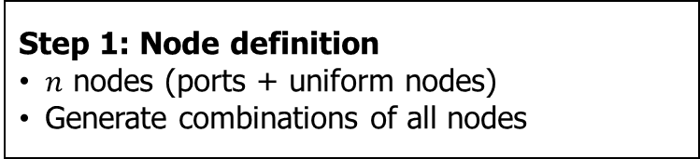
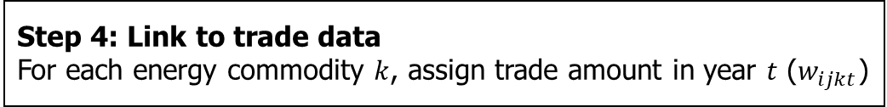
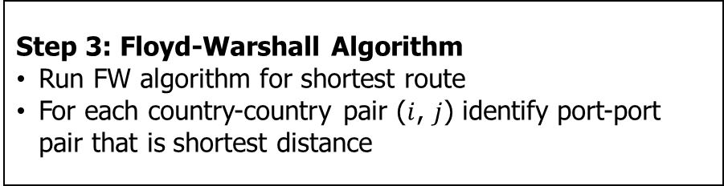
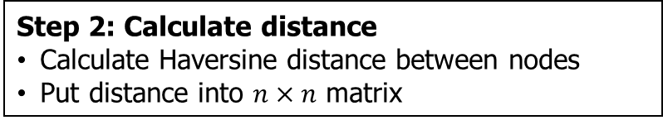
Estimating shipping distance Methods
Step 1: Node definition
$n$ nodes (ports + uniform nodes)
Generate combinations of all nodes
Step 2: Calculate distance
Calculate Haversine distance between nodes
Put distance into $n×n$ matrix
Step 3: Floyd-Warshall Algorithm
Run FW algorithm for shortest route
For each country-country pair ($i$, $j$) identify port-port pair that is shortest distance
Shortest paths between South Africa and India
Step 4: Link to trade data
For each energy commodity $k$, assign trade amount in year $t$ ($w_{ijkt}$)

Slide 45
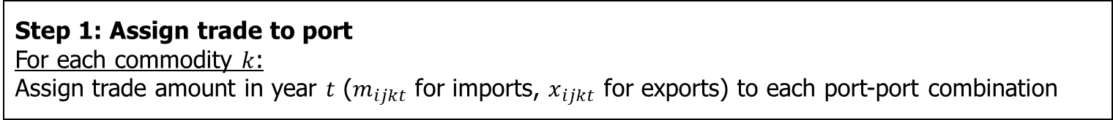
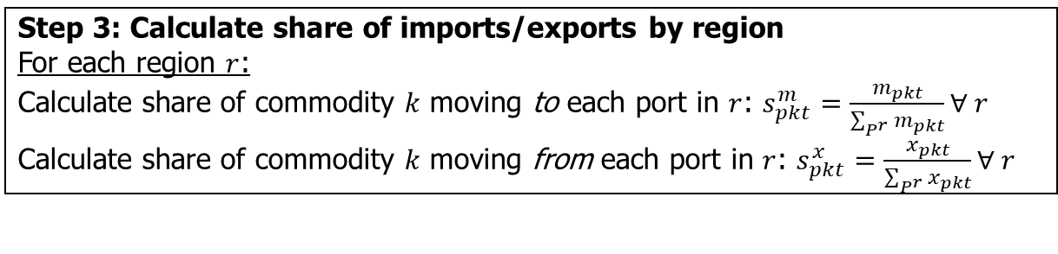
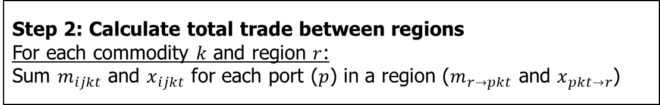
Aggregating distance to regional level Methods
Step 1: Assign trade to port
For each commodity $k$:
Assign trade amount in year $t$ ($m_{ijkt}$ for imports, $x_{ijkt}$ for exports) to each port-port combination
Step 2: Calculate total trade between regions
For each commodity $k$ and region $r$:
Sum $m_{ijkt}$ and $x_{ijkt}$ for each port ($p$) in a region ($m_{r→pkt}$ and $x_{pkt→r}$)
Step 3: Calculate share of imports/exports by region
For each region $r$:
Calculate share of commodity $k$ moving to each port in $r$: $s_{pkt}^{m}=\frac{m_{pkt}}{\sum_{P^{r}}{m_{pkt}}}∀ r$
Calculate share of commodity $k$ moving from each port in $r$: $s_{pkt}^{x}=\frac{x_{pkt}}{\sum_{P^{r}}{x_{pkt}}}∀ r$
Step 4: Identify primary ports by region
For each region $r$:
The port with the largest $s_{pkt}^{m}$ and $s_{pkt}^{x}$ are the primary import/export port for region $r$ in year $t$ for commodity $k$
Notes:
In the first stage, we assigned a port-port combination to each country-country combination
We link this to trade data, so now for each commodity, we have the port-port combination associated with bilateral trade
We aggregate trade up to the region level (like WEU), which is a user specified aggregation

Slide 46
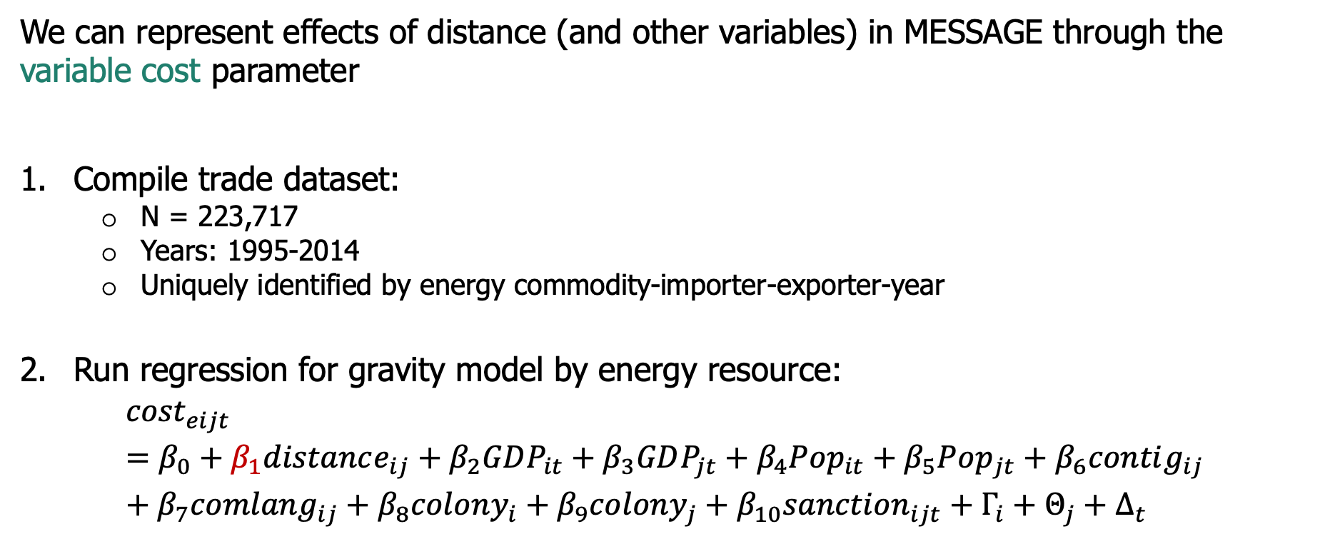
Translating variables to premiums Methods
We can represent effects of distance (and other variables) in MESSAGE through the variable cost parameter
Compile trade dataset:
N = 223,717
Years: 1995-2014
Uniquely identified by energy commodity-importer-exporter-year
Run regression for gravity model by energy resource:
$${cost}_{eijt}=β_{0}+β_{1}distance_{ij}+β_{2}GDP_{it}+β_{3}GDP_{jt}+β_{4}Pop_{it}+β_{5}Pop_{jt}+β_{6}contig_{ij}+β_{7}comlang_{ij}+β_{8}colony_{i}+β_{9}colony_{j}+β_{10}sanction_{ijt}+Γ_{i}+Θ_{j}+Δ_{t}$$
Note: $i$ is exporting country, $j$ is importing country, $t$ is year
Notes:
For translating the effect of variables, we do not worry about regional aggregation (yet)

Slide 47
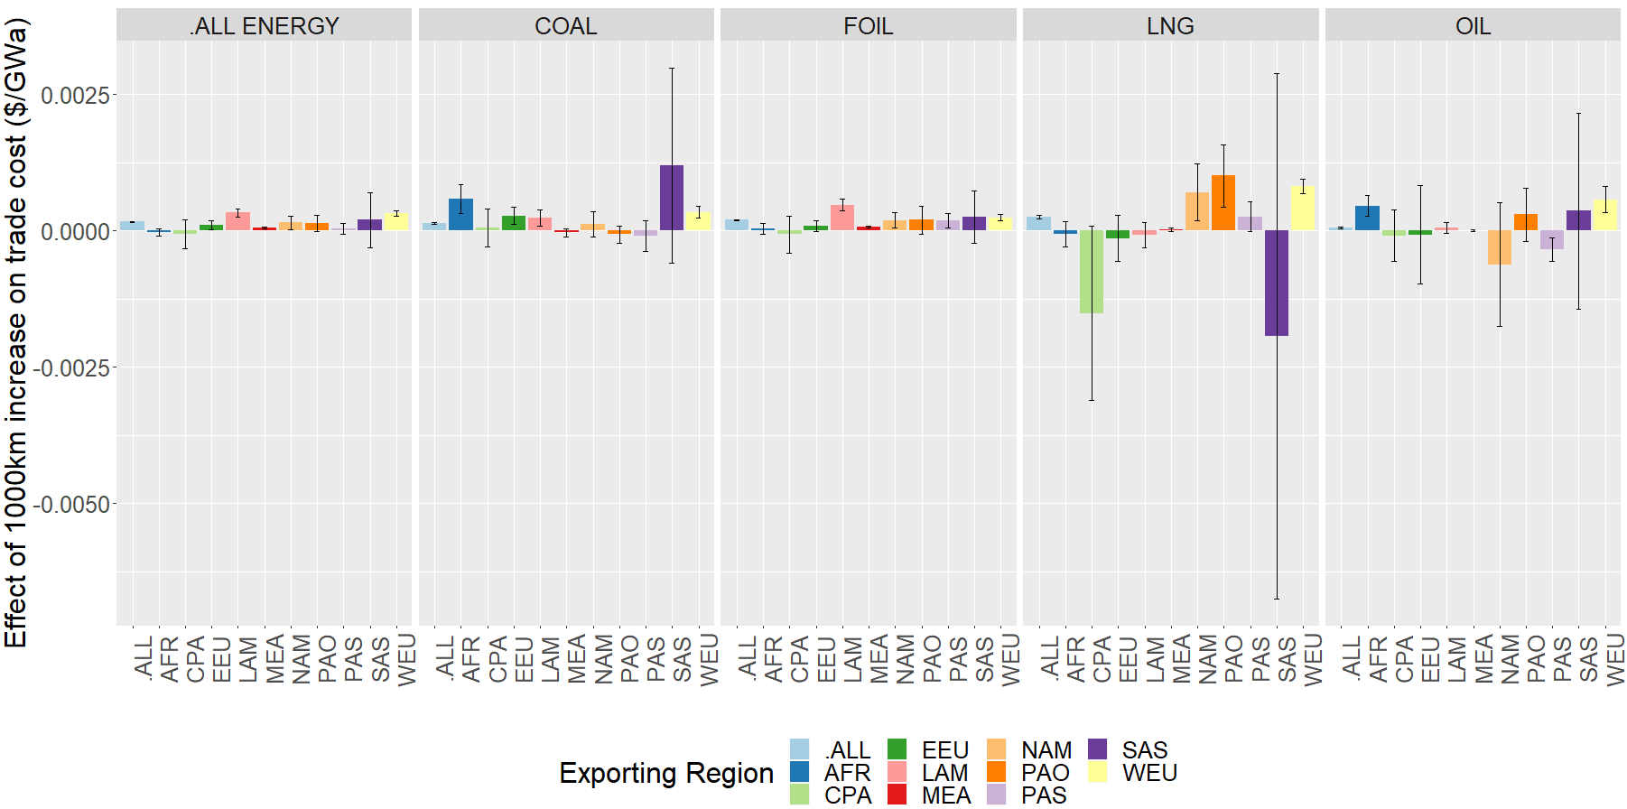
Parameterizing trade through variable costs Results
Effect of distance on trade cost, error bars represent 95% confidence

Slide 48
Parameterizing trade through variable costs Results
Takeaways:
Distance has a significant effect overall
Distance matters for some fuels (e.g. LNG) more than others (e.g. coal)
There is too much uncertainty in heterogeneity by region
Probably best to use a distance effect that is:
Constant across regions
Varies by energy type
Effect of distance on trade cost, error bars represent 95% confidence

Slide 49
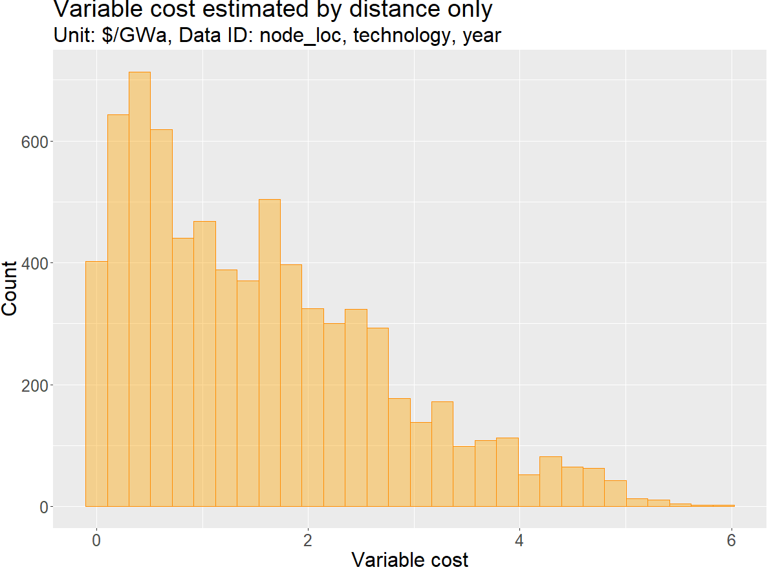

Parameterizing trade through variable costs Regression results
$varcost_{r_{1}r_{2}kt}=β_{1}×distance_{r_{1}r_{2}kt}$
…so variable cost still varies by region,
commodity, and year

Slide 50
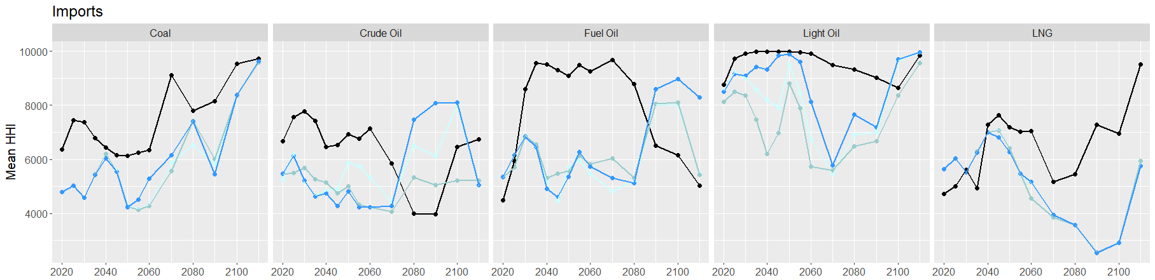
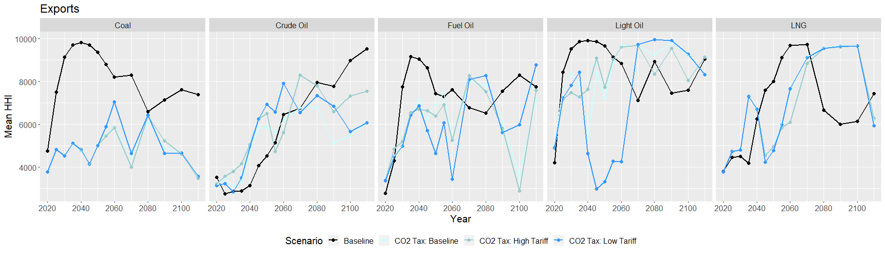
Energy security Effect of an emissions tax

Slide 51
Global pool → bilateral trade in MESSAGEix Technologies of interest
gas_exp_afr
coal_exp_afr
lh2_exp_afr
Natural gas
(piped)
…
Coal
…
Liquid H2
…
gas_exp_weu
coal_exp_weu
lh2_exp_weu
lng_exp_afr
loil_exp_afr
meth_exp_afr
LNG
…
Light oil
(petroleum)
…
Methanol
…
lng_exp_weu
loil_exp_weu
meth_exp_weu
foil_exp_afr
oil_exp_afr
eth_exp_afr
Fuel oil
(petroleum)
…
Crude oil
…
Ethanol
…
foil_exp_weu
oil_exp_weu
eth_exp_weu
22 parameters converted from global pool → bilateral trade schema
5 trade technologies (e.g. crude oil) → 70 region-specific technologies

Slide 52
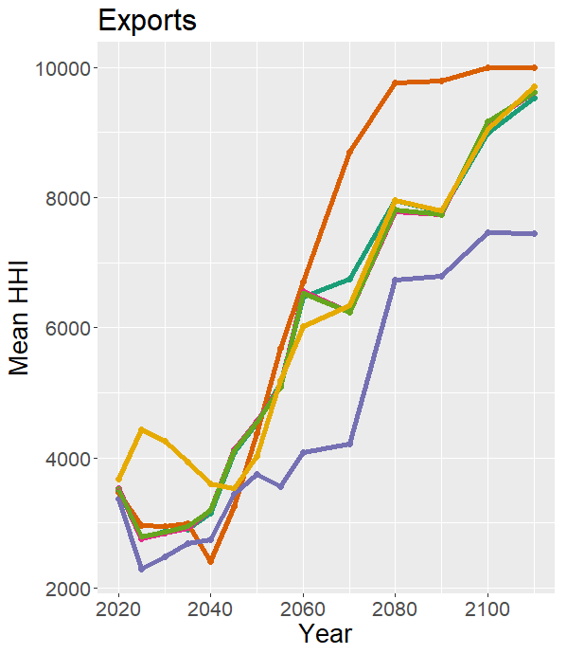
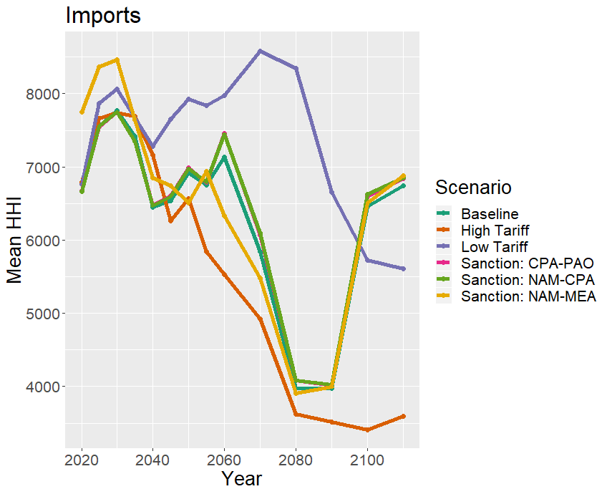
Implications for energy security The case of crude oil trade diversity

Slide 53
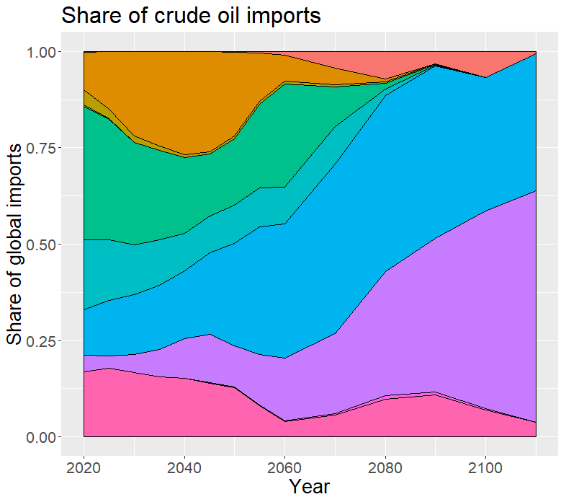
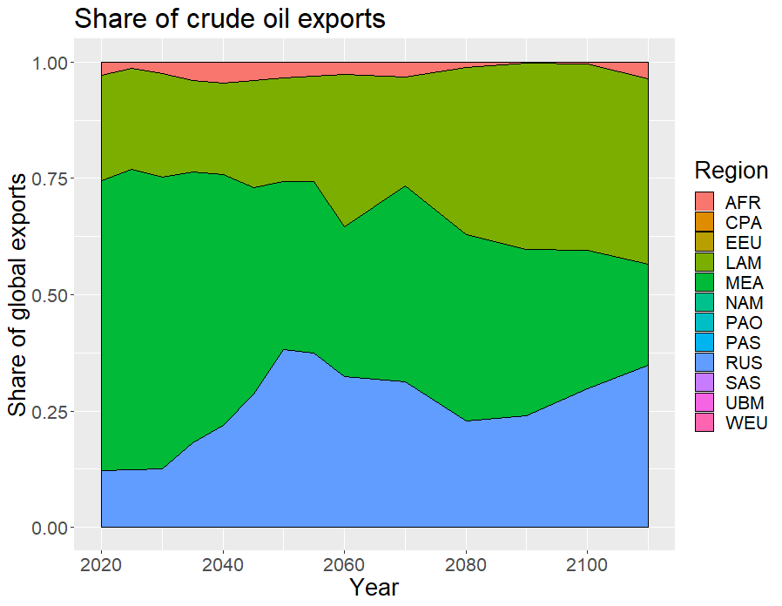
Implications for energy security The case of crude oil trade diversity

Slide 54
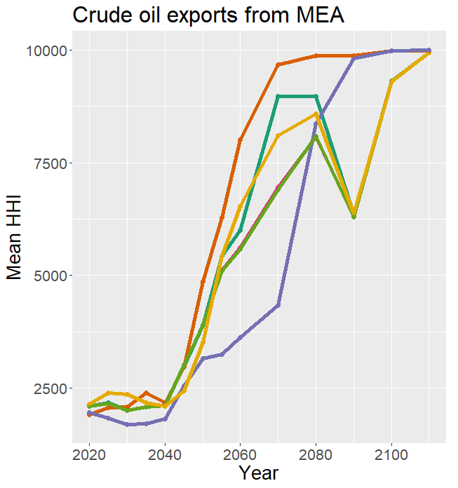
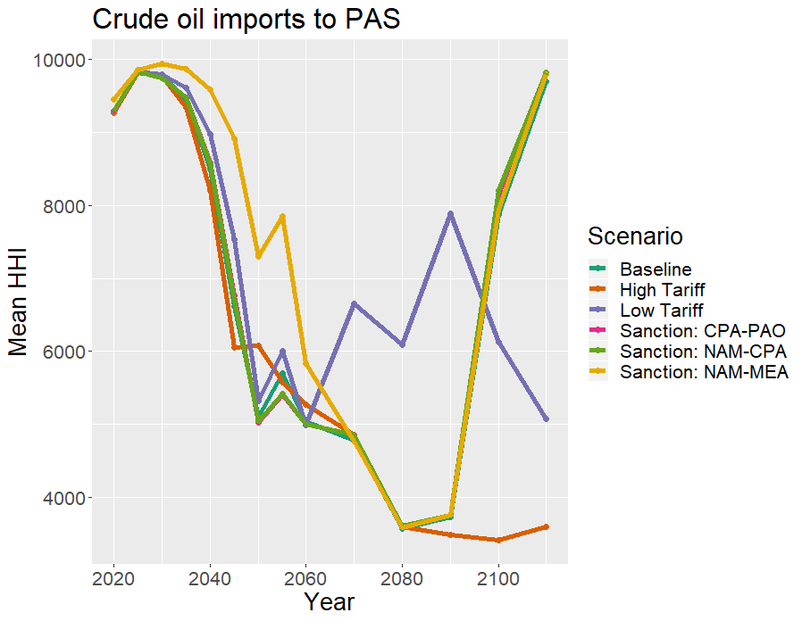
Implications for energy security The case of crude oil trade diversity

Slide 55
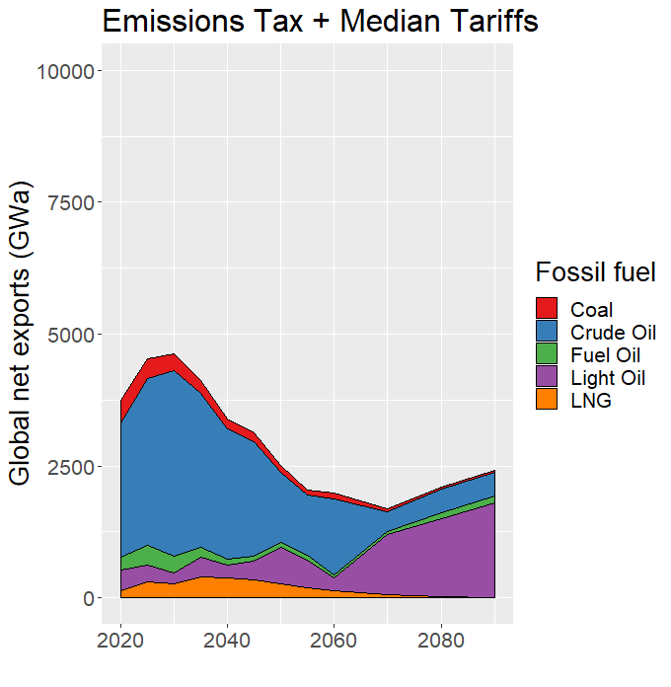
Tariff policies under an emissions tax Tax effect overshadows trade policy effects
Notes:
Under CO2 tax, crude oil networks phase out
The total volume of trade also drops to nearly 50% by 2050 across all CO2 tax scenarios
Of course, low tariff will have more trade than high tariff/baseline
Cost across scenarios is about 5 times that of baseline

Slide 56
Tariff policies under an emissions tax Tax effect overshadows trade policy effects
2050
Fossil fuel trade reduced 50%
Notes:
Under CO2 tax, crude oil networks phase out
The total volume of trade also drops to nearly 50% by 2050 across all CO2 tax scenarios
Of course, low tariff will have more trade than high tariff/baseline
Cost across scenarios is about 5 times that of baseline

Slide 57
Tariff policies under an emissions tax Tax effect overshadows trade policy effects
Differences between tariff policies are minimal when there is also an emissions tax
Notes:
Under CO2 tax, crude oil networks phase out
The total volume of trade also drops to nearly 50% by 2050 across all CO2 tax scenarios
Of course, low tariff will have more trade than high tariff/baseline
Cost across scenarios is about 5 times that of baseline

