Slide 1
Representation of trade and transportation networks in global energy models Updates: 2019-06-18
Jun Ukita Shepard
IIASA-YSSP 2019

Slide 2
Updates
Data validation
Update heating values to IEA-published values
Validation looks OK
Mapping shortest paths
Made flexible shortest path algorithm
Link shortest path to trade values for regional aggregation (flexible)
MESSAGE review

Slide 3
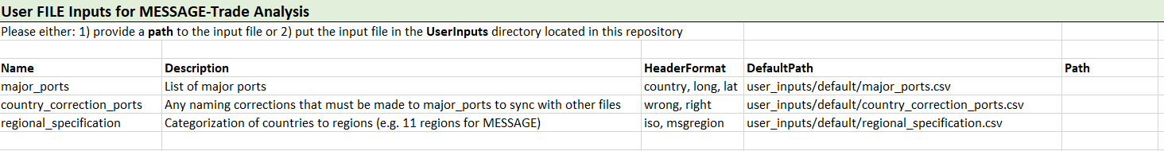
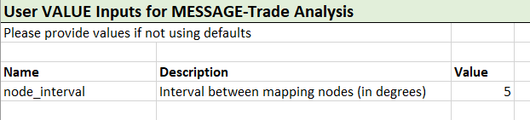
User inputs to shortest path
From: message_trade/user_inputs/User_Inputs.xlsx

Slide 4
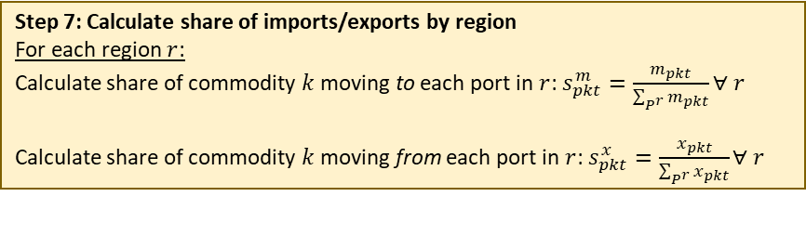
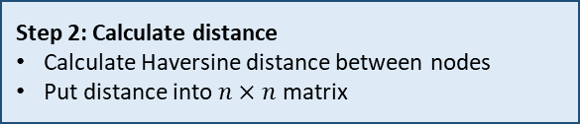
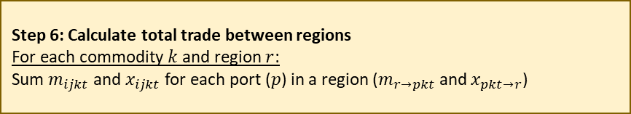
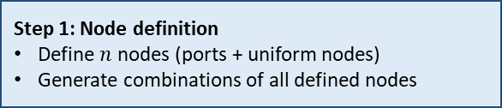
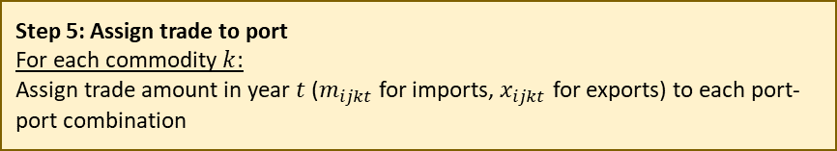
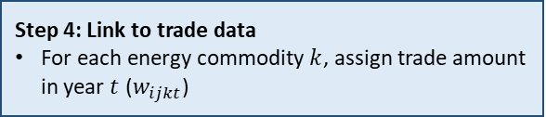
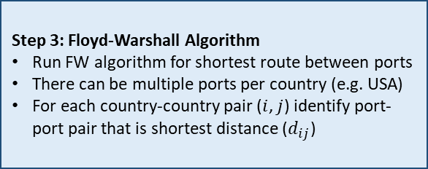
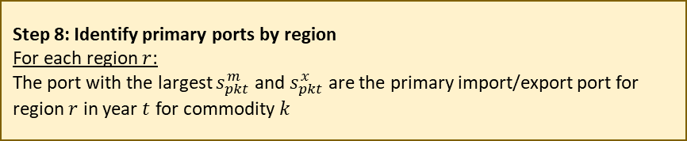
Shortest path algorithm (detailed)
Step 1: Node definition
Define $n$ nodes (ports + uniform nodes)
Generate combinations of all defined nodes
Step 5: Assign trade to port
For each commodity $k$:
Assign trade amount in year $t$ ($m_{ijkt}$ for imports, $x_{ijkt}$ for exports) to each port-port combination
Step 2: Calculate distance
Calculate Haversine distance between nodes
Put distance into $n×n$ matrix
Step 6: Calculate total trade between regions
For each commodity $k$ and region $r$:
Sum $m_{ijkt}$ and $x_{ijkt}$ for each port ($p$) in a region ($m_{r→pkt}$ and $x_{pkt→r}$)
User inputs:
Seaports of interest (csv file)
Level of node granularity (value)
Regional specification (csv file)
Step 3: Floyd-Warshall Algorithm
Run FW algorithm for shortest route between ports
There can be multiple ports per country (e.g. USA)
For each country-country pair ($i$, $j$) identify port-port pair that is shortest distance ($d_{ij}$)
Step 7: Calculate share of imports/exports by region
For each region $r$:
Calculate share of commodity $k$ moving to each port in $r$: $s_{pkt}^{m}=\frac{m_{pkt}}{\sum_{P^{r}}{m_{pkt}}}∀ r$
Calculate share of commodity $k$ moving from each port in $r$: $s_{pkt}^{x}=\frac{x_{pkt}}{\sum_{P^{r}}{x_{pkt}}}∀ r$
Step 8: Identify primary ports by region
For each region $r$:
The port with the largest $s_{pkt}^{m}$ and $s_{pkt}^{x}$ are the primary import/export port for region $r$ in year $t$ for commodity $k$
Step 4: Link to trade data
For each energy commodity $k$, assign trade amount in year $t$ ($w_{ijkt}$)

Slide 5
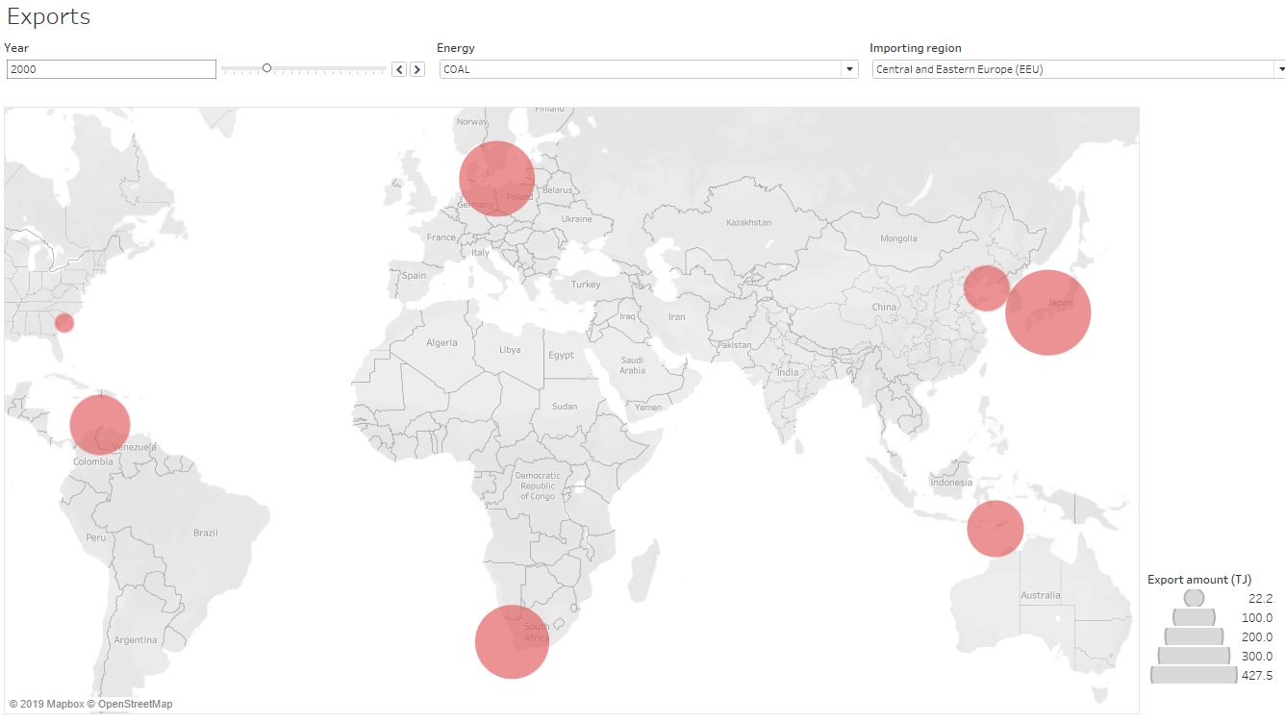
Exporting ports, by region

Slide 6
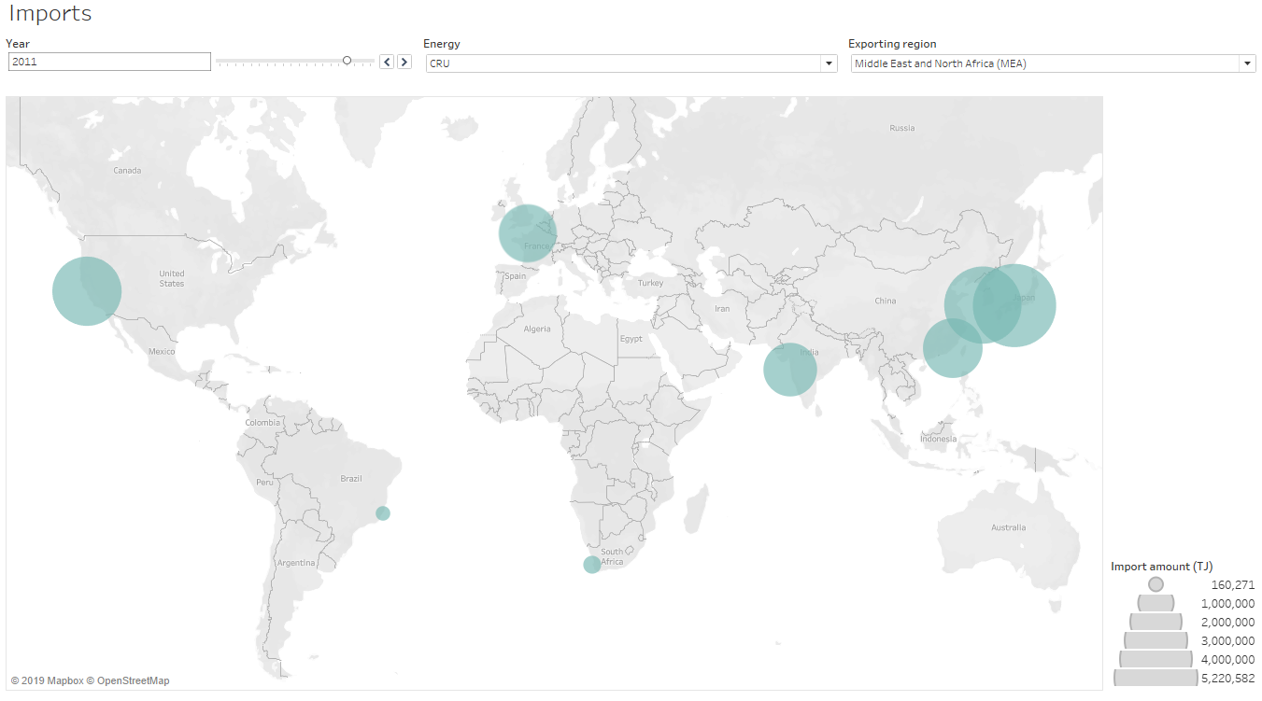
Importing ports, by region

Slide 7
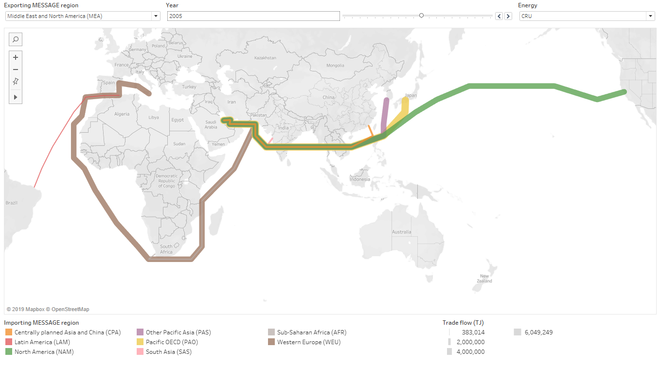
Region-region paths

