Slide 1
Representation of trade and transportation networks in global energy models Updates: 2019-06-27
Jun Ukita Shepard
IIASA-YSSP 2019

Slide 2
Updates
Run regression analysis on distance impacts to country-level trade
Main result: effect of distance is “significant”, but not large
So: We don’t have to be too sophisticated with regional aggregation
Compiled matrices of trade disputes, armed conflicts
Years: 1995-2015
Sources: World Trade Organization, Uppsala University
Built parameters for bilateral trade to substitute into MESSAGE
Ran regression to get the variable cost parameter in MESSAGE

Slide 3
Representing trade in MESSAGE Generalized schema
Level 1
Level 2
Commodity
Commodity
Node 1
Input
Output
Node 2
Technology
Legend:
Level (e.g. primary)
Node (e.g. R14_RUS)
Commodity (e.g. crude oil)
Technology (e.g. oil_exp)
Parameter (e.g. input)

Slide 4
Representing trade in MESSAGE “Global Pool” schema
PRIMARY
GP1
GP2
GP3
EXPORT
EXPORT/IMPORT
SECONDARY
crudeoil
crudeoil
crudeoil
crudeoil
crudeoil
crudeoil
AFR
Input
oil_exp
Output
GLB
GLB
Input
oil_trd
Output
GLB
GLB
Input
oil_imp
Output
NAM
node_loc
node_loc
node_loc
AFR
GLB
NAM
Legend:
Level (e.g. primary)
Node (e.g. R14_RUS)
Commodity (e.g. crude oil)
Technology (e.g. oil_exp)
Parameter (e.g. input)

Slide 5
Representing trade in MESSAGE “Bilateral” schema
PRIMARY
B1
PIPED-GAS
B2
SECONDARY
gas
gas_weu
gas_weu
gas
AFR
Input
gas_exp_weu
Output
GLB
GLB
Input
gas_imp
Output
WEU
node_loc
node_loc
AFR
WEU
Legend:
Level (e.g. primary)
Node (e.g. R14_RUS)
Commodity (e.g. crude oil)
Technology (e.g. oil_exp)
Parameter (e.g. input)

Slide 6
Technologies for bilateral trade
gas_exp_afr
Natural gas
(piped)
…
gas_exp_weu
oil_exp_afr
coal_exp_afr
lh2_exp_afr
Crude oil
…
Coal
…
Liquid H2
…
oil_exp_weu
coal_exp_weu
lh2_exp_weu
lng_exp_afr
loil_exp_afr
meth_exp_afr
LNG
…
Light oil
(petroleum)
…
Methanol
…
lng_exp_weu
loil_exp_weu
meth_exp_weu
foil_exp_afr
eth_exp_afr
Fuel oil
(petroleum)
…
Ethanol
…
foil_exp_weu
eth_exp_weu

Slide 7
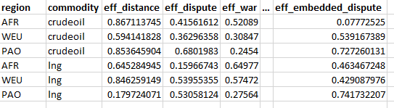
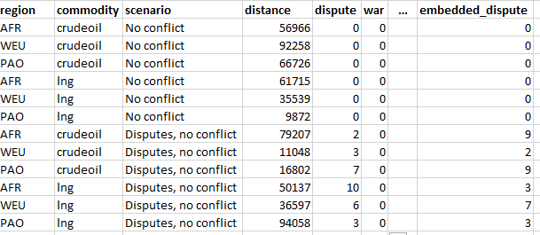
Workflow for trade in MESSAGE
Regression analysis:
Determine coefficient of cost components (e.g. distance) on energy cost ($/GWa)
Might look like
Identify trade scenarios:
Example: many trade disputes, high regional conflict
Might look like
Build parameters:
Note: Importer var_cost based on trade scenario and coefficients
Parameterize bilateral trade by sea routes:
Based on bilateral schema for piped gas
Run MESSAGE for each scenario
Compare to gravity model

Slide 8
Disaggregating parameters Setup
Constant value:
capacity_factor
growth_activity_lo, growth_activity_up
initial_activity_lo, initial_activity_up
input, output
level_cost_activity_soft_lo, level_cost_activity_up
soft_activity_lo, soft_activity_up
technical_lifetime
Requires scaling based on trade data:
historical_activity
bound_activity_lo, bound_activity_up
Allow user to import csv with time-invariant values
fix_cost, inv_cost
Requires regression analysis:
var_cost
Not sure:
emission_factor
historical_new_capacity
ref_activity
ref_new_capacity
relation_activity

Slide 9
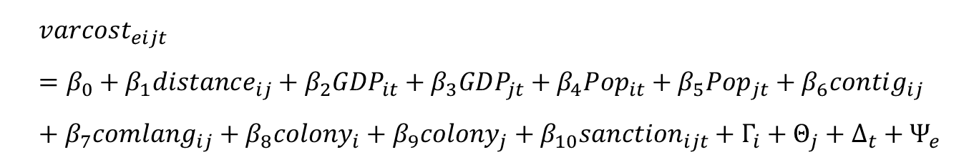
Regression analysis Setup: A simple gravity model
$$varcost_{eijt}=β_{0}+β_{1}distance_{ij}+β_{2}GDP_{it}+β_{3}GDP_{jt}+β_{4}Pop_{it}+β_{5}Pop_{jt}+β_{6}contig_{ij}+β_{7}comlang_{ij}+β_{8}colony_{i}+β_{9}colony_{j}+β_{10}sanction_{ijt}+Γ_{i}+Θ_{j}+Δ_{t}+Ψ_{e}$$

Slide 10
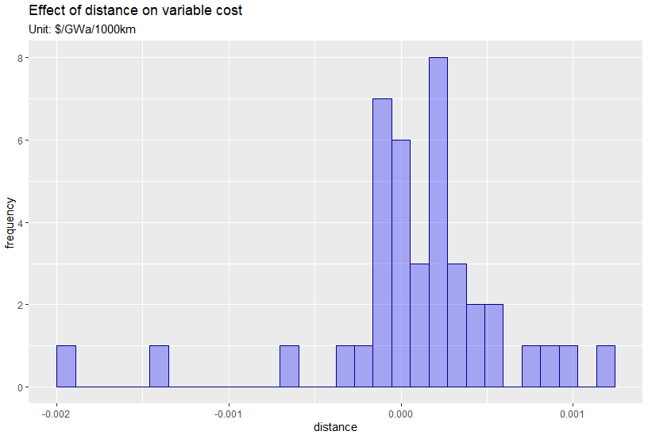
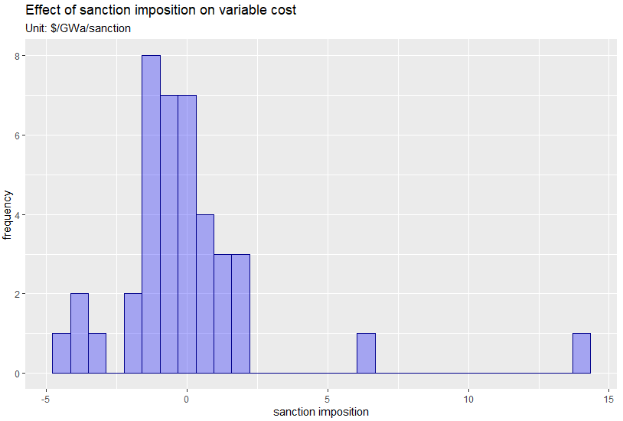
Regression analysis Preliminary Results

Slide 11
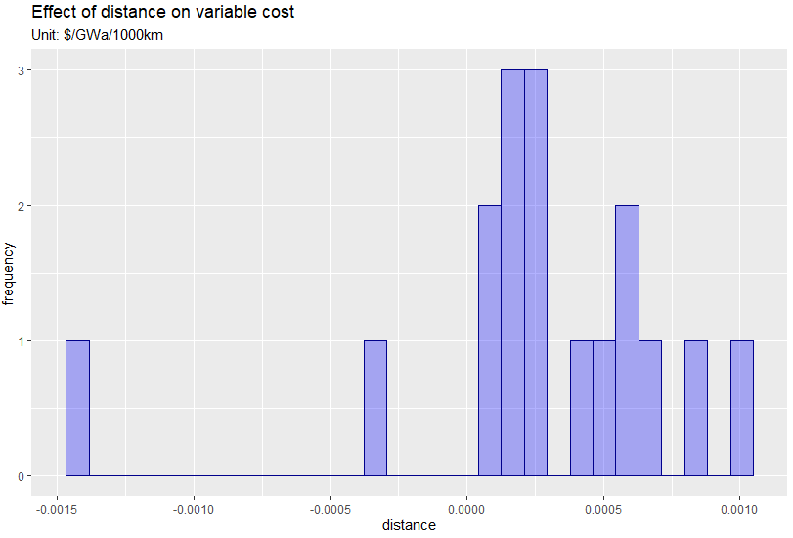
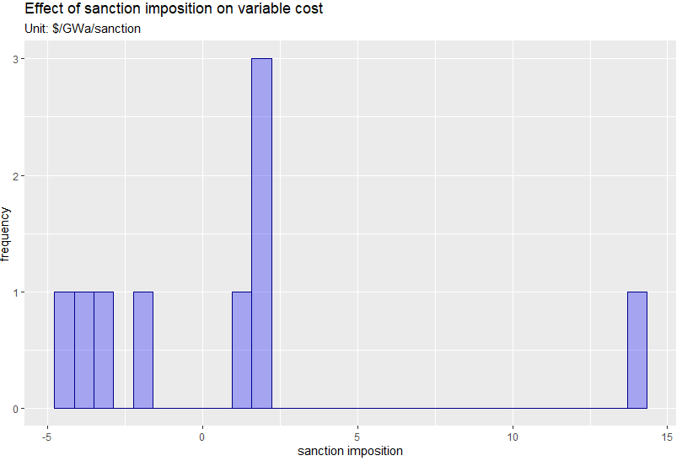
Regression analysis Preliminary Results (p < 0.1)

Slide 12
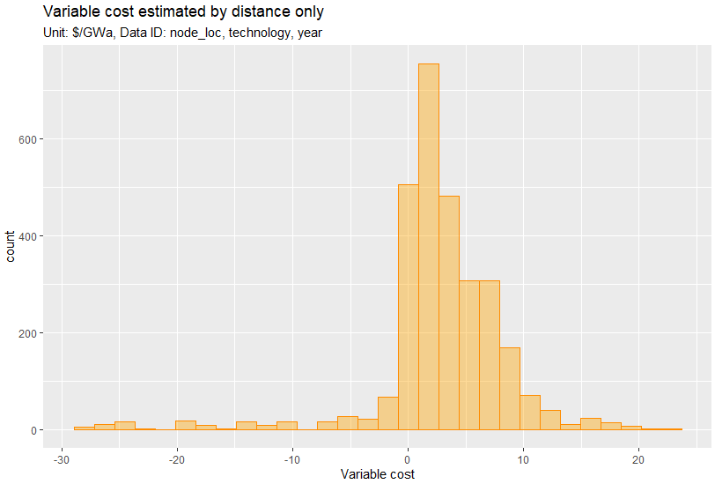
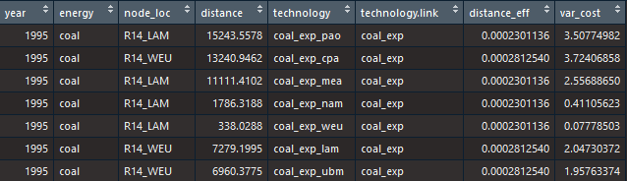
Regression analysis Building parameters for variable cost

