Slide 1
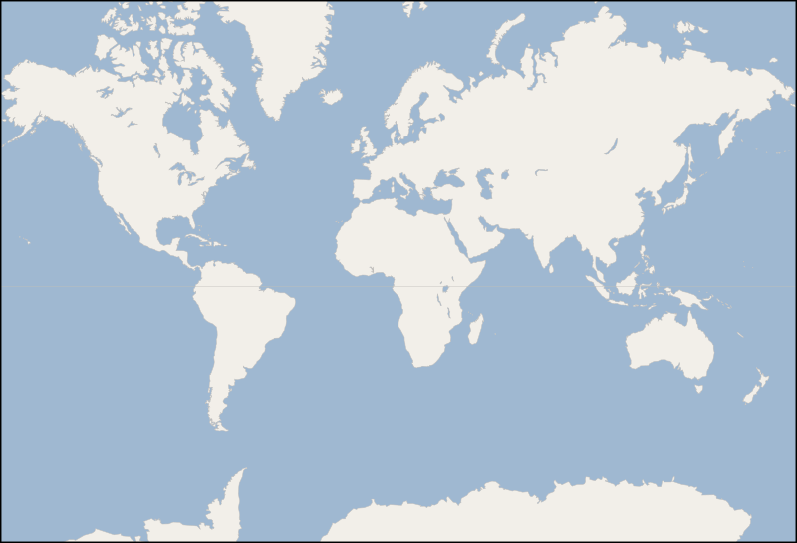
(b) Energy flow in Global Pool Schema
Global energy pool (e.g. crude oil)
Primary
Export
Export/Import
Secondary
crudeoil
crudeoil
crudeoil
crudeoil
crudeoil
crudeoil
AFR
oil_exp
GLB
GLB
oil_trd
GLB
GLB
oil_imp
WEU
Imports
Inputs
Outputs
Inputs
Outputs
Inputs
Outputs
node_loc
AFR
node_loc
GLB
node_loc
WEU
Exports
(d) Energy flow in Bilateral Trade Schema
(a) Global Pool Schema
Secondary
Primary
Shipped-Oil
crudeoil
crudeoil
crudeoil
crudeoil
AFR
oil_exp_weu
GLB
GLB
oil_imp
WEU
Trade Flow
Inputs
Outputs
Inputs
Outputs
node_loc
node_loc
GLB
AFR
█ Level (e.g. primary)
█ Node (e.g. R14_RUS)
█ Commodity (e.g. crude oil)
█ Technology (e.g. oil_exp)
█ Parameter (e.g. input)
(c) Bilateral Trade Schema
Legend:

