Slide 1

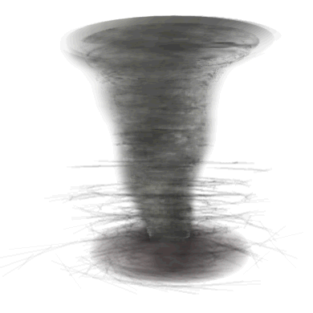
<number>/18
Researched and compiled by
C. Ursal Jr., 2014 July 13

Slide 2
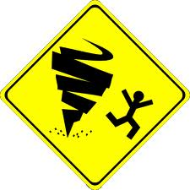
Table of Contents (TOC):
Page
Cover 1
Etymology 3
Definition 4
How a tornado forms 5
Tornado formation 6
Tornado formation continuation 7
Tornado formation animation 8
Tornado Global distribution 9
U.S. annual tornado reports 10
U.S. tornado alley 11
Tornado categories 12
Fujita and Enhanced Fujita scale 13
Tornado animation 14
Types of tornado 15
Interesting facts about tornadoes 16
Tornado in Minglanilla, Cebu 17
End 18
NOTE:
In the Table of Contents, click on the page number to go direct to the page.
Or, click on the TOC (lower left, beside the page number) to go back to the Table of Contents.
<number>/18

Slide 3
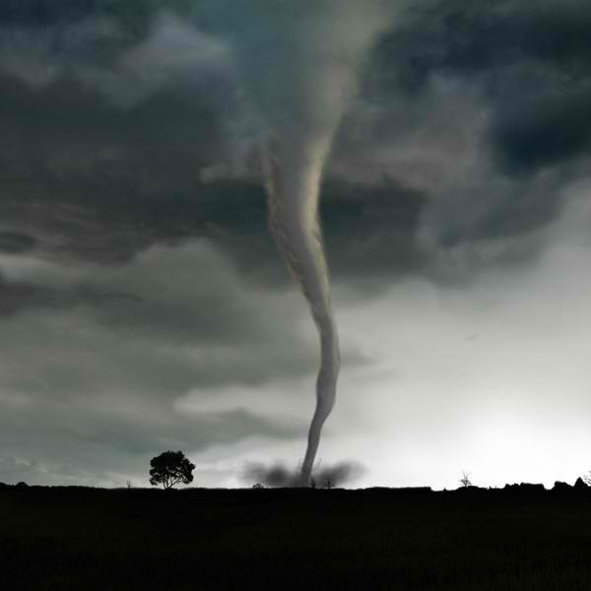
Etymology
The word tornado is an altered form of the Spanish word tronada, which means "thunderstorm". This in turn was taken from the Latin tonare, meaning "to thunder". It most likely reached its present form through a combination of the Spanish tronada and tornar ("to turn"); however, this may be a folk etymology.
<number>/18

Slide 4
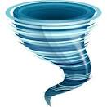
Tornado* is a mobile, destructive vortex of violently rotating winds having the appearance of a funnel-shaped cloud (often but not always visible) and advancing beneath a large storm system.
They are often referred to as twisters or cyclones
Tornadoes are one of the most violent and powerful types of weather. They can be very dangerous as their high speed winds can break apart buildings, knock down trees, and even toss cars into the air.
* In Bisaya:
Buhawi = tornado
Alimpulos = whirlwind
<number>/18

Slide 5
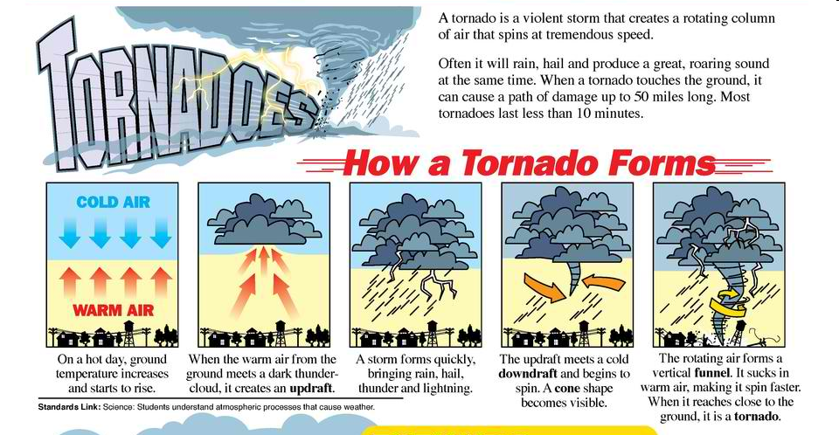
<number>/18

Slide 6
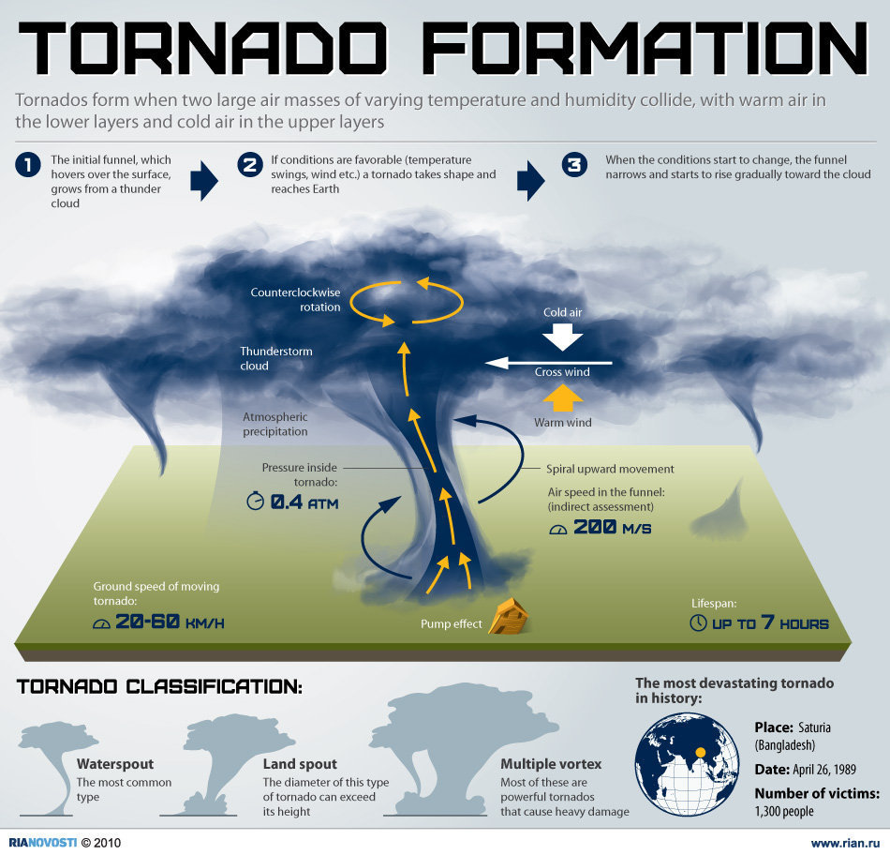
<number>/18

Slide 7
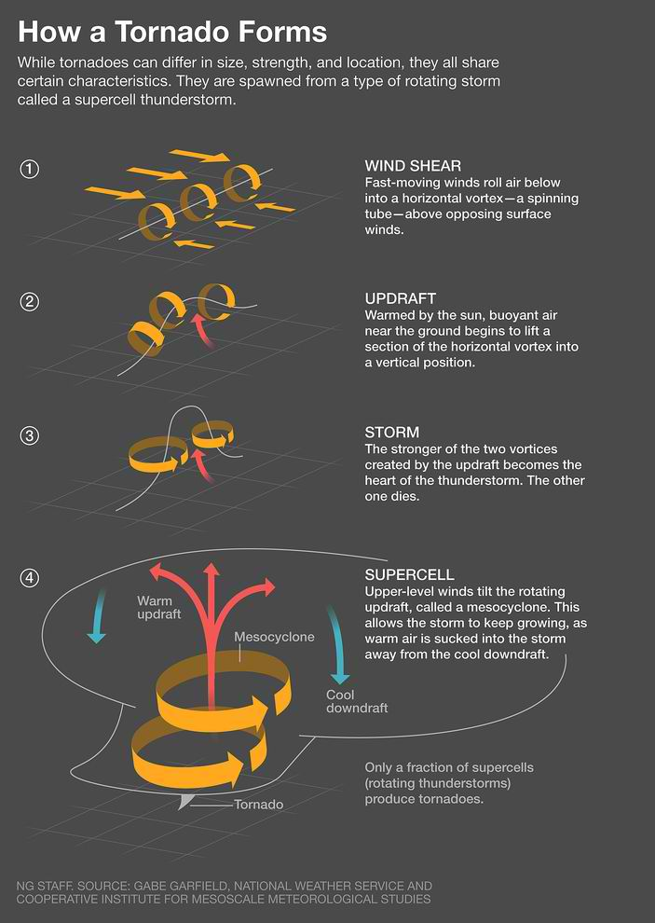
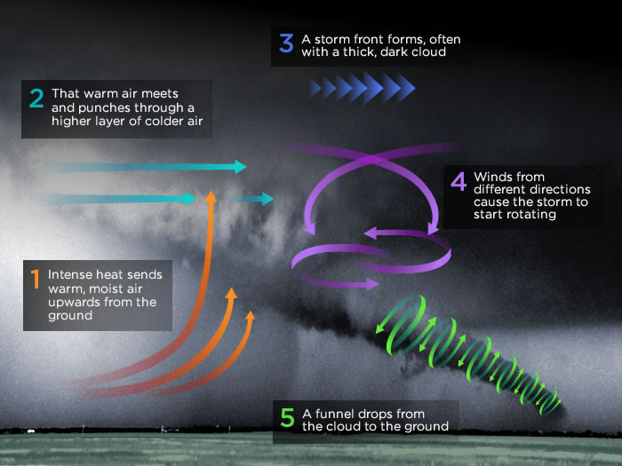
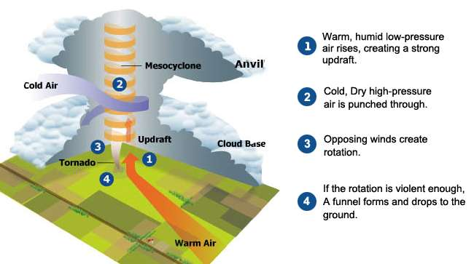
<number>/18

Slide 8
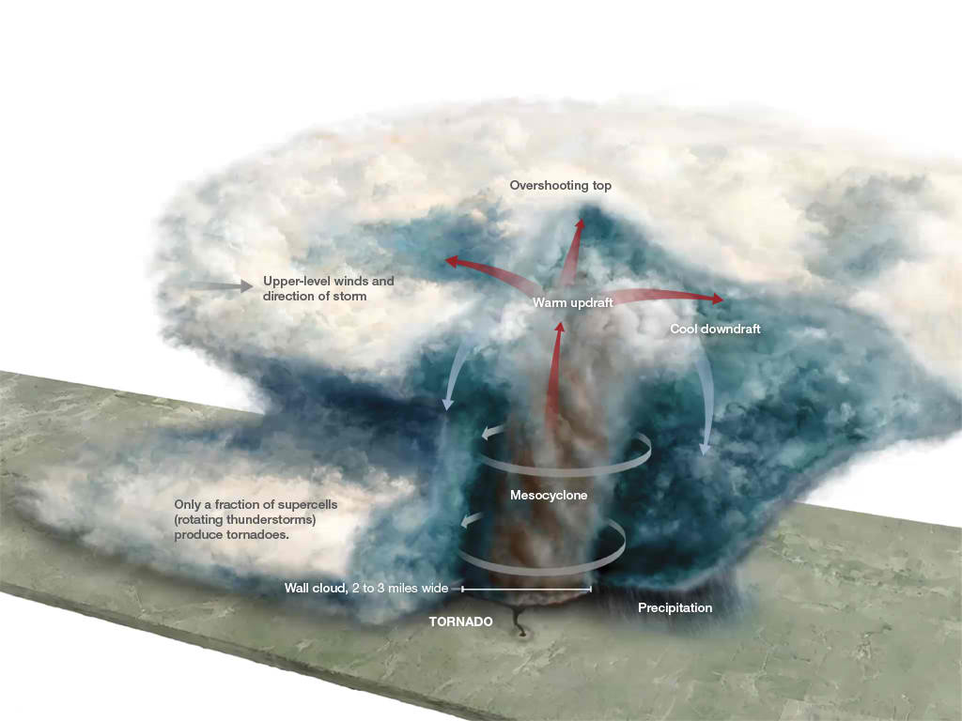
Click this to play the animation
<number>/18

Slide 9
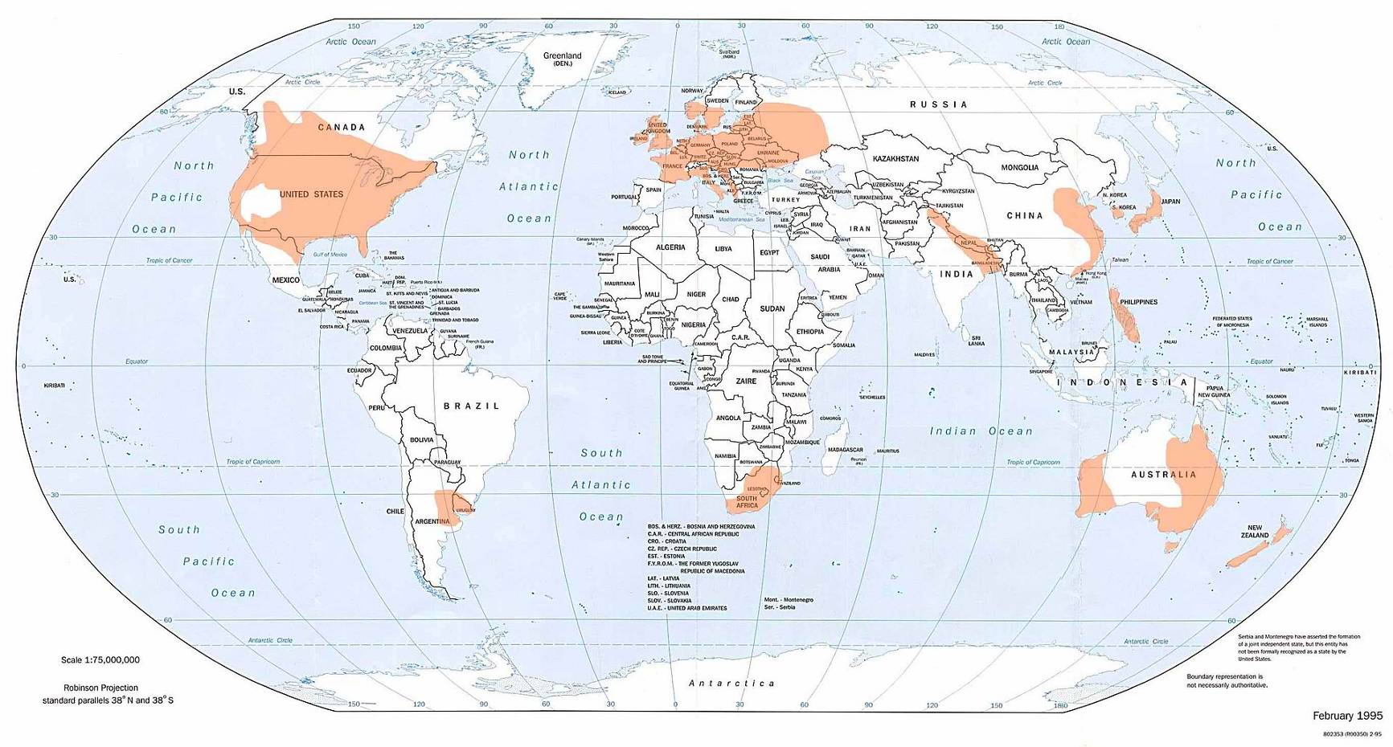
Tornado Global distribution
Areas worldwide which experience the highest chance of seeing by shading.
orange
<number>/18

Slide 10
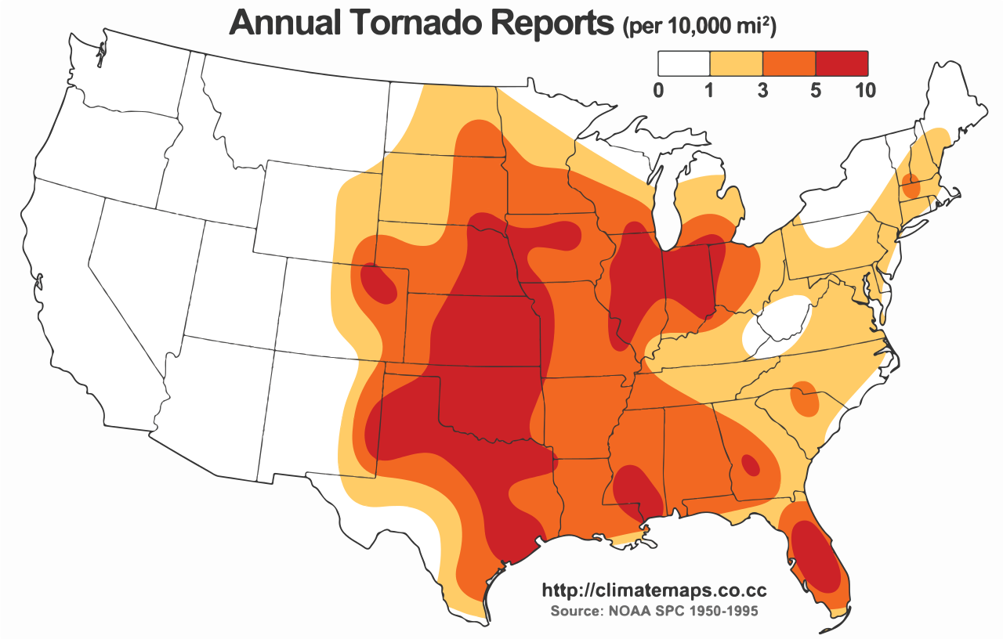
Average annual tornado reports in the United States.
<number>/18

Slide 11
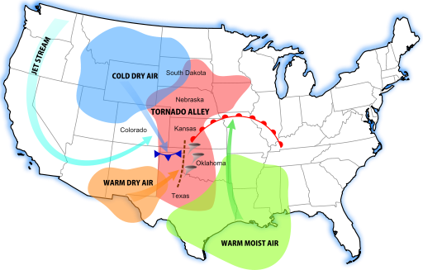
A diagram of tornado alley based on 1 tornado or more per decade. Rough location (red), and its contributing weather systems
The United States has the most tornadoes of any country, as well as the strongest and most violent tornadoes. This is mostly due to the unique geography of the continent and the size of the country. North America is a large continent that extends from the tropics north to arctic areas, and has no major east-west mountain range to block air flow between these two areas.
<number>/18

Slide 12
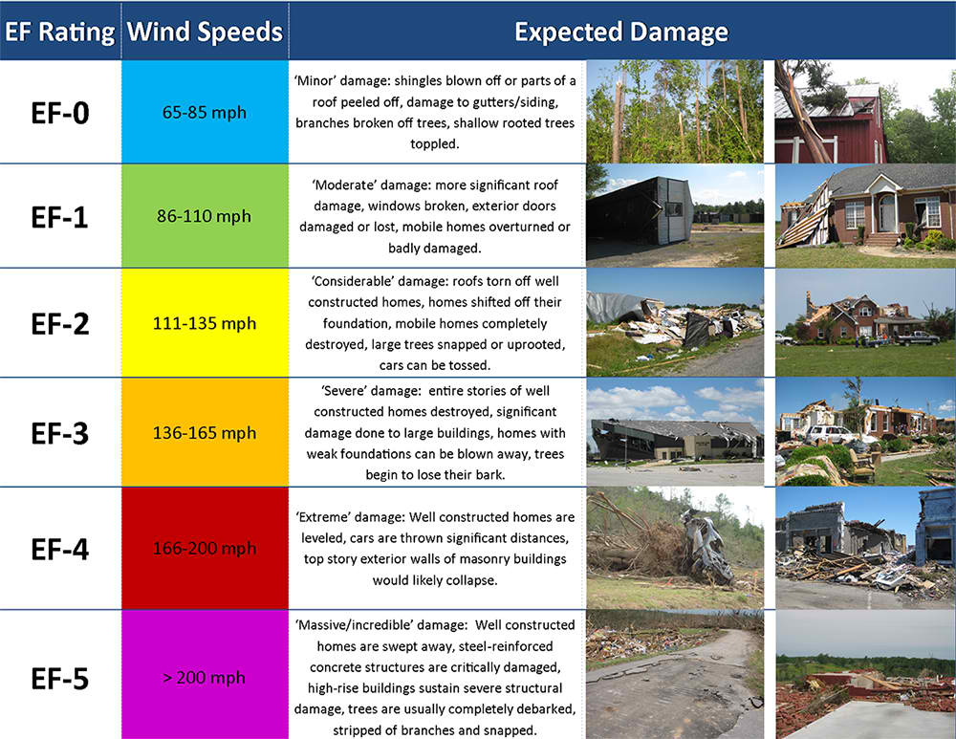
Tornado Categories
Tornadoes are categorized by their wind speed and the amount of damage they cause using a scale called the "Enhanced Fujita" scale. It is usually abbreviated as the "EF" scale.
<number>/18

Slide 13
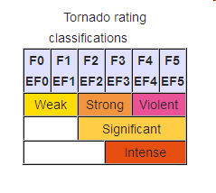
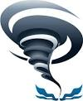
The Fujita scale (F) and the Enhanced Fujita (EF) Scale rate tornadoes by damage caused. The Enhanced Fujita (EF) Scale was an update to the older Fujita scale, using engineered wind estimates and better damage descriptions.
<number>/18

Slide 14
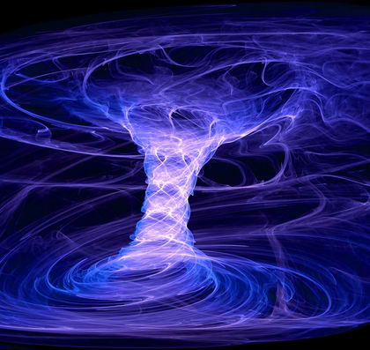
Tornado Guide
Click this to play an animation on tornado guide
<number>/18

Slide 15
Types of Tornadoes
Landspout - A landspout is similar to a waterspout, but on land. It is weak and is not associated with a vortex of air from a thunderstorm. A landspout, or dust-tube tornado, is a tornado not associated with a mesocyclone. A landspout is a very weak tornado that is not associated with a wall cloud or a mesocyclone. It is the land equivalent of a waterspout.
Multiple vortex - A tornado with more than one spinning tube of air. A multiple-vortex tornado is a tornado that contains several vortices rotating around, inside of, and as part of the main vortex.
Waterspout - A waterspout forms over warm waters. They usually dissipate when they hit land. A waterspout is an intense columnar vortex (usually appearing as a funnel-shaped cloud) that occurs over a body of water, connected to a cumuliform cloud. A waterspout is a tornado over water.
<number>/18

Slide 16
Interesting Facts about Tornadoes
Other names for tornado include twister, cyclone, and funnel.
In order for a vortex of wind to be officially called a tornado it must touch the ground.
The funnel in waterspouts is made from fresh water, not salt water.
More tornadoes touch down in the United States than any other country, over 1,000 per year.
The fastest winds on Earth occur inside tornadoes.
Don't plan on outrunning a tornado, the average tornado travels at a speed of 30 miles per hour, but some can move at speeds up to 70 miles per hour
<number>/18

Slide 17
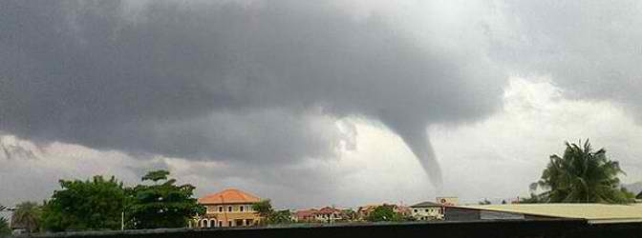
Massive tornado slammed Minglanilla, Cebu, Philippines
A massive tornado slammed the towns of Minglanilla and Talisay in Cebu, Philippines on June 17, 2013. Twister caused significant infrastructural damage and downing trees. The tornado originally started off as a waterspout before coming ashore and inflicting damage on 55 houses. According to PhilStar, one person was reported injured as the tornado ripped through coastal barangays of Calajoan and Tungkil in Minglanilla, and Pooc and Mohon in Talisay City.
According to Oscar Tabada, chief of the Mactan station of the Philippine Atmospheric, Geophysical and Astronomical Services Administration (PAGASA), tornado reached an intensity of more than 200 km/h with a diameter of less than one kilometer and lasted for 20-30 minutes.
<number>/18

Slide 18
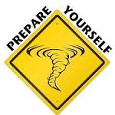
Tornadoes may strike quickly, with little or no warning.
Basements and other underground areas are the safest places to seek refuge during a tornado. It is also a good idea to stay away from windows.
<number>/18
END

