Slide 1


<number>/39
Researched and compiled by
C. Ursal Jr., 2013 October 28
Revised 2013 November 10

Slide 2

Table of Contents (TOC):
Page
Anatomy of an Earthquake 3
Ring of Fire 4
Tectonic plates of the world 5
Subduction zones on the Ring of Fire 6
Philippine Sea Plate 7
Philippine Mobile Belt 8
PHILVOCS Seismic Monitoring Stations 9
Active Faults and Trenches in the Philippines 10
Active Faults and Liquefaction Susceptibility Map
of Region VI & VII 11
Philippines | Earthquake Prone Areas 12
Philippines | Risk to Earthquakes Map 13
Philippines | Liquefaction Susceptibility Map 14
Philippines | Risk to Earthquake-Induced Shallow Landslides Map 15
Philippines | Earthquake-induced Landslide Hazard Map 16
Philippines | Earthquake-induced Landslide Hazard Map
of Region VI & VII 17
Landslide & Flood susceptibility map of Cebu quadrangle 18
Other Landslide & Flood susceptibility maps 19
Tsunami, the power in a tsunami, tsunami alert levels 20
Philippines | Tsunami Prone Areas 21
Philippines | Risk to Tsunamis 22
Volcanoes classification 23
Major Vocanoes of the Philippines 23
Philippines | Distribution of Volcanoes 24
Philippines | Risk to Volcanic Eruptions Map 25
Philippines | Combined Risk to Geophysical Disasters 26
USGS | Philippines Seismic Hazard Map 27
USGS | Philippines Earthquake Density Map 28
USGS | Philippines Seismicity Map – 1900 to Present 29
Page
List of earthquakes in the Philippines since 1900 30
Eleven Deadliest Recorded Earthquakes in the Philippines
since 1600s 31
Other earlier earthquakes in the greater epicenter area
(since 1900) 32
Glossary 33
References 34
Philippine Tsunami Alert Levels TA
Philvocs Earthquake Intensity Scale EI
Magniture & Intensity comparison MI
Modified Mercali Scale MM
Modified Mercalli Intensity scale 37
The Richter scale 38
NOTE:
In the Table of Contents, click on the page number to go direct to the page.
Click on the links provided in each slides to get better display control or additional information.
Or, click on the TOC (lower left, beside the page number) to go back to the Table of Contents.
<number>/39

Slide 3
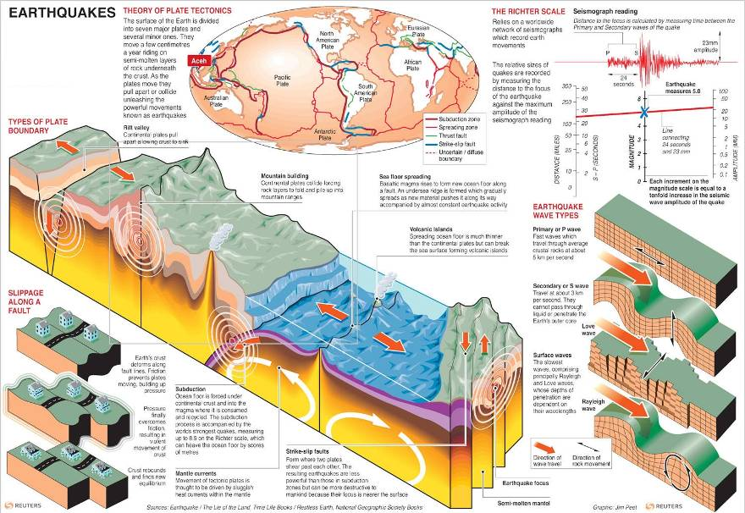
Anatomy of an Earthquake
<number>/39
Anatomy of an earthquake.jpg

Slide 4
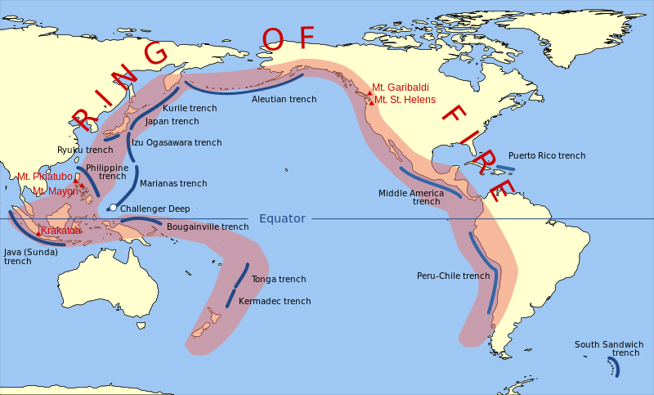
The Pacific Ring of Fire
The Ring of Fire is an area where a large number of earthquakes and volcanic eruptions occur in the basin of the Pacific Ocean. In a 40,000 km (25,000 mi) horseshoe shape, it is associated with a nearly continuous series of oceanic trenches, volcanic arcs, and volcanic belts and/or plate movements. The Ring of Fire has 452 volcanoes and is home to over 75% of the world's active and dormant volcanoes. ^{[4]}
<number>/39

Slide 5
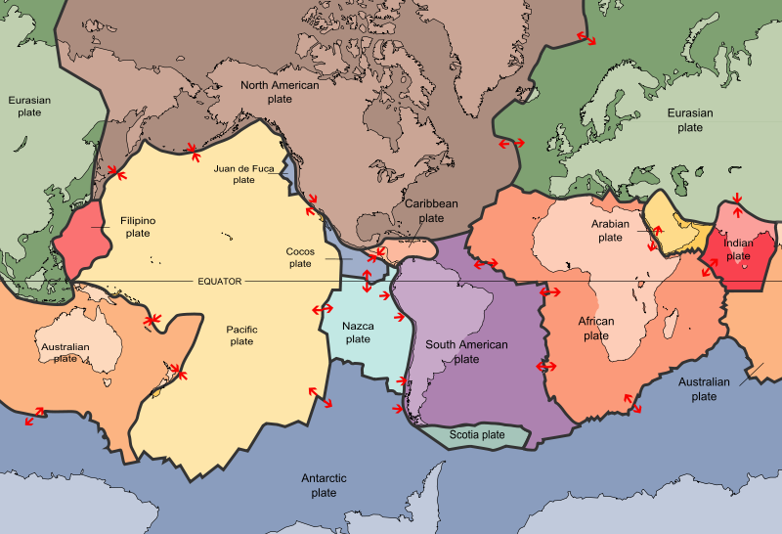
Tectonic plates of the world
The Ring of Fire is a direct result of plate tectonics and the movement and collisions of lithospheric plates. ^{[4]}
<number>/39

Slide 6
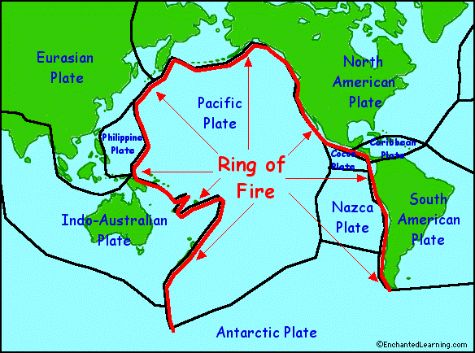
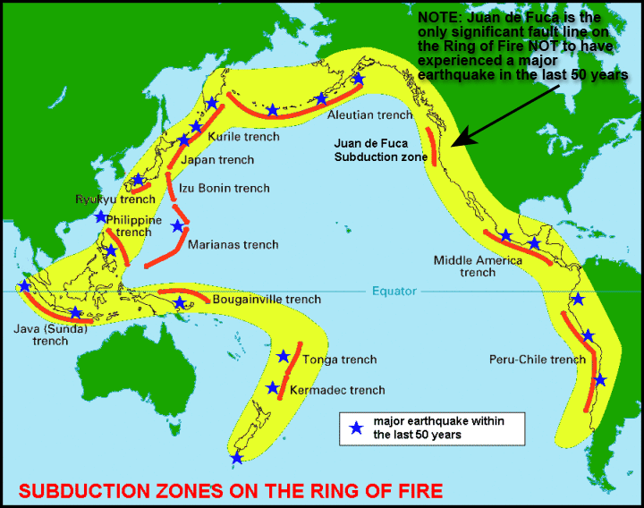
Ring of Fire
Subduction zones on the ring of fire
About 90% of the world's earthquakes and 81% of the world's largest earthquakes occur along the Ring of Fire. ^{[4]}
<number>/39

Slide 7
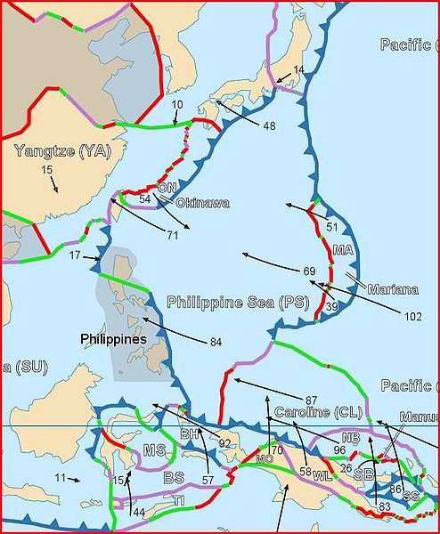

Philippine Sea Plate
The Philippine Sea Plate is a tectonic plate comprising oceanic lithosphere that lies beneath the Philippine Sea, to the east of the Philippines. Most segments of the Philippines, including northern Luzon, are part of the Philippine Mobile Belt, which is geologically and tectonically separate from the Philippine Sea Plate.
<number>/39
Philippine-Sea-plate.jpg

Slide 8
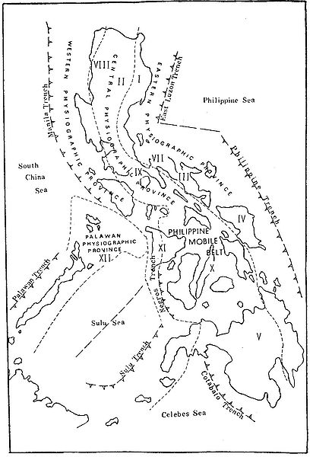

Philippine Mobile Belt
The Philippine Mobile Belt is a complex portion of the tectonic boundary between the Eurasian Plate and the Philippine Sea Plate, comprising most of the country of the Philippines. It includes two subduction zones, the Manila Trench to the west and the Philippine Trench to the east, as well as the Philippine Fault System. Within the Belt, a number of crustal blocks or microplates which have been sheared off the adjoining major plates are undergoing massive deformation.
<number>/39
Philippine-Mobile-Belt.jpg

Slide 9
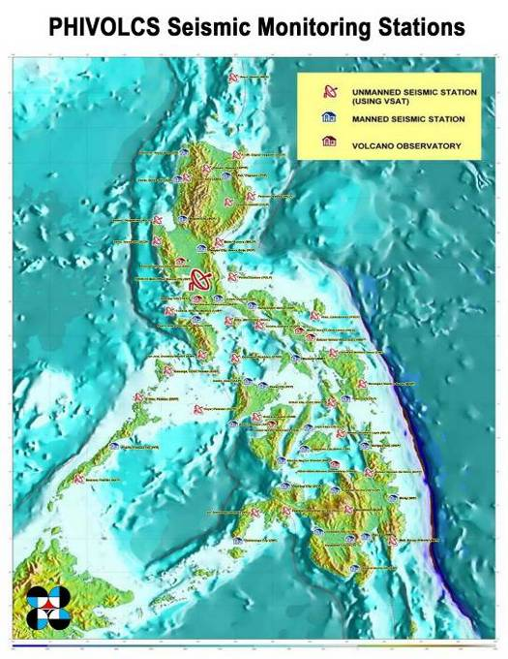
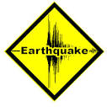
The Philippines has a total of 65 seismic stations, 29 of which are manned, 30 are unmanned, and 6 volcano stations. The central operating station is located at PHIVOLCS Main Office, Diliman, Quezon City. All information is received at the Data Receiving Center (DRC), which is operated 24/7 by the Seismological Observation and Prediction Division (SOEPD).
<number>/39
PHIVOLCS-Seismic-Monitoring-Network.jpg

Slide 10
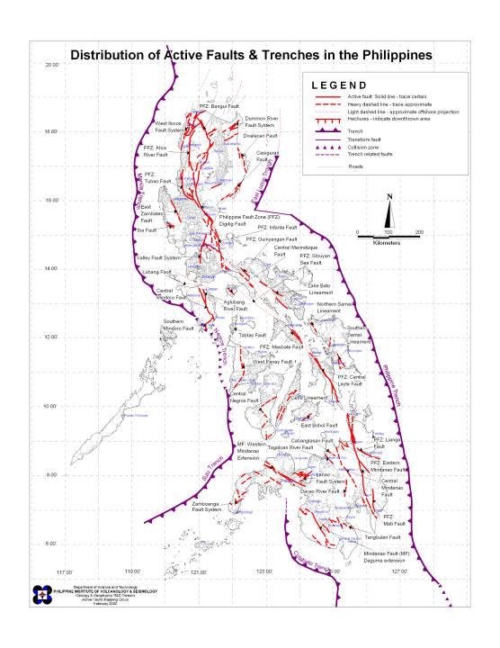

Active Faults and Trenches in the Philippines
<number>/39
af_trench_with-capitals.jpg

Slide 11
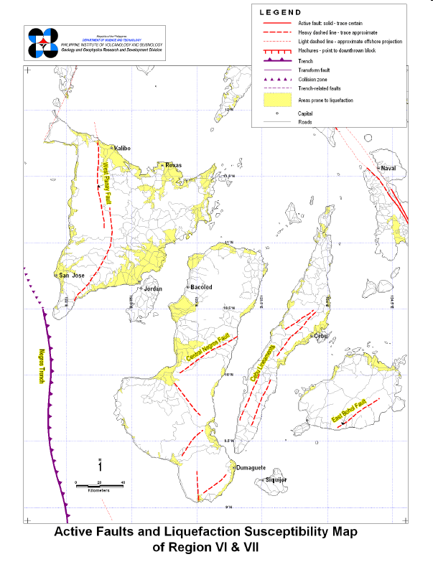
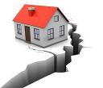
Active Faults and Liquefaction Susceptibility Map of Region VI & VII
Map Showing Active Faults and Liquefaction Susceptibility in Region VI & VII
<number>/39
Activefaults_region vi and vii.pdf

Slide 12
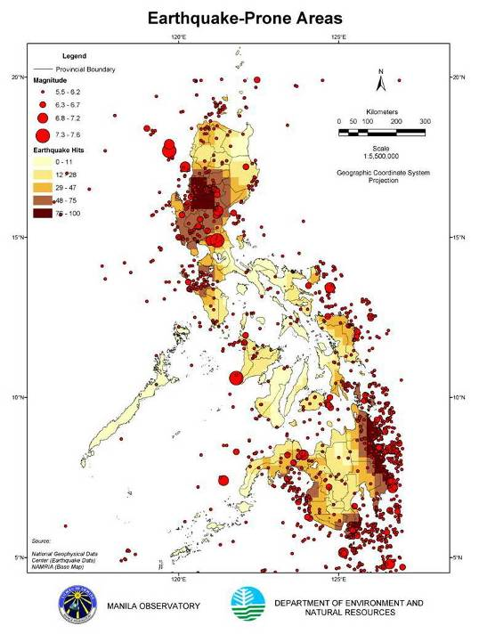
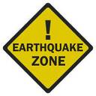
Philippines | Earthquake Prone Areas
<number>/39
Earthquake-Prone-Areas.jpg

Slide 13
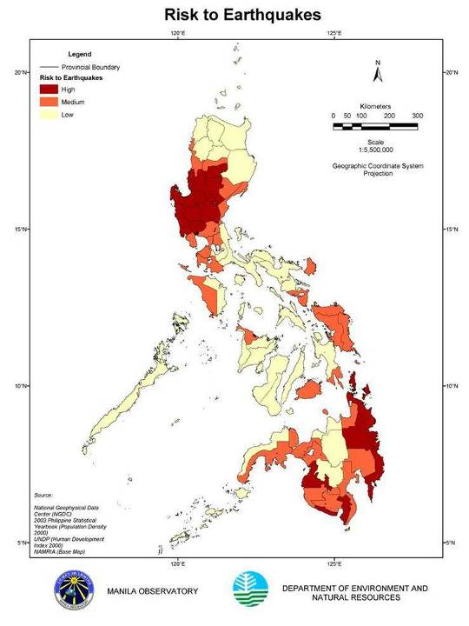
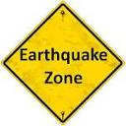
Philippines | Risk to Earthquakes Map
The top ten provinces that are at risk to earthquakes are: Surigao Del Sur, La Union, Benguet, Pangasinan, Pampanga, Tarlac, Ifugao, Davao Oriental, Nueva Vizcaya, Nueva Ecija.
<number>/39
Philippine-Risk-To-Earthquakes.jpg

Slide 14
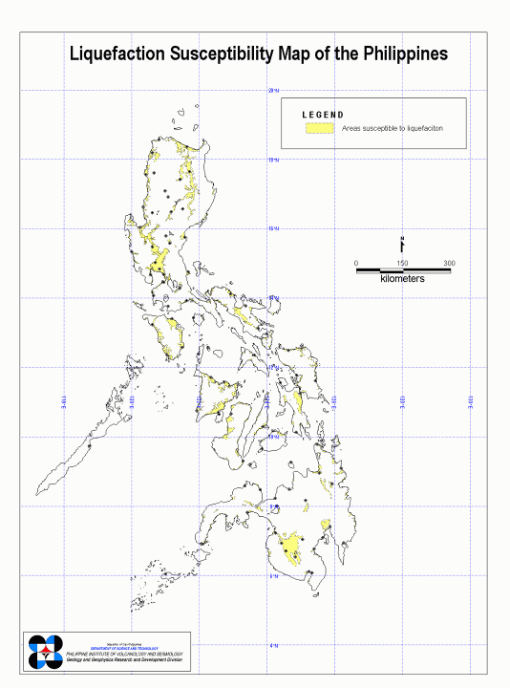
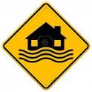
Philippines | Liquefaction Susceptibility Map
Liquefaction refers to the process of becoming a liquid or liquid-like.
In geology, soil liquefaction refers to the process by which water-saturated, unconsolidated sediments are transformed into a substance that acts like a liquid, often in an earthquake.
<number>/39
Liquefaction-Susceptibility-Map-of-the-Philippines.jpg

Slide 15
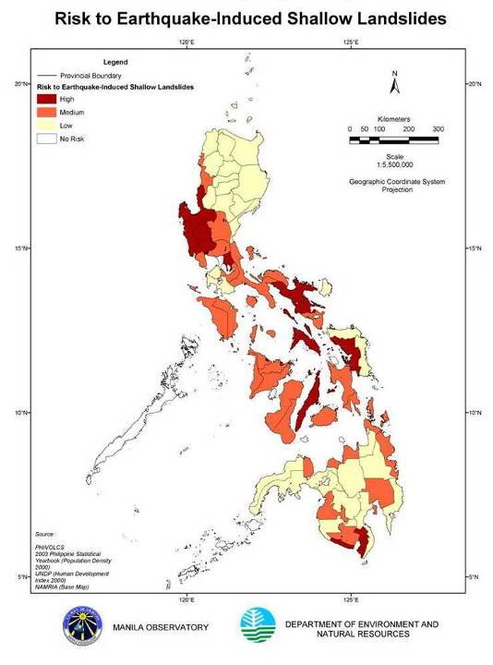
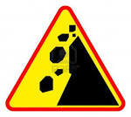
Philippines | Risk to Earthquake-Induced Shallow Landslides Map
Most of the provinces, except Palawan, are susceptible to landslide hazards. The top ten provinces that are at risk to earthquake-induced shallow landslides are: Ifugao, Lanao Del Sur, Sarangani, Benguet, Mountain Province, Bukidnon, Aurora, Davao del Sur, Davao Oriental, Rizal.
<number>/39
Philippine-induced-landslides.jpg

Slide 16
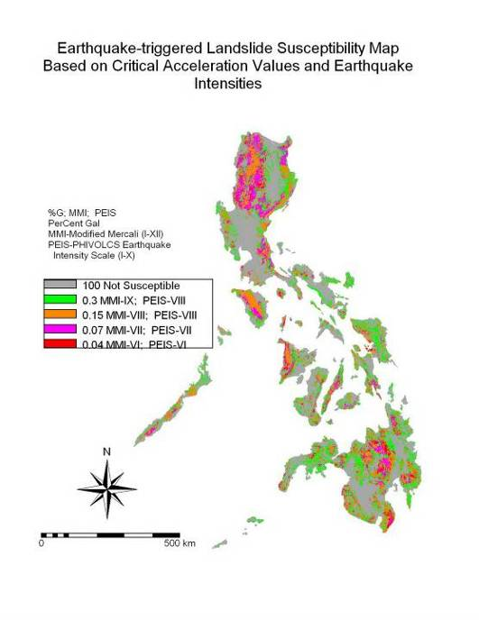

Philippines | Earthquake-induced Landslide Hazard Map
MMI = Modified Mercali Intensity
PEIS = Philvocs Earthquake Intensity Scale
Magnitude & Intensity comparison
<number>/39
Philippine-Earthquake-induced-Landslide-Hazard-Map.jpg

Slide 17
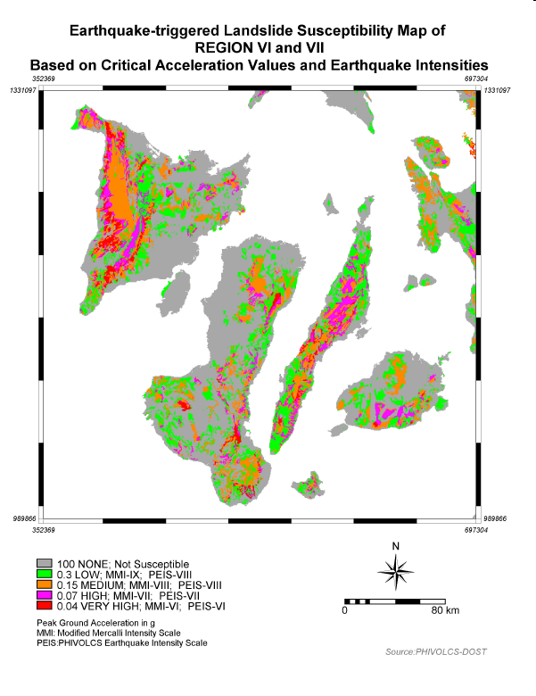
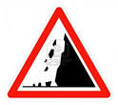
Philippines | Earthquake-induced Landslide Hazard Map of Region VI & VII
earthquake landslides region vi and vii.pdf
<number>/39

Slide 18
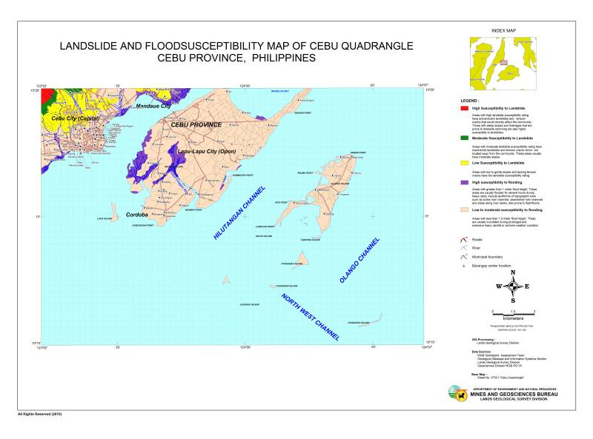
Landslide & Flood susceptibility map of Cebu quadrangle
Cebu Province, Philippines ^{[7][8]}
<number>/39
Cebu_composite_50k.jpg

Slide 19


Other Landslide & Flood susceptibility maps^{[7][8]}
Liloan quadrangle
Liloan_3851-III_composite_layout50k.jpg
Pardo quadrangle
Pardo_3750-IV_lslide&flood_layout50k.jpg
Buanoy quadrangle
Buanoy_flood&lslide_layout.jpg
Danao City quadrangle
Danao_City_3722-II_composite50k.jpg
For other areas in Cebu or in the Philippines geohazard maps, please see Mines and Geosciences Bureau link:
http://gdis.denr.gov.ph/mgbviewer/
<number>/39

Slide 20

Tsunami
What is a tsunami?
A tsunami is a series of sea waves commonly generated by under-the-sea earthquakes and whose heights could be greater than 5 meters. It is erroneously called tidal waves and sometimes mistakenly associated with storm surges. Tsunamis can occur when the earthquake is shallow-seated and strong enough to displace parts of the seabed and disturb the mass of water over it.
Click on the link below for more details on tsunami:
The power in a tsunami
Click on the link below for tsunami alert levels:
Philippine Tsunami Alert Levels
<number>/39

Slide 21
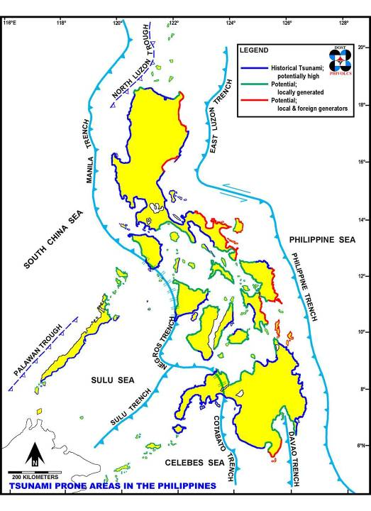
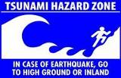
Philippines | Tsunami Prone Areas
<number>/39
Philippine-Tsunami-prone-areas.jpg

Slide 22
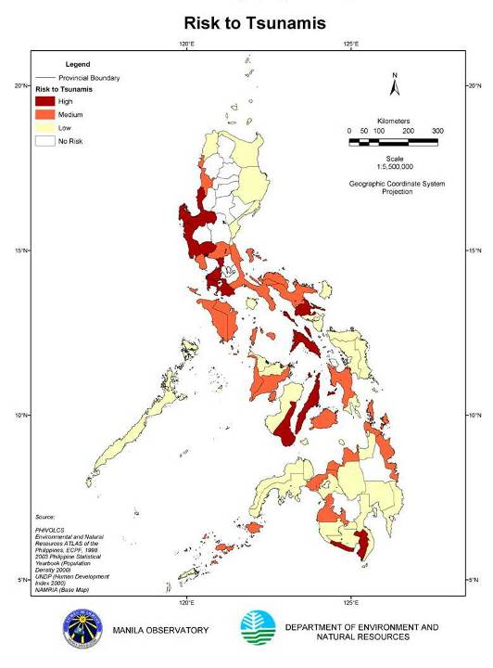

Philippines | Risk to Tsunamis
Most of the coastal areas have experienced a tsunami or have a tsunami hazard potential. The top ten provinces that are at risk to tsunamis are: Sulu Tawi-tawi Basilan Batanes Guimaras Romblon Siquijor Surigao del Norte Camiguin Masbate.
<number>/39
Philippine-risk-tsunamis.jpg

Slide 23
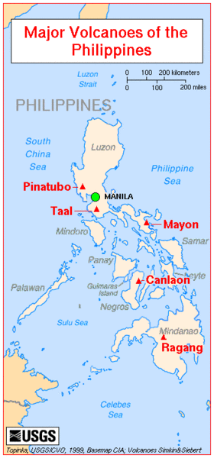
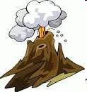
Volcanoes
Classification of Volcanoes
1) Active volcanoes: erupted within historical times (within the last 600 years), accounts of these eruptions were documented by man; erupted within the last 10,000 years based on analyses of datable materials.
2) Potentially active volcanoes: morphologically young-looking but with no historical records of eruption.
3) Inactive volcanoes: no record of eruptions; physical form is being changed by agents of weathering and erosion via formation of deep and long gullies.
Major volcanoes in the Philippines.gif
<number>/39

Slide 24
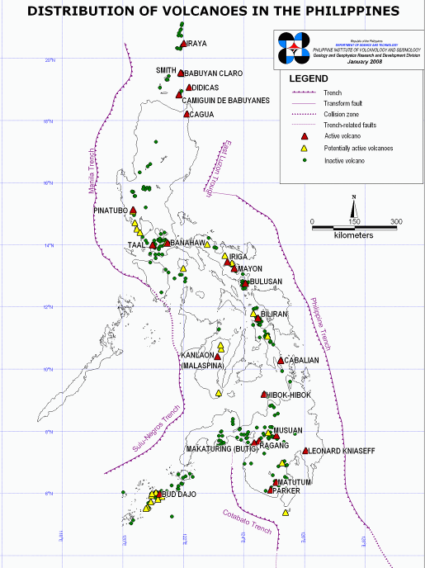
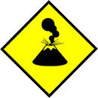
Philippines | Distribution of Volcanoes
The Philippines sits on a unique tectonic setting ideal to volcano formation. The archipelago is surrounded by subducting plates as manifested by the trenches that are related to volcano formation.
<number>/39
Distribution-of-Volcanos-2008.jpg

Slide 25
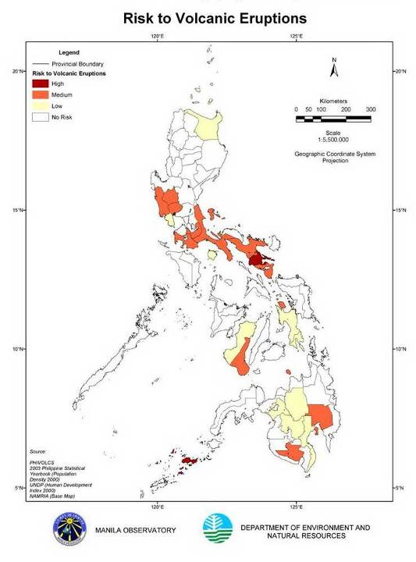
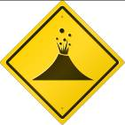
Philippines | Risk to Volcanic Eruptions Map
Philippines lies within the Ring of Fire, a region of subduction zone volcanism surrounding the Pacific Ocean.
<number>/39
Philippine-risk-volcanic-eruptions.jpg

Slide 26
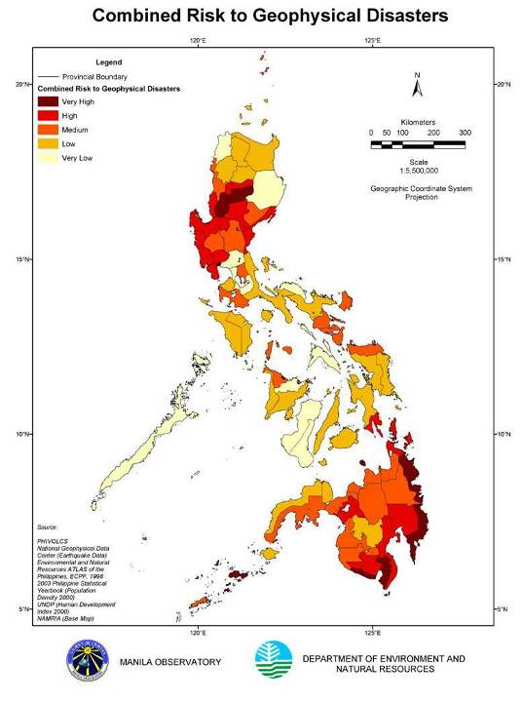


Philippines | Combined Risk to Geophysical Disasters
The composite risk map of all geophysical hazards under consideration.
<number>/39
Combined-risk-to-geophysical-Disasters.jpg

Slide 27
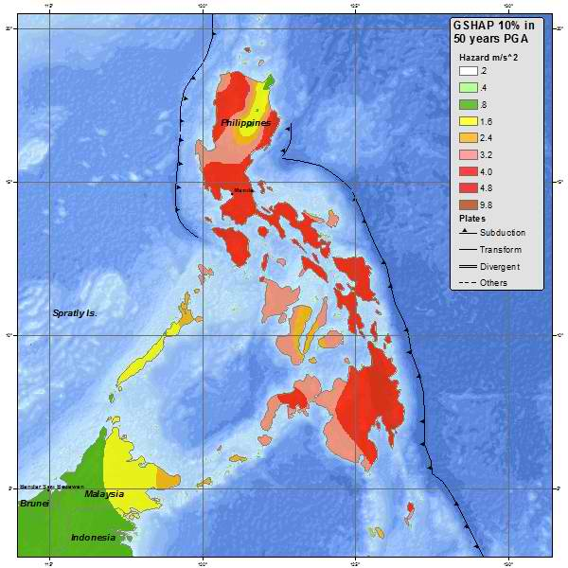

USGS | Philippines Seismic Hazard Map ^{[3]}
<number>/39
USGS-Phil_seismic_hazard_map.jpg

Slide 28
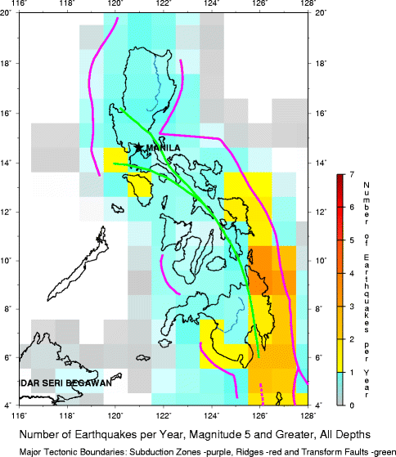

USGS | Philippines Earthquake Density Map ^{[3]}
Average Number of Earthquakes per Year, Magnitude 5 and greater, All depths.
<number>/39
USGS-Phil_earthquake_density_map.gif

Slide 29
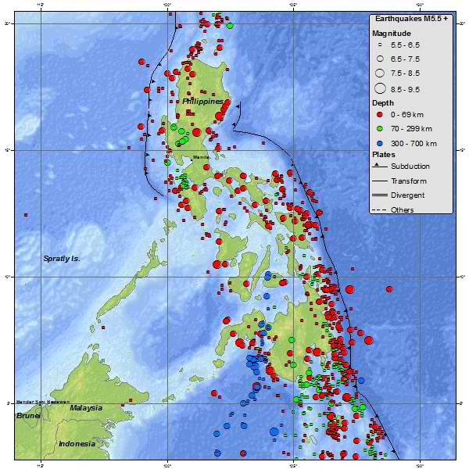

USGS | Philippines Seismicity Map – 1900 to Present ^{[3]}
<number>/39
USGS-Phil_seismicity_map.jpg

Slide 30
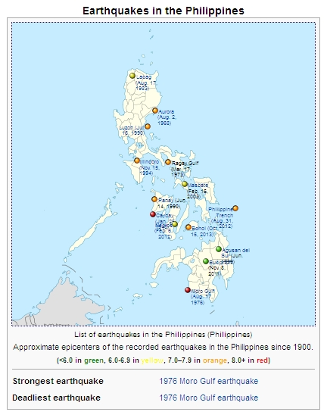

List of earthquakes in the Philippines since 1900 ^{[5]}
<number>/39
Phil_earthquakes_since1900.jpg

Slide 31
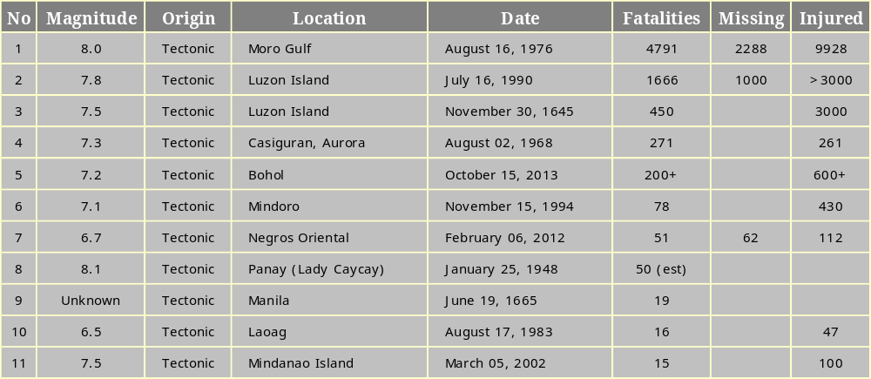
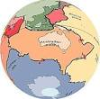
Eleven Deadliest Recorded Earthquakes in the Philippines since 1600s ^{[5]}
<number>/39

Slide 32
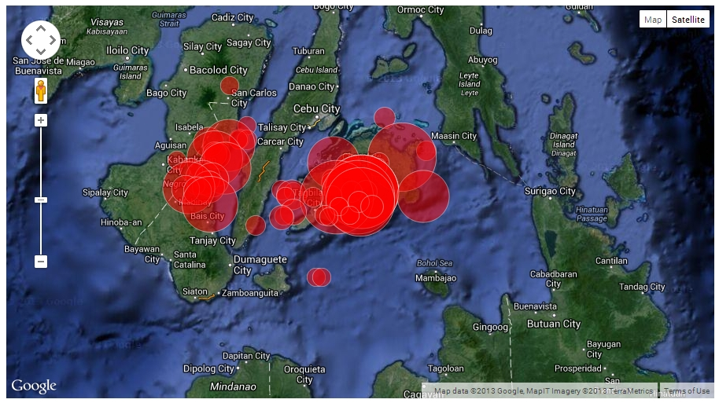
Other earlier earthquakes in the greater epicenter area (since 1900) ^{[6]}
Strongest earthquakes within a 150 km radius from Bohol 2013 Oct. 15 earthquake (max. 60)
<number>/39
Other earlier earthquakes in the greater epicenter area (since 1900).jpg

Slide 33

Glossary: ^{[3]}
Active fault is a fault that is likely to have another earthquake sometime in the future. Faults are commonly considered to be active if they have moved one or more times in the last 10,000 years.
Aftershocks are earthquakes that follow the largest shock of an earthquake sequence. They are smaller than the mainshock and within 1-2 rupture lengths distance from the mainshock. Aftershocks can continue over a period of weeks, months, or years. In general, the larger the mainshock, the larger and more numerous the aftershocks, and the longer they will continue.
Amplitude is the size of the wiggles on an earthquake recording. See Fig-amplitude.
Core is the innermost part of the earth. The outer core extends from 2500 to 3500 miles below the earth's surface and is liquid metal. The inner core is the central 500 miles and is solid metal. See Fig-Core_Mantle.
Crust is the outermost major layer of the earth, ranging from about 10 to 65 km in thickness worldwide. The uppermost 15-35 km of crust is brittle enough to produce earthquakes. See Fig-Crust.
Dip-slip faults are inclined fractures where the blocks have mostly shifted vertically. If the rock mass above an inclined fault moves down, the fault is termed normal, whereas if the rock above the fault moves up, the fault is termed reverse. A thrust fault is a reverse fault with a dip of 45° or less. Oblique-slip faults have significant components of different slip styles.
Displacement is the difference between the initial position of a reference point and any later position. The amount any point affected by an earthquake has moved from where it was before the earthquake. See Fig-displacement.
Earthquake is a term used to describe both sudden slip on a fault, and the resulting ground shaking and radiated seismic energy caused by the slip, or by volcanic or magmatic activity, or other sudden stress changes in the earth.
Epicenter is the point on the earth's surface vertically above the hypocenter (or focus), point in the crust where a seismic rupture begins. See Fig-Epicenter_Hypocenter.
<number>/39

Slide 34

Glossary: ^{[3]}
Fault is a fracture along which the blocks of crust on either side have moved relative to one another parallel to the fracture. See Fig-Fault.
Focus see hypocenter.
Foreshocks are relatively smaller earthquakes that precede the largest earthquake in a series, which is termed the mainshock. Not all mainshocks have foreshocks.
Frequency is the number of times something happens in a certain period of time, such as the ground shaking up and down or back and forth during an earthquake.
Hypocenter is the point within the earth where an earthquake rupture starts. The epicenter is the point directly above it at the surface of the Earth. Also commonly termed the focus. See Fig-Epicenter_Hypocenter.
Intensity is a number (written as a Roman numeral) describing the severity of an earthquake in terms of its effects on the earth's surface and on humans and their structures. Several scales exist, but the ones most commonly used in the United States are the Modified Mercalli scale and the Rossi-Forel scale. There are many intensities for an earthquake, depending on where you are, unlike the magnitude, which is one number for each earthquake. In the Philippines we use the PEIS. See Magnitude & Intensity comparison.
Landslide is a movement of surface material down a slope.
Liquefaction is a process by which water-saturated sediment temporarily loses strength and acts as a fluid, like when you wiggle your toes in the wet sand near the water at the beach. This effect can be caused by earthquake shaking.
Lithosphere is the outer solid part of the earth, including the crust and uppermost mantle. The lithosphere is about 100 km thick, although its thickness is age dependent (older lithosphere is thicker). The lithosphere below the crust is brittle enough at some locations to produce earthquakes by faulting, such as within a subducted oceanic plate. See Fig-MOHO.
Love wave is a surface wave having a horizontal motion that is transverse (or perpendicular) to the direction the wave is traveling. See Fig-Lovewave.
<number>/39

Slide 35

Glossary: ^{[3]}
Magnitude is a number that characterizes the relative size of an earthquake. Magnitude is based on measurement of the maximum motion recorded by a seismograph. Several scales have been defined, but the most commonly used are (1) local magnitude (ML), commonly referred to as "Richter magnitude," (2) surface-wave magnitude (Ms), (3) body-wave magnitude (Mb), and (4) moment magnitude (Mw). Scales 1-3 have limited range and applicability and do not satisfactorily measure the size of the largest earthquakes. The moment magnitude (Mw) scale, based on the concept of seismic moment, is uniformly applicable to all sizes of earthquakes but is more difficult to compute than the other types. All magnitude scales should yield approximately the same value for any given earthquake. See Magnitude & Intensity comparison.
Mainshock is the largest earthquake in a sequence, sometimes preceded by one or more foreshocks, and almost always followed by many aftershocks.
Mantle is the part of the earth's interior between the metallic outer core and the crust. See Fig-Core_Mantle.
Oceanic spreading ridge is the fracture zone along the ocean bottom where molten mantle material comes to the surface, thus creating new crust. This fracture can be seen beneath the ocean as a line of ridges that form as molten rock reaches the ocean bottom and solidifies. See Fig-oceanic spreading.
P wave, or compressional wave, is a seismic body wave that shakes the ground back and forth in the same direction and the opposite direction as the direction the wave is moving. See Fig-PSwaves.
PEIS means Philvocs Earthquake Intensity Scale
PHILVOCS means Philippine Institute of Volcanology and Seismology
Plate Tectonics is the theory supported by a wide range of evidence that considers the earth's crust and upper mantle to be composed of several large, thin, relatively rigid plates that move relative to one another. Slip on faults that define the plate boundaries commonly results in earthquakes. Several styles of faults bound the plates, including thrust faults along which plate material is subducted or consumed in the mantle, oceanic spreading ridges along which new crustal material is produced, and transform faults that accommodate horizontal slip (strike slip) between adjoining plates.
<number>/39

Slide 36
Glossary: ^{[3]}
Rayleigh wave is a seismic surface wave causing the ground to shake in an elliptical motion, with no transverse, or perpendicular, motion. See Fig-Rayleighwave.
Richter Scale the Richter magnitude scale was developed in 1935 by Charles F. Richter of the California Institute of Technology as a mathematical device to compare the size of earthquakes. The magnitude of an earthquake is determined from the logarithm of the amplitude of waves recorded by seismographs. Adjustments are included for the variation in the distance between the various seismographs and the epicenter of the earthquakes. On the Richter Scale, magnitude is expressed in whole numbers and decimal fractions. For example, a magnitude 5.3 might be computed for a moderate earthquake, and a strong earthquake might be rated as magnitude 6.3. Because of the logarithmic basis of the scale, each whole number increase in magnitude represents a tenfold increase in measured amplitude; as an estimate of energy, each whole number step in the magnitude scale corresponds to the release of about 31 times more energy than the amount associated with the preceding whole number value. See Fig-Ricther scale.
S wave, or shear wave, is a seismic body wave that shakes the ground back and forth perpendicular to the direction the wave is moving. See Fig-PSwaves.
Seismic moment is a measure of the size of an earthquake based on the area of fault rupture, the average amount of slip, and the force that was required to overcome the friction sticking the rocks together that were offset by faulting. Seismic moment can also be calculated from the amplitude spectra (see specturm) of seismic waves. See Fig-seismogenic.
Seismicity refers to the geographic and historical distribution of earthquakes.
Seismograph, or seismometer, is an instrument used to detect and record earthquakes. Generally, it consists of a mass attached to a fixed base. During an earthquake, the base moves and the mass does not. The motion of the base with respect to the mass is commonly transformed into an electrical voltage. The electrical voltage is recorded on paper, magnetic tape, or another recording medium. This record is proportional to the motion of the seismometer mass relative to the earth, but it can be mathematically converted to a record of the absolute motion of the ground. Seismograph generally refers to the seismometer and its recording device as a single unit. See Fig-seismograph.
Slip is the relative displacement of formerly adjacent points on opposite sides of a fault, measured on the fault surface.
Spectrum is a curve showing amplitude and phase as a function of frequency or period, or how much of each type of shaking there is from an earthquake. See Fig-spectrum.
<number>/39

Slide 37
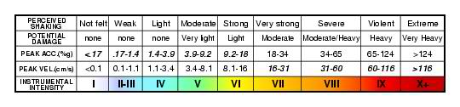
Glossary: ^{[3]}
Subduction is the process of the oceanic lithosphere colliding with and descending beneath the continental lithosphere.
Subduction zone is the place where two lithospheric plates come together, one riding over the other. Most volcanoes on land occur parallel to and inland from the boundary between the two plates. See Fig-subduction.
Tectonic refers to rock-deforming processes and resulting structures that occur over large sections of the lithosphere.
Tectonic plates are the large, thin, relatively rigid plates that move relative to one another on the outer surface of the Earth.
Thrust fault See dip slip.
Transform fault is a special variety of strike-slip fault that accommodates relative horizontal slip between other tectonic elements, such as oceanic crustal plates. Often extend from oceanic ridges.
Tsunami is a sea wave of local or distant origin that results from large-scale seafloor displacements associated with large earthquakes, major submarine slides, or exploding volcanic islands. See Fig-tsunami.
USGS means U.S. Geological Survey
Modified Mercalli Intensity scale
<number>/39

Slide 38
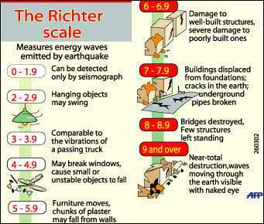
References:
http://www.phivolcs.dost.gov.ph/
http://www.maps.nfo.ph/
http://earthquake.usgs.gov/
http://en.wikipedia.org/wiki/Ring_of_fire
http://en.wikipedia.org/wiki/List_of_earthquakes_in_the_Philippines
http://earthquake-report.com/2013/10/15/very-strong-earthquake-mindanao-philippines-on-october-15-2013/
http://www.mgb.gov.ph/
http://gdis.denr.gov.ph/mgbviewer/
<number>/39

Slide 39

Always be ready for the worst. The most dangerous thing is to be caught unprepared.
<number>/39
END

