Slide 1
Straightforward Bayesian A/B Testing with Dirichlet Posteriors
A scalable Bayesian histogram approach for industry experimentation
Junwei Li
Source: Hayden and Armitage, 2025, arXiv:2508.08077.

Slide 2


A/B Test: Useful in Industry Setting
Background: Sometimes we want to execute a strategy (e.g. change UI design, modify an algorithm parameter, etc.), and it’s hard to analyze its influence theoretically.
Example metric: CTR (the proportion of users who click on something after seeing it, such as an ad, link, etc.)
Group A (Red)
soon
Question: Would changing the color of this link from blue to red improve CTR?
$${CTR}_{A}, σ_{A}^{2}$$
Use hypothesis test to see if the two CTR have significant difference
randomly assign
the users
Group B (Blue, No change)
soon
$${CTR}_{B}, σ_{B}^{2}$$

Slide 3
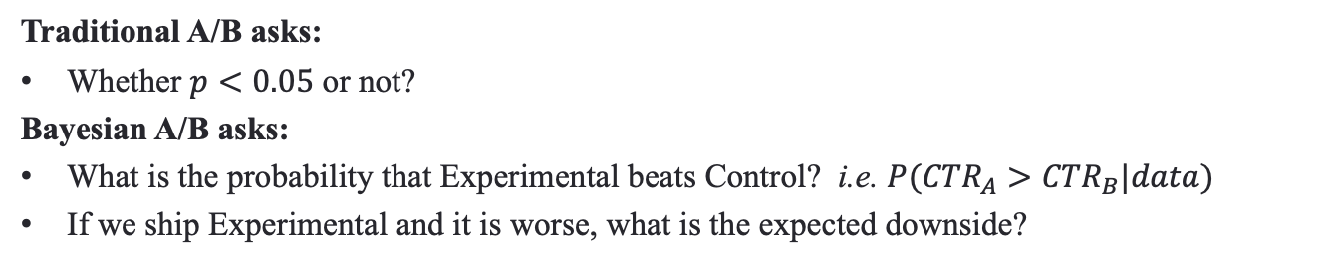
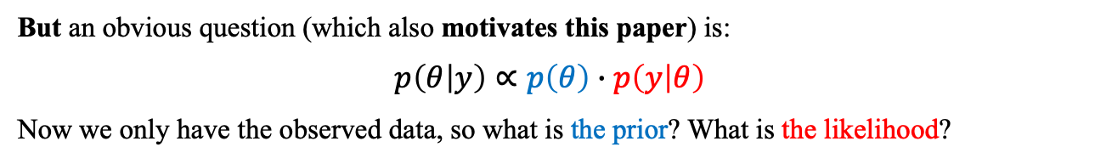
Bayesian A/B Test: Adds Information
Traditional A/B asks:
Whether $p<0.05$ or not?
Bayesian A/B asks:
What is the probability that Experimental beats Control? i.e. $P({CTR}_{A}>{CTR}_{B}|data)$
If we ship Experimental and it is worse, what is the expected downside?
Better for business decision
But an obvious question (which also motivates this paper) is:
$$p\left(θ | y\right)∝p\left(θ\right)∙p\left(y | θ\right)$$
Now we only have the observed data, so what is the prior? What is the likelihood?
Normal, Beta, Gamma… How to choose a reasonable one?
& Big companies run hundreds of A/B tests a day. Picking the right model form one by one is too time-consuming.

Slide 4
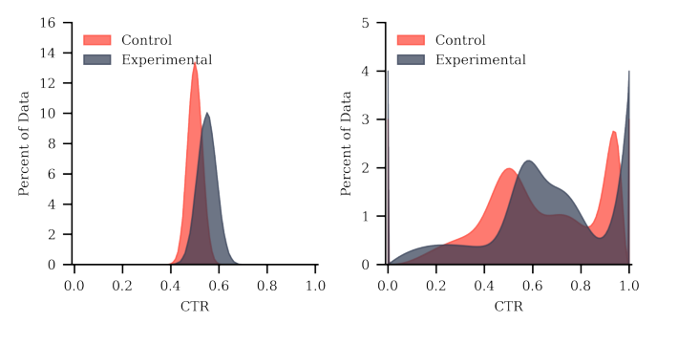
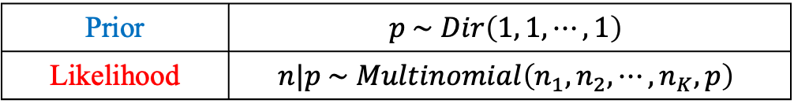
After binning: Dirichlet Prior & Multinomial Likelihood
Key idea: Histogram approximation
Not only a distribution with 1 or 2 parameters, we need to model an entire probability vector
Prior | $$p \sim Dir\left(1, 1, ⋯,1\right)$$
Likelihood | $$n|p \sim Multinomial\left(n_{1}, n_{2}, ⋯,n_{K},p\right)$$

Slide 5
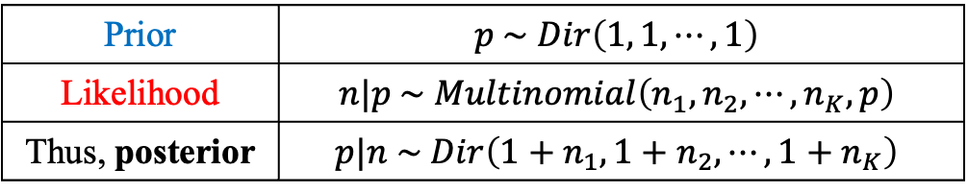
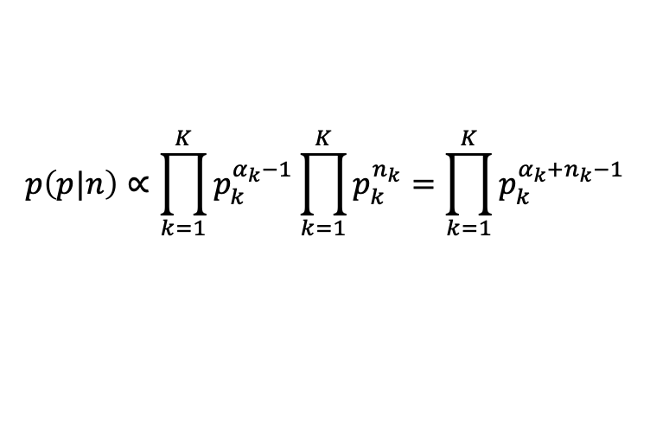
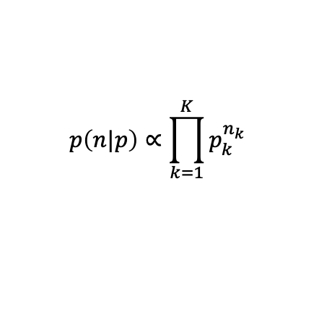
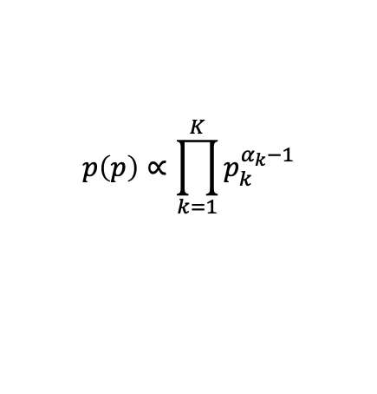
Details about Dirichlet Distribution
$$p\left(p\right)∝\prod_{k=1}^{K}{p_{k}^{α_{k}−1}}$$
$$p\left(p|n\right)∝\prod_{k=1}^{K}{p_{k}^{α_{k}−1}}\prod_{k=1}^{K}{p_{k}^{n_{k}}}=\prod_{k=1}^{K}{p_{k}^{α_{k}+n_{k}−1}}$$
Conjugacy
$$p\left(n|p\right)∝\prod_{k=1}^{K}{p_{k}^{n_{k}}}$$
Prior | $$p \sim Dir\left(1, 1, ⋯,1\right)$$
Likelihood | $$n|p \sim Multinomial\left(n_{1}, n_{2}, ⋯,n_{K},p\right)$$
Thus, posterior | $$p|n \sim Dir\left(1+n_{1}, 1+n_{2}, ⋯, 1+n_{K}\right)$$

Slide 6
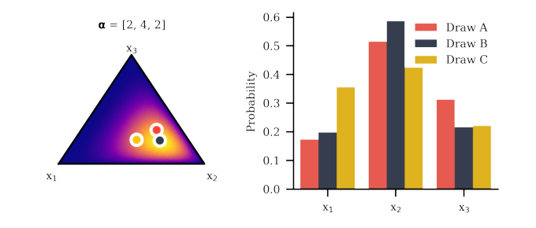
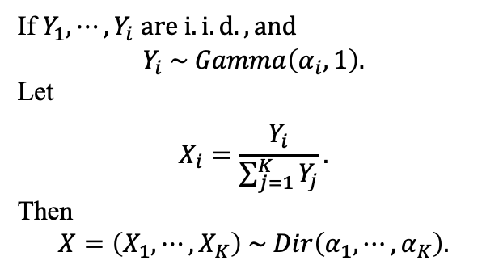
Details about Dirichlet Distribution
Sample Method
If $Y_{1}, ⋯, Y_{i}$ $are i.i.d., and$
$$Y_{i} \sim Gamma\left(α_{i}, 1\right).$$
Let
$$X_{i}=\frac{Y_{i}}{\sum_{j=1}^{K}{Y_{j}}}.$$
Then
$$X=\left(X_{1}, ⋯,X_{K}\right) \sim Dir\left(α_{1}, ⋯,α_{K}\right).$$

Slide 7
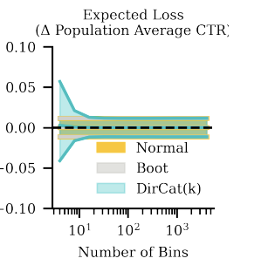
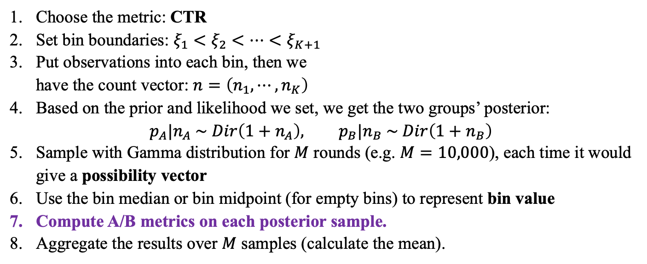
Practical Pipeline
Number of bins:
Depend on metric you want to test, generally, 32 bins for mean, 256 bins for quantile (more sensitive).
Choose the metric: CTR
Set bin boundaries: $ξ_{1}<ξ_{2}<⋯<ξ_{K+1}$
Put observations into each bin, then we
have the count vector: $n=\left(n_{1},⋯,n_{K}\right)$
Based on the prior and likelihood we set, we get the two groups’ posterior:
$$p_{A}|n_{A} \sim Dir\left(1+n_{A}\right), p_{B}|n_{B} \sim Dir\left(1+n_{B}\right)$$
Sample with Gamma distribution for $M$ rounds (e.g. $M=10,000$), each time it would give a possibility vector
Use the bin median or bin midpoint (for empty bins) to represent bin value
Compute A/B metrics on each posterior sample.
Aggregate the results over $M$ samples (calculate the mean).

Slide 8
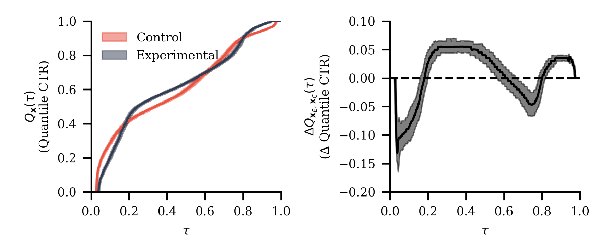



Bayesian A/B Metrics
Quantile difference
Chance to beat
Expected loss
$∆Q\left(τ\right)=Q_{A}\left(τ\right)−Q_{B}\left(τ\right)$, e.g. $τ=0.75$
$Pr⁡({\overline{x}}_{A}>$ ${\overline{x}}_{B}|data)$
$$𝔼\left[\max\left({\overline{x}}_{B}−{\overline{x}}_{A},0\right)|data\right]$$
How likely is the experimental version to outperform the control?
If we choose the wrong version, how much do we expect to lose?
Consider high-value user segments?
Analysis Example
For CTR, the experimental version may show an 87% chance to beat control, an expected loss of only 0.003 CTR points, and a +0.012 increase at the 75th percentile. This suggests it is likely better, low-risk to launch, and especially helpful for higher-engagement users.

Slide 9
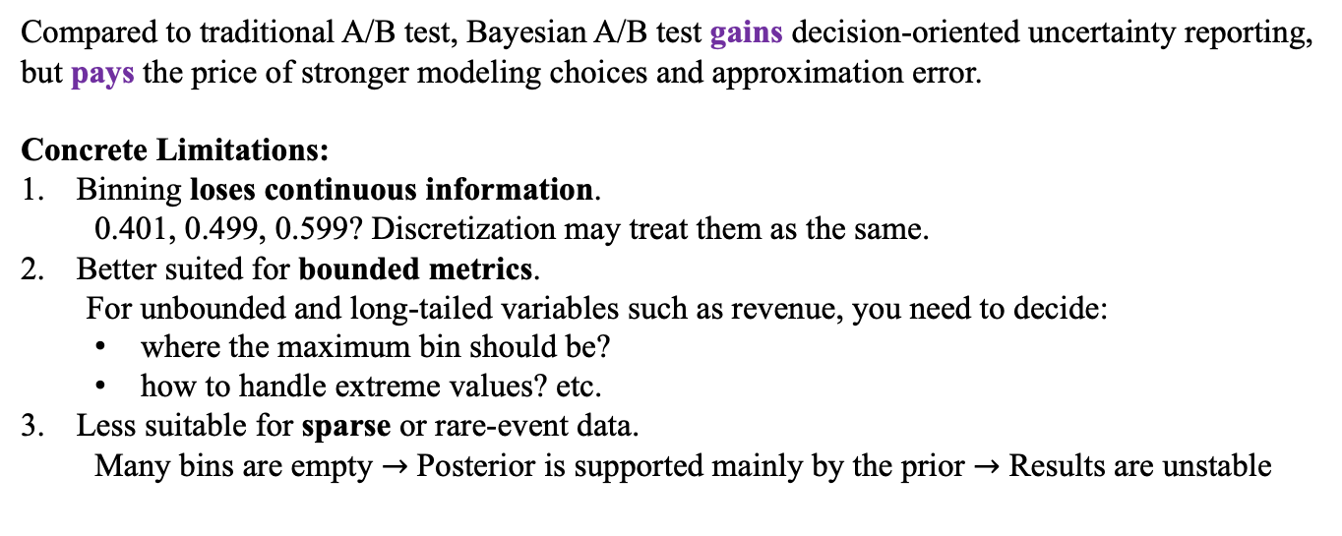
Trade-offs compared to Traditional A/B Test
Compared to traditional A/B test, Bayesian A/B test gains decision-oriented uncertainty reporting, but pays the price of stronger modeling choices and approximation error.
Concrete Limitations:
Binning loses continuous information.
0.401, 0.499, 0.599? Discretization may treat them as the same.
Better suited for bounded metrics.
For unbounded and long-tailed variables such as revenue, you need to decide:
where the maximum bin should be?
how to handle extreme values? etc.
Less suitable for sparse or rare-event data.
Many bins are empty $→$ Posterior is supported mainly by the prior $→$ Results are unstable
It has already been adopted internally at Autotrader as the standard analysis method.

Slide 10
Key Takeaways
This paper proposes a scalable Bayesian A/B testing method for messy industry metrics.
By discretizing continuous outcomes into bins and placing a Dirichlet prior on the bin probabilities, it avoids hand-designing a new Bayesian model for every experiment.
The method is practical because it produces decision-oriented outputs such as chance to beat, expected loss, and quantile differences.
Its main trade-off is that binning makes the analysis simple and scalable, but introduces approximation error and depends on bin choices.
Thanks!

