Slide 1
HW3 Recommender Systems: Part 2 - Presentation
From Sparse Ratings to Hybrid Recommendations:
Combining Bias, Latent Structure, and Feature Signals Junwei Li

Slide 2
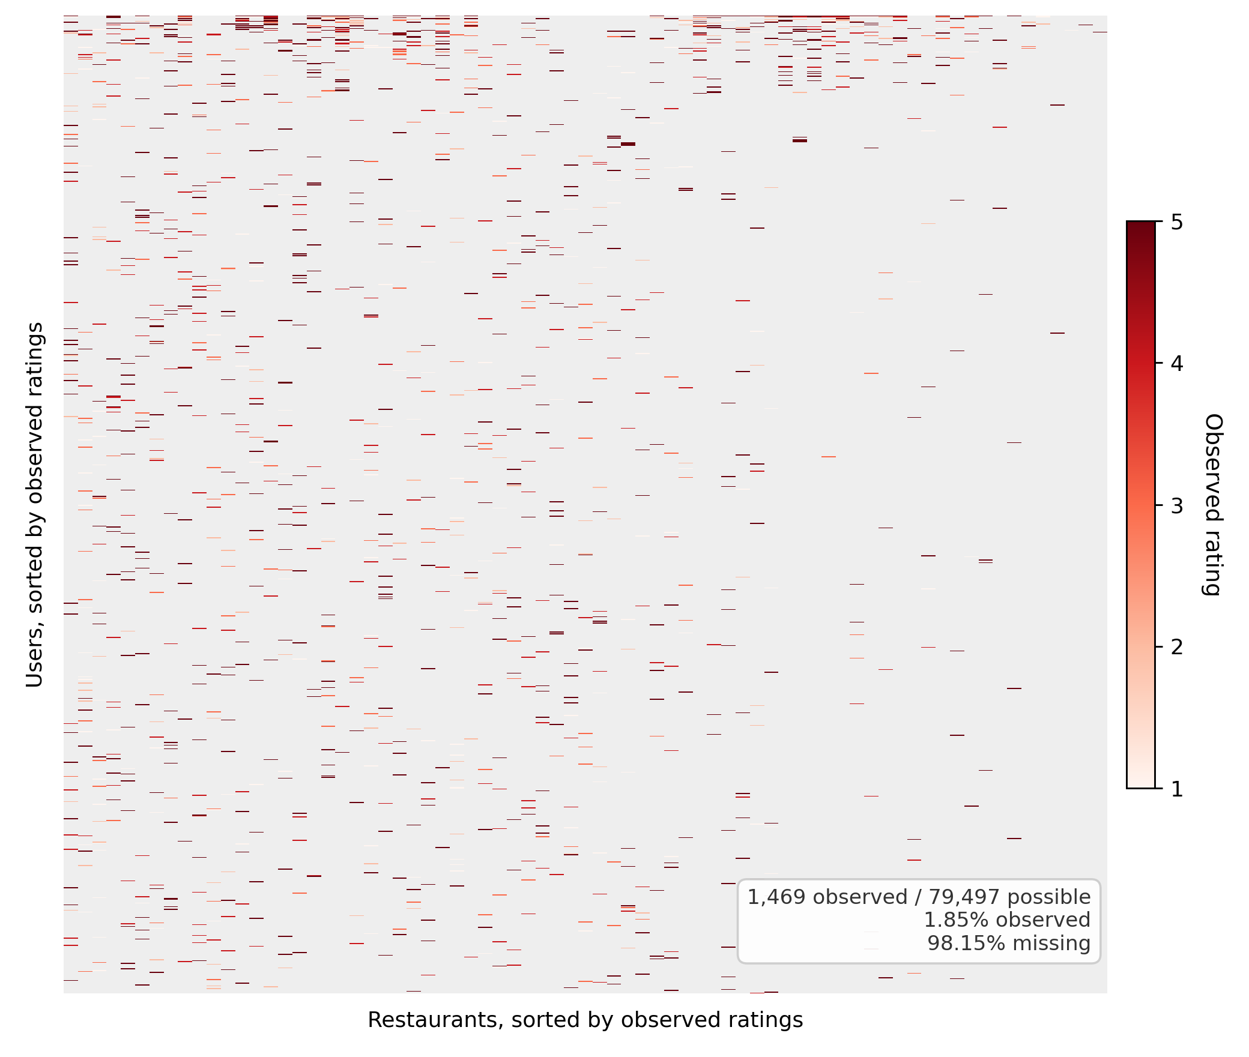
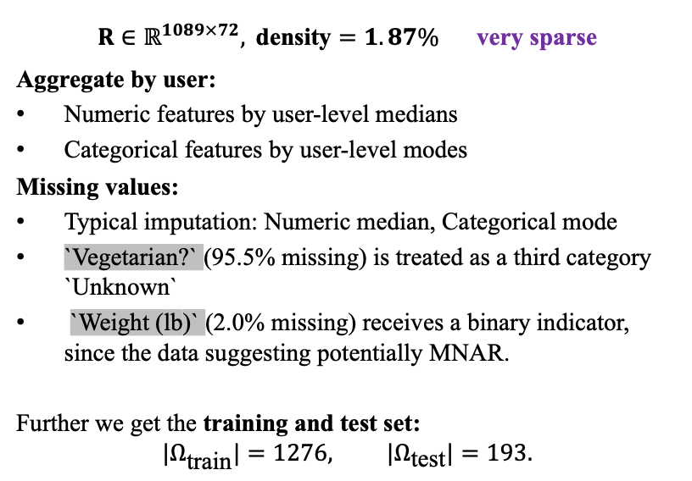
Data Geometry and Cleaning
$R∈ℝ^{1089×72}, \text{density}=1.87\%$ very sparse
Aggregate by user:
Numeric features by user-level medians
Categorical features by user-level modes
Missing values:
Typical imputation: Numeric median, Categorical mode
`Vegetarian?` (95.5% missing) is treated as a third category `Unknown`
`Weight (lb)` (2.0% missing) receives a binary indicator, since the data suggesting potentially MNAR.
Further we get the training and test set:
$$|Ω_{\text{train}}|=1276, |Ω_{\text{test}}|=193.$$
1.87% observed
98.13% missing

Slide 3

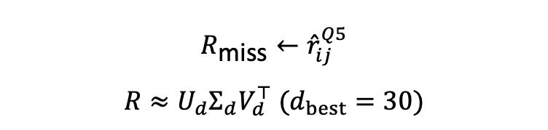

Q1-Q6: Baseline Logic
Similarity from known user features
Bias baseline
SVD after bias imputation
$$R_{\text{miss}}←{\hat{r}}_{ij}^{Q5}$$
$$R≈U_{d}Σ_{d}V_{d}^{⊤} (d_{best}=30)$$
$$d(i,i^{′})={∥z(u_{i})−z(u_{i^{′}})∥}_{2}$$
$${\hat{r}}_{ij}^{Q5}=μ+b_{i}+c_{j}$$
$RMSE \backslash 1.3733 ≈ 1.3765$

Slide 4
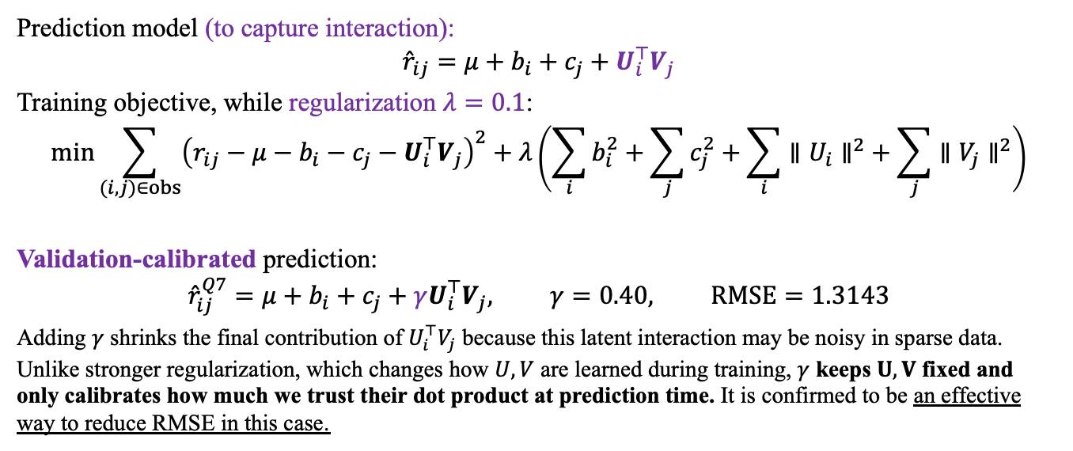
Q7: Observed-Only Matrix Factorization
Prediction model (to capture interaction):
$${\hat{r}}_{ij}=μ+b_{i}+c_{j}+U_{i}^{⊤}V_{j}$$
Training objective, while regularization $λ=0.1$:
$$min\sum_{(i,j)∈obs}^{​}{{\left(r_{ij}−μ−b_{i}−c_{j}−U_{i}^{⊤}V_{j}\right)}^{2}}+λ\left(\sum_{i}^{ }{b_{i}^{2}}+\sum_{j}^{ }{c_{j}^{2}}+\sum_{i}^{ }{{∥U_{i}∥}^{2}}+\sum_{j}^{ }{{∥V_{j}∥}^{2}}\right)$$
Validation-calibrated prediction:
$${\hat{r}}_{ij}^{Q7}=μ+b_{i}+c_{j}+γU_{i}^{⊤}V_{j}, γ=0.40, RMSE=1.3143$$
Adding $γ$ shrinks the final contribution of $U_{i}^{⊤}V_{j}$ because this latent interaction may be noisy in sparse data. Unlike stronger regularization, which changes how $U,V$ are learned during training, $γ$ keeps $U,V$ fixed and only calibrates how much we trust their dot product at prediction time. It is confirmed to be an effective way to reduce RMSE in this case.

Slide 5
Proceed to Q12: Beyond Rating Matrix
Since the rating matrix is extremely sparse, Q12 adds external features and residual corrections to recover information that Q7 cannot learn from ratings alone.
Feature set:
$$𝒳_{ij}^{Q12}=\left[b_{i}^{MF}, c_{i}^{MF}, U_{i}, V_{j}, U_{i}^{T}V_{j}, {\hat{r}}_{ij}^{MF}\right]∪\left[x_{i,S_{u}}^{user}⨂{ x}_{j,S_{r}}^{rest}\right]∪\left[z_{j}^{text}\right]∪\left[x_{i,S_{t}}^{user}⨂z_{j}^{text}\right]∪\left[z_{j}^{text}\left(U_{i}^{T}V_{j}\right)\right]∪[e_{i}, e_{j}]$$
From Q7
PCA-reduced SBERT embeddings of restaurant descriptions
Top-screened user features crossed with restaurant text components
Text components multiplied by latent user-restaurant match
User features crossed with restaurant features (each top 12 coefficient strength)
One-hot indicators for each user & each restaurant
Number of
Features
$$= 1+1+ {10}_{(first)}+{10}_{(first)}+1+1 +20×20+10+10×10+10×1 +1089+72=1705$$

Slide 6
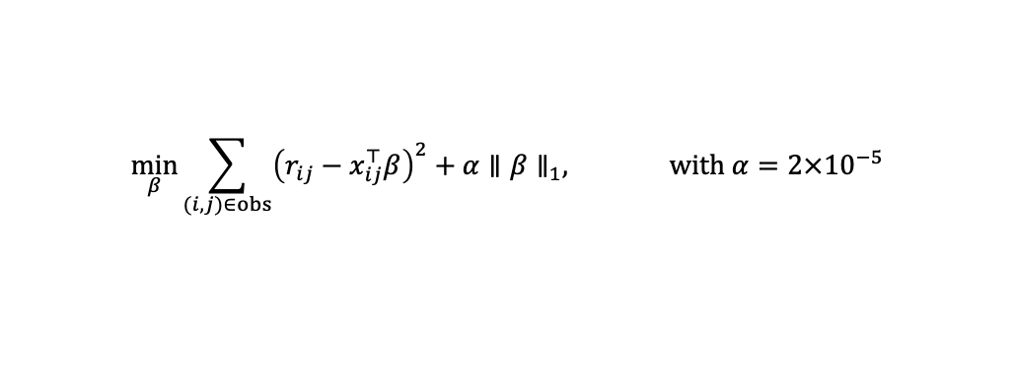
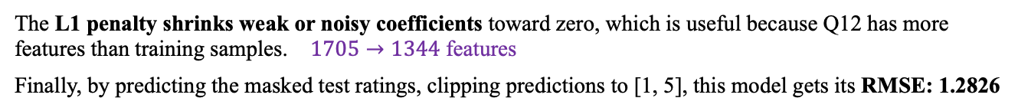
Q12 Hybrid Lasso Architecture
Notes for feature selection:
NO raw user demographics and raw restaurant attributes, because their useful signal is already captured through screened interaction terms and user ID residuals.
NO Q5 bias features, because Q7/MF bias terms provide a stronger, more flexible version of the same bias structure.
AVOID Full unscreened interactions, because they inflate feature count under a small training set.
DROP Extra restaurant × text or bias × text interactions, because ablation tests showed no RMSE improvement.
Then, after standardizing all features, a Lasso regression model is fitted:
$$\min_{β}{\sum_{(i,j)∈obs}^{​}{{\left(r_{ij}−x_{ij}^{⊤}β\right)}^{2}}+α∥β∥_{1}^{ },} with α=2×{10}^{−5}$$
The L1 penalty shrinks weak or noisy coefficients toward zero, which is useful because Q12 has more features than training samples. $1705→1344$ features
Finally, by predicting the masked test ratings, clipping predictions to [1, 5], this model gets its RMSE: 1.2826

Slide 7
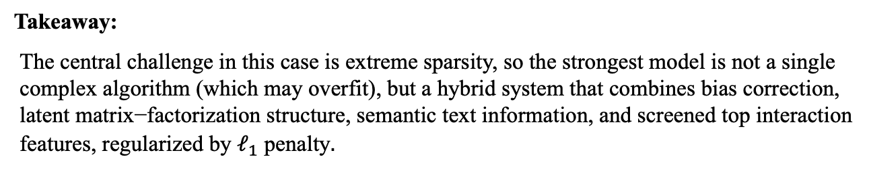
Performance Summary & Takeaways
Model | Bias Baseline | SVD | SGD + Interaction | Hybrid Lasso
RMSE | 1.3733 | 1.3765 | 1.3143 | 1.2826
Takeaway:
$\text{The} \text{central} \text{challenge} \text{in} \text{this} \text{case} \text{is} \text{extreme} \text{sparsity}\text{, }\text{so} \text{the} \text{strongest} \text{model} \text{is} \text{not} \text{a} \text{single} \text{complex} \text{algorithm}\text{ (}\text{which} \text{may} \text{overfit}\text{),} \text{but} \text{a} \text{hybrid} \text{system} \text{that} \text{combines} \text{bias} \text{correction}\text{, }\text{latent} \text{matrix}\text{−}\text{factorization} \text{structure}\text{, }\text{semantic} \text{text} \text{information}\text{, }\text{and} \text{screened} \text{top} \text{interaction} \text{features}\text{, }\text{regularized} \text{by} ℓ_{1} \text{penalty}.$

Slide 8
Thanks!

